Slide 1
Information Extraction
David Kauchak
cs457
Fall 2011
some content adapted from:
http://www.cs.cmu.edu/~knigam/15-505/ie-lecture.ppt

Slide 2
Administrative
Projects
  evaluation
  writeup
    reread the writeup section in the final project handout
    NOT a report of what happened
    common format
      abstract: high-level summary of the paper, including problem, approach, results and take-home message from paper (1 paragraph)
      introduction: what is the problem, why do we care (cite related papers)
      algorithm/approach: what is your approach
      experiments/results: evaluation metric, experimental setup, results and analysis of the results
      conclusion: a paragraph of two wrapping up

Slide 3
Administrative
Quiz 4
  keep up with book reading
  Search
    uninformed search:
      BFS
      DFS
      uniform cast search
      depth limited search
      iterative deepening search
    informed search:
      greedy-first search
      A* search
    completeness, optimality
    heuristics
      admissibility
    graph search vs. tree search

Slide 4
Administrivia
Quiz 4 continued
  machine translation
    noisy channel model
    MT problems
      preprocessing
      translation modeling
        phrase-based model
      decoding/search
      parameter evaluation
      evaluation (BLEU)

Slide 5
Administrivia
Information retrieval
  challenges
  inverted index
  boolean vs. ranked query
    tf-idf query
  phrases/proximity queries
  pagerank
  Information extraction (Today’s material)

Slide 6
Administrative
Talk by Joe 12:30 in MBH 505 tomorrow (Wednesday)
http://www.cs.middlebury.edu/~schar/dept/seminars/cs-seminar-2011-12-7-Redmon.pdf

Slide 7
Simplification evaluation
Head-to-head
 | Grammatical | Meaning | Simplicity
Syntax | 4.7 | 4.07 | 2.9
Phrase | 4.5 | 4.23 | 2
Simple Wiki | 4.5 | 3.73 | 2.73
Reasonable correlation: 0.5-0.75
Individual
 | Grammatical | Meaning | Simplicity
Syntax | 4.7 | 4.1 | 2.4
Phrase | 4.38 | 4 | 1.94

Slide 8
Simplification evaluation
More labeling?

Slide 9
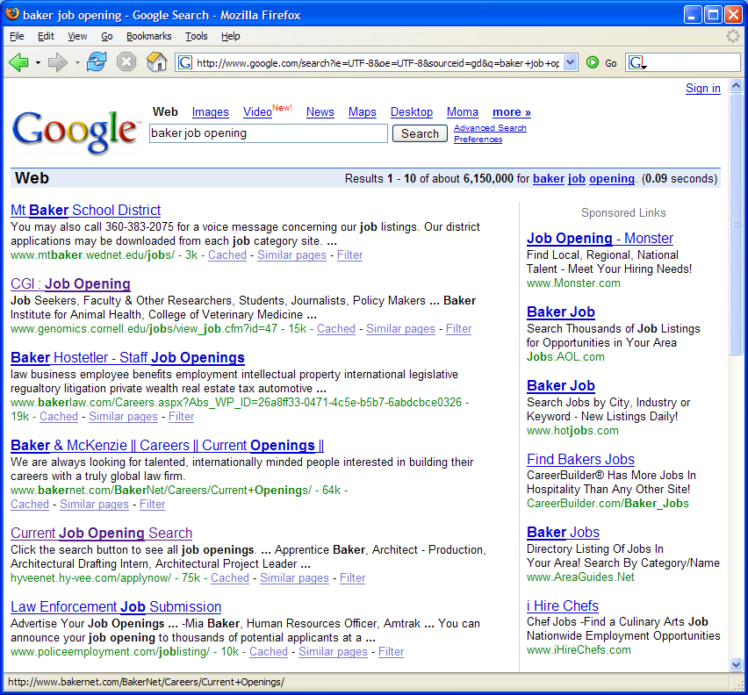
A problem
Mt. Baker, the school district
Baker Hostetler, the company
Baker, a job opening
Genomics job

Slide 10
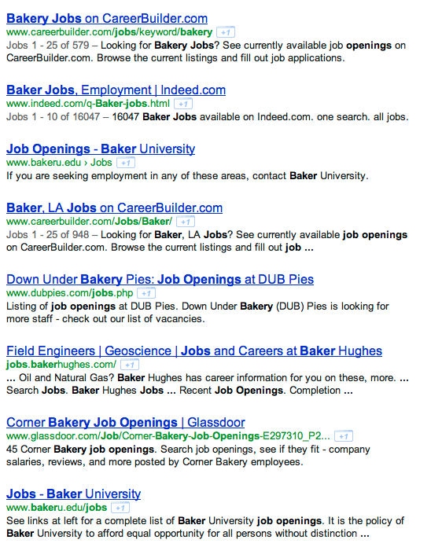
Timeless…

Slide 11
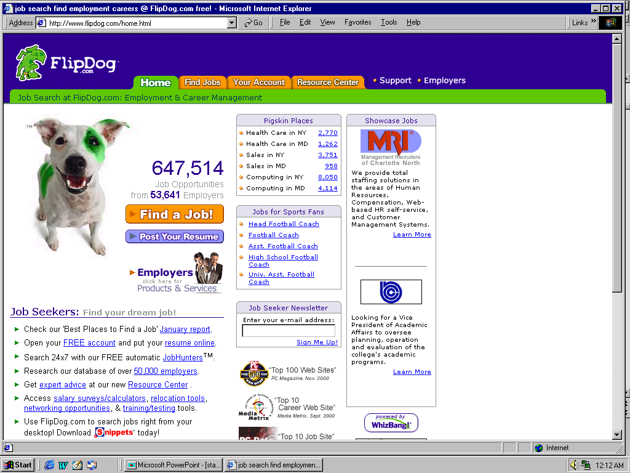
A solution
Why is this better?
How does it happen?

Slide 12
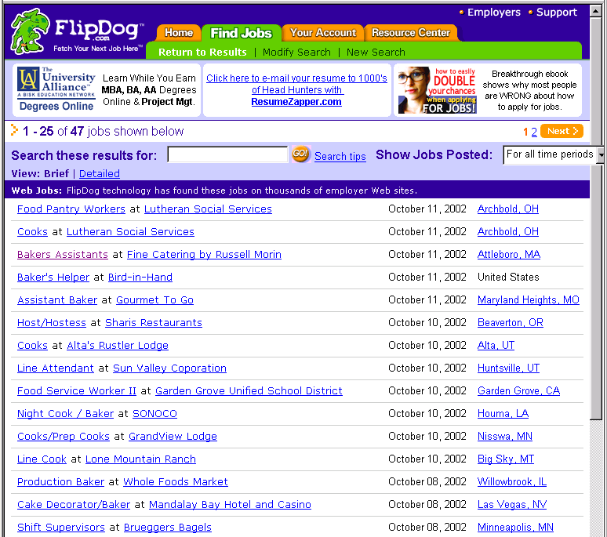
Job Openings:
Category = Food Services
Keyword = Baker
Location = Continental U.S.
Notes:
Not only did this support extremely useful and targeted search and data navigation, with highly summarized display

Slide 13

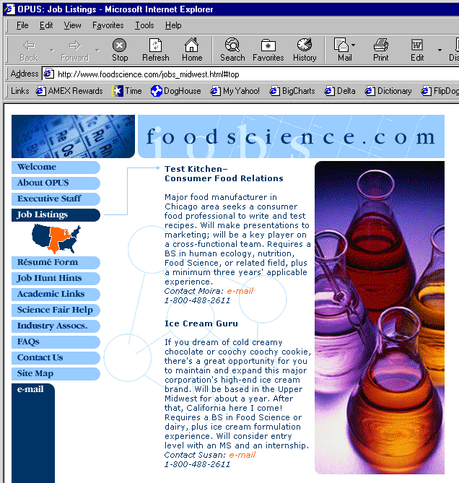
Extracting Job Openings from the Web
Title: Ice Cream Guru
Description: If you dream of cold creamy…
Contact: susan@foodscience.com
Category: Travel/Hospitality
Function: Food Services

Slide 14
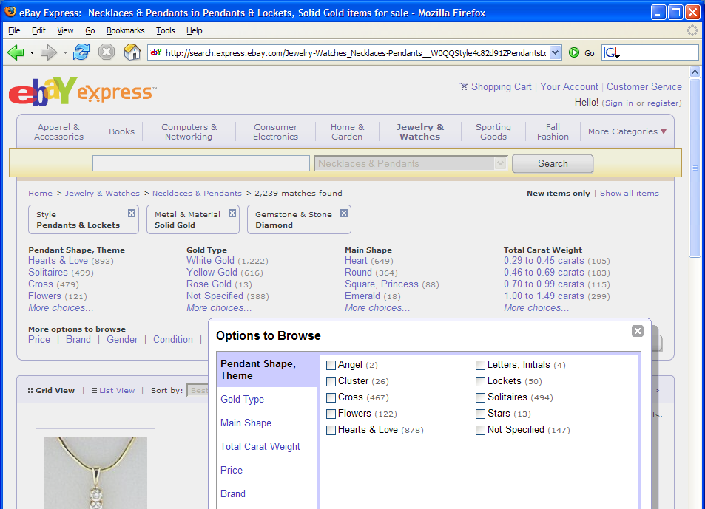
Another Problem

Slide 15

Often structured information in text

Slide 16
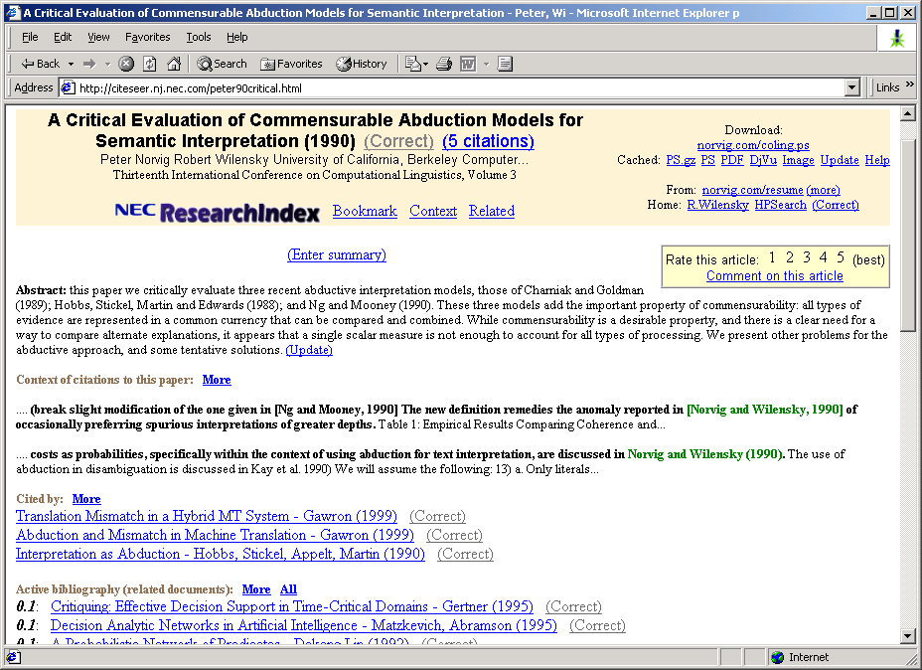
Another Problem
Notes:
CiteSeer, which we all know and love, is made possible by the automatic extraction of title and author information from research paper headers and references in order to build the reference graph that we use to find related work.

Slide 17
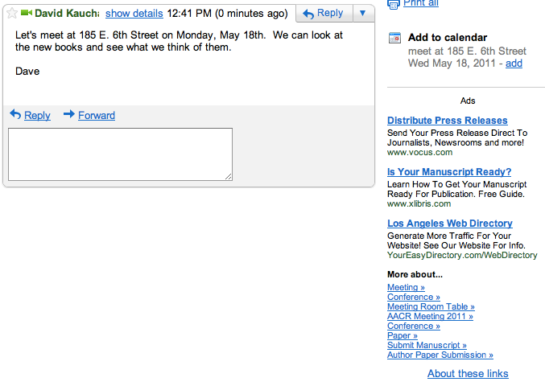
And One more

Slide 18
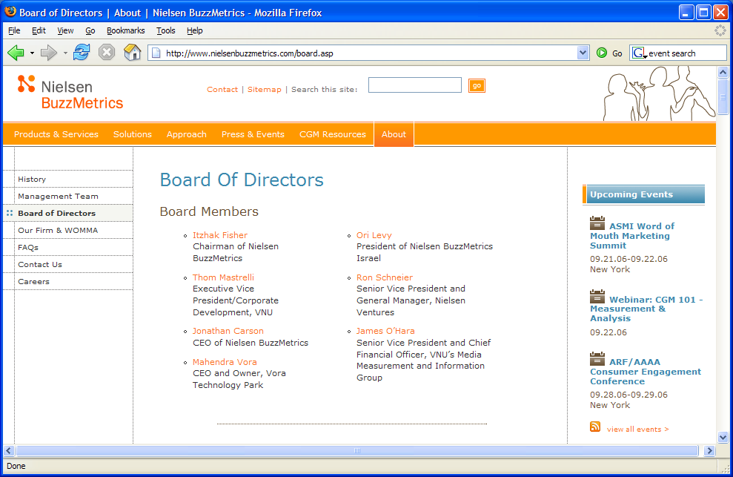
Information Extraction
Traditional definition: Recovering structured data from text
What are some of the sub-problems/challenges?

Slide 19
Information Extraction?
Recovering structured data from text
  Identifying fields (e.g. named entity recognition)

Slide 20
Information Extraction?
Recovering structured data from text
  Identifying fields (e.g. named entity recognition)
  Understanding relations between fields (e.g. record association)

Slide 21
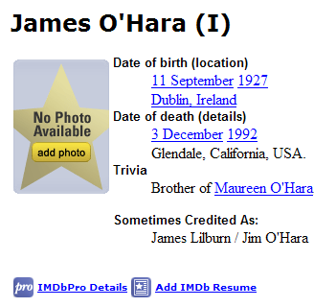
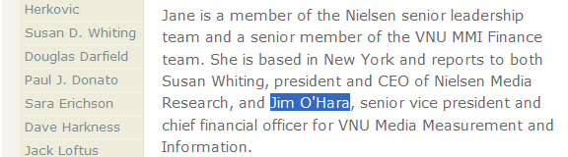
Information Extraction?
Recovering structured data from text
  Identifying fields (e.g. named entity recognition)
  Understanding relations between fields (e.g. record association)
  Normalization and deduplication

Slide 22

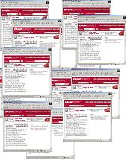
Information extraction
Input: Text Document
  Various sources: web, e-mail, journals, …
Output: Relevant fragments of text and relations possibly to be processed later in some automated way
IE
User Queries

Slide 23
Not all documents are created equal…
Varying regularity in document collections
Natural or unstructured
  Little obvious structural information
Partially structured
  Contain some canonical formatting
Highly structured
  Often, automatically generated
Examples?

Slide 24
Natural Text: MEDLINE
Journal Abstracts
Extract number of subjects, type of study, conditions, etc.
BACKGROUND: The most challenging aspect of revision hip surgery is the management of bone loss. A reliable and valid measure of bone loss is important since it will aid in future studies of hip revisions and in preoperative planning. We developed a measure of femoral and acetabular bone loss associated with failed total hip arthroplasty. The purpose of the present study was to measure the reliability and the intraoperative validity of this measure and to determine how it may be useful in preoperative planning. METHODS: From July 1997 to December 1998, forty-five consecutive patients with a failed hip prosthesis in need of revision surgery were prospectively followed. Three general orthopaedic surgeons were taught the radiographic classification system, and two of them classified standardized preoperative anteroposterior and lateral hip radiographs with use of the system. Interobserver testing was carried out in a blinded fashion. These results were then compared with the intraoperative findings of the third surgeon, who was blinded to the preoperative ratings. Kappa statistics (unweighted and weighted) were used to assess correlation. Interobserver reliability was assessed by examining the agreement between the two preoperative raters. Prognostic validity was assessed by examining the agreement between the assessment by either Rater 1 or Rater 2 and the intraoperative assessment (reference standard). RESULTS: With regard to the assessments of both the femur and the acetabulum, there was significant agreement (p < 0.0001) between the preoperative raters (reliability), with weighted kappa values of >0.75. There was also significant agreement (p < 0.0001) between each rater's assessment and the intraoperative assessment (validity) of both the femur and the acetabulum, with weighted kappa values of >0.75. CONCLUSIONS: With use of the newly developed classification system, preoperative radiographs are reliable and valid for assessment of the severity of bone loss that will be found intraoperatively.

Slide 25
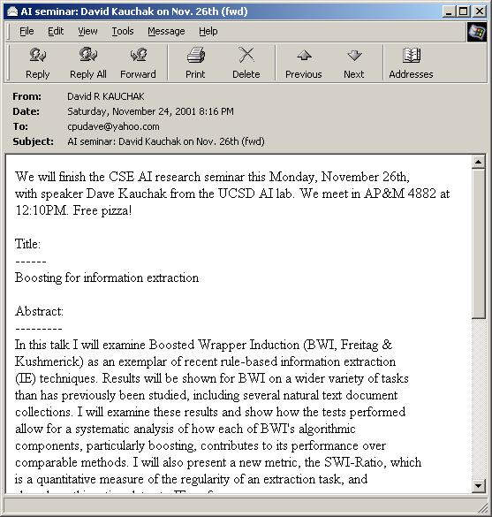
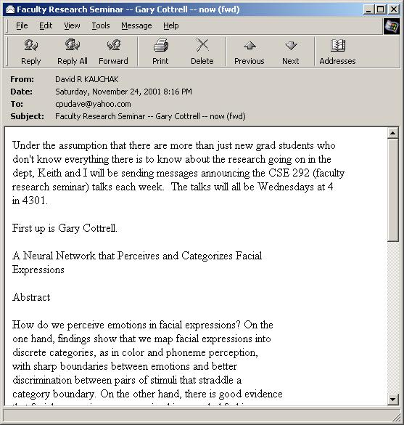
Partially Structured:
Seminar Announcements
Extract time, location, speaker, etc.

Slide 26
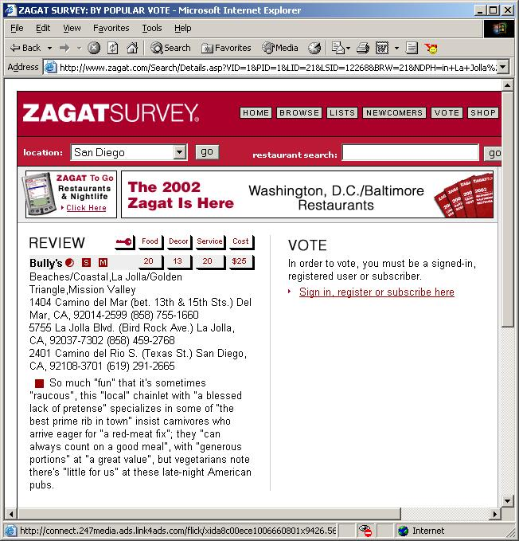
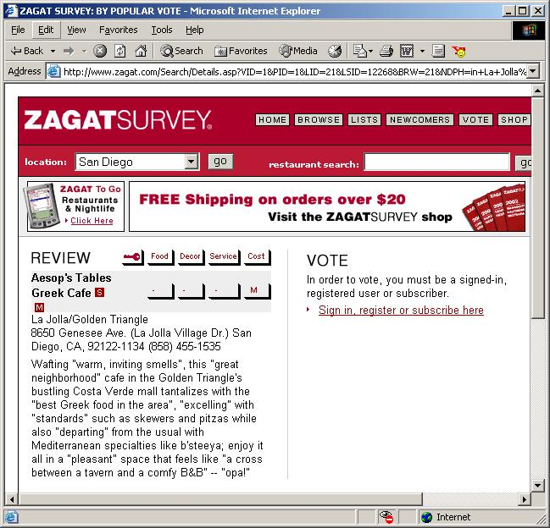
Highly Structured:
Zagat’s Reviews
Extract restaurant, location, cost, etc.

Slide 27
Information extraction approaches
For years, Microsoft Corporation CEO Bill Gates was against open source. But today he appears to have changed his mind. "We can be open source. We love the concept of shared source," said Bill Veghte, a Microsoft VP. "That's a super-important shift for us in terms of code access.“
Richard Stallman, founder of the Free Software Foundation, countered saying…
Name Title Organization
Bill Gates CEO Microsoft
Bill Veghte VP Microsoft
Richard Stallman Founder Free Soft..
How can we do this? Can we utilize any tools/approaches we’ve seen so far?

Slide 28
IE Posed as a Machine Learning Task
Training data: documents marked up with ground truth
Extract features around words/information
Pose as a classification problem
…
00 : pm Place : Wean Hall Rm 5409 Speaker : Sebastian Thrun
…
prefix
contents
suffix
What features would be useful?

Slide 29
Good Features for Information Extraction
begins-with-number
begins-with-ordinal
begins-with-punctuation
begins-with-question-word
begins-with-subject
blank
contains-alphanum
contains-bracketed-number
contains-http
contains-non-space
contains-number
contains-pipe
Example word features:
  identity of word
  is in all caps
  ends in “-ski”
  is part of a noun phrase
  is in a list of city names
  is under node X in WordNet or Cyc
  is in bold font
  is in hyperlink anchor
  features of past & future
  last person name was female
  next two words are “and Associates”
contains-question-mark
contains-question-word
ends-with-question-mark
first-alpha-is-capitalized
indented
indented-1-to-4
indented-5-to-10
more-than-one-third-space
only-punctuation
prev-is-blank
prev-begins-with-ordinal
shorter-than-30

Slide 30
Good Features for Information Extraction
Is Capitalized
Is Mixed Caps
Is All Caps
Initial Cap
Contains Digit
All lowercase
Is Initial
Punctuation
Period
Comma
Apostrophe
Dash
Preceded by HTML tag
Character n-gram classifier
says string is a person
name (80% accurate)
In stopword list
(the, of, their, etc)
In honorific list
(Mr, Mrs, Dr, Sen, etc)
In person suffix list
(Jr, Sr, PhD, etc)
In name particle list
(de, la, van, der, etc)
In Census lastname list;
segmented by P(name)
In Census firstname list;
segmented by P(name)
In locations lists
(states, cities, countries)
In company name list
(“J. C. Penny”)
In list of company suffixes
(Inc, & Associates, Foundation)
Word Features
  lists of job titles,
  Lists of prefixes
  Lists of suffixes
  350 informative phrases
HTML/Formatting Features
  {begin, end, in} x
  {<b>, <i>, <a>, <hN>} x
  {lengths 1, 2, 3, 4, or longer}
  {begin, end} of line

Slide 31
How can we pose this as a classification (or learning) problem?
…
00 : pm Place : Wean Hall Rm 5409 Speaker : Sebastian Thrun
…
prefix
contents
suffix
Data
Label
0
0
classifier
1
train a
predictive
model
1
0

Slide 32
Lots of possible techniques
Classify Candidates
Sliding Window
Boundary Models
Abraham Lincoln was born in Kentucky.
Abraham Lincoln was born in Kentucky.
Abraham Lincoln was born in Kentucky.
Classifier
BEGIN
Classifier
which class?
which class?
Classifier
Try alternate
window sizes:
which class?
BEGIN
END
BEGIN
END
Finite State Machines
Wrapper Induction
Abraham Lincoln was born in Kentucky.
<b><i>Abraham Lincoln</i></b> was born in Kentucky.
Most likely state sequence?
Learn and apply pattern for a website
<b>
<i>
PersonName
Any of these models can be used to capture words, formatting or both.

Slide 33
Information Extraction by Sliding Window
GRAND CHALLENGES FOR MACHINE LEARNING
Jaime Carbonell
School of Computer Science
Carnegie Mellon University
3:30 pm
7500 Wean Hall
Machine learning has evolved from obscurity in the 1970s into a vibrant and popular discipline in artificial intelligence during the 1980s and 1990s. As a result of its success and growth, machine learning is evolving into a collection of related disciplines: inductive concept acquisition, analytic learning in problem solving (e.g. analogy, explanation-based learning), learning theory (e.g. PAC learning), genetic algorithms, connectionist learning, hybrid systems, and so on.
CMU UseNet Seminar Announcement

Slide 34
Information Extraction by Sliding Window
GRAND CHALLENGES FOR MACHINE LEARNING
Jaime Carbonell
School of Computer Science
Carnegie Mellon University
3:30 pm
7500 Wean Hall
Machine learning has evolved from obscurity in the 1970s into a vibrant and popular discipline in artificial intelligence during the 1980s and 1990s. As a result of its success and growth, machine learning is evolving into a collection of related disciplines: inductive concept acquisition, analytic learning in problem solving (e.g. analogy, explanation-based learning), learning theory (e.g. PAC learning), genetic algorithms, connectionist learning, hybrid systems, and so on.
CMU UseNet Seminar Announcement

Slide 35
Information Extraction by Sliding Window
GRAND CHALLENGES FOR MACHINE LEARNING
Jaime Carbonell
School of Computer Science
Carnegie Mellon University
3:30 pm
7500 Wean Hall
Machine learning has evolved from obscurity in the 1970s into a vibrant and popular discipline in artificial intelligence during the 1980s and 1990s. As a result of its success and growth, machine learning is evolving into a collection of related disciplines: inductive concept acquisition, analytic learning in problem solving (e.g. analogy, explanation-based learning), learning theory (e.g. PAC learning), genetic algorithms, connectionist learning, hybrid systems, and so on.
CMU UseNet Seminar Announcement

Slide 36
Information Extraction by Sliding Window
GRAND CHALLENGES FOR MACHINE LEARNING
Jaime Carbonell
School of Computer Science
Carnegie Mellon University
3:30 pm
7500 Wean Hall
Machine learning has evolved from obscurity in the 1970s into a vibrant and popular discipline in artificial intelligence during the 1980s and 1990s. As a result of its success and growth, machine learning is evolving into a collection of related disciplines: inductive concept acquisition, analytic learning in problem solving (e.g. analogy, explanation-based learning), learning theory (e.g. PAC learning), genetic algorithms, connectionist learning, hybrid systems, and so on.
CMU UseNet Seminar Announcement

Slide 37
Information Extraction by Sliding Window
GRAND CHALLENGES FOR MACHINE LEARNING
Jaime Carbonell
School of Computer Science
Carnegie Mellon University
3:30 pm
7500 Wean Hall
Machine learning has evolved from obscurity in the 1970s into a vibrant and popular discipline in artificial intelligence during the 1980s and 1990s. As a result of its success and growth, machine learning is evolving into a collection of related disciplines: inductive concept acquisition, analytic learning in problem solving (e.g. analogy, explanation-based learning), learning theory (e.g. PAC learning), genetic algorithms, connectionist learning, hybrid systems, and so on.
CMU UseNet Seminar Announcement

Slide 38
Information Extraction by Sliding Window
…
00 : pm Place : Wean Hall Rm 5409 Speaker : Sebastian Thrun
…
w _{t-m}
w _{t-1}
w _{t}
w _{t+n}
w _{t+n+1}
w _{t+n+m}
prefix
contents
suffix
Standard supervised learning setting
  Positive instances?
  Negative instances?

Slide 39
Information Extraction by Sliding Window
…
00 : pm Place : Wean Hall Rm 5409 Speaker : Sebastian Thrun
…
w _{t-m}
w _{t-1}
w _{t}
w _{t+n}
w _{t+n+1}
w _{t+n+m}
prefix
contents
suffix
Standard supervised learning setting
  Positive instances: Windows with real label
  Negative instances: All other windows
  Features based on candidate, prefix and suffix

Slide 40
IE by Boundary Detection
GRAND CHALLENGES FOR MACHINE LEARNING
Jaime Carbonell
School of Computer Science
Carnegie Mellon University
3:30 pm
7500 Wean Hall
Machine learning has evolved from obscurity in the 1970s into a vibrant and popular discipline in artificial intelligence during the 1980s and 1990s. As a result of its success and growth, machine learning is evolving into a collection of related disciplines: inductive concept acquisition, analytic learning in problem solving (e.g. analogy, explanation-based learning), learning theory (e.g. PAC learning), genetic algorithms, connectionist learning, hybrid systems, and so on.
CMU UseNet Seminar Announcement

Slide 41
IE by Boundary Detection
GRAND CHALLENGES FOR MACHINE LEARNING
Jaime Carbonell
School of Computer Science
Carnegie Mellon University
3:30 pm
7500 Wean Hall
Machine learning has evolved from obscurity in the 1970s into a vibrant and popular discipline in artificial intelligence during the 1980s and 1990s. As a result of its success and growth, machine learning is evolving into a collection of related disciplines: inductive concept acquisition, analytic learning in problem solving (e.g. analogy, explanation-based learning), learning theory (e.g. PAC learning), genetic algorithms, connectionist learning, hybrid systems, and so on.
CMU UseNet Seminar Announcement

Slide 42
IE by Boundary Detection
GRAND CHALLENGES FOR MACHINE LEARNING
Jaime Carbonell
School of Computer Science
Carnegie Mellon University
3:30 pm
7500 Wean Hall
Machine learning has evolved from obscurity in the 1970s into a vibrant and popular discipline in artificial intelligence during the 1980s and 1990s. As a result of its success and growth, machine learning is evolving into a collection of related disciplines: inductive concept acquisition, analytic learning in problem solving (e.g. analogy, explanation-based learning), learning theory (e.g. PAC learning), genetic algorithms, connectionist learning, hybrid systems, and so on.
CMU UseNet Seminar Announcement

Slide 43
IE by Boundary Detection
GRAND CHALLENGES FOR MACHINE LEARNING
Jaime Carbonell
School of Computer Science
Carnegie Mellon University
3:30 pm
7500 Wean Hall
Machine learning has evolved from obscurity in the 1970s into a vibrant and popular discipline in artificial intelligence during the 1980s and 1990s. As a result of its success and growth, machine learning is evolving into a collection of related disciplines: inductive concept acquisition, analytic learning in problem solving (e.g. analogy, explanation-based learning), learning theory (e.g. PAC learning), genetic algorithms, connectionist learning, hybrid systems, and so on.
CMU UseNet Seminar Announcement

Slide 44
IE by Boundary Detection
GRAND CHALLENGES FOR MACHINE LEARNING
Jaime Carbonell
School of Computer Science
Carnegie Mellon University
3:30 pm
7500 Wean Hall
Machine learning has evolved from obscurity in the 1970s into a vibrant and popular discipline in artificial intelligence during the 1980s and 1990s. As a result of its success and growth, machine learning is evolving into a collection of related disciplines: inductive concept acquisition, analytic learning in problem solving (e.g. analogy, explanation-based learning), learning theory (e.g. PAC learning), genetic algorithms, connectionist learning, hybrid systems, and so on.
CMU UseNet Seminar Announcement

Slide 45
IE by Boundary Detection
Input: Linear Sequence of Tokens
Date : Thursday , October 25 Time : 4 : 15 - 5 : 30 PM
How can we pose this as a machine learning problem?
Data
Label
0
0
classifier
1
train a
predictive
model
1
0

Slide 46
IE by Boundary Detection
Input: Linear Sequence of Tokens
Date : Thursday , October 25 Time : 4 : 15 - 5 : 30 PM
Method: Identify start and end Token Boundaries
Start / End of Content
Date : Thursday , October 25 Time : 4 : 15 - 5 : 30 PM
…
Unimportant Boundaries
Output: Tokens Between Identified Start / End Boundaries
Date : Thursday , October 25 Time : 4 : 15 - 5 : 30 PM

Slide 47
Learning: IE as Classification
Learn TWO binary classifiers, one for the beginning and one for the end
Begin
Date : Thursday , October 25 Time : 4 : 15 - 5 : 30 PM
End
POSITIVE (1)
Date : Thursday , October 25 Time : 4 : 15 - 5 : 30 PM
ALL OTHERS NEGATIVE (0)
1 if i begins a field
0 otherwise
Begin(i)=

Slide 48
One approach: Boundary Detectors
A “Boundary Detectors” is a pair of token sequences ‹p,s›
  A detector matches a boundary if p matches text before boundary and s matches text after boundary
  Detectors can contain wildcards, e.g. “capitalized word”, “number”, etc.
  <Date: , [CapitalizedWord]>
  Date: Thursday, October 25
Would this boundary detector match anywhere?

Slide 49
One approach: Boundary Detectors
A “Boundary Detectors” is a pair of token sequences ‹p,s›
  A detector matches a boundary if p matches text before boundary and s matches text after boundary
  Detectors can contain wildcards, e.g. “capitalized word”, “number”, etc.
  <Date: , [CapitalizedWord]>
  Date: Thursday, October 25

Slide 50
Combining Detectors
Prefix | Suffix
<a href=" | http
empty | ">
Begin boundary detector:
End boundary detector:
text<b><a href=“http://www.cs.pomona.edu”>
match(es)?

Slide 51
Combining Detectors
Prefix | Suffix
<a href=" | http
empty | ">
Begin boundary detector:
End boundary detector:
text<b><a href=“http://www.cs.pomona.edu”>
Begin
End

Slide 52
Learning: IE as Classification
Learn TWO binary classifiers, one for the beginning and one for the end
Begin
Date : Thursday , October 25 Time : 4 : 15 - 5 : 30 PM
End
POSITIVE (1)
Date : Thursday , October 25 Time : 4 : 15 - 5 : 30 PM
ALL OTHERS NEGATIVE (0)
Say we learn Begin and End, will this be enough? Any improvements? Any ambiguities?

Slide 53
Some concerns
Begin
Begin
End
Begin
Begin
End
End
…
Begin
End

Slide 54
Learning to detect boundaries
Learn three probabilistic classifiers:
  Begin(i) = probability position i starts a field
  End(j) = probability position j ends a field
  Len(k) = probability an extracted field has length k
Score a possible extraction (i,j) by
  Begin(i) * End(j) * Len(j-i)
Len(k) is estimated from a histogram data
Begin(i) and End(j) may combine multiple boundary detectors!

Slide 55
Problems with Sliding Windows and Boundary Finders
Decisions in neighboring parts of the input are made independently from each other.
  Sliding Window may predict a “seminar end time” before the “seminar start time”.
  It is possible for two overlapping windows to both be above threshold.
  In a Boundary-Finding system, left boundaries are laid down independently from right boundaries

Slide 56
Modeling the sequential nature of data: citation parsing
Fahlman, Scott & Lebiere, Christian (1989). The cascade-correlation learning architecture. Advances in Neural Information Processing Systems, pp. 524-532.
Fahlman, S.E. and Lebiere, C., “The Cascade Correlation Learning Architecture,” Neural Information Processing Systems, pp. 524-532, 1990.
Fahlman, S. E. (1991) The recurrent cascade-correlation learning architecture. NIPS 3, 190-205.
What patterns do you see here?
Ideas?
Notes:
Task: clustering bibliographic citations
Here are 3 citations from bibliography sections of 3 different papers. First two clustered together. Third refers to different paper and forms separate cluster
Note that variations in formatting, field ordering, abbreviation and even misspellings and misinformation make this a challenging clustering problem.
Why collected this data?

Slide 57
Some sequential patterns
Authors come first
Title comes before journal
Page numbers come near the end
All types of things generally contain multiple words

Slide 58
Predict a sequence of tags
author
author
year
title
title
title
Fahlman, S. E. (1991) The recurrent cascade
title
title
title
journal
pages
correlation learning architecture. NIPS 3, 190-205.
Ideas?

Slide 59
Hidden Markov Models (HMMs)
Author
Title
Journal
Year
Pages

Slide 60
HMM: Model
States: x_{i}
State transitions: P(x_{i}|x_{j}) = a[x_{i}|x_{j}]
Output probabilities: P(o_{i}|x_{j}) = b[o_{i}|x_{j}]
Markov independence assumption

Slide 61
HMMs: Performing Extraction
Given output words:
  fahlman s e 1991 the recurrent cascade correlation learning architecture nips 3 190 205
Find state sequence that maximizes:
Lots of possible state sequences to test (5¹⁴)
State transition
Output probabilities

Slide 62
IE Evaluation
precision
  of those we identified, how many were correct?
recall
  what fraction of the correct ones did we identify?
F1
  blend of precision and recall

Slide 63
IE Evaluation
Ground truth
author
author
year
title
title
title
Fahlman, S. E. (1991) The recurrent cascade
System
author
pages
year
title
title
title
Fahlman, S. E. (1991) The recurrent cascade
How should we calculate precision?

Slide 64
IE Evaluation
Ground truth
author
author
year
title
title
title
Fahlman, S. E. (1991) The recurrent cascade
System
author
pages
year
title
title
title
Fahlman, S. E. (1991) The recurrent cascade
5/6? 2/3? something else?

Slide 65
Data regularity is important!
Highly structured
Partially structured
Natural text
As the regularity decreases, so does the performance

Slide 66
Improving task regularity
Instead of altering methods, alter text
Idea: Add limited grammatical information
  Run shallow parser over text
  Flatten parse tree and insert as tags
Example of Tagged Sentence:
Uba2p is located largely in the nucleus.
NP_SEG
VP_SEG
PP_SEG
NP_SEG

Slide 67
Tagging Results on Natural Domain
21% increase
65% increase
45% increase

Slide 68
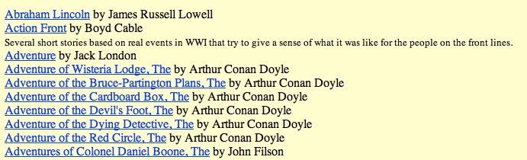
Bootstrapping
Problem: Extract (author, title) pairs from the web

Slide 69

Approach 1: Old school style
Download the web:

Slide 70
Approach 1: Old school style
Download the web:
Grab a sample and label:

Slide 71
Approach 1: Old school style
Download the web:
Grab a sample and label:
train model:
classifier

Slide 72
Approach 1: Old school style
Download the web:
Grab a sample and label:
train model:
classifier
run model on web and get titles/authors

Slide 73
Approach 1: Old school style
Problems? Better ideas?

Slide 74
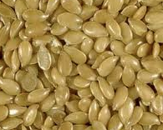

Bootstrapping
Seed set
author/title pairs
author/title occurrences in context

Slide 75
Bootstrapping
Seed set
author/title pairs
author/title occurrences in context
patterns

Slide 76
Bootstrapping
Seed set
author/title pairs
author/title occurrences in context
patterns

Slide 77
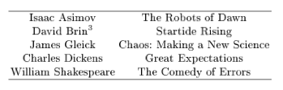

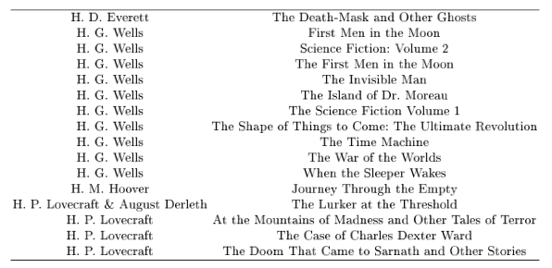
Brin, 1998
(Extracting patterns and relations from the world wide web)
Seed books
Patterns
New books

Slide 78
Experiments
Notes:
- Brin, 1998

Slide 79
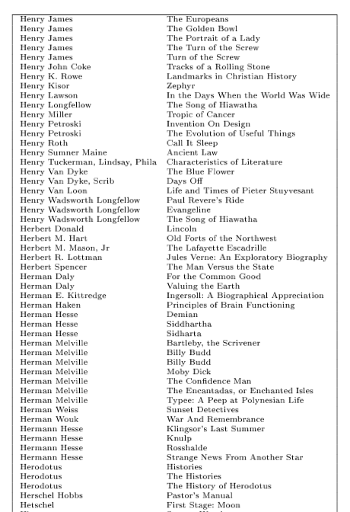
Final list

Slide 80
NELL
NELL: Never-Ending Language Learning
  http://rtw.ml.cmu.edu/rtw/
  continuously crawls the web to grab new data
  learns entities and relationships from this data
    started with a seed set
    uses learning techniques based on current data to learn new information

Slide 81
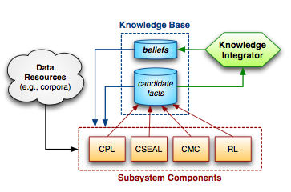
NELL
4 different approaches to learning relationships
Combine these in the knowledge integrator
  idea: using different approaches will avoid overfitting
Initially was wholly unsupervised, now some human supervision
  cookies are food => internet cookies are food => files are food

Slide 82
An example learner: coupled pattern learner (CPL)
Cities:
Los Angeles
San Francisco
New York
Seattle
…
… city of X …
... the official guide to X …
… only in X …
… what to do in X …
… mayor of X …
… mayor of X …
extract occurrences of group
statistical co-occurrence test

Slide 83
CPL
… mayor of <CITY> …
extract other cities from the data
Albequerque
Springfield
…

Slide 84
CPL
Can also learn patterns with multiple groups
… X is the mayor of Y …
… X plays for Y …
... X is a player of Y …
can extract other groups, but also relationships
Antonio Villaraigosa
mayor of
Los Angeles

Slide 85
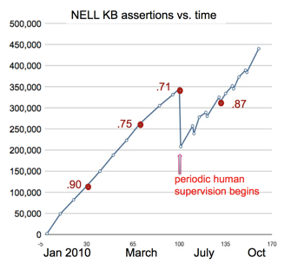
NELL performance
estimated accuracy in red
For more details: http://rtw.ml.cmu.edu/papers/carlson-aaai10.pdf

Slide 86
NELL
The good:
  Continuously learns
  Uses the web (a huge data source)
  Learns generic relationships
  Combines multiple approaches for noise reduction
The bad:
  makes mistakes (overall accuracy still may be problematic for real world use)
  does require some human intervention
  still many general phenomena won’t be captured

