Slide 1
Introduction to
Statistical Machine Translation
David Kauchak
CS457 – Fall 2011
Some slides adapted from
Philipp Koehn Kevin Knight
CSAIL
Massachusetts Institute of Technology
USC/Information Sciences Institute
USC/Computer Science Department

Slide 2
Admin
How are the projects going?
Remaining classes applications
  3 MT
    General overview today
    Dive into one specific implementation next time
    MT lab
  Other applications
    Information extraction
    Information retrieval
    Question answering/summarization

Slide 3





Language translation
Yo quiero Taco Bell

Slide 4
MT Systems
Where have you seen machine translation systems?

Slide 5
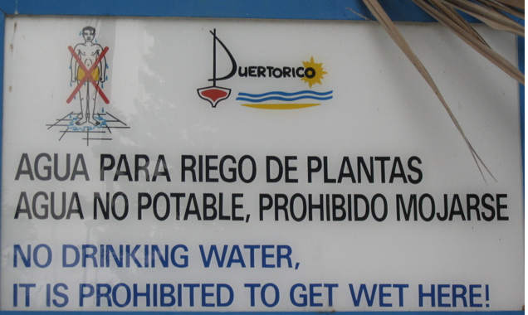

Slide 6
Machine Translation
美国关岛国际机场及其办公室均接获一名自称沙地阿拉伯富商拉登等发出的电子邮件，威胁将会向机场等公众地方发动生化袭击後，关岛经保持高度戒备。
The U.S. island of Guam is maintaining a high state of alert after the Guam airport and its offices both received an e-mail from someone calling himself the Saudi Arabian Osama bin Laden and threatening a biological/chemical attack against public places such as the airport .
The classic acid test for natural language processing.
Requires capabilities in both interpretation and generation.
People around the world stubbornly refuse to write
everything in English.

Slide 7
Machine Translation
美国关岛国际机场及其办公室均接获一名自称沙地阿拉伯富商拉登等发出的电子邮件，威胁将会向机场等公众地方发动生化袭击後，关岛经保持高度戒备。
Machine translation is becoming very prevalent
Even PowerPoint has translation built into it!
The U.S. island of Guam is maintaining a high state of alert after the Guam airport and its offices both received an e-mail from someone calling himself the Saudi Arabian Osama bin Laden and threatening a biological/chemical attack against public places such as the airport .
United States Guam International Airport and the Office received one claiming to be a wealthy Saudi Arabia an email such as Osama bin Laden, threats to the airport after biochemical attacks in public places such as Guam remain on high alert.

Slide 8
Which is the human?
Beijing Youth Daily said that under the Ministry of Agriculture, the beef will be destroyed after tests.
The Beijing Youth Daily pointed out that the seized beef would be disposed of after being examined according to advice from the Ministry of Agriculture.
?

Slide 9
Which is the human?
Pakistan President Pervez Musharraf Wins Senate Confidence Vote
Pakistani President Musharraf Won the Trust Vote in Senate and Lower House
?

Slide 10
Which is the human?
There was not a single vote against him."
No members vote against him. "
?

Slide 11
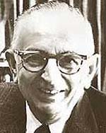
Warren Weaver (1947)
ingcmpnqsnwf cv fpn owoktvcv
hu ihgzsnwfv rqcffnw cw owgcnwf
kowazoanv ...

Slide 12
Warren Weaver (1947)
e e e e
ingcmpnqsnwf cv fpn owoktvcv
e e e
hu ihgzsnwfv rqcffnw cw owgcnwf
e
kowazoanv ...

Slide 13
Warren Weaver (1947)
e e e the
ingcmpnqsnwf cv fpn owoktvcv
e e e
hu ihgzsnwfv rqcffnw cw owgcnwf
e
kowazoanv ...

Slide 14
Warren Weaver (1947)
e he e the
ingcmpnqsnwf cv fpn owoktvcv
e e e t
hu ihgzsnwfv rqcffnw cw owgcnwf
e
kowazoanv ...

Slide 15
Warren Weaver (1947)
e he e of the
ingcmpnqsnwf cv fpn owoktvcv
e e e t
hu ihgzsnwfv rqcffnw cw owgcnwf
e
kowazoanv ...

Slide 16
Warren Weaver (1947)
e he e of the fof
ingcmpnqsnwf cv fpn owoktvcv
e f o e o oe t
hu ihgzsnwfv rqcffnw cw owgcnwf
ef
kowazoanv ...

Slide 17
Warren Weaver (1947)
e he e of the
ingcmpnqsnwf cv fpn owoktvcv
e e e t
hu ihgzsnwfv rqcffnw cw owgcnwf
e
kowazoanv ...

Slide 18
Warren Weaver (1947)
e he e is the sis
ingcmpnqsnwf cv fpn owoktvcv
e s i e i ie t
hu ihgzsnwfv rqcffnw cw owgcnwf
es
kowazoanv ...

Slide 19
Warren Weaver (1947)
decipherment is the analysis
ingcmpnqsnwf cv fpn owoktvcv
of documents written in ancient
hu ihgzsnwfv rqcffnw cw owgcnwf
languages ...
kowazoanv ...

Slide 20
Warren Weaver (1947)
The non-Turkish guy next to me is even deciphering Turkish! All he needs is a statistical table of letter-pair frequencies in Turkish …
Can this be
computerized?
Collected mechanically from a
Turkish body of text, or corpus

Slide 21
“When I look at an article in Russian, I say: this is really written in English, but it has been coded in some strange symbols. I will now proceed to decode.”
- Warren Weaver, March 1947

Slide 22
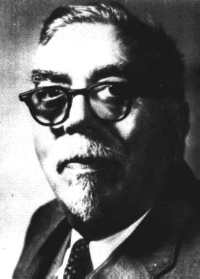
“When I look at an article in Russian, I say: this is really written in English, but it has been coded in some strange symbols. I will now proceed to decode.”
- Warren Weaver, March 1947
“... as to the problem of mechanical translation, I frankly am afraid that the [semantic] boundaries of words in different languages are too vague ... to make any quasi-mechanical translation scheme very hopeful.”
- Norbert Wiener, April 1947

Slide 23
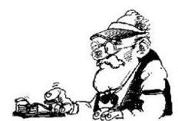

Noisy channel
along the way things get messed up
Some message is sent
What was originally sent?
We have the mutated message, but would like to recover the original

Slide 24
Noisy channel
known system
If we know something about what goes on inside here, we might be to decode/recover the message.

Slide 25
Noisy channel
“Hi bob”
I baab

Slide 26
Noisy channel
“Hi bob”
‘H’s often get dropped
‘o’s go to ‘aa’ sometimes
…
I baab

Slide 27
Noisy channel
“Hi bob”
‘H’s often get dropped
‘o’s go to a sometimes
…
I baab
Hi bob

Slide 28
Noisy channel
?
Sometime, we don’t know what goes on or we only have a rough guess…
What then?

Slide 29
Noisy channel
“Hi bob”
“hello”
“banana”
…
“I baab”
“ello”
“banana”
…
?
A data driven approach
Send a bunch of data through where we know what is being sent

Slide 30
Noisy channel
“Hi bob”
“hello”
“banana”
…
“I baab”
“ello”
“banana”
…
Use this data to train a model
A data driven approach: learn a model of the types of transformations that occur

Slide 31
Noisy channel
source (s): what was originally sent
target (t): what did we get through the noisy channel
We want a probabilistic model of the process:
What is the probability of a given source sentence, given that we’ve seen target

Slide 32
How does a model p(s | t) help us?
“….” (s)
“….” (t)
Decode:

Slide 33
Noisy channel model
Bayes’ rule
how likely is it to receive the target message
What types of messages are likely to be sent?
What do sent messages look like?
What types of transformation happen?
How likely are we to generate t from s?

Slide 34
Noisy channel model
model
channel model
translation model
source model language model
how does the target get “messed up” from the source?
what types of things should I expect?

Slide 35
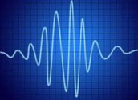
Applications: Speech recognition
words
source
noise
given the target audio, what were the original words?
target

Slide 36
Applications: Speech recognition
model
channel model
translation model
language model
acoustic model, how words turn in to sounds
what are likely words/word sequences

Slide 37
Applications: Spelling correction
words
source
noise
given the target text with misspellings, what were the original, correctly spelled words?
baskteball comitee
target

Slide 38
Applications: Spelling correction
model
channel model
translation model
language model
mistake model, keyboard map, phonetics
what are likely words/word sequences

Slide 39
Applications: Sentence compression
The dog runs.
source
noise
given the target uncompressed text, what was the original compressed text?
The dog runs slowly through the large park.
target

Slide 40
Applications: Sentence compression
model
channel model
translation model
language model
compression model, what words/constituents get deleted, rephrasing
what are likely words/word sequences?

Slide 41
Applications: Machine translation
English text
source
noise
given the target Chinese text, what was the original English text?
美国关岛国际机场及其办公室均接获一名自称沙地阿拉伯富商拉登等发出的电子邮件，威胁将会向机场等公众地方发动生化袭击後，关岛经保持高度戒备。
target

Slide 42
Applications: Machine translation
model
channel model
translation model
language model
how do English words/phrases translate to Chinese?
what are likely English words/word sequences?

Slide 43

Data-Driven Machine Translation
Hmm, every time he sees
“banco”, he either types
“bank” or “bench” … but if
he sees “banco de…”,
he always types “bank”,
never “bench”…
Man, this is so boring.
Translated documents

Slide 44
Welcome to the Chinese Room
Chinese texts with
English translations
New
Chinese
Document
English
Translation
You can teach yourself to translate Chinese
using only bilingual data (without grammar books,
dictionaries, any people to answer your questions…)

Slide 45
Centauri/Arcturan [Knight, 1997]
Your assignment, translate this to Arcturan: farok crrrok hihok yorok clok kantok ok-yurp
1a. ok-voon ororok sprok .
1b. at-voon bichat dat .
7a. lalok farok ororok lalok sprok izok enemok .
7b. wat jjat bichat wat dat vat eneat .
2a. ok-drubel ok-voon anok plok sprok .
2b. at-drubel at-voon pippat rrat dat .
8a. lalok brok anok plok nok .
8b. iat lat pippat rrat nnat .
3a. erok sprok izok hihok ghirok .
3b. totat dat arrat vat hilat .
9a. wiwok nok izok kantok ok-yurp .
9b. totat nnat quat oloat at-yurp .
4a. ok-voon anok drok brok jok .
4b. at-voon krat pippat sat lat .
10a. lalok mok nok yorok ghirok clok .
10b. wat nnat gat mat bat hilat .
5a. wiwok farok izok stok .
5b. totat jjat quat cat .
11a. lalok nok crrrok hihok yorok zanzanok .
11b. wat nnat arrat mat zanzanat .
6a. lalok sprok izok jok stok .
6b. wat dat krat quat cat .
12a. lalok rarok nok izok hihok mok .
12b. wat nnat forat arrat vat gat .

Slide 46
Centauri/Arcturan [Knight, 1997]
Your assignment, translate this to Arcturan: farok crrrok hihok yorok clok kantok ok-yurp
1a. ok-voon ororok sprok .
1b. at-voon bichat dat .
7a. lalok farok ororok lalok sprok izok enemok .
7b. wat jjat bichat wat dat vat eneat .
2a. ok-drubel ok-voon anok plok sprok .
2b. at-drubel at-voon pippat rrat dat .
8a. lalok brok anok plok nok .
8b. iat lat pippat rrat nnat .
3a. erok sprok izok hihok ghirok .
3b. totat dat arrat vat hilat .
9a. wiwok nok izok kantok ok-yurp .
9b. totat nnat quat oloat at-yurp .
4a. ok-voon anok drok brok jok .
4b. at-voon krat pippat sat lat .
10a. lalok mok nok yorok ghirok clok .
10b. wat nnat gat mat bat hilat .
5a. wiwok farok izok stok .
5b. totat jjat quat cat .
11a. lalok nok crrrok hihok yorok zanzanok .
11b. wat nnat arrat mat zanzanat .
6a. lalok sprok izok jok stok .
6b. wat dat krat quat cat .
12a. lalok rarok nok izok hihok mok .
12b. wat nnat forat arrat vat gat .

Slide 47
Centauri/Arcturan [Knight, 1997]
Your assignment, translate this to Arcturan: farok crrrok hihok yorok clok kantok ok-yurp
1a. ok-voon ororok sprok .
1b. at-voon bichat dat .
7a. lalok farok ororok lalok sprok izok enemok .
7b. wat jjat bichat wat dat vat eneat .
2a. ok-drubel ok-voon anok plok sprok .
2b. at-drubel at-voon pippat rrat dat .
8a. lalok brok anok plok nok .
8b. iat lat pippat rrat nnat .
3a. erok sprok izok hihok ghirok .
3b. totat dat arrat vat hilat .
9a. wiwok nok izok kantok ok-yurp .
9b. totat nnat quat oloat at-yurp .
4a. ok-voon anok drok brok jok .
4b. at-voon krat pippat sat lat .
10a. lalok mok nok yorok ghirok clok .
10b. wat nnat gat mat bat hilat .
5a. wiwok farok izok stok .
5b. totat jjat quat cat .
11a. lalok nok crrrok hihok yorok zanzanok .
11b. wat nnat arrat mat zanzanat .
6a. lalok sprok izok jok stok .
6b. wat dat krat quat cat .
12a. lalok rarok nok izok hihok mok .
12b. wat nnat forat arrat vat gat .

Slide 48
Centauri/Arcturan [Knight, 1997]
Your assignment, translate this to Arcturan: farok crrrok hihok yorok clok kantok ok-yurp
1a. ok-voon ororok sprok .
1b. at-voon bichat dat .
7a. lalok farok ororok lalok sprok izok enemok .
7b. wat jjat bichat wat dat vat eneat .
2a. ok-drubel ok-voon anok plok sprok .
2b. at-drubel at-voon pippat rrat dat .
8a. lalok brok anok plok nok .
8b. iat lat pippat rrat nnat .
3a. erok sprok izok hihok ghirok .
3b. totat dat arrat vat hilat .
9a. wiwok nok izok kantok ok-yurp .
9b. totat nnat quat oloat at-yurp .
4a. ok-voon anok drok brok jok .
4b. at-voon krat pippat sat lat .
10a. lalok mok nok yorok ghirok clok .
10b. wat nnat gat mat bat hilat .
5a. wiwok farok izok stok .
5b. totat jjat quat cat .
11a. lalok nok crrrok hihok yorok zanzanok .
11b. wat nnat arrat mat zanzanat .
???
6a. lalok sprok izok jok stok .
6b. wat dat krat quat cat .
12a. lalok rarok nok izok hihok mok .
12b. wat nnat forat arrat vat gat .

Slide 49
Centauri/Arcturan [Knight, 1997]
Your assignment, translate this to Arcturan: farok crrrok hihok yorok clok kantok ok-yurp
1a. ok-voon ororok sprok .
1b. at-voon bichat dat .
7a. lalok farok ororok lalok sprok izok enemok .
7b. wat jjat bichat wat dat vat eneat .
2a. ok-drubel ok-voon anok plok sprok .
2b. at-drubel at-voon pippat rrat dat .
8a. lalok brok anok plok nok .
8b. iat lat pippat rrat nnat .
3a. erok sprok izok hihok ghirok .
3b. totat dat arrat vat hilat .
9a. wiwok nok izok kantok ok-yurp .
9b. totat nnat quat oloat at-yurp .
4a. ok-voon anok drok brok jok .
4b. at-voon krat pippat sat lat .
10a. lalok mok nok yorok ghirok clok .
10b. wat nnat gat mat bat hilat .
5a. wiwok farok izok stok .
5b. totat jjat quat cat .
11a. lalok nok crrrok hihok yorok zanzanok .
11b. wat nnat arrat mat zanzanat .
6a. lalok sprok izok jok stok .
6b. wat dat krat quat cat .
12a. lalok rarok nok izok hihok mok .
12b. wat nnat forat arrat vat gat .

Slide 50
Centauri/Arcturan [Knight, 1997]
Your assignment, translate this to Arcturan: farok crrrok hihok yorok clok kantok ok-yurp
1a. ok-voon ororok sprok .
1b. at-voon bichat dat .
7a. lalok farok ororok lalok sprok izok enemok .
7b. wat jjat bichat wat dat vat eneat .
2a. ok-drubel ok-voon anok plok sprok .
2b. at-drubel at-voon pippat rrat dat .
8a. lalok brok anok plok nok .
8b. iat lat pippat rrat nnat .
3a. erok sprok izok hihok ghirok .
3b. totat dat arrat vat hilat .
9a. wiwok nok izok kantok ok-yurp .
9b. totat nnat quat oloat at-yurp .
4a. ok-voon anok drok brok jok .
4b. at-voon krat pippat sat lat .
10a. lalok mok nok yorok ghirok clok .
10b. wat nnat gat mat bat hilat .
5a. wiwok farok izok stok .
5b. totat jjat quat cat .
11a. lalok nok crrrok hihok yorok zanzanok .
11b. wat nnat arrat mat zanzanat .
6a. lalok sprok izok jok stok .
6b. wat dat krat quat cat .
12a. lalok rarok nok izok hihok mok .
12b. wat nnat forat arrat vat gat .

Slide 51
Centauri/Arcturan [Knight, 1997]
Your assignment, translate this to Arcturan: farok crrrok hihok yorok clok kantok ok-yurp
1a. ok-voon ororok sprok .
1b. at-voon bichat dat .
7a. lalok farok ororok lalok sprok izok enemok .
7b. wat jjat bichat wat dat vat eneat .
2a. ok-drubel ok-voon anok plok sprok .
2b. at-drubel at-voon pippat rrat dat .
8a. lalok brok anok plok nok .
8b. iat lat pippat rrat nnat .
3a. erok sprok izok hihok ghirok .
3b. totat dat arrat vat hilat .
9a. wiwok nok izok kantok ok-yurp .
9b. totat nnat quat oloat at-yurp .
4a. ok-voon anok drok brok jok .
4b. at-voon krat pippat sat lat .
10a. lalok mok nok yorok ghirok clok .
10b. wat nnat gat mat bat hilat .
5a. wiwok farok izok stok .
5b. totat jjat quat cat .
11a. lalok nok crrrok hihok yorok zanzanok .
11b. wat nnat arrat mat zanzanat .
6a. lalok sprok izok jok stok .
6b. wat dat krat quat cat .
12a. lalok rarok nok izok hihok mok .
12b. wat nnat forat arrat vat gat .

Slide 52
Centauri/Arcturan [Knight, 1997]
Your assignment, translate this to Arcturan: farok crrrok hihok yorok clok kantok ok-yurp
1a. ok-voon ororok sprok .
1b. at-voon bichat dat .
7a. lalok farok ororok lalok sprok izok enemok .
7b. wat jjat bichat wat dat vat eneat .
2a. ok-drubel ok-voon anok plok sprok .
2b. at-drubel at-voon pippat rrat dat .
8a. lalok brok anok plok nok .
8b. iat lat pippat rrat nnat .
3a. erok sprok izok hihok ghirok .
3b. totat dat arrat vat hilat .
9a. wiwok nok izok kantok ok-yurp .
9b. totat nnat quat oloat at-yurp .
4a. ok-voon anok drok brok jok .
4b. at-voon krat pippat sat lat .
10a. lalok mok nok yorok ghirok clok .
10b. wat nnat gat mat bat hilat .
???
5a. wiwok farok izok stok .
5b. totat jjat quat cat .
11a. lalok nok crrrok hihok yorok zanzanok .
11b. wat nnat arrat mat zanzanat .
6a. lalok sprok izok jok stok .
6b. wat dat krat quat cat .
12a. lalok rarok nok izok hihok mok .
12b. wat nnat forat arrat vat gat .

Slide 53
Centauri/Arcturan [Knight, 1997]
Your assignment, translate this to Arcturan: farok crrrok hihok yorok clok kantok ok-yurp
1a. ok-voon ororok sprok .
1b. at-voon bichat dat .
7a. lalok farok ororok lalok sprok izok enemok .
7b. wat jjat bichat wat dat vat eneat .
2a. ok-drubel ok-voon anok plok sprok .
2b. at-drubel at-voon pippat rrat dat .
8a. lalok brok anok plok nok .
8b. iat lat pippat rrat nnat .
3a. erok sprok izok hihok ghirok .
3b. totat dat arrat vat hilat .
9a. wiwok nok izok kantok ok-yurp .
9b. totat nnat quat oloat at-yurp .
4a. ok-voon anok drok brok jok .
4b. at-voon krat pippat sat lat .
10a. lalok mok nok yorok ghirok clok .
10b. wat nnat gat mat bat hilat .
5a. wiwok farok izok stok .
5b. totat jjat quat cat .
11a. lalok nok crrrok hihok yorok zanzanok .
11b. wat nnat arrat mat zanzanat .
6a. lalok sprok izok jok stok .
6b. wat dat krat quat cat .
12a. lalok rarok nok izok hihok mok .
12b. wat nnat forat arrat vat gat .

Slide 54
Centauri/Arcturan [Knight, 1997]
Your assignment, translate this to Arcturan: farok crrrok hihok yorok clok kantok ok-yurp
1a. ok-voon ororok sprok .
1b. at-voon bichat dat .
7a. lalok farok ororok lalok sprok izok enemok .
7b. wat jjat bichat wat dat vat eneat .
2a. ok-drubel ok-voon anok plok sprok .
2b. at-drubel at-voon pippat rrat dat .
8a. lalok brok anok plok nok .
8b. iat lat pippat rrat nnat .
3a. erok sprok izok hihok ghirok .
3b. totat dat arrat vat hilat .
9a. wiwok nok izok kantok ok-yurp .
9b. totat nnat quat oloat at-yurp .
4a. ok-voon anok drok brok jok .
4b. at-voon krat pippat sat lat .
10a. lalok mok nok yorok ghirok clok .
10b. wat nnat gat mat bat hilat .
process of
elimination
5a. wiwok farok izok stok .
5b. totat jjat quat cat .
11a. lalok nok crrrok hihok yorok zanzanok .
11b. wat nnat arrat mat zanzanat .
6a. lalok sprok izok jok stok .
6b. wat dat krat quat cat .
12a. lalok rarok nok izok hihok mok .
12b. wat nnat forat arrat vat gat .

Slide 55
Centauri/Arcturan [Knight, 1997]
Your assignment, translate this to Arcturan: farok crrrok hihok yorok clok kantok ok-yurp
1a. ok-voon ororok sprok .
1b. at-voon bichat dat .
7a. lalok farok ororok lalok sprok izok enemok .
7b. wat jjat bichat wat dat vat eneat .
2a. ok-drubel ok-voon anok plok sprok .
2b. at-drubel at-voon pippat rrat dat .
8a. lalok brok anok plok nok .
8b. iat lat pippat rrat nnat .
3a. erok sprok izok hihok ghirok .
3b. totat dat arrat vat hilat .
9a. wiwok nok izok kantok ok-yurp .
9b. totat nnat quat oloat at-yurp .
4a. ok-voon anok drok brok jok .
4b. at-voon krat pippat sat lat .
10a. lalok mok nok yorok ghirok clok .
10b. wat nnat gat mat bat hilat .
5a. wiwok farok izok stok .
5b. totat jjat quat cat .
11a. lalok nok crrrok hihok yorok zanzanok .
11b. wat nnat arrat mat zanzanat .
cognate?
6a. lalok sprok izok jok stok .
6b. wat dat krat quat cat .
12a. lalok rarok nok izok hihok mok .
12b. wat nnat forat arrat vat gat .

Slide 56
Centauri/Arcturan [Knight, 1997]
Your assignment, put these words in order: { jjat, arrat, mat, bat, oloat, at-yurp }
1a. ok-voon ororok sprok .
1b. at-voon bichat dat .
7a. lalok farok ororok lalok sprok izok enemok .
7b. wat jjat bichat wat dat vat eneat .
2a. ok-drubel ok-voon anok plok sprok .
2b. at-drubel at-voon pippat rrat dat .
8a. lalok brok anok plok nok .
8b. iat lat pippat rrat nnat .
3a. erok sprok izok hihok ghirok .
3b. totat dat arrat vat hilat .
9a. wiwok nok izok kantok ok-yurp .
9b. totat nnat quat oloat at-yurp .
4a. ok-voon anok drok brok jok .
4b. at-voon krat pippat sat lat .
10a. lalok mok nok yorok ghirok clok .
10b. wat nnat gat mat bat hilat .
5a. wiwok farok izok stok .
5b. totat jjat quat cat .
11a. lalok nok crrrok hihok yorok zanzanok .
11b. wat nnat arrat mat zanzanat .
zero
fertility
6a. lalok sprok izok jok stok .
6b. wat dat krat quat cat .
12a. lalok rarok nok izok hihok mok .
12b. wat nnat forat arrat vat gat .

Slide 57
It’s Really Spanish/English
Clients do not sell pharmaceuticals in Europe => Clientes no venden medicinas en Europa
1a. Garcia and associates .
1b. Garcia y asociados .
7a. the clients and the associates are enemies .
7b. los clients y los asociados son enemigos .
2a. Carlos Garcia has three associates .
2b. Carlos Garcia tiene tres asociados .
8a. the company has three groups .
8b. la empresa tiene tres grupos .
3a. his associates are not strong .
3b. sus asociados no son fuertes .
9a. its groups are in Europe .
9b. sus grupos estan en Europa .
4a. Garcia has a company also .
4b. Garcia tambien tiene una empresa .
10a. the modern groups sell strong pharmaceuticals .
10b. los grupos modernos venden medicinas fuertes .
5a. its clients are angry .
5b. sus clientes estan enfadados .
11a. the groups do not sell zenzanine .
11b. los grupos no venden zanzanina .
6a. the associates are also angry .
6b. los asociados tambien estan enfadados .
12a. the small groups are not modern .
12b. los grupos pequenos no son modernos .

Slide 58
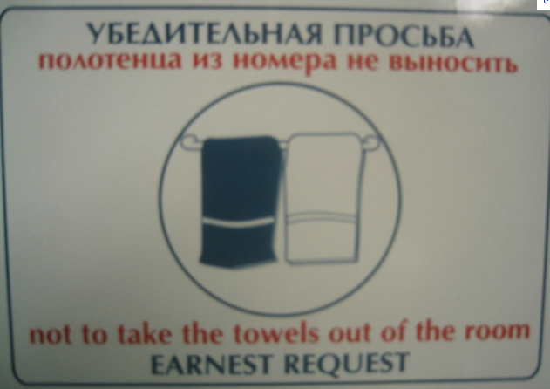

Slide 59
Data available
Many languages
  Europarl corpus has all European languages
    http://www.statmt.org/europarl/
    From a few hundred thousand sentences to a few million
  French/English from French parliamentary proceedings
  Lots of Chinese/English and Arabic/English from government projects/interests
    Chinese-English: 440 million words (15-20 million sentence pairs)
    Arabic-English: 790 million words (30-40 million sentence pairs)
  Smaller corpora in many, many other languages
Lots of monolingual data available in many languages
Even less data with multiple translations available
Available in limited domains
  most data is either news or government proceedings
  some other domains recently, like blogs

Slide 60
Statistical MT Overview
training
learned parameters
Bilingual data
model
monolingual data
Find the best
translation given the foreign sentence and the model
Translation
Foreign sentence
English
sentence

Slide 61
Statistical MT
We will model the translation process probabilistically
Given a foreign sentence to translate, for any possible English sentence, we want to know the probability that sentence is a translation of the foreign sentence
If we can find the most probable English sentence, we’re done
p(english sentence | foreign sentence)

Slide 62
Noisy channel model
model
translation model
language model
how do foreign sentences get translated to English sentences?
what do English sentences look like?

Slide 63
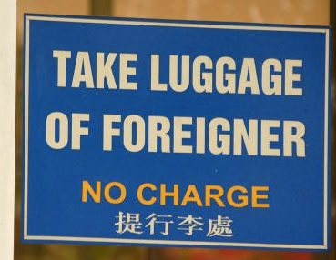

Slide 64
Translation model
The models define probabilities over inputs
Morgen fliege ich nach Kanada zur Konferenz
Tomorrow I will fly to the conference in Canada
What is the probability that the English sentence is a translation of the foreign sentence?

Slide 65
Translation model
The models define probabilities over inputs
Morgen
fliege
ich
nach Kanada
zur Konferenz
Tomorrow
I
will fly
to the conference
In Canada
What is the probability of a foreign word being translated as a particular English word?
What is the probability of a foreign foreign phrase being translated as a particular English phrase?
What is the probability of a word/phrase changing ordering?
What is the probability of a foreign word/phrase disappearing?
What is the probability of a English word/phrase appearing?

Slide 66
Translation model
The models define probabilities over inputs
p( Morgen fliege ich nach Kanada zur Konferenz |
Tomorrow I will fly to the conference in Canada )
= 0.1
p( Morgen fliege ich nach Kanada zur Konferenz |
I like peanut butter and jelly )
= 0.0001

Slide 67
Language model
The models define probabilities over inputs
Tomorrow I will fly to the conference in Canada

Slide 68
What is a probability distribution?
A probability distribution defines the probability over a space of possible inputs
For the language model, what is the space of possible inputs?
  A language model describes the probability over ALL possible combinations of English words
For the translation model, what is the space of possible inputs?
  ALL possible combinations of foreign words with ALL possible combinations of English words

Slide 69
One way to think about it…
Translation
model
Broken
English
language
model
Spanish
(foreign)
English
What hunger have I,
Hungry I am so,
I am so hungry,
Have I that hunger …
Que hambre tengo yo
I am so hungry

Slide 70
Translation
Let’s assume we have a translation model and a language model
Given a foreign sentence, what question do we want to ask to translate that sentence into English?

Slide 71
Statistical MT Overview
training
learned parameters
“nice” fragment aligned data
Bilingual data
Translation model
preprocessing
monolingual data
Language model
Decoder
(what English sentence is most probable given foreign sentence with learned models)
Translation
Foreign sentence

Slide 72
Problems for Statistical MT
Preprocessing
  How do we get aligned bilingual text?
  Tokenization
  Segmentation (document, sentence, word)
Language modeling
  Given an English string e, assigns P(e) by formula
Translation modeling
  Given a pair of strings <f,e>, assigns P(f | e) by formula
Decoding
  Given a language model, a translation model, and a new sentence f … find translation e maximizing P(e) * P(f | e)
Parameter optimization
  Given a model with multiple feature functions, how are they related? What are the optimal paraeters?
Evaluation
  How well is a system doing? How can we compare two systems?

Slide 73
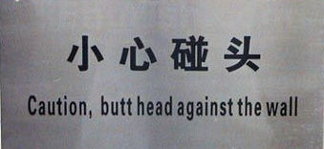

Slide 74
Problems for Statistical MT
Preprocessing
Language modeling
Translation modeling
Decoding
Parameter optimization
Evaluation

Slide 75
Data
We want pairs of aligned sentences/text fragments. How do we get them?

Slide 76
From No Data to Sentence Pairs
Easy way 1: Linguistic Data Consortium (LDC)
Easy way 2: pay $$$
  Suppose one billion words of parallel data were sufficient
  At 20 cents/word, that’s $200 million
Hard way: Find it, and then earn it!
  De-formatting
  Remove strange characters
  Character code conversion
  Document alignment
  Sentence alignment
  Tokenization (also called Segmentation)

Slide 77
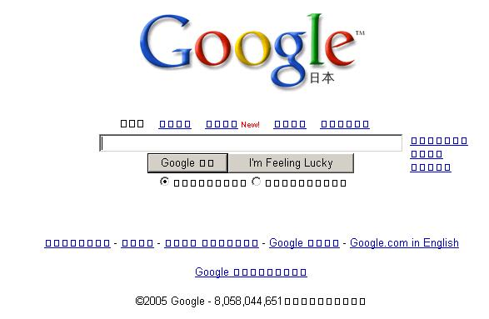
If you don’t get the characters right…

Slide 78
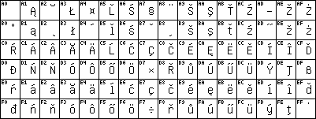
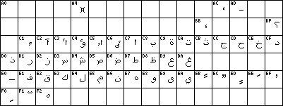
http://en.wikipedia.org/wiki/ISO/IEC_8859
ISO-8859-2 (Latin2)
ISO-8859-6 (Arabic)

Slide 79
Chinese?
GB Code
GBK Code
Big 5 Code
CNS-11643-1992
…

Slide 80
Document Alignment
Input:
  Big bag of files obtained from somewhere, believed to contain pairs of files that are translations of each other.
Output:
  List of pairs of files that are actually translations.
E
C
E
C
C
C
E
E
C
E
E
C
C
E
E
E
C
C
C
C
E
E
C
E
E
C
C
C
E
E

Slide 81
Document Alignment
Input:
  Big bag of files obtained from somewhere, believed to contain pairs of files that are translations of each other.
Output:
  List of pairs of files that are actually translations.
E
C
E
C
C
C
E
E
C
E
E
C
C
E
E
E
C
C
C
C
E
E
C
E
E
C
C
C
E
E

Slide 82
Sentence Alignment
The old man is happy. He has fished many times. His wife talks to him. The fish are jumping. The sharks await.
El viejo está feliz porque ha pescado muchos veces. Su mujer habla con él. Los tiburones esperan.

Slide 83
Sentence Alignment
The old man is happy.
He has fished many times.
His wife talks to him.
The fish are jumping.
The sharks await.
El viejo está feliz porque ha pescado muchos veces.
Su mujer habla con él.
Los tiburones esperan.

Slide 84
Sentence Alignment
The old man is happy.
He has fished many times.
His wife talks to him.
The fish are jumping.
The sharks await.
El viejo está feliz porque ha pescado muchos veces.
Su mujer habla con él.
Los tiburones esperan.

Slide 85
Sentence Alignment
The old man is happy. He has fished many times.
His wife talks to him.
The sharks await.
El viejo está feliz porque ha pescado muchos veces.
Su mujer habla con él.
Los tiburones esperan.
Note that unaligned sentences are thrown out, and
sentences are merged in n-to-m alignments (n, m > 0).

Slide 86
Tokenization (or Segmentation)
English
  Input (some byte stream):
    "There," said Bob.
  Output (7 “tokens” or “words”):
  " There , " said Bob .
Chinese
  Input (byte stream):
  Output:
美国关岛国际机场及其办公室均接获一名自称沙地阿拉伯富商拉登等发出的电子邮件。
美国 关岛国 际机 场 及其 办公 室均接获 一名 自称 沙地 阿拉 伯富 商拉登 等发 出 的 电子邮件。

Slide 87
Problems for Statistical MT
Preprocessing
Language modeling
Translation modeling
Decoding
Parameter optimization
Evaluation

Slide 88
Language Modeling
Most common: n-gram language models
More data the better (Google n-grams)
Domain is important

Slide 89
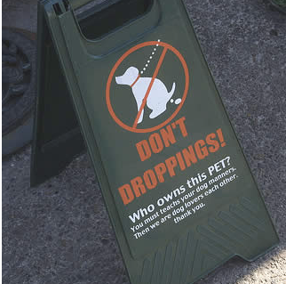

Slide 90
Problems for Statistical MT
Preprocessing
Language modeling
Translation modeling
Decoding
Parameter optimization
Evaluation

Slide 91
MT Pyramid
interlingua
semantics
semantics
syntax
syntax
phrases
phrases
words
words
SOURCE
TARGET

Slide 92
Translation Model
Learn How to Translate from Data
Direct Estimation:
Mary did not slap the green witch
not enough data for this
(most input sentences unseen)
Maria no dió una botefada a la bruja verde

Slide 93
Generative Model
Break up process into smaller steps:
Mary did not slap the green witch
sufficient statistics for smaller steps
Maria no dió una botefada a la bruja verde

Slide 94
What kind of Translation Model?
May use syntactic and semantic representations:
Mary did not slap the green witch
Word-level models
Phrasal models
Syntactic models
Semantic models
Maria no dió una botefada a la bruja verde

Slide 95
The Classic Translation Model
Word Substitution/Permutation [IBM Model 3, Brown et al., 1993]
Generative story:
Mary did not slap the green witch
n(3|slap)
Mary not slap slap slap the green witch
P-Null
Mary not slap slap slap NULL the green witch
t(la|the)
Maria no dió una botefada a la verde bruja
d(j|i)
Maria no dió una botefada a la bruja verde
Probabilities can be learned from raw bilingual text.

Slide 96
Phrase-Based Statistical MT
Morgen
fliege
ich
nach Kanada
zur Konferenz
Tomorrow
I
will fly
to the conference
In Canada
Foreign input segmented in to phrases
  “phrase” is any sequence of words
Each phrase is probabilistically translated into English
  P(to the conference | zur Konferenz)
  P(into the meeting | zur Konferenz)
Phrases are probabilistically re-ordered
See [Koehn et al, 2003] for an intro.

Slide 97
Advantages of Phrase-Based
Many-to-many mappings can handle non-compositional phrases
Easy to understand
Local context is very useful for disambiguating
  “Interest rate” → …
  “Interest in” → …
The more data, the longer the learned phrases
  Sometimes whole sentences

Slide 98
Syntax
S
VP
NP
VP
PP
NP
NP
NP
NP
NP
DT
CD
NNS
VBP
NNS
VBG
IN
NNP
CC
NNP
PUNC
These
7
people
include
astronauts
coming
from
France
and
Russia
.

Slide 99
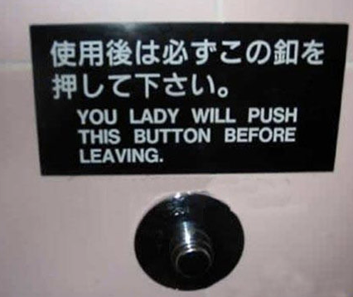

Slide 100
Problems for Statistical MT
Preprocessing
Language modeling
Translation modeling
Decoding
Parameter optimization
Evaluation

Slide 101
Decoding
Of all conceivable English word strings, find the one maximizing P(e) x P(f | e)
Decoding is an NP-complete problem (for many translation models
  (Knight, 1999)
Several decoding strategies are often available

Slide 102
Search
f₁ f₂ f₃ f₄ f₅ f₆

Slide 103
Search
partial trans.
f₁ f₂ f₃ f₄ f₅ f₆
f₁ f₂ f₃ f₄ f₅ f₆
partial trans.
f₁ f₂ f₃ f₄ f₅ f₆
…
partial trans.
f₁ f₂ f₃ f₄ f₅ f₆

Slide 104
Search
partial trans.
f₁ f₂ f₃ f₄ f₅ f₆
partial trans.
f₁ f₂ f₃ f₄ f₅ f₆
partial trans.
f₁ f₂ f₃ f₄ f₅ f₆
partial trans.
f₁ f₂ f₃ f₄ f₅ f₆
f₁ f₂ f₃ f₄ f₅ f₆
partial trans.
f₁ f₂ f₃ f₄ f₅ f₆
…
…
partial trans.
f₁ f₂ f₃ f₄ f₅ f₆

Slide 105
Search
partial trans.
f₁ f₂ f₃ f₄ f₅ f₆
partial trans.
f₁ f₂ f₃ f₄ f₅ f₆
partial trans.
f₁ f₂ f₃ f₄ f₅ f₆
partial trans.
f₁ f₂ f₃ f₄ f₅ f₆
f₁ f₂ f₃ f₄ f₅ f₆
partial trans.
f₁ f₂ f₃ f₄ f₅ f₆
…
…
partial trans.
f₁ f₂ f₃ f₄ f₅ f₆
State space search problem
Huge space
Evaluate intermediate hypotheses using model and prune partial hypotheses

Slide 106
Problems for Statistical MT
Preprocessing
Language modeling
Translation modeling
Decoding
Parameter optimization
Evaluation

Slide 107
Basic Model, Revisited
argmax P(e | f) =
e
argmax P(e) x P(f | e) / P(f) =
e
argmax P(e) x P(f | e)
e

Slide 108
Basic Model, Revisited
argmax P(e | f) =
e
argmax P(e) x P(f | e) / P(f) =
e
argmax P(e)^{2.4} x P(f | e) … works better!
e

Slide 109
Basic Model, Revisited
argmax P(e | f) =
e
argmax P(e) x P(f | e) / P(f)
e
argmax P(e)^{2.4} x P(f | e) x length(e)^{1.1}
e
Rewards longer hypotheses, since
these are unfairly punished by P(e)

Slide 110
Basic Model, Revisited
argmax P(e)^{2.4} x P(f | e) x length(e)^{1.1} x KS ^{3.7} …
e
Lots of knowledge sources vote on any given hypothesis.
“Knowledge source” = “feature function” = “score component”.
A feature function simply scores a hypothesis with a real value.
(May be binary, as in “e has a verb”).

Slide 111
The Problem: Learn Lambdas
Given a data set with foreign/English sentences, find the λ’s that:
maximize the likelihood of the data
maximize an evaluation criterion

