Slide 1
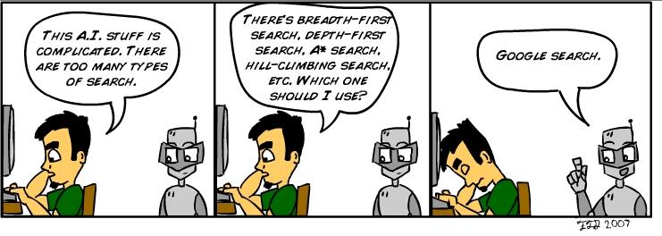
http://blog.lib.umn.edu/torre107/si/pics/superficialintelligence2.jpg

Slide 2
Uninformed Search
CS457 David Kauchak Fall 2011
Adapted from notes from:
Sara Owsley Sood, Eric Eaton

Slide 3
Administrative
Final project proposals
Assignment 5

Slide 4
AI is a huge field
So, what is AI…
One definition: “Building programs that enable computers to do what humans can do.”
for example: read, walk around, drive, play games, solve problems, learn, have conversations…

Slide 5
How do we measure success?
“Building programs that enable computers to do what humans can do.”
there are many interpretations of this goal…
human vs. rational
Think like a human Cognitive Modeling | Think rationally Logic-based Systems
Act like a human Turing Test | Act rationally Rational Agents
thinking vs.
acting

Slide 6
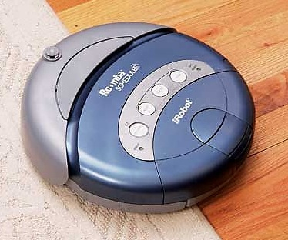
How do we make a computer "smart?"
Computer,
clean the house!
Um… OK…??
This one's got no chance…
Notes:
Assume that we want this vacuum to clean this house
To us - if someone told us to use a vacuum to clean a house, the sequence of events that should follow are pretty clear
We’d walk into the house, figure out what rooms needed to be vacuumed and start vacuuming
We’d methodically go through the room, not vacuuming over places we’ve already been, until we cover the whole room, then move to the next room

Slide 7
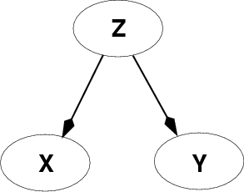
Fundamental problem of AI
Reasoning with knowledge and uncertainty
Search
Many different ways of making an agent intelligent
Learning
Reasoning with Utility

Slide 8
Today: search
Brute force approach
Very unlikely how humans do it
Enumerate out possibilities in a reasonable order
Think like a human Cognitive Modeling | Think rationally Logic-based Systems
Act like a human Turing Test | Act rationally Rational Agents

Slide 9
What is an “agent”?
“anything that can be viewed as perceiving its environment through sensors and acting upon that environment through actuators”
Human agent
sensors = eyes, ears, etc
actuators = hands, legs, mouth, etc
Software agent
sensors = any input devices - keyboard gives it keystrokes, commands over the network, files give it text or data
actuators = any output devices - using the screen to display things, pass things over the network, write things to files, etc

Slide 10
search agents
A search agent is an agent that approaches problem solving via search
To accomplish a task:
Formulate problem and goal
Search for a sequence of actions that will lead to the goal (the policy)
Execute the actions one at a time
done offline!

Slide 11
Formulating the problem:
What information does a search agent need to know to plan out a solution?

Slide 12
Formulating the problem:
Initial state: where are we starting from
what are the states?
Actions: what are the possible actions
Transition model: aka state-space, mapping from action x state to state
Goal/goal test: what is the end result we’re trying to achieve?
Cost: what are the costs of the different actions

Slide 13
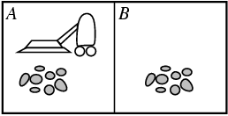
Let’s start with our vacuum cleaner example
State space
Just two possible spaces in the house (though this generalizes easily to more)
each space can either be dirty or clean
vaccum is in one space at a time

Slide 14
Let’s start with our vacuum cleaner example
State space
Just two possible spaces in the house (though this generalizes easily to more)
each space can either be dirty or clean
vaccum is in one space at a time
How many states?

Slide 15
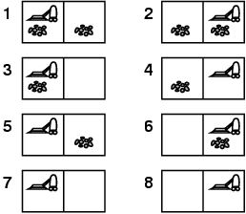
Vacuum world
Only 8 states (options^{spaces})

Slide 16
Vacuum world
goal state(s)?

Slide 17
Vacuum world

Slide 18
Vacuum world
Actions?
move left
move right
suck
no-op

Slide 19
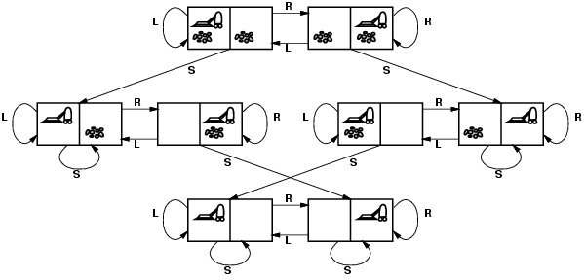
Vacuum world: state space/transition model

Slide 20
Problem characteristics
What are some of the challenges of solving even this simple version in the real world?

Slide 21
Problem characteristics
Fully observable vs. partially observable
do we have access to all of the relevant information
noisy information, inaccurate sensors, missing information
Deterministic vs. non-deterministic (stochastic)
outcome of actions are not always certain
probabilistic sometimes
Known/unknown environment
Do we know a priori what the problem space is like (e.g. do we have a map)

Slide 22
Example: vacuum world
Deterministic, fully observable
start in #5. Solution?
[Right, Suck]

Slide 23
Example: vacuum world
Sensorless
start in {1,2,3,4,5,6,7,8} Solution?
[Right,Suck,Left,Suck]

Slide 24
Example: Vacuum world
Non-deterministic and/or partially observable
Nondeterministic: Suck may dirty a clean carpet
Partially observable: location, dirt at current location.
Percept: [L, Clean], i.e., start in #5 or #7 Solution?
[Right, if dirt then Suck]

Slide 25
Vacuum world
Cost?

Slide 26
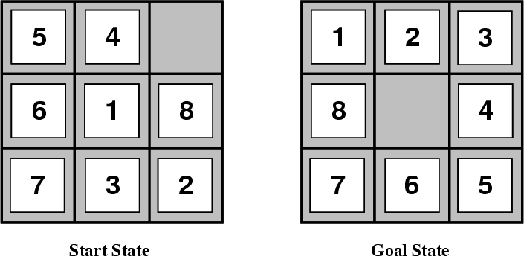
Another problem: 8-Puzzle

Slide 27
8-puzzle
goal
states?
actions?
path cost?

Slide 28
8-puzzle
state:
all 3 x 3 configurations of the tiles on the board
actions:
Move Blank Square Left, Right, Up or Down.
This is a more efficient encoding than moving each of the 8 distinct tiles
path cost:
+1 for each action

Slide 29
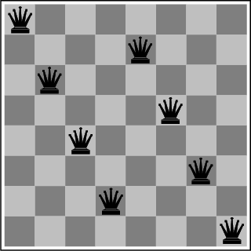
The 8-Queens Problem
State transition: ?
Initial State: ?
Actions: ?
Goal: Place eight queens on a chessboard such that no queen attacks any other!

Slide 30
Missionaries and Cannibals
Three missionaries and three cannibals wish to cross the river. They have a small boat that will carry up to two people. Everyone can navigate the boat. If at any time the Cannibals outnumber the Missionaries on either bank of the river, they will eat the Missionaries. Find the smallest number of crossings that will allow everyone to cross the river safely.

Slide 31
Cryptarithmetic
Find an assignment of digits (0, ..., 9) to letters so that a given arithmetic expression is true. examples: SEND + MORE = MONEY and
FORTY Solution: 29786
+ TEN 850
+ TEN 850
----- -----
SIXTY 31486
F=2, O=9, R=7, etc.

Slide 32
Remove 5 Sticks
Given the following configuration of sticks, remove exactly 5 sticks in such a way that the remaining configuration forms exactly 3 squares.

Slide 33
Water Jug Problem
Given a full 5-gallon jug and a full 2-gallon jug, fill the 2-gallon jug with exactly one gallon of water.
5
2

Slide 34
Some real-world problems
Route finding
directions, maps
computer networks
airline travel
VLSI layout
Touring (traveling salesman)
Agent planning

Slide 35
Search algorithms
We’ve defined the problem
Now we want to find the solution!
Use search techniques
offline, simulated exploration of state space by generating successors of already-explored states (a.k.a. expanding states)
Start at the initial state and search for a goal state
What are candidate search techniques?
BFS
DFS
Uniform-cost search
Depth limited DFS
Depth-first iterative deepening

