Slide 1
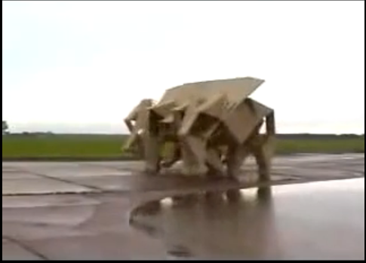
http://www.youtube.com/watch?v=OR_-Y-eIlQo

Slide 2
Unsupervised learning
David Kauchak
CS 457 – Spring 2011
some slides adapted from Dan Klein

Slide 3
Admin
Assignment 4 grades
Assignment 5 part 1
Quiz next Tuesday

Slide 4
Final project
Read the entire handout
Groups of 2-3 people
  e-mail me asap if you’re looking for a group
research-oriented project
  must involve some evaluation!
  must be related to NLP
Schedule
  Tuesday 11/15 project proposal
  11/24 status report 1
  12/1 status report 2
  12/9 writeup (last day of classes)
  12/6 presentation (final exam slot)
There are lots of resources out there that you can leverage

Slide 5
Supervised learning: summarized
Classification
  Bayesian classifiers
    Naïve Bayes classifier (linear classifier)
  Multinomial logistic regression (linear classifier)
    aka Maximum Entropy Classifier (MaxEnt)
Regression
  linear regression (fit a line to the data)
  logistic regression (fit a logistic to the data)

Slide 6
Supervised learning: summarized
NB vs. multinomial logistic regression
  NB has stronger assumptions: better for small amounts of training data
  MLR has more realistic independence assumptions and performs better with more data
  NB is faster and easier
Regularization
Training
  minimize an error function
  maximize the likelihood of the data (MLE)

Slide 7
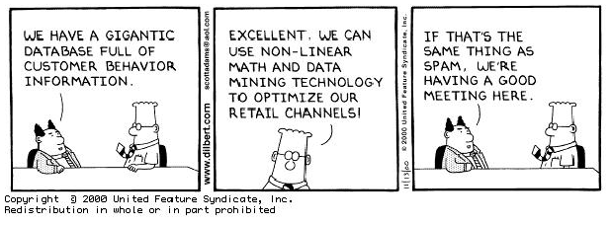
A step back: data

Slide 8
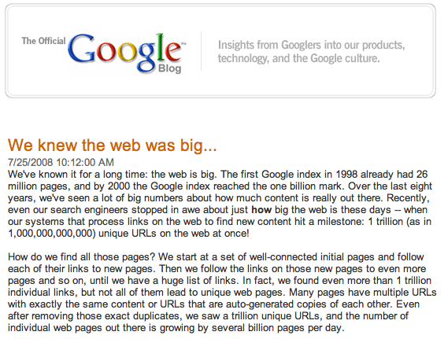
Why do we need computers for dealing with natural text?
Notes:
besides being a complex problem, there’s a lot of data! (which is a good thing and a bad thing)
some people may say… outsource it (India, the Philippines, etc.). And there are frameworks, like mechanical Turk
world population: ~7M
let’s say you had a simple task to perform on each web page that only took 10 seconds to do. If every single person in the world worked on this non-stop, they would have to work for 20 days straight.
what if it’s a task like translating the page or finding information that requires specialization?

Slide 9


Web is just the start…
e-mail
27 million tweets a day
247 billion e-mails a day
corporate
databases
Blogs:
126 million different blogs
http://royal.pingdom.com/2010/01/22/internet-2009-in-numbers/
Notes:
- web pages are just the beginning…

Slide 10
Corpora examples
Linguistic Data Consortium
  http://www.ldc.upenn.edu/Catalog/byType.jsp
Dictionaries
  WordNet – 206K English words
  CELEX2 – 365K German words
Monolingual text
  Gigaword corpus
    4M documents (mostly news articles)
    1.7 trillion words
    11GB of data (4GB compressed)

Slide 11
Corpora examples
Monolingual text continued
  Enron e-mails
    517K e-mails
  Twitter
  Chatroom
  Many non-English resources
Parallel data
  ~10M sentences of Chinese-English and Arabic-English
  Europarl
    ~1.5M sentences English with 10 different languages

Slide 12
Corpora examples
Annotated
  Brown Corpus
    1M words with part of speech tag
  Penn Treebank
    1M words with full parse trees annotated
  Other Treebanks
    Treebank refers to a corpus annotated with trees (usually syntactic)
    Chinese: 51K sentences
    Arabic: 145K words
    many other languages…
    BLIPP: 300M words (automatically annotated)
Notes:
Many other data

Slide 13
Corpora examples
Many others…
  Spam and other text classification
  Google n-grams
    2006 (24GB compressed!)
    13M unigrams
    300M bigrams
    ~1B 3,4 and 5-grams
  Speech
  Video (with transcripts)

Slide 14
Problem
Labeled
Unlabeled
web
  Penn Treebank
    1M words with full parse trees annotated
1 trillion web pages
e-mail
☹
247 billion e-mails a day

Slide 15

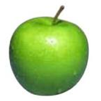
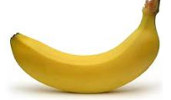
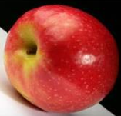
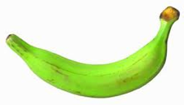
Unsupervised learning
Unupervised learning: given data, but no labels

Slide 16
How would you group these points?

Slide 17
K-Means
Most well-known and popular clustering algorithm
Start with some initial cluster centers
Iterate:
  Assign/cluster each example to closest center
  Recalculate centers as the mean of the points in a cluster, c:

Slide 18
K-means

Slide 19
K-means: Initialize centers randomly

Slide 20
K-means: assign points to nearest center

Slide 21
K-means: readjust centers

Slide 22
K-means: assign points to nearest center

Slide 23
K-means: readjust centers

Slide 24
K-means: assign points to nearest center

Slide 25
K-means: readjust centers

Slide 26
K-means: assign points to nearest center
No changes: Done

Slide 27
K-means variations/parameters
Initial (seed) cluster centers
Convergence
  A fixed number of iterations
  partitions unchanged
  Cluster centers don’t change
K

Slide 28
Hard vs. soft clustering
Hard clustering: Each example belongs to exactly one cluster
Soft clustering: An example can belong to more than one cluster (probabilistic)
  Makes more sense for applications like creating browsable hierarchies
  You may want to put a pair of sneakers in two clusters: (i) sports apparel and (ii) shoes

Slide 29
Learning a grammar
Parsed sentences
Grammar
S → NP VP
S → VP
NP → Det A N
NP → NP PP
NP → PropN
A → ε
A → Adj A
PP → Prep NP
VP → V NP
VP → VP PP
0.9
0.1
0.5
0.3
0.2
0.6
0.4
1.0
0.7
0.3
Learning/
Training
English
…

Slide 30
Parsing other data sources
What if we wanted to parse sentences from the web?
web
1 trillion web pages

Slide 31
Idea 1
Penn Treebank
Penn Grammar
S → NP VP
S → VP
NP → Det A N
NP → NP PP
NP → PropN
A → ε
A → Adj A
PP → Prep NP
VP → V NP
VP → VP PP
0.9
0.1
0.5
0.3
0.2
0.6
0.4
1.0
0.7
0.3
Learning/
Training
English
…

Slide 32
Idea 1
Penn Grammar
S → NP VP
S → VP
NP → Det A N
NP → NP PP
NP → PropN
A → ε
A → Adj A
PP → Prep NP
VP → V NP
VP → VP PP
0.9
0.1
0.5
0.3
0.2
0.6
0.4
1.0
0.7
0.3
web
1 trillion web pages
English
How well will this work?

Slide 33
Parsing other data sources
What if we wanted to parse “sentences” from twitter?
27 million tweets a day

Slide 34
Idea 1
Penn Grammar
S → NP VP
S → VP
NP → Det A N
NP → NP PP
NP → PropN
A → ε
A → Adj A
PP → Prep NP
VP → V NP
VP → VP PP
0.9
0.1
0.5
0.3
0.2
0.6
0.4
1.0
0.7
0.3
27 million tweets a day
English
Probably not going to work very well
Ideas?

Slide 35
Idea 2
Pseudo-Twitter grammar
S → NP VP
S → VP
NP → Det A N
NP → NP PP
NP → PropN
A → ε
A → Adj A
PP → Prep NP
VP → V NP
VP → VP PP
0.9
0.1
0.5
0.3
0.2
0.6
0.4
1.0
0.7
0.3
Learning/
Training
English

Slide 36
Idea 2
Pseudo-Twitter grammer
S → NP VP
S → VP
NP → Det A N
NP → NP PP
NP → PropN
A → ε
A → Adj A
PP → Prep NP
VP → V NP
VP → VP PP
0.9
0.1
0.5
0.3
0.2
0.6
0.4
1.0
0.7
0.3
*
27 million tweets a day
English
Often, this improves the parsing performance

Slide 37
Idea 3
Pseudo-Twitter grammer
S → NP VP
S → VP
NP → Det A N
NP → NP PP
NP → PropN
A → ε
A → Adj A
PP → Prep NP
VP → V NP
VP → VP PP
0.9
0.1
0.5
0.3
0.2
0.6
0.4
1.0
0.7
0.3
Learning/
Training
*
English
27 million tweets a day

Slide 38
Idea 3: some things to think about
How many iterations should we do it for?
  When should we stop?
Will we always get better?
What does “get better” mean?

Slide 39
Idea 3: some things to think about
How many iterations should we do it for?
  We should keep iterating as long as we improve
Will we always get better?
  Not guaranteed for most measures
What does “get better” mean?
  Use our friend the development set
  Does it increase the likelihood of the training data

Slide 40
Idea 4
What if we don’t have any parsed data?
Penn Grammar
S → NP VP
S → VP
NP → Det A N
NP → NP PP
NP → PropN
A → ε
A → Adj A
PP → Prep NP
VP → V NP
VP → VP PP
0.9
0.1
0.5
0.3
0.2
0.6
0.4
1.0
0.7
0.3
27 million tweets a day
English

Slide 41
Idea 4
Randomly initialized grammar
S → NP VP
S → VP
NP → Det A N
NP → NP PP
NP → PropN
A → ε
A → Adj A
PP → Prep NP
VP → V NP
VP → VP PP
?
?
?
?
?
?
?
?
?
?
Pseudo-random
27 million tweets a day
English

Slide 42
Idea 4
Pseudo-Twitter grammar
S → NP VP
S → VP
NP → Det A N
NP → NP PP
NP → PropN
A → ε
A → Adj A
PP → Prep NP
VP → V NP
VP → VP PP
0.9
0.1
0.5
0.3
0.2
0.6
0.4
1.0
0.7
0.3
Pseudo-random
Learning/
Training
English

Slide 43
Idea 4
Pseudo-Twitter grammer
S → NP VP
S → VP
NP → Det A N
NP → NP PP
NP → PropN
A → ε
A → Adj A
PP → Prep NP
VP → V NP
VP → VP PP
0.9
0.1
0.5
0.3
0.2
0.6
0.4
1.0
0.7
0.3
Learning/
Training
*
English
27 million tweets a day

Slide 44
Idea 4
Viterbi approximation of EM
  Fast
  Works ok (but we can do better)
  Easy to get biased based on initial randomness
What information is the Viterbi approximation throwing away?
  We’re somewhat randomly picking the best parse
  We’re ignoring all other possible parses
  Real EM takes these into account

Slide 45
A digression
Why is this called Maximum Likelihood Estimation (MLE)?
Parsed sentences
Grammar
S → NP VP
S → VP
NP → Det A N
NP → NP PP
NP → PropN
A → ε
A → Adj A
PP → Prep NP
VP → V NP
VP → VP PP
0.9
0.1
0.5
0.3
0.2
0.6
0.4
1.0
0.7
0.3
Learning/
Training
English
…

Slide 46
MLE
Maximum likelihood estimation picks the values for the model parameters that maximize the likelihood of the training data
S → NP VP
S → VP
NP → Det A N
NP → NP PP
NP → PropN
A → ε
A → Adj A
PP → Prep NP
VP → V NP
VP → VP PP
0.9
0.1
0.5
0.3
0.2
0.6
0.4
1.0
0.7
0.3
parameter values
parameters
model (Θ)

Slide 47
Expectation Maximization (EM)
EM also tries to maximized the likelihood of the training data
  EM works without labeled training data, though!
However, because we don’t have labeled data, we cannot calculate the exact solution in closed form
Attempt to maximize training data
parameters
parameter values
EM
Training
S → NP VP
S → VP
NP → Det A N
NP → NP PP
NP → PropN
A → ε
A → Adj A
PP → Prep NP
VP → V NP
VP → VP PP
0.9
0.1
0.5
0.3
0.2
0.6
0.4
1.0
0.7
0.3
MLE
Training
model (Θ)

Slide 48
EM is a general framework
Create an initial model, θ’
  Arbitrarily, randomly, or with a small set of training examples
Use the model θ’ to obtain another model θ such that
  Σ_{i} log P_{θ}(data_{i}) > Σ_{i} log P_{θ’}(data_{i})
Let θ’ = θ and repeat the above step until reaching a local maximum
  Guaranteed to find a better model after each iteration
i.e. better models data
(increased log likelihood)
Where else have you seen EM?

Slide 49
EM shows up all over the place
Training HMMs (Baum-Welch algorithm)
Learning probabilities for Bayesian networks
EM-clustering
Learning word alignments for language translation
Learning Twitter friend network
Genetics
Finance
Anytime you have a model and unlabeled data!

Slide 50
E and M steps: creating a better model
Expectation: Given the current model, figure out the expected probabilities of the each example
What is the probability of each point belonging to each cluster?
p(x|θ_{c})
What is the probability of sentence being grammatical?
Maximization: Given the probabilities of each of the examples, estimate a new model, θ_{c}
Just like maximum likelihood estimation, except we use fractional counts instead of whole counts

Slide 51
EM clustering
We have some points in space
We would like to put them into some known number of groups (e.g. 2 groups/clusters)
Soft-clustering: rather than explicitly assigning a point to a group, we’ll probabilistically assign it
P(red) = 0.75
P(blue) = 0.25

Slide 52
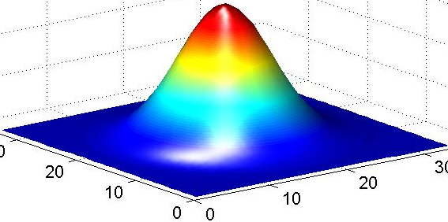
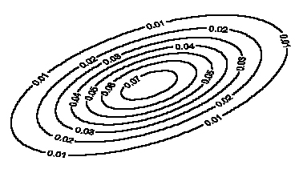
EM clustering
Model: mixture of Gaussians
Covariance determines
the shape of these contours
Fit these Gaussian densities to the data, one per cluster

Slide 53
E and M steps: creating a better model
Expectation: Given the current model, figure out the expected probabilities of the data points to each cluster
p(x|θ_{c})
What is the current probability of each point belonging to each cluster?
Maximization: Given the probabilistic assignment of all the points, estimate a new model, θ_{c}
Do MLE of the parameters (i.e. Gaussians), but use fractional counts based on probabilities (i.e. p(x | Θ_{c})

Slide 54
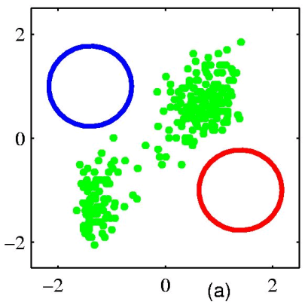
EM example
Figure from Chris Bishop

Slide 55
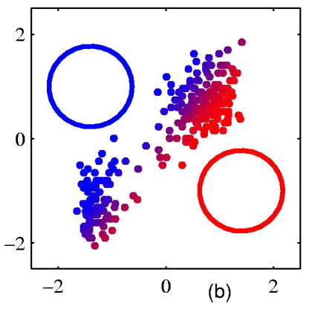
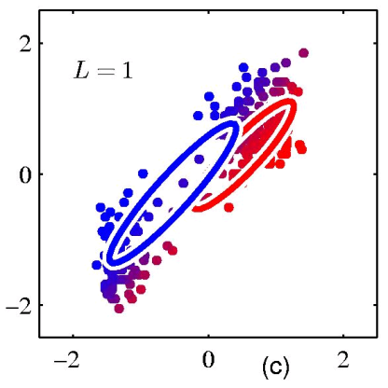
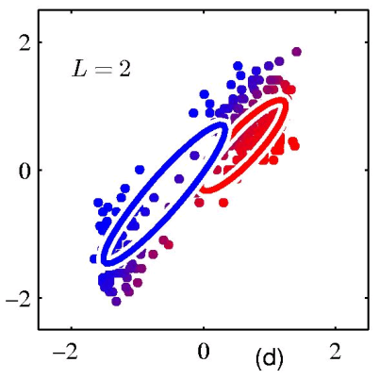
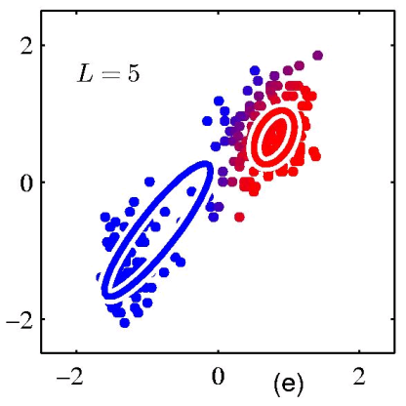
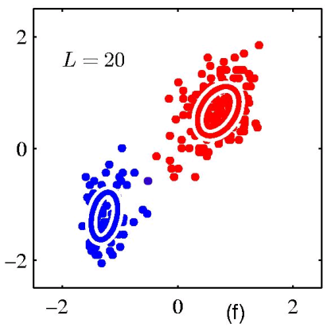
EM example
Figure from Chris Bishop

Slide 56
EM for parsing (Inside-Outside algorithm)
Expectation: Given the current model, figure out the expected probabilities of the each example
p(x|θ_{c})
What is the probability of sentence being grammatical?
Maximization: Given the probabilities of each of the examples, estimate a new model, θ_{c}
Just like maximum likelihood estimation, except we use fractional counts instead of whole counts

Slide 57
Expectation step
p(sentence)_{grammar}
p(time flies like an arrow)_{grammar} = ?
Note: This is the language modeling problem

Slide 58
Expectation step
p(time flies like an arrow)_{grammar} = ?
Most likely parse?
S
NP
time
VP
| S) = p(S → NP VP | S) * p(NP → time | NP)
p(
V
flies
PP
* p(VP → V PP | VP)
P
like
NP
* p(V → flies | V) * …
Det
an
N
arrow

Slide 59
Expectation step
p(time flies like an arrow)_{grammar} = ?
Sum over all the possible parses!
Often, we really want: p(time flies like an arrow | S)
S
S
NP
time
VP
| S)
NP
VP
| S) + …
p(
+ p(
N
time
V
like
NP
V
flies
PP
N
flies
P
like
NP
Det
an
N
arrow
Det
an
N
arrow

Slide 60
Expectation step
p(time flies like an arrow)_{grammar} = ?
Sum over all the possible parses!
Often, we really want: p(time flies like an arrow | S)
how can we calculate this sum?

Slide 61
Expectation step
p(time flies like an arrow)_{grammar} = ?
Sum over all the possible parses!
Often, we really want: p(time flies like an arrow | S)
CKY parsing except sum over possible parses instead of max

Slide 62
Probabilistic CKY Parser
Book the flight through Houston
S:.05*.5*
.000864
=.0000216
S :.01, VP:.1,
Verb:.5
Nominal:.03
Noun:.1
S:.05*.5*.054
=.00135
For any entry, sum over the possibilities!
None
VP:.5*.5*.054
=.0135
None
NP:.6*.6*
.0024
=.000864
S:.03*.0135*
.032
=.00001296
NP:.6*.6*.15
=.054
Det:.6
None
Nominal:.15
Noun:.5
Nominal:
.5*.15*.032
=.0024
None
Prep:.2
PP:1.0*.2*.16
=.032
S → VP PP 0.03
S → Verb NP 0.05
NP:.16
PropNoun:.8
Notes:
62

Slide 63
Maximization step
Calculate the probabilities of the grammar rules using partial counts
MLE
EM
?

Slide 64
Maximization step
Say we’re trying to figure out VP -> V PP
EM
MLE
S
NP
time
VP
V
flies
PP
P
like
NP
Det
an
N
arrow
fractional count based on the sentence and how likely the sentence is to be grammatical
count this as one occurrence

Slide 65
Maximization step
def. of conditional probability
conditional independence as specified by the PCFG

Slide 66
Maximization step
S
time
VP
V
PP
flies like an arrow

Slide 67
Inside & Outside Probabilities
S
“outside” the VP
NP
time
VP
α_{VP}(1,5) = p(time VP today | S)
VP
NP
today
The “outside” probabilities we can calculate using top-down approach (after we have the “inside” probabilities
V
flies
PP
P
like
NP
β_{VP}(1,5) = p(flies like an arrow | VP)
Det
an
N
arrow
The “inside” probabilities we can calculate using a CKY-style, bottom-up approach
“inside” the VP

Slide 68
EM grammar induction
The good:
  We learn a grammar
  At each step we’re guaranteed to increase (or keep the same) the likelihood of the training data
The bad
  Slow: O(m³n³), where m = sentence length and n = non-terminals in the grammar
  Lot’s of local maxima
  Often have to use more non-terminals in the grammar than are theoretically motivated (often ~3 times)
  Often non-terminals learned have no relation to traditional constituents

Slide 69
But…
If we bootstrap and start with a reasonable grammar, we can often obtain very interesting results
Penn Grammar
S → NP VP
S → VP
NP → Det A N
NP → NP PP
NP → PropN
A → ε
A → Adj A
PP → Prep NP
VP → V NP
VP → VP PP
0.9
0.1
0.5
0.3
0.2
0.6
0.4
1.0
0.7
0.3
English

Slide 70
EM: Finding Word Alignments
… la maison … la maison bleue … la fleur …
… the house … the blue house … the flower …
In machine translation, we train from pairs of translated sentences
Often useful to know how the words align in the sentences
Use EM: learn a model of P(french-word | english-word)
Idea?

Slide 71
EM: Finding Word Alignments
Expectation: Given the current model, figure out the expected probabilities of the each example
p(x|θ_{c})
What is the probability of this word alignment?
Maximization: Given the probabilities of each of the examples, estimate a new model, θ_{c}
Just like maximum likelihood estimation, except we use fractional counts instead of whole counts:
count the fractional counts of one word aligning to another

Slide 72
EM: Finding Word Alignments
… la maison … la maison bleue … la fleur …
… the house … the blue house … the flower …
All word alignments equally likely
All P(french-word | english-word) equally likely

Slide 73
EM: Finding Word Alignments
… la maison … la maison bleue … la fleur …
… the house … the blue house … the flower …
“la” and “the” observed to co-occur frequently,
so P(la | the) is increased.

Slide 74
EM: Finding Word Alignments
… la maison … la maison bleue … la fleur …
… the house … the blue house … the flower …
“house” co-occurs with both “la” and “maison”, but
P(maison | house) can be raised without limit, to 1.0,
while P(la | house) is limited because of “the”
(pigeonhole principle)

Slide 75
EM: Finding Word Alignments
… la maison … la maison bleue … la fleur …
… the house … the blue house … the flower …
settling down after another iteration

Slide 76
EM: Finding Word Alignments
… la maison … la maison bleue … la fleur …
… the house … the blue house … the flower …
Inherent hidden structure revealed by EM training!
For details, see
- “A Statistical MT Tutorial Workbook” (Knight, 1999).
- 37 easy sections, final section promises a free beer.
- “The Mathematics of Statistical Machine Translation”
(Brown et al, 1993)
- Software: GIZA++

Slide 77
Statistical Machine Translation
… la maison … la maison bleue … la fleur …
… the house … the blue house … the flower …
P(maison | house ) = 0.411
P(maison | building) = 0.027
P(maison | manson) = 0.020
…
Estimating the model from training data

Slide 78
EM summary
EM is a popular technique in NLP
EM is useful when we have lots of unlabeled data
  we may have some labeled data
  or partially labeled data
Broad range of applications
Can be hard to get it right, though…

Slide 79
Human Parsing
How do humans do it?
How might you try and figure it out computationally/experimentally?

Slide 80
Human Parsing
Read these sentences
Which one was fastest/slowest?
  John put the dog in the pen with a lock.
  John carried the dog in the pen with a bone in the car.
  John liked the dog in the pen with a bone.

Slide 81
Human Parsing
Computational parsers can be used to predict human reading time as measured by tracking the time taken to read each word in a sentence.
Psycholinguistic studies show that words that are more probable given the preceding lexical and syntactic context are read faster.
  John put the dog in the pen with a lock.
  John carried the dog in the pen with a bone in the car.
  John liked the dog in the pen with a bone.
Modeling these effects requires an incremental statistical parser that incorporates one word at a time into a continuously growing parse tree.

Slide 82
Human Parsing
Computational parsers can be used to predict human reading time as measured by tracking the time taken to read each word in a sentence.
Psycholinguistic studies show that words that are more probable given the preceding lexical and syntactic context are read faster.
  John put the dog in the pen with a lock.
  John carried the dog in the pen with a bone in the car.
  John liked the dog in the pen with a bone.
Modeling these effects requires an incremental statistical parser that incorporates one word at a time into a continuously growing parse tree.

Slide 83
Garden Path Sentences
People are confused by sentences that seem to have a particular syntactic structure but then suddenly violate this structure, so the listener is “lead down the garden path”.
  The horse raced past the barn fell.
    vs. The horse raced past the barn broke his leg.
  The complex houses married students.
  The old man the sea.
  While Anna dressed the baby spit up on the bed.
Incremental computational parsers can try to predict and explain the problems encountered parsing such sentences.

