Slide 1
Machine Learning basics
David Kauchak
CS457 Fall 2011

Slide 2
Admin
Assignment 4
  How’d it go?
  How much time?
Assignment 5
  Last assignment!
  “Written” part due Friday
  Rest, due next Friday
Read article for discussion on Thursday

Slide 3
Final project ideas
spelling correction
part of speech tagger
text chunker
dialogue generation
pronoun resolution
compare word similarity measures (more than the ones we’re looking at for assign. 5)
word sense disambiguation
machine translation
  compare sentence alignment techniques
information retrieval
information extraction
question answering
summarization
speech recognition

Slide 4
Final project ideas
pick a text classification task
  evaluate different machine learning methods
  implement a machine learning method
  analyze different feature categories
n-gram language modeling
  implement and compare other smoothing techniques
  implement alternative models
parsing
  PCFG-based language modeling
  lexicalized PCFG (with smoothing)
  true n-best list generation
  parse output reranking
  implement another parsing approach and compare
  parsing non-traditional domains (e.g. twitter)
EM
  word-alignment for text-to-text translation
  grammar induction

Slide 5
Word similarity
Four general categories
  Character-based
    turned vs. truned
    cognates (night, nacht, nicht, natt, nat, noc, noch)
  Semantic web-based (e.g. WordNet)
  Dictionary-based
  Distributional similarity-based
    similar words occur in similar contexts

Slide 6
Corpus-based approaches
Word
ANY blurb
aardvark
beagle
dog

Slide 7
Corpus-based
The Beagle is a breed of small to medium-sized dog. A member of the Hound Group, it is similar in appearance to the Foxhound but smaller, with shorter leg
Beagles are intelligent, and are popular as pets because of their size, even temper, and lack of inherited health problems.
Dogs of similar size and purpose to the modern Beagle can be traced in Ancient Greece[2] back to around the 5th century BC.
From medieval times, beagle was used as a generic description for the smaller hounds, though these dogs differed considerably from the modern breed.
In the 1840s, a standard Beagle type was beginning to develop: the distinction between the North Country Beagle and Southern

Slide 8
Corpus-based: feature extraction
The Beagle is a breed of small to medium-sized dog. A member of the Hound Group, it is similar in appearance to the Foxhound but smaller, with shorter leg
We’d like to utilize or vector-based approach
How could we we create a vector from these occurrences?
  collect word counts from all documents with the word in it
  collect word counts from all sentences with the word in it
  collect all word counts from all words within X words of the word
  collect all words counts from words in specific relationship: subject-object, etc.

Slide 9
Word-context co-occurrence vectors
The Beagle is a breed of small to medium-sized dog. A member of the Hound Group, it is similar in appearance to the Foxhound but smaller, with shorter leg
Beagles are intelligent, and are popular as pets because of their size, even temper, and lack of inherited health problems.
Dogs of similar size and purpose to the modern Beagle can be traced in Ancient Greece[2] back to around the 5th century BC.
From medieval times, beagle was used as a generic description for the smaller hounds, though these dogs differed considerably from the modern breed.
In the 1840s, a standard Beagle type was beginning to develop: the distinction between the North Country Beagle and Southern

Slide 10
Word-context co-occurrence vectors
The Beagle is a breed
Beagles are intelligent, and
to the modern Beagle can be traced
From medieval times, beagle was used as
1840s, a standard Beagle type was beginning
the: 2
is: 1
a: 2
breed: 1
are: 1
intelligent: 1
and: 1
to: 1
modern: 1
…
Often do some preprocessing like lowercasing and removing stop words

Slide 11
Corpus-based similarity
sim(dog, beagle) =
sim(context_vector(dog), context_vector(beagle))
the: 5
is: 1
a: 4
breeds: 2
are: 1
intelligent: 5
…
the: 2
is: 1
a: 2
breed: 1
are: 1
intelligent: 1
and: 1
to: 1
modern: 1
…

Slide 12
Another feature weighting
TFIDF weighting takes into account the general importance of a feature
For distributional similarity, we have the feature (f_{i}), but we also have the word itself (w) that we can use for information
sim(context_vector(dog), context_vector(beagle))
the: 5
is: 1
a: 4
breeds: 2
are: 1
intelligent: 5
…
the: 2
is: 1
a: 2
breed: 1
are: 1
intelligent: 1
and: 1
to: 1
modern: 1
…

Slide 13
Another feature weighting
Feature weighting ideas given this additional information?
sim(context_vector(dog), context_vector(beagle))
the: 5
is: 1
a: 4
breeds: 2
are: 1
intelligent: 5
…
the: 2
is: 1
a: 2
breed: 1
are: 1
intelligent: 1
and: 1
to: 1
modern: 1
…

Slide 14
Another feature weighting
count how likely feature f_{i} and word w are to occur together
  incorporates co-occurrence
  but also incorporates how often w and f_{i} occur in other instances
sim(context_vector(dog), context_vector(beagle))
the: 5
is: 1
a: 4
breeds: 2
are: 1
intelligent: 5
…
the: 2
is: 1
a: 2
breed: 1
are: 1
intelligent: 1
and: 1
to: 1
modern: 1
…

Slide 15
Mutual information
A bit more probability ☺
When will this be high and when will this be low?

Slide 16
Mutual information
A bit more probability ☺
if x and y are independent (i.e. one occurring doesn’t impact the other occurring) p(x,y) = p(x)p(y) and the sum is 0
if they’re dependent then p(x,y) = p(x)p(y|x) = p(y)p(x|y) then we get p(y|x)/p(y) (i.e. how much more likely are we to see y given x has a particular value) or vice versa p(x|y)/p(x)

Slide 17
Point-wise mutual information
Mutual information
How related are two variables (i.e. over all possible values/events)
Point-wise mutual information
How related are two events/values

Slide 18
PMI weighting
Mutual information is often used for feature selection in many problem areas
PMI weighting weights co-occurrences based on their correlation (i.e. high PMI)
context_vector(beagle)
this would likely be lower
the: 2
is: 1
a: 2
breed: 1
are: 1
intelligent: 1
and: 1
to: 1
modern: 1
…
this would likely be higher

Slide 19
The mind-reading game
How good are you at guessing random numbers?
Repeat 100 times:
Computer guesses whether you’ll type 0/1
You type 0 or 1
http://seed.ucsd.edu/~mindreader/
[written by Y. Freund and R. Schapire]

Slide 20
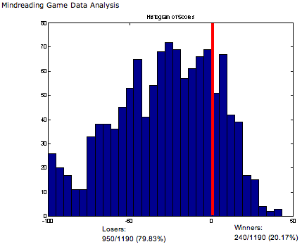
The mind-reading game
The computer is right much more than half the time…

Slide 21
The mind-reading game
The computer is right much more than half the time…
Strategy: computer predicts next keystroke based on the last few (maintains weights on different patterns)
There are patterns everywhere… even in “randomness”!

Slide 22
Why machine learning?
Lot’s of data
Hand-written rules just don’t do it
Performance is much better than what people can do
Why not just study machine learning?
  Domain knowledge/expertise is still very important
  What types of features to use
  What models are important

Slide 23
Machine learning problems
Lots of different types of problems
  What data is available:
    Supervised, unsupervised, semi-supervised, reinforcement learning
  How are we getting the data:
    online vs. offline learning
  Type of model:
    generative vs. disciminative
    parametric vs. non-parametric
    SVM, NB, decision tree, k-means
  What are we trying to predict:
    classification vs. regression

Slide 24
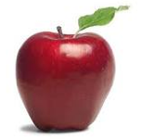
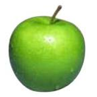
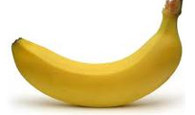
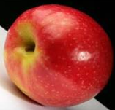
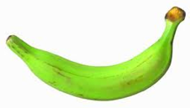
Unsupervised learning
Unupervised learning: given data, but no labels

Slide 25
Unsupervised learning
Much easier to get our hands on unlabeled data
Examples:
  learn clusters/groups without any label
  learn grammar probabilities without trees
  learn HMM probabilities without labels
Because there is no label, often can get odd results
  unsupervised grammar learned often has little relation to linguistically motivated grammar
  may cluster bananas/apples or green/red/yellow

Slide 26
Supervised learning
APPLES
BANANAS
Supervised learning: given labeled data

Slide 27
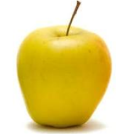
Supervised learning
Given labeled examples, learn to label unlabeled examples
APPLE or BANANA?
Supervised learning: learn to classify unlabeled

Slide 28
Supervised learning: training
Labeled data
Data
Label
0
0
model
1
train a
predictive
model
1
0

Slide 29
Supervised learning: testing/classifying
Unlabeled data
labels
1
0
model
0
1
predict
the label
0

Slide 30
Feature based learning
Training or learning phase
Raw data
Label
features
Label
f₁, f₂, f₃, …, f_{m}
0
0
f₁, f₂, f₃, …, f_{m}
0
0
f₁, f₂, f₃, …, f_{m}
1
classifier
1
f₁, f₂, f₃, …, f_{m}
1
train a
predictive
model
extract
features
1
f₁, f₂, f₃, …, f_{m}
0
0

Slide 31
Feature based learning
Testing or classification phase
Raw data
labels
features
f₁, f₂, f₃, …, f_{m}
1
f₁, f₂, f₃, …, f_{m}
0
f₁, f₂, f₃, …, f_{m}
classifier
0
extract
features
f₁, f₂, f₃, …, f_{m}
1
predict
the label
f₁, f₂, f₃, …, f_{m}
0

Slide 32
Feature examples
Raw data
Features?

Slide 33
Feature examples
Raw data
Features
Clinton said banana repeatedly last week on tv, “banana, banana, banana”
(1, 1, 1, 0, 0, 1, 0, 0, …)
clinton
said
california
across
tv
wrong
banana
capital
Occurrence of words

Slide 34
Feature examples
Raw data
Features
Clinton said banana repeatedly last week on tv, “banana, banana, banana”
(4, 1, 1, 0, 0, 1, 0, 0, …)
clinton
said
california
across
tv
wrong
banana
capital
Frequency of word occurrence

Slide 35
Feature examples
Raw data
Features
Clinton said banana repeatedly last week on tv, “banana, banana, banana”
(1, 1, 1, 0, 0, 1, 0, 0, …)
clinton said
said banana
california schools
across the
tv banana
wrong way
capital city
banana repeatedly
Occurrence of bigrams

Slide 36
Lots of other features
POS: occurrence, counts, sequence
Constituents
Whether ‘V1agra’ occurred 15 times
Whether ‘banana’ occurred more times than ‘apple’
If the document has a number in it
…
Features are very important, but we’re going to focus on the models today

Slide 37

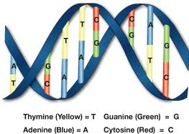
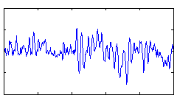
Power of feature-base methods
General purpose: any domain where we can represent a data point as a set of features, we can use the method

Slide 38
The feature space
f₂
Government
Science
Arts
f₁
Notes:
- once we have the features, often nice to think about these as just data points in some m-dimensional space

Slide 39
The feature space
Spam
f₂
not-Spam
f₃
f₁

Slide 40
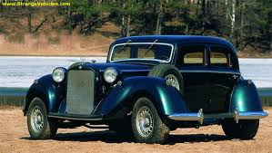
Feature space
f₁, f₂, f₃, …, f_{m}
m-dimensional space
How big will m be for us?

Slide 41
Bayesian Classification
We represent a data item based on the features:
Training
a:
b:
For each label/class, learn a probability distribution based on the features

Slide 42
Bayesian Classification
We represent a data item based on the features:
Classifying
Given an new example, classify it as the label with the largest conditional probability

Slide 43
Bayes rule for classification
conditional
(posterior)
probability
prior
probability
Why not model P(Label|Data) directly?
Notes:
as we talked about before, often much easier to estimate P(L|D) vs. P(D|L)
sometimes nicer to break it into two separate models so we don’t have to handle everything in a singe model and instead, use two simpler models

Slide 44
Bayesian classifiers
different distributions for different labels
Bayes rule
two models to learn for each label/class

Slide 45
The Naive Bayes Classifier
spam
buy
enlargement
assume binary features for now
viagra
now
the
Conditional Independence Assumption: features are independent of each other given the class:

Slide 46
Estimating parameters
p(‘v1agra’ | spam)
p(‘the’ | spam)
p(‘enlargement’ | not-spam)
…
For us:

Slide 47
Maximum likelihood estimates
number of items with label
total number of items
number of items with the label with feature
number of items with label

Slide 48
Naïve Bayes Text Classification
Features: word occurring in a document (though others could be used…)
Does the Naïve Bayes assumption hold?
  Are word occurrences independent given the label?
Lot’s of text classification problems
  sentiment analysis: positive vs. negative reviews
  category classification
  spam

Slide 49
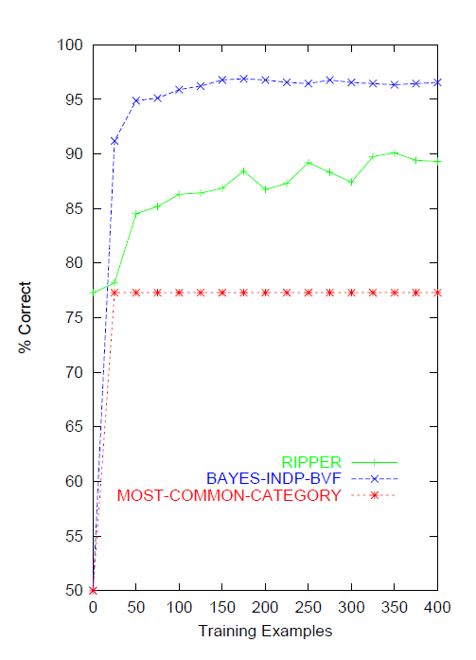
Naive Bayes on spam email
http://www.cnbc.cmu.edu/~jp/research/email.paper.pdf
Notes:
This graph is from
http://www.cs.utexas.edu/users/jp/research/email.paper.pdf
Naive-Bayes vs. Rule-Learning in Classification of Email
Jefferson Provost, UT Austin

Slide 50
Linear models
A linear model predicts the label based on a weighted, linear combination of the features
For two classes, a linear model can be viewed as a plane (hyperplane) in the feature space
f₂
f₃
f₁

Slide 51
Linear models
Is naïve bayes a linear model?
f₂
f₃
f₁

Slide 52
Linear models: NB
f₁w₁
f₂w₂
w₀
only one of f₁ and f₂ will every be 1

Slide 53
Regression vs. classification
Raw data
Label
features
Label
f₁, f₂, f₃, …, f_{n}
0
classification: discrete (some finite set of labels)
regression: real value
f₁, f₂, f₃, …, f_{n}
0
f₁, f₂, f₃, …, f_{n}
1
extract
features
f₁, f₂, f₃, …, f_{n}
1
f₁, f₂, f₃, …, f_{n}
0

Slide 54
Regression vs. classification
Examples
features
response
predict a readability score between 0-100 for a document
predict the number of votes/reposts
predict cost to insure
predict income
predict life longevity
…
f₁, f₂, f₃, …, f_{n}
1.0
f₁, f₂, f₃, …, f_{n}
2.3
f₁, f₂, f₃, …, f_{n}
.3
f₁, f₂, f₃, …, f_{n}
100.4
f₁, f₂, f₃, …, f_{n}
123

Slide 55
Model-based regression
A model
  Often we have an idea of what the data might look like
  … or we don’t, but we assume the data looks like something we know how to handle
Learning then involves finding the best parameters for the model based on the data
Regression models (describe how the features combine to get the result/label)
  linear
  logistic
  polynomial
  …

Slide 56
Linear regression
Given some points, find the line that best fits/explains the data
Our model is a line, i.e. we’re assuming a linear relationship between the feature and the label value
response
(y)
f₁
How can we find this line?

Slide 57
Linear regression
Learn a line h that minimizes some error function:
Sum of the individual errors:
response
(y)
for that example, what was the difference between actual and predicted
feature (x)
Notes:
- squared error is optimal if we assume that the data was actually generated from a line with gaussian data

Slide 58
Error minimization
How do we find the minimum of an equation (think back to calculus…)?
Take the derivative, set to 0 and solve (going to be a min or a max)
Any problems here?
Ideas?

Slide 59
Linear regression
response
what’s the difference?
feature
Notes:
- squared error is optimal if we assume that the data was actually generated from a line with gaussian data

Slide 60
Linear regression
Learn a line h that minimizes an error function:
response
in the case of a 2d line:
function for a line
feature
Notes:
- squared error is optimal if we assume that the data was actually generated from a line with gaussian data

Slide 61
Linear regression
We’d like to minimize the error
  Find w₁ and w₀ such that the error is minimized
We can solve this in closed form

Slide 62
Multiple linear regression
Often, we don’t just have one feature, but have many features, say m
Now we have a line in m dimensions
Still just a line
weights
A linear model is additive. The weight of the feature dimension specifies importance/direction

Slide 63
Multiple linear regression
We can still calculate the squared error like before
Still can solve this exactly!

Slide 64
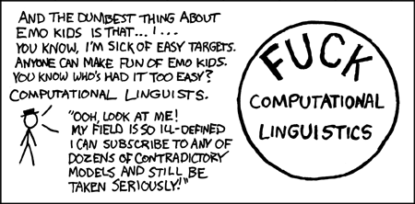
Probabilistic classification
We’re NLP people
We like probabilities!
http://xkcd.com/114/
We’d like to do something like regression, but that gives us a probability
Notes:
we could just train a model with our labels between 0 and 1

Slide 65
Classification
- Nothing constrains it to be a probability
- Could still have combination of features and weight that exceeds 1 or is below 0

Slide 66
The challenge
Linear regression
probability
+∞
1
Find some equation based on the probability that ranges from -∞ to +∞
-∞
0

Slide 67
Odds ratio
Rather than predict the probability, we can predict the ratio of 1/0 (true/false)
Predict the odds that it is 1 (true): How much more likely is 1 than 0.
Does this help us?

Slide 68
Odds ratio
Linear regression
odds ratio
+∞
+∞
Where is the dividing line between class 1 and class 0 being selected?
-∞
0

Slide 69
Odds ratio
We’re trying to find some transformation that transforms the odds ratio to a number that is -∞ to +∞
Does this suggest another transformation?
odds ratio
0 1 2 3 4 5 6 7 8 9 ….

Slide 70
Log odds (logit function)
Linear regression
odds ratio
+∞
+∞
How do we get the probability of an example?
-∞
-∞

Slide 71
Log odds (logit function)
…
anyone recognize this?

Slide 72
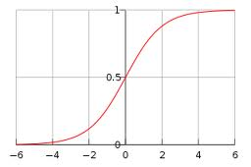
Logistic function

Slide 73
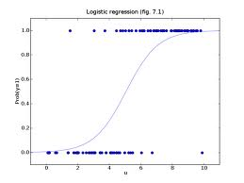
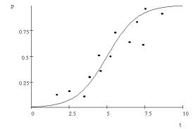
Logistic regression
Find the best fit of the data based on a logistic

Slide 74
Logistic regression
How would we classify examples once we had a trained model?
If the sum > 0 then p(1)/p(0) > 1, so positive
if the sum < 0 then p(1)/p(0) < 1, so negative
Still a linear classifier (decision boundary is a line)

