Slide 1
Word Similarity
David Kauchak
CS457 Fall 2011

Slide 2
Admin
Assignment 3 grades sent back
Quiz 2
  Average 22.7
Assignment 4
Reading

Slide 3
Text Similarity
A common question in NLP is how similar are texts
sim(
,
) = ?
score:
rank:
?

Slide 4
Bag of words representation
For now, let’s ignore word order:
Obama said banana repeatedly last week on tv, “banana, banana, banana”
(4, 1, 1, 0, 0, 1, 0, 0, …)
obama
said
california
across
tv
wrong
banana
capital
Frequency of word occurrence

Slide 5
Vector based word
A
a₁: When 1
a₂: the 2
a₃: defendant 1
a₄: and 1
a₅: courthouse 0
…
Multi-dimensional vectors, one dimension per word in our vocabulary
B
b₁: When 1
b₂: the 2
b₃: defendant 1
b₄: and 0
b₅: courthouse 1
…
How do we calculate the similarity based on these vectors?

Slide 6
Normalized distance measures
Cosine
L2
L1
a’ and b’ are length normalized versions of the vectors

Slide 7
Our problems
Which of these have we addressed?
  word order
  length
  synonym
  spelling mistakes
  word importance
  word frequency

Slide 8
Our problems
Which of these have we addressed?
  word order
  length
  synonym
  spelling mistakes
  word importance
  word frequency

Slide 9
Word overlap problems
Treats all words the same
A: When the defendant and his lawyer walked into the court, some of the victim supporters turned their backs to him.
B: When the defendant walked into the courthouse with his attorney, the crowd truned their backs on him.

Slide 10
Word importance
Include a weight for each word/feature
A
a₁: When 1
a₂: the 2
a₃: defendant 1
a₄: and 1
a₅: courthouse 0
…
w₁
w₂
w₃
w₄
w₅
…
B
b₁: When 1
b₂: the 2
b₃: defendant 1
b₄: and 0
b₅: courthouse 1
…
w₁
w₂
w₃
w₄
w₅
…

Slide 11
Distance + weights
We can incorporate the weights into the distances
Think of it as either (both work out the same):
  preprocessing the vectors by multiplying each dimension by the weight
  incorporating it directly into the similarity measure

Slide 12
Idea: use corpus statistics
the
defendant
What would be a quantitative measure of word importance?

Slide 13
Document frequency
document frequency (DF) is one measure of word importance
Terms that occur in many documents are weighted less, since overlapping with these terms is very likely
  In the extreme case, take a word like the that occurs in EVERY document
Terms that occur in only a few documents are weighted more

Slide 14
Document vs. overall frequency
The overall frequency of a word is the number of occurrences in a dataset, counting multiple occurrences
Example:
Word | Overall frequency | Document frequency
insurance | 10440 | 3997
try | 10422 | 8760
Which word is a more informative (and should get a higher weight)?

Slide 15
Document frequency
Word | Collection frequency | Document frequency
insurance | 10440 | 3997
try | 10422 | 8760
Document frequency is often related to word importance, but we want an actual weight. Problems?

Slide 16
From document frequency to weight
Word | Collection frequency | Document frequency
insurance | 10440 | 3997
try | 10422 | 8760
weight and document frequency are inversely related
  higher document frequency should have lower weight and vice versa
document frequency is unbounded
document frequency will change depending on the size of the data set (i.e. the number of documents)

Slide 17
Inverse document frequency
# of documents in dataset
document frequency of w
IDF is inversely correlated with DF
  higher DF results in lower IDF
N incorporates a dataset dependent normalizer
log dampens the overall weight

Slide 18
IDF example, suppose N=1 million
term | df_{t} | idf_{t}
calpurnia | 1
animal | 100
sunday | 1,000
fly | 10,000
under | 100,000
the | 1,000,000
What are the IDFs assuming log base 10?

Slide 19
IDF example, suppose N=1 million
term | df_{t} | idf_{t}
calpurnia | 1 | 6
animal | 100 | 4
sunday | 1,000 | 3
fly | 10,000 | 2
under | 100,000 | 1
the | 1,000,000 | 0
There is one idf value/weight for each word

Slide 20
IDF example, suppose N=1 million
term | df_{t} | idf_{t}
calpurnia | 1
animal | 100
sunday | 1,000
fly | 10,000
under | 100,000
the | 1,000,000
What if we didn’t use the log to dampen the weighting?

Slide 21
IDF example, suppose N=1 million
term | df_{t} | idf_{t}
calpurnia | 1 | 1,000,000
animal | 100 | 10,000
sunday | 1,000 | 1,000
fly | 10,000 | 100
under | 100,000 | 10
the | 1,000,000 | 1
What if we didn’t use the log to dampen the weighting?

Slide 22
TF-IDF
One of the most common weighting schemes
TF = term frequency
IDF = inverse document frequency
word importance weight
We can then use this with any of our similarity measures!

Slide 23
Stoplists: extreme weighting
Some words like ‘a’ and ‘the’ will occur in almost every document
  IDF will be 0 for any word that occurs in all document
  For words that occur in almost all of the documents, they will be nearly 0
A stoplist is a list of words that should not be considered (in this case, similarity calculations)
  Sometimes this is the n most frequent words
  Often, it’s a list of a few hundred words manually created

Slide 24
Stoplist
I
a
aboard
about
above
across
after
afterwards
against
agin
ago
agreed-upon
ah
alas
albeit
all
all-over
almost
along
alongside
altho
although
amid
amidst
among
amongst
an
and
another
any
anyone
anything
around
as
aside
astride
at
atop
avec
away
back
be
because
before
beforehand
behind
behynde
below
beneath
beside
besides
between
bewteen
beyond
bi
both
but
by
ca.
de
des
despite
do
down
due
durin
during
each
eh
either
en
every
ever
everyone
everything
except
far
fer
for
from
go
goddamn
goody
gosh
half
have
he
hell
her
herself
hey
him
himself
his
ho
how
If most of these end up with low weights anyway, why use a stoplist?

Slide 25
Stoplists
Two main benefits
  More fine grained control: some words may not be frequent, but may not have any content value (alas, teh, gosh)
  Often does contain many frequent words, which can drastically reduce our storage and computation
Any downsides to using a stoplist?
  For some applications, some stop words may be important

Slide 26
Text similarity so far…
Set based – easy and efficient to calculate
  word overlap
  Jaccard
  Dice
Vector based
  create a feature vector based on word occurrences (or other features)
  Can use any distance measure
    L1 (Manhattan)
    L2 (Euclidean)
    Cosine
  Normalize the length
  Feature/dimension weighting
    inverse document frequency (IDF)

Slide 27
Our problems
Which of these have we addressed?
  word order
  length
  synonym
  spelling mistakes
  word importance
  word frequency
A model of word similarity!

Slide 28
Word overlap problems
A: When the defendant and his lawyer walked into the court, some of the victim supporters turned their backs to him.
B: When the defendant walked into the courthouse with his attorney, the crowd truned their backs on him.

Slide 29
Word similarity
How similar are two words?
w₁
w₂
w₃
w
?
sim(w₁, w₂) = ?
score:
rank:
list: w₁ and w₂ are synonyms
applications?

Slide 30
Word similarity applications
General text similarity
Thesaurus generation
Automatic evaluation
Text-to-text
  paraphrasing
  summarization
  machine translation
information retrieval (search)

Slide 31
Word similarity
How similar are two words?
w₁
w₂
w₃
w
?
sim(w₁, w₂) = ?
score:
rank:
list: w₁ and w₂ are synonyms
ideas? useful resources?

Slide 32
Word similarity
Four categories of approaches (maybe more)
  Character-based
    turned vs. truned
    cognates (night, nacht, nicht, natt, nat, noc, noch)
  Semantic web-based (e.g. WordNet)
  Dictionary-based
  Distributional similarity-based
    similar words occur in similar contexts

Slide 33
WordNet
Lexical database for English
  155,287 words
  206,941 word senses
  117,659 synsets (synonym sets)
  ~400K relations between senses
  Parts of speech: nouns, verbs, adjectives, adverbs
Word graph, with word senses as nodes and edges as relationships
Psycholinguistics
  WN attempts to model human lexical memory
  Design based on psychological testing
Created by researchers at Princeton
  http://wordnet.princeton.edu/
Lots of programmatic interfaces

Slide 34
WordNet relations
synonym
antonym
hypernyms
hyponyms
holonym
meronym
troponym
entailment
(and a few others)
Notes:
hypernym: word whose meaning includes the meaning of another word
hyponym: opposite (e.g. “is-a” relationship) a bike is-a vehicle (vehicle is a hypernym of bike)
holonym/meronym: X is a holonym of Y if Ys are parts of Xs (bike is a holonym of tire)
troponym: (verbs) verb Y is a troponym of verb X if the activity Y is doing X in some manner (saunter is a troponym of walk)
entailment: (verbs) verby Y is entailed by X if by doing X you must be doing Y (sleep is entailed by snore)

Slide 35
WordNet relations
synonym – X and Y have similar meaning
antonym – X and Y have opposite meanings
hypernyms – subclass
  beagle is a hypernym of dog
hyponyms – superclass
  dog is a hyponym of beagle
holonym – contains part
  car is a holonym of wheel
meronym – part of
  wheel is a meronym of car
troponym – for verbs, a more specific way of doing an action
  run is a troponym of move
  dice is a troponym of cut
entailment – for verbs, one activity leads to the next
(and a few others)

Slide 36
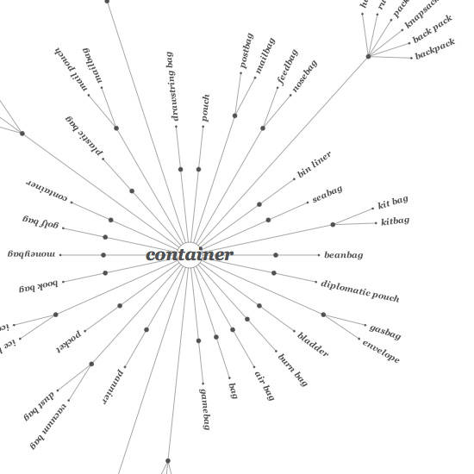
WordNet
Graph, where nodes are words and edges are relationships
There is some hierarchical information, for example with
hyp-er/o-nomy

Slide 37
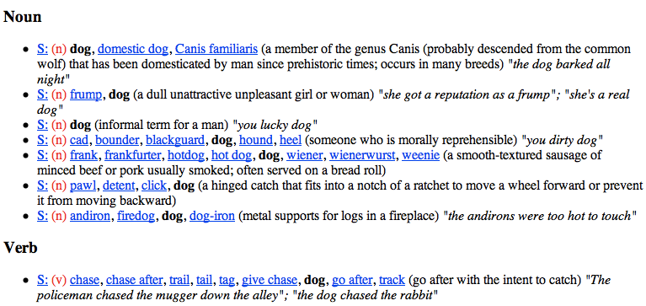
WordNet: dog

Slide 38
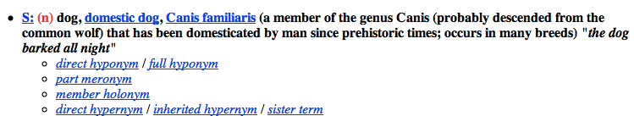
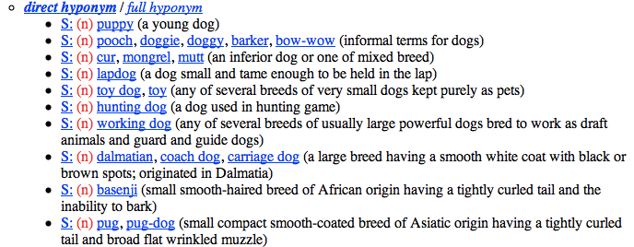
WordNet: dog

Slide 39
Word similarity: Exercise
How could you calculate word similarity if your only resource was:
  the words themselves
  WordNet
  a dictionary
  a corpus

Slide 40
Word similarity
Four general categories
  Character-based
    turned vs. truned
    cognates (night, nacht, nicht, natt, nat, noc, noch)
  Semantic web-based (e.g. WordNet)
  Dictionary-based
  Distributional similarity-based
    similar words occur in similar contexts

Slide 41
Character-based similarity
sim(turned, truned) = ?
How might we do this using only the words (i.e. no outside resources?

Slide 42
Edit distance (Levenshtein distance)
The edit distance between w₁ and w₂ is the minimum number of operations to transform w₁ into w₂
Operations:
  insertion
  deletion
  substitution
EDIT(turned, truned) = ?
EDIT(computer, commuter) = ?
EDIT(banana, apple) = ?
EDIT(wombat, worcester) = ?

Slide 43
Edit distance
EDIT(turned, truned) = 2
  delete u
  insert u
EDIT(computer, commuter) = 1
  replace p with m
EDIT(banana, apple) = 5
  delete b
  replace n with p
  replace a with p
  replace n with l
  replace a with e
EDIT(wombat, worcester) = 6

Slide 44
Better edit distance
Are all operations equally likely?
  No
Improvement, give different weights to different operations
  replacing a for e is more likely than z for y
Ideas for weightings?
  Learn from actual data (known typos, known similar words)
  Intuitions: phonetics
  Intuitions: keyboard configuration

Slide 45
Vector character-based word similarity
sim(turned, truned) = ?
Any way to leverage our vector-based similarity approaches from last time?

Slide 46
Vector character-based word similarity
sim(turned, truned) = ?
Generate a feature vector based on the characters
(or could also use the set based measures at the character level)
a: 0
b: 0
c: 0
d: 1
e: 1
f: 0
g: 0
…
a: 0
b: 0
c: 0
d: 1
e: 1
f: 0
g: 0
…
problems?

Slide 47
Vector character-based word similarity
sim(restful, fluster) = ?
Character level loses a lot of information
a: 0
b: 0
c: 0
d: 1
e: 1
f: 0
g: 0
…
a: 0
b: 0
c: 0
d: 1
e: 1
f: 0
g: 0
…
ideas?

Slide 48
Vector character-based word similarity
sim(restful, fluster) = ?
Use character bigrams or even trigrams
aa: 0
ab: 0
ac: 0
…
es: 1
…
fu: 1
…
re: 1
…
aa: 0
ab: 0
ac: 0
…
er: 1
…
fl: 1
…
lu: 1
…

Slide 49
Word similarity
Four general categories
  Character-based
    turned vs. truned
    cognates (night, nacht, nicht, natt, nat, noc, noch)
  Semantic web-based (e.g. WordNet)
  Dictionary-based
  Distributional similarity-based
    similar words occur in similar contexts

Slide 50
WordNet-like Hierarchy
animal
fish
mammal
reptile
amphibian
wolf
horse
dog
cat
mare
stallion
hunting dog
dachshund
terrier
To utilize WordNet, we often want to think about some graph-based measure.

Slide 51
WordNet-like Hierarchy
animal
fish
mammal
reptile
amphibian
wolf
horse
dog
cat
mare
stallion
hunting dog
dachshund
terrier
Rank the following based on similarity:
SIM(wolf, dog)
SIM(wolf, amphibian)
SIM(terrier, wolf)
SIM(dachshund, terrier)

Slide 52
WordNet-like Hierarchy
animal
fish
mammal
reptile
amphibian
wolf
horse
dog
cat
SIM(dachshund, terrier)
SIM(wolf, dog)
SIM(terrier, wolf)
SIM(wolf, amphibian)
mare
stallion
hunting dog
dachshund
terrier
What information/heuristics did you use to rank these?

Slide 53
WordNet-like Hierarchy
animal
fish
mammal
reptile
amphibian
wolf
horse
dog
cat
SIM(dachshund, terrier)
SIM(wolf, dog)
SIM(terrier, wolf)
SIM(wolf, amphibian)
mare
stallion
hunting dog
dachshund
terrier
path length is important (but not the only thing)
words that share the same ancestor are related
words lower down in the hierarchy are finer grained and therefore closer

Slide 54
WordNet similarity measures
path length doesn’t work very well
Some ideas:
  path length scaled by the depth (Leacock and Chodorow, 1998)
With a little cheating:
  Measure the “information content” of a word using a corpus: how specific is a word?
    words higher up tend to have less information content
    more frequent words (and ancestors of more frequent words) tend to have less information content

Slide 55
WordNet similarity measures
Utilizing information content:
  information content of the lowest common parent (Resnik, 1995)
  information content of the words minus information content of the lowest common parent (Jiang and Conrath, 1997)
  information content of the lowest common parent divided by the information content of the words (Lin, 1998)

Slide 56
Word similarity
Four general categories
  Character-based
    turned vs. truned
    cognates (night, nacht, nicht, natt, nat, noc, noch)
  Semantic web-based (e.g. WordNet)
  Dictionary-based
  Distributional similarity-based
    similar words occur in similar contexts

Slide 57
Dictionary-based similarity
Word
Dictionary blurb
a large, nocturnal, burrowing mammal, Orycteropus afer, ofcentral and southern Africa, feeding on ants and termites andhaving a long, extensile tongue, strong claws, and long ears.
aardvark
One of a breed of small hounds having long ears, short legs, and a usually black, tan, and white coat.
beagle
Any carnivore of the family Canidae, having prominent canine teeth and, in the wild state, a long and slender muzzle, a deep-chested muscular body, a bushy tail, and large, erect ears. Compare canid.
dog

Slide 58
Dictionary-based similarity
Utilize our text similarity measures
sim(dog, beagle) =
sim( ,
One of a breed of small hounds having long ears, short legs, and a usually black, tan, and white coat.
Any carnivore of the family Canidae, having prominent canine teeth and, in the wild state, a long and slender muzzle, a deep-chested muscular body, a bushy tail, and large, erect ears. Compare canid.
)

Slide 59
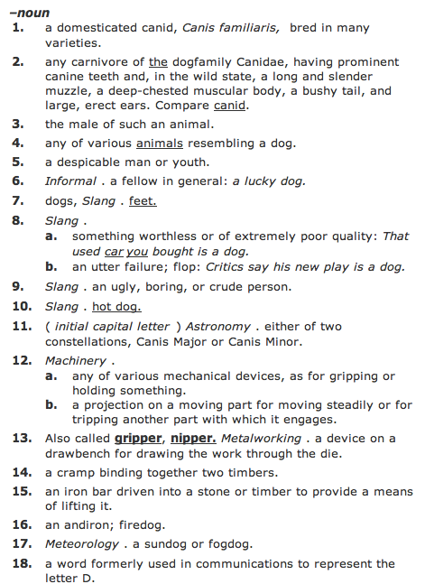
Dictionary-based similarity
What about words that have multiple senses/parts of speech?

Slide 60
Dictionary-based similarity
part of speech tagging
word sense disambiguation
most frequent sense
average similarity between all senses
max similarity between all senses
sum of similarity between all senses

Slide 61
Dictionary + WordNet
WordNet also includes a “gloss” similar to a dictionary definition
Other variants include the overlap of the word senses as well as those word senses that are related (e.g. hypernym, hyponym, etc.)
  incorporates some of the path information as well
  Banerjee and Pedersen, 2003

Slide 62
Word similarity
Four general categories
  Character-based
    turned vs. truned
    cognates (night, nacht, nicht, natt, nat, noc, noch)
  Semantic web-based (e.g. WordNet)
  Dictionary-based
  Distributional similarity-based
    similar words occur in similar contexts

Slide 63
Corpus-based approaches
Word
ANY blurb
aardvark
Ideas?
beagle
dog

Slide 64
Corpus-based
The Beagle is a breed of small to medium-sized dog. A member of the Hound Group, it is similar in appearance to the Foxhound but smaller, with shorter leg
Beagles are intelligent, and are popular as pets because of their size, even temper, and lack of inherited health problems.
Dogs of similar size and purpose to the modern Beagle can be traced in Ancient Greece[2] back to around the 5th century BC.
From medieval times, beagle was used as a generic description for the smaller hounds, though these dogs differed considerably from the modern breed.
In the 1840s, a standard Beagle type was beginning to develop: the distinction between the North Country Beagle and Southern

Slide 65
Corpus-based: feature extraction
The Beagle is a breed of small to medium-sized dog. A member of the Hound Group, it is similar in appearance to the Foxhound but smaller, with shorter leg
We’d like to utilize or vector-based approach
How could we we create a vector from these occurrences?
  collect word counts from all documents with the word in it
  collect word counts from all sentences with the word in it
  collect all word counts from all words within X words of the word
  collect all words counts from words in specific relationship: subject-object, etc.

Slide 66
Word-context co-occurrence vectors
The Beagle is a breed of small to medium-sized dog. A member of the Hound Group, it is similar in appearance to the Foxhound but smaller, with shorter leg
Beagles are intelligent, and are popular as pets because of their size, even temper, and lack of inherited health problems.
Dogs of similar size and purpose to the modern Beagle can be traced in Ancient Greece[2] back to around the 5th century BC.
From medieval times, beagle was used as a generic description for the smaller hounds, though these dogs differed considerably from the modern breed.
In the 1840s, a standard Beagle type was beginning to develop: the distinction between the North Country Beagle and Southern

Slide 67
Word-context co-occurrence vectors
The Beagle is a breed
Beagles are intelligent, and
to the modern Beagle can be traced
From medieval times, beagle was used as
1840s, a standard Beagle type was beginning
the: 2
is: 1
a: 2
breed: 1
are: 1
intelligent: 1
and: 1
to: 1
modern: 1
…
Often do some preprocessing like lowercasing and removing stop words

Slide 68
Corpus-based similarity
sim(dog, beagle) =
sim(context_vector(dog), context_vector(beagle))
the: 5
is: 1
a: 4
breeds: 2
are: 1
intelligent: 5
…
the: 2
is: 1
a: 2
breed: 1
are: 1
intelligent: 1
and: 1
to: 1
modern: 1
…

Slide 69
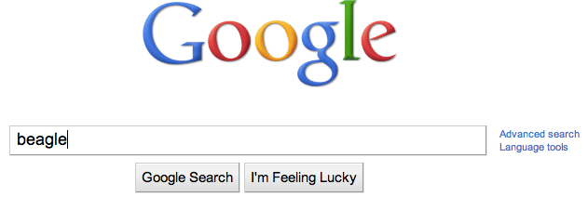
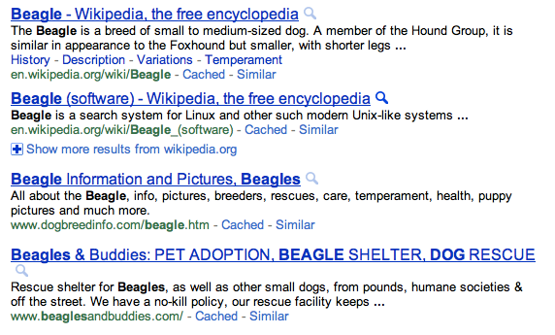
Web-based similarity
beagle
How can we make a document/blurb from this?
Notes:
yahoo and some others allow you API access to their search engine

Slide 70
Web-based similarity
Concatenate the snippets for the top N results
Concatenate the web page text for the top N results

