Slide 1
Text Similarity
David Kauchak
CS457 Fall 2011

Slide 2
Admin
Assignment 4
  Get started!

Slide 3
Course at a high-level
Applications
  Corpus analysis
  Language modeling
  Parsing
For the next 3 weeks: tools
  text similarity
  machine learning
  search
Regroup for the last 3 weeks with more applications

Slide 4
Text Similarity
A common question in NLP is how similar are texts
sim(
,
) = ?
score:
?
How could these be useful? Applications?
rank:

Slide 5
Text similarity: applications
Information retrieval (search)
Data set (e.g. web)
query

Slide 6
Text similarity: applications
Text classification
sports
These “documents” could be actual documents, for example using k-means or pseudo-documents, like a class centroid/average
politics
business

Slide 7
Text similarity: applications
Text clustering
Notes:
need some notion of the distance between text documents if we’re going to cluster them

Slide 8
Text similarity: applications
Automatic evaluation
human answer
sim
text to text
output
(machine translation,
summarization,
simplification)

Slide 9
Text similarity: applications
Word similarity
Word-sense disambiguation
sim( banana, apple ) = ?
I went to the bank to get some money.
financial bank
river bank

Slide 10
Text similarity: application
Automatic grader
Question: what is a variable?
Answer: a location in memory that can store a value
How good are:
a variable is a location in memory where a value can be stored
a named object that can hold a numerical or letter value
it is a location in the computer 's memory where it can be stored for use by a program
a variable is the memory address for a specific type of stored data or from a mathematical perspective a symbol representing a fixed definition with changing values
a location in memory where data can be stored and retrieved

Slide 11
Text similarity
There are many different notions of similarity depending on the domain and the application
Today, we’ll look at some different tools
There is no one single tool that works in all domains

Slide 12
Text similarity approaches
sim(
,
) = ?
A: When the defendant and his lawyer walked into the court, some of the victim supporters turned their backs to him.
B: When the defendant walked into the courthouse with his attorney, the crowd truned their backs on him.
How can we do this?

Slide 13
The basics: text overlap
Texts that have overlapping words are more similar
A: When the defendant and his lawyer walked into the court, some of the victim supporters turned their backs to him.
B: When the defendant walked into the courthouse with his attorney, the crowd truned their backs on him.

Slide 14
Word overlap: a numerical score
Idea 1: number of overlapping words
A: When the defendant and his lawyer walked into the court, some of the victim supporters turned their backs to him.
B: When the defendant walked into the courthouse with his attorney, the crowd truned their backs on him.
sim( T1, T2 ) = 11
problems?

Slide 15
Word overlap problems
Doesn’t take into account word order
Related: doesn’t reward longer overlapping sequences
A: defendant his the When lawyer into walked backs him the court, of supporters and some the victim turned their backs him to.
B: When the defendant walked into the courthouse with his attorney, the crowd truned their backs on him.
sim( T1, T2 ) = 11

Slide 16
Word overlap problems
Doesn’t take into account length
A: When the defendant and his lawyer walked into the court, some of the victim supporters turned their backs to him.
B: When the defendant walked into the courthouse with his attorney, the crowd truned their backs on him. I ate a large banana at work today and thought it was great!
sim( T1, T2 ) = 11

Slide 17
Word overlap problems
Doesn’t take into account synonyms
A: When the defendant and his lawyer walked into the court, some of the victim supporters turned their backs to him.
B: When the defendant walked into the courthouse with his attorney, the crowd truned their backs on him.
sim( T1, T2 ) = 11

Slide 18
Word overlap problems
Doesn’t take into account spelling mistakes
A: When the defendant and his lawyer walked into the court, some of the victim supporters turned their backs to him.
B: When the defendant walked into the courthouse with his attorney, the crowd truned their backs on him.
sim( T1, T2 ) = 11

Slide 19
Word overlap problems
Treats all words the same
A: When the defendant and his lawyer walked into the court, some of the victim supporters turned their backs to him.
B: When the defendant walked into the courthouse with his attorney, the crowd truned their backs on him.

Slide 20
Word overlap problems
May not handle frequency properly
A: When the defendant and his lawyer walked into the court, some of the victim supporters turned their backs to him. I ate a banana and then another banana and it was good!
B: When the defendant walked into the courthouse with his attorney, the crowd truned their backs on him. I ate a large banana at work today and thought it was great!

Slide 21
Word overlap: sets
and
backs
court
defendant
him
…
A: When the defendant and his lawyer walked into the court, some of the victim supporters turned their backs to him.
B: When the defendant walked into the courthouse with his attorney, the crowd truned their backs on him.
and
backs
courthouse
defendant
him
…

Slide 22
Word overlap: sets
What is the overlap, using sets?
  |A∧B| the size of the intersection
How can we incorporate length/size into this measure?

Slide 23
Word overlap: sets
What is the overlap, using sets?
  |A∧B| the size of the intersection
How can we incorporate length/size into this measure?
Jaccard index (Jaccard similarity coefficient)
Dice’s coefficient

Slide 24
Word overlap: sets
How are these related?
Hint: break them down in terms of
words in A but not B
words in B but not A
words in both A and B

Slide 25
Word overlap: sets
in A but not B
in B but not A
Dice’s coefficient gives twice the weight to overlapping words

Slide 26
Set overlap
Our problems:
  word order
  length
  synonym
  spelling mistakes
  word importance
  word frequency
Set overlap measures can be good in some situations, but often we need more general tools

Slide 27
Bag of words representation
For now, let’s ignore word order:
Obama said banana repeatedly last week on tv, “banana, banana, banana”
(4, 1, 1, 0, 0, 1, 0, 0, …)
obama
said
california
across
tv
wrong
banana
capital
Frequency of word occurrence

Slide 28
Vector based word
A
a₁: When 1
a₂: the 2
a₃: defendant 1
a₄: and 1
a₅: courthouse 0
…
Multi-dimensional vectors, one dimension per word in our vocabulary
B
b₁: When 1
b₂: the 2
b₃: defendant 1
b₄: and 0
b₅: courthouse 1
…
How do we calculate the similarity based on these vectors?

Slide 29
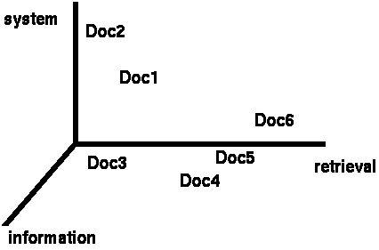
Vector based similarity
We have a |V|-dimensional vector space
Terms are axes of the space
Documents are points or vectors in this space
Very high-dimensional
This is a very sparse vector - most entries are zero
What question are we asking in this space for similarity?

Slide 30
Vector based similarity
Similarity relates to distance
We’d like to measure the similarity of documents in the |V| dimensional space
What are some distance measures?

Slide 31
Distance measures
Euclidean (L2)
Manhattan (L1)

Slide 32
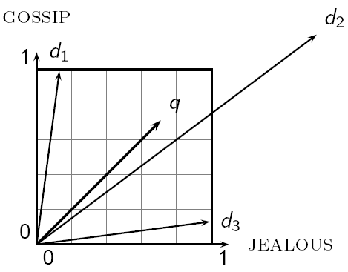
Distance can be problematic
Which d is closest to q using one of the previous distance measures?
Which do you think should be closer?

Slide 33
Distance can be problematic
The Euclidean (or L1) distance between q and d₂ is large even though the distribution of words is similar

Slide 34
Use angle instead of distance
Thought experiment:
  take a document d
  make a new document d’ by concatenating two copies of d
  “Semantically” d and d’ have the same content
What is the Euclidean distance between d and d’? What is the angle between them?
  The Euclidean distance can be large
  The angle between the two documents is 0

Slide 35
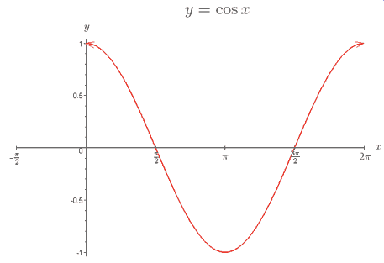
From angles to cosines
Cosine is a monotonically decreasing function for the interval [0º, 180º]
decreasing angle is equivalent to increasing cosine

Slide 36
cosine
How do we calculate the cosine between two vectors?

Slide 37
Cosine of two vectors
Dot product
Dot product between unit length vectors

Slide 38
Cosine as a similarity
ignoring length normalization
Just another distance measure, like the others:

Slide 39
Length normalization
A vector can be length-normalized by dividing each of its components by its length
Often, we’ll use L₂ norm (could also normalize by other norms):
Dividing a vector by its L₂ norm makes it a unit (length) vector

Slide 40
Unit length vectors
1
1
1
1
In many situations, normalization improves similarity, but not in all situations

Slide 41
Normalized distance measures
Cosine
L2
L1
a’ and b’ are length normalized versions of the vectors

