Slide 1
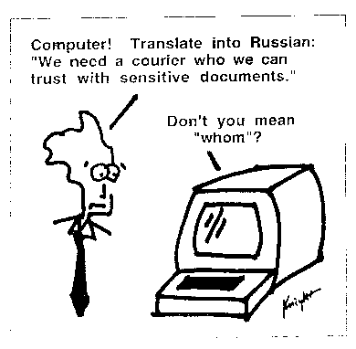
Kevin Knight, http://www.isi.edu/natural-language/people/pictures/ieee-expert-1.gif

Slide 2
Relevance Feedback
Query Expansion
David Kauchak
cs160
Fall 2009
adapted from:
http://www.stanford.edu/class/cs276/handouts/lecture9-queryexpansion.ppt

Slide 3
Administrative
Assignment 3 out

Slide 4
Google’s page search

Slide 5
Anomalous State of Knowledge
Basic paradox:
  Information needs arise because the user doesn’t know something: “an anomaly in his state of knowledge with respect to the problem faced”
  Search systems are designed to satisfy these needs, but the user needs to know what he is looking for
  However, if the user knows what he’s looking for, there may not be a need to search in the first place

Slide 6

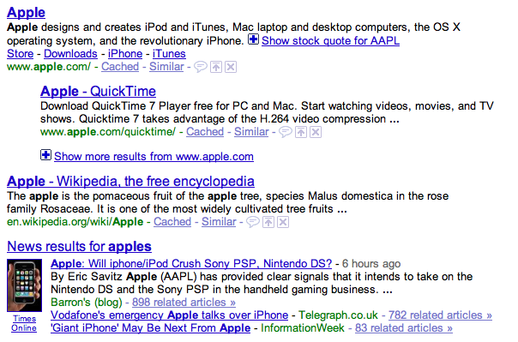
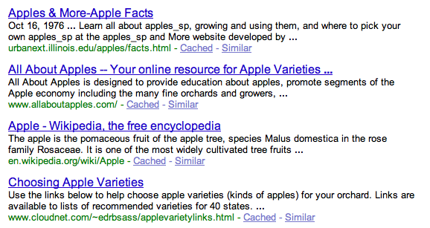
What should be returned?

Slide 7
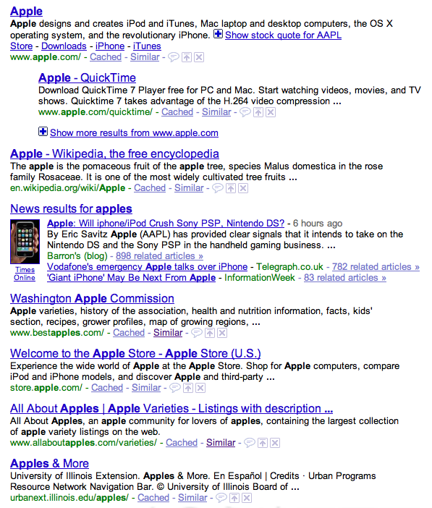
What is actually returned…

Slide 8

Similar pages
What does “similar pages” do?
Does this solve our problem?

Slide 9
Relevance feedback
User provides feedback on relevance of documents in the initial set of results
  User issues a query
  The user marks some results as relevant or non-relevant
  The system computes a better results based on the feedback
  May iterate

Slide 10
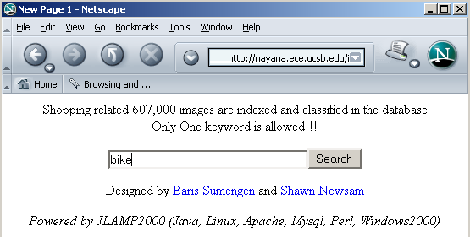
An example
Image search engine:
http://nayana.ece.ucsb.edu/imsearch/imsearch.html

Slide 11
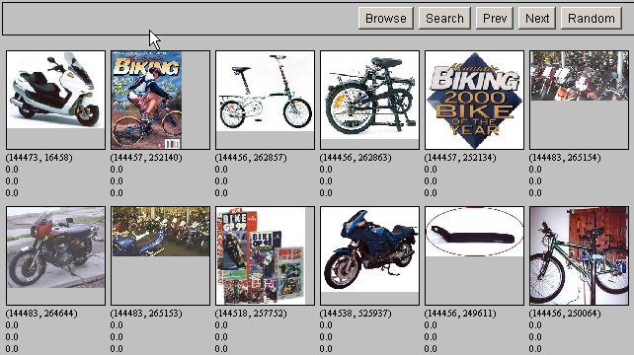
Results for initial query

Slide 12
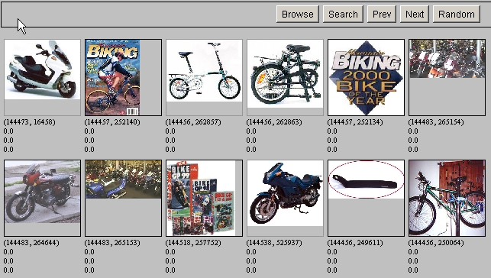
Relevance Feedback

Slide 13
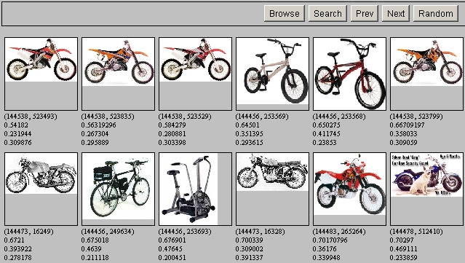
Results after Relevance Feedback

Slide 14
Ideas?
For ranking models we represent our query as a vector of weights, which we view as a point in a high dimensional space
We want to bias the query towards documents that the user selected (the “relevant documents”)
We want to bias the query away from documents that the user did not select (the “non-relevant documents”)
0
4
0
8
0
0

Slide 15
Relevance feedback
Initial query
x
x
x
o
x
x
x
x
Δ
x
x
x
o
x
x
o
x
o
x
o
o
x
x
x
x
x known non-relevant documents
o known relevant documents

Slide 16
Relevance feedback
Initial query
x
x
x
o
x
x
x
x
Δ
x
x
x
o
x
x
o
x
o
x
o
o
x
x
x
x
x known non-relevant documents
o known relevant documents

Slide 17
Relevance feedback on initial query
Initial query
x
x
x
o
x
x
x
x
Δ
x
x
x
o
x
o
x
Δ
x
o
x
o
o
x
x
x
x
Revised query
x known non-relevant documents
o known relevant documents
How can we “move” the query?

Slide 18
Rocchio Algorithm
The Rocchio algorithm uses the vector space model to pick a better query
Rocchio seeks the query q_{opt} that maximizes the difference between the query similarity with the relevant set of documents (C_{r}) vs. the non-relevant set of documents (C_{nr})

Slide 19
Centroid
The centroid is the center of mass of a set of points
x
x
x
x
x
x
x
x
x
x
x
x
x
x
x
x
x
x
x
x

Slide 20
Rocchio Algorithm
Find the new query by moving it towards the centroid of the relevant queries and away from the centroid of the non-relevant queries

Slide 21
Rocchio in action
Original query
0
4
0
8
0
0
Relevant centroid
1
2
4
0
0
1
(+)
Non-relevant centroid
2
0
1
1
0
4
(-)
?
New query
-1
6
3
7
0
-3
Notes:
16

Slide 22
Rocchio in action
Original query
0
4
0
8
0
0
Relevant centroid
1
2
4
0
0
1
(+)
Non-relevant centroid
2
0
1
1
0
4
(-)
New query
0
6
3
7
0
0
Notes:
16

Slide 23
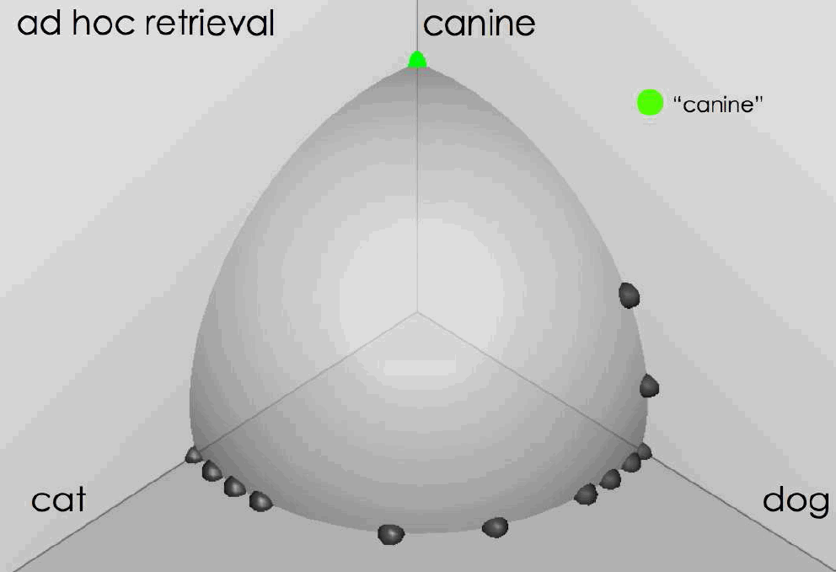
Rocchio in action source: Fernando Diaz

Slide 24
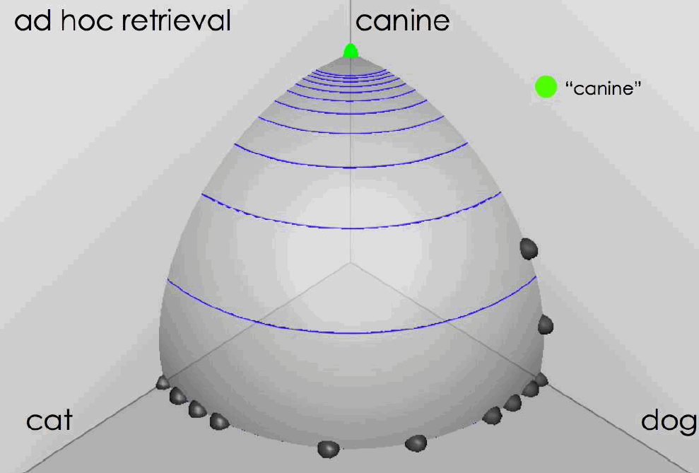
Rocchio in action
source: Fernando Diaz

Slide 25
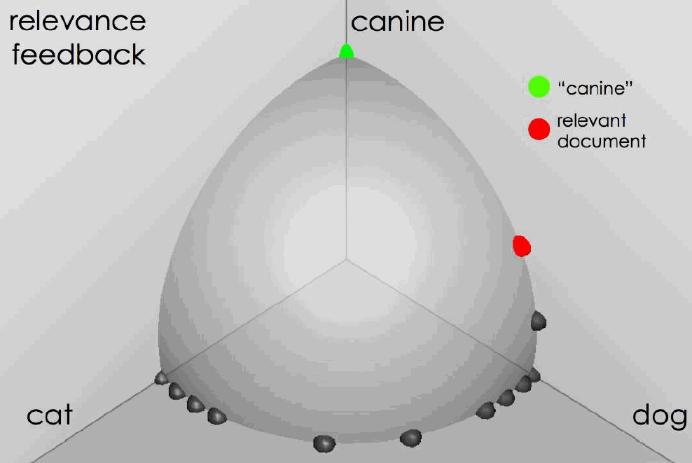
User feedback: Select what is relevant source: Fernando Diaz

Slide 26
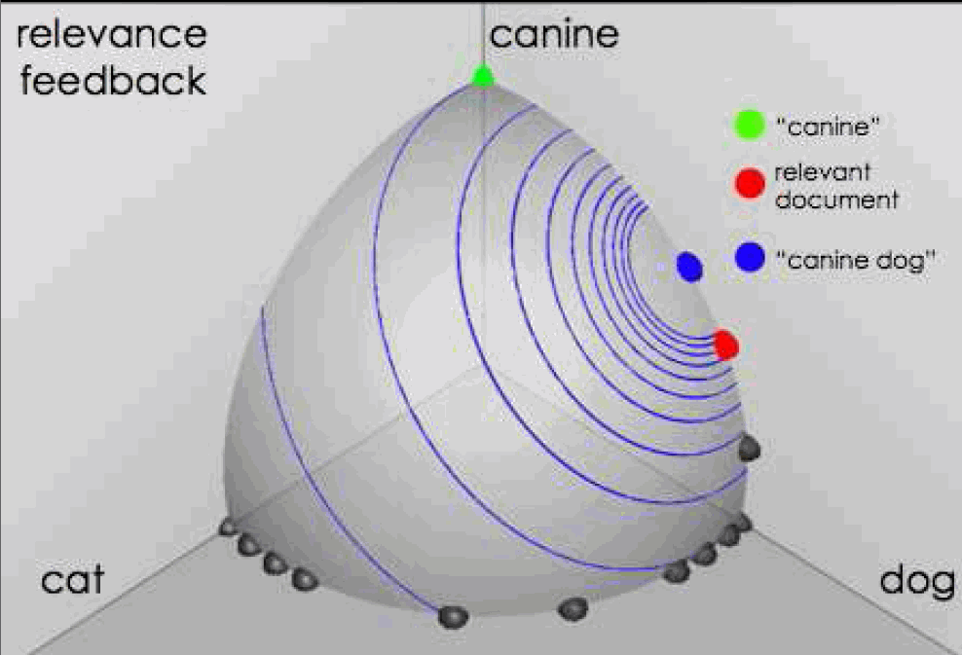
Results after relevance feedback source: Fernando Diaz

Slide 27
Any problems with this?
Ignores the original query!
C_{r} and C_{nr} are all the relevant and non-relevant documents
In practice, we don’t know all of these

Slide 28
Rocchio 1971 Algorithm (SMART)
Used in practice:
D_{r} = set of known relevant doc vectors
D_{nr} = set of known irrelevant doc vectors
  Different from C_{r} and C_{nr}
q_{m} = modified query vector; q₀ = original query vector; α,β,γ: weights (hand-chosen or set empirically)
New query moves toward relevant documents and away from irrelevant documents
Notes:
SMART: Cornell (Salton) IR system of 1970s to 1990s.

Slide 29
Relevance Feedback in vector spaces
Relevance feedback can improve recall and precision
Relevance feedback is most useful for increasing recall in situations where recall is important
  Users can be expected to review results and to take time to iterate
Positive feedback is more valuable than negative feedback (so, set γ < β; e.g. γ = 0.25, β = 0.75).
Many systems only allow positive feedback (γ=0)
Notes:
Just as we modified the query in the vector space model, we can also modify it here. I’m not aware of work that uses language model based Ir this way.

Slide 30
Another example
Initial query: New space satellite applications
  1. 0.539, 08/13/91, NASA Hasn’t Scrapped Imaging Spectrometer
  2. 0.533, 07/09/91, NASA Scratches Environment Gear From Satellite Plan
  3. 0.528, 04/04/90, Science Panel Backs NASA Satellite Plan, But Urges Launches of Smaller Probes
  4. 0.526, 09/09/91, A NASA Satellite Project Accomplishes Incredible Feat: Staying Within Budget
  5. 0.525, 07/24/90, Scientist Who Exposed Global Warming Proposes Satellites for Climate Research
  6. 0.524, 08/22/90, Report Provides Support for the Critics Of Using Big Satellites to Study Climate
  7. 0.516, 04/13/87, Arianespace Receives Satellite Launch Pact From Telesat Canada
  8. 0.509, 12/02/87, Telecommunications Tale of Two Companies
User then marks relevant documents with “+”.
+
+
+

Slide 31
Expanded query after relevance feedback
2.074 new 15.106 space
30.816 satellite 5.660 application
5.991 nasa 5.196 eos
4.196 launch 3.972 aster
3.516 instrument 3.446 arianespace
3.004 bundespost 2.806 ss
2.790 rocket 2.053 scientist
2.003 broadcast 1.172 earth
0.836 oil 0.646 measure

Slide 32
Results for expanded query
1. 0.513, 07/09/91, NASA Scratches Environment Gear From Satellite Plan
2. 0.500, 08/13/91, NASA Hasn’t Scrapped Imaging Spectrometer
3. 0.493, 08/07/89, When the Pentagon Launches a Secret Satellite, Space Sleuths Do Some Spy Work of Their Own
4. 0.493, 07/31/89, NASA Uses ‘Warm’ Superconductors For Fast Circuit
5. 0.492, 12/02/87, Telecommunications Tale of Two Companies
6. 0.491, 07/09/91, Soviets May Adapt Parts of SS-20 Missile For Commercial Use
7. 0.490, 07/12/88, Gaping Gap: Pentagon Lags in Race To Match the Soviets In Rocket Launchers
8. 0.490, 06/14/90, Rescue of Satellite By Space Agency To Cost $90 Million

Slide 33
Expanded query after relevance feedback
2.074 new 15.106 space
30.816 satellite 5.660 application
5.991 nasa 5.196 eos
4.196 launch 3.972 aster
3.516 instrument 3.446 arianespace
3.004 bundespost 2.806 ss
2.790 rocket 2.053 scientist
2.003 broadcast 1.172 earth
0.836 oil 0.646 measure
Any problem with this?

Slide 34
Relevance Feedback: Problems
Long queries are inefficient for typical IR engine
  Long response times for user
  High cost for retrieval system
  Partial solution:
    Only reweight certain prominent terms
      Perhaps top 20 by term frequency
Users are often reluctant to provide explicit feedback
It’s often harder to understand why a particular document was retrieved after applying relevance feedback
Notes:
A long vector space query is like a disjunction: you have to consider documents with any of the words, and sum partial cosine similarities over the various terms.

Slide 35
Will relevance feedback work?
Brittany Speers
hígado
Cosmonaut

Slide 36
RF assumes the user has sufficient knowledge for initial query
Misspellings - Brittany Speers
Cross-language information retrieval – hígado
Mismatch of searcher’s vocabulary vs. collection vocabulary
  Cosmonaut/astronaut

Slide 37
Relevance Feedback on the Web
Some search engines offer a similar/related pages feature (this is a trivial form of relevance feedback)
  Google (link-based)
  Altavista
  Stanford WebBase
But some don’t because it’s hard to explain to average user:
  Alltheweb
  msn live.com
  Yahoo
Excite initially had true relevance feedback, but abandoned it due to lack of use

Slide 38
Excite Relevance Feedback
Spink et al. 2000
Only about 4% of query sessions from a user used relevance feedback option
  Expressed as “More like this” link next to each result
But about 70% of users only looked at first page of results and didn’t pursue things further
  So 4% is about 1/8 of people extending search
Relevance feedback improved results about 2/3 of the time

Slide 39
Pseudo relevance feedback
Pseudo-relevance algorithm:
  Retrieve a ranked list of hits for the user’s query
  Assume that the top k documents are relevant.
  Do relevance feedback (e.g., Rocchio)
Works very well on average
But can go horribly wrong for some queries
Several iterations can cause query drift
What is query drift?
  http://thenextweb.com/2009/06/04/bing-commercials/

Slide 40
Expanding the query
We would like to suggest alternative query formulations to the user with the goal of:
  increasing precision
  increasing recall
What are methods we might try to accomplish this?

Slide 41

Increasing precision
Query assist:
  Generally done by query log mining
  Recommend frequent recent queries that contain partial string typed by user (or query typed)

Slide 42

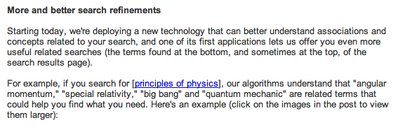
Increasing precision…
http://googleblog.blogspot.com/2009/03/two-new-improvements-to-google-results.html

Slide 43
Increasing recall: query expansion
Automatically expand the query with related terms and run through index
Spelling correction can be thought of a special case of this
cosmonaut
cosmonaut astronaut space pilot
How might we come up with these expansions?

Slide 44
How do we augment the user query?
Manual thesaurus
  E.g. MedLine: physician, syn: doc, doctor, MD, medico
  Wordnet
Global Analysis: (static; of all documents in collection)
  Automatically derived thesaurus
    (co-occurrence statistics)
  Refinements based on query log mining
    Common on the web
Local Analysis: (dynamic)
  Analysis of documents in result set

Slide 45
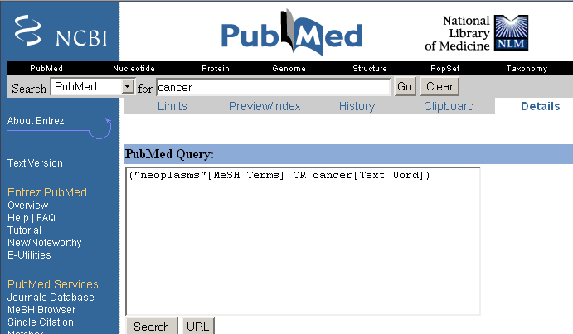
Example of manual thesaurus

Slide 46
Thesaurus-based query expansion
For each term, t, in a query, expand the query with synonyms and related words of t from the thesaurus
  feline → feline cat
May weight added terms less than original query terms.
May significantly decrease precision, particularly with ambiguous terms
  “interest rate” → “interest rate fascinate evaluate”
There is a high cost of manually producing a thesaurus
  And for updating it for scientific changes
?
?

Slide 47
Automatic thesaurus generation
Given a large collection of documents, how might we determine if two words are synonyms?
Two words are synonyms if they co-occur with similar words
I drive a car
I drive an automobile
I bought new tires for my car
I bought new tires
for my automobile
can I hitch a ride with
you in your car
can I hitch a ride with
you in your automobile

Slide 48
Automatic thesaurus generation
Given a large collection of documents, how might we determine if two words are synonyms?
Two words are synonyms if they co-occur with similar words
I drive a car
I drive an automobile
I bought new tires for my car
I bought new tires
for my automobile
can I hitch a ride with
you in your car
can I hitch a ride with
you in your automobile

Slide 49
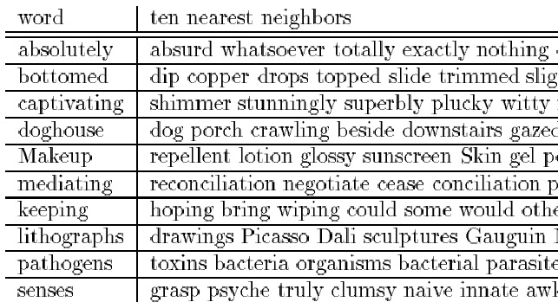
Automatic Thesaurus Generation
Example

Slide 50
Automatic Thesaurus Generation
Discussion
Quality of associations is usually a problem
Term ambiguity may introduce irrelevant statistically correlated terms
  “Apple computer” → “Apple red fruit computer”
Problems:
  False positives: Words deemed similar that are not
  False negatives: Words deemed dissimilar that are similar
Since terms are highly correlated anyway, expansion may not retrieve many additional documents

