Slide 1
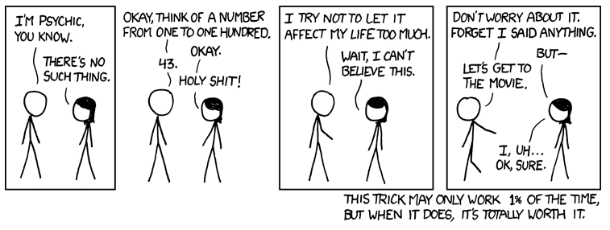
http://www.xkcd.com/628/

Slide 2
Results Summaries Spelling Correction
David Kauchak
cs160
Fall 2009
adapted from: http://www.stanford.edu/class/cs276/handouts/lecture3-tolerantretrieval.ppt
http://www.stanford.edu/class/cs276/handouts/lecture8-evaluation.ppt

Slide 3
Administrative
Course feedback

Slide 4
www.fordvehicles.com/cars/mustang/
en.wikipedia.org/wiki/Ford_Mustang
www.mustangseats.com/
www.mustangsurvival.com/

Slide 5
www.fordvehicles.com/cars/mustang/
en.wikipedia.org/wiki/Ford_Mustang
www.mustangseats.com/
www.mustangsurvival.com/
2010 For Mustang | Official Site of the Ford Mustang
www.fordvehicles.com/cars/mustang/
Ford Mustang – Wikipedia, the free encyclopedia
en.wikipedia.org/wiki/Ford_Mustang
Mustang Motorcycle Products, Inc.
www.mustangseats.com/
Mustang Survival Corporation
www.mustangsurvival.com/

Slide 6
2010 For Mustang | Official Site of the Ford Mustang
2010 Ford Mustang - The official homepage of the Ford Mustang | FordVehicles.com
www.fordvehicles.com/cars/mustang/
Ford Mustang – Wikipedia, the free encyclopedia
The Ford Mustang is an automobile manufactured by the Ford Motor Company. It was initially based on the second generation North American Ford Falcon, ...
en.wikipedia.org/wiki/Ford_Mustang
Mustang Motorcycle Products, Inc.
What a Difference Comfort Makes! Mustang is the world's leader in comfortable aftermarket motorcycle seats for Harley-Davidson®, Victory and Metric Cruiser ...
www.mustangseats.com/
Mustang Survival Corporation
Design, development, and manufacture of marine and aerospace safety and survival wear. Includes detailed product catalog, sizing charts, FAQs, ...
www.mustangsurvival.com/

Slide 7
2010 For Mustang | Official Site of the Ford Mustang
Warriors in Pink News SYNC News & Events
www.fordvehicles.com/cars/mustang/
Ford Mustang – Wikipedia, the free encyclopedia
I told the team that I wanted the car to appeal to women, but I wanted men to desire it, too...
en.wikipedia.org/wiki/Ford_Mustang
Mustang Motorcycle Products, Inc.
New Tank Bibs with Pouches ...
www.mustangseats.com/
Mustang Survival Corporation
Terms of Use | Privacy Policy ...
www.mustangsurvival.com/

Slide 8
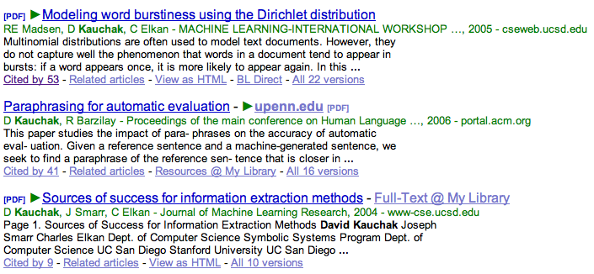
IR Display
In many domains, we have metadata about the documents we’re retrieving
For web pages, we have titles and URLs
For other collections, we may have other types of information
For academic articles, what information do we have?

Slide 9
Other information
Other times, we may not have explicit meta-data, but may still want to provide additional data
Web pages don’t provide “snippets”/summaries
Even when pages do provide metadata, we may want to ignore this. Why?
The search engine may have different goals/motives than the webmasters, e.g. ads

Slide 10
Summaries
We can generate these ourselves!
Lots of summarization techniques
Most common (and successful) approach is to extract segments from the documents
How might we identify good segments?
Text early on in a document
First/last sentence in a document, paragraph
Text formatting (e.g. <h1>)
Document frequency
Distribution in document
Grammatical correctness
User query!

Slide 11
Summaries
In typical systems, the summary is a subset of the document
Simplest heuristic: the first 50 (or so – this can be varied) words of the document
More sophisticated: extract from each document a set of “key” sentences
Simple NLP heuristics to score each sentence
Learning approach based on training data
Summary is made up of top-scoring sentences

Slide 12
Segment identification
f₁, f₂, …, f_{n}
f₁, f₂, …, f_{n}
extract features
f₁, f₂, …, f_{n}
learning
approach
f₁, f₂, …, f_{n}
f₁, f₂, …, f_{n}
segment identifier
f₁, f₂, …, f_{n}
f₁, f₂, …, f_{n}
f₁, f₂, …, f_{n}

Slide 13
Summaries
A static summary of a document is always the same, regardless of the query that hit the doc
A dynamic summary is a query-dependent attempt to explain why the document was retrieved for the query at hand

Slide 14
Dynamic summaries
Present one or more “windows” within the document that contain several of the query terms
“KWIC” snippets: Keyword in Context presentation
Generated in conjunction with scoring
If query found as a phrase, all or some occurrences of the phrase in the doc
If not, document windows that contain multiple query terms
The summary itself gives the entire content of the window – all terms, not only the query terms

Slide 15
Dynamic vs. Static
What are the benefits and challenges of each approach?
Static
Create the summaries during indexing
Don’t need to store the documents
Dynamic
Better user experience
Makes the summarization process easier
Unfortunately, must generate summaries on the fly and so must store documents and retrieve documents for every query!

Slide 16
Generating dynamic summaries
If we cache the documents at index time, can find windows in it, cueing from hits found in the positional index
E.g., positional index says “the query is a phrase in position 4378” so we go to this position in the cached document and stream out the content
Most often, cache only a fixed-size prefix of the doc
Note: Cached copy can be outdated

Slide 17
Dynamic summaries
Producing good dynamic summaries is a tricky optimization problem
The real estate for the summary is normally small and fixed
Want short item, so show as many KWIC matches as possible, and perhaps other things like title
But users really like snippets, even if they complicate IR system design

Slide 18
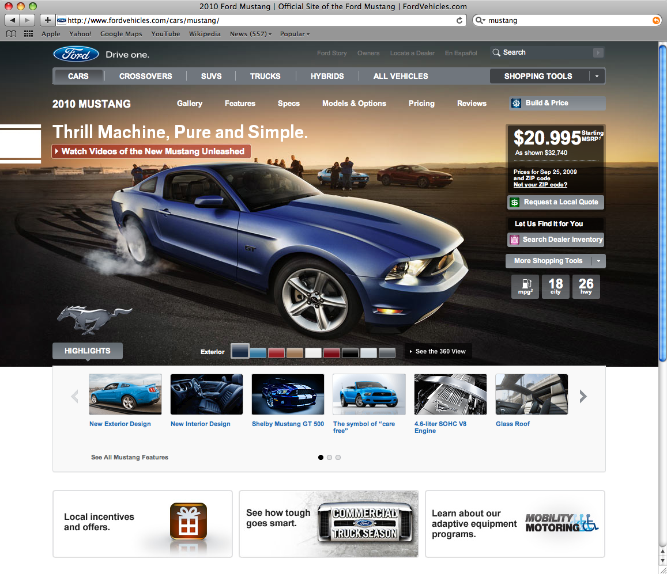
Challenge…

Slide 19
Challenge…
<!DOCTYPE html PUBLIC "-//W3C//DTD XHTML 1.0 Strict//EN" "http://www.w3.org/TR/xhtml1/DTD/xhtml1-strict.dtd"><html xmlns="http://www.w3.org/1999/xhtml" xml:lang="en" lang="en"><head><script type="text/javascript">var __params = {};__params.site = "bs"; // Used in DHTML Form library to identify brandsites pages__params.model = "Mustang2010";__params.modelName = "Mustang";__params.year = "2010";__params.make = "Ford";__params.segment = "cars";__params.baseURL = "http://www.fordvehicles.com";__params.canonicalURL = "/cars/mustang/";__params.anchorPage = "page";__params.domain="fordvehicles.com";</script><script type="text/javascript" src="http://www.fordvehicles.com/ngtemplates/ngassets/com/forddirect/ng/log4javascript.js?gtmo=ngbs"></script><script type="text/javascript">log4javascript.setEnabled(false);var log = log || log4javascript.getDefaultLogger();if ( log4javascript.isEnabled() ) {log.info("Log initialized");}</script><script language="javascript" type="text/javascript">document.domain = "fordvehicles.com";</script><script type="text/javascript">var akamaiQueryStringFound = false;var isCookieEnabled = false;/*Checking For QueryString Parameters Being Present*/if (__params && __params.gtmo && __params.gtmo === "ngbs") {akamaiQueryStringFound = true;}/*Checking For Cookies Being Enabled*/var cookieenabled = false;document.cookie = "testcookie=val";if (document.cookie.indexOf("testcookie=") === -1) {isCookieEnabled = false;} else {isCookieEnabled = true;}/*Redirection Check and Redirecting if required*/// Commenting out the redirection logic for v0.27/*if ((!akamaiQueryStringFound) && (!isCookieEnabled)) {window.location.replace("http://www2.fordvehicles.com");}

Slide 20
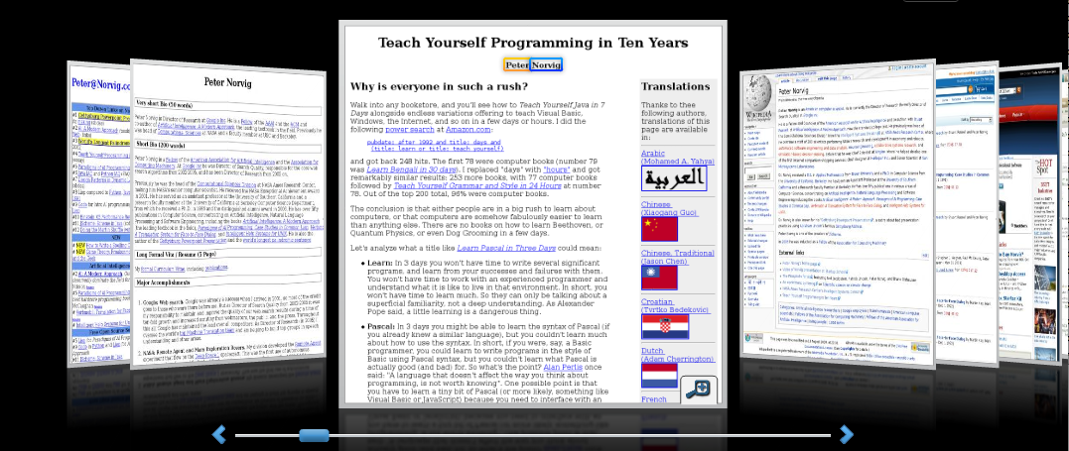
Alternative results presentations?
An active area of HCI research
An alternative: http://www.searchme.com/ copies the idea of Apple’s Cover Flow for search results
Notes:
For the moment, the search engine market has really coalesced around one dominant style (consistency has strong benefits – Jakob Nielsen.

Slide 21
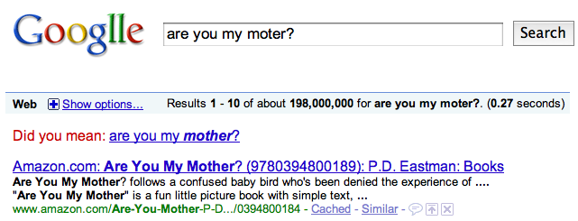
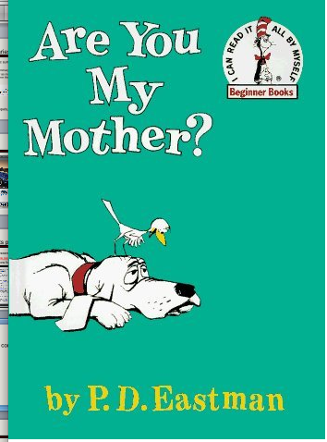
Spelling correction

Slide 22
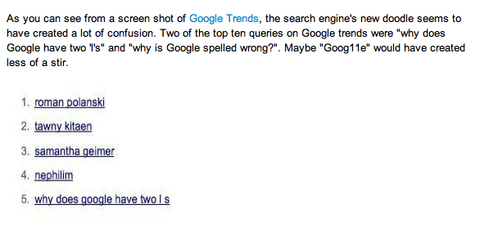
Googlle?
http://www.huffingtonpost.com/2009/09/27/googlle-google-logo-spell_n_301123.html

Slide 23
Spell correction
How might we utilize spelling correction?
Two principal uses
Correcting user queries to retrieve “right” answers
Correcting documents being indexed

Slide 24
Document correction
Especially needed for OCR’ed documents
Correction algorithms are tuned for this
Can use domain-specific knowledge
E.g., OCR can confuse O and D more often than it would confuse O and I (adjacent on the QWERTY keyboard, so more likely interchanged in typing).
Web pages and even printed material have typos
Often we don’t change the documents but aim to fix the query-document mapping

Slide 25
Query misspellings
Our principal focus here
E.g., the query Alanis Morisett
We can either
Retrieve documents indexed by the correct spelling
Return several suggested alternative queries with the correct spelling
Did you mean … ?
Advantages/disadvantages?

Slide 26
Spell correction
Two main flavors/approaches:
Isolated word
Check each word on its own for misspelling
Which of these is mispelled?
moter
from
Will not catch typos resulting in correctly spelled words
Context-sensitive
Look at surrounding words,
e.g., I flew form Heathrow to Narita.

Slide 27
Isolated word correction
a
able
about
account
acid
across
act
addition
adjustment
advertisement
after
again
against
agreement
air
all
almost
…
Fundamental premise – there is a lexicon from which the correct spellings come
Two basic choices for this
A standard lexicon such as
Webster’s English Dictionary
An “industry-specific” lexicon – hand-maintained
The lexicon of the indexed corpus
E.g., all words on the web
All names, acronyms etc.
(Including the mis-spellings)

Slide 28
Isolated word correction
Given a lexicon and a character sequence Q, return the words in the lexicon closest to Q
How might we measure “closest”?
Edit distance (Levenshtein distance)
Weighted edit distance
n-gram overlap
Lexicon
?
q₁q₂…q_{m}

Slide 29
Edit distance
Given two strings S₁ and S₂, the minimum number of operations to convert one to the other
Operations are typically character-level
Insert, Delete, Replace, (Transposition)
E.g., the edit distance from dof to dog is 1
from cat to act is ? (with transpose?)
from cat to dog is ?
Generally found by dynamic programming
See http://www.merriampark.com/ld.htm for a nice example plus an applet.

Slide 30
Weighted edit distance
As above, but the weight of an operation depends on the character(s) involved
Meant to capture OCR or keyboard errors, e.g. m more likely to be mis-typed as n than as q
Therefore, replacing m by n is a smaller edit distance than by q
This may be formulated as a probability model
Requires weight matrix as input
Modify dynamic programming to handle weights

Slide 31
Using edit distance
We have a function edit that calculates the edit distance between two strings
We have a query word
We have a lexicon
Lexicon
?
now what?
q₁q₂…q_{m}

Slide 32
Using edit distance
We have a function edit that calculates the edit distance between two strings
We have a query word
We have a lexicon
Lexicon
We need to reduce the candidate lexicon set
Ideas?
?
q₁q₂…q_{m}

Slide 33
Enumerating candidate strings
Given query, enumerate all character sequences within a preset (weighted) edit distance (e.g., 2)
Intersect this set with the lexicon
dog
doa, dob, …, do, og, …, dogs, dogm, …

Slide 34
Character n-grams
Just like word n-grams, we can talk about character n-grams
A character n-gram is n contiguous characters in a word
unigrams
bigrams
trigrams
4-grams
r
e
m
o
t
e
re
em
mo
ot
te
rem
emo
mot
ote
remo
emot
mote
remote

Slide 35
Character n-gram overlap
Enumerate all n-grams in the query string
Identify all lexicon terms matching any of the query n-grams
Threshold by number of matching n-grams
Weight by keyboard layout, etc.
What is the trigram overlap between “november” and “december”?

Slide 36
Example
What is the trigram overlap between “november” and “december”?
november
december
nov
ove
vem
emb
mbe
ber
dec
ece
cem
emb
mbe
ber

Slide 37
Example
What is the trigram overlap between “november” and “december”?
november
december
nov
ove
vem
emb
mbe
ber
dec
ece
cem
emb
mbe
ber
3 trigrams of 6 overlap. How can we quantify this?

Slide 38
One option – Jaccard coefficient
A commonly-used measure of overlap
Let X and Y be two sets; then the J.C. is
What does this mean?
number of overlapping ngrams
total n-grams between the two

Slide 39
Example
november
december
nov
ove
vem
emb
mbe
ber
dec
ece
cem
emb
mbe
ber
3
JC = 1/3
9

Slide 40
Jaccard coefficient
Equals 1 when X and Y have the same elements and zero when they are disjoint
X and Y don’t have to be of the same size
Always assigns a number between 0 and 1
Threshold to decide if you have a match
E.g., if J.C. > 0.8, declare a match

Slide 41
Efficiency
We have all the n-grams for our query word
How can we efficiently compute the words in our lexicon that have non-zero n-gram overlap with our query word?
Index the words by n-grams!
lo
alone
lord
sloth

Slide 42
Matching trigrams
Consider the query lord – we wish to identify words matching 2 of its 3 bigrams (lo, or, rd)
lo
alone
lord
sloth
or
border
lord
morbid
rd
ardent
border
card
Standard postings “merge” will enumerate …
Adapt this to using Jaccard (or another) measure.

Slide 43
Context-sensitive spell correction
Text: I flew from Heathrow to Narita.
Consider the phrase query “flew form Heathrow”
We’d like to respond: Did you mean “flew from Heathrow”?
How might you do this?

Slide 44
Context-sensitive correction
Similar to isolated correction, but incorporate surrounding context
Retrieve dictionary terms close to each query term (e.g. isolated spelling correction)
Try all possible resulting phrases with one word “fixed” at a time
flew from heathrow
fled form heathrow
flea form heathrow
Rank alternatives based on frequency in corpus
Can we do this efficiently?

Slide 45
Another approach?
What do you think the search engines actually do?
Often a combined approach
Generally, context-sensitive correction
One overlooked resource so far…

Slide 46
Query logs
How might we use query logs to assist in spelling correction?
Find similar queries, e.g. “flew form heathrow” and “flew from heathrow”
Query logs contain a temporal component!
User will type “flew form heathrow”
Not get any results (or any relevant results)
User will issue another query “flew from heathrow”
We can make this connection!

Slide 47
General issues in spell correction
We enumerate multiple alternatives for “Did you mean?”
Need to figure out which to present to the user
Use heuristics
The alternative hitting most docs
Query log analysis + tweaking
For especially popular, topical queries
Spell-correction is computationally expensive
Avoid running routinely on every query?
Run only on queries that matched few docs

Slide 48
Dictionaries
How do new ways to get information change our information needs?
How does our reliance on Google for all different types of information affect it’s ability to provide specific useful information?
How does the undermining of traditional sources of rules of English (and other languages) affect society’s use of English?

