Slide 1
Faster TF-IDF
David Kauchak
cs160
Fall 2009
adapted from:
http://www.stanford.edu/class/cs276/handouts/lecture6-tfidf.ppt

Slide 2
Administrative
Assignment 1
Assignment 2
  Look at the assignment by Wed!
  New turnin procedure
Class participation

Slide 3
Stoplist and dictionary size

Slide 4
Recap: Queries as vectors
Represent the queries as vectors
Represent the documents as vectors
proximity = similarity of vectors
What do the entries in the vector represent in the tf-idf scheme?

Slide 5
Recap: tf-idf weighting
The tf-idf weight of a term is the product of its tf weight and its idf weight.
For each document, there is one entry for every term in the vocabulary
Each entry in that vector is the tf-idf weight above
How do we calculate the similarity?

Slide 6
Recap: cosine(query,document)
Dot product
Unit vectors
cos(q,d) is the cosine similarity of q and d … or,
equivalently, the cosine of the angle between q and d.

Slide 7
Outline
Calculating tf-idf score
Faster ranking
Static quality scores
Impact ordering
Cluster pruning

Slide 8
Calculating cosine similarity
tf-idf entries
Traverse entries calculating the product
Accumulate the vector lengths and divide at the end
How can we do it faster if we have a sparse representation?

Slide 9
Calculating cosine tf-idf from index
index
What should we store in the index?
How do we construct the index?
How do we calculate the document ranking?
w₁
w₂
w₃
…

Slide 10
Index construction: collect documentIDs
Doc 1
I did enact Julius
Caesar I was killed
i' the Capitol;
Brutus killed me.
Doc 2
So let it be with
Caesar. The noble
Brutus hath told you
Caesar was ambitious

Slide 11
Index construction: sort dictionary
sort based on terms

Slide 12
Index construction: create postings list
word 1
word 2
create postings lists
from identical entries
…
word n
Do we have all the information we need?

Slide 13
Obtaining tf-idf weights
Store the tf initially in the index
In addition, store the number of documents the term occurs in in the index
How do we get the idfs?
  We can either compute these on the fly using the number of documents in each term
  We can make another pass through the index and update the weights for each entry
Pros and cons of each approach?
Notes:
Computing on the fly
could save memory (store integer rather than real number)
could use different weighting schemes with the index
Store in index
more efficient

Slide 14
Do we have everything we need?
Still need the document lengths
  Store these in a separate data structure
  Make another pass through the data and update the weights
Benefits/drawbacks?
Notes:
separate
flexibility to use different weighting schemes
one less pass during indexing
store in structure
efficient
simpler

Slide 15
Computing cosine scores
Similar to the merge operation
Accumulate scores for each document
float scores[N] = 0
for each query term t
  calculate w_{t,q}
  for each entry in t’s postings list: docID, w_{t,d}
    scores[docID] += w_{t,q} * w_{t,d}
return top k components of scores

Slide 16
Efficiency
What are the inefficiencies here?
  Only want the scores for the top k but are calculating all the scores
  Sort to obtain top k?
float scores[N] = 0
for each query term t
  calculate w_{t,q}
  for each entry in t’s postings list: docID, w_{t,d}
    scores[docID] += w_{t,q} * w_{t,d}
return top k components of scores

Slide 17
Outline
Calculating tf-idf score
Faster ranking
Static quality scores
Impact ordering
Cluster pruning

Slide 18
Efficient cosine ranking
What we’re doing in effect: solving the K-nearest neighbor problem for a query vector
In general, we do not know how to do this efficiently for high-dimensional spaces
Two simplifying assumptions
  Queries are short!
  Assume no weighting on query terms and that each query term occurs only once
  Then for ranking, don’t need to normalize query vector

Slide 19
Computing cosine scores
  Assume no weighting on query terms and that each query term occurs only once
float scores[N] = 0
for each query term t
  for each entry in t’s postings list: docID, w_{t,d}
    scores[docID] += w_{t,d}
return top k components of scores

Slide 20
Selecting top K
We could sort the scores and then pick the top K
What is the runtime of this approach?
  O(N log N)
Can we do better?
Use a heap (i.e. priority queue)
  Build a heap out of the scores
  Get the top K scores from the heap
  Running time?
    O(N + K log N)
For N=1M, K=100, this is about 10% of the cost
of sorting
1
.9
.3
.3
.8
.1
.1

Slide 21
Inexact top K
What if we don’t return the exactly the top K, but a set close to the top K?
  User has a task and a query formulation
  Cosine is a proxy for matching this task/query
  If we get a list of K docs “close” to the top K by cosine measure, should still be ok

Slide 22
Current approach
Documents
Score documents
Pick top K

Slide 23
Approximate approach
Documents
Select A candidates
K < A << N
Score documents in A
Pick top K in A

Slide 24
Exact vs. approximate
Depending on how A is selected and how large A is, can get different results
Can think of it as pruning the initial set of docs
How might we pick A?
Exact
Approximate

Slide 25
Docs containing many query terms
So far, we consider any document with at least one query term in it
For multi-term queries, only compute scores for docs containing several of the query terms
  Say, at least 3 out of 4
  Imposes a “soft conjunction” on queries seen on web search engines (early Google)
Easy to implement in postings traversal

Slide 26
3 of 4 query terms
Antony
3
4
8
16
32
64
128
Brutus
2
4
8
16
32
64
128
Caesar
1
2
3
5
8
13
21
34
Calpurnia
13
16
32
Scores only computed for 8, 16 and 32.

Slide 27
High-idf query terms only
For a query such as catcher in the rye
Only accumulate scores from catcher and rye
Intuition: in and the contribute little to the scores and don’t alter rank-ordering much
Benefit:
  Postings of low-idf terms have many docs → these (many) docs get eliminated from A
Can we calculate this efficiently from the index?

Slide 28
Champion lists
Precompute for each dictionary term the r docs of highest weight in the term’s postings
  Call this the champion list for a term
  (aka fancy list or top docs for a term)
This must be done at index time
Antony
3
4
8
16
32
64
128
Brutus
2
4
8
16
32
64
128
Caesar
1
2
3
5
8
13
21
34

Slide 29
Champion lists
At query time, only compute scores for docs in the champion list of some query term
  Pick the K top-scoring docs from amongst these
Are we guaranteed to always get K documents?
Antony
8
16
128
Brutus
8
32
128
Caesar
1
16
128

Slide 30
High and low lists
For each term, we maintain two postings lists called high and low
  Think of high as the champion list
When traversing postings on a query, only traverse high lists first
  If we get more than K docs, select the top K and stop
  Else proceed to get docs from the low lists
A means for segmenting index into two tiers

Slide 31
Tiered indexes
Break postings up into a hierarchy of lists
  Most important
  …
  Least important
Inverted index thus broken up into tiers of decreasing importance
At query time use top tier unless it fails to yield K docs
  If so drop to lower tiers

Slide 32
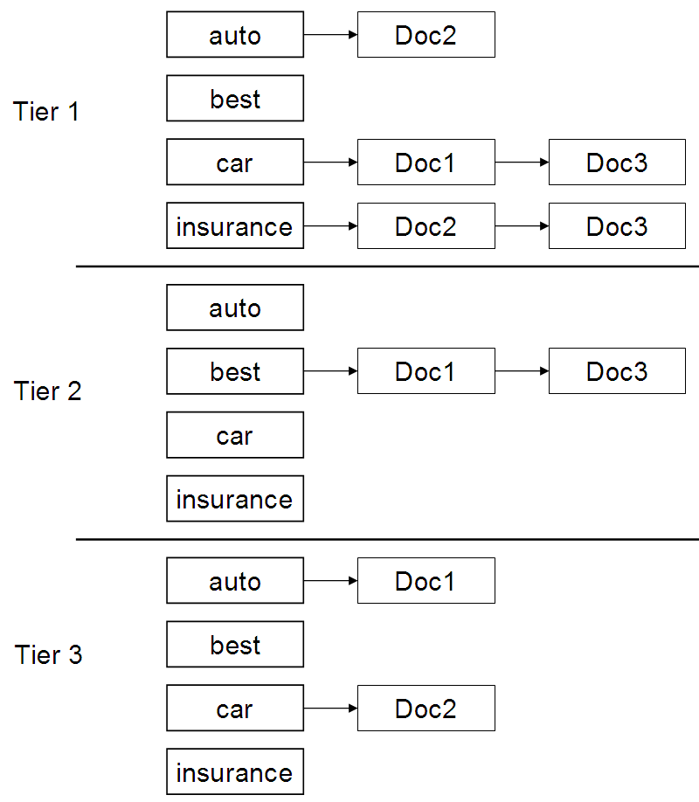
Example tiered index

Slide 33
Quick review
Rather than selecting the best K scores from all N documents
  Initially filter the documents to a smaller set
  Select the K best scores from this smaller set
Methods for selecting this smaller set
  Documents with more than one query term
  Terms with high IDF
  Documents with the highest weights

Slide 34
Discussion
How can Champion Lists be implemented in an inverted index? How do we modify the data structure?
Antony
3
4
8
16
32
64
128
Brutus
2
4
8
16
32
64
128
Caesar
1
2
3
5
8
13
21
34

Slide 35
Outline
Calculating tf-idf score
Faster ranking
Static quality scores
Impact ordering
Cluster pruning

Slide 36
Static quality scores
We want top-ranking documents to be both relevant and authoritative
Relevance is being modeled by cosine scores
Authority is typically a query-independent property of a document
What are some examples of authority signals?
  Wikipedia among websites
  Articles in certain newspapers
  A paper with many citations
  Many diggs, Y!buzzes or del.icio.us marks
  Pagerank

Slide 37
Modeling authority
Assign to each document a query-independent quality score in [0,1] denoted g(d)
Thus, a quantity like the number of citations is scaled into [0,1]
Google PageRank

Slide 38
Net score
We want a total score that combines cosine relevance and authority
  net-score(q,d) = g(d) + cosine(q,d)
  Can use some other linear combination than an equal weighting
  Indeed, any function of the two “signals” of user happiness
Now we seek the top K docs by net score
Doing this exactly, is similar to incorporating document length normalization

Slide 39
Top K by net score – fast methods
Order all postings by g(d)
Is this ok? Does it change our merge/traversal algorithms?
  Key: this is still a common ordering for all postings
Antony
1
2
Brutus
3
1
2
Caesar
3
2
g(1) = 0.5, g(2) = .25, g(3) = 1

Slide 40
Why order postings by g(d)?
Under g(d)-ordering, top-scoring docs likely to appear early in postings traversal
In time-bound applications (say, we have to return whatever search results we can in 50 ms), this allows us to stop postings traversal early
Antony
1
2
Brutus
3
1
2
Caesar
3
2
g(1) = 0.5, g(2) = .25, g(3) = 1

Slide 41
Champion lists in g(d)-ordering
We can still use the notion of champion lists…
Combine champion lists with g(d)-ordering
Maintain for each term a champion list of the r docs with highest g(d) + tf-idf_{td}
Seek top-K results from only the docs in these champion lists

Slide 42
Outline
Calculating tf-idf score
Faster ranking
Static quality scores
Impact ordering
Cluster pruning

Slide 43
Impact-ordered postings
Why do we need a common ordering of the postings list?
  Allows us to easily traverse the postings list and check for intersection
Is that required for our tf-idf traversal algorithm?
float scores[N] = 0
for each query term t
  for each entry in t’s postings list: docID, w_{t,d}
    scores[docID] += w_{t,d}
return top k components of scores

Slide 44
Impact-ordered postings
The ordering no long plays a role
Our algorithm for computing document scores “accumulates” scores for each document
Idea: sort each postings list by w_{t,d}
Only compute scores for docs for which w_{t,d} is high enough
Given this ordering, how might we construct A when processing a query?

Slide 45
Impact-ordering: early termination
When traversing a postings list, stop early after either
  a fixed number of r docs
  w_{t,d} drops below some threshold
Take the union of the resulting sets of docs
  One from the postings of each query term
Compute only the scores for docs in this union

Slide 46
Impact-ordering: idf-ordered terms
When considering the postings of query terms
Look at them in order of decreasing idf
  High idf terms likely to contribute most to score
As we update score contribution from each query term
  Stop if doc scores relatively unchanged
Can apply to cosine or other net scores

Slide 47
Outline
Calculating tf-idf score
Faster ranking
Static quality scores
Impact ordering
Cluster pruning

Slide 48
Cluster pruning: preprocessing
Pick √N docs, call these leaders
For every other doc, pre-compute nearest leader
  Docs attached to a leader are called followers
  Likely: each leader has ~ √N followers

Slide 49
Cluster pruning: query processing
Process a query as follows:
  Given query Q, find its nearest leader L
  Seek K nearest docs from among L’s followers

Slide 50
Visualization
Query
Leader
Follower

Slide 51
Cluster pruning variants
Have each follower attached to b₁ (e.g. 2) nearest leaders
From query, find b₂ (e.g. 3) nearest leaders and their followers
Query
Leader
Follower

Slide 52
Can Microsoft's Bing, or Anyone, Seriously Challenge Google?
Will it ever be possible to dethrone Google as the leader in web search?
What would a search engine need to improve upon the model Google oﬀers?
Is Bing a serious threat to Google’s dominance?

