Slide 1
TF-IDF
David Kauchak
cs160
Fall 2009
adapted from:
http://www.stanford.edu/class/cs276/handouts/lecture6-tfidf.ppt

Slide 2
Administrative
Homework 3 available soon
Assignment 2 available soon
Popular media article

Slide 3
Ranked retrieval
Thus far, our queries have all been Boolean
  Documents either match or don’t
Good for expert users with precise understanding of their needs and the collection
Also good for applications: Applications can easily consume 1000s of results
  Not good for the majority of users
  Most users incapable of writing Boolean queries (or they are, but they think it’s too much work)
More importantly: most users don’t want to wade through 1000s of results

Slide 4
Problem with Boolean search: feast or famine
Boolean queries often result in either too few (=0) or too many (1000s) results.
Query 1: “standard user dlink 650” → 200,000 hits
Query 2: “standard user dlink 650 no card found”: 0 hits
It takes skill to come up with a query that produces a manageable number of hits
With a ranked list of documents it does not matter how large the retrieved set is

Slide 5
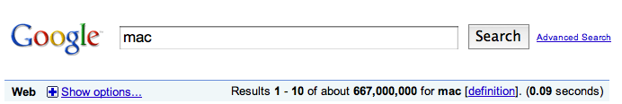
Scoring as the basis of ranked retrieval
We wish to return in order the documents most likely to be useful to the searcher
Assign a score that measures how well document and query “match”

Slide 6
Query-document matching scores
We need a way of assigning a score to a query/document pair
Besides whether or not a query (or query word) occurs in a document, what other indicators might be useful?
  How many times the word occurs in the document
  Where the word occurs
  How “important” is the word – for example, a vs. motorcycle

Slide 7
Recall: Binary term-document incidence matrix
Each document is represented by a binary vector ∈ {0,1}^{|V|}

Slide 8
Term-document count matrices
Consider the number of occurrences of a term in a document:
  Each document is a count vector in ℕ^{v}: a column below
What information is lost with this representation?

Slide 9
Bag of words representation
Represent a document by the occurrence counts of each word
Ordering of words is lost
John is quicker than Mary and Mary is quicker than John have the same vectors

Slide 10
Boolean queries: another view
query
document
For the boolean representation, we can view a
query/document as a set of words

Slide 11
Boolean queries: another view
query
document
We want to return those documents where there is an overlap, i.e. intersection between the two sets

Slide 12
Bag of words
query
document
What is the notion of “intersection” for the bag or words model?

Slide 13
Bag of words
query
document
Want to take into account term frequency

Slide 14
Some things to be careful of…
query
query
document
document
Say I take the document and simply append it to itself. What happens to the overlap?

Slide 15
Some things to be careful of…
query
query
document
document
What is the issue?
Need some notion of the length of a document

Slide 16
Some things to be careful of…
query
query
document
the the the
the the …
What about a document that contains only frequent words, e.g. the?

Slide 17
Some things to be careful of…
query
query
document
the the the
the the …
Need some notion of the importance of words

Slide 18
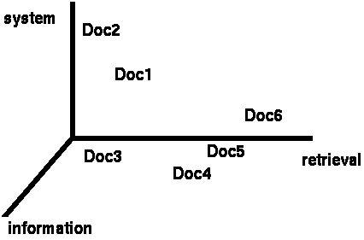
Documents as vectors
We have a |V|-dimensional vector space
Terms are axes of the space
Documents are points or vectors in this space
Very high-dimensional: hundreds of millions of dimensions when you apply this to a web search engine
This is a very sparse vector - most entries are zero

Slide 19
Queries as vectors
Key idea 1: Do the same for queries: represent them as vectors in the space
Key idea 2: Rank documents according to their proximity to the query in this space
How should we rank documents?
|V| dimensional space

Slide 20
Formalizing vector space proximity
We have points in a |V| dimensional space
How can we measure the proximity of documents in this space?
First cut: distance between two points
Euclidean distance?

Slide 21
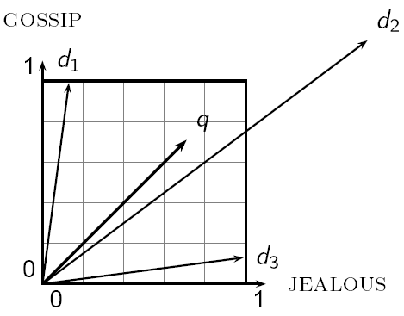
Why distance is a bad idea
Which document is closer using Euclidian distance?
Which do you think should be closer?

Slide 22
Issues with Euclidian distance
The Euclidean distance between q
and d₂ is large even though the
distribution of terms in the query q and the distribution of
terms in the document d₂ are
very similar.

Slide 23
Use angle instead of distance
Thought experiment: take a document d and append it to itself. Call this document d′
“Semantically” d and d′ have the same content
The Euclidean distance between the two documents can be quite large
The angle between the two documents is 0, corresponding to maximal similarity
Any other ideas?
Rank documents according to angle with query

Slide 24
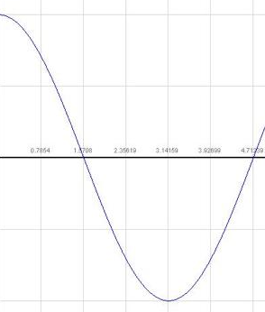
From angles to cosines
Cosine is a monotonically decreasing function for the interval [0º, 180º]
The following two notions are equivalent.
  Rank documents in decreasing order of the angle between query and document
  Rank documents in increasing order of cosine(query,document)

Slide 25
cosine(query,document)
How do we calculate the cosine between two vectors?

Slide 26
cosine(query,document)
Dot product
cos(q,d) is the cosine similarity of q and d … or,
equivalently, the cosine of the angle between q and d.

Slide 27
Some things to be careful of…
query
query
document
document
Need some notion of the length of a document

Slide 28
Length normalization
A vector can be (length-) normalized by dividing each of its components by its length – for this we use the L₂ norm:
Dividing a vector by its L₂ norm makes it a unit (length) vector
What is a “unit vector” or “unit length vector”?
Effect on the two documents d and d′ (d appended to itself) from earlier slide: they have identical vectors after length-normalization.

Slide 29
cosine(query,document)
Dot product
Unit vectors
cos(q,d) is the cosine similarity of q and d … or,
equivalently, the cosine of the angle between q and d.

Slide 30
Cosine similarity with 3 documents
How similar are
the novels:
SaS: Sense and
Sensibility
PaP: Pride and
Prejudice, and
WH: Wuthering
Heights?
term | SaS | PaP | WH
affection | 115 | 58 | 20
jealous | 10 | 7 | 11
gossip | 2 | 0 | 6
Term frequencies (counts)
Notes:
plot out vectors on the board

Slide 31
Some things to be careful of…
query
query
document
the the the
the the …
Need some notion of the importance of words

Slide 32
Term importance
Rare terms are more informative than frequent terms
  Recall stop words
Consider a term in the query that is rare in the collection (e.g., arachnocentric)
A document containing this term is very likely to be relevant to the query arachnocentric
→ We want a high weight for rare terms like arachnocentric
Ideas?

Slide 33
Document frequency
We will use document frequency (df) to capture this in the score
Terms that occur in many documents are weighted less, since overlapping with these terms is very likely
  In the extreme case, take a word like the that occurs in EVERY document
Terms that occur in only a few documents are weighted more

Slide 34
Collection vs. Document frequency
The collection frequency of t is the number of occurrences of t in the collection, counting multiple occurrences
Example:
Which word is a better search term (and should get a higher weight)?
Word | Collection frequency | Document frequency
insurance | 10440 | 3997
try | 10422 | 8760

Slide 35
Document frequency
How does “importance” or “informativeness” relate to document frequency?
Word | Collection frequency | Document frequency
insurance | 10440 | 3997
try | 10422 | 8760

Slide 36
Inverse document frequency
df_{t} is the document frequency of t: the number of documents that contain t
  df is a measure of the informativeness of t
We define the idf (inverse document frequency) of t by
We use log N/df_{t} instead of N/df_{t} to “dampen” the effect of idf

Slide 37
idf example, suppose N= 1 million
term | df_{t} | idf_{t}
calpurnia | 1 | 6
animal | 100 | 4
sunday | 1,000 | 3
fly | 10,000 | 2
under | 100,000 | 1
the | 1,000,000 | 0
There is one idf value for each term t in a collection.

Slide 38
idf example, suppose N= 1 million
term | df_{t} | idf_{t}
calpurnia | 1
animal | 100
sunday | 1,000
fly | 10,000
under | 100,000
the | 1,000,000
What if we didn’t use the log to dampen the weighting?

Slide 39
idf example, suppose N= 1 million
term | df_{t} | idf_{t}
calpurnia | 1 | 1,000,000
animal | 100 | 10,000
sunday | 1,000 | 1,000
fly | 10,000 | 100
under | 100,000 | 10
the | 1,000,000 | 1
What if we didn’t use the log to dampen the weighting?

Slide 40
Putting it all together
We have a notion of term frequency overlap
We have a notion of term importance
We have a similarity measure (cosine similarity)
Can we put all of these together?
  Define a weighting for each term
  The tf-idf weight of a term is the product of its tf weight and its idf weight

Slide 41
tf-idf weighting
Best known weighting scheme in information retrieval
Increases with the number of occurrences within a document
Increases with the rarity of the term in the collection
Works surprisingly well!
Works in many other application domains

Slide 42
Binary → count → weight matrix
Each document is now represented by a real-valued vector of tf-idf weights ∈ R^{|V|}
We then calculate the similarity using cosine similarity with these vectors

Slide 43
Burstiness
Take a rare word like arachnocentric
What is the likelihood that arachnocentric occurs in a document?
Given that you’ve seen it once, what is the likelihood that you’ll see it again?
Does this have any impact on our model?

Slide 44
Log-frequency weighting
Want to reduce the effect of multiple occurrences of a term
A document about “Clinton” will have “Clinton” occuring many times
Rather than use the frequency, us the log of the frequency
0 → 0, 1 → 1, 2 → 1.3, 10 → 2, 1000 → 4, etc.

Slide 45
Cosine similarity with 3 documents
How similar are
the novels:
SaS: Sense and
Sensibility
PaP: Pride and
Prejudice, and
WH: Wuthering
Heights?
term | SaS | PaP | WH
affection | 115 | 58 | 20
jealous | 10 | 7 | 11
gossip | 2 | 0 | 6
Term frequencies (counts)

Slide 46
3 documents example contd.
Log frequency weighting
After normalization
term | SaS | PaP | WH
affection | 3.06 | 2.76 | 2.30
jealous | 2.00 | 1.85 | 2.04
gossip | 1.30 | 0 | 1.78
wuthering | 0 | 0 | 2.58
term | SaS | PaP | WH
affection | 0.789 | 0.832 | 0.524
jealous | 0.515 | 0.555 | 0.465
gossip | 0.335 | 0 | 0.405
wuthering | 0 | 0 | 0.588
cos(SaS,PaP) ≈
0.789 ∗ 0.832 + 0.515 ∗ 0.555 + 0.335 ∗ 0.0 + 0.0 ∗ 0.0
≈ 0.94
cos(SaS,WH) ≈ 0.79
cos(PaP,WH) ≈ 0.69

Slide 47
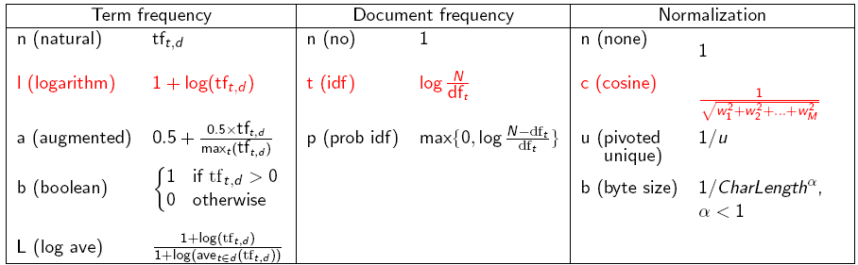
tf-idf weighting has many variants
Columns headed ‘n’ are acronyms for weight schemes.
Why is the base of the log in idf immaterial?

Slide 48
Weighting may differ in queries vs documents
Many search engines allow for different weightings for queries vs documents
To denote the combination in use in an engine, we use the notation qqq.ddd with the acronyms from the previous table
Example: ltn.ltc means:
Query: logarithmic tf (l in leftmost column), idf (t in second column), no normalization …
Document logarithmic tf, no idf and cosine normalization
Is this a bad idea?

Slide 49
tf-idf example: ltn.lnc
(log idf none . log none cosine)
Document: car insurance auto insurance
Query: best car insurance
Term | Query |  |  |  |  | Document |  |  | Prod
 | tf-raw | tf-wt | df | idf | wt | tf-raw | tf-wt | n’lized
auto | 0 | 0 | 5000 | 2.3 | 0 | 1
best | 1 | 1 | 50000 | 1.3 | 1.3 | 0
car | 1 | 1 | 10000 | 2.0 | 2.0 | 1
insurance | 1 | 1 | 1000 | 3.0 | 3.0 | 2
Doc length =

Slide 50
tf-idf example: ltn.lnc
Document: car insurance auto insurance
Query: best car insurance
Term | Query |  |  |  |  | Document |  |  | Prod
 | tf-raw | tf-wt | df | idf | wt | tf-raw | tf-wt | n’lized
auto | 0 | 0 | 5000 | 2.3 | 0 | 1 | 1 | 0.52 | 0
best | 1 | 1 | 50000 | 1.3 | 1.3 | 0 | 0 | 0 | 0
car | 1 | 1 | 10000 | 2.0 | 2.0 | 1 | 1 | 0.52 | 1.04
insurance | 1 | 1 | 1000 | 3.0 | 3.0 | 2 | 1.3 | 0.677 | 2.04
Doc length =
Score = 0+0+1.04+2.04 = 3.08

Slide 51
Summary – vector space ranking
Represent the query as a weighted tf-idf vector
Represent each document as a weighted tf-idf vector
Compute the cosine similarity score for the query vector and each document vector
Rank documents with respect to the query by score
Return the top K (e.g., K = 10) to the user

