Slide 1
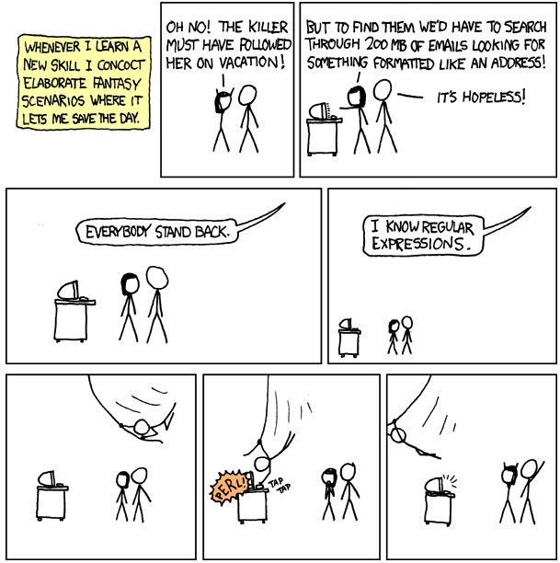
http://www.xkcd.com/208/

Slide 2
Online Advertising
David Kauchak
cs160
Fall 2009

Slide 3
Administrative
CS Lunch Friday Frank West
Jeremy Frank (class of 1990)
Project reports should be ~3 pages

Slide 4
SVN
Checkout the project
Run the following in your “src” directory of eclipse (though be careful not to overwrite your existing code!!!)
svn checkout https://svn.cs.pomona.edu/cs160-f09/search
refresh your eclipse project
“svn add” to add new files (added files won’t be added to the repository until you commit changes)
“svn update” gets the latest version
“svn diff” will get you the difference between your local file and the file(s) in the repository
No changes are made to the repository until you commit your changes using “svn commit”
Only after you’re sure that what you’re going to commit compiles and works, should you commit your changes
To get any of the data reading files with “DB” in the name, you’ll need to link in the mysql…jar file into your build path

Slide 5
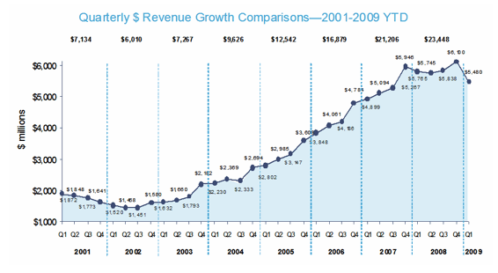
Online advertising $
http://www.iab.net/about_the_iab/recent_press_releases/press_release_archive/press_release/pr-060509

Slide 6
Where the $ comes from
http://www.informationweek.com/news/internet/reporting/showArticle.jhtml?articleID=207800456

Slide 7
3 major types of online ads
Banner ads
Keyword linked ads
Context linked ads

Slide 8
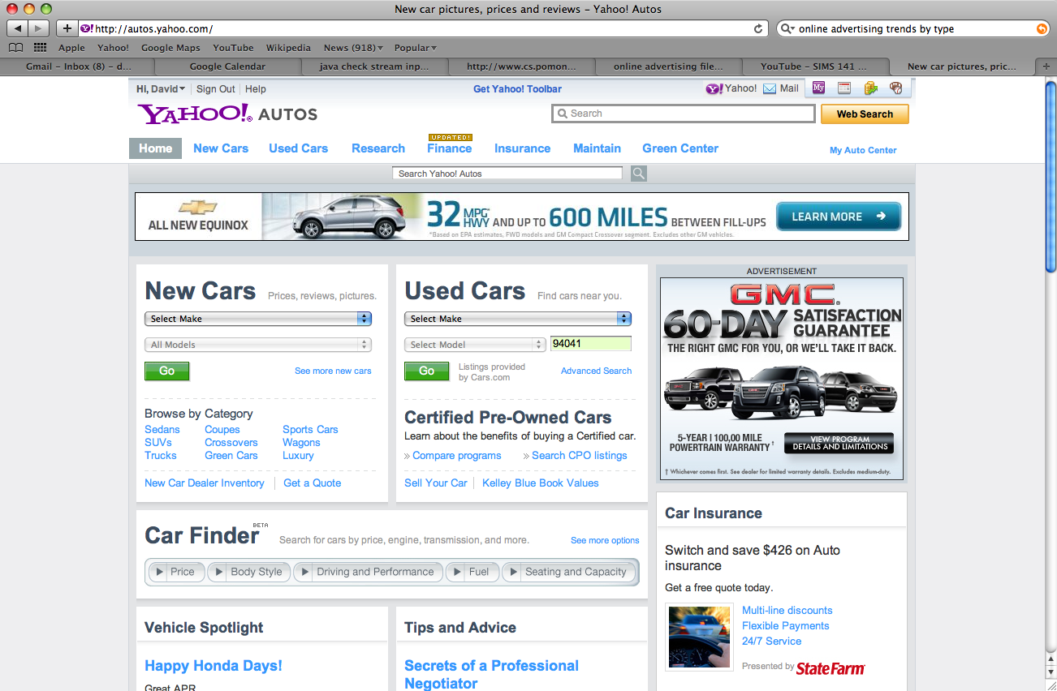
Banner ads
standardized set of sizes

Slide 9
Ad formats
Floating ad: An ad which moves across the user's screen or floats above the content.
Expanding ad: An ad which changes size and which may alter the contents of the webpage.
Polite ad: A method by which a large ad will be downloaded in smaller pieces to minimize the disruption of the content being viewed
Wallpaper ad: An ad which changes the background of the page being viewed.
Trick banner: A banner ad that looks like a dialog box with buttons. It simulates an error message or an alert.
Pop-up: A new window which opens in front of the current one, displaying an advertisement, or entire webpage.
Pop-under: Similar to a Pop-Up except that the window is loaded or sent behind the current window so that the user does not see it until they close one or more active windows.
Video ad: similar to a banner ad, except that instead of a static or animated image, actual moving video clips are displayed.
Map ad: text or graphics linked from, and appearing in or over, a location on an electronic map such as on Google Maps.
Mobile ad: an SMS text or multi-media message sent to a cell phone.
http://people.ischool.berkeley.edu/~hal/Courses/StratTech09/Lectures/Advertising/online-advertising.ppt

Slide 10
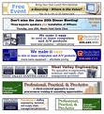
Components for display advertising
User
Ad server
Advertiser
Ad platform/exchange
Publisher

Slide 11
Banner ad process
Advertiser “purchases inventory”
directly from the publisher
from an ad exchange
to avoid the headache, publishers often sell inventory to an exchange
Specifies a price in CPM
cost per 1000 impressions
Specify max impressions
Advertiser
Publisher
Ad platform/exchange

Slide 12
Banner ad process
Advertiser uploads banners to banner server
Ad server
Advertiser

Slide 13
Banner ad process
User
Publisher
User visits a page with places for ads
Need to decide which ads to show

Slide 14
Banner ad process
Publisher
Ad platform/exchange
Ad server

Slide 15
What are the problems/inefficiencies with this process?
Pricing
Fairly static: difficult to change price regularly
variable pricing based on user, etc
cpm pricing doesn’t take into account clicks, revenue, etc.
User targeting
We’re only targeting users based on the site/page visited
What about a user that visits the same page everyday (e.g. nytimes)?
Banner creation is fairly static
situation specific banners

Slide 16
Current trends: user targeting
User
What information might we know about a user?
many of the sites a user has visited
cookies
everytime an ad is shown to a user, the ad is requested and we know which site the user is at
e.g. doubleclick cookie
Which ads the user has seen
Which ads the user has clicked on
Geographic information (via IP)
Demographic information (age, gender, profession, …)
Signed in to Yahoo, Hotmail, etc.
Day of week, time of day, part of the month
Lots of other information
How much money they make
Whether they’ve bought anything recently
Mortgage payment
Habits, etc.

Slide 17
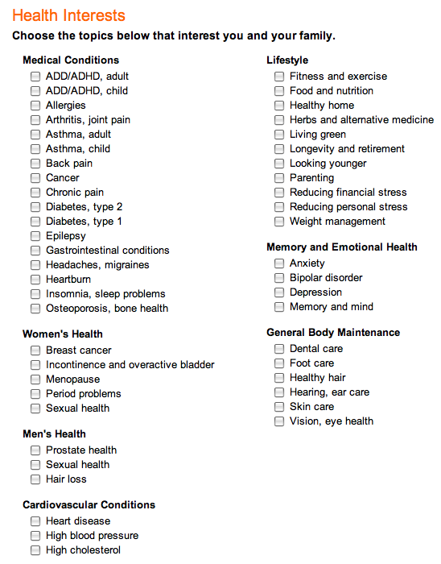
User targeting: RealAge
Calculate your “biological age” based on a questionaire
150 questions
27 million people have taken the test
Information is used for marketing purposes

Slide 18
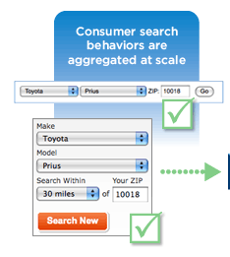
User targeting: data aggregation
Companies aggregate this data
Bluekai
Excelate

Slide 19
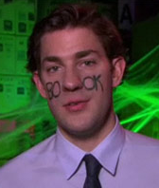
User targeting: Social networking sites
Sites like myspace and facebook have lots of information about users, users’ friends, etc
use content on a user’s page
use information about a user’s friends, e.g. purchases

Slide 20
User targeting: bottom line
On a per impression basis, we have lots of information about the user the ad will be shown to
User
age
gender
location
income
search history
number of ad views
…

Slide 21
Banner ad pricing
Advertising exchange
Auction-based system for purchasing ads
Auction happens roughly per impression
Auction targeting based on user characteristics
recent trend (last year or two)
$3 CPM for men, ages 20-25, CA NY FL from 12-5pm

Slide 22
Banner ad exchanges
Advertiser “uploads” bids to exchange
via spreadsheet
or programmatically
Specify targeting
Can also set thresholds on user views
Auction is performed by exchange
Downsides?
Advertiser
Ad platform/exchange

Slide 23
Ideal ad exchange: true auction
User
Publisher
age
gender
location
income
search history
number of ad views
…
Advertiser
Ad platform/exchange
bid($)

Slide 24
True auction: technical challenges
We need to make a decision quickly (on the order of a few hundred ms)
multiple advertisers
advertiser must make decision
network latency
perform auction
this happens millions of times a day
…

Slide 25
True auction: some first attempts
Doubleclick “callback”
specify a “bidder” based on some targeting specifications
bidder only bids on impressions that match criterion
bidder1
men, 20-25
Advertiser
Ad platform/exchange
bidder2
NY
bidder3
women, CA
bid($)

Slide 26
True auction: AppNexus
Ex-RightMedia folks
Initially, cloud computing
Advertiser runs a bidder server side
avoid network latency
auction is self-contained at the exchange
Requires framework on exchange side for security, speed, etc.

Slide 27
Pricing
Advertisers don’t care about CPM
CPC (cost per click)
CPA (cost per action)
RPM (revenue per impression)
Some work to move exchanges towards this
Challenge?
Need to estimate these from data
Data is very sparse ~1/1000 people click
Similar order of magnitude purchase (though depends on the space)

Slide 28
Paid search components
User
Advertiser
Ad platform/exchange
Publisher
Ad server

Slide 29
Paid search query
Ad platform/exchange
query
User
Publisher
Ad server

Slide 30
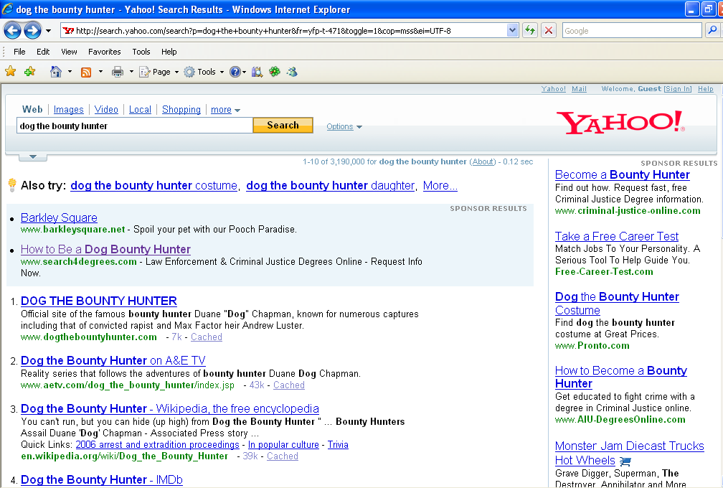

Slide 31
What is required of the advertiser?
Ad platform/exchange
Advertiser
Publisher
Ad server

Slide 32
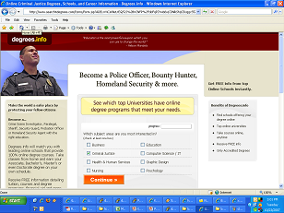
Advertiser
landing page
set of keywords
bids
$
ad copy

Slide 33
A bit more structure than this…
Advertiser
millions of keywords
<100K keywords
campaign1
…
<100 keywords
…
adgroup1
adgroup2
adgroup3
…
keyword1
keyword2

Slide 34
Adgroups
Adgroups are the key structure
Adcopy and landing pages are associated at the adcopy level
Keywords should be tightly themed
promotes targeting
makes google, yahoo, etc. happy

Slide 35
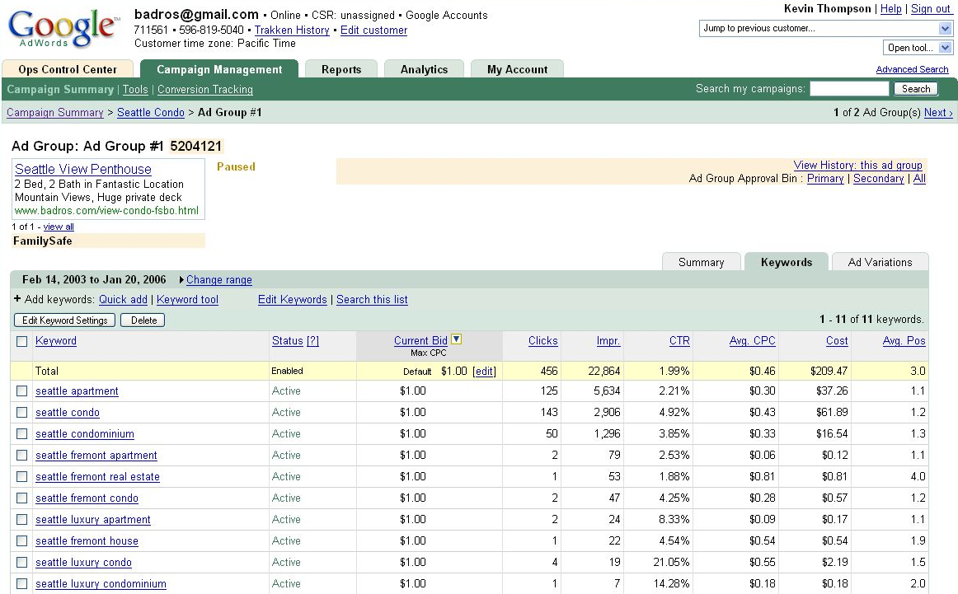
Creating an AdWords Ad

Slide 36
Behind the scenes
keywords
Advertiser
Ad platform/exchange
keywords
Publisher
Advertiser
Ad server
query
keywords
Advertiser

Slide 37
Behind the scenes
keywords
Advertiser
Ad platform/exchange
keywords
Publisher
Advertiser
?
Ad server
query
keywords
Advertiser
matching problem

Slide 38
Behind the scenes
Other data (site content, ad content, account, …)
For all the matches…
advertiser A
bid $
Search engine ad ranking
advertiser B
bid $
advertiser C
bid $

Slide 39
Behind the scenes: keyword auction
Other data (site content, ad content, account, …)
Site bids for keyword: “dog the bounty hunter”
Display ranking
Web site A
bid $
Web site B
Search engine ad ranking
Web site B
Web site A
bid $
Web site C
Web site C
bid $

Slide 40
Search ad ranking
Bids are CPC (cost per click)
How do you think Google determines ad ranking?
score = CPC * CTR * “quality score” * randomness
cost/clicks * clicks/impression = cost/impression
Is it a good web pages?
Good adcopy?
Adcopy related to keyword?
Enhances user experience, promoting return users
don’t want people reverse engineering the system
data gathering

Slide 41
1st price auction
Each bidder pays what they bid
Not used by search engines. Why?
Don’t work well for repeat auctions!
Bidder
value
Bid1
A
9
10
How would the bids change next time (assuming a blind auction)?
B
7
5

Slide 42
1st price auction
Each bidder pays what they bid
Not used by search engines. Why?
Don’t work well for repeat auctions!
Bidder
value
Bid1
Bid2
A
9
10
7
A is going to want to decrease it’s bid
B increase
B
7
5
6

Slide 43
1st price auction
Each bidder pays what they bid
Not used by search engines. Why?
Don’t work well for repeat auctions!
Bidder
value
Bid1
Bid2
Bid3
A
9
10
7
6
A decrease
B increase
B
7
5
6
7

Slide 44
1st price auction
Each bidder pays what they bid
Not used by search engines. Why?
Don’t work well for repeat auctions!
Bidder
value
Bid1
Bid2
Bid3
Bid4
A
9
10
7
6
8
B
7
5
6
7
7

Slide 45
1st price auction
Each bidder pays what they bid
Not used by search engines. Why?
Don’t work well for repeat auctions!
Bidder
value
Bid1
Bid2
Bid3
Bid4
Bid5
A
9
10
7
6
8
8
B
7
5
6
7
7
5

Slide 46
1st price auction
Each bidder pays what they bid
Not used by search engines. Why?
Don’t work well for repeat auctions!
In general, tend to end up with unstable bids in a “sawtooth” pattern
bid down when you’re winning
bid up to get back in first
bid back down

Slide 47
Auction system
2nd price auction
Winner pays one penny more than the 2nd place bid
Slightly complicated by modified scoring
Avoids sawtooth problem, but still not perfect
Bidder
Bid
Bidder
Price
A
10
A
5.01
B
5
B
1.01
C
1
C
1

Slide 48
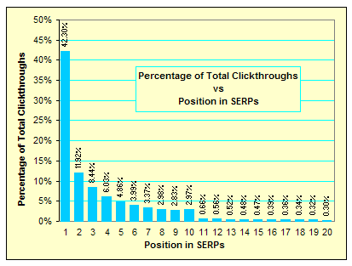
CTR with respect to position
Note, these are not CTRs, but relative CTRs
http://www.seo-blog.com/serps-position-and-clickthroughs.php

Slide 49
Predicted CTR
score = CPC * CTR * “quality score” * randomness
Any problem with using CTR of a keyword?
Zipf’s law: most keywords get very little traffic
CTRs are generally ~1-3%
Need a lot of impressions to accurately predict CTR
New advertisers, new adcopy, …
Major prediction task
machine learning
lots of features
share data within an advertiser and across advertisers

Slide 50
Factors affecting revenue for search engine
Monetization (RPM)
Revenue
Queries
=
Revenue
Clicks
Clicks
Queries
=
x
Revenue
Clicks
Queries w/ Ads
Queries
Ads
Queries w/ Ads
Clicks
Ads
=
x
x
x
=
x
CPC
Coverage
x
Depth
x
CTR per Ad
Price
Quantity
Quality
http://people.ischool.berkeley.edu/~hal/Courses/StratTech09/Lectures/Advertising/online-advertising.ppt

Slide 51
Increasing search engine revenue
Increase CPC (cost per click)
Increase conversion rate (i.e. post click performance)
Increase competition (higher bids)
Increase coverage and depth
More keywords
more keywords per advertiser (i.e. keyword tools)
more advertisers
More broadly matching keywords to queries
Increase CTR (click through rate)
Show more relevant ads in higher positions
Encourage high quality ads
Precise keyword/query matching

Slide 52
Advertiser margin
margin= revenue - cost
Revenue
Action
Actions
Impression
x
Impressions
- cost
=
x
Revenue
Action
Actions
Click
Clicks
Impression
Impressions
- cost
=
x
x
x
Revenue
Action
Actions
Click
Clicks
Impression
-
Cost
Click
=
x
x
x
Impressions
revenue per transaction
conversion rate
CTR
CPC

Slide 53
Increasing advertiser margin
Increase revenue per transaction
sales, marketing
increase price
Increase conversion rate (actions per click)
better landing page
better offers
cheaper price
more offers/options
Increase click through rate
better adcopy
Increase impressions
more keywords
Decrease cost per click
decrease bid
increase “quality score”
bid on less competitive keywords

Slide 54
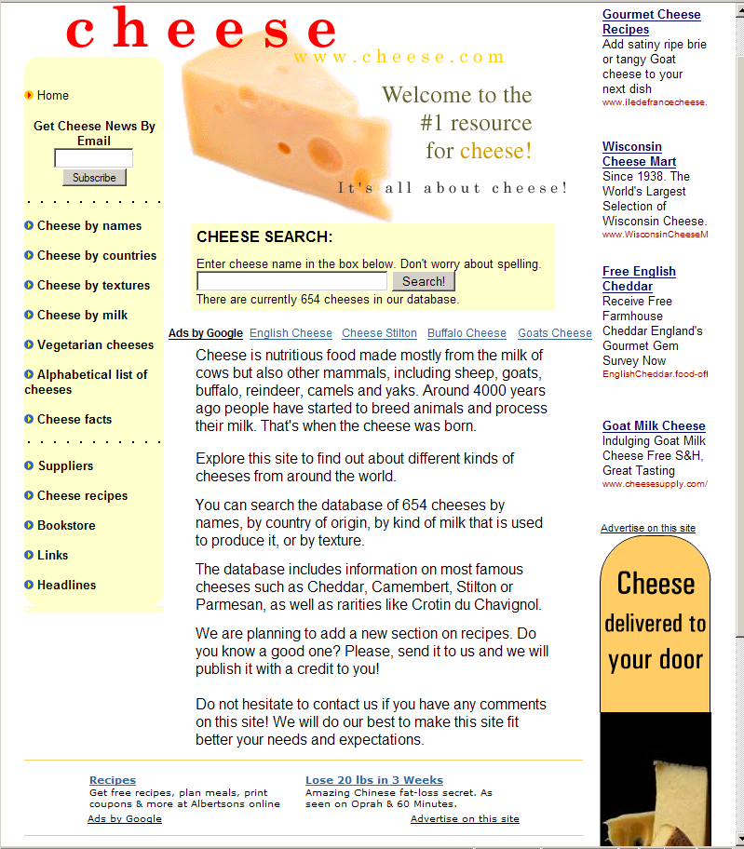
Contextual advertising

Slide 55
Contextual Advertising
Text ads on web pages
Uses similar technology and framework to search advertising
Advertiser supplies keywords, adgroups, adcopy, bids
Rather than match queries, match text on page
Some differences
A lot more text, so many more matches and multiple matches
Generally lower CTRs, lower conversion performance, adjustments made in payment
Easy way for search engines to expand revenue
Challenges
extracting “keywords” from a web page
be careful about matching. e.g. wouldn’t want to show a competitors ad

Slide 56
How the ads are served
function google_show_ad() {
var w = window;
w.google_ad_url = 'http://pagead2.googlesyndication.com/pagead/ads?' +
'&url=' + escape(w.google_page_url) +
'&hl=' + w.google_language;
document.write('<ifr' + 'ame' +
' width=' + w.google_ad_width +
' height=' + w.google_ad_height +
' scrolling=no></ifr' + 'ame>');
}
google_show_ad();
http://people.ischool.berkeley.edu/~hal/Courses/StratTech09/Lectures/Advertising/online-advertising.ppt

Slide 57
Lots of problems in online advertising
Display (banner ads)
Banners on the fly
User targeting
Predict performance based on user data
Tracking users
auctions
buyer strategy
auction holder policies
Banner/ad selection

Slide 58
Lots of problems in online advertising
Paid search
keyword generation
adgroup generation
keyword performance estimation
impressions/volume, CTR, conversion rate, rev.
adcopy generation
bid management
auction mechanisms
keyword/query matching

Slide 59
Lots of problems
Misc
Data analysis
What works well
Trends in the data
Anomalies
click fraud
scale (many of these things must happen fast!)
Landing page optimization

Slide 60
Typical CPMs in advertising
Outdoor: $1-5 CPM
Cable TV: $5-8 CPM
Radio: $8 CPM
Online
Display $5-30 CPM
Contextual: $1-$5 CPM
Search: $1 to $200 CPM
Network/Local TV: $20 CPM
Magazine: $10-30 CPM
Newspaper: $30-35 CPM
Direct Mail: $250 CPM
http://people.ischool.berkeley.edu/~hal/Courses/StratTech09/Lectures/Advertising/online-advertising.ppt

