Slide 1


http://ps3.kombo.com/images/content/news/blurb_valve_store_camiseta_portal_2008-730.jpges
Fireflies
http://www.youtube.com/watch?v=Y6ljFaKRTrI

Slide 2
Hierarchical Clustering
David Kauchak
cs160
Fall 2009
some slides adapted from:
http://www.stanford.edu/class/cs276/handouts/lecture17-clustering.ppt

Slide 3
Administrative
Project schedule
Ethics in IR lecture
  http://www.cs.pomona.edu/classes/cs160/ethics.html

Slide 4
Hierarchical Clustering
Recursive partitioning/merging of a data set
1−clustering
5
2−clustering
1
3−clustering
4
2
4−clustering
3
5−clustering
1 2 3 4 5

Slide 5
Dendogram
  Represents all partitionings of the data
  We can get a K clustering by looking at the connected components at any given level
  Frequently binary dendograms, but n-ary dendograms are generally easy to obtain with minor changes to the algorithms

Slide 6
Advantages of hierarchical clustering
Don’t need to specify the number of clusters
Good for data visualization
  See how the data points interact at many levels
  Can view the data at multiple levels of granularity
  Understand how all points interact
Specifies all of the K clusterings/partitions

Slide 7
Hierarchical Clustering
Common in many domains
  Biologists and social scientists
  Gene expression data
  Document/web page organization
    DMOZ
    Yahoo directories
Two main approaches…
animal
vertebrate
invertebrate
fish reptile amphib. mammal worm insect crustacean

Slide 8
Divisive hierarchical clustering
Finding the best partitioning of the data is generally exponential in time
Common approach:
  Let C be a set of clusters
  Initialize C to be the one-clustering of the data
  While there exists a cluster c in C
    remove c from C
    partition c into 2 clusters using a flat clustering algorithm, c₁ and c₂
    Add to c₁ and c₂ C
Bisecting k-means

Slide 9
Divisive clustering

Slide 10
Divisive clustering
start with one cluster

Slide 11
Divisive clustering
split using flat clustering

Slide 12
Divisive clustering

Slide 13
Divisive clustering
split using flat clustering

Slide 14
Divisive clustering
split using flat clustering

Slide 15
Divisive clustering
Note, there is a “temporal” component not seen here

Slide 16
Hierarchical Agglomerative Clustering (HAC)
Let C be a set of clusters
Initialize C to be all points/docs as separate clusters
While C contains more than one cluster
  find c₁ and c₂ in C that are closest together
  remove c₁ and c₂ from C
  merge c₁ and c₂ and add resulting cluster to C
The history of merging forms a binary tree or hierarchy
How do we measure the distance between clusters?

Slide 17
Distance between clusters
Single-link
  Similarity of the most similar (single-link)

Slide 18
Distance between clusters
Complete-link
  Similarity of the “furthest” points, the least similar
Why are these “local” methods used?
efficiency

Slide 19
Distance between clusters
Centroid
  Clusters whose centroids (centers of gravity) are the most similar

Slide 20
Distance between clusters
Centroid
  Clusters whose centroids (centers of gravity) are the most similar
Ward’s method
What does this do?

Slide 21
Distance between clusters
Centroid
  Clusters whose centroids (centers of gravity) are the most similar
Ward’s method
Encourages similar sized clusters

Slide 22
Distance between clusters
Average-link
  Average similarity between all pairs of elements

Slide 23
Single Link Example

Slide 24
Complete Link Example

Slide 25
Computational Complexity
For
  m dimensions
  n documents/points
How many iterations?
  n-1 iterations
First iteration
  Need to compute similarity of all pairs of n points/documents: O(n²m)
Remaining n−2 iterations
  compute the distance between the most recently created cluster and all other existing clusters: O(nm)
  Does depend on the cluster similarity approach
Overall run-time: O(n²m) – generally slower than flat clustering!

Slide 26
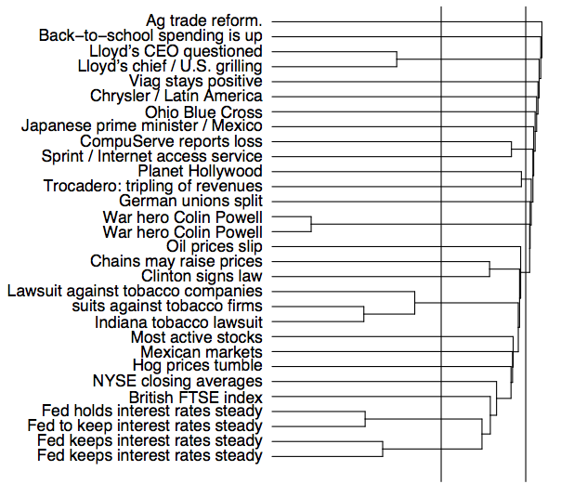
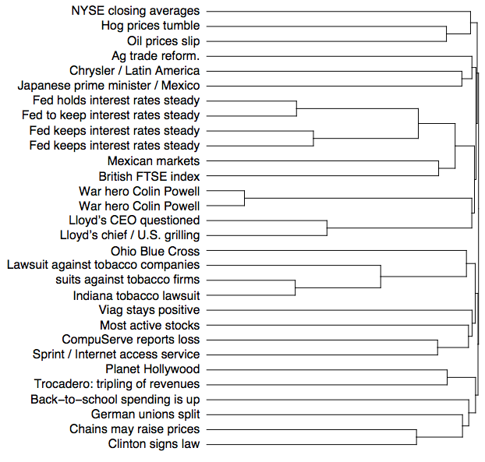
complete linkage
single linkage

Slide 27
Problems with hierarchical clustering

Slide 28
Problems with hierarchical clustering
Locally greedy: once a merge decision has been made it cannot be changed
Single-linkage: chaining effect
1 - jδ
…
…
1
2
3
j
j+1
n

Slide 29
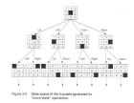
State space search approach
View hierarchical clustering problem as a state space search problem
Each hierarchical clustering represents a state
Goal is to find a state that minimizes some criterion function
Avoids problem of traditional greedy methods

Slide 30
Basic state space search algorithm
Start at some initial state
Repeat
  List all next states
  Evaluate all next states using some criterion function
  Pick choice based on some search method/criterion

Slide 31
State space search components
State space
  What is a state?
  How to move between states?
Search
  State criterion function
  Method to choose next state

Slide 32
State space
1
2
3
4
Each state is a hierarchical
clustering
n points
n –1 sub-clusters labeled with temporal component (i.e. split order or inverse merge order)
Huge state space!
A B C D E

Slide 33
Moving between states
Move should be:
  Simple/Straightforward
  Well motivated
  Traverse entire state space (state space complete)
Ideas?
2 options
  node swap
  node graft
Also include a temporal swap

Slide 34
Swap without temporal constraints, example 1
swap B and D
A B C D E
A D C B E
no change to the structure

Slide 35
Swap without temporal constraints, example 2
swap (D,E) and C
A B C D E
A B D E C
structure changed!

Slide 36
Swap with temporal constraints
Move split numbers with sub-clusters (nodes)
Some swap moves don’t result in legal hierarchies
1
2
3
What would be an illegal swap?
4
A B C D E

Slide 37
Swap with temporal constraints
Move split numbers with sub-clusters (nodes)
Some swap moves don’t result in legal hierarchies
The split number of the parent must be less than the split number of the child
1
4
3
cannot swap 2 and 4
2
D E C A B

Slide 38
Graft without temporal constraints
A B
D E C
D E C
A B D E C
D E C
A B

Slide 39
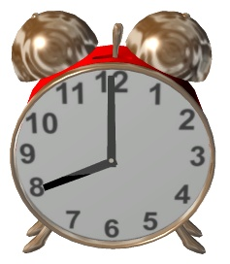
Graft with temporal constraints
Move split number with sub-cluster
Same as swap, only allow swaps that satisfy parent < child

Slide 40
Swap using grafts
Emulate:
swap (A,B) and (D,E)
A B C D E
C D E A B
D E C A B
graft (A,B)
graft (D,E)

Slide 41
Graft using swaps
Emulate: graft (A,B) to above (D,E)
A B C D E
A B D E C
C D E A B
swap sibling of one with other: swap C with (D,E)
swap C and (A,B,D,E)

Slide 42
Temporal swap
Must obey parent/child constraints
In general, could swap any two that satisfy constraints
Only consider adjacent numbers (i.e. 2, 3 or 3, 4)
1
1
2
3
3
2
4
4
A B C D E
A B C D E

Slide 43
Evaluating states
For a given k-clustering, the k-means criterion function is the squared difference between a point and it’s assigned center for all points and all centers

Slide 44
Leveraging k-means criterion
For a hierarchical clustering, calculate a weighted sum of the k-means criterion function for all n -1 clusterings represented by the hierarchy

Slide 45
Calculating criterion function
How long does it take to calculate k-means cost?
  O(nm)
How long then for the overall cost?
  n –1 clusterings: O(n²m)
We can do better!
  Using a few tricks… O(nm) time

Slide 46
How to pick the next state
Greedy: Pick best choice
ε-greedy: Pick best choice with probability ε, otherwise choose randomly
Soft-max: Choose option with probability
Simulated annealing: Vary parameters for above algorithms over time

Slide 47
Overall run-time ☹
List all next states
  How many next states are there?
    All combinations of n data points and n – 1 sub-clusters
    O(n²)
Evaluate all next states using criterion function
  O(nm)
Pick choice based on some search method/criterion
O(n³) per iteration

Slide 48
Bad case for single linkage
1 - jδ
…
…
1
2
3
j
j+1
n
Examined n = 8
Greedy method
Using simulated annealing
“best” was found 3 out of 10
Lowest criterion value is
“best” clustering (3304)
3469
d3 d2 d1 d6 d7 d8 d4 d5

Slide 49
SS-Hierarchical vs. Ward’s
Yeast gene expression data set
 | SS-Hierarchical Greedy, Ward’s initialize | Ward’s
20 points | 21.59 8 iterations | 21.99
100 points | 411.83 233 iterations | 444.15
500 points | 5276.30 ? iterations | 5570.95

Slide 50
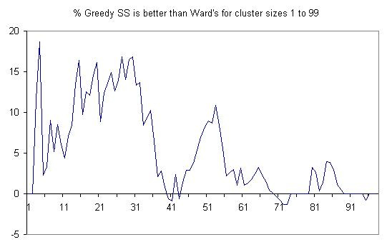
SS-Hierarchical vs. Ward’s:
Individual clusters

Slide 51
What Is A Good Clustering?
Internal criterion: A good clustering will produce high quality clusters in which:
  the intra-class (that is, intra-cluster) similarity is high
  the inter-class similarity is low
How would you evaluate clustering?

Slide 52
Common approach: use labeled data
Use data with known classes
  For example, document classification data
Measure how well the clustering algorithm reproduces class partitions
Purity, the proportion of the dominant class in the cluster
  Good for comparing two algorithms, but not understanding how well a single algorithm is doing, why?
    Increasing the number of clusters increases purity
Average entropy of classes in clusters
  for example, prefers 50/50 vs. 50/25/25

Slide 53
Purity example
• •
• •
• •
• •
• •
• •
• •
• •
•
Cluster I
Cluster II
Cluster III
Cluster I: Purity = 1/6 (max(5, 1, 0)) = 5/6
Cluster II: Purity = 1/6 (max(1, 4, 1)) = 4/6
Cluster III: Purity = 1/5 (max(2, 0, 3)) = 3/5

Slide 54
Googlenomics
http://www.wired.com/culture/culturereviews/magazine/17-06/nep_googlenomics
The article mentions the “quality score” as an important ingredient to the search. How is it important/useful?
What are the drawbacks to this algorithm?

