Slide 1
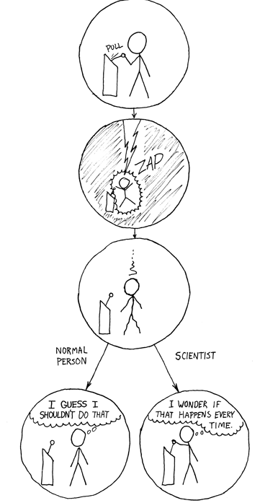
http://xkcd.com/242/

Slide 2
Text Classification 2
David Kauchak
cs160
Fall 2009
adapted from:
http://www.stanford.edu/class/cs276/handouts/lecture10-textcat-naivebayes.ppt
http://www.stanford.edu/class/cs276/handouts/lecture11-vector-classify.ppt
http://www.stanford.edu/class/cs276/handouts/lecture12-SVMs.ppt

Slide 3
Administrative
Image teams/GUI teams, let’s setup a meeting time
Project deadlines
hw6 out

Slide 4
Bias/Variance
Bias: How well does the model predict the training data?
  high bias – the model doesn’t do a good job of predicting the training data (high training set error)
  The model predictions are biased by the model
Variance: How sensitive to the training data is the learned model?
  high variance – changing the training data can drastically change the learned model

Slide 5
Bias/Variance
Another way to think about it is model complexity
Simple models
  may not model data well
  high bias
Complicated models
  may overfit to the training data
  high variance
Why do we care about bias/variance?

Slide 6
Bias/variance trade-off
We want to fit a polynomial to this, which one should we use?

Slide 7
Bias/variance trade-off
Bias: How well does the model predict the training data?
  high bias – the model doesn’t do a good job of predicting the training data (high training set error)
  The model predictions are biased by the model
Variance: How sensitive to the training data is the learned model?
  high variance – changing the training data can drastically change the learned model
High variance OR high bias?

Slide 8
Bias/variance trade-off
Bias: How well does the model predict the training data?
  high bias – the model doesn’t do a good job of predicting the training data (high training set error)
  The model predictions are biased by the model
Variance: How sensitive to the training data is the learned model?
  high variance – changing the training data can drastically change the learned model
High bias

Slide 9
Bias/variance trade-off
Bias: How well does the model predict the training data?
  high bias – the model doesn’t do a good job of predicting the training data (high training set error)
  The model predictions are biased by the model
Variance: How sensitive to the training data is the learned model?
  high variance – changing the training data can drastically change the learned model
High variance OR high bias?

Slide 10
Bias/variance trade-off
Bias: How well does the model predict the training data?
  high bias – the model doesn’t do a good job of predicting the training data (high training set error)
  The model predictions are biased by the model
Variance: How sensitive to the training data is the learned model?
  high variance – changing the training data can drastically change the learned model
High variance

Slide 11
Bias/variance trade-off
Bias: How well does the model predict the training data?
  high bias – the model doesn’t do a good job of predicting the training data (high training set error)
  The model predictions are biased by the model
Variance: How sensitive to the training data is the learned model?
  high variance – changing the training data can drastically change the learned model
What do we want?

Slide 12
Bias/variance trade-off
Bias: How well does the model predict the training data?
  high bias – the model doesn’t do a good job of predicting the training data (high training set error)
  The model predictions are biased by the model
Variance: How sensitive to the training data is the learned model?
  high variance – changing the training data can drastically change the learned model
Compromise between bias and variance

Slide 13
k-NN vs. Naive Bayes
How do k-NN and NB sit on the variance/bias plane?
k-NN has high variance and low bias.
  more complicated model
  can model any boundary
  but very dependent on the training data
NB has low variance and high bias.
  Decision surface has to be linear
  Cannot model all data
  but, less variation based on the training data
Notes:
Bias/variance in terms of resulting classifier given randomly selected training set; why it is a tradeoff; when to choose low-bias method, when to choose low-variance method

Slide 14
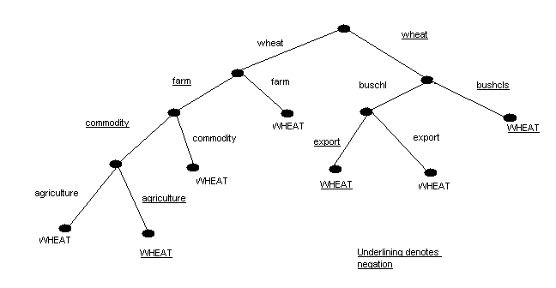
Decision trees
Tree with internal nodes labeled by terms/features
Branches are labeled by tests on the weight that the term has
  farm vs. not farm
  x > 100

Slide 15
Decision trees
Roots are labeled with the class

Slide 16
Decision trees
Classifier categorizes a document by descending tree following tests to leaf
The label of the leaf node is then assigned to the document

Slide 17
Decision trees
wheat, not(farm), commodity, not(agriculture)?

Slide 18
Decision trees
not(wheat), not(farm), commodity, export, buschi?

Slide 19
Decision trees
Most decision trees are binary trees
DT make good use of a few high-leverage features
Linear or non-linear classifier?

Slide 20
Decision Tree Learning
Learn a sequence of tests on features, typically using top-down, greedy search
  Choose the unused feature with highest Information Gain/mutual information with the class
When will this be large?

Slide 21
Decision Tree Learning
Measure of how much information two variables share
if p(c,f) is high when both p(c) and p(f) are high and vice versa, then high mutual information

Slide 22
Decision Tree Learning
Pick one feature at each step and split the tree
Eventually, stop splitting and calculate the probability for each class based on the training examples that satisfy the chain of constraints
Key challenge is when to stop splitting
f₁
!f₁
f₇
!f₇
P(class) = .9
P(class) = .6
P(class) = .2

Slide 23
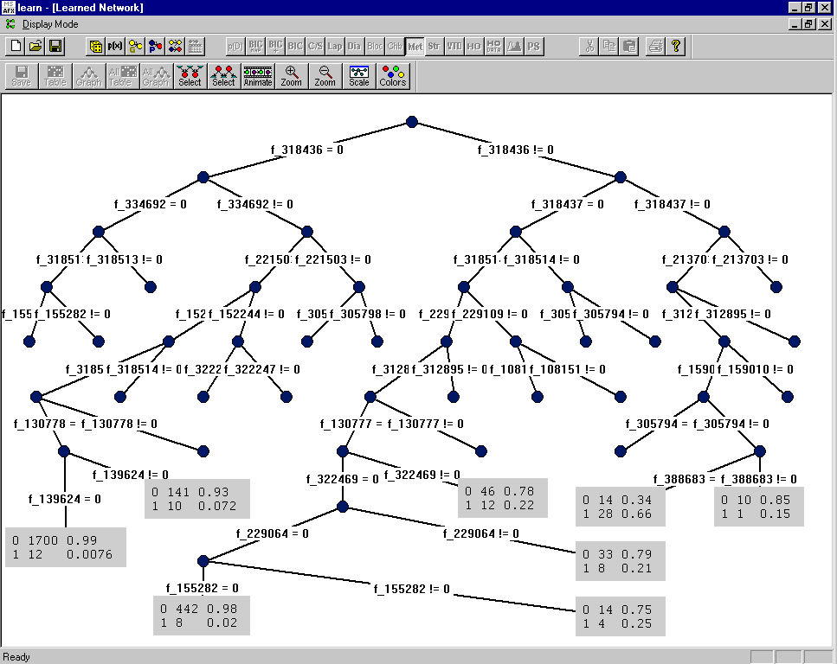
Category: “interest” – Dumais et al. (Microsoft) Decision Tree
rate=1
rate.t=1
lending=0
prime=0
discount=0
pct=1
year=0
year=1

Slide 24
Decision trees:
The good and the bad
Good
  Easy to understand/interpret (set of rules/decisions)
  Reasonable performance
  Non-linear decision boundary
Bad
  Pruning: when do we stop splitting (overfitting)
  Problems with large numbers of features/sparse data
  Doesn’t handle data with complex feature interactions well
  Not generally the best performing methods

Slide 25
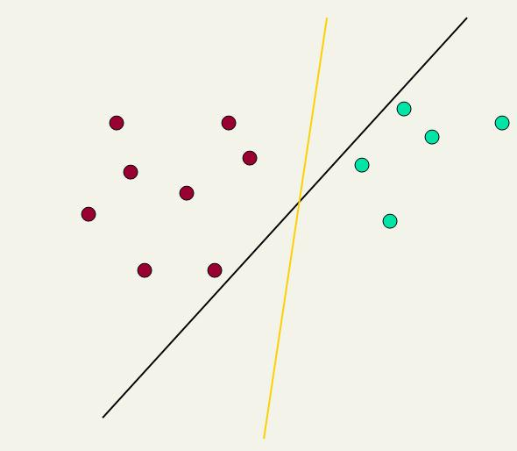
Linear classifiers: Which Hyperplane?
Lots of possible solutions for a,b,c.
Support Vector Machine (SVM) finds an optimal solution
  Maximizes the distance between the hyperplane and the “difficult points” close to decision boundary
This line represents the decision boundary:
ax + by - c = 0
15.0

Slide 26
Another intuition
If you have to place a fat separator between classes, you have less choices, and so the capacity of the model has been decreased

Slide 27
Support Vector Machine (SVM)
SVMs maximize the margin around the separating hyperplane.
    A.k.a. large margin classifiers
The decision function is fully specified by a subset of training samples, the support vectors.
Solving SVMs is a quadratic programming problem
Seen by many as the most successful current text classification method*
Support vectors
Maximize
margin
*but other discriminative methods often perform very similarly

Slide 28
Margin maximization

Slide 29
Margin maximization

Slide 30
Measuring the margin
What defines a hyperplane?

Slide 31
Measuring the margin
The support vectors define the hyperplane
and the margin
w
b

Slide 32
Measuring the margin
In an n-dimensional space, how can we represent this hyperplane?
w
b

Slide 33
Measuring the margin
An n dimensional normal vector, w
and?
Note that the vector is perpendicular to the actual hyperplane
w

Slide 34
Measuring the margin
An n dimensional vector, w and an offset, b
w
b

Slide 35
Measuring the margin
How do we classify points given this information?
w
b

Slide 36
Measuring the margin
f(x_{i}) = sign(w^{T}x_{i} + b)
w
b

Slide 37
Measuring the margin
How can we calculate margin?
ρ
w
b

Slide 38
Measuring the margin
Minimum of the distance from the hyperplane
to any point(s) (specifically the support vectors)
ρ
w
b

Slide 39
Measuring the margin
x’ – x is perpendicular to hyperplane
Want to calculate r
w/|w| is the unit vector in direction of w
x
ρ
x’ = x – rw/|w|
x’ satisfies w^{T}x’+b = 0 because it’s on w^{T}
r
x′
So w^{T}(x –rw/|w|) + b = 0
w^{T}x –w^{T}rw/|w| + b = 0
|w| = sqrt(w^{T}w)
w^{T}x –w^{T}rw|w|/|w||w| + b = 0
w^{T}x –w^{T}rw|w|/w^{T}w + b = 0
w^{T}x –r|w| + b = 0
w
b

Slide 40
Linear SVM Mathematically
The linearly separable case
Assume that all data is at least distance 1 from the hyperplane, then the following two constraints follow for a training set {(x_{i} ,y_{i})}
For support vectors, the inequality becomes an equality
Then, since each example’s distance from the hyperplane is
The margin is:
w^{T}x_{i} + b ≥ 1 if y_{i} = 1
w^{T}x_{i} + b ≤ -1 if y_{i} = -1

Slide 41
Linear SVMs Mathematically (cont.)
Then we can formulate the quadratic optimization problem:
A better formulation (min ||w|| = max 1/ ||w|| ):
Find w and b such that
is maximized; and for all {(x_{i} , y_{i})}
w^{T}x_{i} + b ≥ 1 if y_{i}=1; w^{T}x_{i} + b ≤ -1 if y_{i} = -1
Find w and b such that
Φ(w) = w^{T}w is minimized;
and for all {(x_{i} ,y_{i})}: y_{i} (w^{T}x_{i} + b) ≥ 1

Slide 42
Solving the Optimization Problem
This is now optimizing a quadratic function subject to linear constraints
Quadratic optimization problems are a well-known class of mathematical programming problem, and many (intricate) algorithms exist for solving them (with many special ones built for SVMs)
The solution involves constructing a dual problem where a Lagrange multiplier α_{i} is associated with every constraint in the primary problem:
Find w and b such that
Φ(w) = w^{T}w is minimized;
and for all {(x_{i} ,y_{i})}: y_{i} (w^{T}x_{i} + b) ≥ 1
Find α₁…α_{N} such that
Q(α) =Σα_{i} - ΣΣα_{i}α_{j}y_{i}y_{j}x_{i}^{T}x_{j} is maximized and
(1) Σα_{i}y_{i} = 0
(2) α_{i} ≥ 0 for all α_{i}

Slide 43
An LP example
400
300
200
100
100
200
300
400

Slide 44
An LP example
400
300
200
100
100
200
300
400
Where is the feasibility region?

Slide 45
An LP example
400
300
200
100
100
200
300
400

Slide 46
An LP example
400
300
c = 2100
200
c = 1800
c = 1500
100
c = 1200
c = 900
c = 600
100
200
300
400

Slide 47
An LP example
400
300
c = 2100
200
c = 1800
c = 1500
100
c = 1200
c = 900
c = 600
100
200
300
400
to maximize, move as far in this direction as the constraints allow

Slide 48
The Optimization Problem Solution
The solution has the form:
Each non-zero α_{i} indicates that corresponding x_{i} is a support vector.
Then the classifying function will have the form:
Notice that it relies on an inner product between the test point x and the support vectors x_{i} – we will return to this later.
Also keep in mind that solving the optimization problem involved computing the inner products x_{i}^{T}x_{j} between all pairs of training points.
w =Σα_{i}y_{i}x_{i} b= y_{k}- w^{T}x_{k} for any x_{k} such that α_{k}≠ 0
f(x) = Σα_{i}y_{i}x_{i}^{T}x + b

Slide 49
Soft Margin Classification
If the training data is not linearly separable, slack variables ξ_{i} can be added to allow misclassification of difficult or noisy examples.
Allow some errors
  Let some points be moved to where they belong, at a cost
Still, try to minimize training set errors, and to place hyperplane “far” from each class (large margin)
ξ_{i}
ξ_{j}

Slide 50
Soft Margin Classification Mathematically
The old formulation:
The new formulation incorporating slack variables:
Parameter C can be viewed as a way to control overfitting – a regularization term
Find w and b such that
Φ(w) =½ w^{T}w is minimized and for all {(x_{i} ,y_{i})}
y_{i} (w^{T}x_{i} + b) ≥ 1
Find w and b such that
Φ(w) =½ w^{T}w + CΣξ_{i} is minimized and for all {(x_{i} ,y_{i})}
y_{i} (w^{T}x_{i} + b) ≥ 1- ξ_{i} and ξ_{i} ≥ 0 for all i

Slide 51
Linear SVMs: Summary
The classifier is a separating hyperplane.
Most “important” training points are support vectors; they define the hyperplane.
Quadratic optimization algorithms can identify which training points x_{i} are support vectors with non-zero Lagrangian multipliers α_{i}.
Both in the dual formulation of the problem and in the solution training points appear only inside inner products:
Find α₁…α_{N} such that
Q(α) =Σα_{i} - ½ΣΣα_{i}α_{j}y_{i}y_{j}x_{i}^{T}x_{j} is maximized and
(1) Σα_{i}y_{i} = 0
(2) 0 ≤ α_{i} ≤ C for all α_{i}
f(x) = Σα_{i}y_{i}x_{i}^{T}x + b

Slide 52
Non-linear SVMs
Datasets that are linearly separable (with some noise) work out great:
But what are we going to do if the dataset is just too hard?
How about … mapping data to a higher-dimensional space:
0
x
0
x
x²
0
x

Slide 53
Non-linear SVMs: Feature spaces
General idea: the original feature space can always be mapped to some higher-dimensional feature space where the training set is separable:
Φ: x → φ(x)

Slide 54
The “Kernel Trick”
The linear classifier relies on an inner product between vectors K(x_{i},x_{j})=x_{i}^{T}x_{j}
If every datapoint is mapped into high-dimensional space via some transformation Φ: x → φ(x), the inner product becomes:
K(x_{i},x_{j})= φ(x_{i}) ^{T}φ(x_{j})
A kernel function is some function that corresponds to an inner product in some expanded feature space.

Slide 55

Kernels
Why use kernels?
  Make non-separable problem separable.
  Map data into better representational space
Common kernels
  Linear
  Polynomial K(x,z) = (1+x^{T}z)^{d}
    Gives feature conjunctions
  Radial basis function (infinite dimensional space)
Haven’t been very useful in text classification

Slide 56
Evaluation:
Micro- vs. Macro-Averaging
If we have more than one class, how do we combine multiple performance measures into one quantity?
  Macroaveraging: Compute performance for each class, then average
  Microaveraging: Collect decisions for all classes, compute contingency table, evaluate
Benefits and drawbacks?

Slide 57
Which classifier do I use for a given text classification problem?
Is there a learning method that is optimal for all text classification problems?
No, because there is a tradeoff between bias and variance
Factors to take into account:
  How much training data is available?
  How simple/complex is the problem? (linear vs. nonlinear decision boundary)
  How noisy is the problem?
  How stable is the problem over time?
    For an unstable problem, it’s better to use a simple and robust classifier.

Slide 58
Manually written rules
No training data, adequate editorial staff?
Never forget the hand-written rules solution!
  If (wheat or grain) and not (whole or bread) then
    Categorize as grain
In practice, rules get a lot bigger than this
  Can also be phrased using tf or tf.idf weights
With careful crafting (human tuning on development data) performance is high:
  Construe: 94% recall, 84% precision over 675 categories (Hayes and Weinstein 1990)
Amount of work required is huge
  Estimate 2 days per class … plus maintenance

Slide 59
Very little data?
If you’re just doing supervised classification, you should stick to something with high bias
  There are theoretical results that Naïve Bayes should do well in such circumstances (Ng and Jordan 2002 NIPS)
The interesting theoretical answer is to explore semi-supervised training methods:
  Bootstrapping, EM over unlabeled documents, …
The practical answer is to get more labeled data as soon as you can
  How can you insert yourself into a process where humans will be willing to label data for you??

Slide 60
A reasonable amount of data?
We can use any number of different classifiers
Roll out the SVM!
But if you are using an SVM/NB etc., you should probably be prepared with the “hybrid” solution where there is a Boolean overlay
  Or else to use user-interpretable Boolean-like models like decision trees
  Users like to hack, and management likes to be able to implement quick fixes immediately

Slide 61
A huge amount of data?
This is great in theory for doing accurate classification…
But it could easily mean that expensive methods like SVMs (train time) or kNN (test time) are quite impractical
Naïve Bayes can come back into its own again!
  Or other advanced methods with linear training/test complexity like regularized logistic regression (though much more expensive to train)
When you have lots of data, simple things work well!

Slide 62
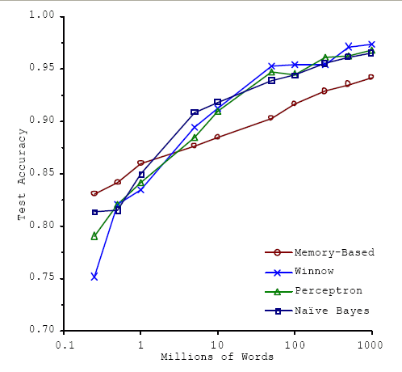
A huge amount of data?
With enough data the choice of classifier may not matter much, and the best choice may be unclear
  Data: Brill and Banko on context-sensitive spelling correction
But the fact that you have to keep doubling your data to improve performance is a little unpleasant

Slide 63
The Real World
P. Jackson and I. Moulinier: Natural Language Processing for Online Applications
“There is no question concerning the commercial value of being able to classify documents automatically by content. There are myriad potential applications of such a capability for corporate Intranets, government departments, and Internet publishers”
“Understanding the data is one of the keys to successful categorization, yet this is an area in which most categorization tool vendors are extremely weak. Many of the ‘one size fits all’ tools on the market have not been tested on a wide range of content types.”

Slide 64
Does putting in “hacks” help?
You can get a lot of value by differentially weighting contributions from different document zones:
  Upweighting title words helps (Cohen & Singer 1996)
    Doubling the weighting on the title words is a good rule of thumb
  Upweighting the first sentence of each paragraph helps (Murata, 1999)
  Upweighting sentences that contain title words helps (Ko et al, 2002)

Slide 65
Does stemming/lowercasing/… help?
As always it’s hard to tell, and empirical evaluation is normally the gold standard
But note that the role of tools like stemming is rather different for TextCat vs. IR:
  For IR, you often want to collapse forms of the verb oxygenate and oxygenation, since all of those documents will be relevant to a query for oxygenation
  For TextCat, with sufficient training data, stemming does no good. It only helps in compensating for data sparseness (which can be severe in TextCat applications). Overly aggressive stemming can easily degrade performance.

Slide 66
References
IIR 14
Fabrizio Sebastiani. Machine Learning in Automated Text Categorization. ACM Computing Surveys, 34(1):1-47, 2002.
Tom Mitchell, Machine Learning. McGraw-Hill, 1997.
Yiming Yang & Xin Liu, A re-examination of text categorization methods. Proceedings of SIGIR, 1999.
Evaluating and Optimizing Autonomous Text Classification Systems (1995) David Lewis. Proceedings of the 18th Annual International ACM SIGIR Conference on Research and Development in Information Retrieval
Trevor Hastie, Robert Tibshirani and Jerome Friedman, Elements of Statistical Learning: Data Mining, Inference and Prediction. Springer-Verlag, New York.
Open Calais: Automatic Semantic Tagging
  Free (but they can keep your data), provided by Thompson/Reuters
Weka: A data mining software package that includes an implementation of many ML algorithms

