Slide 1
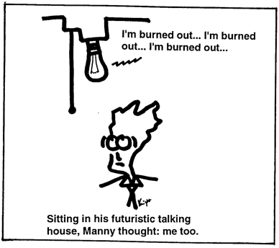
http://www.isi.edu/natural-language/people/knight3.html

Slide 2
Text Classification
David Kauchak
cs160
Fall 2009
adapted from:
http://www.stanford.edu/class/cs276/handouts/lecture10-textcat-naivebayes.ppt
http://www.stanford.edu/class/cs276/handouts/lecture11-vector-classify.ppt
http://www.stanford.edu/class/cs276/handouts/lecture12-SVMs.ppt

Slide 3
Administrative
Colloquium
Project proposals
  year and where published for references
  speed is important for most of your approaches
Project status report due 11/18
  be specific!
  but, be concise

Slide 4
Document Classification
“planning
language
proof
intelligence”
Test
Data:
(AI)
(Programming)
(HCI)
Classes:
ML
Planning
Semantics
Garb.Coll.
Multimedia
GUI
Training
Data:
learning
intelligence
algorithm
reinforcement
network...
planning
temporal
reasoning
plan
language...
programming
semantics
language
proof...
garbage
collection
memory
optimization
region...
...
...

Slide 5
How might this be useful for IR?

Slide 6
Standing queries
The path from information retrieval to text classification:
  You have an information need, say:
    Unrest in the Niger delta region
  You want to rerun an appropriate query periodically to find new news items on this topic
  You will be sent new documents that are found
    I.e., it’s classification not ranking
Such queries are called standing queries
  Long used by “information professionals”
  A modern mass instantiation is Google Alerts

Slide 7
Spam filtering
From: "" <takworlld@hotmail.com>
Subject: real estate is the only way... gem oalvgkay
Anyone can buy real estate with no money down
Stop paying rent TODAY !
There is no need to spend hundreds or even thousands for similar courses
I am 22 years old and I have already purchased 6 properties using the
methods outlined in this truly INCREDIBLE ebook.
Change your life NOW !
=================================================
Click Below to order:
http://www.wholesaledaily.com/sales/nmd.htm
=================================================

Slide 8
More Text Classification Examples:
Many search engine functionalities use classification
Assign labels to each document or web-page:
Labels are most often topics such as Yahoo-categories
e.g., "finance," "sports," "news>world>asia>business"
Labels may be genres
e.g., "editorials" "movie-reviews" "news“
Labels may be opinion on a person/product
e.g., “like”, “hate”, “neutral”
Labels may be domain-specific
e.g., "interesting-to-me" : "not-interesting-to-me”
e.g., “contains adult language” : “doesn’t”
e.g., language identification: English, French, Chinese, …
e.g., search vertical: about Linux versus not
e.g., “link spam” : “not link spam”

Slide 9
How would you do it?
…
Pros and cons of different approaches?

Slide 10
Manual approach
Manual classification
  Used by Yahoo! (originally; now present but downplayed), Looksmart, about.com, ODP, PubMed
  Very accurate when job is done by experts
  Consistent when the problem size and team is small
  Difficult and expensive to scale
    Means we need automatic classification methods for big problems

Slide 11
A slightly better manual approach
Hand-coded rule-based systems
  One technique used by many spam filter, Reuters, CIA, etc.
  Companies (Verity) provide “IDE” for writing such rules
  E.g., assign category if document contains a given boolean combination of words
  Accuracy is often very high if a rule has been carefully refined over time by a subject expert
  Building and maintaining these rules is expensive

Slide 12
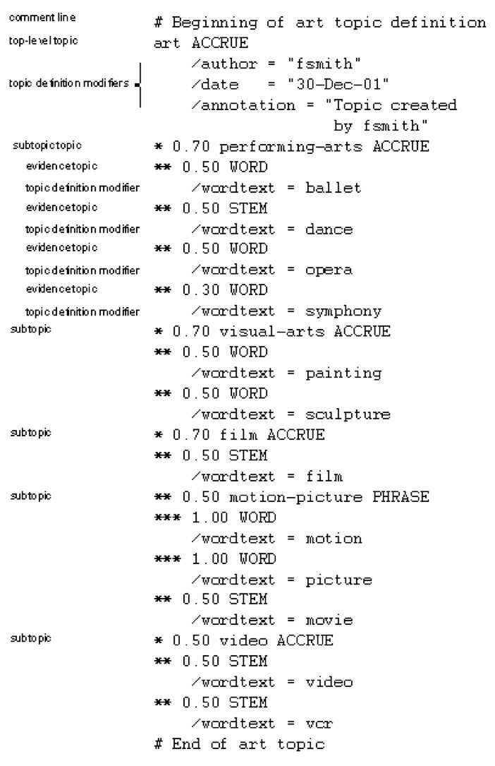
A Verity topic (a complex classification rule)
Note:
  maintenance issues (author, etc.)
  Hand-weighting of terms

Slide 13
Automated approaches
Supervised learning of a document-label assignment function
  Many systems partly rely on machine learning (Autonomy, MSN, Verity, Enkata, Yahoo!, …)
    k-Nearest Neighbors (simple, powerful)
    Naive Bayes (simple, common method)
    Support-vector machines (new, more powerful)
    … plus many other methods
    No free lunch: requires hand-classified training data
Note that many commercial systems use a mixture of methods

Slide 14
Bayes’ Rule
How can we use this?

Slide 15
Bayes’ Rule
conditional
probability
prior
probability

Slide 16
Naive Bayes Classifiers
Represent a document D based on a attribute values

Slide 17
The Naive Bayes Classifier
Flu
x₁
x₂
x₃
x₄
x₅
runnynose
sinus
cough
fever
muscle-ache
Conditional Independence Assumption: features detect term presence and are independent of each other given the class:

Slide 18
Estimating parameters
I flip a coin 1000 times, how would you estimate the probability of heads?
I roll a 6-sided die 1000 times, how you estimate the probability of getting a ‘6’?
For us:
Ideas?

Slide 19
Maximum likelihood estimates
number of document with class
total number of document
number of document in class with feature
number of document with class
What’s the problem with this approach?

Slide 20
Problem with Max Likelihood
What if we have seen no training cases where patient had no flu and muscle aches?
Zero probabilities cannot be conditioned away, no matter the other evidence!

Slide 21
Smoothing to Avoid Overfitting
Make every event a little probable…
# of values of X_{i}

Slide 22
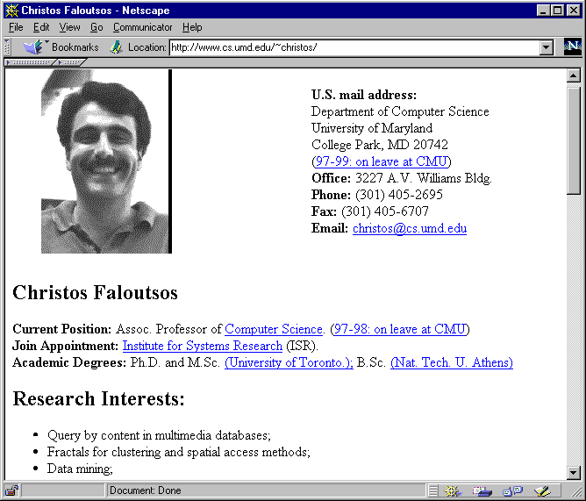
WebKB Experiment (1998)
Classify webpages from CS departments into:
  student, faculty, course,project
Train on ~5,000 hand-labeled web pages
  Cornell, Washington, U.Texas, Wisconsin
Crawl and classify a new site (CMU)
Results:

Slide 23
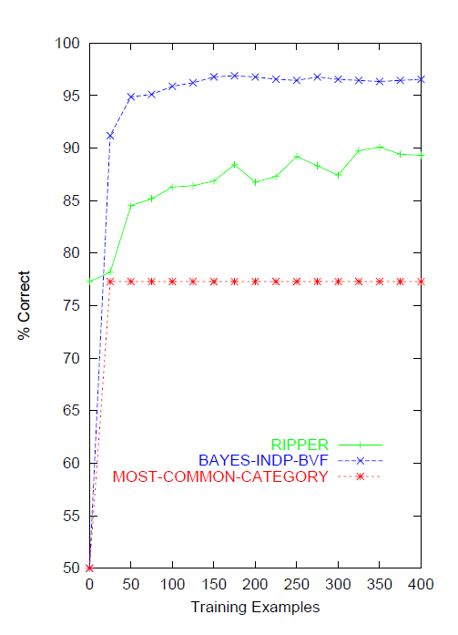
Naive Bayes on spam email
http://www.cnbc.cmu.edu/~jp/research/email.paper.pdf
Notes:
This graph is from
http://www.cs.utexas.edu/users/jp/research/email.paper.pdf
Naive-Bayes vs. Rule-Learning in Classification of Email
Jefferson Provost, UT Austin

Slide 24
SpamAssassin
Naive Bayes has found a home in spam filtering
  Paul Graham’s A Plan for Spam
    A mutant with more mutant offspring...
  Naive Bayes-like classifier with weird parameter estimation
  Widely used in spam filters
  But also many other things: black hole lists, etc.
Many email topic filters also use NB classifiers

Slide 25
NB: The good and the bad
Good
  Easy to understand
  Fast to train
  Reasonable performance
Bad
  We can do better
  Independence assumptions are rarely true
  Smoothing is challenging
  Feature selection is usually required

Slide 26
Recall: Vector Space Representation
Each document is a vector, one component for each term/word
Normally normalize vectors to unit length
High-dimensional vector space:
  Terms are axes
  10,000+ dimensions, or even 100,000+
  Docs are vectors in this space
How can we do classification in this space?

Slide 27
Documents in a Vector Space
Government
Science
Arts

Slide 28
Test Document of what class?
Government
Science
Arts

Slide 29
Test Document = Government
Government
Science
Arts

Slide 30
k-Nearest Neighbor (k-NN)
To classify document d:
  Find k nearest neighbors of d
  Choose as the class the majority class within the k nearest neightbors
Can get rough approximations of probability of belonging to a class as fraction of k
Does not explicitly compute boundary or model
Also called:
  Case-based learning
  Memory-based learning
  Lazy learning

Slide 31
Example: k=6 (6-NN)
Government
Science
Arts

Slide 32
k Nearest Neighbor
What value of k should we use?
  Using only the closest example (1NN) to determine the class is subject to errors due to:
    A single atypical example
    Noise
  Pick k too large and you end up with looking at neighbors that are not that close
  Value of k is typically odd to avoid ties; 3 and 5 are most common.

Slide 33
k-NN decision boundaries
Government
Science
Arts
k-NN gives locally defined decision boundaries between
classes – far away points do not influence each classification
decision (unlike in Naïve Bayes, etc.)

Slide 34
Similarity Metrics
Nearest neighbor methods depends on a similarity (or distance) metric
  Euclidean distance.
  Binary instance space is Hamming distance (number of feature values that differ)
  For text, cosine similarity of tf.idf weighted vectors is typically most effective

Slide 35
k-NN: The good and the bad
Good
  No training is necessary
  No feature selection necessary
  Scales well with large number of classes
    Don’t need to train n classifiers for n classes
Bad
  Classes can influence each other
    Small changes to one class can have ripple effect
  Scores can be hard to convert to probabilities
  Can be more expensive at test time
  “Model” is all of your training examples which can be large

Slide 36
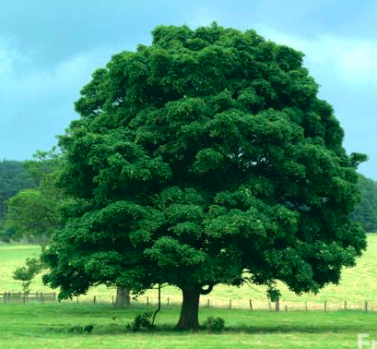
Bias/variance trade-off
Is this a tree?

Slide 37

Bias/variance trade-off
Is this a tree?

Slide 38
Bias/variance trade-off
Is this a tree?

Slide 39
Bias/variance trade-off
Is this a tree?

Slide 40
Bias vs. variance
Another way to think about it:
  Generalizability vs. Precision
Consider asking a botanist: Is an object a tree?
  High variance, low bias
    Botanist who memorizes
    Will always say “no” to new object (e.g., different # of leaves)
  Low variance, high bias
    Lazy botanist
    Says “yes” if the object is green
  You want the middle ground
        (Example due to C. Burges)
Notes:
Bias/variance in terms of resulting classifier given randomly selected training set; why it is a tradeoff; when to choose low-bias method, when to choose low-variance method

Slide 41
k-NN vs. Naive Bayes
How do k-NN and NB sit on the variance/bias plane?
k-NN has high variance and low bias.
  Infinite memory
NB has low variance and high bias.
  Decision surface has to be linear (hyperplane – see later)
Notes:
Bias/variance in terms of resulting classifier given randomly selected training set; why it is a tradeoff; when to choose low-bias method, when to choose low-variance method

Slide 42
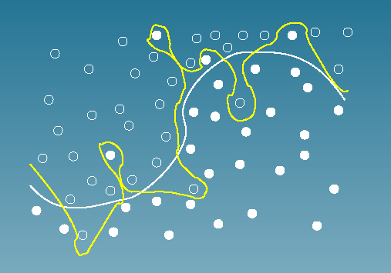
Bias vs. variance:
Choosing the correct model capacity
Which separating line should we use?

Slide 43
Separation by Hyperplanes
A strong high-bias assumption is linear separability:
  in 2 dimensions, can separate classes by a line
  in higher dimensions, need hyperplanes

Slide 44
Lots of linear classifiers
Many common text classifiers are linear classifiers
  Naïve Bayes
  Perceptron
  Rocchio
  Logistic regression
  Support vector machines (with linear kernel)
  Linear regression
Despite this similarity, noticeable performance difference
How might algorithms differ?

Slide 45
Which Hyperplane?
lots of possible solutions

Slide 46
Which Hyperplane?
lots of possible solutions

Slide 47
Which examples are important?

Slide 48
Which examples are important?

Slide 49
Which examples are important?

Slide 50
Dealing with noise
linearly separable?

Slide 51
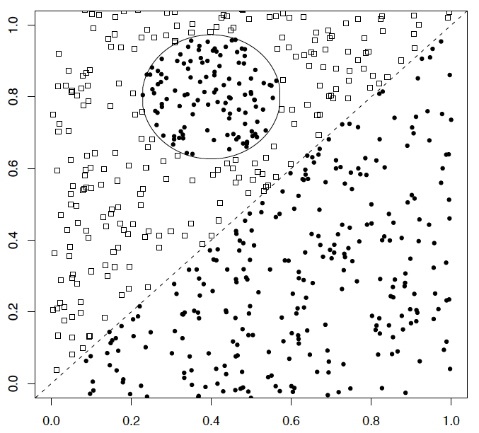
A nonlinear problem
A linear classifier like Naïve Bayes does badly on this task
k-NN will do very well (assuming enough training data)

Slide 52
A nonlinear problem
For text applications non-linear methods often do not perform better than linear
Why not?

Slide 53
High Dimensional Data
Pictures like we’ve seen are misleading!
Documents are zero along almost all axes
Most document pairs are very far apart (i.e., not strictly orthogonal, but only share very common words and a few scattered others)
In classification terms: often document sets are separable, for most any classification
This is part of why linear classifiers are quite successful in this domain

Slide 54
Dealing with multiple classes
Scenarios
  Document can belong to zero or more classes
  Document must belong to exactly one class
How can we do this?

Slide 55
Set of Binary Classifiers
Build a separator between each class and its complementary set (docs from all other classes).

Slide 56
Set of Binary Classifiers
Build a separator between each class and its complementary set (docs from all other classes).
Red binary classifier
positive
negative

Slide 57
Set of Binary Classifiers
Build a separator between each class and its complementary set (docs from all other classes).
positive
Green binary classifier
negative

Slide 58
Set of Binary Classifiers
Given a test doc, evaluate it for membership in each class with each binary classifier
Assign document to class with:
  maximum score
  maximum confidence
  maximum probability
  threshold of the above
Why different from multiclass/ any of classification?
?
?
?

