Slide 1

http://www.phdcomics.com/comics.php

Slide 2
Information Extraction
David Kauchak
cs160
Fall 2009
some content adapted from:
http://www.cs.cmu.edu/~knigam/15-505/ie-lecture.ppt

Slide 3
Administrative
Colloquium tomorrow (substitute class)
  Thursday, 4:15pm in Rose Hill Theater
  Make-up assignment

Slide 4
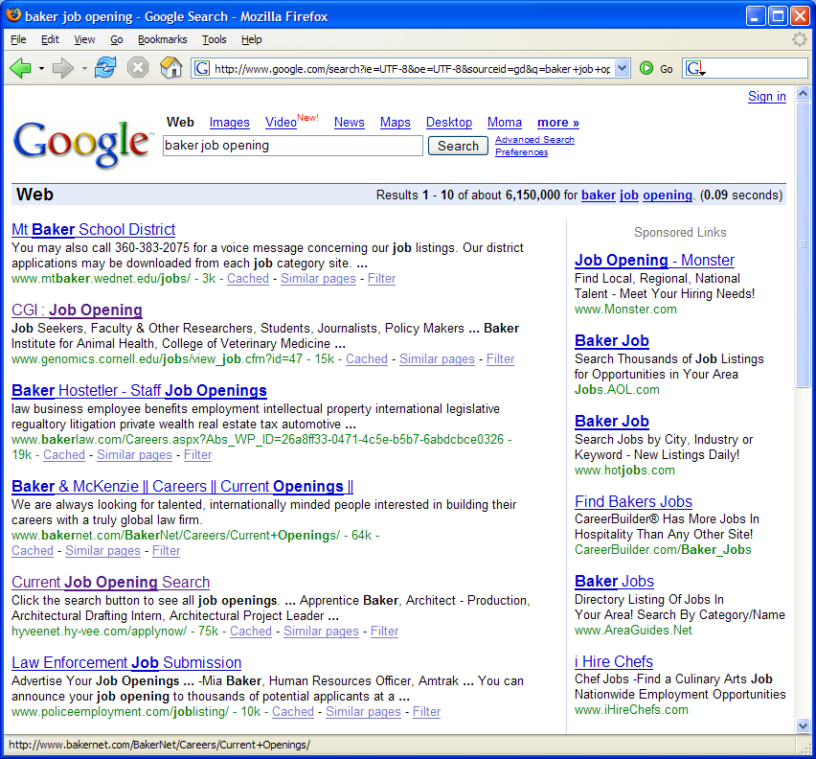
A problem
Mt. Baker, the school district
Baker Hostetler, the company
Baker, a job opening
Genomics job

Slide 5
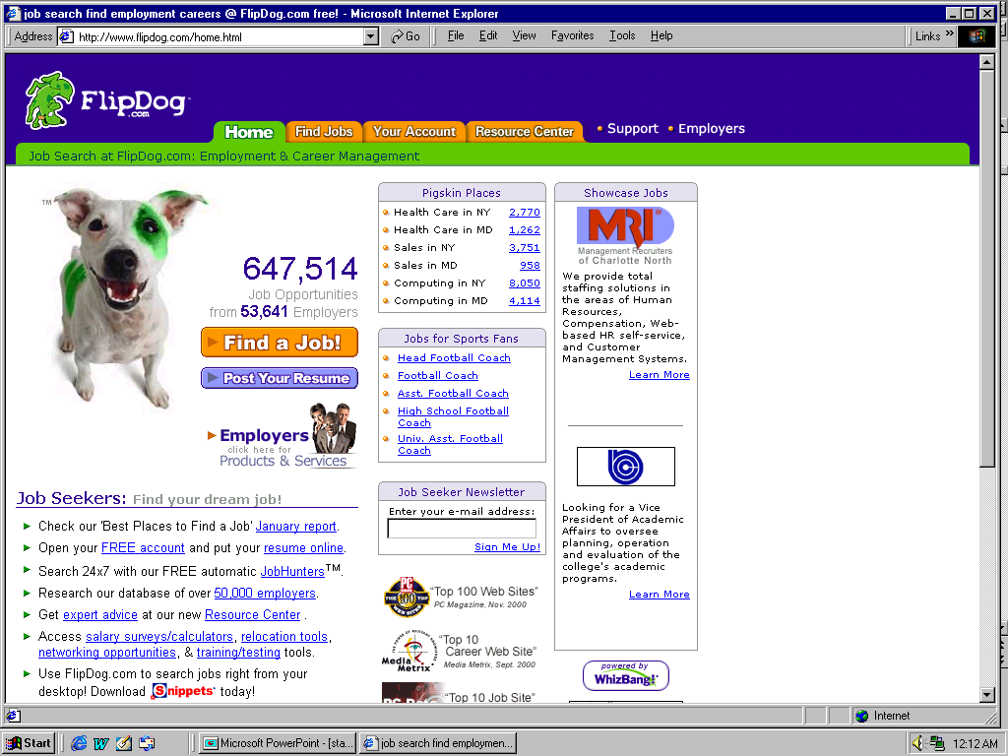
A solution
Why is this better?
How does it happen?

Slide 6

Job Openings:
Category = Food Services
Keyword = Baker
Location = Continental U.S.
Notes:
Not only did this support extremely useful and targeted search and data navigation, with highly summarized display

Slide 7

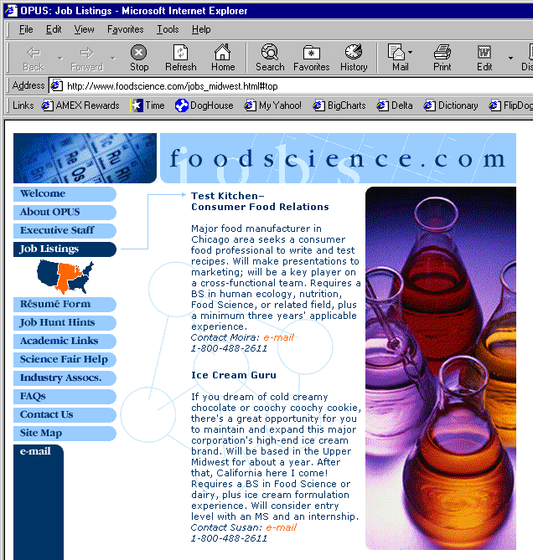
Extracting Job Openings from the Web
Title: Ice Cream Guru
Description: If you dream of cold creamy…
Contact: susan@foodscience.com
Category: Travel/Hospitality
Function: Food Services

Slide 8
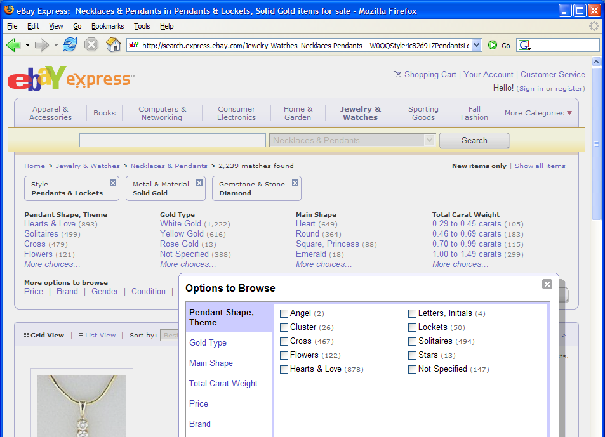
Potential Enabler of Faceted Search

Slide 9

Often structured information in text

Slide 10
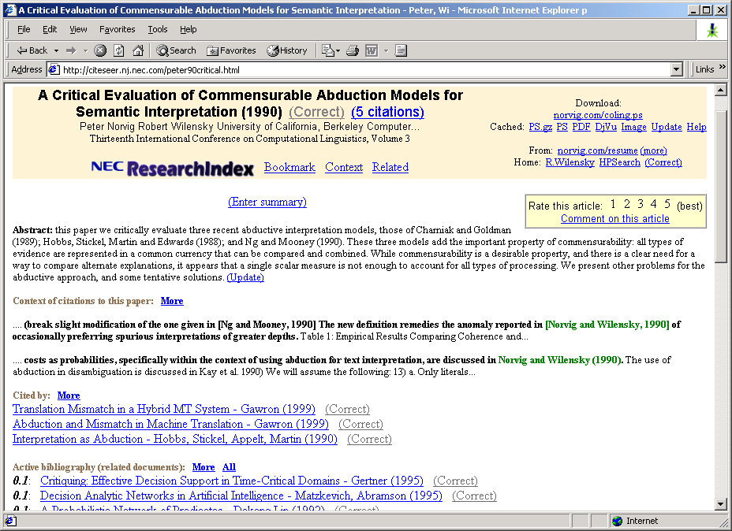
Research papers
Notes:
CiteSeer, which we all know and love, is made possible by the automatic extraction of title and author information from research paper headers and references in order to build the reference graph that we use to find related work.

Slide 11
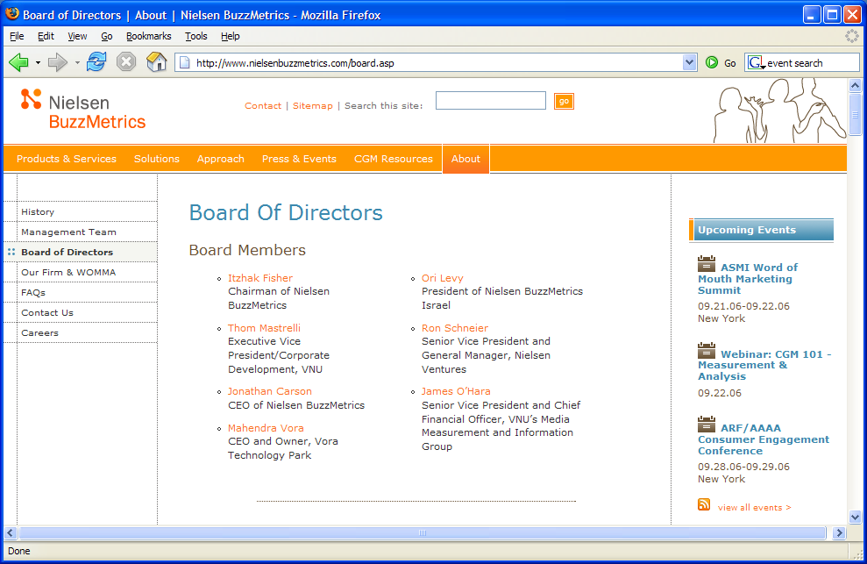
What is Information Extraction?
Traditional definition:
Recovering structured data from formatted text

Slide 12
What is Information Extraction?
Recovering structured data from formatted text
  Identifying fields (e.g. named entity recognition)

Slide 13
What is Information Extraction?
Recovering structured data from formatted text
  Identifying fields (e.g. named entity recognition)
  Understanding relations between fields (e.g. record association)

Slide 14
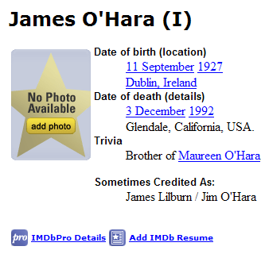

What is Information Extraction?
Recovering structured data from formatted text
  Identifying fields (e.g. named entity recognition)
  Understanding relations between fields (e.g. record association)
  Normalization and deduplication

Slide 15

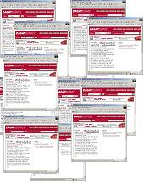
What is information extraction?
Input: Text Document
  Various sources: web, e-mail, journals, …
Output: Relevant fragments of text, possibly to be processed later in some automated way
IE
User Queries

Slide 16
Not all documents are created equal…
Varying regularity in document collections
Natural or unstructured
  Little obvious structural information
Partially structured
  Contain some canonical formatting
Highly structured
  Often, automatically generated

Slide 17
Natural Text: MEDLINE
Journal Abstracts
Extract number of subjects, type of study, conditions, etc.
BACKGROUND: The most challenging aspect of revision hip surgery is the management of bone loss. A reliable and valid measure of bone loss is important since it will aid in future studies of hip revisions and in preoperative planning. We developed a measure of femoral and acetabular bone loss associated with failed total hip arthroplasty. The purpose of the present study was to measure the reliability and the intraoperative validity of this measure and to determine how it may be useful in preoperative planning. METHODS: From July 1997 to December 1998, forty-five consecutive patients with a failed hip prosthesis in need of revision surgery were prospectively followed. Three general orthopaedic surgeons were taught the radiographic classification system, and two of them classified standardized preoperative anteroposterior and lateral hip radiographs with use of the system. Interobserver testing was carried out in a blinded fashion. These results were then compared with the intraoperative findings of the third surgeon, who was blinded to the preoperative ratings. Kappa statistics (unweighted and weighted) were used to assess correlation. Interobserver reliability was assessed by examining the agreement between the two preoperative raters. Prognostic validity was assessed by examining the agreement between the assessment by either Rater 1 or Rater 2 and the intraoperative assessment (reference standard). RESULTS: With regard to the assessments of both the femur and the acetabulum, there was significant agreement (p < 0.0001) between the preoperative raters (reliability), with weighted kappa values of >0.75. There was also significant agreement (p < 0.0001) between each rater's assessment and the intraoperative assessment (validity) of both the femur and the acetabulum, with weighted kappa values of >0.75. CONCLUSIONS: With use of the newly developed classification system, preoperative radiographs are reliable and valid for assessment of the severity of bone loss that will be found intraoperatively.

Slide 18
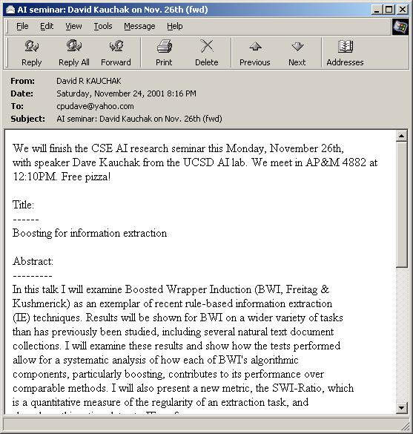
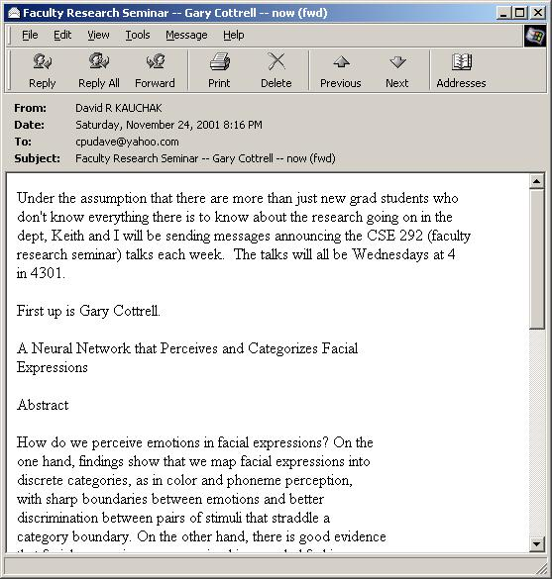
Partially Structured:
Seminar Announcements
Extract time, location, speaker, etc.

Slide 19
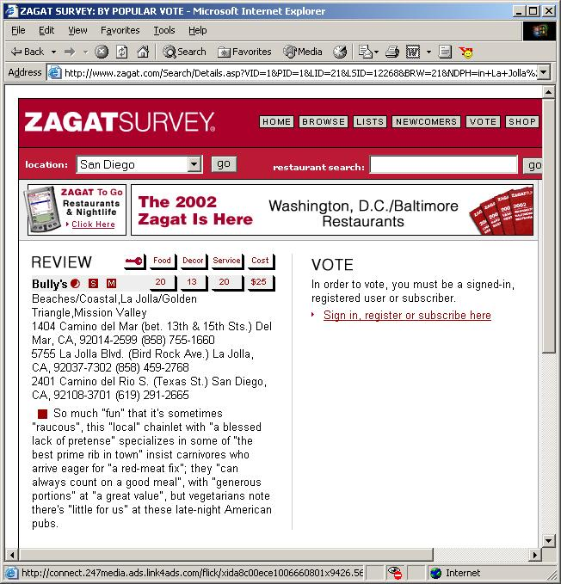
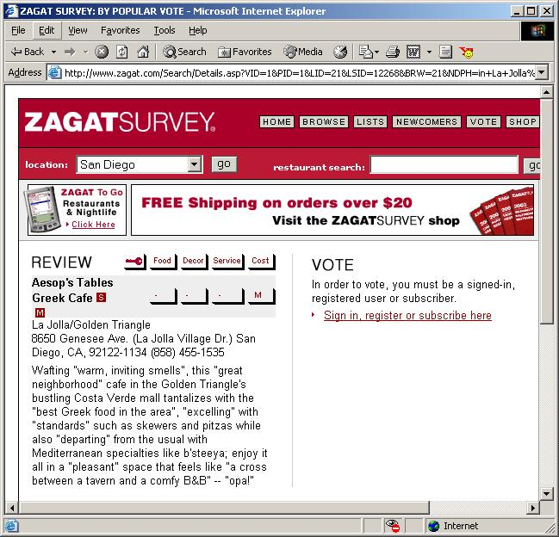
Highly Structured:
Zagat’s Reviews
Extract restaurant, location, cost, etc.

Slide 20
IE for Information Retrieval
How is this useful for IR?
  zone/field based queries
    explicit: author search
    implicit: recognizing addresses
  zone weighting
  index whole entities “Michael Jackson”
  understand relationships between entities
    doc: “X was acquired by Y”
    query: “Y acquisitions”

Slide 21
Classifier setup
Training or learning phase
Raw data
Label
features
Label
f₁, f₂, f₃, …, f_{n}
f₁, f₂, f₃, …, f_{n}
f₁, f₂, f₃, …, f_{n}
classifier
f₁, f₂, f₃, …, f_{n}
train a
predictive
model
extract
features
f₁, f₂, f₃, …, f_{n}

Slide 22
Classifier setup
Testing or classification phase
Raw data
labels
features
f₁, f₂, f₃, …, f_{n}
f₁, f₂, f₃, …, f_{n}
f₁, f₂, f₃, …, f_{n}
classifier
extract
features
f₁, f₂, f₃, …, f_{n}
predict
the label
f₁, f₂, f₃, …, f_{n}

Slide 23
IE Posed as a Machine Learning Task
Training data: documents marked up with ground truth
Local features crucial
…
00 : pm Place : Wean Hall Rm 5409 Speaker : Sebastian Thrun
…
prefix
contents
suffix
What features would be useful?

Slide 24
Good Features for Information Extraction
Creativity and Domain Knowledge Required!
begins-with-number
begins-with-ordinal
begins-with-punctuation
begins-with-question-word
begins-with-subject
blank
contains-alphanum
contains-bracketed-number
contains-http
contains-non-space
contains-number
contains-pipe
Example word features:
  identity of word
  is in all caps
  ends in “-ski”
  is part of a noun phrase
  is in a list of city names
  is under node X in WordNet or Cyc
  is in bold font
  is in hyperlink anchor
  features of past & future
  last person name was female
  next two words are “and Associates”
contains-question-mark
contains-question-word
ends-with-question-mark
first-alpha-is-capitalized
indented
indented-1-to-4
indented-5-to-10
more-than-one-third-space
only-punctuation
prev-is-blank
prev-begins-with-ordinal
shorter-than-30

Slide 25
Good Features for Information Extraction
Creativity and Domain Knowledge Required!
Is Capitalized
Is Mixed Caps
Is All Caps
Initial Cap
Contains Digit
All lowercase
Is Initial
Punctuation
Period
Comma
Apostrophe
Dash
Preceded by HTML tag
Character n-gram classifier
says string is a person
name (80% accurate)
In stopword list
(the, of, their, etc)
In honorific list
(Mr, Mrs, Dr, Sen, etc)
In person suffix list
(Jr, Sr, PhD, etc)
In name particle list
(de, la, van, der, etc)
In Census lastname list;
segmented by P(name)
In Census firstname list;
segmented by P(name)
In locations lists
(states, cities, countries)
In company name list
(“J. C. Penny”)
In list of company suffixes
(Inc, & Associates, Foundation)
Word Features
  lists of job titles,
  Lists of prefixes
  Lists of suffixes
  350 informative phrases
HTML/Formatting Features
  {begin, end, in} x
  {<b>, <i>, <a>, <hN>} x
  {lengths 1, 2, 3, 4, or longer}
  {begin, end} of line

Slide 26
How can we pose this as a classification (or learning) problem?
classifier

Slide 27
Landscape of ML Techniques for IE:
Classify Candidates
Sliding Window
Boundary Models
Abraham Lincoln was born in Kentucky.
Abraham Lincoln was born in Kentucky.
Abraham Lincoln was born in Kentucky.
Classifier
BEGIN
Classifier
which class?
which class?
Classifier
Try alternate
window sizes:
which class?
BEGIN
END
BEGIN
END
Finite State Machines
Wrapper Induction
Abraham Lincoln was born in Kentucky.
<b><i>Abraham Lincoln</i></b> was born in Kentucky.
Most likely state sequence?
Learn and apply pattern for a website
<b>
<i>
PersonName
Any of these models can be used to capture words, formatting or both.

Slide 28
Sliding Windows & Boundary Detection

Slide 29
Information Extraction by Sliding Windows
GRAND CHALLENGES FOR MACHINE LEARNING
Jaime Carbonell
School of Computer Science
Carnegie Mellon University
3:30 pm
7500 Wean Hall
Machine learning has evolved from obscurity in the 1970s into a vibrant and popular discipline in artificial intelligence during the 1980s and 1990s. As a result of its success and growth, machine learning is evolving into a collection of related disciplines: inductive concept acquisition, analytic learning in problem solving (e.g. analogy, explanation-based learning), learning theory (e.g. PAC learning), genetic algorithms, connectionist learning, hybrid systems, and so on.
CMU UseNet Seminar Announcement

Slide 30
Information Extraction by Sliding Windows
GRAND CHALLENGES FOR MACHINE LEARNING
Jaime Carbonell
School of Computer Science
Carnegie Mellon University
3:30 pm
7500 Wean Hall
Machine learning has evolved from obscurity in the 1970s into a vibrant and popular discipline in artificial intelligence during the 1980s and 1990s. As a result of its success and growth, machine learning is evolving into a collection of related disciplines: inductive concept acquisition, analytic learning in problem solving (e.g. analogy, explanation-based learning), learning theory (e.g. PAC learning), genetic algorithms, connectionist learning, hybrid systems, and so on.
CMU UseNet Seminar Announcement

Slide 31
Information Extraction by Sliding Window
GRAND CHALLENGES FOR MACHINE LEARNING
Jaime Carbonell
School of Computer Science
Carnegie Mellon University
3:30 pm
7500 Wean Hall
Machine learning has evolved from obscurity in the 1970s into a vibrant and popular discipline in artificial intelligence during the 1980s and 1990s. As a result of its success and growth, machine learning is evolving into a collection of related disciplines: inductive concept acquisition, analytic learning in problem solving (e.g. analogy, explanation-based learning), learning theory (e.g. PAC learning), genetic algorithms, connectionist learning, hybrid systems, and so on.
CMU UseNet Seminar Announcement

Slide 32
Information Extraction by Sliding Window
GRAND CHALLENGES FOR MACHINE LEARNING
Jaime Carbonell
School of Computer Science
Carnegie Mellon University
3:30 pm
7500 Wean Hall
Machine learning has evolved from obscurity in the 1970s into a vibrant and popular discipline in artificial intelligence during the 1980s and 1990s. As a result of its success and growth, machine learning is evolving into a collection of related disciplines: inductive concept acquisition, analytic learning in problem solving (e.g. analogy, explanation-based learning), learning theory (e.g. PAC learning), genetic algorithms, connectionist learning, hybrid systems, and so on.
CMU UseNet Seminar Announcement

Slide 33
Information Extraction by Sliding Window
GRAND CHALLENGES FOR MACHINE LEARNING
Jaime Carbonell
School of Computer Science
Carnegie Mellon University
3:30 pm
7500 Wean Hall
Machine learning has evolved from obscurity in the 1970s into a vibrant and popular discipline in artificial intelligence during the 1980s and 1990s. As a result of its success and growth, machine learning is evolving into a collection of related disciplines: inductive concept acquisition, analytic learning in problem solving (e.g. analogy, explanation-based learning), learning theory (e.g. PAC learning), genetic algorithms, connectionist learning, hybrid systems, and so on.
CMU UseNet Seminar Announcement

Slide 34
Information Extraction with Sliding Windows
[Freitag 97, 98; Soderland 97; Califf 98]
…
00 : pm Place : Wean Hall Rm 5409 Speaker : Sebastian Thrun
…
w _{t-m}
w _{t-1}
w _{t}
w _{t+n}
w _{t+n+1}
w _{t+n+m}
prefix
contents
suffix
Standard supervised learning setting
  Positive instances: Windows with real label
  Negative instances: All other windows
  Features based on candidate, prefix and suffix

Slide 35
IE by Boundary Detection
GRAND CHALLENGES FOR MACHINE LEARNING
Jaime Carbonell
School of Computer Science
Carnegie Mellon University
3:30 pm
7500 Wean Hall
Machine learning has evolved from obscurity in the 1970s into a vibrant and popular discipline in artificial intelligence during the 1980s and 1990s. As a result of its success and growth, machine learning is evolving into a collection of related disciplines: inductive concept acquisition, analytic learning in problem solving (e.g. analogy, explanation-based learning), learning theory (e.g. PAC learning), genetic algorithms, connectionist learning, hybrid systems, and so on.
CMU UseNet Seminar Announcement

Slide 36
IE by Boundary Detection
GRAND CHALLENGES FOR MACHINE LEARNING
Jaime Carbonell
School of Computer Science
Carnegie Mellon University
3:30 pm
7500 Wean Hall
Machine learning has evolved from obscurity in the 1970s into a vibrant and popular discipline in artificial intelligence during the 1980s and 1990s. As a result of its success and growth, machine learning is evolving into a collection of related disciplines: inductive concept acquisition, analytic learning in problem solving (e.g. analogy, explanation-based learning), learning theory (e.g. PAC learning), genetic algorithms, connectionist learning, hybrid systems, and so on.
CMU UseNet Seminar Announcement

Slide 37
IE by Boundary Detection
GRAND CHALLENGES FOR MACHINE LEARNING
Jaime Carbonell
School of Computer Science
Carnegie Mellon University
3:30 pm
7500 Wean Hall
Machine learning has evolved from obscurity in the 1970s into a vibrant and popular discipline in artificial intelligence during the 1980s and 1990s. As a result of its success and growth, machine learning is evolving into a collection of related disciplines: inductive concept acquisition, analytic learning in problem solving (e.g. analogy, explanation-based learning), learning theory (e.g. PAC learning), genetic algorithms, connectionist learning, hybrid systems, and so on.
CMU UseNet Seminar Announcement

Slide 38
IE by Boundary Detection
GRAND CHALLENGES FOR MACHINE LEARNING
Jaime Carbonell
School of Computer Science
Carnegie Mellon University
3:30 pm
7500 Wean Hall
Machine learning has evolved from obscurity in the 1970s into a vibrant and popular discipline in artificial intelligence during the 1980s and 1990s. As a result of its success and growth, machine learning is evolving into a collection of related disciplines: inductive concept acquisition, analytic learning in problem solving (e.g. analogy, explanation-based learning), learning theory (e.g. PAC learning), genetic algorithms, connectionist learning, hybrid systems, and so on.
CMU UseNet Seminar Announcement

Slide 39
IE by Boundary Detection
GRAND CHALLENGES FOR MACHINE LEARNING
Jaime Carbonell
School of Computer Science
Carnegie Mellon University
3:30 pm
7500 Wean Hall
Machine learning has evolved from obscurity in the 1970s into a vibrant and popular discipline in artificial intelligence during the 1980s and 1990s. As a result of its success and growth, machine learning is evolving into a collection of related disciplines: inductive concept acquisition, analytic learning in problem solving (e.g. analogy, explanation-based learning), learning theory (e.g. PAC learning), genetic algorithms, connectionist learning, hybrid systems, and so on.
CMU UseNet Seminar Announcement

Slide 40
IE by Boundary Detection
Input: Linear Sequence of Tokens
Date : Thursday , October 25 Time : 4 : 15 - 5 : 30 PM
Method: Identify start and end Token Boundaries
Start / End of Content
Date : Thursday , October 25 Time : 4 : 15 - 5 : 30 PM
…
Unimportant Boundaries
Output: Tokens Between Identified Start / End Boundaries
Date : Thursday , October 25 Time : 4 : 15 - 5 : 30 PM

Slide 41
Learning: IE as Classification
The set of training examples is all of the boundaries in a document
The goal is to approximate two extraction functions Begin and End:
Begin
Date : Thursday , October 25 Time : 4 : 15 - 5 : 30 PM
POSITIVE (1)
End
Date : Thursday , October 25 Time : 4 : 15 - 5 : 30 PM
ALL OTHERS NEGATIVE (0)
1 if i begins a field
0 otherwise
Begin(i)=

Slide 42
Boundary Detectors
“Boundary Detectors” are pairs of token sequences ‹p,s›
  A detector matches a boundary iff p matches text before boundary and s matches text after boundary
  Detectors can contain wildcards, e.g. “capitalized word”, “number”, etc.
Example:
  <Date:,[CapitalizedWord]> matches:
  Date: Thursday, October 25

Slide 43

Another Detector Example
Prefix | Suffix
< a href = " | http
empty | ">
Begin boundary detector:
End boundary detector:
Input Text:
text<b><a href=http://www.cs.ucsd.edu>
Matches:

Slide 44
BWI: Learning to detect boundaries
[Freitag & Kushmerick, AAAI 2000]
Another formulation: learn three probabilistic classifiers:
  Begin(i) = Prob( position i starts a field)
  End(j) = Prob( position j ends a field)
  Len(k) = Prob( an extracted field has length k)
Then score a possible extraction (i,j) by
  Begin(i) * End(j) * Len(j-i)
Len(k) is estimated from a histogram
Begin(i) and End(j) learned by boosting over simple boundary patterns and features

Slide 45
Problems with Sliding Windows and Boundary Finders
Decisions in neighboring parts of the input are made independently from each other.
  Sliding Window may predict a “seminar end time” before the “seminar start time”.
  It is possible for two overlapping windows to both be above threshold.
  In a Boundary-Finding system, left boundaries are laid down independently from right boundaries, and their pairing happens as a separate step.

Slide 46
Modeling the sequential nature of data: citation parsing
Fahlman, Scott & Lebiere, Christian (1989). The cascade-correlation learning architecture. Advances in Neural Information Processing Systems, pp. 524-532.
Fahlman, S.E. and Lebiere, C., “The Cascade Correlation Learning Architecture,” Neural Information Processing Systems, pp. 524-532, 1990.
Fahlman, S. E. (1991) The recurrent cascade-correlation learning architecture. NIPS 3, 190-205.
What patterns to you see here?
Ideas?
Notes:
Task: clustering bibliographic citations
Here are 3 citations from bibliography sections of 3 different papers. First two clustered together. Third refers to different paper and forms separate cluster
Note that variations in formatting, field ordering, abbreviation and even misspellings and misinformation make this a challenging clustering problem.
Why collected this data?

Slide 47
Some sequential patterns
Something interesting in the sequence of fields that we’d like to capture
  Authors come first
  Title comes before journal
  Page numbers come near the end
  All types of things generally contain multiple words

Slide 48
Predict a sequence of tags
author
author
year
title
title
title
Fahlman, S. E. (1991) The recurrent cascade
title
title
title
journal
pages
correlation learning architecture. NIPS 3, 190-205.
Ideas?

Slide 49
Hiddent Markov Models(HMMs)
Author
Title
Journal
Year
Pages

Slide 50
HMM: Generative Model (3)
States: x_{i}
State transitions: P(x_{i}|x_{j}) = a[x_{i}|x_{j}]
Output probabilities: P(o_{i}|x_{j}) = b[o_{i}|x_{j}]
Markov independence assumption

Slide 51
HMMs: Performing Extraction
Given output words:
  fahlman s e 1991 the recurrent cascade correlation learning architecture nips 3 190 205
Find state sequence that maximizes:
Lots of possible state sequences to test (5¹⁴)

Slide 52
HMM Example: Nymble
[Bikel, et al 97]
Task: Named Entity Extraction
Bigram within classes
Backoff to unigram
Special capitalization and number features…
Person
end-of-sentence
start-of-sentence
Org
(Five other name classes)
Other
Train on 450k words of news wire text.
Results:
Case Language F1 .
Mixed English 93%
Upper English 91%
Mixed Spanish 90%

Slide 53
System Comparison
16 different extraction tasks
Algorithms
  BWI vs.
  Two rule learners: SRV and Rapier
  One algorithm based on hidden Markov models
  One wrapper induction algorithm: Stalker

Slide 54
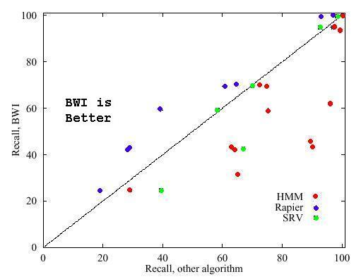
Recall

Slide 55
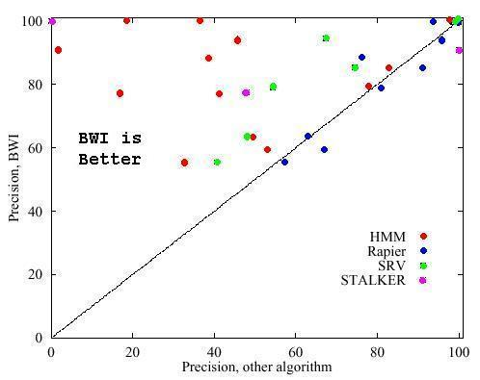
Precision

Slide 56
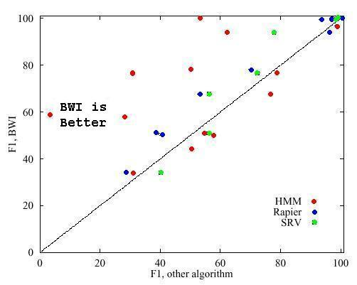
F1

Slide 57
Data regularity is important!
Highly structured
Partially structured
Natural text
As the regularity decreases, so does the performance
Algorithms interact differently at with different levels of regularity

Slide 58
How important are features?
- One of the challenges for IE methods is generalizability
- Wildcards can help with this
wildcards |  | speaker | location | stime | etime
none |  | 15.1 | 69.2 | 95.7 | 83.4
just <*> |  | 49.4 | 73.5 | 99.3 | 95.0
default |  | 67.7 | 76.7 | 99.4 | 94.6
lexical |  | 73.5 | - | - | -
default: a set of eight wildcards
lexical: task specific lexical resources:
  <FName>: common first names released by U.S. Census Bureau.
  <LName>: common last names
  <NEW>: tokens not found in /usr/dict/words on Unix

Slide 59
Improving task regularity
Instead of altering methods, alter text
Idea: Add limited grammatical information
  Run shallow parser over text
  Flatten parse tree and insert as tags
Example of Tagged Sentence:
Uba2p is located largely in the nucleus.
NP_SEG
VP_SEG
PP_SEG
NP_SEG

Slide 60
Tagging Results on
Natural Domain
21% increase
65% increase
45% increase

Slide 61
Tagging increases regularity
Average decrease of 21%
measure of document regularity

Slide 62
Collaborative Searching
What are other gains that can be achieved through collaborative searching?
What are cons to collaborative searching?
Who do you think will be the primary users of collaborative searching sites?

