Slide 1
Image Processing
Empirical Evaluation of Dissimilarity Measures for Color and Texture
Jan Puzicha, Joachim M. Buhmann, Yossi Rubner & Carlo Tomasi
David Kauchak
cs160
Fall 2009

Slide 2
Administrative
11/4 class project discussion
  project proposal draft due
11/5 4:15pm Rose Hill Theatre
CS Lunch today

Slide 3
Image processing
Image processing
  http://webcast.berkeley.edu/course_details.php?seriesid=1906978282
Computer vision
  http://cseweb.ucsd.edu/classes/sp09/cse252b/
CVPR
  http://www.cvpr2009.org/full-program

Slide 4
Text retrieval
What was the key problem we needed to solve for text retrieval?
sim(
) = ?
,
query
document

Slide 5


The Problem: Image Similarity
sim(
) = ?
,

Slide 6
Where does this problem arise in computer vision?
Image Classification
Image Retrieval
Image Segmentation

Slide 7
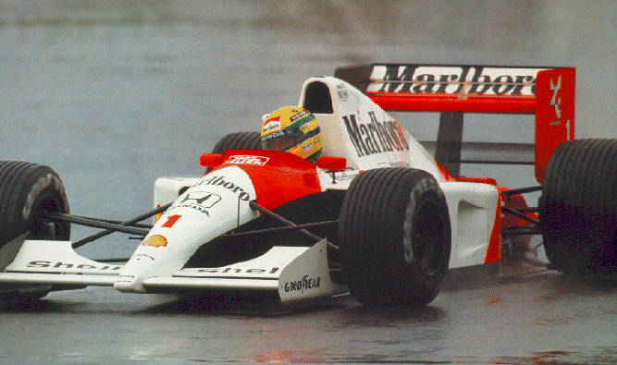
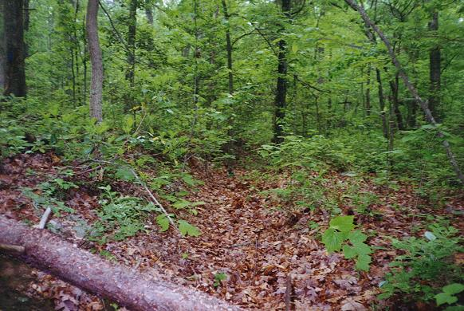
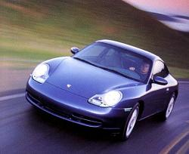
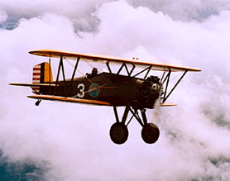
Classification
?
?
?

Slide 8
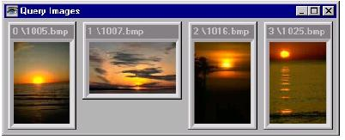
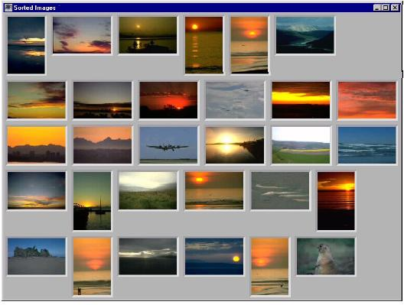
Retrieval
Jeremy S. De Bonet, Paul Viola (1997). Structure Driven Image Database Retrieval. Neural Information Processing 10 (1997).

Slide 9

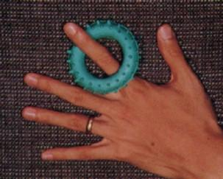
Segmentation
http://vizlab.rutgers.edu/~comanici/segm_images.html

Slide 10
How is an image represented?

Slide 11
How is an image represented?
images are made up of pixels
for a color image, each pixel corresponds to an RGB value (i.e. three numbers)

Slide 12
Image file formats
BitMaP
JPEG
TIFF
Gif
Png
…

Slide 13
Bitmap
R, G, B

Slide 14
JPEG Compression Process

Slide 15
JPEG Compression Process

Slide 16
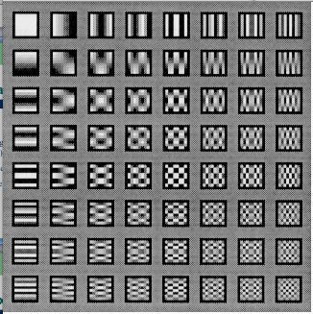
JPEG Compression Process

Slide 17
JPEG Compression Process
Quantizer: Weights the various spectral coefficients according to their importance, with respect to the human visual system.

Slide 18
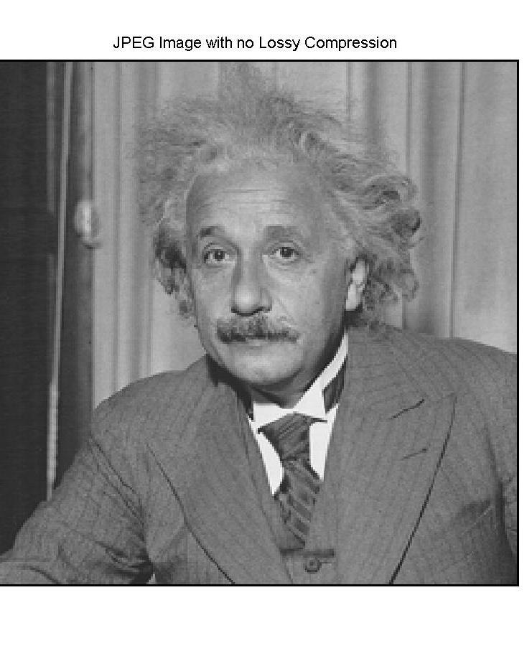
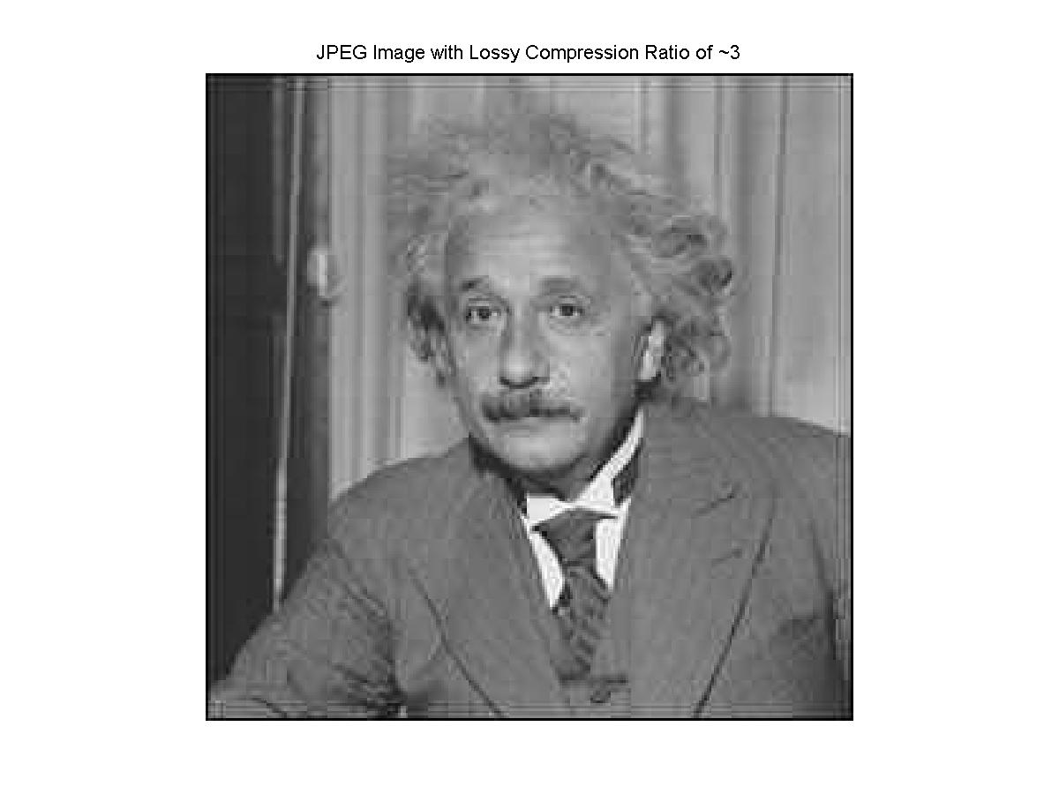
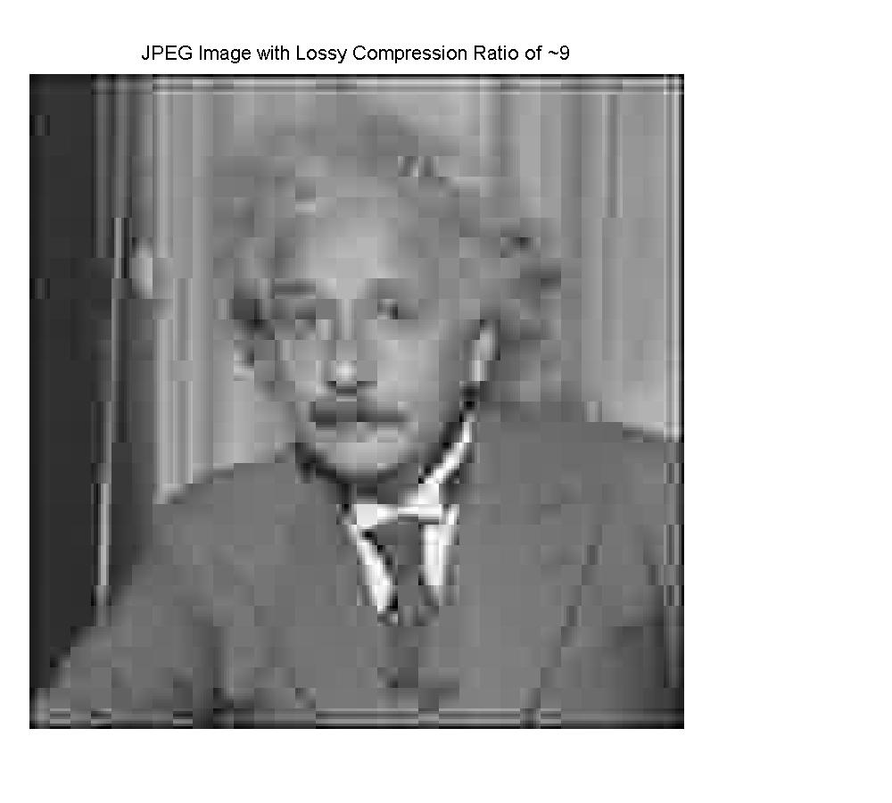
JPEG Compression

Slide 19
Image features

Slide 20
Color
Which is more similar?
L*a*b* was designed to be uniform in that perceptual “closeness” corresponds to Euclidean distance in the space.

Slide 21
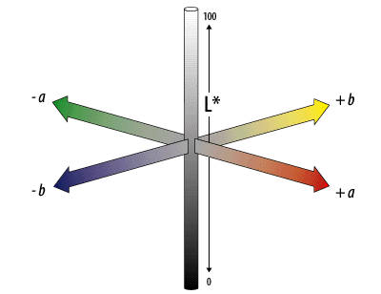
L*a*b*
L – lightness (white to black)
a – red-greeness
b – yellowness-blueness
Notes:
Nice features: easy to adjust contrast

Slide 22
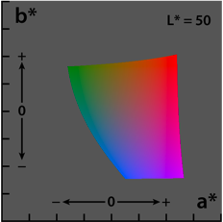
L*a*b*

Slide 23
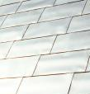
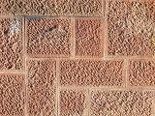

Texture
How is texture different than color?

Slide 24
Texture
Texture is not pointwise like color
Texture involves a local neighborhood
How can we capture texture?
How did we capture audio texture?

Slide 25
Gabor Filters
Gabor filters are Gaussians modulated by sinusoids
They can be tuned in both the scale (size) and the orientation
A filter is applied to a region and is characterized by some feature of the energy distribution (often mean and standard deviation)
Similar idea to wavelets (Gabor wavelet)!

Slide 26



Examples of Gabor Filters
Scale: 3 at 72°
Scale: 4 at 108°
Scale: 5 at 144°

Slide 27
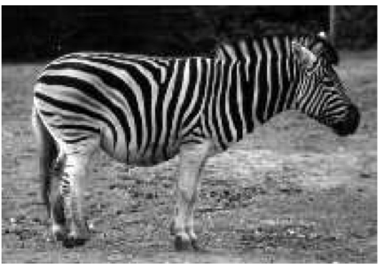
Gabor filters
What would the response look like to a vertical filter?

Slide 28
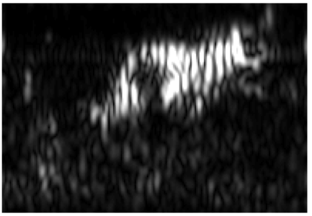
Gabor filters

Slide 29
Features
For each pixel:
set of color features
set of texture features (i.e. responses to different filters)
…
any problem?

Slide 30
Features
For each pixel:
set of color features
set of texture features (i.e. responses to different filters)
…
Lots of features!
Extremely sparse
Features are position dependent
Ideas?

Slide 31
One approach: histograms
Examine the distribution of features, rather than the features themselves
General purpose (i.e. any distribution of features)
Resilient to variations (shadowing, changes in illumination, shading, etc.)
Can use previous work in statistics, etc.

Slide 32
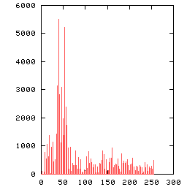
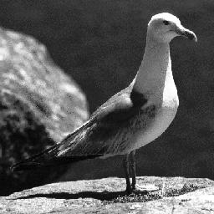
Histogram Example

Slide 33
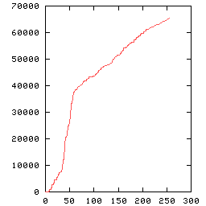
Cumulative Histogram
Normal Histogram
Cumulative Histogram

Slide 34
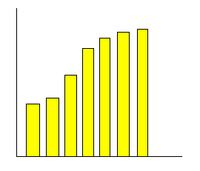
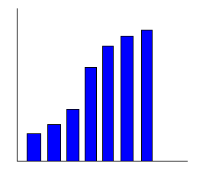
Similarity Measures Using the Histograms
Histogram 1
Histogram 2
Need to quantify how similar two histograms are

Slide 35
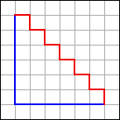
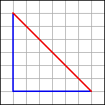
Heuristic Histogram Distances
Minkowski-form distance L_{p}
Special cases:
  L₁: absolute, cityblock, or Manhattan distance
  L₂: Euclidian distance
  L∞: Maximum value distance

Slide 36
More heuristic distances
Weighted-Mean-Variance (WMV)
  Only includes minimal information about distribution

Slide 37
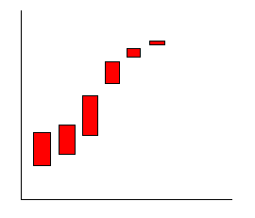

Cumulative Difference Example
Histogram 1
Histogram 2
Difference
-
=
K-S =
CvM =

Slide 38
How would you test the perfomance of these algorithms?
Three tasks
  classification
  retrieval
  segmentation

Slide 39
Data Set: Color
Randomly chose 94 images from set of 2000
  94 images represent separate classes
Randomly select disjoint set of pixels from the images
  Set size of 4, 8, 16, 32, 64 pixels
  16 disjoint samples per set per image

Slide 40








Data Set: Texture
Brodatz album
  Collection of wide range of texture (e.g. cork, lawn, straw, pebbles, sand, etc.)
Each image is considered a class (as in color)
Extract sets of 16 non-overlapping blocks
  sizes 8x8, 16x16,…, 256x256

Slide 41
Setup: Classification
How can we use similarity for classification?
k-Nearest Neighbor classifier is used
  Nearest Neighbor classification: given a collection of labeled points S and a query point q, what point belonging to S is closest to q?
  k nearest is a majority vote of the k closest points

Slide 42
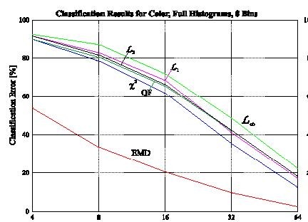
Results: Classification, color data set
sample size

Slide 43
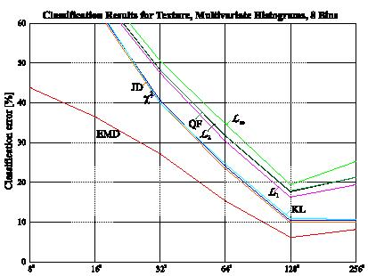
Results: Classification, texture data set
sample size

Slide 44
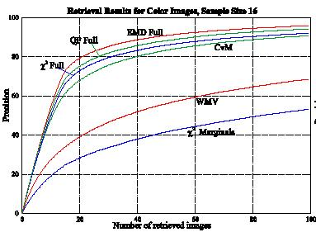
Results: Image Retrieval

Slide 45
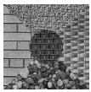
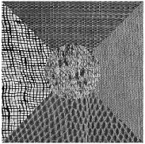
Setup: Segmentation
100 images
Each image consists of 5 different textures

Slide 46
Setup: Segmentation
How can we solve this problem using our similarity measures?

Slide 47
Setup: Segmentation (cont.)
Image is divided into 16384 sites (128 x 128 grid)
A histogram is calculate for each site
Each site histogram is then compared with 80 randomly selected sites
Image sites with high average similarity are then grouped

Slide 48
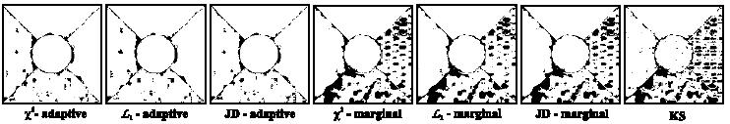
Results: Segmentation

Slide 49
Something fun…
http://www.popsci.com/gear-amp-gadgets/article/2009-09/building-virtual-cities-automatically-150000-flickr-photos

Slide 50
Cyberchondria

Slide 51
Homework for next time…
Spend 15 minutes playing with three different image retrieval systems
  http://en.wikipedia.org/wiki/Image_retrieval has a number
  What works well?
  What doesn’t work well?
  Anything interesting you noticed?
You won’t hand anything in, but we’ll start class on Monday with a discussion of the systems

