Slide 1
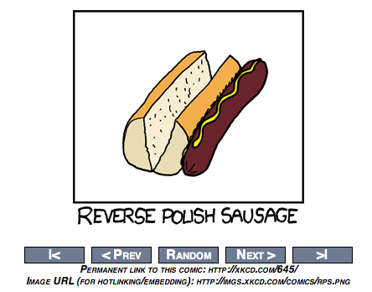

Slide 2
Link Analysis
David Kauchak
cs160
Fall 2009
adapted from:
http://www.stanford.edu/class/cs276/handouts/lecture15-linkanalysis.ppt
http://webcourse.cs.technion.ac.il/236522/Spring2007/ho/WCFiles/Tutorial05.ppt

Slide 3
Administrative
Course feedback
  homeworks
Midterm review today
Assign 4 out soon

Slide 4
The Web as a Directed Graph
Page A
Page B
hyperlink
A hyperlink between pages denotes author perceived relevance AND importance
How can we use this information?

Slide 5
Query-independent ordering
First generation: using link counts as simple measures of popularity
Two basic suggestions:
  Undirected popularity:
    Each page gets a score = the number of in-links plus the number of out-links (3+2=5)
  Directed popularity:
    Score of a page = number of its in-links (3)
problems?

Slide 6

What is pagerank?
The random surfer model
Imagine a user surfing the web randomly using a web browser
The pagerank score of a page is the probability that that user will visit a given page
http://images.clipartof.com/small/7872-Clipart-Picture-Of-A-World-Earth-Globe-Mascot-Cartoon-Character-Surfing-On-A-Blue-And-Yellow-Surfboard.jpg

Slide 7
Random surfer model
We want to model the behavior of a “random” user interfacing the web through a browser
Model is independent of content (i.e. just graph structure)
What types of behavior should we model and how?
  Where to start
  Following links on a page
  Typing in a url (bookmarks)
  What happens if we get a page with no outlinks
  Back button on browser

Slide 8
Random surfer model
Start at a random page
Go out of the current page along one of the links on that page, equiprobably
“Teleporting”
  If a page has no outlinks always jump
  to random page
  With some fixed probability, randomly jump to any other page, otherwise follow links
1/3
1/3
1/3

Slide 9
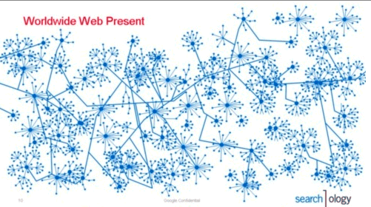
The questions…
Given a graph and a teleporting probability, we have some probability of visiting every page
What is that probability for each page in the graph?
http://3.bp.blogspot.com/_ZaGO7GjCqAI/Rkyo5uCmBdI/AAAAAAAACLo/zsHdSlKc-q4/s640/searchology-web-graph.png

Slide 10
Markov process
A markov process is defined by:
  x₁, x₂, …, x_{n} a set of states
  An n by n transition matrix describing the probability of transitioning to state x_{j} given that you’re in state x_{i}
…
x₁
x₂
x_{n}
x₁
x₂
rows must sum to 1
x_{ij}: p(x_{j}|x_{i})
…
x_{n}

Slide 11
Markov Process
Coke vs. Pepsi Example
Given that a person’s last cola purchase was Coke, there is a 90% chance that his next cola purchase will also be Coke.
If a person’s last cola purchase was Pepsi, there is an 80% chance that his next cola purchase will also be Pepsi.
transition matrix:
coke
pepsi
0.9
0.1
0.8
coke
coke
pepsi
pepsi
0.2

Slide 12
Markov Process
Coke vs. Pepsi Example (cont)
Given that a person is currently a Pepsi purchaser, what is the probability that he will purchase Coke two purchases from now?
transition matrix:
coke
pepsi
0.9
0.1
0.8
coke
coke
pepsi
pepsi
0.2

Slide 13
Markov Process
Coke vs. Pepsi Example (cont)
Given that a person is currently a Pepsi purchaser, what is the probability that he will purchase Coke two purchases from now?
coke
pepsi
coke
pepsi
coke
pepsi
coke
pepsi
Pepsi → ?
? → Coke

Slide 14
Markov Process
Coke vs. Pepsi Example (cont)
Given that a person is currently a Coke purchaser, what is the probability that he will purchase Pepsi three purchases from now?
coke
pepsi
coke
pepsi
coke
pepsi
coke
pepsi

Slide 15
Steady state
In general, we can calculate the probability after n purchases as P^{n}
We might also ask the question, what is the probability of being in state coke or pepsi?
This is described by the steady state distribution of a markov process
  Note, this is a distribution over states not state transitions
How might we obtain this?

Slide 16
Steady state
We have some initial vector describing the probabilities of each starting state
  For example, coke drinker: x = [1, 0]
  We could have said a person that drinks coke 80% of the time, x = [0.80, 0.20]
coke
pepsi
coke
pepsi
coke
pepsi

Slide 17
Steady state
Most common
  start with some initial x
  xP, xP², xP³, xP⁴, …
  For many processes, this will eventually settle

Slide 18
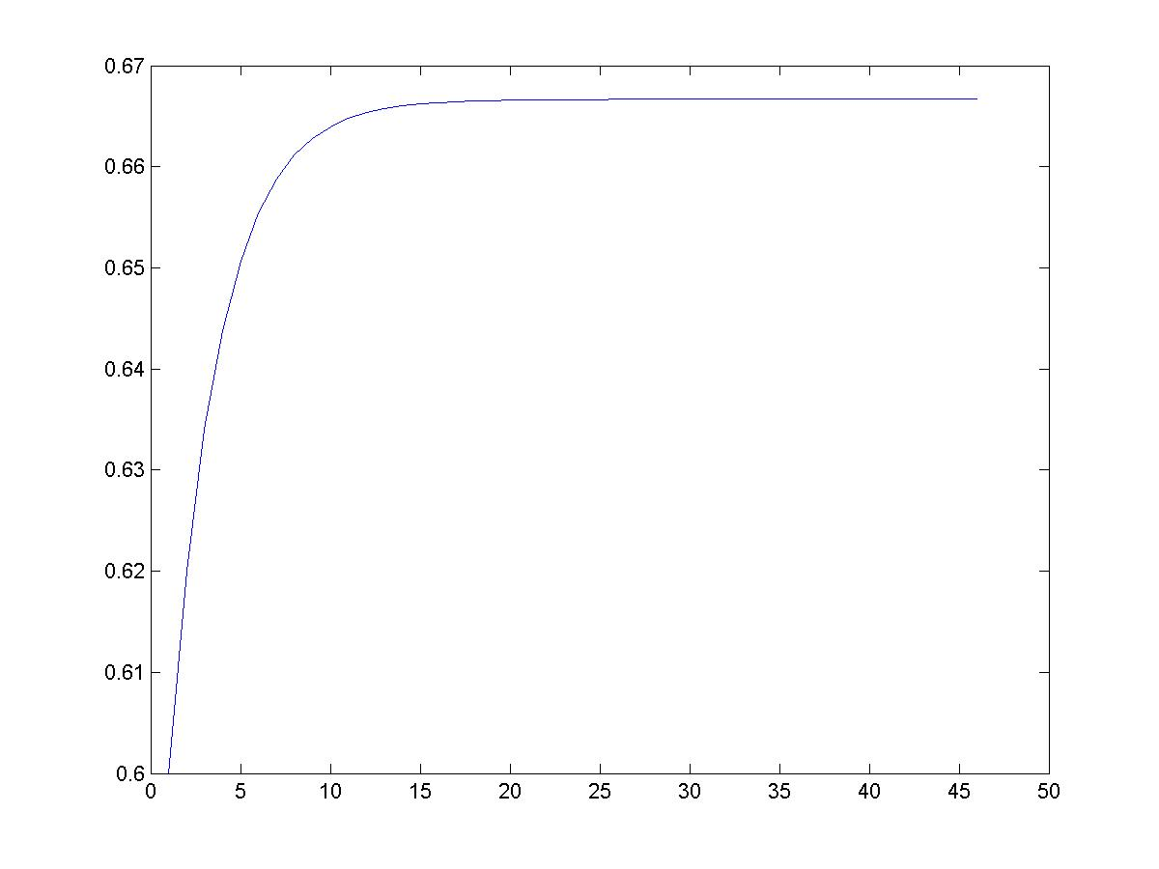
Markov Process
Coke vs. Pepsi Example (cont)
Simulation:
2/3
Pr[X_{i} = Coke]
0.9
0.1
0.8
coke
pepsi
0.2
week - i

Slide 19
Back to pagerank
Can we use this to solve our random surfer problem?
  States are web pages
  Transitions matrix is the probability of transitioning to page A given at page B
  “Teleport” operation makes sure that we can get to any page from any other page
Matrix is much bigger, but same approach is taken…
  P, P², P³, P⁴, …

Slide 20
Pagerank summary
Preprocessing:
  Given a graph of links, build matrix P
  From it compute steady state of each state
  An entry is a number between 0 and 1: the pagerank of a page
Query processing:
  Retrieve pages meeting query
  Integrate pagerank score with other scoring (e.g. tf-idf)
  Rank pages by this combined score

Slide 21
The reality
Pagerank is used in google, but so are many other clever heuristics

Slide 22
Pagerank: Issues and Variants
How realistic is the random surfer model?
  Modeling the back button
  Surfer behavior sharply skewed towards short paths
  Search engines, bookmarks & directories make jumps non-random
Note that all of these just vary how we create our initial transition probability matrix

Slide 23
Biased surfer models
Random teleport to any page is not very reasonable
Biased Surfer Models
  Weight edge traversal probabilities based on match with topic/query (non-uniform edge selection)
  Bias jumps to pages on topic (e.g., based on personal bookmarks & categories of interest)

Slide 24
Topic Specific Pagerank
Conceptually, we use a random surfer who teleports, with say 10% probability, using the following rule:
    Selects a category based on a query & user-specific distribution over the categories
    Teleport to a page uniformly at random within the chosen category
  What is the challenge?

Slide 25
Topic Specific Pagerank
Ideas?
Offline:Compute pageranks for individual categories
  Query independent as before
  Each page has multiple pagerank scores – one for each category, with teleportation only to that category
Online: Distribution of weights over categories computed by query context classification
  Generate a dynamic pagerank score for each page - weighted sum of category-specific pageranks

Slide 26
Spamming pagerank

Slide 27
Other link analysis
Pagerank is not the only link analysis method
  Many improvements/variations of pagerank
  Hubs and authorities

Slide 28
Midterm review: general notes
We’ve covered a lot of material
  Anything from lecture, readings, homeworks and assignments is fair game
  Today’s material NOT on the midterm
T/F, short answer, short workthrough problems
Some questions like homework, but also many “conceptual” questions
Won’t need calculator
1hr and 15 mins goes by fast
Grading for the class

Slide 29
Midterm review
indexes
  representation
  skip pointers
  why we need an index
boolean index
  merge operation
  query optimization
  phrase queries (query proximity)

Slide 30
Midterm review
index construction
  implementing efficiently
  sort-based
  spimi
  distributed index contruction
    map reduce
  dealing with data that refreshes frequently

Slide 31
Midterm review
index compression
  dictionary compression
    variable width entries
    blocking
    front-coding
  postings list compression
    gaps
    gap encoding/compression

Slide 32
Midterm review
documents in the index
text preprocessing
  tokenization
  text normalization
  stop lists
  java regex
computer hardware basics
data set analysis
  statistics
  heaps’ law
  zipf's law

Slide 33
Midterm review
ranked retrieval
  vector space representation and retrieval
  representing documents and queries as vectors
  cosine similarity measure
  normalization/reweighting techniques
  calculating similarities from index
  Speeding up ranking calculations
    approximate top K approaches (e.g. champion lists)
    cluster pruning

Slide 34
Midterm review
Evaluation
  precision
  recall
  F1
  11-point precision
  MAP
  Kappa statistic
  A/B testing

Slide 35
Midterm review
snippet/summary generation
spelling correction
  edit distance
  word n-grams
  jaccard coefficient
relevance feedback

Slide 36
Midterm review
web
  basic web search engine
  spam
  estimating the size of the web (or the size of a search engine's index)
  duplicate detection at web scale
  crawling

