Slide 1
Linked list visualized
[1, 8, 4, 7]
data: 1
data: 8
data: 4
data: 7
head
next:
next:
next:
next: null

Slide 2
Adding to the front
[1, 8, 4, 7]
data: 1
data: 8
data: 4
data: 7
head
next:
next:
next:
next: null
How can we add a value to the front of the list?

Slide 3
Adding to the front: add 9 to front
[1, 8, 4, 7]
data: 1
data: 8
data: 4
data: 7
head
next:
next:
next:
next: null
data: 9
create a new Node
next: null

Slide 4
Adding to the front: add 9 to front
[1, 8, 4, 7]
data: 1
data: 8
data: 4
data: 7
head
next:
next:
next:
next: null
data: 9
set the next value of that node to be head
next:

Slide 5
Adding to the front: add 9 to front
[1, 8, 4, 7]
data: 1
data: 8
data: 4
data: 7
head
next:
next:
next:
next: null
data: 9
set head to this new node
next:

Slide 6
Adding to the front: add 9 to front
[1, 8, 4, 7]
data: 9
data: 1
data: 8
data: 4
data: 7
head
next:
next:
next:
next:
next: null

Slide 7
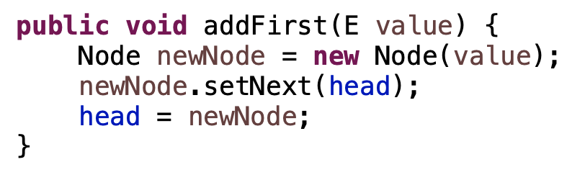
Adding to the front: add 9 to front
[1, 8, 4, 7]
data: 9
data: 1
data: 8
data: 4
data: 7
head
next:
next:
next:
next:
next: null

Slide 8
Adding to the front: add 9 to front
[1, 8, 4, 7]
data: 1
data: 8
data: 4
data: 7
head
next:
next:
next:
next: null
data: 9
newNode
next: null

Slide 9
Adding to the front: add 9 to front
[1, 8, 4, 7]
data: 1
data: 8
data: 4
data: 7
head
next:
next:
next:
next: null
data: 9
newNode
next:

Slide 10
Adding to the front: add 9 to front
[9, 1, 8, 4, 7]
data: 1
data: 8
data: 4
data: 7
head
next:
next:
next:
next: null
data: 9
newNode
next:

Slide 11
Adding to the front
Does this work if the linked list is empty?
head: null

Slide 12
Adding to the front
Does this work if the linked list is empty?
head: null
data: 9
newNode
next: null

Slide 13
Adding to the front
Does this work if the linked list is empty?
head: null
data: 9
newNode
next: null

Slide 14
Adding to the front
Does this work if the linked list is empty?
head:
data: 9
newNode
next: null

Slide 15
Removing from the front
[1, 8, 4, 7]
data: 1
data: 8
data: 4
data: 7
head
next:
next:
next:
next: null
How can we delete a value to the front of the list?
(assuming the list isn’t empty)

Slide 16
Removing from the front
[1, 8, 4, 7]
data: 1
data: 8
data: 4
data: 7
head
next:
next:
next:
next: null
Simply move head down the list!

Slide 17
Removing from the front
[1, 8, 4, 7]
data: 1
data: 8
data: 4
data: 7
head
next:
next:
next:
next: null
Simply move head down the list!

Slide 18
Removing from the front
[1, 8, 4, 7]
data: 1
data: 8
data: 4
data: 7
head
next:
next:
next:
next: null
How can do this in code?

Slide 19

Removing from the front
[1, 8, 4, 7]
data: 1
data: 8
data: 4
data: 7
head
next:
next:
next:
next: null
How can do this in code?

Slide 20
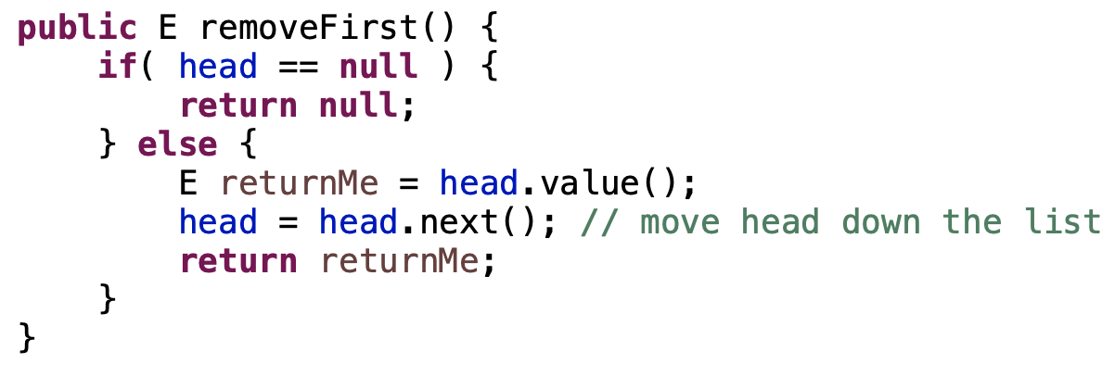
Removing from the front
[1, 8, 4, 7]
data: 1
data: 8
data: 4
data: 7
head
next:
next:
next:
next: null

Slide 21
Iterating through a linked list
data: 1
data: 8
data: 4
data: 7
head
next:
next:
next:
next: null
How can we iterate through a linked list?

Slide 22
Iterating through a linked list
data: 1
data: 8
data: 4
data: 7
head
next:
next:
next:
next: null
finger
Use a variable starting at the head and move it down the list

Slide 23
Iterating through a linked list
data: 1
data: 8
data: 4
data: 7
head
next:
next:
next:
next: null
finger
Use a variable starting at the head and move it down the list
How will we know when we’re at the end?

Slide 24
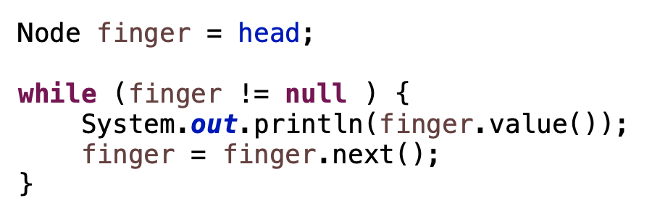
Iterating through a linked list: printing it
data: 1
data: 8
data: 4
data: 7
head
next:
next:
next:
next: null

Slide 25
Iterating through a linked list: printing it
data: 1
data: 8
data: 4
data: 7
head
next:
next:
next:
next: null
finger

Slide 26
Iterating through a linked list: printing it
data: 1
data: 8
data: 4
data: 7
head
next:
next:
next:
next: null
finger

Slide 27
Iterating through a linked list: printing it
data: 1
data: 8
data: 4
data: 7
head
next:
next:
next:
next: null
finger
1

Slide 28
Iterating through a linked list: printing it
data: 1
data: 8
data: 4
data: 7
head
next:
next:
next:
next: null
finger
1

Slide 29
Iterating through a linked list: printing it
data: 1
data: 8
data: 4
data: 7
head
next:
next:
next:
next: null
finger
1
8

Slide 30
Iterating through a linked list: printing it
data: 1
data: 8
data: 4
data: 7
head
next:
next:
next:
next: null
finger
1
8

Slide 31
Iterating through a linked list: printing it
data: 1
data: 8
data: 4
data: 7
head
next:
next:
next:
next: null
finger
1
8
4

Slide 32
Iterating through a linked list: printing it
data: 1
data: 8
data: 4
data: 7
head
next:
next:
next:
next: null
finger
1
8
4

Slide 33
Iterating through a linked list: printing it
data: 1
data: 8
data: 4
data: 7
head
next:
next:
next:
next: null
finger
1
8
4

Slide 34
Iterating through a linked list: printing it
data: 1
data: 8
data: 4
data: 7
head
next:
next:
next:
next: null
finger
1
8
4
7

Slide 35
Iterating through a linked list: printing it
data: 1
data: 8
data: 4
data: 7
head
next:
next:
next:
next: null
finger:null
1
8
4
7

Slide 36
Iterating through a linked list: printing it
data: 1
data: 8
data: 4
data: 7
head
next:
next:
next:
next: null
finger:null
1
8
4
7

Slide 37
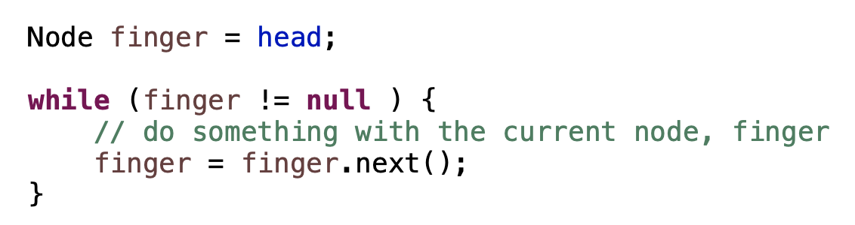
Iterating through a linked list
data: 1
data: 8
data: 4
data: 7
head
next:
next:
next:
next: null

Slide 38
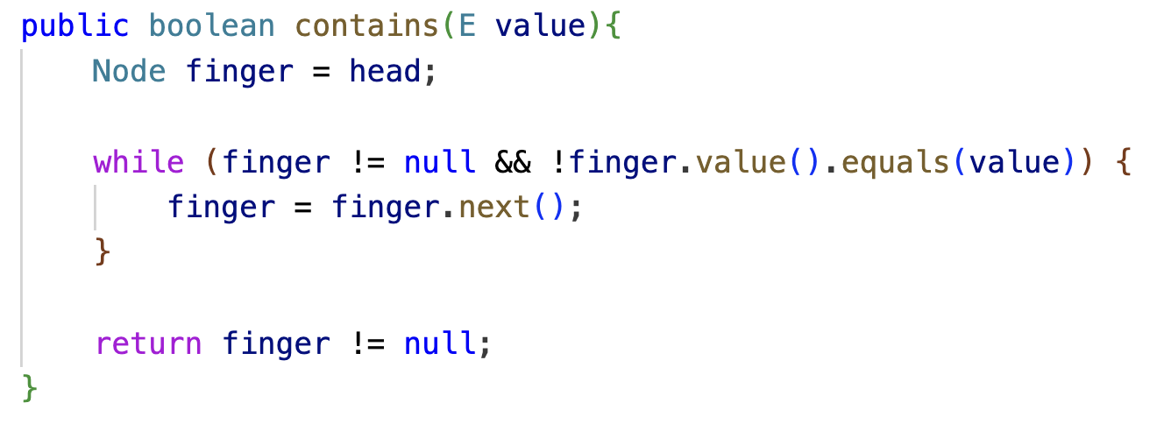
Checking if a value is in the list
data: 1
data: 8
data: 4
data: 7
head
next:
next:
next:
next: null
Write a method contains that takes a value as input and returns a boolean indicating whether or not the linked list contains that value:

Slide 39
Checking if a value is in the list
data: 1
data: 8
data: 4
data: 7
head
next:
next:
next:
next: null
Write a method contains that takes a value as input and returns a boolean indicating whether or not the linked list contains that value:

Slide 40
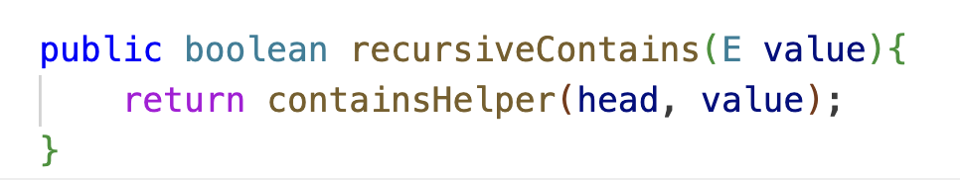
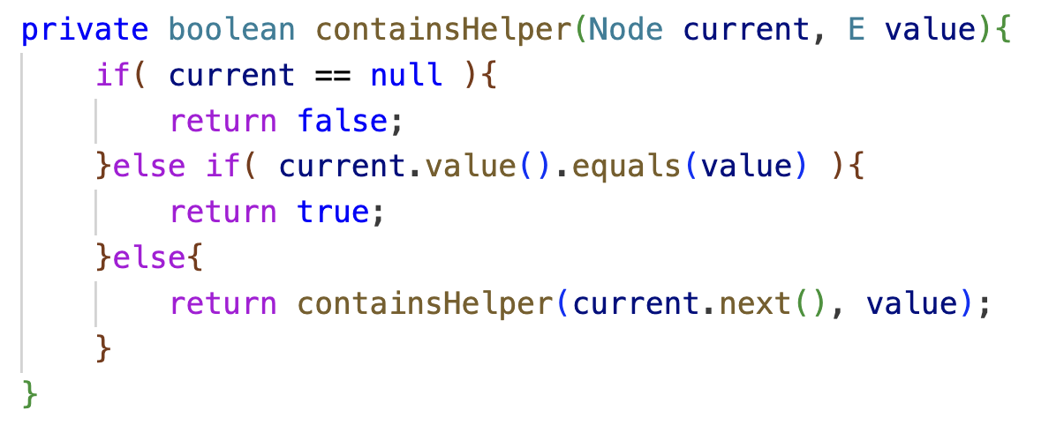
Checking if a value is in the list
data: 1
data: 8
data: 4
data: 7
head
next:
next:
next:
next: null

Slide 41
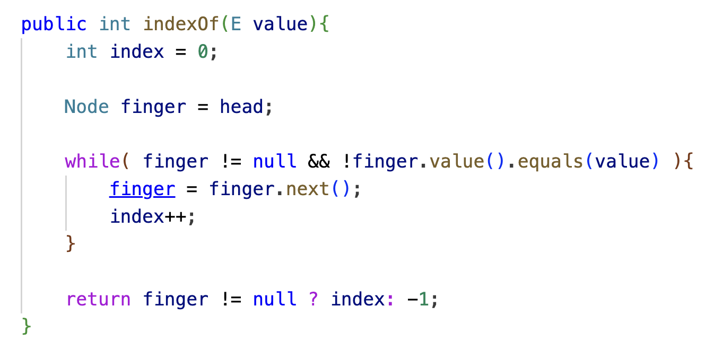
Checking if a value is in the list
data: 1
data: 8
data: 4
data: 7
head
next:
next:
next:
next: null
What does this method do?

Slide 42
Checking if a value is in the list
data: 1
data: 8
data: 4
data: 7
head
next:
next:
next:
next: null
Returns the index the value occurs at

Slide 43
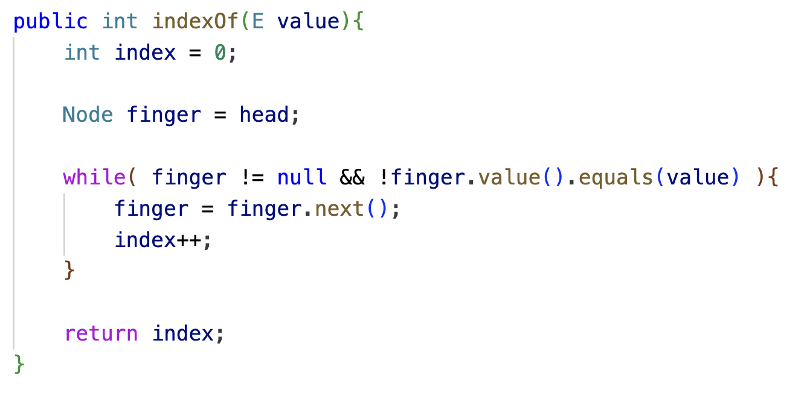

Slide 44
Adding to the end
[1, 8, 4, 7]
data: 1
data: 8
data: 4
data: 7
head
next:
next:
next:
next: null
How can we add a value to the end of the list?

Slide 45
Adding to the end: add 9 to the end
[1, 8, 4, 7]
data: 1
data: 8
data: 4
data: 7
head
next:
next:
next:
next: null
find the end of the list
finger
How do we know we’re at the end?

Slide 46
Adding to the end: add 9 to the end
[1, 8, 4, 7]
data: 1
data: 8
data: 4
data: 7
head
next:
next:
next:
next: null
find the end of the list
finger
finger.next() == null

Slide 47
Adding to the end: add 9 to the end
[1, 8, 4, 7]
data: 1
data: 8
data: 4
data: 7
data: 9
head
next:
next:
next:
next: null
next: null
finger
create a new node and add it to the end

Slide 48
Adding to the end: add 9 to the end
[1, 8, 4, 7]
data: 1
data: 8
data: 4
data: 7
data: 9
head
next:
next:
next:
next:
next: null
finger
create a new node and add it to the end

Slide 49
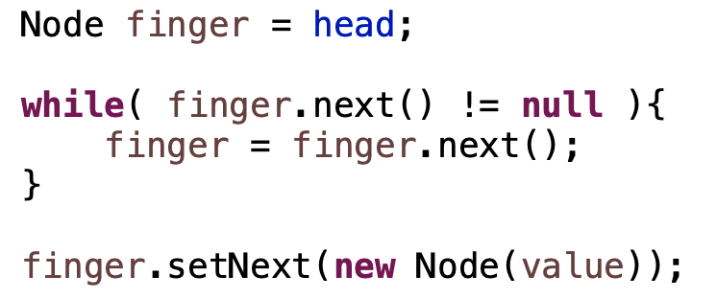
Adding to the end: add 9 to the end
[1, 8, 4, 7]
data: 1
data: 8
data: 4
data: 7
data: 9
head
next:
next:
next:
next:
next: null
finger

Slide 50
Adding to the end
[1, 8, 4, 7]
data: 1
data: 8
data: 4
data: 7
head
next:
next:
next:
next: null
Any special cases we need to handle?

Slide 51
Adding to the end
[1, 8, 4, 7]
What would happen here?
head: null
Notes:
null pointer exception!

Slide 52
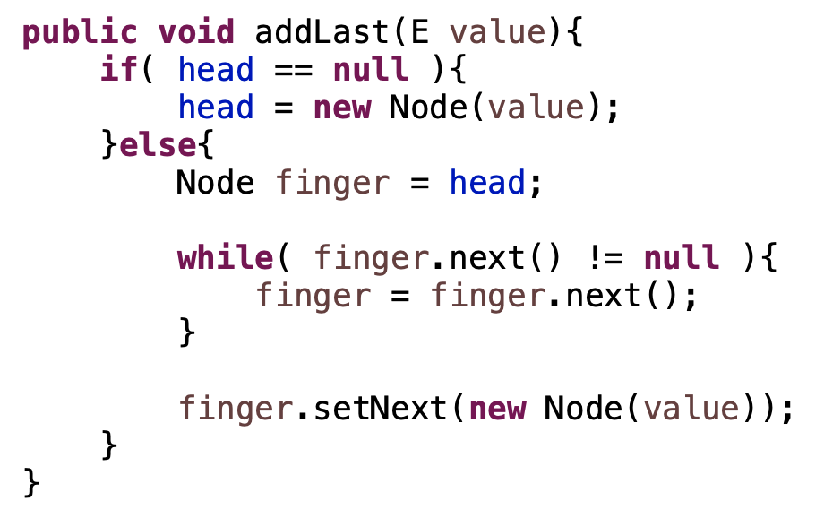
Adding to the end
[1, 8, 4, 7]
head: null

Slide 53
Removing a value
[1, 8, 4, 7]
data: 1
data: 8
data: 4
data: 7
head
next:
next:
next:
next: null
How can we we remove a value from the list?

Slide 54
Removing a value: remove 4
[1, 8, 4, 7]
data: 1
data: 8
data: 4
data: 7
head
next:
next:
next:
next: null
finger
Find it

Slide 55
Removing a value: remove 4
[1, 8, 4, 7]
data: 1
data: 8
data: 4
data: 7
head
next:
next:
next:
next: null
prev
finger
Need the node before it too!

Slide 56
Removing a value: remove 4
[1, 8, 4, 7]
data: 1
data: 8
data: 4
data: 7
head
next:
next:
next:
next: null
prev
finger
splice it out

Slide 57
Removing a value: remove 4
[1, 8, 4, 7]
data: 1
data: 8
data: 4
data: 7
head
next:
next:
next:
next: null
prev
finger
splice it out

Slide 58
Removing a value: remove 4
[1, 8, 4, 7]
data: 1
data: 8
data: 7
head
next:
next:
next: null
prev
splice it out

Slide 59
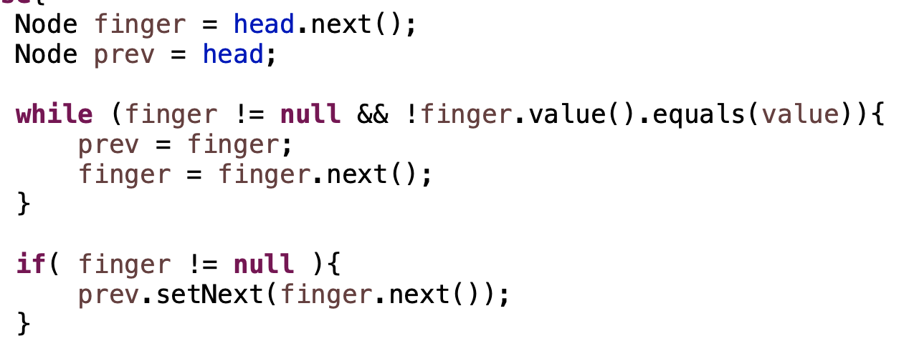
Removing a value
data: 1
data: 8
data: 4
data: 7
head
next:
next:
next:
next: null

Slide 60
Removing a value
data: 1
data: 8
data: 4
data: 7
head
next:
next:
next:
next: null
prev
finger

Slide 61
Removing a value
data: 1
data: 8
data: 4
data: 7
head
next:
next:
next:
next: null
prev
finger

Slide 62
Removing a value
data: 1
data: 8
data: 4
data: 7
head
next:
next:
next:
next: null
prev
finger

Slide 63
Removing a value
data: 1
data: 8
data: 4
data: 7
head
next:
next:
next:
next: null
prev
finger

Slide 64
Removing a value
data: 1
data: 8
data: 4
data: 7
head
next:
next:
next:
next: null
prev
finger

Slide 65
Removing a value
data: 1
data: 8
data: 4
data: 7
head
next:
next:
next:
next: null
prev
finger
When would finger be null?

Slide 66
Removing a value
data: 1
data: 8
data: 4
data: 7
head
next:
next:
next:
next: null
prev
finger

Slide 67
Removing a value
data: 1
data: 8
data: 4
data: 7
head
next:
next:
next:
next: null
Any special cases we need to handle?

Slide 68
Removing a value
head: null
What would happen here?

Slide 69
Removing a value
data: 1
data: 8
data: 4
data: 7
head
next:
next:
next:
next: null
Any other special cases we need to handle?

Slide 70
Removing a value
data: 1
data: 8
data: 4
data: 7
head
next:
next:
next:
next: null
Delete 1. Does it work?

Slide 71
Removing a value
data: 1
data: 8
data: 4
data: 7
head
next:
next:
next:
next: null
prev
finger
Delete 1. Does it work?

Slide 72
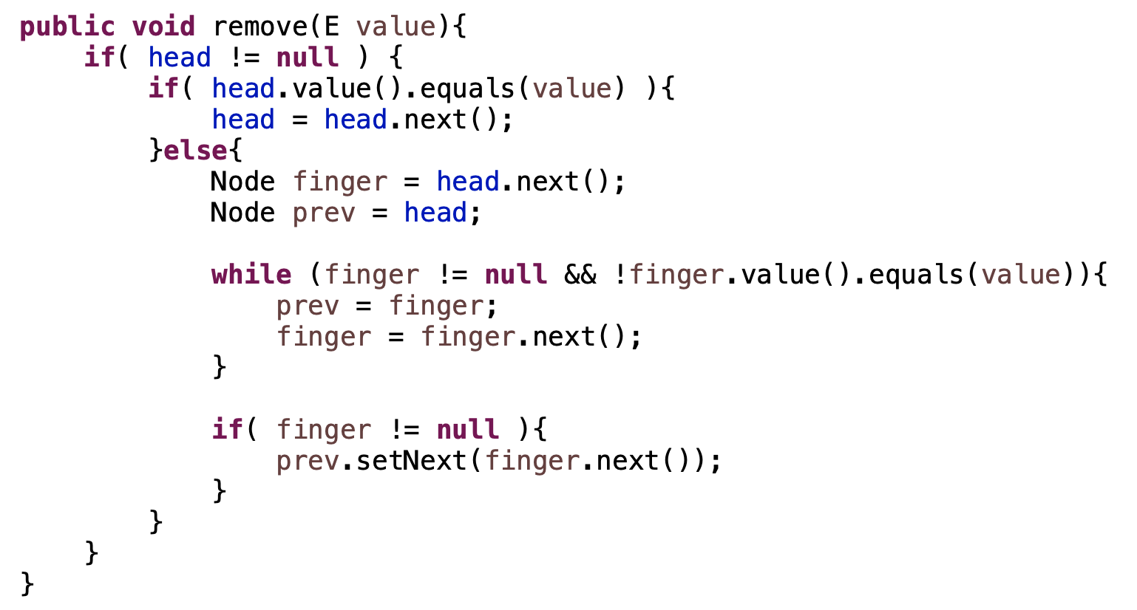
Removing a value

Slide 73
Removing a value
handle empty list
removing first element
all other elements

Slide 74
Linked lists: fast or slow?
 | Linked list
add to end
add to front
insert at index
contains
get
set
remove
remove from end
remove from front
size

Slide 75
Linked lists: fast or slow?
 | Singly linked list
add to end | slow
add to front | fast
insert at index | slow
contains | slow
get | slow
set | slow
remove | slow
remove from end | slow
remove from front | fast
size | fast
fast = O(1)
slow = O(n)

Slide 76
Linked lists: fast or slow?
 | ArrayList | Singly linked list
add to end |  | slow
add to front |  | fast
insert at index |  | slow
contains |  | slow
get |  | slow
set |  | slow
remove |  | slow
remove from end |  | slow
remove from front |  | fast
size |  | fast
How does this compare to ArrayLists?

Slide 77
Linked lists: fast or slow?
 | ArrayList | Singly linked list
add to end | fast (amortized) | slow
add to front | slow | fast
insert at index | slow | slow
contains | slow | slow
get | fast | slow
set | fast | slow
remove | slow | slow
remove from end | fast | slow
remove from front | slow | fast
size | fast | fast

Slide 78
Linked lists: fast or slow?
 | ArrayList | Singly linked list
add to end | fast (amortized) | slow
add to front | slow | fast
insert at index | slow | slow
contains | slow | slow
get | fast | slow
set | fast | slow
remove | slow | slow
remove from end | fast | slow
remove from front | slow | fast
size | fast | fast

Slide 79
Linked lists: fast or slow?
 | Singly linked list
add to end | slow
add to front | fast
insert at index | slow
contains | slow
get | slow
set | slow
remove | slow
remove from end | slow
remove from front | fast
size | fast
Can we make any of these faster?

Slide 80
Adding a tail reference
 | Singly linked list
add to end | slow
add to front | fast
insert at index | slow
contains | slow
get | slow
set | slow
remove | slow
remove from end | slow
remove from front | fast
size | fast
[8, 4, 7]
data: 8
data: 4
data: 7
head
next:
next:
next: null
tail
How does this help us?

Slide 81
Adding a tail reference
 | Singly linked list | Singly linked list (tail)
add to end | slow | fast
add to front | fast | fast
insert at index | slow | slow
contains | slow | slow
get | slow | slow
set | slow | slow
remove | slow | slow
remove from end | slow | slow
remove from front | fast | fast
size | fast | fast
[8, 4, 7]
data: 8
data: 4
data: 7
head
next:
next:
next: null
tail
Add to the end quickly!

Slide 82
Adding a tail reference
[1, 8, 4, 7]
data: 1
data: 8
data: 4
data: 7
head
next:
next:
next:
next: null
tail
Is removing from the end fast?

Slide 83
Adding a tail reference
[1, 8, 4, 7]
data: 1
data: 8
data: 4
data: 7
head
next:
next:
next:
next: null
tail
No! Need access to previous

Slide 84
Doubly linked list visualized
Keep track of both the next and previous node in the list
data: 1
data: 8
data: 4
data: 7
head
next:
next:
next:
next: null
prev: null
prev:
prev:
prev:
tail

Slide 85
Doubly linked list visualized
data: 1
data: 8
data: 4
data: 7
head
next:
next:
next:
next: null
prev: null
prev:
prev:
prev:
tail
Is removing from the end fast?

Slide 86
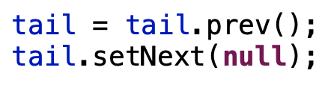
Doubly linked list visualized
data: 1
data: 8
data: 4
data: 7
head
next:
next:
next:
next: null
prev: null
prev:
prev:
prev:
tail

Slide 87
Doubly linked list visualized
data: 1
data: 8
data: 4
data: 7
head
next:
next:
next:
next: null
prev: null
prev:
prev:
prev:
tail

Slide 88
Doubly linked list visualized
data: 1
data: 8
data: 4
data: 7
head
next:
next:
next: null
next: null
prev: null
prev:
prev:
prev:
tail

Slide 89
Doubly linked list visualized
finger
data: 1
data: 8
data: 4
data: 7
head
next:
next:
next:
next: null
prev: null
prev:
prev:
prev:
tail
Could I remove a node if I had a reference to it?

Slide 90
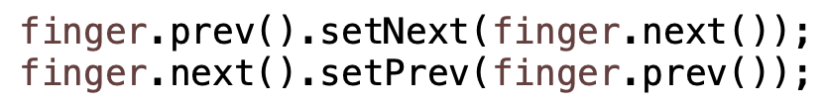
Doubly linked list visualized
finger
data: 1
data: 8
data: 4
data: 7
head
next:
next:
next:
next: null
prev: null
prev:
prev:
prev:
tail

Slide 91
Doubly linked list visualized
finger
data: 1
data: 8
data: 4
data: 7
head
next:
next:
next:
next: null
prev: null
prev:
prev:
prev:
tail

Slide 92
Doubly linked list visualized
finger
data: 1
data: 8
data: 4
data: 7
head
next:
next:
next:
next: null
prev: null
prev:
prev:
prev:
tail

Slide 93
Doubly linked list visualized
finger
data: 1
data: 8
data: 4
data: 7
head
next:
next:
next:
next: null
prev: null
prev:
prev:
prev:
tail

Slide 94
Doubly linked list visualized
finger
data: 1
data: 8
data: 4
data: 7
head
next:
next:
next:
next: null
prev: null
prev:
prev:
prev:
tail
How does this help us? We still have to find the node?

Slide 95
Doubly linked list visualized
finger
data: 1
data: 8
data: 4
data: 7
head
next:
next:
next:
next: null
prev: null
prev:
prev:
prev:
tail
If we’re iterating over the data already
Other scenarios (see upcoming assignment ☺)

Slide 96
List performance
 | ArrayList | Singly linked list | Singly linked list (tail) | Doubly linked list
add to end | fast (amortized) | slow | fast
add to front | slow | fast | fast
insert at index | slow | slow | slow
contains | slow | slow | slow
get | fast | slow | slow
set | fast | slow | slow
remove | slow | slow | slow
remove from end | fast | slow | slow
remove from front | slow | fast | fast
size | fast | fast | fast
Which of these change with doubly linked lists?

Slide 97
List performance
 | ArrayList | Singly linked list | Singly linked list (tail) | Doubly linked list
add to end | fast (amortized) | slow | fast | fast
add to front | slow | fast | fast | fast
insert at index | slow | slow | slow | slow
contains | slow | slow | slow | slow
get | fast | slow | slow | slow
set | fast | slow | slow | slow
remove | slow | slow | slow | slow*
remove from end | fast | slow | slow | fast
remove from front | slow | fast | fast | fast
size | fast | fast | fast | fast

Slide 98
List performance
 | ArrayList | Singly linked list | Singly linked list (tail) | Doubly linked list
add to end | fast (amortized) | slow | fast | fast
add to front | slow | fast | fast | fast
insert at index | slow | slow | slow | slow
contains | slow | slow | slow | slow
get | fast | slow | slow | slow
set | fast | slow | slow | slow
remove | slow | slow | slow | slow*
remove from end | fast | slow | slow | fast
remove from front | slow | fast | fast | fast
size | fast | fast | fast | fast

Slide 99
Java implementation
https://docs.oracle.com/javase/8/docs/api/java/util/LinkedList.html

Slide 100
Circularly linked list visualized
data: 1
data: 8
data: 4
data: 7
head
next:
next:
next:
next:
prev: null
prev:
prev:
prev:
tail
The “next” references of the last item in the list points back to the front

Slide 101
Circularly linked list visualized
data: 1
data: 8
data: 4
data: 7
head
next:
next:
next:
next:
prev: null
prev:
prev:
prev:
tail
The “next” references of the last item in the list points back to the front
Any advantage of this?

Slide 102
Circularly linked list visualized
data: 1
data: 8
data: 4
data: 7
next:
next:
next:
next:
prev: null
prev:
prev:
prev:
tail
The “next” references of the last item in the list points back to the front
Can get rid of head! head = tail.next()

