Slide 1
Hashtables
David Kauchak
CS 62 – Fall 2026

Slide 2
Admin
No mentor/office hours over fall break
Wordle due Friday @ 5pm

Slide 3
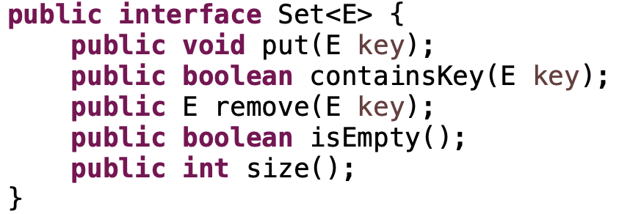
Sets
An unordered collection
Things can be added and removes
Check if things are in the set
Could we do this with any of our data structures so far?
Big-O runtime of methods?

Slide 4
Sets
An unordered collection
Things can be added and removes
Check if things are in the set
We’d like to make these operations fast: O(1)!

Slide 5
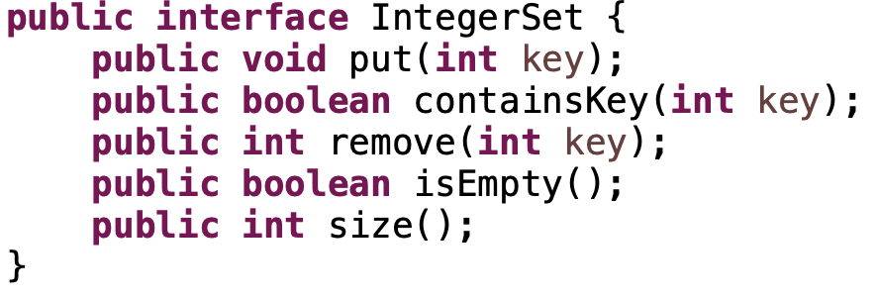
Integer sets
What if we assume that they’re integers.
Any ideas how to do this fast?

Slide 6
Integer sets
Array
null
null
null
null
null
null
null
null
null
null
null
null
null
null
null

Slide 7
Integer sets
put(5)
Where should we put it?
Array
null
null
null
null
null
null
null
null
null
null
null
null
null
null
null

Slide 8
Integer sets
put(5)
Array
null
null
null
null
null
5
null
null
null
null
null
null
null
null
null

Slide 9
Integer sets
put(7)
Where should we put it?
Array
null
null
null
null
null
5
null
null
null
null
null
null
null
null
null

Slide 10
Integer sets
put(7)
Where should we put it?
Array
null
null
null
null
null
5
null
7
null
null
null
null
null
null
null

Slide 11
Integer sets
containsKey(4)?
Array
null
null
null
null
null
5
null
7
null
null
null
null
null
null
null

Slide 12
Integer sets
containsKey(4)?
No!
Array
null
null
null
null
null
5
null
7
null
null
null
null
null
null
null

Slide 13
Integer sets
containsKey(7)?
Array
null
null
null
null
null
5
null
7
null
null
null
null
null
null
null

Slide 14
Integer sets
containsKey(7)?
Yes!
Array
null
null
null
null
null
5
null
7
null
null
null
null
null
null
null

Slide 15
Integer sets
remove(5)?
Array
null
null
null
null
null
5
null
7
null
null
null
null
null
null
null

Slide 16
Integer sets
remove(5)?
Array
null
null
null
null
null
null
null
7
null
null
null
null
null
null
null

Slide 17
Integer sets
What is the big-O runtime of the methods?
O(1)
Array
null
null
null
null
null
5
null
7
null
null
null
null
null
null
null

Slide 18
Integer sets
Any problems?
Array
null
null
null
null
null
5
null
7
null
null
null
null
null
null
null

Slide 19
Integer sets
Negative numbers (could fix this by adding a constant)
The array would have to be huge!
(ints range from -2³¹ to 2³¹-1,
2³¹= ~2 billion)
Any problems?
Array
null
null
null
null
null
5
null
7
null
null
null
null
null
null
null

Slide 20
Keys
universe of keys - U
For whatever key we’re using (e.g., integers), there is a universe of all possible keys

Slide 21
Why not just arrays?
array must be as large as the universe of keys
universe of keys - U
Array

Slide 22
Why not just arrays?
array must be as large as the universe of keys
universe of keys - U
space of actual keys used is often much, much smaller than the universe of keys
actual
keys, n
Array

Slide 23
Why not arrays?
Think of indexing all last names < 10 characters
  Census listing of all last names https://www.census.gov/topics/population/genealogy/data/2020_names.htm
  156,621 last names
  What is the size of our space of keys?
    26¹⁰ = a big number
  Not feasible!
  Even if it were, not space efficient

Slide 24
Hashtables
Using an array is still a good idea
Key idea: need to translate from the key into an index in the array
Array
null
null
null
null
null
5
null
7
null
null
null
null
null
null
null
m

Slide 25
Hash function, h
A hash function is a function that maps the universe of keys to a restricted range (e.g., the size of an array)
universe of keys - U
hash function, h: U ➔m
m << |U|

Slide 26
Hash function, h
A hash function is a function that maps the universe of keys to a restricted range (e.g., the size of an array)
universe of keys - U
hash function, h: U ➔m
m << |U|

Slide 27
Hash function, h
A hash function is a function that maps the universe of keys to a restricted range (e.g., the size of an array)
universe of keys - U
hash function, h: U ➔m
m << |U|

Slide 28
Hash function, h
What can happen if m < |U|?
universe of keys - U
hash function, h: U ➔m
m << |U|

Slide 29
Collisions
If m < |U|, then two keys can map to the same position in the hashtable (pidgeonhole principle)
universe of keys - U
hash function, h
m << |U|

Slide 30
Collisions
A collision occurs when h(x) = h(y), but x ≠ y
A good hash function will minimize the number of collisions
Because the number of hashtable (array) entries is less than the possible keys (i.e. m < |U|) collisions are inevitable!
We need to handle collisions!
Collision resolution techniques?

Slide 31
Collision resolution by chaining
Hashtable consists of an array of linked lists
When a collision occurs, the element is added to linked list at that location
If two entries x ≠ y have the same hash value h(x) = h(y), then table[h(x)] will contain a linked list with both values
null
null
null
null
null
null
null
null
null
null
null
null

Slide 32
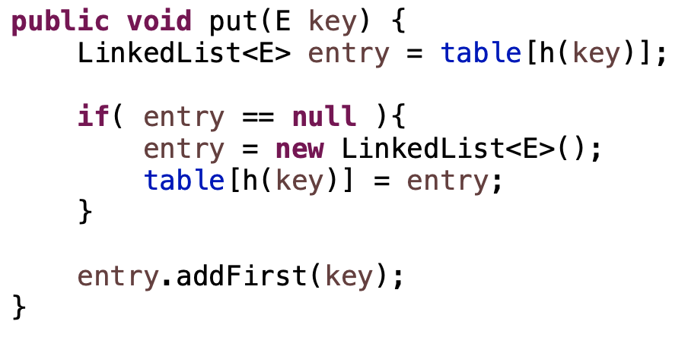
put
What does this code do?

Slide 33
put( )
null
null
null
null
null
null
null
null
null
null
null
null
null

Slide 34
put( )
h( )
hash function is a mapping from the key to some value < m
null
null
null
null
null
null
null
null
null
null
null
null
null

Slide 35
put( )
h( )
hash function is a mapping from the key to some value < m
null
null
null
null
null
null
null
null
null
null
null
null
null

Slide 36
put( )
h( )
hash function is a mapping from the key to some value < m
null
null
null
null
null
null
null
null
null
null
null
null
null

Slide 37
More methods
containsKey?
remove?
null
null
null
null
null
null
null
null
null
null
null
null

Slide 38
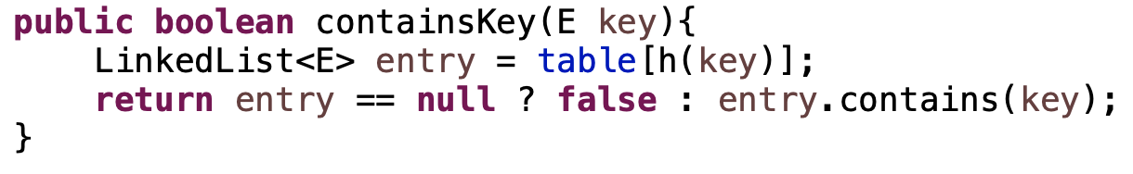
containsKey
null
null
null
null
null
null
null
null
null
null
null
null

Slide 39
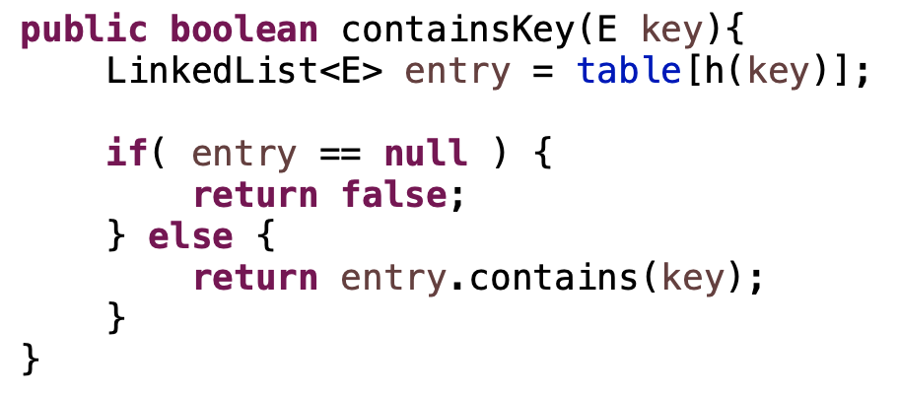
ternary operator

Slide 40
containsKey
containsKey( )
null
null
null
null
null
null
null
null
null
null
null
null

Slide 41
containsKey
containsKey( )
h( )
null
null
null
null
null
null
null
null
null
null
null
null

Slide 42
containsKey
containsKey( )
h( )
null
null
null
null
null
null
null
null
null
null
null
null

Slide 43
containsKey
containsKey( )
h( )
null
null
null
null
null
null
null
null
null
null
null
null

Slide 44
containsKey
containsKey( )
h( )
null
null
null
null
null
null
null
null
null
null
null
null

Slide 45
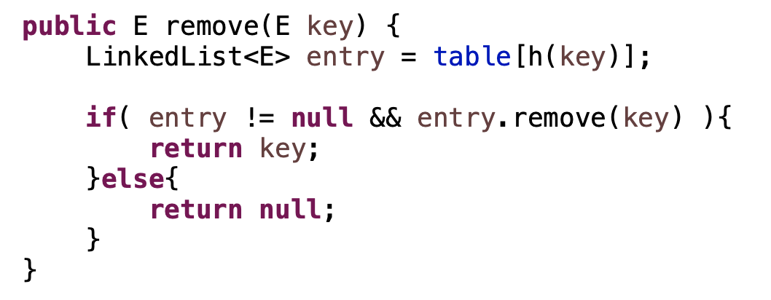
remove
null
null
null
null
null
null
null
null
null
null
null
null

Slide 46
remove
containsKey( )
null
null
null
null
null
null
null
null
null
null
null
null

Slide 47
remove
containsKey( )
h( )
null
null
null
null
null
null
null
null
null
null
null
null

Slide 48
remove
containsKey( )
h( )
null
null
null
null
null
null
null
null
null
null
null
null

Slide 49
remove
containsKey( )
h( )
null
null
null
null
null
null
null
null
null
null
null
null

Slide 50
remove
containsKey( )
h( )
null
null
null
null
null
null
null
null
null
null
null
null

Slide 51
Average case running time?
put
containsKey
remove
null
null
null
null
null
null
null
null
null
null
null
null

Slide 52
Average case running time?
put: O(1)
containsKey:
O(length of linked list)
remove:
O(length of linked list)
null
null
null
null
null
null
null
null
null
null
null
null

Slide 53
Length of the chain
Worst case?

Slide 54
Length of the chain
Worst case?
  All elements hash to the same location
  h(k) = 4
  n
…

Slide 55
Length of the chain
Average case:
  Depends on how well the hash function distributes the keys
  What is the best we could hope for a hash function?
    simple uniform hashing: an element is equally likely to end up in any of the m slots

Slide 56
Average chain length
If you roll a fair m sided die n times, how many times are we likely to see a given value?
For example, 10 sided die:
  1 time
    1/10
  100 times
    100/10 = 10

Slide 57
Length of the chain
Average case:
  Depends on how well the hash function distributes the keys
  What is the best we could hope for a hash function?
    simple uniform hashing: an element is equally likely to end up in any of the m slots
  Under simple uniform hashing what is the average length of a chain in the table (table size m with n elements)?
    n keys over m slots = n / m = α

Slide 58
The load of a table/hashtable
m = number of possible entries in the table
n = number of keys stored in the table
α = n/m is the load factor of the hashtable
The smaller α, the more wasteful the table
The load also helps us talk about run time

Slide 59
containsKey average running time
Two cases:
  Key is not in the table
    must search all entries
    O(1 + α)
  Key is in the table
    on average search half of the entries
    O(1 + α)

Slide 60
Hash functions
Function that takes as input a key and return a value from 0 to m-1 (the size of the hashtable)
universe of keys - U
hash function, h: U ➔m

Slide 61
Hash functions
What makes a good hash function?
  Approximates the assumption of simple uniform hashing
  Deterministic – h(x) should always return the same value
  Low cost – if it is expensive to calculate the hash value (e.g. log n) then we don’t gain anything by using a table
Challenge: we don’t generally know the distribution of the keys
  Frequently data tend to be clustered (e.g. similar strings, run-times, SSNs). A good hash function should spread these out across the table

Slide 62
Division method
h(k) = k mod m
m k h(k)
11 25
11 1
11 17
13 133
13 7
13 25

Slide 63
Division method
h(k) = k mod m
m k h(k)
11 25
3
11 1
1
11 17
6
13 133
3
13 7
7
13 25
12

Slide 64
Division method
Don’t use a power of two. Why?
m k bin(k) h(k)
25 11001
8 1 00001
8 17 10001

Slide 65
Division method
Don’t use a power of two. Why?
if h(k) = k mod 2^{p}, the hash function is just the lower p bits of the value
m k bin(k) h(k)
25 11001 1
8 1 00001 1
8 17 10001 1

Slide 66
Division method
Good rule of thumb for m is a prime number not too close to a power of 2
Pros:
  quick to calculate
  easy to understand
Cons:
  keys close to each other will end up close in the hashtable

Slide 67
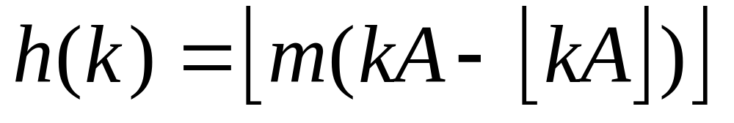
Multiplication method
Multiply the key by a constant 0 < A < 1 and extract the fractional part of kA, then scale by m to get the index
extracts the fractional portion of kA

Slide 68
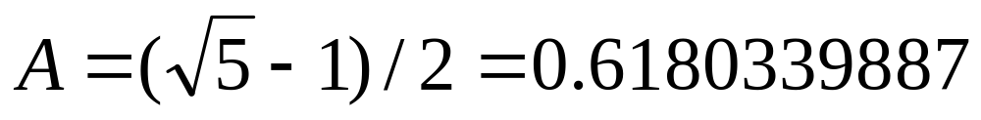
Multiplication method
Common choice is for m as a power of 2 and
Why a power of 2?
Book has other heuristics

Slide 69
Multiplication method
m k A
8 15 0.618
8 23 0.618
8 100 0.618
kA h(k)

Slide 70
Multiplication method
m k A
8 15 0.618
8 23 0.618
8 100 0.618
kA h(k)
9.27
14.214
61.8

Slide 71
Multiplication method
m k A
8 15 0.618
8 23 0.618
8 100 0.618
kA h(k)
9.27
floor(0.27*8) = 2
14.214
floor(0.214*8) = 1
61.8
floor(0.8*8) = 6

Slide 72
Other hash functions
http://en.wikipedia.org/wiki/List_of_hash_functions
cyclic redundancy checks (i.e. disks, cds, dvds)
Checksums (i.e. networking, file transfers)
Cryptographic (i.e. MD5, SHA)

