Slide 1
quicksort
David Kauchak
CS 62 – Fall 2026

Slide 2
Admin
Wordle Assignment
No office hours Thursday (reach out, I can meet other times)
No mentor hours over fall break

Slide 3
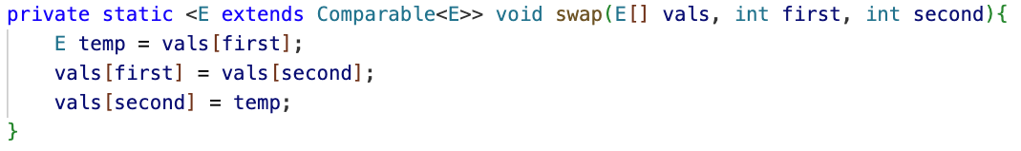
swap
What does this method do?

Slide 4
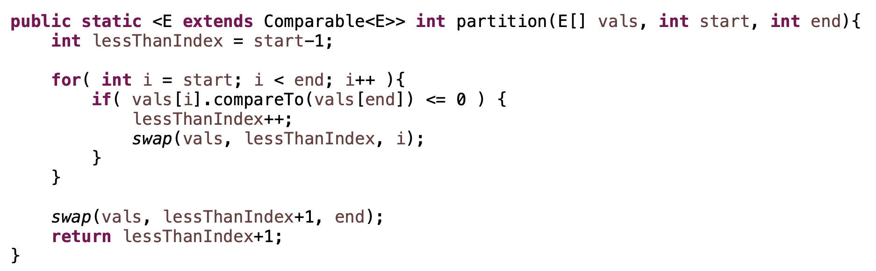
Partition
what does this method do?

Slide 5
… 5 7 1 2 8 4 3 6 …
start
end

Slide 6
lessThanIndex
… 5 7 1 2 8 4 3 6 …
start
end

Slide 7
lessThanIndex
i
… 5 7 1 2 8 4 3 6 …
start
end

Slide 8
lessThanIndex
i
… 5 7 1 2 8 4 3 6 …
start
end

Slide 9
lessThanIndex
i
… 5 7 1 2 8 4 3 6 …
start
end

Slide 10
lessThanIndex
i
… 5 7 1 2 8 4 3 6 …
start
end

Slide 11
lessThanIndex
i
… 5 7 1 2 8 4 3 6 …
start
end

Slide 12
lessThanIndex
i
… 5 7 1 2 8 4 3 6 …
start
end

Slide 13
lessThanIndex
i
… 5 7 1 2 8 4 3 6 …
start
end

Slide 14
lessThanIndex
i
… 5 1 7 2 8 4 3 6 …
start
end

Slide 15
lessThanIndex
i
… 5 1 7 2 8 4 3 6 …
start
end

Slide 16
lessThanIndex
i
… 5 1 7 2 8 4 3 6 …
start
end

Slide 17
lessThanIndex
i
… 5 1 2 7 8 4 3 6 …
start
end

Slide 18
lessThanIndex
i
… 5 1 2 7 8 4 3 6 …
start
end

Slide 19
lessThanIndex
i
… 5 1 2 7 8 4 3 6 …
start
end
What’s happening?

Slide 20
lessThanIndex
i
… 5 1 2 7 8 4 3 6 …
start
end
≤ pivot
> pivot
unprocessed

Slide 21
lessThanIndex
i
… 5 1 2 7 8 4 3 6 …
start
end

Slide 22
lessThanIndex
i
… 5 1 2 4 8 7 3 6 …
start
end

Slide 23
lessThanIndex
i
… 5 1 2 4 3 7 8 6 …
start
end

Slide 24
lessThanIndex
i
… 5 1 2 4 3 6 8 7 …
start
end

Slide 25
vals[end] is called the pivot
Partitions the elements nums[start…end-1] in to two sets, those ≤ pivot and those > pivot
Operates in place
Final result:
start
pivot
end
nums
≤ pivot
> pivot

Slide 26
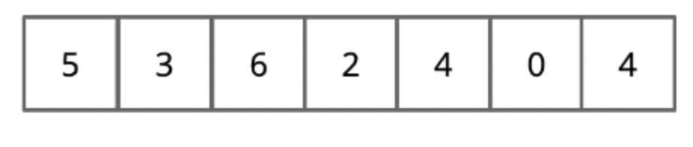
What would be the result if we called partition on this list?

Slide 27
lessThanIndex
i
5 3 6 2 4 0 4

Slide 28
lessThanIndex
i
5 3 6 2 4 0 4

Slide 29
lessThanIndex
i
3 5 6 2 4 0 4

Slide 30
lessThanIndex
i
3 2 6 5 4 0 4

Slide 31
lessThanIndex
i
3 2 4 5 6 0 4

Slide 32
lessThanIndex
i
3 2 4 0 6 5 4

Slide 33
3 2 4 0 4 5 6

Slide 34
Partition running time?
n = end - start
Notes:
where n is end-start
just walks through each element in this range and does a constant amount of work

Slide 35
Partition running time?
O(n)
Notes:
where n is end-start
just walks through each element in this range and does a constant amount of work

Slide 36
Quicksort
How can we use this method to sort?

Slide 37
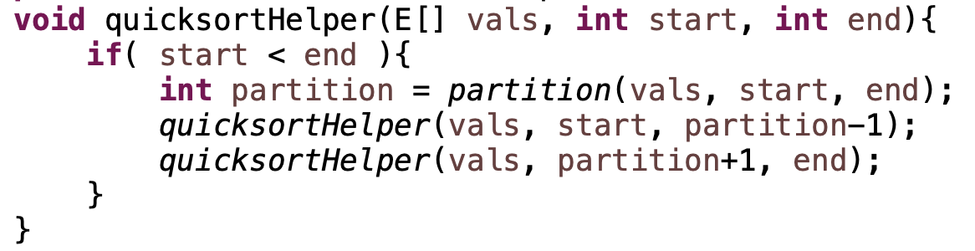
Quicksort

Slide 38
Quicksort
8 5 1 3 6 2 7 4

Slide 39
Quicksort
8 5 1 3 6 2 7 4

Slide 40
Quicksort
1 3 2 4 6 8 7 5

Slide 41
Quicksort
1 3 2 4 6 8 7 5

Slide 42
Quicksort
1 3 2 4 6 8 7 5

Slide 43
Quicksort
1 2 3 4 6 8 7 5

Slide 44
Quicksort
1 2 3 4 6 8 7 5

Slide 45
Quicksort
1 2 3 4 6 8 7 5

Slide 46
Quicksort
1 2 3 4 6 8 7 5

Slide 47
Quicksort
1 2 3 4 6 8 7 5

Slide 48
Quicksort
1 2 3 4 5 8 7 6
What happens here?

Slide 49
Quicksort
1 2 3 4 5 8 7 6

Slide 50
Quicksort
1 2 3 4 5 8 7 6

Slide 51
Quicksort
1 2 3 4 5 6 7 8

Slide 52
Quicksort
1 2 3 4 5 6 7 8

Slide 53
Running time of Quicksort?
Worst case?
Each call to Partition splits the array into an empty array and n-1 array

Slide 54
Quicksort: Worst case running time
n-1 + n-2 + n-3 + … + 1 =
O(n²)
When does this happen?
  sorted
  reverse sorted
  near sorted/reverse sorted

Slide 55
Quicksort best case?
Each call to Partition splits the array into two equal parts
…
How much work is done at each “level”, i.e. running time of a level?
O(n)

Slide 56
Quicksort best case?
Each call to Partition splits the array into two equal parts
…
How many levels are there?
Similar to mergesort, each call to Partition will throw away half the data until we’re down to one element: log₂ n levels

Slide 57
Quicksort best case?
Each call to Partition splits the array into two equal parts
…
Overall runtime?
O(n log n)

Slide 58
Quicksort Average case?
Two intuitions
  As long as the Partition procedure always splits the array into some constant ratio between the left and the right, say L-to-R, e.g. 9-to-1, then we maintain O(n log n)
  As long as we only have a constant number of “bad” partitions intermixed with a “good partition” then we maintain O(n log n)

Slide 59
How can we avoid the worst case?
Inject randomness into the data
void randomizedPartition(E [] nums, int start, int end){
int i = randomInt(start, end);
swap(nums, i, end);
return partition = partition(nums, start, end);
}
Randomized quicksort is average case O(n log n)

Slide 60
What is the wost case running time of randomized Quicksort?
O(n²)
We could still get very unlucky and pick “bad” partitions at every step

Slide 61
Quicksort properties
Stable?
In-place?

Slide 62
Quicksort properties
Stable: possible, but not the way we’ve written it (and requires more storage!0
In-place: yes!

Slide 63
Sorting summarized
 | in-place? | stable? | Best | Average | Worst | Notes
Selection | X |  | O(n²) | O(n²) | O(n²) | n swaps
Insertion | X | X | O(n) | O(n²) | O(n²) | use for partially ordered
Merge |  | X | O(n log n) | O(n log n) | O(n log n) | guaranteed
Quick | X |  | O(n log n) | O(n log n) | O(n²) | fastest in practice

Slide 64
Comparable interface
https://docs.oracle.com/javase/8/docs/api/java/lang/Comparable.html
Interface Comparable<T>
int compareTo(T other)
-1: this object is less than other (technically, any negative number)
0: this object is equal to other
1: this object is greater than other (technically, any positive number)

Slide 65
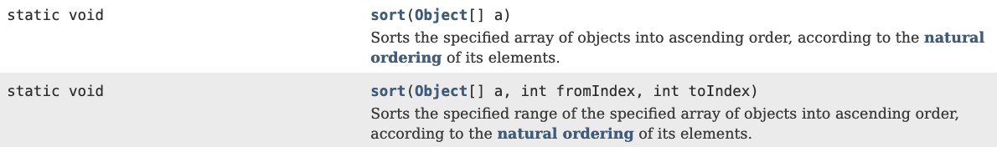
Built-in sorting
Arrays: (https://docs.oracle.com/javase/8/docs/api/java/util/Arrays.html)
Collections:(https://docs.oracle.com/javase/8/docs/api/java/util/Collections.html)

Slide 66
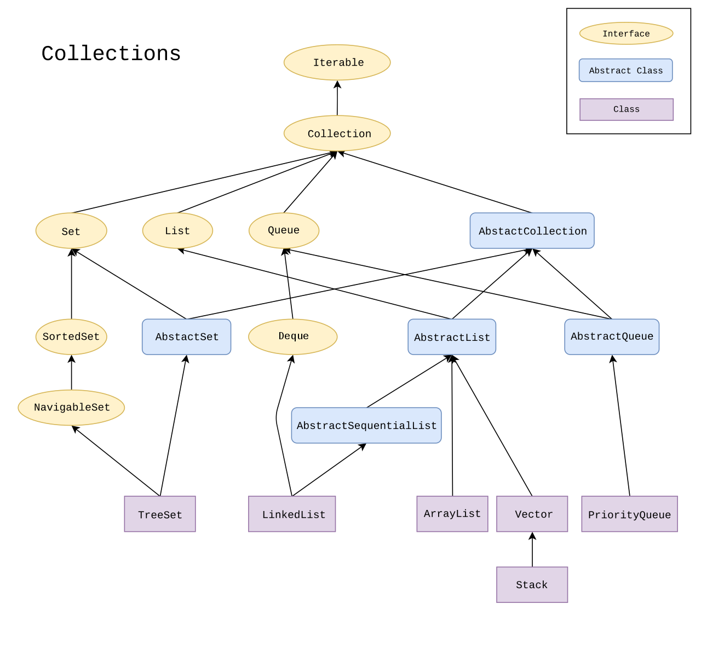
Collections

Slide 67
Naturally sorting cards
https://github.com/pomonaCS62-fa2026/LectureCode/tree/main/SortingCards
SortableCard:
implements Comparable<SortableCard>
Utilizes String.compareTo and Integer.compare
Foreach loop!
naturalSort()

Slide 68
Comparator: unnatural sorting
https://docs.oracle.com/javase/8/docs/api/java/util/Comparator.html
Create a different ordering without having to modify the class!
Interface Comparator<T>
int compare(T o1, T o2)
-1: o1 is less than o2 (technically, any negative number)
0: o1 is equal to o2
1: o1 is greater than o2 (technically, any positive number)

Slide 69
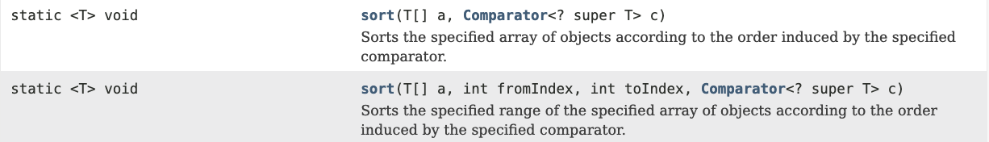
Unnatural sorting
Arrays: (https://docs.oracle.com/javase/8/docs/api/java/util/Arrays.html)
Collections:(https://docs.oracle.com/javase/8/docs/api/java/util/Collections.html)

Slide 70
Unnaturally sorting cards
https://github.com/pomonaCS62-fa2026/LectureCode/blob/main/SortingCards/BridgeCardSort.java
Add 20 to aces
Reverse the suit ordering
Reverse the number ordering
bridgeOrderingSort
Notes:
implements Comparable
utilize String.compareTo and Integer.compare
point out foreach loop

Slide 71
Iterator
https://docs.oracle.com/javase/8/docs/api/java/util/Iterator.html
A way to move through all of the data in a collection
Interface Iterator<E>:
boolean hasNext()
E next()
Have we seen this before? How can we iterate through the data?

Slide 72
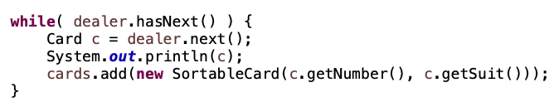
Iterator

Slide 73
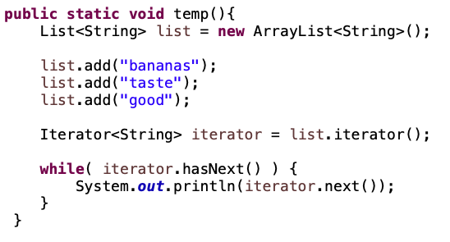
Iterator example
What would we see printed?

Slide 74
Iterator example
bananas
taste
good

Slide 75
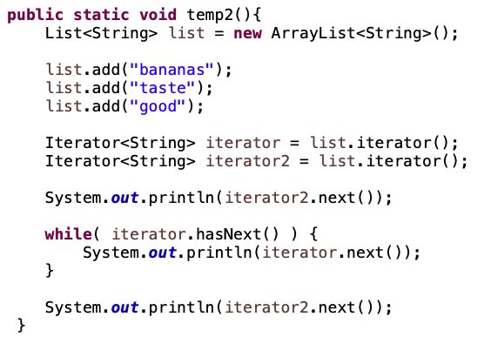
Iterator example
What would we see printed?

Slide 76
Iterator example
bananas
bananas
taste
good
taste
Each iterator has its own state!

Slide 77
Iterable
https://docs.oracle.com/javase/8/docs/api/java/lang/Iterable.html
interface Iterable<E>:
Iterator<E> iterator()
Just a single method that returns an Iterator.

Slide 78

Why Iterable??
Any class that implements the Iterable class can be used in a foreach loop!

Slide 79
How to make a class Iterable
Implement Iterable interface
Make a private inner class that implements the Iterator interface
Have the iterator method return an instance of the private inner class

Slide 80
An example
https://github.com/pomonaCS62-fa2026/LectureCode/tree/main/Iterable
Each instance of the inner class will have its own count instance variable

Slide 81
Iterator vs. Iterable
Iterators are a useful mechanism for iterating over almost any type of data
Iterators are the thing that do most of the work (and require most of the coding!)
Iterable allows us to use it in a foreach loop and is often just creating an instance of an Iterator

