Slide 1
Mergesort
David Kauchak
CS 62 – Fall 2026

Slide 2
Admin
Assignment 5 (Wordle) out and due Friday (10/16) @ 5pm
Checkpoint 1 corrections

Slide 3
Comparable interface
https://docs.oracle.com/javase/8/docs/api/java/lang/Comparable.html
Interface Comparable<T>
int compareTo(T other)
-1: this object is less than other (technically, any negative number)
0: this object is equal to other
1: this object is greater than other (technically, any positive number)

Slide 4
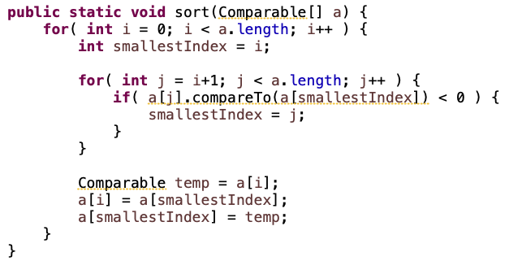
Selection sort

Slide 5
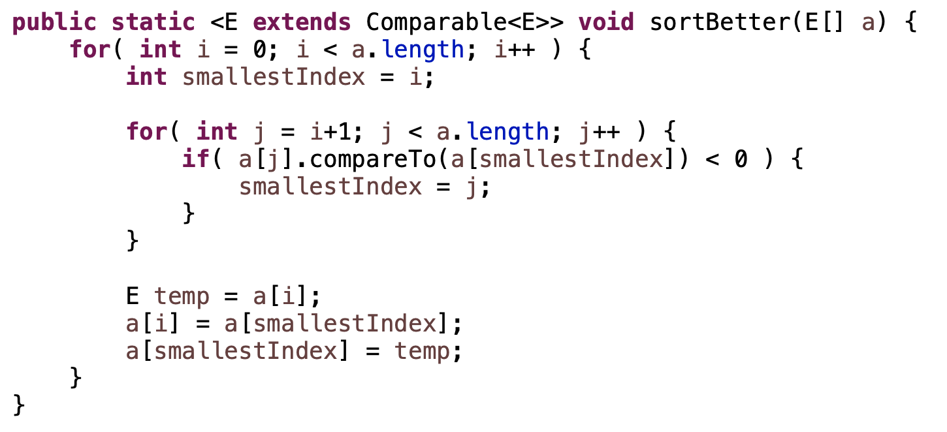
A better way
We can constrain the type variable to only allow for classes that implement Comparable<E>.

Slide 6
Insertion sort

Slide 7
Merge
Assuming left (L) and right (R) are sorted already, merge the two to create a new, single sorted array
L: 1 3 5 8
R: 2 4 6 7
How can we do this?

Slide 8
Merge
L: 1 3 5 8
R: 2 4 6 7
Create a new array to hold the result that is the combined length
Notes:
Eventually, all of the things in L and R will make it down here

Slide 9
Merge
L: 1 3 5 8
R: 2 4 6 7
What item is first?
How did you know?

Slide 10
Merge
L: 1 3 5 8
R: 2 4 6 7
Compare the first two elements in the lists!

Slide 11
Merge
L: 1 3 5 8
R: 2 4 6 7
1
What item is second?
How did you know?

Slide 12
Merge
L: 1 3 5 8
R: 2 4 6 7
1
Compare the smallest element that hasn’t been used yet in each list
For L, this is next element in the list
For R, this is still the first element

Slide 13
Merge
L: 1 3 5 8
R: 2 4 6 7
1
General algorithm?

Slide 14
Merge
L: 1 3 5 8
R: 2 4 6 7
General algorithm:
Keep the index for where we are in each input array
Start them both at 0
Repeat until we’re done:
  Compare current elements
  Copy smaller one down and increment that index

Slide 15
Merge
L: 1 3 5 8
R: 2 4 6 7
1
General algorithm:
Keep the index for where we are in each input array
Start them both at 0
Repeat until we’re done:
  Compare current elements
  Copy smaller one down and increment that index

Slide 16
Merge
L: 1 3 5 8
R: 2 4 6 7
1
General algorithm:
Keep the index for where we are in each input array
Start them both at 0
Repeat until we’re done:
  Compare current elements
  Copy smaller one down and increment that index

Slide 17
Merge
L: 1 3 5 8
R: 2 4 6 7
1 2
General algorithm:
Keep the index for where we are in each input array
Start them both at 0
Repeat until we’re done:
  Compare current elements
  Copy smaller one down and increment that index

Slide 18
Merge
L: 1 3 5 8
R: 2 4 6 7
1 2
General algorithm:
Keep the index for where we are in each input array
Start them both at 0
Repeat until we’re done:
  Compare current elements
  Copy smaller one down and increment that index

Slide 19
Merge
L: 1 3 5 8
R: 2 4 6 7
1 2 3
General algorithm:
Keep the index for where we are in each input array
Start them both at 0
Repeat until we’re done:
  Compare current elements
  Copy smaller one down and increment that index

Slide 20
Merge
L: 1 3 5 8
R: 2 4 6 7
1 2 3
General algorithm:
Keep the index for where we are in each input array
Start them both at 0
Repeat until we’re done:
  Compare current elements
  Copy smaller one down and increment that index

Slide 21
Merge
L: 1 3 5 8
R: 2 4 6 7
1 2 3 4
General algorithm:
Keep the index for where we are in each input array
Start them both at 0
Repeat until we’re done:
  Compare current elements
  Copy smaller one down and increment that index

Slide 22
Merge
L: 1 3 5 8
R: 2 4 6 7
1 2 3 4
General algorithm:
Keep the index for where we are in each input array
Start them both at 0
Repeat until we’re done:
  Compare current elements
  Copy smaller one down and increment that index

Slide 23
Merge
L: 1 3 5 8
R: 2 4 6 7
1 2 3 4 5
General algorithm:
Keep the index for where we are in each input array
Start them both at 0
Repeat until we’re done:
  Compare current elements
  Copy smaller one down and increment that index

Slide 24
Merge
L: 1 3 5 8
R: 2 4 6 7
1 2 3 4 5
General algorithm:
Keep the index for where we are in each input array
Start them both at 0
Repeat until we’re done:
  Compare current elements
  Copy smaller one down and increment that index

Slide 25
Merge
L: 1 3 5 8
R: 2 4 6 7
1 2 3 4 5 6
General algorithm:
Keep the index for where we are in each input array
Start them both at 0
Repeat until we’re done:
  Compare current elements
  Copy smaller one down and increment that index

Slide 26
Merge
L: 1 3 5 8
R: 2 4 6 7
1 2 3 4 5 6
General algorithm:
Keep the index for where we are in each input array
Start them both at 0
Repeat until we’re done:
  Compare current elements
  Copy smaller one down and increment that index

Slide 27
Merge
L: 1 3 5 8
R: 2 4 6 7
1 2 3 4 5 6 7
What do we do now?

Slide 28
Merge
L: 1 3 5 8
R: 2 4 6 7
1 2 3 4 5 6 7 8
If we run off the end of either array, just copy the remaining from the other array

Slide 29
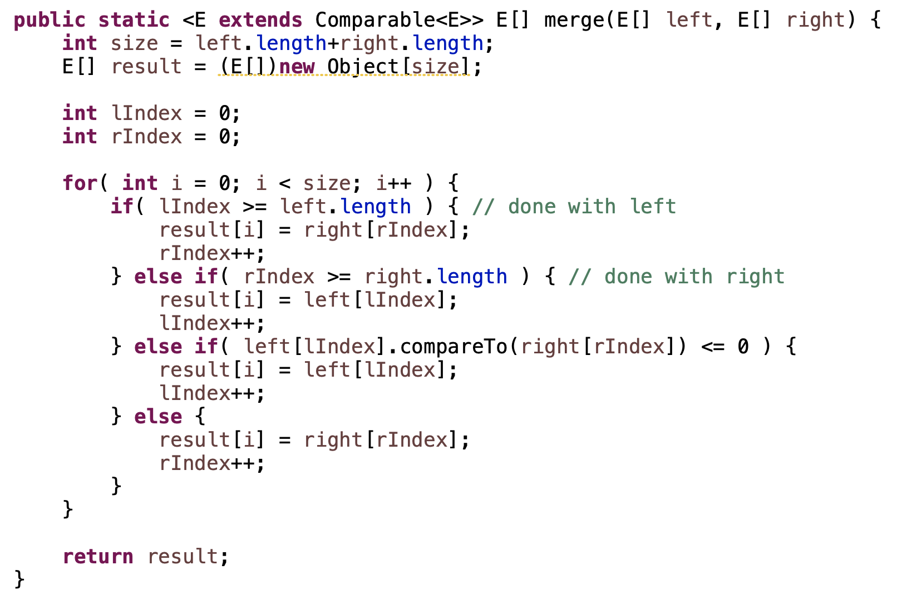
Merge in code
What are the different cases?

Slide 30
Merge in code

Slide 31
MergeSort
Divide the data in half
Recursively call MergeSort on each half (resulting in two sorted halves)
Merge the two halves

Slide 32
MergeSort
Divide the data in half
Recursively call MergeSort on each half (resulting in two sorted halves)
Merge the two halves
If the two halves are sorted, does MergeSort work?

Slide 33
MergeSort
Divide the data in half
Recursively call MergeSort on each half (resulting in two sorted halves)
Merge the two halves
What are we missing? Why does this work?

Slide 34
MergeSort
Divide the data in half
Recursively call MergeSort on each half (resulting in two sorted halves)
Merge the two halves
MergeSort is recursive. We’re missing a base case!

Slide 35
MergeSort: base case
7
Is this array sorted?

Slide 36
MergeSort: base case
7
If the array is of size 1 (or 0), it’s sorted

Slide 37
MergeSort
ms(7 1 4 2 6 5 3 8)

Slide 38
MergeSort
ms(7 1 4 2 6 5 3 8)
7 1 4 2
6 5 3 8
split in half

Slide 39
MergeSort
ms(7 1 4 2 6 5 3 8)
ms(7 1 4 2)
6 5 3 8
sort left side

Slide 40
MergeSort
ms(7 1 4 2 6 5 3 8)
ms(7 1 4 2)
6 5 3 8
7 1
4 2
split in half

Slide 41
MergeSort
ms(7 1 4 2 6 5 3 8)
ms(7 1 4 2)
6 5 3 8
ms(7 1)
4 2
sort left side

Slide 42
MergeSort
ms(7 1 4 2 6 5 3 8)
ms(7 1 4 2)
6 5 3 8
ms(7 1)
4 2
7
1
split in half

Slide 43
MergeSort
ms(7 1 4 2 6 5 3 8)
ms(7 1 4 2)
6 5 3 8
ms(7 1)
4 2
ms(7)
1
sort left side

Slide 44
MergeSort
ms(7 1 4 2 6 5 3 8)
ms(7 1 4 2)
6 5 3 8
ms(7 1)
4 2
ms(7)
1
what now?

Slide 45
MergeSort
ms(7 1 4 2 6 5 3 8)
ms(7 1 4 2)
6 5 3 8
ms(7 1)
4 2
7
ms(7)
1
Base case!

Slide 46
MergeSort
ms(7 1 4 2 6 5 3 8)
ms(7 1 4 2)
6 5 3 8
ms(7 1)
4 2
7
ms(7)
1
what now?

Slide 47
MergeSort
ms(7 1 4 2 6 5 3 8)
ms(7 1 4 2)
6 5 3 8
ms(7 1)
4 2
7
ms(7)
ms(1)
sort right side!

Slide 48
MergeSort
ms(7 1 4 2 6 5 3 8)
ms(7 1 4 2)
6 5 3 8
ms(7 1)
4 2
7
1
ms(7)
ms(1)
sort right side!

Slide 49
MergeSort
ms(7 1 4 2 6 5 3 8)
ms(7 1 4 2)
6 5 3 8
ms(7 1)
4 2
7
1
ms(7)
ms(1)
what now?

Slide 50
MergeSort
ms(7 1 4 2 6 5 3 8)
ms(7 1 4 2)
6 5 3 8
ms(7 1)
4 2
7
1
ms(7)
ms(1)
merge!

Slide 51
MergeSort
ms(7 1 4 2 6 5 3 8)
ms(7 1 4 2)
6 5 3 8
1 7
ms(7 1)
4 2
7
1
ms(7)
ms(1)
merge!

Slide 52
MergeSort
ms(7 1 4 2 6 5 3 8)
ms(7 1 4 2)
6 5 3 8
1 7
ms(7 1)
ms(4 2)
7
1
ms(7)
ms(1)
sort right

Slide 53
MergeSort
ms(7 1 4 2 6 5 3 8)
ms(7 1 4 2)
6 5 3 8
1 7
ms(7 1)
ms(4 2)
7
1
4
2
ms(7)
ms(1)
ms(4)
ms(2)
split in half
sort left
sort right

Slide 54
MergeSort
ms(7 1 4 2 6 5 3 8)
ms(7 1 4 2)
6 5 3 8
1 7
ms(7 1)
ms(4 2)
7
1
4
2
ms(7)
ms(1)
ms(4)
ms(2)
merge!

Slide 55
MergeSort
ms(7 1 4 2 6 5 3 8)
ms(7 1 4 2)
6 5 3 8
1 7
2 4
ms(7 1)
ms(4 2)
7
1
4
2
ms(7)
ms(1)
ms(4)
ms(2)
merge!

Slide 56
MergeSort
ms(7 1 4 2 6 5 3 8)
ms(7 1 4 2)
6 5 3 8
1 7
2 4
ms(7 1)
ms(4 2)
7
1
4
2
ms(7)
ms(1)
ms(4)
ms(2)
now what?

Slide 57
MergeSort
ms(7 1 4 2 6 5 3 8)
1 2 4 7
ms(7 1 4 2)
6 5 3 8
1 7
2 4
ms(7 1)
ms(4 2)
7
1
4
2
ms(7)
ms(1)
ms(4)
ms(2)
merge!

Slide 58
MergeSort
ms(7 1 4 2 6 5 3 8)
1 2 4 7
ms(7 1 4 2)
ms(6 5 3 8)
1 7
2 4
ms(7 1)
ms(4 2)
7
1
4
2
ms(7)
ms(1)
ms(4)
ms(2)
sort right side!

Slide 59
MergeSort
ms(7 1 4 2 6 5 3 8)
1 2 4 7
3 5 6 8
ms(7 1 4 2)
ms(6 5 3 8)
1 7
2 4
…
ms(7 1)
ms(4 2)
7
1
4
2
ms(7)
ms(1)
ms(4)
ms(2)
sort right side!

Slide 60
MergeSort
ms(7 1 4 2 6 5 3 8)
1 2 4 7
3 5 6 8
ms(7 1 4 2)
ms(6 5 3 8)
1 7
2 4
…
ms(7 1)
ms(4 2)
7
1
4
2
ms(7)
ms(1)
ms(4)
ms(2)
merge!

Slide 61
MergeSort
1 2 3 4 5 6 7 8
ms(7 1 4 2 6 5 3 8)
1 2 4 7
3 5 6 8
ms(7 1 4 2)
ms(6 5 3 8)
1 7
2 4
…
ms(7 1)
ms(4 2)
7
1
4
2
ms(7)
ms(1)
ms(4)
ms(2)
merge!

Slide 62
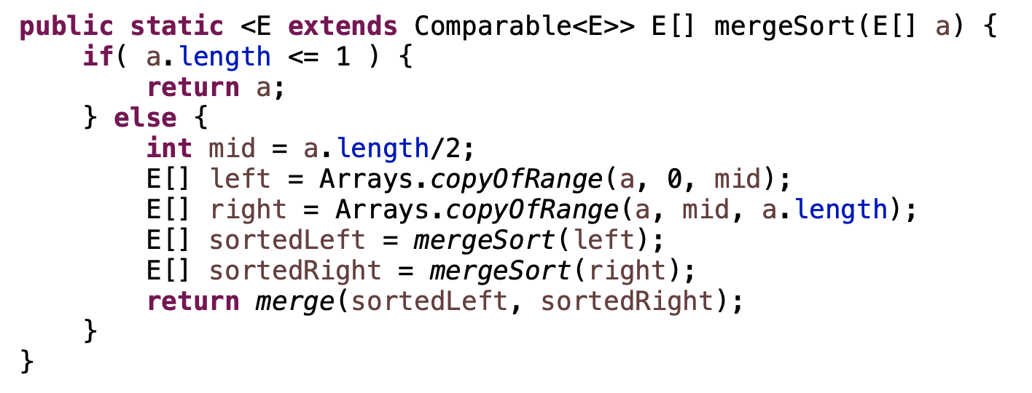
MergeSort: implementation 1

Slide 63
MergeSort: implementation 1
requires copying the data

Slide 64
MergeSort: implementation 2
mergeSortHelper(data, low, high)
if high-low > 1
midPoint = low + (high-low)/2
mergeSortHelper(data, low, mid)
mergeSortHelper(data, mid, high)
merge(data, low, mid, high)
How is this different?

Slide 65
MergeSort: implementation 2
mergeSortHelper(data, low, high)
if high-low > 1
midPoint = low + (high-low)/2
mergeSortHelper(data, low, mid)
mergeSortHelper(data, mid, high)
merge(data, low, mid, high)
doesn’t require the extra copy!
low/high specify the range we’re sorting
merge = mergeSortHelper(data, 0, data.length)

Slide 66
Merge:
merge(data, low, mid, high)
Assume:
data starting at low up to, but not including, mid is sorted
data starting at mid up to, but not including, high is sorted
Goal:
data from low up to, but not including, high is sorted
Note: merge still requires an extra helper array!

Slide 67
MergeSort runtime
Divide the data in half
Call MergeSort on each half (resulting in two sorted halves)
Merge the two halves
What is the runtime of mergesort??

Slide 68
Merge runtime
What is the runtime of merge?

Slide 69
Merge runtime
O(left.length + right.length) = O(n)

Slide 70
MergeSort runtime
Divide the data in half
Call MergeSort on each half (resulting in two sorted halves)
Merge the two halves
Ignoring the cost of the recursive call, how much work is done per call of MergeSort?

Slide 71
MergeSort runtime
Divide the data in half
Call MergeSort on each half (resulting in two sorted halves)
Merge the two halves
Ignoring the cost of the recursive call, how much work is done per call of MergeSort?
O(n)

Slide 72
Mergesort runtime
work done
ms(length=n)
n

Slide 73
Mergesort runtime
work done
ms(length=n)
n
ms(n/2)
ms(n/2)

Slide 74
Mergesort runtime
work done
ms(length=n)
n
ms(n/2)
ms(n/2)
How much work is done for these calls?

Slide 75
Mergesort runtime
work done
ms(length=n)
n
ms(n/2)
ms(n/2)
n/2+n/2 = n
How much work is done for these calls?

Slide 76
Mergesort runtime
work done
ms(length=n)
n
ms(n/2)
ms(n/2)
n
ms(n/4)
ms(n/4)
ms(n/4)
ms(n/4)

Slide 77
Mergesort runtime
work done
ms(length=n)
n
ms(n/2)
ms(n/2)
n
ms(n/4)
ms(n/4)
ms(n/4)
ms(n/4)
How much work is done for these calls?

Slide 78
Mergesort runtime
work done
ms(length=n)
n
ms(n/2)
ms(n/2)
n
n
ms(n/4)
ms(n/4)
ms(n/4)
ms(n/4)
How much work is done for these calls?

Slide 79
Mergesort runtime
work done
ms(length=n)
n
ms(n/2)
ms(n/2)
n
n
ms(n/4)
ms(n/4)
ms(n/4)
ms(n/4)
…
…
How many levels are there?

Slide 80
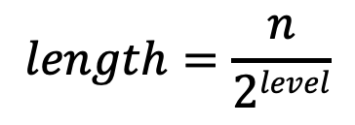
We’ve seen this before…
Each level down we decrease the size by 2:
$$length=\frac{n}{2level}$$

Slide 81
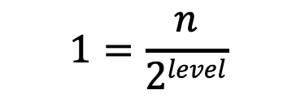


We’ve seen this before…
Each level down we decrease the size by 2:
$$length=\frac{n}{2level}$$
We stop when the length is 1:
$$1=\frac{n}{2level}$$
$$2level=n$$
$$level=log2n$$

Slide 82
MergeSort running time
O(n) work at each level
log n levels
Overall runtime: O(n log n) (best, worst, average)

Slide 83
MergeSort properties
Stable?
In-place?

Slide 84
MergeSort properties
Stable: yes!

Slide 85
MergeSort properties
Stable: yes
In-place: sort of
easy way to implement is not
very hard to do (but possible)
in practice, variants of merge sort that combine with insertion sort are in-place

