Slide 1
CS62
Checkpoint 1 Review

Slide 2
Topics
Java syntax differences
Java concepts
static (variables and methods)
final
public, private, protected
arrays
equals vs ==
built-in data types vs. classes/objects
this
I/O in Java (BufferedReader, Scanner, PrintWriter)
Inheritance
super
Object

Slide 3
Topics
Exceptions
try/catch
throw
checked vs. unchecked
Generics
Writing classes using them
Instantiating an array of generics
Type casting
Big-O
Interfaces

Slide 4
Topics
ArrayLists
Using
Big-O run-time
Implementation
Amortized analysis

Slide 5
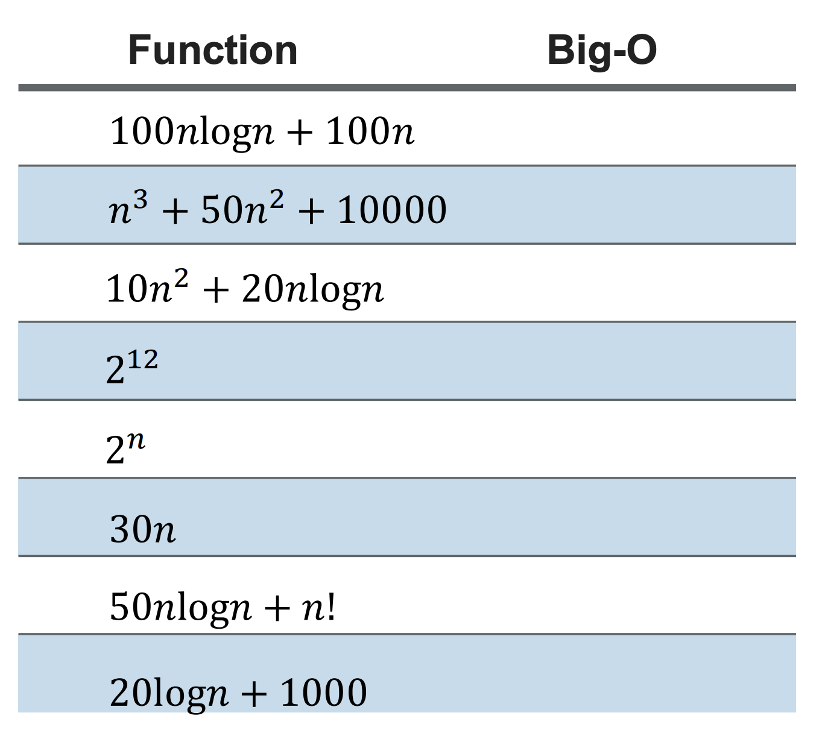

Slide 6
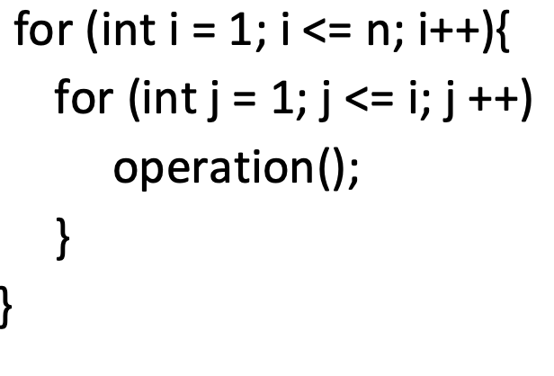
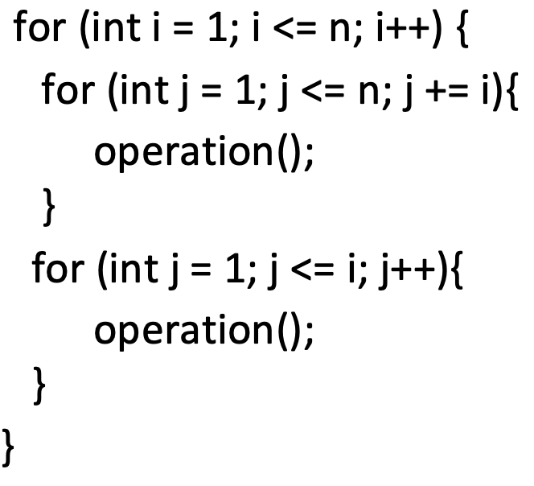
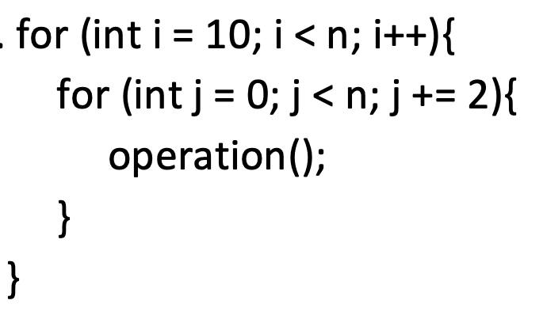
Big-O

Slide 7
Solutions

Slide 8
O(n log n)
O(n³)
O(n²)
O(1)
O(2^{n})
O(n)
O(n!)
O(log n)

Slide 9
Big-O
O(n²)
O(n²)
O(n²)

