Slide 1
Lecture 22: Analyzing Algorithms
CS 51P November 30, 2023

Slide 2
Sorting Algorithms
Selection Sort
Insertion Sort
def selection_sort(l):
# for each pos in list
for pos in range(len(l)):
# find obj that should be there
min_index = pos
for i in range(pos+1, len(l)):
if l[i] < l[min_pos]:
min_index = i
# swap that obj into position pos
(l[pos], l[min_index]) = \
(l[min_index], l[pos])
def insertion_sort(l):
# for each obj in list
for pos in range(len(l)):
# move obj to correct position
curr_pos = pos
while curr_pos > 0 and
l[curr_pos]<l[curr_pos-1]:
(l[curr_pos],l[curr_pos-1])=\
(l[curr_pos-1],l[curr_pos])
curr_pos = curr_pos - 1
Merge Sort
def merge_sort_helper(lst, start, end):
# Base Case
if end-start < 2:
return
# Recursive Case
else:
middle = start + int((end-start) / 2)
merge_sort_helper(lst, start, middle)
merge_sort_helper(lst, middle, end)
merge(lst, start, end)
Which algorithm is better?

Slide 3
What Makes a Good Algorithm?
Suppose you have two possible algorithms that do the same thing; which is better?
What do we mean by better?
  Correct(er)?
  Faster?
  Less space?
  Less power consumption?
  Easier to code?
  Easier to maintain?
  Required for homework?
  Correct(er)?
  Faster?
  Less space?
Notes:
Note: should we cover big-O/asymptotics???

Slide 4
Basic Step: one “constant time” operation
Constant time operation: its time doesn’t depend on the size or length of anything. Always roughly the same. Time is bounded above by some number
Example Basic steps:
  Access value of a variable, list element, or object attr
  Assign to a variable, list element, or object attr
  Do one arithmetic or logical operation
  Call a function

Slide 5
Counting Steps
# Store sum of 0..n-1 in sum
sum = 0
for i in range(n):
sum = sum + i
Statement: # times done sum = 0 1
i= v n
sum = sum + i n
Total steps: 2n + 1
Linear algorithm in n
All basic steps take time 1.
There are n loop iterations. Therefore, takes time proportional to n.

Slide 6
Not all operations are basic steps
Statement: # times done s = "" 1
i = v n
s = s + 'c' n
Total steps: 2n + 1
# Store n copies of ‘c’ in s
s = ""
for i in range(n):
s = s + 'c'
❌
Concatenation is not a basic step. For each i, concatenation creates and fills a sequence with i elements.

Slide 7
Not all operations are basic steps
# Store n copies of ‘c’ in s
s = ""
for i in range(n):
s = s + 'c'
Statement: # times # steps
s = "" 1 1
i = v n 1
s = s + 'c'; n i
Total steps: (n-1)*n/2 + n + 1
Concatenation is not a basic step. For each i, concatenation creates and fills a sequence with i elements.
Quadratic algorithm in n

Slide 8
Linear versus quadractic
# Store sum of 1..n in sum
sum = 0
for i in range(1, n+1):
sum = sum + k;
# Store n copies of ‘c’ in s
s = ""
for i in range(n):
s = s + 'c'
Linear algorithm
Quadratic algorithm
In comparing the runtimes of these algorithms, the exact number of basic steps is not important. What’s important is that
One is linear in n—takes time proportional to n
One is quadratic in n—takes time proportional to n²

Slide 9
Looking at execution speed
Number of operations executed
2n+2, n+2, n are all linear in n, proportional to n
2n + 2 ops
n*n ops
n + 2 ops
n ops
Constant time
0 1 2 3 …
size n of the list

Slide 10

"Big O" Notation
$n^{2} +2n + 5$ $O(n^{2})$
$1000n+25000$ $O(n)$
$\frac{2^{n}}{15}+n^{100}$ $O(2^{n})$
$n log n +25n$ $O(n log n)$

Slide 11
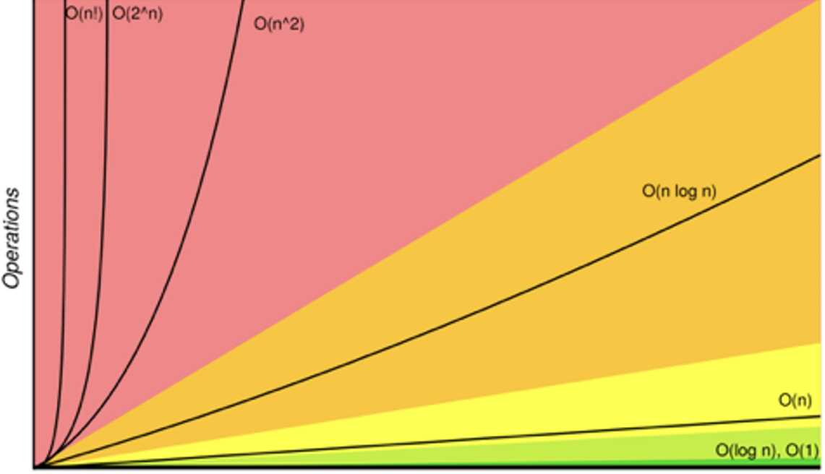
Order of growth

Slide 12
How Fast is Fast enough?
O(1) | constant | excellent
O(log n) | logarithmic | excellent
O(n) | linear | good
O(n log n) | n log n | pretty good
O(n²) | quadratic | maybe OK
O(n³) | cubic | not good
O(2^{n}) | exponential | too slow
O(n!) | factorial | too slow

Slide 13
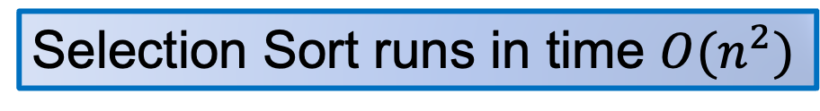
Evaluating Speed of Selection Sort
def selection_sort(l):
# for each pos in the list
for pos in range(len(l)):
# find the object that should be there
min_index = pos
for i in range(pos+1, len(l)):
if l[i] < l[min_index]:
min_index = i
# swap the object to position pos
(l[pos], l[min_index]) = \
(l[min_index], l[pos])
# Times | # Steps
n | O(1)
n | O(1)
n*O(n) | O(1)
n*O(n) | O(1)
<= n*O(n) | O(1)
n | O(1)
Selection Sort runs in time $O(n^{2})$

Slide 14
Comparison
 | selection sort
worst case | O(n²)
best case | O(n²)
avg case | O(n²)
space | O(1)

Slide 15
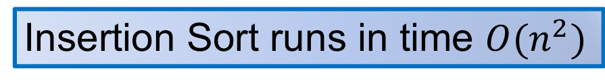
Evaluating Speed of Insertion Sort
def insertion_sort(l):
# for each obj at position pos
for pos in range(1, len(l)):
# move the obj to the right position
curr_pos = pos
while curr_pos > 0 and \
l[curr_pos] < l[curr_pos-1]:
(l[curr_pos], l[curr_pos-1]) = \
(l[curr_pos-1], l[curr_pos])
curr_pos -= 1
# Times | # Steps
n | O(1)
n | O(1)
<=n*O(n) | O(1)
<= n*O(n) | O(1)
<= n*O(n) | O(1)
Insertion Sort runs in time $O(n^{2})$

Slide 16
Comparison
 | selection sort | insertion sort
worst case | O(n²) | O(n²)
best case | O(n²) | O(n)
avg case | O(n²) | O(n²)
space | O(1) | O(1)

Slide 17
Evaluating Speed of Merge Sort
def merge_sort_helper(lst, start, end):
# Base Case
if (end-start) < 2:
return
# Recursive Case
else:
middle = start + int((end-start)/2)
merge_sort_helper(lst, start, middle)
merge_sort_helper(lst, middle, end)
merge(lst, start, end)
def merge_sort(lst):
merge_sort_helper(lst, 0, len(lst))
# Times | # Steps
1 | O(1)
<=1 | O(1)
1 | O(1)
 | ?
 | ?
 | ?

Slide 18
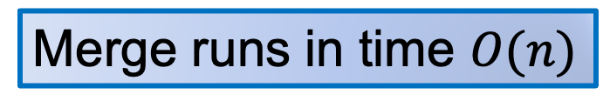
Evaluating Speed of Merge Sort
def merge(lst, start, end):
middle = (end-start)//2
first = lst[:middle]
pos, i, j = start, start, middle
while i < middle and j < end:
if first[i] < lst[j]:
lst[pos] = first[i]
i += 1
else:
lst[pos] = lst[j]
j += 1
pos += 1
if j == end:
while i < middle:
lst[pos] = first[i]
pos += 1
i += 1
# Times | # Steps
1 | O(1)
1 | O(end-start)
1 | 3
(end-start)/2 | O(1)
(end-start)/2 | O(1)
<=(end-start)/2 | O(1)
<=(end-start)/2 | O(1)
<=(end-start)/2 | O(1)
<=(end-start)/2 | O(1)
(end-start)/2 | O(1)
1 | 1
<=(end-start)/2 | O(1)
<=(end-start)/2 | O(1)
<=(end-start)/2 | O(1)
<=(end-start)/2 | O(1)
Merge runs in time $O(n)$

Slide 19
Evaluating Speed of Merge Sort
Merge is executed for O(log(n)) times

Slide 20
Comparison
 | selection sort | insertion sort | merge sort
worst case | O(n²) | O(n²) | O(n log n)
best case | O(n²) | O(n) | O(n log n)
avg case | O(n²) | O(n²) | O(n log n)
space | O(1) | O(1) | O(n)

Slide 21
Sorting in Python
List.sort()
  Sorts list in place
  Optional argument reverse=True to reverse order (greatest->least)
sorted(lst)
  Creates sorted copy of list
  Optional arguments reverse
Notes:
Python’s default sorting algorithm, which is used by the built-in sorted function as well as the sort method of list objects, is called Timsort. It’s an algorithm developed by Tim Peters in 2002 for use in Python. Timsort is a modified version of merge sort which uses insertion sort to arrange the list of items into conveniently mergeable sections.

