Slide 1
Lecture 19: Visualizations
CS 51P November 13, 2023

Slide 2
Last Week: Dictionaries
a data structure that stores key:value pairs
d = {'apple': .99, 'banana': .19, 'cantelope': 2.99}
restriction:
  key must be immutable

Slide 3
Last Week: Dictionary Operations
other
adding to a dictionary
a_dict[key] = value
a_dict.update(b_dict)
removing from a dictionary
del (a_dict[key])
a_dict.pop(key)
  returns a_dict[key]
len(a_dict)
a_dict.keys()
  returns list
a_dict.values()
  returns list
a_dict.items()
  returns list of tuples
b_dict = a_dict.copy()
  shallow copy!

Slide 4
Last Week: Lists vs. dictionaries
Both data structures.
Why would you choose one over the other?
  a data structure is something that holds a collection of data and that supports certain operations for working with that data
Lists: sequential access
Dictionaries: fast lookup

Slide 5
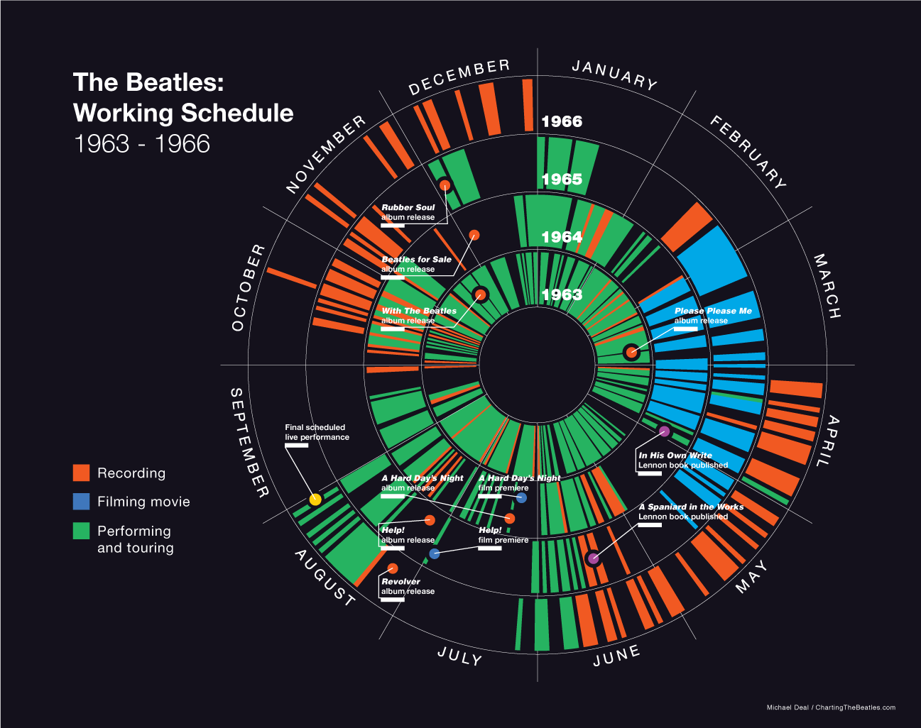
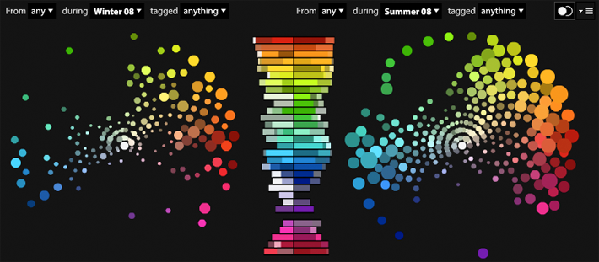
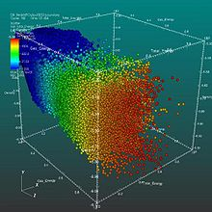
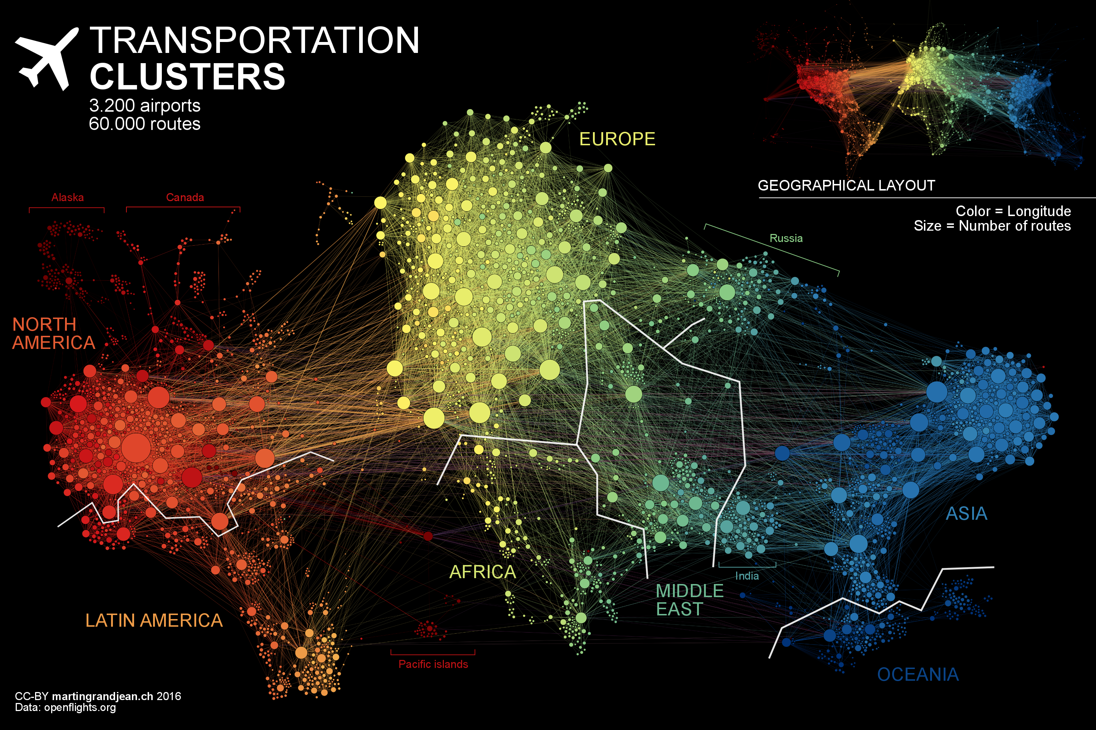
Data Visualization
Notes:
Demo example dataset, then general intro to visualization, then demo election visualiations

Slide 6
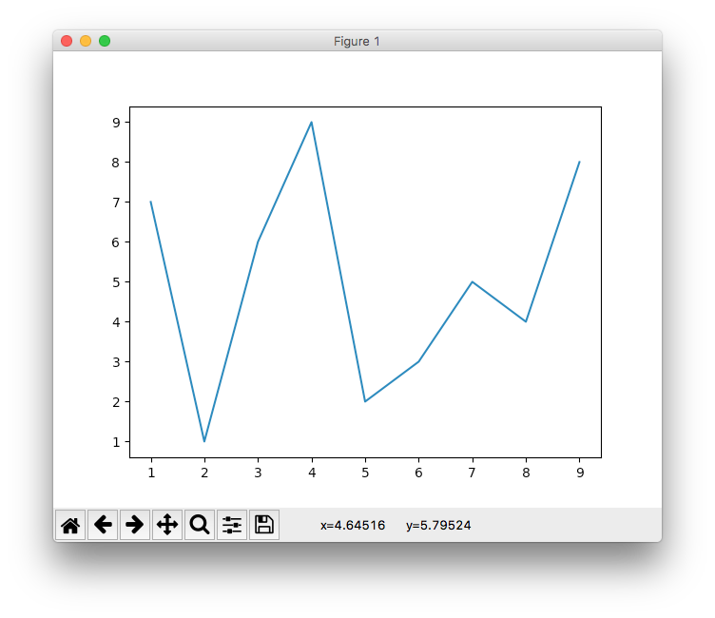
Data Visualization
matplotlib
  https://matplotlib.org/index.html
  based on Matlab
import matplotlib.pyplot as plt
from random import shuffle
x = list(range(1,10))
y = x.copy()
shuffle(y)
plt.plot(x, y)
plt.show()

Slide 7
Exercise
Generate a line graph showing the powers of 2 from 1, 2, 4, 8, … 1024

Slide 8
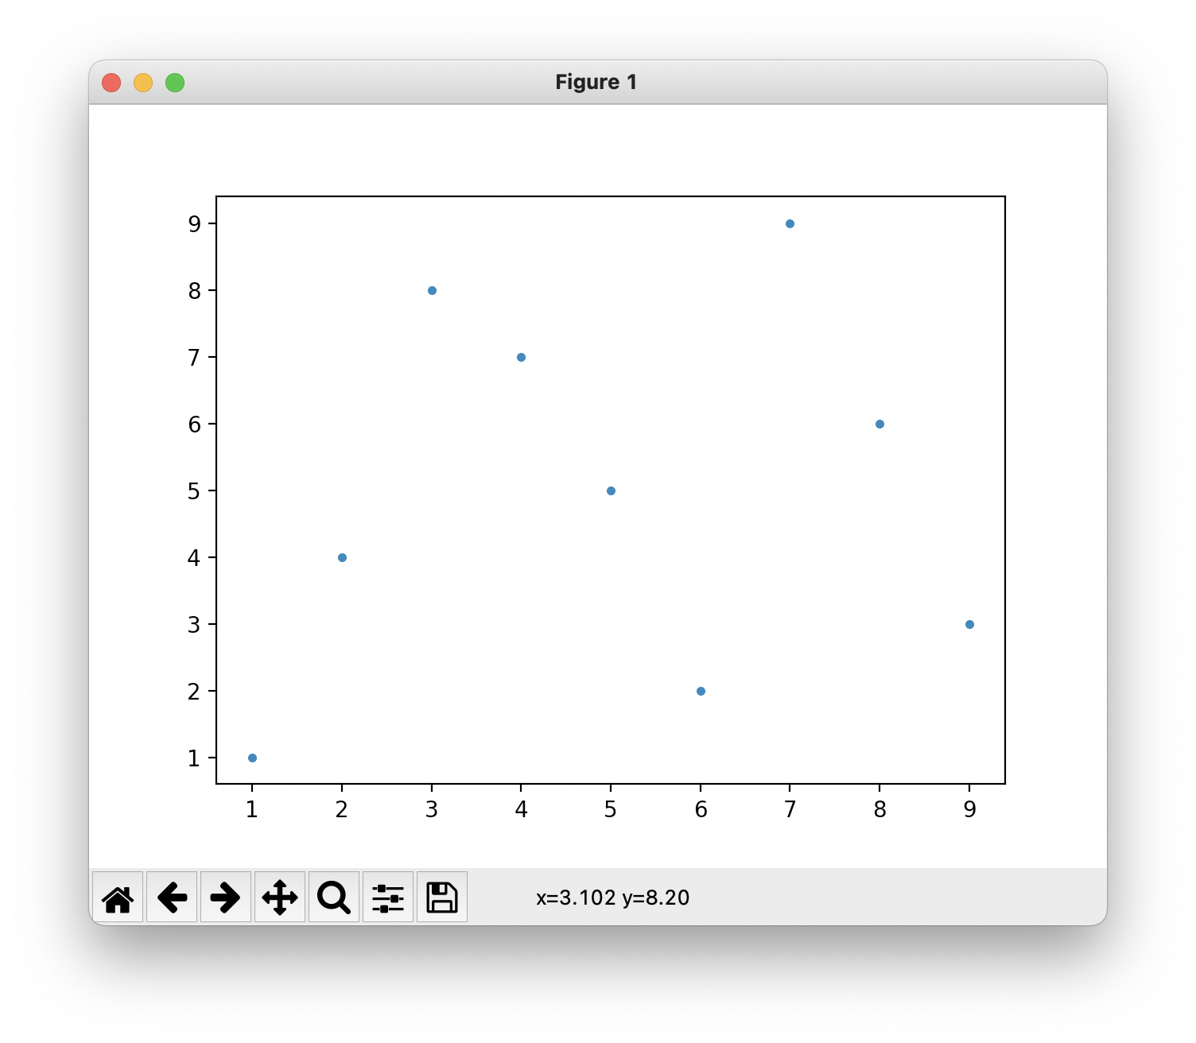
Scatter Plots
matplotlib
  https://matplotlib.org/index.html
  based on Matlab
import matplotlib.pyplot as plt
from random import shuffle
x = list(range(1, 10))
y = x.copy()
shuffle(y)
plt.plot(x, y, '.')
plt.show()

Slide 9
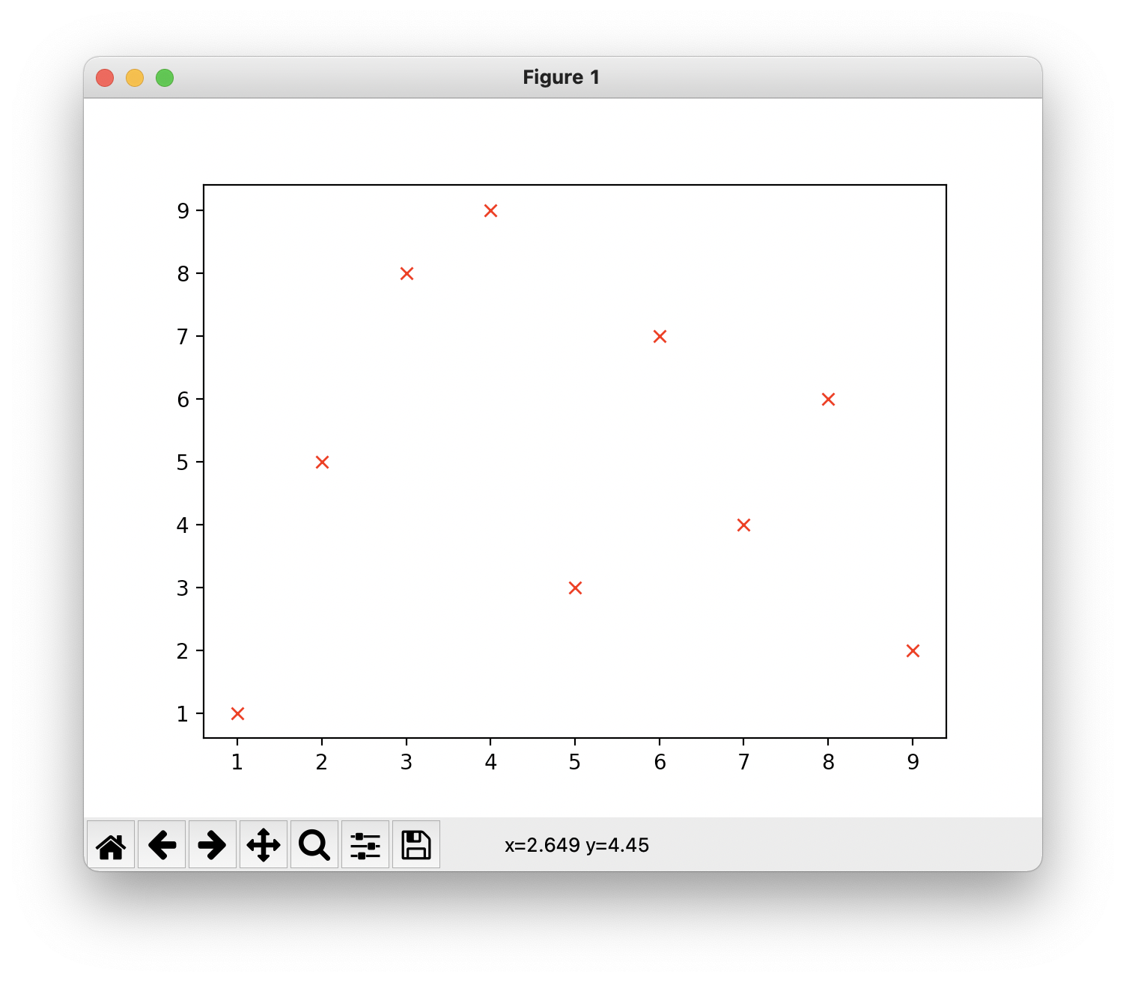
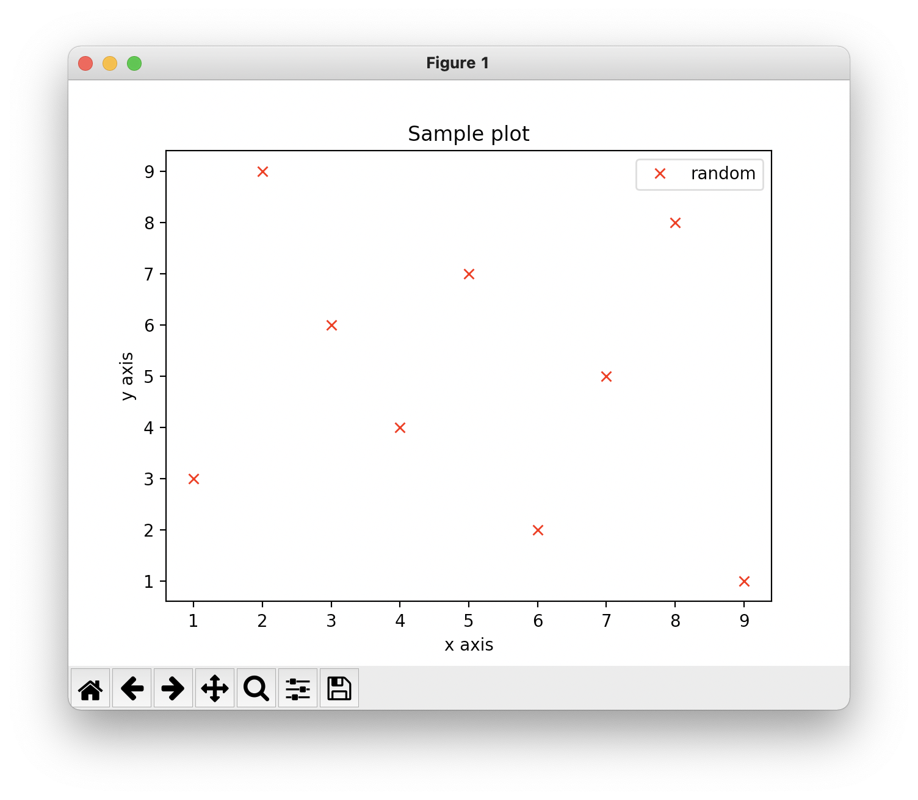
Customizing
import matplotlib.pyplot as plt
from random import shuffle
x = list(range(1, 10))
y = x.copy()
shuffle(y)
plt.plot(x, y, 'rx')
plt.xlabel("x axis")
plt.ylabel("y axis")
plt.title("Sample plot")
plt.legend()
plt.show()
, label="random")

Slide 10
Exercise
Modify your plot of the powers of 2 from 1, 2, 4, 8, … 1024 to include axis labels, a title, and a legend.

Slide 11
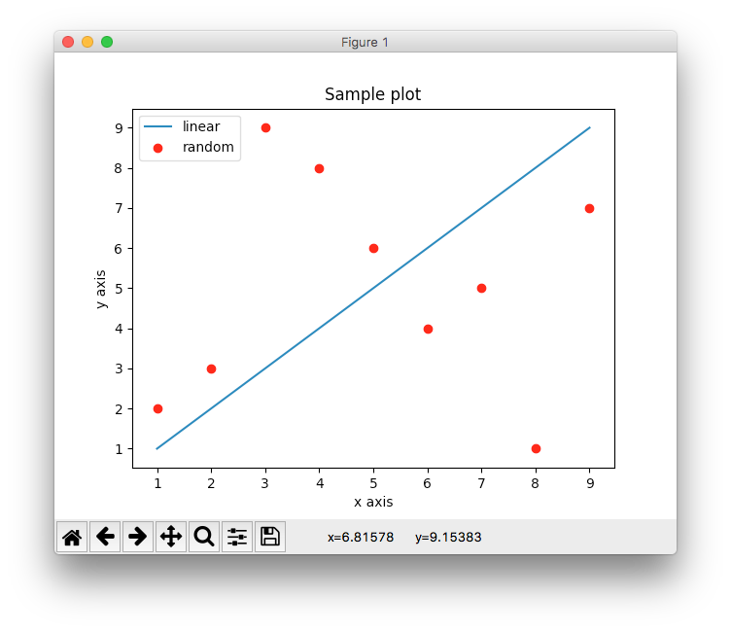
Multiple Datasets
import matplotlib.pyplot as plt
from random import shuffle
x = list(range(1,10))
y = x.copy()
shuffle(y)
plt.plot(x, x, label="linear")
plt.plot(x, y, 'r.' label="random")
plt.xlabel("x axis")
plt.ylabel("y axis")
plt.title("Sample plot")
plt.legend()
plt.show()

Slide 12
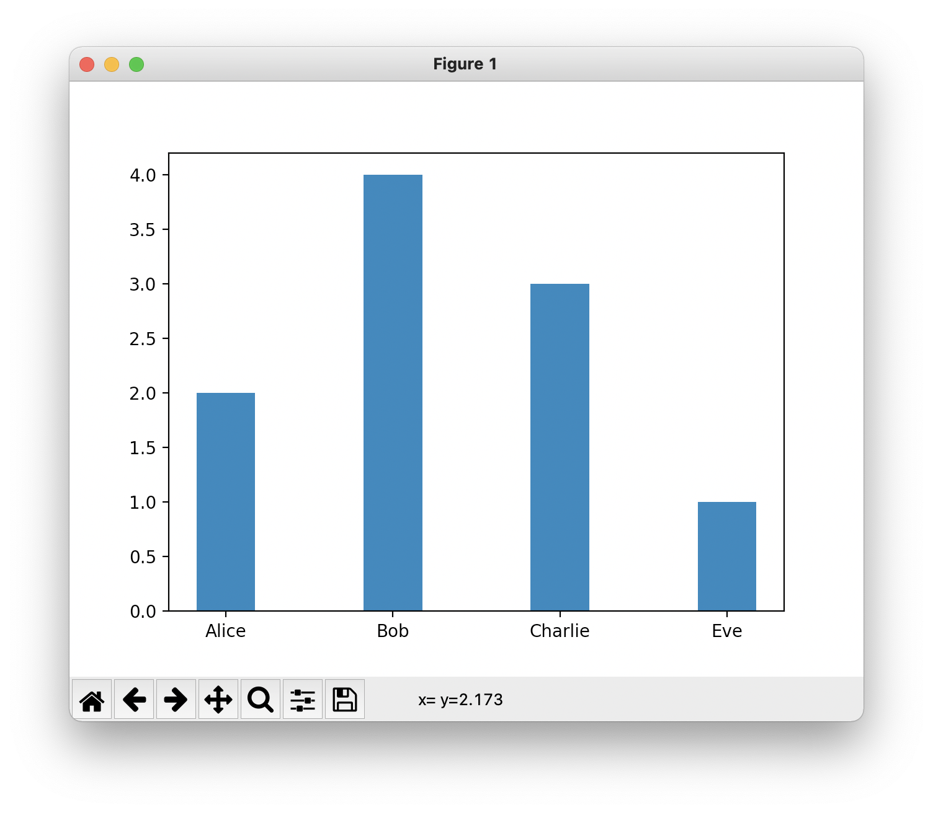
Bar Graphs
import matplotlib.pyplot as plt
from random import shuffle
x = list(range(1, 5))
y = x.copy()
shuffle(y)
bar_width = .35
plt.bar(x, y, bar_width)
plt.xticks(x, ('Alice', 'Bob', 'Charlie', 'Eve'))
plt.show()

Slide 13
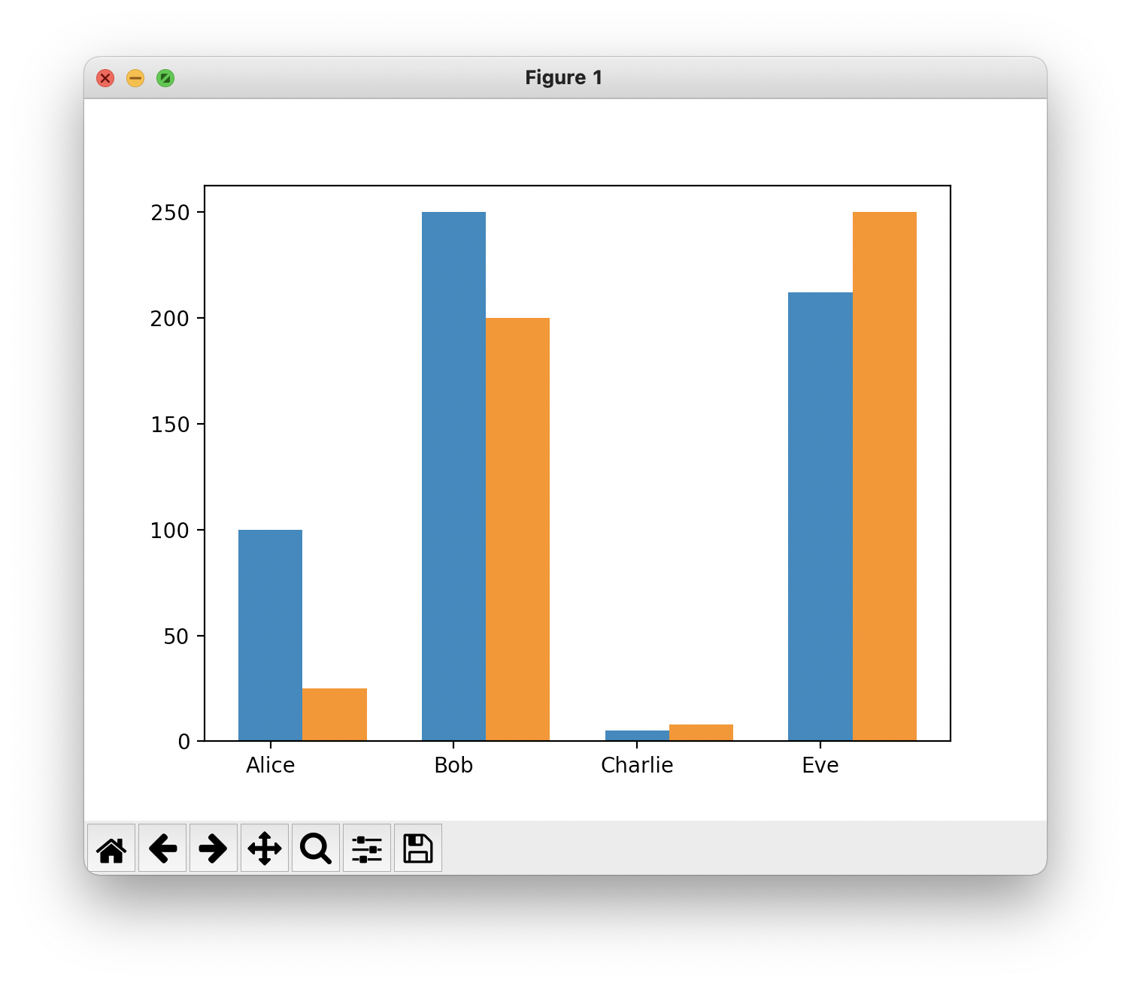
Bar Graphs w/ Multiple Datasets
import matplotlib.pyplot as plt
from random import shuffle
x = list(range(0, 4))
y1 = [100, 250, 5, 212]
bar_width = .35
x2 = [x[0] + bar_width, x[1] + bar_width, x[2] + bar_width, x[3] + bar_width]
y2 = [25, 200, 8, 250]
plt.bar(x, y1, bar_width)
plt.bar(x2, y2, bar_width)
plt.xticks(x, ('Alice', 'Bob', 'Charlie', 'Eve'))
plt.show()

Slide 14
Exercise
Generate a bar graph of the powers of 2 from 1, 2, 4, 8, … 1024

Slide 15
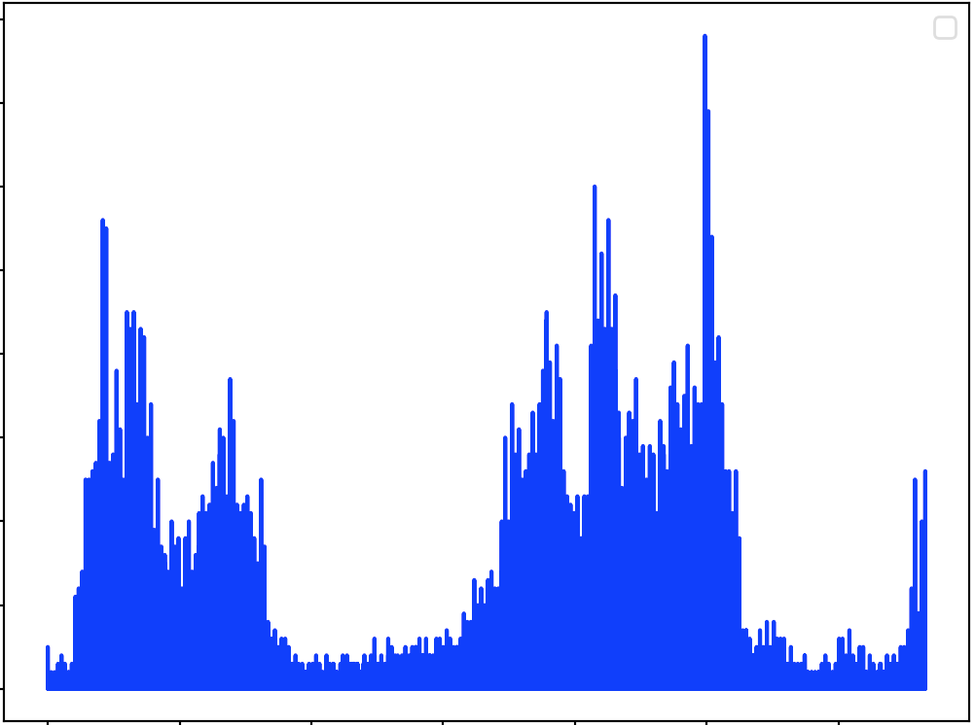
Exercise
Write a function plot_ppm that takes a filename as input and produces an image histogram (a plot of the number of pixels for each rgb value).
  Hint: you will want to use a bar graph
  Hint: r g b values in a ppm file are represented by three numbers (e.g., 250 50 100). You can represent this pixel as a number 250*(255*255) + 50*(255) + 100

Slide 16
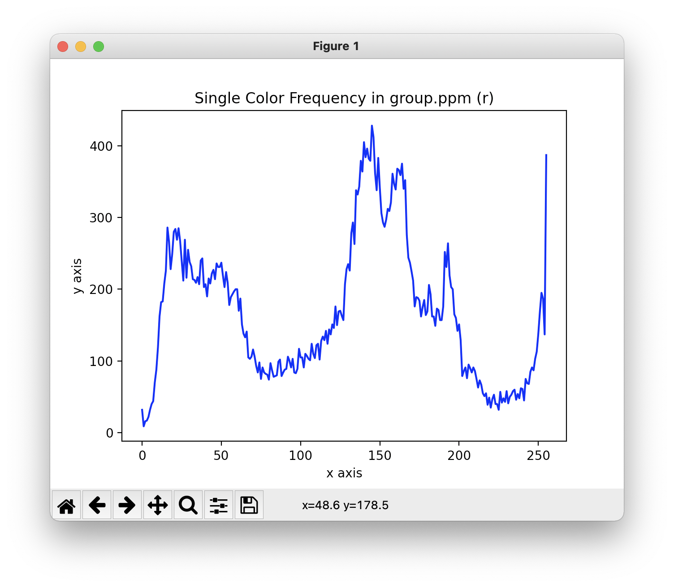
Exercise
Write a function plot_ppm_color that takes two arguments, a filename and a color option ("r", "g", or "b"), as input and produces a graph of the frequencies of that color (a plot of the number of pixels for each value for that color)
  Hint: r g b values in a ppm file are represented by three numbers (e.g., 250 50 100).

Slide 17
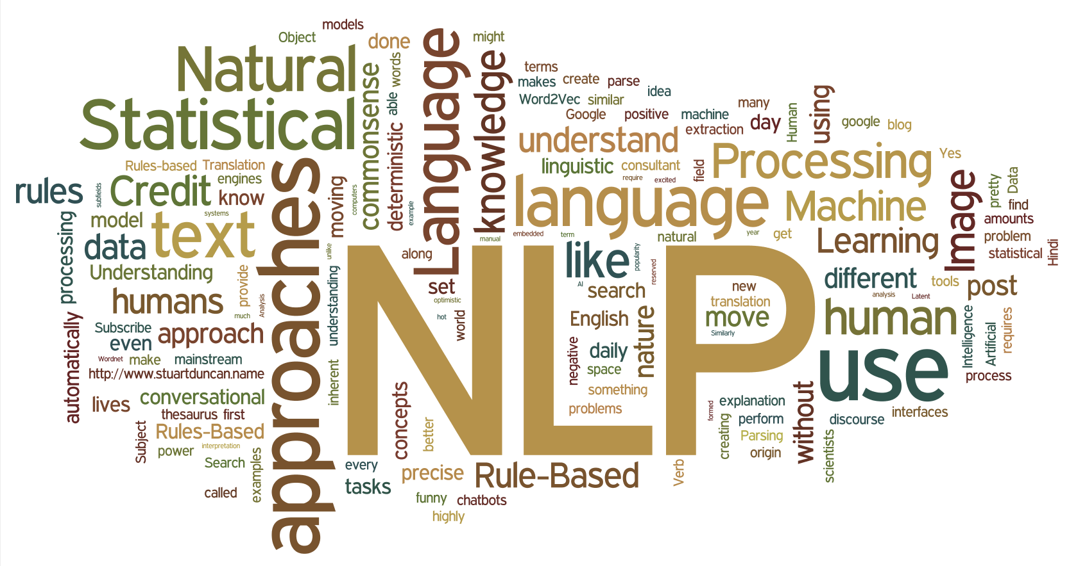
Exercise: Visualizing Text Files

