Slide 1
Lecture 17: Dictionaries
CS 51P Fall 2023

Slide 2
Example: Processing files
Write a function count_word that takes a file and a word and returns the number of times that word appears in the file.
What if you wanted to process a file so you could answer repeated queries of the form "How many times does the word _____ appear?"
def count_word(file, word_in):
count = 0
lines = file.readlines()
for line in lines:
words = line.split()
for word in words:
w = word.strip(string.punctuation)
if w == word_in:
count = count + 1
return count
Notes:
mention naïve version with counting to answer each query
discuss pre-processing and try naïve version with a list of pairs
then motivate dictionaries

Slide 3
Dictionaries
a data structure that associates a key with a value
  key is a unique identifier
  value is something we associate with that key
  dictionary stores key:value pairs
(must be immutable)
d = {'apple': .99, 'banana': .19, 'cantelope': 2.99}
Real world examples
  dictionary (key: word, value: definition)
  phonebooks (key: name, value: phone number)
  price list (key: product, value: price)

Slide 4
Creating Dictionaries
Dictionaries start/end with curly braces
Kev:value pairs have colons in between
Each pair is separated by a common
Examples:
  empty_dict = {}
  phone_book = {"Joe": "909-607-9799", "Alexandra": "909-607-0969"}
  prices = {"apple": .99, "banana": .19, "melon": 2.99}
prices
"apple"
0.99
"banana"
0.19
"melon"
2.99

Slide 5
Accessing Dictionary Elements
Given a dictionary d, use any key k to access the associated value d[k]
Example:
  prices = {"apple": .99, "banana": .19, "melon": 2.99}
  prices["apple"] is .99
  prices["melon"] is 2.99
  price["grape"] is ???
prices
"apple"
0.99
"banana"
0.19
"melon"
2.99
KeyError

Slide 6
Accessing all Dictionary Elements
Given a dictionary d:
  d.keys() returns a list of all the keys in d
  d.values() returns a list of all the values in d
  d.items() returns a list of all the (key, value) pairs in d
Example:
  prices = {"apple": .99, "banana": .19, "melon": 2.99}
for key in prices.keys():
price = prices[key]
print("The price of a", key, "is", price)
price_list
"apple"
0.99
"banana"
0.19
"melon"
2.99

Slide 7
Example
Define a function most_expensive that takes one parameter, a dictionary prices, and returns the item with the highest price.
You may assume that prices contains at least one item.

Slide 8
Exercise 1
Define a function under_price(grocery_store, p) that takes two parameters, a dictionary grocery_store and a price p, and returns the number of unique items available for less than (or equal to) price p.

Slide 9
Checking for Dictionary Elements
Given a dictionary d:
  d.keys() returns a list of all the keys in d
  d.values() returns a list of all the values in d
  d.items() returns a list of all the (key, value) pairs in d
Example:
  prices = {"apple": .99, "banana": .19, "melon": 2.99}
if "apple" in prices.keys():
print("The price of an apple is", price)
price_list
"apple"
0.99
"banana"
0.19
"melon"
2.99

Slide 10
Exercise 2
Define a function compute_cost that takes two arguments, a dictionary prices and list of items shopping_list and returns the total cost of buying all the items on the shopping list. If an item on the shopping list is not in the prices dictionary, just exclude it from the total cost.

Slide 11
Modifying Dictionaries
price_list
price_list
"apple"
"apple"
0.99
price_list
"apple"
0.99
1.99
1.99
"banana"
"banana"
0.19
"banana"
0.19
0.19
"melon"
"melon"
2.99
2.99
"lemon"
.50
"lemon"
.50
add: d["lemon"] = .50
update: d["apple"] = 1.99
delete: d.pop("melon")
returns 2.99

Slide 12
Example
Define a function add_items that takes two arguments, a dictionary grocery_store and list of item-price pairs new_items and adds the new items (with their associated prices) to the grocery store.

Slide 13
Exercise 3
def mystery(my_dict):
d = {}
for i in my_dict.keys():
if my_dict[i] in d:
d[my_dict[i]].append(i)
else:
d[my_dict[i]] = [i]
return d
def main():
d = {"a":1, "b":2, "c":1, "d":0, "e":2}
print(mystery(d))
main()

Slide 14
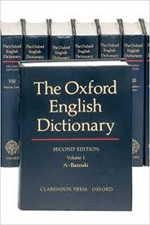
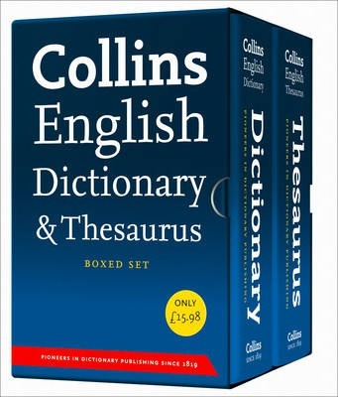
Exercise: Merge
Write a function merge(d1,d2) that merges two dictionaries and returns a single dictionary containing all the key:value pairs from both input dictionaries.

Slide 15
Dictionary Operations
other
adding to a dictionary
a_dict[key] = value
a_dict.update(b_dict)
removing from a dictionary
del (a_dict[key])
a_dict.pop(key)
  returns a_dict[key]
len(a_dict)
a_dict.keys()
  returns list
a_dict.values()
  returns list
a_dict.items()
  returns list of tuples
b_dict = a_dict.copy()
  shallow copy!

Slide 16
Lists, dictionaries
Both data structures.
Why would you choose one over the other?
  a data structure is something that holds a collection of data and that supports certain operations for working with that data
Lists: sequential access
Dictionaries: fast lookup

Slide 17
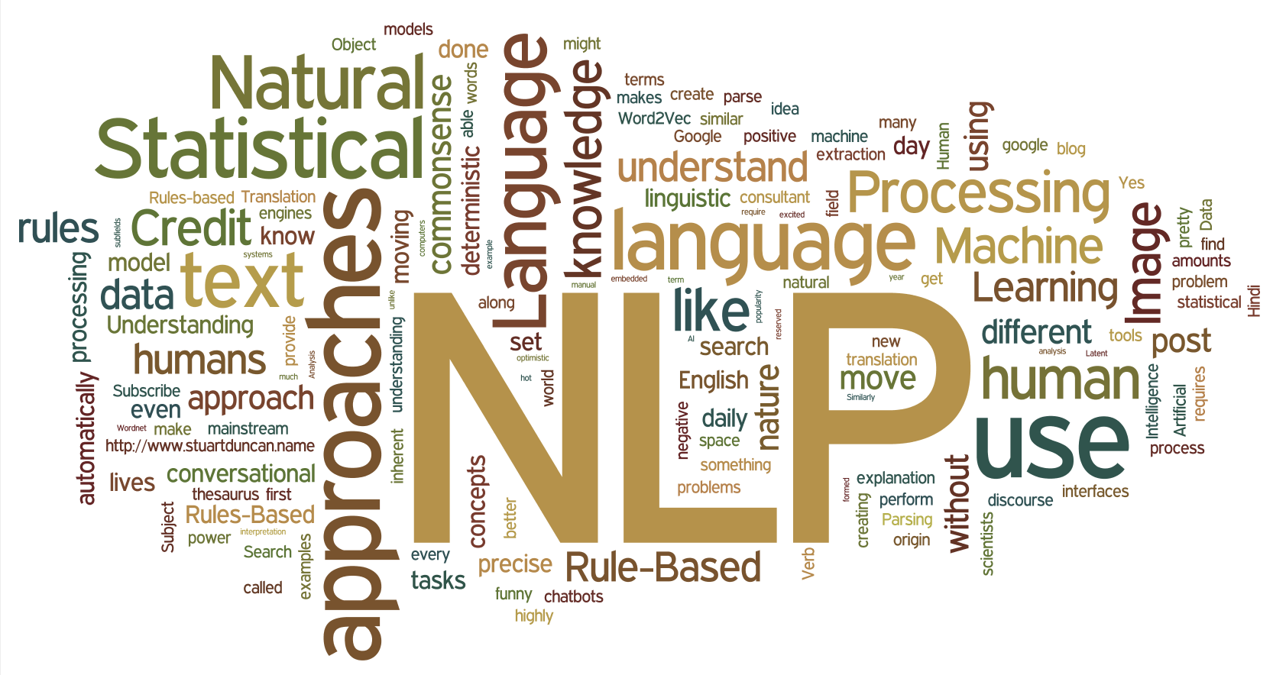
Example: Word Count
Write a function that processes a file and returns a dictionary for handling repeated queries of the form "How many times does the word _____ appear?"

Slide 18
Example: Word Count
Write a function that processes a file and returns a dictionary for handling repeated queries of the form "How many times does the word _____ appear?"
def count_words(filename):
counts = {}
f = open(filename, "r")
text = f.readlines()
for line in text:
words = line.split()
for w in words:
w2 = w.strip(string.punctuation)
if w2 in counts.keys():
counts[w2] = counts[w2] + 1
else:
counts[w2] = 1
f.close()
return counts

