Slide 1
Lecture 10: Recursion
CS 51P October 9, 2023

Slide 2
Recursion
Objects containing smaller copies of itself
Define a base case when an answer can be returned directly, e.g., doesn’t need to recursively call the function itself anymore
Define a recursive case when the function calls itself with a different (e.g., smaller) arguments
Solution is built up as you come back up the call stack

Slide 3
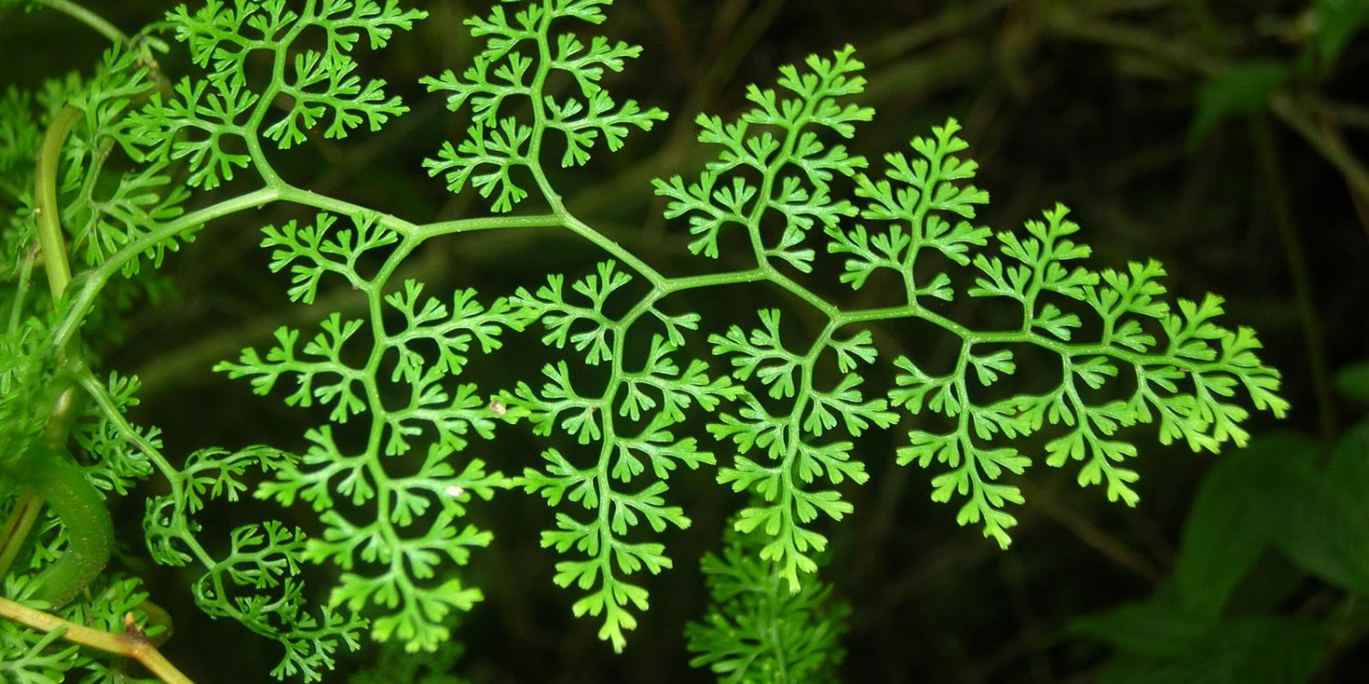
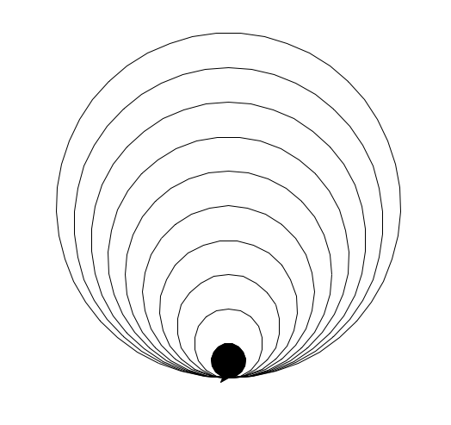
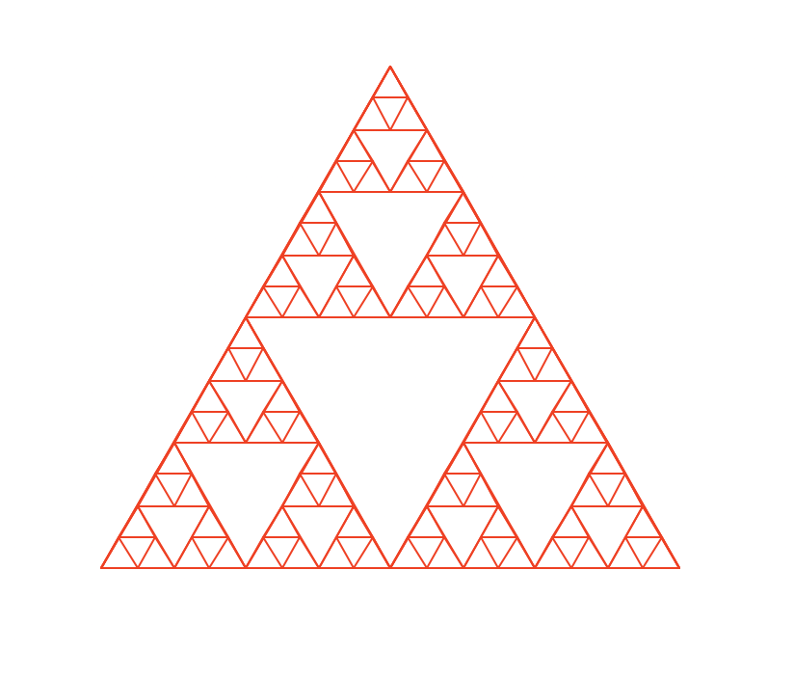
Recursion
1, 1, 2, 3, 5, 8, 13, 21, ...

Slide 4
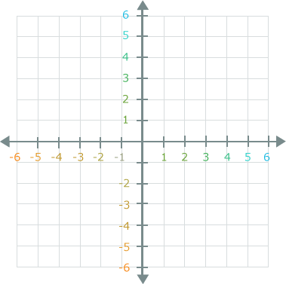

Turtle graphics

Slide 5
Example
Define a function called draw_triangle, which takes in the length of a side (e.g., a float) as input, and draws a triangle with equal length of each side.
Can you create another function to draw a square with length as input?

Slide 6
Recursive definition
Recursive case
A _x_ is _y_ plus _#_ smaller _x_. unless it is very small, in which case it is _z_.
Base case

Slide 7
Example: matryoshka
a _x_ is _y_ plus _#_ smaller _x_. unless it is very small, in which case it is _z_.
What is a matryoshka?
a matryoshka is a doll plus 1 smaller matryoshka. unless it is very small, in which case it is nothing.

Slide 8
Example: circle_drawing
a _x_ is _y_ plus _#_ smaller _x_. unless it is very small, in which case it is _z_.
What is a circle_drawing?
a circle_drawing is a circle plus 1 smaller circle_drawing. unless it is very small, in which case it is a filled circle

Slide 9
Example
Draw a set of circles (each circle has radius 20 smaller than the circle outside it), same bottommost point. Once the radius is < 20, draw filled in circle
Return how many circles are drawn.

Slide 10
Exercise
a _x_ is _y_ plus _#_ smaller _x_. unless it is very small, in which case it is _z_.
A recursive_squares is a square
plus 4 smaller recursive_squares
of half the size
centered at each of the corners of the large square
unless it's very small in which case it's nothing

Slide 11
Bonus Exercise
Define a function called recursive_squares, which takes in three input parameters, which are x, y, and l (floats). x and y are the coordinates of the bottom left corner of the big square, and l is the length of each side of the square. Recursively draw squares at the four corners of the big square as long as l is greater than 10. In each recursion, l will be shortened by half.
Return how many squares are drawn.

