Slide 1
Lecture 9: Recursion
CS 51P October 4, 2023

Slide 2
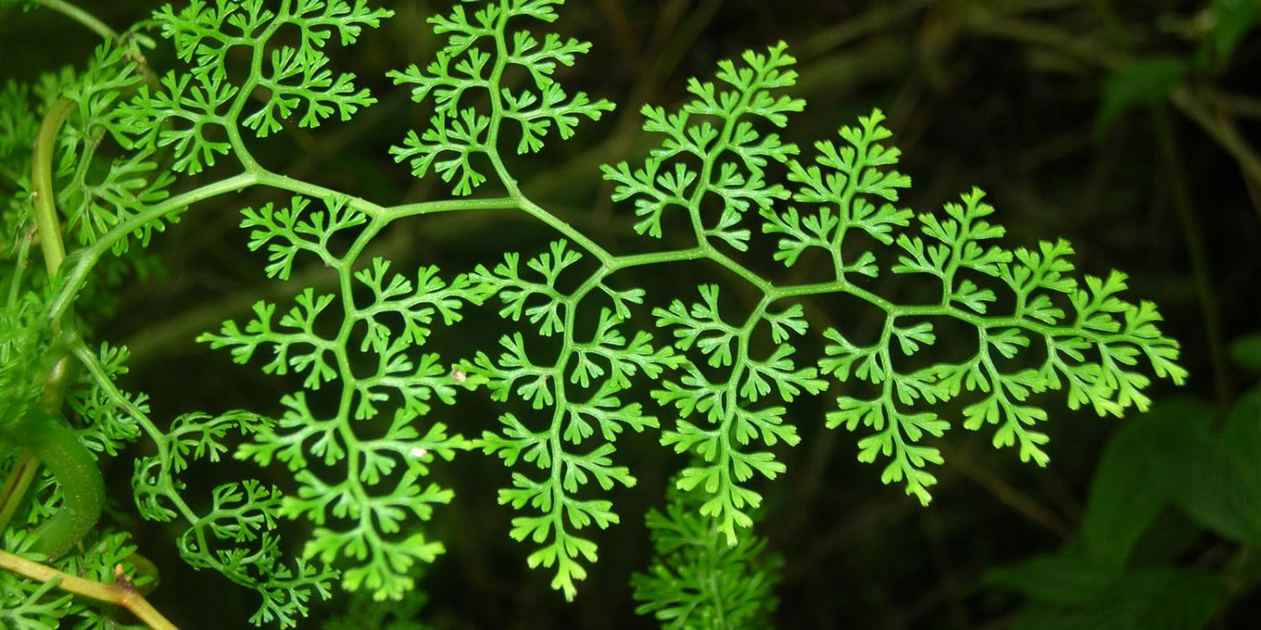
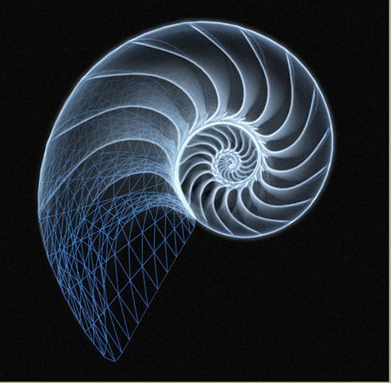
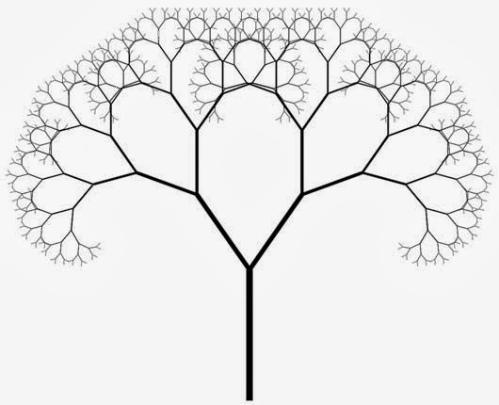
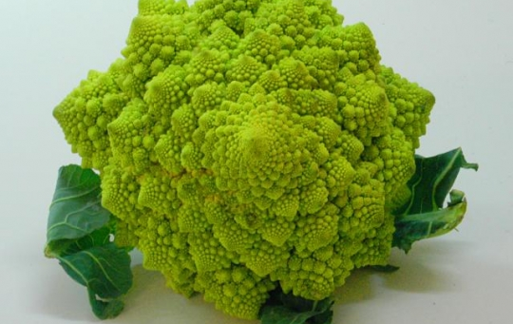
Recursion

Slide 3
What is recursion?
Wikipedia: “Recursion occurs when a thing is defined in terms of itself.”
Object containing smaller copies of itself

Slide 4
Recursion in programming
A function calls itself by passing a different arguments
A powerful substitute for loops
A technique for tackling a complicated problem by taking one bite of the problem at a time
  Divide and conquer
Short code and easy to understand

Slide 5
How many students in a row?
Loops or iteration
Walk around and count
The first student looks back, counts and reports

Slide 6
How many students in a row?
Don’t walk around
Don’t look back
Don’t rely on one person (minimize each student’s amount of work)
Don’t use indexing

Slide 7
How many students in a row?
Recursion
Ask behind “how many people are sitting behind you?”
  If no response, then answer 0
  If the student behind you says “let me check”, you will wait for their response. The student behind you will recur to ask behind “how many people are sitting behind you?”
  When a response (e.g., N) is received, respond (N + 1) to the person who asks this question (e.g., the one in front of you)

Slide 8
Two main components of recursion
Base case:
  The simplest version of your problem that all other cases reduce to
  An occurrence that can be answered directly
  What is the base case of the demo?
Recursive case:
  The step where you break down more complex versions of the task into smaller occurrences
  Cannot be answered directly
  What is the recursive case of the demo?

Slide 9
Recursion summary
Reduce problem into repeated, smaller tasks of the same form
Recursion has 2 main parts: base case and recursive case
Solution is built up as you come back up the call stack

Slide 10
Example
def mystery(n):
1 if n == 1:
2 return 1
3 else:
4 return n + mystery(n-1)
what is returned by mystery(3)? mystery(5)? mystery(k)?

Slide 11
Exercise
The number n factorial, n! in math notation, is defined as:
  n! = n * (n-1) * (n-2) * … * 2 * 1
For example:
  3! = 3 * 2 * 1 = 6
  5! = 5 * 4 * 3 * 2 * 1 = 120
  0! = 1 (by definition)
Define a function called factorial, which takes in an integer number n as input, and returns n!

Slide 12
Exercise
Fibonacci numbers:
1, 1, 2, 3, 5, 8, 13, 21, ...
Define a function fib which takes a parameter n (an int) and returns the n^{th} Fibonacci number

