Slide 1
Lecture 1: Expressions and Variables
CS 51P August 30, 2023

Slide 2
Types
A type is a set of values and plan for representing/interpreting those values in binary
int
string
Values: 0, 1, -10, 34022, …
Operations: +, -, /, *
** (exponent),
% (remainder)
// (truncated division)
Values: "Hi!", "", "2.0",…
Operations: + (concatenation)
* (duplication),
All values have types
Common types: int, float, str, bool

Slide 3
Terminology
Value
Type
Operator
Expression
Notes:
A value is one of the basic things a program works with, like a letter or a number (e.g., 47, 2.0, "Hello, World!")
Every value has a type
A type is a set of values + a set of operations on those values
Operators are special symbols that represent computations like addition, subtraction, and multiplication
int, float: +,-,/,*,** (exponentiation), % (remainder), // (integer division)
string: +, *

Slide 4
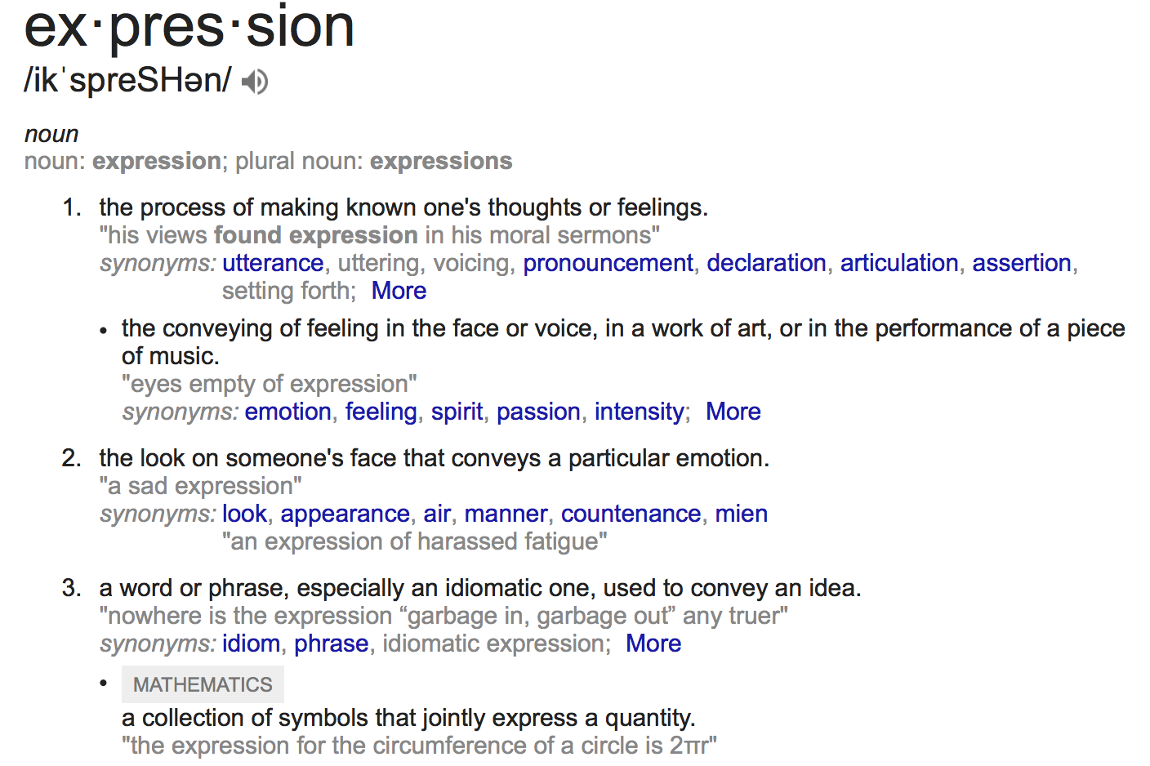
Expressions

Slide 5
Expressions
Expressions represent a value
Python evaluates expressions (similar to a calculator)
47
1.0+2.001
1*3
"1.0"+"2.0"
"Happy"*2 + "?!"*3
type(1+2)
Values
Operators

Slide 6
Exercise 1: Expressions
1/2
13
4 + 3 * 2
( "A"*2 + "?"*3 ) * 2
14 % 5
5 ** 2
Hi!
1*2 + "2"*2

Slide 7
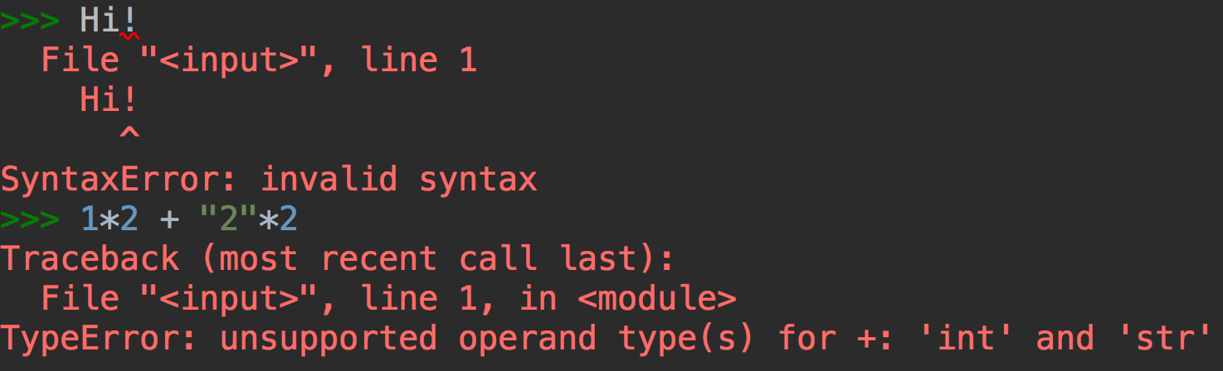
Errors
Three types of errors:
ValueError: unsupported operand value(s)
TypeError: unsupported operand type(s) for +: 'int' and 'str'
SyntaxError: invalid syntax

Slide 8
Exercise 2: Expressions and Errors
3 * "5"
str(3) * int("5")
1 / 2 * "Hello"
"1.0" + 2.0
int("2") * "2"
1 ** 2.5
str("2") * 4

Slide 9
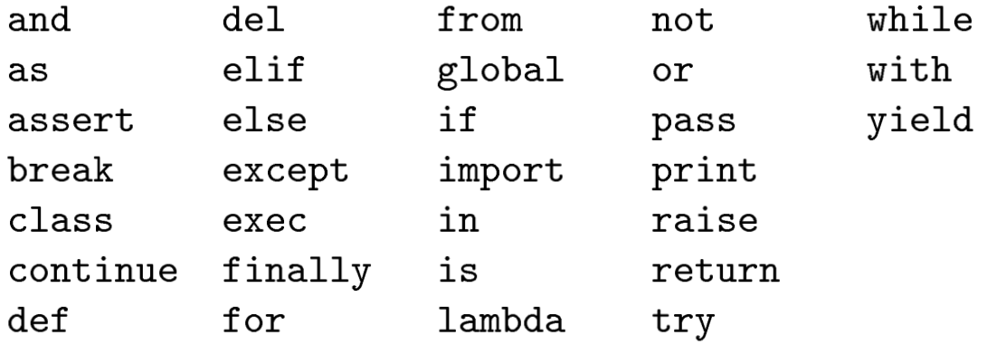
Variables
A variable is a name that refers to a value
names should be meaningful
by convention words separated by an underscore
names cannot be a keyword (e.g. print), cannot include spaces, must begin with a letter

Slide 10
Assigning variables
Can assign a value to a variable
x = 47
a_string = "Hello"
x (int)
00000000000000000000000000101111
a_string (str)
0100100001100101011011000110110001101111
Notes:
Demo: variables don't have types type(x) ; x = 10; type(x); x = "10"; type(x)

Slide 11
Assigning variables
Can assign a value to a variable
Right hand side can be any expression (anything that is, or that evaluates to, a value)
x = 13
a_string = 1*str(2) + "2"*2
x_type = type(1+2.001)
Notes:
Demo: variables don't have types type(x) ; x = 10; type(x); x = "10"; type(x)

Slide 12
Variables and Expressions
a variable evaluates to the value stored in that variable
variables can be used in expressions
my_num = 13
new_num = my_num + 34

Slide 13
Example: Word Problem
If you run a 10 kilometer race in 43 minutes 30 seconds, what is your average time per mile? (Hint: there are 1.61 kilometers in a mile).

Slide 14
Example: Writing a Program
If you run a 10 kilometer race in 43 minutes 30 seconds, what is your average time per mile? (Hint: there are 1.61 kilometers in a mile).
Notes:
miles = 10/1.61 time_mins = 43.5 pace = time_mins/miles

Slide 15
Exercise 3: Writing a Program
If you run a 10 kilometer race in 43 minutes 30 seconds, what is your average speed in miles per hour? (Hint: there are 1.61 kilometers in a mile).
Notes:
time_hrs = time_mins/60 speed = miles/time_hrs

Slide 16
Demo: Running a Program

Slide 17
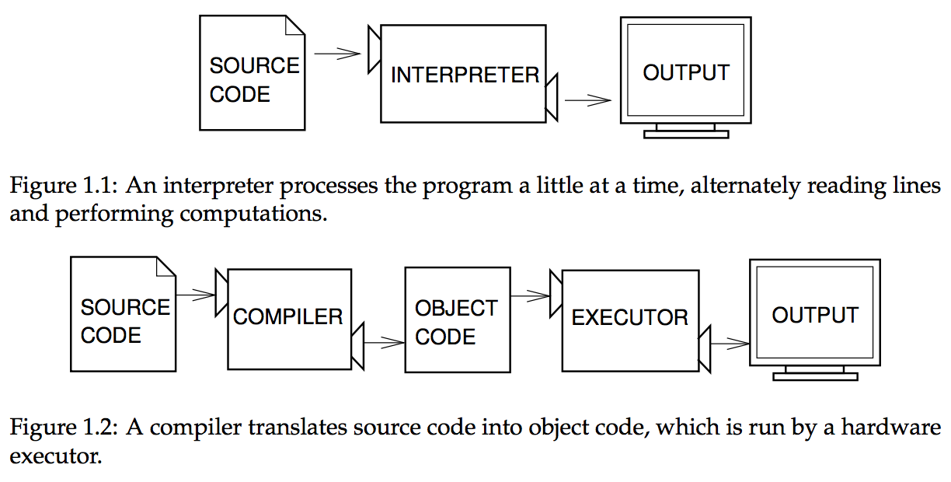
High-level languages
pushq %rbp
movq %rsp, %rbp
subq $32, %rsp
leaq L_.str(%rip), %rax
movl $0, -4(%rbp)
movl %edi, -8(%rbp)
movq %rsi, -16(%rbp)
movq %rax, %rdi
movb $0, %al
callq _printf
xorl %ecx, %ecx
movl %eax, -20(%rbp)
movl %ecx, %eax
addq $32, %rsp
popq %rbp
retq
print("Hello World!\n")
Notes:
citation: page 2, Think Python 2nd edition
walk through on board w/ boxes for variables

Slide 18
Input an Output
print() is a function that allows you to display text on the screen
input() is a function that allows you to get a value from your user
Notes:
Demo input

Slide 19
Example
How would you change this program so that it asks the user for their time in minutes and seconds and then prints out their average time per mile for the 10K race?
Notes:
edit on screen then walk through on board w/ boxes for variables

Slide 20
Exercise 4: Interactive Programs
Write a program that asks the user for word and a number, then prints the word followed by an exclamation point and a space that many times. For example:
Enter a word:
happy
Enter a positive integer:
3
happy! happy! happy!
Notes:
walk through solution on board with boxes for variables

