Slide 1
Lecture 0: Introduction to Computer Science
CS 51P August 28, 2023
Notes:
Discussion: What is computer science

Slide 2
Computer Science
Notes:
What do these areas have in common?

Slide 3

Computational Thinking
Notes:
Computational Thinking is the thought processes involved in formulating a problem and expressing its solution(s) in such a way that a computer—human or machine—can effectively carry out.
Computational Thinking is an iterative process based on three stages:
Problem formulation (abstraction)
Solution expression (automation)
Solution execution and evaluation (analyses)
https://en.wikipedia.org/wiki/Computational_thinking
checked 1/16/2018

Slide 4
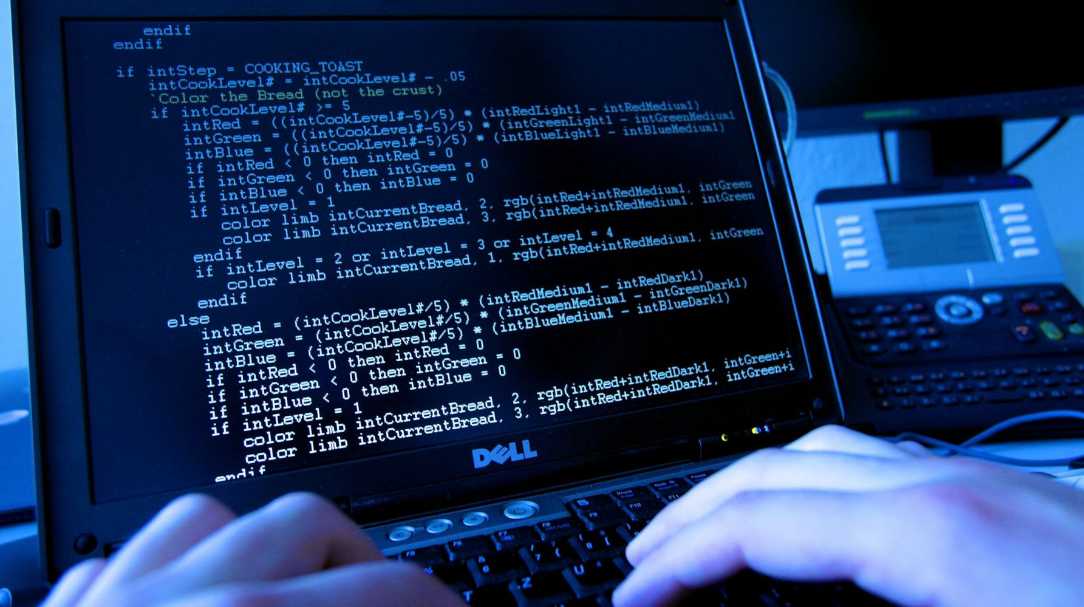
Programming
Notes:
A program is a sequence of instructions that specifies how to perform a computation, in a language that a computer can execute
A programming language is a set of instructions that are used to write programs

Slide 5
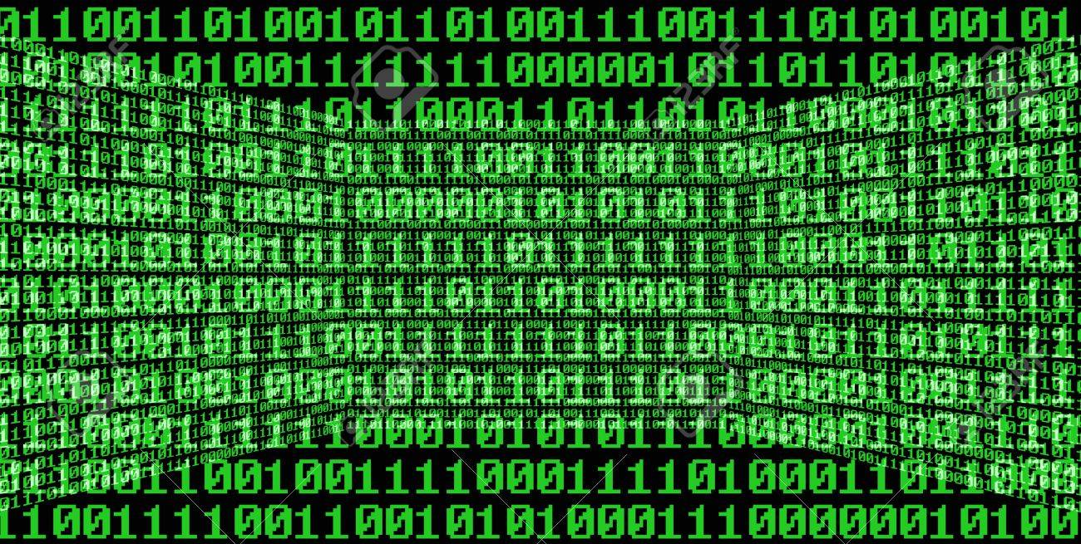
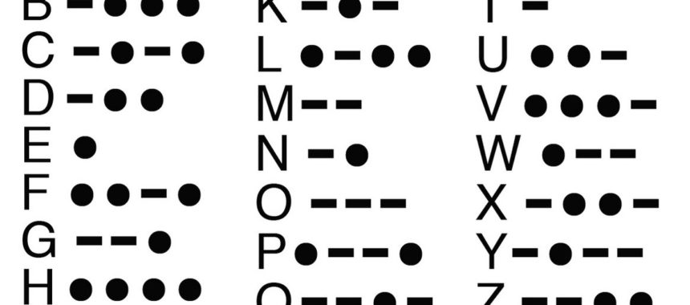
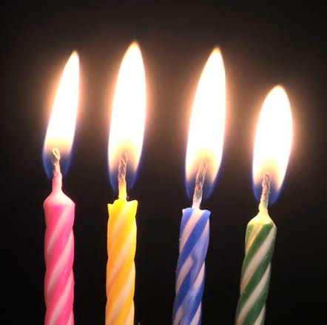



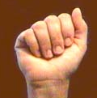
Bits
a bit is piece of data that can have two possible values
can be physically represented with a two state device

Slide 6
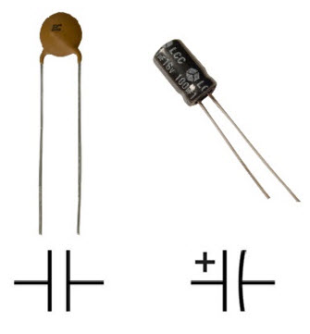
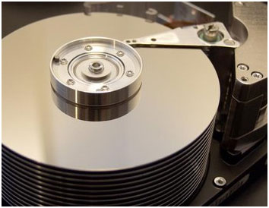
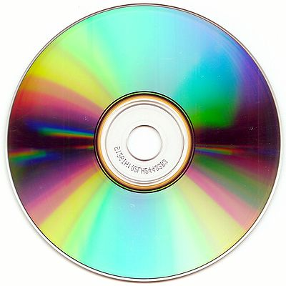
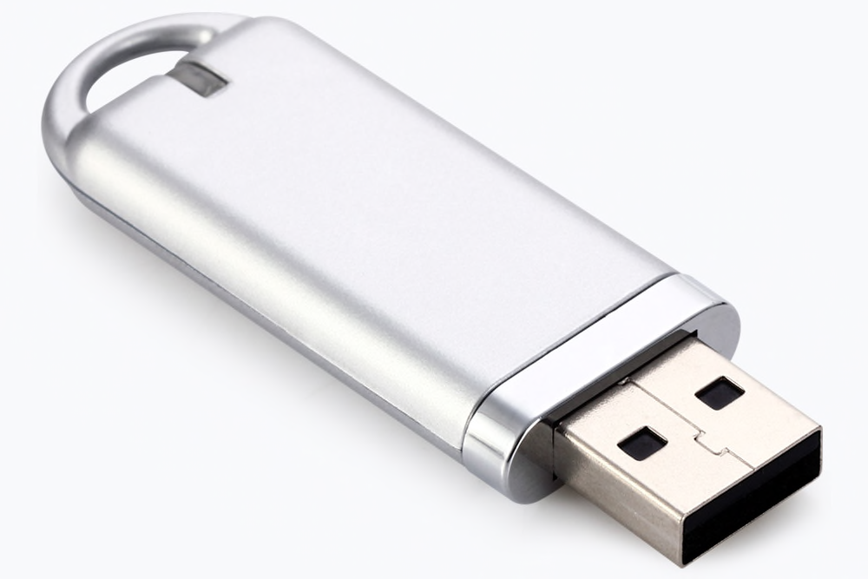
Storing bits
Dynamic Memory (DRAM): stores each bit of data in a capacitor, which stores energy in an electric field (or not)
Magnetic Disk: regions of the platter are magnetized with either N-S polarity or S-N polarity
Optical Disk: stores bits as tiny indentations (pits) or not (lands) that reflect light differently
Flash Disk: electrons are stored in one of two gates separated by oxide layers

Slide 7
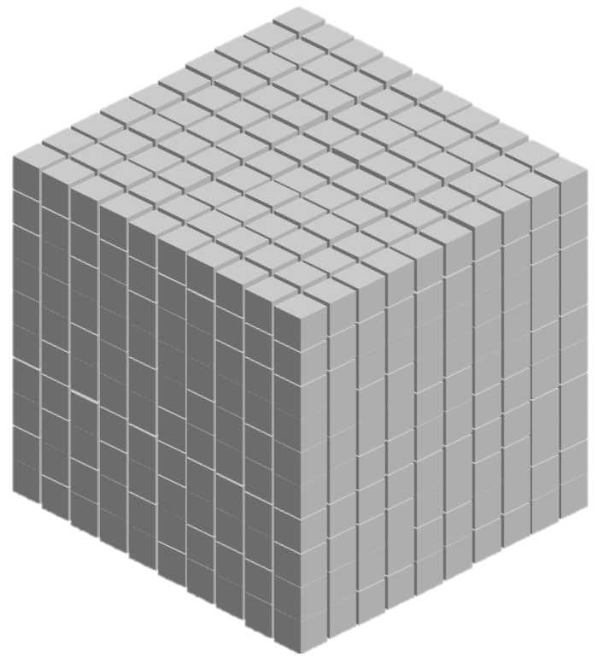
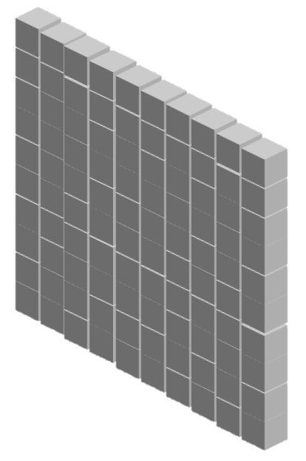


"Normal" Integers
(aka Base-10 Integers)
1000 | 100 | 10 | 1
(10³) | (10²) | (10¹) | (10⁰)
0 | 0 | 0 | 5
0 | 0 | 4 | 7
2 | 0 | 2 | 3

Slide 8
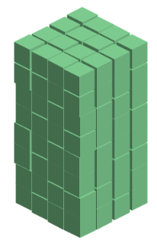
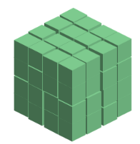
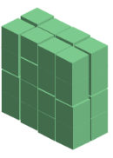
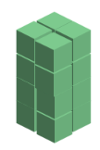



Binary Numbers (aka Base-2 Integers)
128 (2⁷) | 64 (2⁶) | 32 (2⁵) | 16 (2⁴) | 8 (2³) | 4 (2²) | 2 (2¹) | 1 (2⁰)
0 | 0 | 0 | 0 | 0 | 1 | 0 | 1
0 | 0 | 1 | 0 | 1 | 1 | 1 | 1
1 | 1 | 1 | 1 | 1 | 1 | 1 | 1

Slide 9
Exercise 1: Binary Numbers
Consider the following four-bit binary values. What is the integer interpretation of these values?
0001
1010
0111
1111

Slide 10
Exercise 2: Binary Numbers
Consider the following integer values. What is the 4-bit binary representation of each of these values?
2
12
13
14

Slide 11
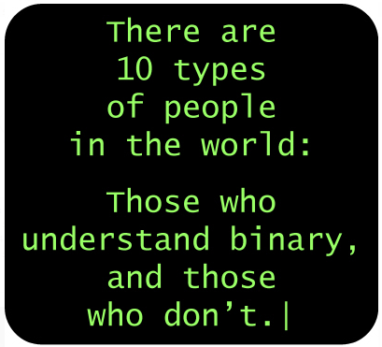
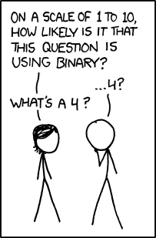
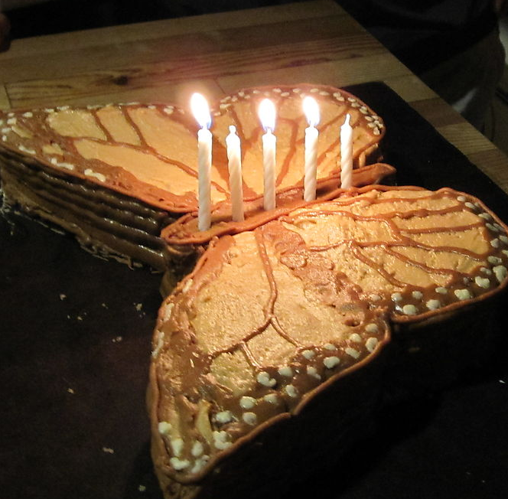
Binary Numbers

Slide 12
ASCII characters
Ch | Dec | Binary
! | 33 | 00100001
" | 34 | 00100010
# | 35 | 00100011
$ | 36 | 00100100
% | 37 | 00100101
& | 38 | 00100110
' | 39 | 00100111
( | 40 | 00101000
) | 41 | 00101001
* | 42 | 00101010
+ | 43 | 00101011
, | 44 | 00101100
- | 45 | 00101101
. | 46 | 00101110
/ | 47 | 00101111
0 | 48 | 00110000
Ch | Dec | Binary
1 | 49 | 00110001
2 | 50 | 00110010
3 | 51 | 00110011
4 | 52 | 00110100
5 | 53 | 00110101
6 | 54 | 00110110
7 | 55 | 00110111
8 | 56 | 00111000
9 | 57 | 00111001
: | 58 | 00111010
; | 59 | 00111011
< | 60 | 00111100
= | 61 | 00111101
> | 62 | 00111110
? | 63 | 00111111
@ | 64 | 01000000
Ch | Dec | Binary
A | 65 | 01000001
B | 66 | 01000010
C | 67 | 01000011
D | 68 | 01000100
E | 69 | 01000101
F | 70 | 01000110
G | 71 | 01000111
H | 72 | 01001000
I | 73 | 01001001
J | 74 | 01001010
K | 75 | 01001011
L | 76 | 01001100
M | 77 | 01001101
N | 78 | 01001110
O | 79 | 01001111
P | 80 | 01010000
Ch | Dec | Binary
Q | 81 | 01010001
R | 82 | 01010010
S | 83 | 01010011
T | 84 | 01010100
U | 85 | 01010101
V | 86 | 01010110
W | 87 | 01010111
X | 88 | 01011000
Y | 89 | 01011001
Z | 90 | 01011010
[ | 91 | 01011011
\ | 92 | 01011100
] | 93 | 01011101
^ | 94 | 01011110
_ | 95 | 01011111
` | 96 | 01100000
Ch | Dec | Binary
a | 97 | 01100001
b | 98 | 01100010
c | 99 | 01100011
d | 100 | 01100100
e | 101 | 01100101
f | 102 | 01100110
g | 103 | 01100111
h | 104 | 01101000
i | 105 | 01101001
j | 106 | 01101010
k | 107 | 01101011
l | 108 | 01101100
m | 109 | 01101101
n | 110 | 01101110
o | 111 | 01101111
p | 112 | 01110000

Slide 13
Exercise 3: ASCII Characters
Consider the following words. How would we represent each of these words in binary?
a
I
Hello

Slide 14
Interpreting Binary
What is the following value?
01000001

Slide 15
Interpreting Binary
What is the following value?
01000001
?
?
65
A

Slide 16
Types
A type is a set of values and plan for representing/interpreting those values in binary
integer (int)
string (str)
Values: 0, 1, -10, 34022, …
Values: "Hi!", "", "2.0",…
All values have types.
Integers and strings are two common types
You can determine the type of a value
using the command type(<value>)
Notes:
demo using type

Slide 17
Types
Values that look similar to a person can have very different representations if they are different types
47 (int)
00000000000000000000000000101111
"47" (str)
0011010000111111
You can switch types (aka cast) using
commands like int(<value>) and str(<value>)
Notes:
demo casting
demo type error

Slide 18
ValueErrors
You can't always do things for all possible values

Slide 19
Exercise 4: Casting and Representations
How would we represent each of following?
13
str(13)
"Hi!"
int("Hi!")

Slide 20
Operations
Each type has a set of things you can do with values of that type. These are called operations.
int
string
Values: 0, 1, -10, 34022, …
Operations: +, -, /, *
** (exponent),
% (remainder)
// (truncated division)
Values: "Hi!", "", "2.0",…
Operations: + (concatenation)
* (duplication),

Slide 21
TypeErrors
You can't always do things for all possible types

Slide 22
Logistics

Slide 23

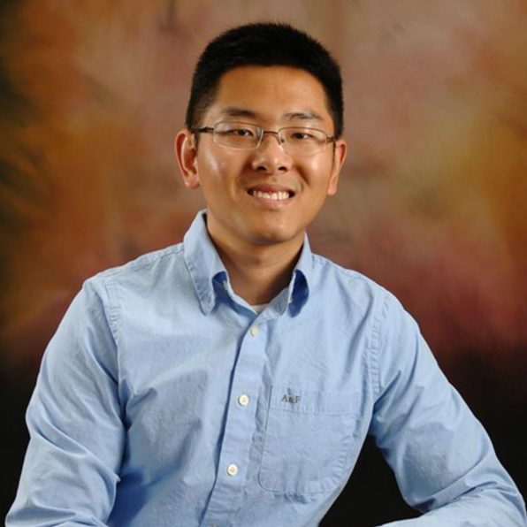
Course Logistics
Prof. Eleanor Birrell Prof. Zilong Ye
Class Meetings:
Monday and Wednesday, 1:15-2:30pm or 2:45-4pm in Edmunds 114
Lab:
Monday or Tuesday, 7-9:50pm in Edmunds 219/229

Slide 24
Course Work
Homework Assignments (20%)
Approximately 10 assignments
Mostly individual, some may be done in pairs
Assignments will be started in Lab
Final Project (20%)
Use what you've learned!
Checkpoints (60%)
Three checkpoints (Sept 27, Oct 23, and Dec 6, in class)
No final exam
All assignments will be due Mondays at 5pm PT.

Slide 25
Course Website
All information is on the Course website:
https://cs.pomona.edu/classes/cs51p/
51p communications, community, q&a, etc. on slack:
#cs51p-2023fa
CS Community
Slack (Everyone!) pomonacs.slack.com
BBICS
WACM

