Slide 1
informed Search
David Kauchak
CS51A – Spring 2025

Slide 2
Admin
Assignment 9
Assignment 10

Slide 3
Foxes and Chickens
Three foxes and three chickens wish to cross the river. They have a small boat that will carry up to two animals. Everyone can navigate the boat. If at any time the foxes outnumber the chickens on either bank of the river, they will eat the chickens. Find the smallest number of crossings that will allow everyone to cross the river safely.
What is the “state” of this problem (it should capture all possible valid configurations)?

Slide 4
Foxes and Chickens
Three foxes and three chickens wish to cross the river. They have a small boat that will carry up to two animals. Everyone can navigate the boat. If at any time the foxes outnumber the chickens on either bank of the river, they will eat the chickens. Find the smallest number of crossings that will allow everyone to cross the river safely.

Slide 5
Foxes and Chickens
Three foxes and three chickens wish to cross the river. They have a small boat that will carry up to two animals. Everyone can navigate the boat. If at any time the foxes outnumber the chickens on either bank of the river, they will eat the chickens. Find the smallest number of crossings that will allow everyone to cross the river safely.
FFFCCC B
FFCC B FC
FC B FFCC
…

Slide 6
Searching for a solution
FFFCCC B ~~
What states can we get to from here?

Slide 7
Searching for a solution
FFFCCC B ~~
FCCC ~~ B FF
FFCCC ~~ B F
FFCC ~~ B FC
Next states?

Slide 8
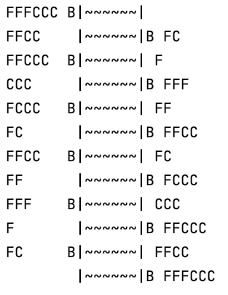
Fox and Chickens Solution
How is this solution different than the n-queens problem?

Slide 9
Fox and Chickens Solution
Solution is not a state, but a sequence of actions (or a sequence of states)

Slide 10
Code!
https://cs.pomona.edu/classes/cs51a/examples/chickens.txt

Slide 11
One other problem
FFFCCC B ~~
FCCC ~~ B FF
FFCCC ~~ B F
FFCC ~~ B FC
FFFCCC B~~
FFCCC B~~ F
FFFCCC B~~
What would happen if we ran DFS here?

Slide 12
One other problem
FFFCCC B ~~
FCCC ~~ B FF
FFCCC ~~ B F
FFCC ~~ B FC
FFFCCC B~~
FFCCC B~~ F
FFFCCC B~~
If we always go left first, will continue forever!

Slide 13
One other problem
FFFCCC B ~~
FCCC ~~ B FF
FFCCC ~~ B F
FFCC ~~ B FC
FFFCCC B~~
FFCCC B~~ F
FFFCCC B~~
Does BFS have this problem?

Slide 14
One other problem
FFFCCC B ~~
FCCC ~~ B FF
FFCCC ~~ B F
FFCC ~~ B FC
FFFCCC B~~
FFCCC B~~ F
FFFCCC B~~
Does BFS have this problem?
No!

Slide 15
DFS vs. BFS
Why do we use DFS then, and not BFS?

Slide 16
DFS vs. BFS
1
Consider a search problem where each state has two states you can reach
Assume the goal state involves 20 actions, i.e. moving between ~20 states
2
3
4
5
6
7
…
How big can the queue get for BFS?

Slide 17
DFS vs. BFS
1
Consider a search problem where each state has two states you can reach
Assume the goal state involves 20 actions, i.e. moving between ~20 states
2
3
4
5
6
7
…
At any point, need to remember roughly a “row”

Slide 18
DFS vs. BFS
1
Consider a search problem where each state has two states you can reach
Assume the goal state involves 20 actions, i.e. moving between ~20 states
2
3
4
5
6
7
…
How big does this get?

Slide 19
DFS vs. BFS
1
Consider a search problem where each state has two states you can reach
Assume the goal state involves 20 actions, i.e. moving between ~20 states
2
3
4
5
6
7
…
Doubles every level we have to go deeper.
For 20 actions that is 2²⁰ = ~1 million states!

Slide 20
DFS vs. BFS
1
Consider a search problem where each state has two states you can reach
Assume the goal state involves 20 actions, i.e. moving between ~20 states
2
3
4
5
6
7
…
How many states would DFS keep on the stack?

Slide 21
DFS vs. BFS
1
Consider a search problem where each state has two states you can reach
Assume the goal state involves 20 actions, i.e. moving between ~20 states
2
3
4
5
6
7
…
Only one path through the tree, roughly 20 states (really 20*2)

Slide 22
One other problem
FFFCCC B ~~
FCCC ~~ B FF
FFCCC ~~ B F
FFCC ~~ B FC
FFFCCC B~~
FFCCC B~~ F
FFFCCC B~~
If we always go left first, will continue forever!
Solution?

Slide 23
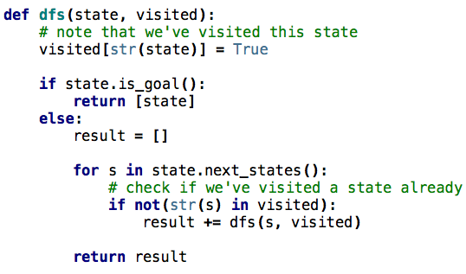
DFS avoiding repeats
Notes:
visited is a dictionary of states we’ve visited

Slide 24
Other search problems
What problems have you seen that could be posed as search problems?
What is the state?
Start state
Goal state
State-space/transition between states

Slide 25
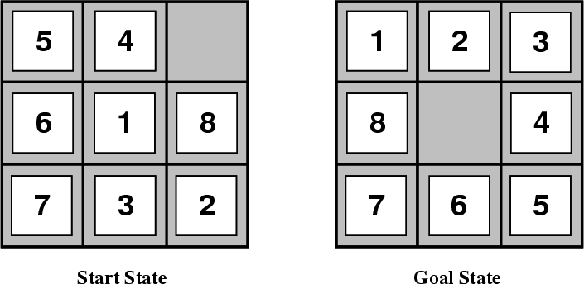
8-puzzle

Slide 26
8-puzzle
goal
state representation?
start state?
state-space/transitions?

Slide 27
8-puzzle
state:
all 3 x 3 configurations of the tiles on the board
transitions between states:
Move Blank Square Left, Right, Up or Down.
This is a more efficient encoding than moving each of the 8 distinct tiles

Slide 28
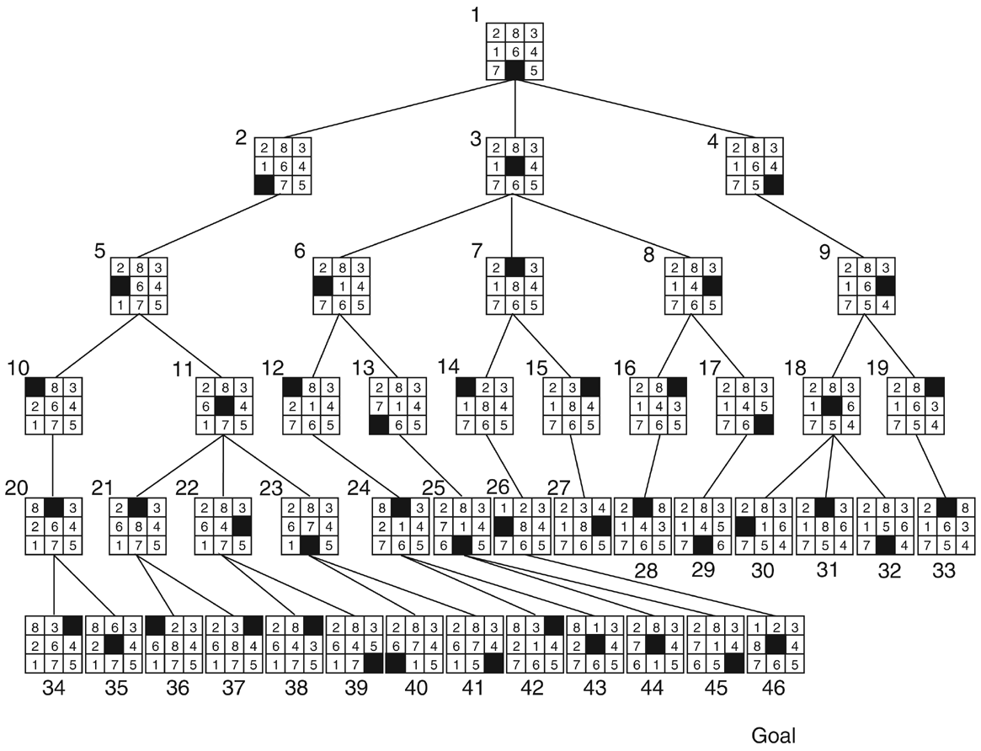

Slide 29
Cryptarithmetic
Find an assignment of digits (0, ..., 9) to letters so that a given arithmetic expression is true. examples: SEND + MORE = MONEY
FORTY Solution: 29786
+ TEN 850
+ TEN 850
----- -----
SIXTY 31486
F=2, O=9, R=7, etc.

Slide 30
Remove 5 Sticks
Given the following configuration of sticks, remove exactly 5 sticks in such a way that the remaining configuration forms exactly 3 squares.

Slide 31
Water Jug Problem
Given a full 5-gallon jug and a full 2-gallon jug, fill the 2-gallon jug with exactly one gallon of water.
5
2

Slide 32
Water Jug Problem
State = (x,y), where x is the number of gallons of water in the 5-gallon jug and y is # of gallons in the 2-gallon jug
Initial State = (5,2)
Goal State = (*,1), where * means any amount
Operator table
5
Name | Cond. | Transition | Effect
Empty5 | – | (x,y)→(0,y) | Empty 5-gal. jug
Empty2 | – | (x,y)→(x,0) | Empty 2-gal. jug
2to5 | x ≤ 3 | (x,2)→(x+2,0) | Pour 2-gal. into 5-gal.
5to2 | x ≥ 2 | (x,0)→(x-2,2) | Pour 5-gal. into 2-gal.
5to2part | y < 2 | (1,y)→(0,y+1) | Pour partial 5-gal. into 2-gal.
2

Slide 33
8-puzzle revisited
How hard is this problem?
1
3
8
4
7
6
5
2

Slide 34
8-puzzle revisited
The average depth of a solution for an 8-puzzle is 22 moves
An exhaustive search requires searching ~3²² = 3.1 x 10¹⁰ states
BFS: 10 terabytes of memory
DFS: 8 hours (assuming one million nodes/second)
Can we do better?
Are DFS and BFS intelligent?
1
3
8
4
7
6
5
2

Slide 35
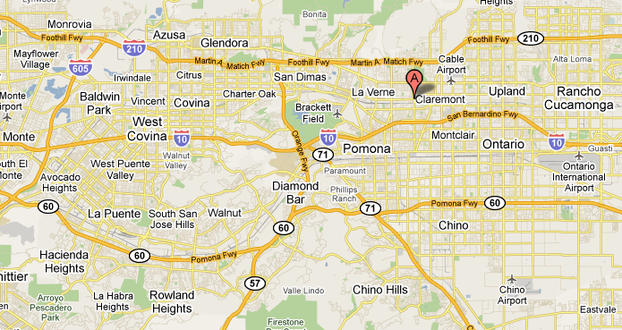
from: Claremont to:Rowland Heights
How do you think google maps does it?

Slide 36
from: Claremont to:Rowland Heights
What would the search algorithms do?

Slide 37
from: Claremont to:Rowland Heights
DFS

Slide 38
from: Claremont to:Rowland Heights
BFS

Slide 39
from: Claremont to: Rowland Heights
Ideas?

Slide 40
from: Claremont to: Rowland Heights
We’d like to bias search towards the actual solution

Slide 41
Informed search
Order to_visit based on some knowledge of the world that estimates how “good” a state is
h(n) is called an evaluation function
Best-first search
rank to_visit based on h(n)
take the most desirable state in to_visit first
different approaches depending on how we define h(n)

Slide 42
Heuristic
Merriam-Webster's Online Dictionary
Heuristic (pron. \hyu-’ris-tik\): adj. [from Greek heuriskein to discover.] involving or serving as an aid to learning, discovery, or problem-solving by experimental and especially trial-and-error methods
The Free On-line Dictionary of Computing (2/19/13)
heuristic 1. Of or relating to a usually speculative formulation serving as a guide in the investigation or solution of a problem: "The historian discovers the past by the judicious use of such a heuristic device as the 'ideal type'" (Karl J. Weintraub).

Slide 43
Heuristic function: h(n)
An estimate of how close the node is to a goal
Uses domain-specific knowledge!
Examples
Map path finding?
straight-line distance from the node to the goal (“as the crow flies”)
8-puzzle?
how many tiles are out of place
sum of the “distances” of the out of place tiles
Foxes and Chickens?
number of animals on the final bank

Slide 44
Two heuristics
2 | 8 | 3
1 | 6 | 4
 | 7 | 5
1 | 2 | 3
8 |  | 4
7 | 6 | 5
1 | 2 | 3
8 | 6 | 4
 | 7 | 5
Which state is better?
GOAL
6 | 2 | 3
8 |  | 4
7 | 1 | 5

Slide 45
Two heuristics
2 | 8 | 3
1 | 6 | 4
 | 7 | 5
1 | 2 | 3
8 |  | 4
7 | 6 | 5
Goal
How many tiles are out of place?

Slide 46
Two heuristics
2 | 8 | 3
1 | 6 | 4
 | 7 | 5
1 | 2 | 3
8 |  | 4
7 | 6 | 5
Goal
5

Slide 47
Two heuristics
2 | 8 | 3
1 | 6 | 4
 | 7 | 5
1 | 2 | 3
8 |  | 4
7 | 6 | 5
Goal
What is the “distance” of the tiles that are out of place?

Slide 48
Two heuristics
2 | 8 | 3
1 | 6 | 4
 | 7 | 5
1 | 2 | 3
8 |  | 4
7 | 6 | 5
1
2
1
1
1
Goal
6

Slide 49
Two heuristics
Tiles out of place
Sum of distances for out of place tiles
2 | 8 | 3
1 | 6 | 4
 | 7 | 5
5
6
1 | 2 | 3
8 |  | 4
7 | 6 | 5
1 | 2 | 3
8 | 6 | 4
 | 7 | 5
?
GOAL
6 | 2 | 3
8 |  | 4
7 | 1 | 5

Slide 50
Two heuristics
Tiles out of place
Sum of distances for out of place tiles
2 | 8 | 3
1 | 6 | 4
 | 7 | 5
5
6
1 | 2 | 3
8 |  | 4
7 | 6 | 5
1 | 2 | 3
8 | 6 | 4
 | 7 | 5
2
2
GOAL
1
1
6 | 2 | 3
8 |  | 4
7 | 1 | 5
3
2
6
3

Slide 51
Two heuristics
Tiles out of place
Sum of distances for out of place tiles
2 | 8 | 3
1 | 6 | 4
 | 7 | 5
5
6
Which heuristic is better (if either)?
1 | 2 | 3
8 |  | 4
7 | 6 | 5
1 | 2 | 3
8 | 6 | 4
 | 7 | 5
2
2
GOAL
1
1
6 | 2 | 3
8 |  | 4
7 | 1 | 5
3
2
6
3

Slide 52
Two heuristics
Tiles out of place
Sum of distances for out of place tiles
2 | 8 | 3
1 | 6 | 4
 | 7 | 5
5
6
More closely approximates “real” number of steps remaining?
1 | 2 | 3
8 |  | 4
7 | 6 | 5
1 | 2 | 3
8 | 6 | 4
 | 7 | 5
2
2
GOAL
2
1
6 | 2 | 3
8 |  | 4
7 | 1 | 5
3
2
6
3

Slide 53
2 | 8 | 3
1 | 6 | 4
7 |  | 5
Next states?

Slide 54
2 | 8 | 3
1 | 6 | 4
7 |  | 5
2 | 8 | 3
1 | 6 | 4
 | 7 | 5
2 | 8 | 3
1 |  | 4
7 | 6 | 5
2 | 8 | 3
1 | 6 | 4
7 | 5
Which would you do?

Slide 55
2 | 8 | 3
1 | 6 | 4
7 |  | 5
2 | 8 | 3
1 | 6 | 4
 | 7 | 5
2 | 8 | 3
1 |  | 4
7 | 6 | 5
2 | 8 | 3
1 | 6 | 4
7 | 5
Which would DFS choose
Completely depends on how next states are generated.
Not an “intelligent” decision!

Slide 56
1 | 2 | 3
8 |  | 4
7 | 6 | 5
2 | 8 | 3
1 | 6 | 4
7 |  | 5
GOAL
2 | 8 | 3
1 | 6 | 4
 | 7 | 5
2 | 8 | 3
1 |  | 4
7 | 6 | 5
2 | 8 | 3
1 | 6 | 4
7 | 5
Best first search: out of place tiles?

Slide 57
1 | 2 | 3
8 |  | 4
7 | 6 | 5
2 | 8 | 3
1 | 6 | 4
7 |  | 5
GOAL
2 | 8 | 3
1 | 6 | 4
 | 7 | 5
2 | 8 | 3
1 |  | 4
7 | 6 | 5
2 | 8 | 3
1 | 6 | 4
7 | 5
1
2
1
2
1
2
6
4
6
1
1
1
1
1
1
1
Best first search: distance of tiles?

Slide 58
1 | 2 | 3
8 |  | 4
7 | 6 | 5
2 | 8 | 3
1 | 6 | 4
7 |  | 5
GOAL
2 | 8 | 3
1 | 6 | 4
 | 7 | 5
2 | 8 | 3
1 |  | 4
7 | 6 | 5
2 | 8 | 3
1 | 6 | 4
7 | 5
Next states?

Slide 59
1 | 2 | 3
8 |  | 4
7 | 6 | 5
2 | 8 | 3
1 | 6 | 4
7 |  | 5
GOAL
2 | 8 | 3
1 | 6 | 4
 | 7 | 5
2 | 8 | 3
1 |  | 4
7 | 6 | 5
2 | 8 | 3
1 | 6 | 4
7 | 5
1
2
6
4
6
1
2 |  | 3
1 | 8 | 4
7 | 6 | 5
2 | 8 | 3
 | 1 | 4
7 | 6 | 5
2 | 8 | 3
1 | 6 | 4
7 |  | 5
2 | 8 | 3
1 | 4
7 | 6 | 5
3
5
5
5
Which next for best first search?

Slide 60
1 | 2 | 3
8 |  | 4
7 | 6 | 5
2 | 8 | 3
1 | 6 | 4
7 |  | 5
GOAL
2 | 8 | 3
1 | 6 | 4
 | 7 | 5
2 | 8 | 3
1 |  | 4
7 | 6 | 5
2 | 8 | 3
1 | 6 | 4
7 | 5
1
2
4
1
2 |  | 3
1 | 8 | 4
7 | 6 | 5
2 | 8 | 3
 | 1 | 4
7 | 6 | 5
2 | 8 | 3
1 | 6 | 4
7 |  | 5
2 | 8 | 3
1 | 4
7 | 6 | 5
3
5
5
5
 | 2 | 3
1 | 8 | 4
7 | 6 | 5
2 | 8 | 3
1 |  | 4
7 | 6 | 5
2 | 3
1 | 8 | 4
7 | 6 | 5
2
4
4

Slide 61
1 | 2 | 3
8 |  | 4
7 | 6 | 5
2 | 8 | 3
1 | 6 | 4
7 |  | 5
GOAL
2 | 8 | 3
1 | 6 | 4
 | 7 | 5
2 | 8 | 3
1 |  | 4
7 | 6 | 5
2 | 8 | 3
1 | 6 | 4
7 | 5
1
2
4
1
2 |  | 3
1 | 8 | 4
7 | 6 | 5
2 | 8 | 3
 | 1 | 4
7 | 6 | 5
2 | 8 | 3
1 | 6 | 4
7 |  | 5
2 | 8 | 3
1 | 4
7 | 6 | 5
3
5
5
5
 | 2 | 3
1 | 8 | 4
7 | 6 | 5
2 | 8 | 3
1 |  | 4
7 | 6 | 5
2 | 3
1 | 8 | 4
7 | 6 | 5
2
4
4
…

Slide 62
Informed search algorithms
Best first search is called an “informed” search algorithm
Why wouldn’t we always use an informed algorithm?
Coming up with good heuristics can be hard for some problems
There is computational overhead (both in calculating the heuristic and in keeping track of the next “best” state)

Slide 63
Informed search algorithms
Any other problems/concerns about best first search?

Slide 64
Informed search algorithms
Any other problems/concerns about best first search?
Only as good as the heuristic function
START
GOAL
Best first search using straight line distance as heuristic
What would the search do?

Slide 65
Informed search algorithms
Any other problems/concerns about best first search?
Only as good as the heuristic function
START
GOAL
Best first search using straight line distance as heuristic
What is the problem?

Slide 66
Informed search algorithms
Any other problems/concerns about best first search?
Only as good as the heuristic function
START
GOAL
Best first search using straight line distance as heuristic
Doesn’t take into account how far it has come.
Best first search is a “greedy” algorithm

Slide 67
Informed search algorithms
Best first search is called an “informed” search algorithm
There are many other informed search algorithms:
A* search (and variants)
Theta*
Beam search

Slide 68
Sudoku
 | 4 | 3 |  |  |  | 6 | 7
5 |  |  | 4 |  | 2 |  |  | 8
8 |  |  |  | 6 |  |  |  | 1
2 |  |  |  |  |  |  |  | 5
 | 5 |  |  |  |  |  | 4
 |  | 6 |  |  |  | 7
 |  |  | 5 |  | 1
 |  |  |  | 8
Fill in the grid with the numbers 1-9
each row has 1-9 (without repetition)
each column has 1-9 (without repetition)
each quadrant has 1-9 (without repetition)

Slide 69
Sudoku
7 | 2 | 8 | 9 | 3 | 6 | 5 | 1 | 4
9 | 4 | 3 | 1 | 5 | 8 | 6 | 7 | 2
5 | 6 | 1 | 4 | 7 | 2 | 9 | 3 | 8
8 | 3 | 4 | 7 | 6 | 5 | 2 | 9 | 1
2 | 1 | 7 | 8 | 4 | 9 | 3 | 6 | 5
6 | 5 | 9 | 2 | 1 | 3 | 8 | 4 | 7
1 | 8 | 6 | 3 | 2 | 4 | 7 | 5 | 9
3 | 7 | 2 | 5 | 9 | 1 | 4 | 8 | 6
4 | 9 | 5 | 6 | 8 | 7 | 1 | 2 | 3
Fill in the grid with the numbers 1-9
each row has 1-9 (without repetition)
each column has 1-9 (without repetition)
each quadrant has 1-9 (without repetition)

Slide 70
Sudoku
 | 4 | 3 |  |  |  | 6 | 7
5 |  |  | 4 |  | 2 |  |  | 8
8 |  |  |  | 6 |  |  |  | 1
2 |  |  |  |  |  |  |  | 5
 | 5 |  |  |  |  |  | 4
 |  | 6 |  |  |  | 7
 |  |  | 5 |  | 1
 |  |  |  | 8
How can we pose this as a search problem?
State
Start state
Goal state
State space/transitions
Fill in the grid with the numbers 1-9
each row has 1-9 (without repetition)
each column has 1-9 (without repetition)
each quadrant has 1-9 (without repetition)

Slide 71
Sudoku
 | 4 | 3 |  |  |  | 6 | 7
5 |  |  | 4 |  | 2 |  |  | 8
8 |  |  |  | 6 |  |  |  | 1
2 |  |  |  |  |  |  |  | 5
 | 5 |  |  |  |  |  | 4
 |  | 6 |  |  |  | 7
 |  |  | 5 |  | 1
 |  |  |  | 8
How can we pose this as a search problem?
State: 9 x 9 grid with 1-9 or empty
Start state:
Goal state:
State space/transitions
Fill in the grid with the numbers 1-9
each row has 1-9 (without repetition)
each column has 1-9 (without repetition)
each quadrant has 1-9 (without repetition)

Slide 72
Sudoku
 | 4 | 3 |  |  |  | 6 | 7
5 |  |  | 4 |  | 2 |  |  | 8
8 |  |  |  | 6 |  |  |  | 1
2 |  |  |  |  |  |  |  | 5
 | 5 |  |  |  |  |  | 4
 |  | 6 |  |  |  | 7
 |  |  | 5 |  | 1
 |  |  |  | 8
Generate next states:
pick an open entry
try all possible numbers that meet constraints
Fill in the grid with the numbers 1-9
each row has 1-9 (without repetition)
each column has 1-9 (without repetition)
each quadrant has 1-9 (without repetition)

Slide 73
Sudoku
 | 4 | 3 |  |  |  | 6 | 7
5 |  |  | 4 |  | 2 |  |  | 8
8 |  |  |  | 6 |  |  |  | 1
2 |  |  |  |  |  |  |  | 5
 | 5 |  |  |  |  |  | 4
 |  | 6 |  |  |  | 7
 |  |  | 5 |  | 1
 |  |  |  | 8
Generate next states:
pick an open entry
try all possible numbers that meet constraints
How many next states?
What are they?
Fill in the grid with the numbers 1-9
each row has 1-9 (without repetition)
each column has 1-9 (without repetition)
each quadrant has 1-9 (without repetition)

Slide 74
Sudoku
 | 4 | 3 |  |  |  | 6 | 7
5 |  |  | 4 |  | 2 |  |  | 8
8 |  |  |  | 6 |  |  |  | 1
2 |  |  |  |  |  |  |  | 5
 | 5 |  |  |  |  |  | 4
 |  | 6 |  |  |  | 7
 |  |  | 5 |  | 1
 |  |  |  | 8
Generate next states:
pick an open entry
try all possible numbers that meet constraints
1, 6, 7, 9
Fill in the grid with the numbers 1-9
each row has 1-9 (without repetition)
each column has 1-9 (without repetition)
each quadrant has 1-9 (without repetition)

Slide 75
Sudoku
1
 | 4 | 3 |  |  |  | 6 | 7
5 |  |  | 4 |  | 2 |  |  | 8
8 |  |  |  | 6 |  |  |  | 1
2 |  |  |  |  |  |  |  | 5
 | 5 |  |  |  |  |  | 4
 |  | 6 |  |  |  | 7
 |  |  | 5 |  | 1
 |  |  |  | 8
Generate next states:
pick an open entry
try all possible numbers that meet constraints
1, 6, 7, 9
Fill in the grid with the numbers 1-9
each row has 1-9 (without repetition)
each column has 1-9 (without repetition)
each quadrant has 1-9 (without repetition)

Slide 76
Sudoku
1
 | 4 | 3 |  |  |  | 6 | 7
5 |  |  | 4 |  | 2 |  |  | 8
8 |  |  |  | 6 |  |  |  | 1
2 |  |  |  |  |  |  |  | 5
 | 5 |  |  |  |  |  | 4
 |  | 6 |  |  |  | 7
 |  |  | 5 |  | 1
 |  |  |  | 8
Generate next states:
pick an open entry
try all possible numbers that meet constraints
How many next states?
What are they?
Fill in the grid with the numbers 1-9
each row has 1-9 (without repetition)
each column has 1-9 (without repetition)
each quadrant has 1-9 (without repetition)

Slide 77
Sudoku
1
 | 4 | 3 |  |  |  | 6 | 7
5 |  |  | 4 |  | 2 |  |  | 8
8 |  |  |  | 6 |  |  |  | 1
2 |  |  |  |  |  |  |  | 5
 | 5 |  |  |  |  |  | 4
 |  | 6 |  |  |  | 7
 |  |  | 5 |  | 1
 |  |  |  | 8
Generate next states:
pick an open entry
try all possible numbers that meet constraints
2, 6, 7, 8, 9
Fill in the grid with the numbers 1-9
each row has 1-9 (without repetition)
each column has 1-9 (without repetition)
each quadrant has 1-9 (without repetition)

Slide 78
Sudoku
1 | 2
 | 4 | 3 |  |  |  | 6 | 7
5 |  |  | 4 |  | 2 |  |  | 8
8 |  |  |  | 6 |  |  |  | 1
2 |  |  |  |  |  |  |  | 5
 | 5 |  |  |  |  |  | 4
 |  | 6 |  |  |  | 7
 |  |  | 5 |  | 1
 |  |  |  | 8
Generate next states:
pick an open entry
try all possible numbers that meet constraints
2, 6, 7, 8, 9
Fill in the grid with the numbers 1-9
each row has 1-9 (without repetition)
each column has 1-9 (without repetition)
each quadrant has 1-9 (without repetition)

Slide 79
Sudoku
1 | 2
 | 4 | 3 |  |  |  | 6 | 7
5 |  |  | 4 |  | 2 |  |  | 8
8 |  |  |  | 6 |  |  |  | 1
2 |  |  |  |  |  |  |  | 5
 | 5 |  |  |  |  |  | 4
 |  | 6 |  |  |  | 7
 |  |  | 5 |  | 1
 |  |  |  | 8
Generate next states:
pick an open entry
try all possible numbers that meet constraints
What are the next states?
Fill in the grid with the numbers 1-9
each row has 1-9 (without repetition)
each column has 1-9 (without repetition)
each quadrant has 1-9 (without repetition)

Slide 80
Sudoku
1 | 2
 | 4 | 3 |  |  |  | 6 | 7
5 |  |  | 4 |  | 2 |  |  | 8
8 |  |  |  | 6 |  |  |  | 1
2 |  |  |  |  |  |  |  | 5
 | 5 |  |  |  |  |  | 4
 |  | 6 |  |  |  | 7
 |  |  | 5 |  | 1
 |  |  |  | 8
Generate next states:
pick an open entry
try all possible numbers that meet constraints
7, 8, 9
Fill in the grid with the numbers 1-9
each row has 1-9 (without repetition)
each column has 1-9 (without repetition)
each quadrant has 1-9 (without repetition)

Slide 81
Sudoku
1 | 2 | 7
 | 4 | 3 |  |  |  | 6 | 7
5 |  |  | 4 |  | 2 |  |  | 8
8 |  |  |  | 6 |  |  |  | 1
2 |  |  |  |  |  |  |  | 5
 | 5 |  |  |  |  |  | 4
 |  | 6 |  |  |  | 7
 |  |  | 5 |  | 1
 |  |  |  | 8
Generate next states:
pick an open entry
try all possible numbers that meet constraints
7, 8, 9
Fill in the grid with the numbers 1-9
each row has 1-9 (without repetition)
each column has 1-9 (without repetition)
each quadrant has 1-9 (without repetition)

Slide 82
Sudoku
1 | 2 | 7
 | 4 | 3 |  |  |  | 6 | 7
5 |  |  | 4 |  | 2 |  |  | 8
8 |  |  |  | 6 |  |  |  | 1
2 |  |  |  |  |  |  |  | 5
 | 5 |  |  |  |  |  | 4
 |  | 6 |  |  |  | 7
 |  |  | 5 |  | 1
 |  |  |  | 8
Generate next states:
pick an open entry
try all possible numbers that meet constraints
Fill in the grid with the numbers 1-9
each row has 1-9 (without repetition)
each column has 1-9 (without repetition)
each quadrant has 1-9 (without repetition)

Slide 83
Sudoku
1 | 2 | 7
9 | 4 | 3 |  |  |  | 6 | 7
5 | 6 |  | 4 |  | 2 |  |  | 8
8 |  |  |  | 6 |  |  |  | 1
2 |  |  |  |  |  |  |  | 5
 | 5 |  |  |  |  |  | 4
 |  | 6 |  |  |  | 7
 |  |  | 5 |  | 1
 |  |  |  | 8
Generate next states:
pick an open entry
try all possible numbers that meet constraints
Fill in the grid with the numbers 1-9
each row has 1-9 (without repetition)
each column has 1-9 (without repetition)
each quadrant has 1-9 (without repetition)

Slide 84
Sudoku
1 | 2 | 7
9 | 4 | 3 |  |  |  | 6 | 7
5 | 6 |  | 4 |  | 2 |  |  | 8
8 |  |  |  | 6 |  |  |  | 1
2 |  |  |  |  |  |  |  | 5
 | 5 |  |  |  |  |  | 4
 |  | 6 |  |  |  | 7
 |  |  | 5 |  | 1
 |  |  |  | 8
Generate next states:
pick an open entry
try all possible numbers that meet constraints
Now what?
Try another branch, i.e. go back to a place where we had a decision and try a different one
Fill in the grid with the numbers 1-9
each row has 1-9 (without repetition)
each column has 1-9 (without repetition)
each quadrant has 1-9 (without repetition)

Slide 85
Sudoku
1 | 2 | 8
 | 4 | 3 |  |  |  | 6 | 7
5 |  |  | 4 |  | 2 |  |  | 8
8 |  |  |  | 6 |  |  |  | 1
2 |  |  |  |  |  |  |  | 5
 | 5 |  |  |  |  |  | 4
 |  | 6 |  |  |  | 7
 |  |  | 5 |  | 1
 |  |  |  | 8
Generate next states:
pick an open entry
try all possible numbers that meet constraints
7, 8, 9
Fill in the grid with the numbers 1-9
each row has 1-9 (without repetition)
each column has 1-9 (without repetition)
each quadrant has 1-9 (without repetition)

Slide 86
Best first Sudoku search
DFS and BFS will choose entries (and numbers within those entries) randomly
Is that how people do it?
How do you do it?
Heuristics for best first search?
Generate next states:
pick an open entry
try all possible numbers that meet constraints

Slide 87
Best first Sudoku search
DFS and BFS will choose entries (and numbers within those entries) randomly
Pick the entry that is MOST constrained
People often try and find entries where only one option exists and only fill it in that way (very little search)
Generate next states:
pick an open entry
try all possible numbers that meet constraints

Slide 88
Representing the Sudoku board
 | 4 | 3 |  |  |  | 6 | 7
5 |  |  | 4 |  | 2 |  |  | 8
8 |  |  |  | 6 |  |  |  | 1
2 |  |  |  |  |  |  |  | 5
 | 5 |  |  |  |  |  | 4
 |  | 6 |  |  |  | 7
 |  |  | 5 |  | 1
 |  |  |  | 8
[1, 6, 7, 9], [1, 2, 6, 7, 8, 9], [1, 2, 7, 8, 9],
[1, 9], 4, 3,
5, [1, 6, 7, 9], [1, 7, 9]
Which is the most constrained (of the ones above)?
Board is a matrix (list of lists)
Each entry is either:
a number (if we’ve filled in the space already, either during search or as part of the starting state)
a list of numbers that are valid to put in that entry if it hasn’t been filled in yet

Slide 89
Representing the Sudoku board
 | 4 | 3 |  |  |  | 6 | 7
5 |  |  | 4 |  | 2 |  |  | 8
8 |  |  |  | 6 |  |  |  | 1
2 |  |  |  |  |  |  |  | 5
 | 5 |  |  |  |  |  | 4
 |  | 6 |  |  |  | 7
 |  |  | 5 |  | 1
 |  |  |  | 8
[1, 6, 7, 9], [1, 2, 6, 7, 8, 9], [1, 2, 7, 8, 9],
[1, 9], 4, 3,
5, [1, 6, 7, 9], [1, 7, 9]
Which is the most constrained (of the ones above)?
Board is a matrix (list of lists)
Each entry is either:
a number (if we’ve filled in the space already, either during search or as part of the starting state)
a list of numbers that are valid to put in that entry if it hasn’t been filled in yet

Slide 90
Representing the Sudoku board
1 | 4 | 3 |  |  |  | 6 | 7
5 |  |  | 4 |  | 2 |  |  | 8
8 |  |  |  | 6 |  |  |  | 1
2 |  |  |  |  |  |  |  | 5
 | 5 |  |  |  |  |  | 4
 |  | 6 |  |  |  | 7
 |  |  | 5 |  | 1
 |  |  |  | 8
What would the state look like if we add pick 1?
Board is a matrix (list of lists)
Each entry is either:
a number (if we’ve filled in the space already, either during search or as part of the starting state)
a list of numbers that are valid to put in that entry if it hasn’t been filled in yet

Slide 91
Representing the Sudoku board
1 | 4 | 3 |  |  |  | 6 | 7
5 |  |  | 4 |  | 2 |  |  | 8
8 |  |  |  | 6 |  |  |  | 1
2 |  |  |  |  |  |  |  | 5
 | 5 |  |  |  |  |  | 4
 |  | 6 |  |  |  | 7
 |  |  | 5 |  | 1
 |  |  |  | 8
[6, 7, 9], [ 2, 6, 7, 8, 9], [2, 7, 8, 9],
1, 4, 3,
5, [6, 7, 9], [7, 9]
Remove 1 from all entries in the quadrant
What other parts of the board need to be updated?
Board is a matrix (list of lists)
Each entry is either:
a number (if we’ve filled in the space already, either during search or as part of the starting state)
a list of numbers that are valid to put in that entry if it hasn’t been filled in yet

Slide 92
Representing the Sudoku board
1 | 4 | 3 |  |  |  | 6 | 7
5 |  |  | 4 |  | 2 |  |  | 8
8 |  |  |  | 6 |  |  |  | 1
2 |  |  |  |  |  |  |  | 5
 | 5 |  |  |  |  |  | 4
 |  | 6 |  |  |  | 7
 |  |  | 5 |  | 1
 |  |  |  | 8
[6, 7, 9], [ 2, 6, 7, 8, 9], [2, 7, 8, 9],
1, 4, 3,
5, [6, 7, 9], [7, 9]
Remove 1 from all entries in the quadrant
Remove 1 from all entries in the same column
Remove 1 from all entries in the same row
Board is a matrix (list of lists)
Each entry is either:
a number (if we’ve filled in the space already, either during search or as part of the starting state)
a list of numbers that are valid to put in that entry if it hasn’t been filled in yet

