Slide 1
Adversarial Search
CS51A
David Kauchak
Spring 2022
Some material borrowed from :
Sara Owsley Sood and others

Slide 2
Admin
  Assignment 10

Slide 3
A quick review of search
Problem solving via search:
To define the state space, define three things:
  is_goal
  next_states
  starting state
Uninformed search vs. informed search
  what’s the difference?
  what are the techniques we’ve seen?
  pluses and minuses?

Slide 4
Why should we study games?
Clear success criteria
Important historically for AI
Fun ☺
Good application of search
  hard problems (chess 35¹⁰⁰ states in search space, 10⁴⁰ legal states)
Some real-world problems fit this model
  game theory (economics)
  multi-agent problems

Slide 5
Types of games
What are some of the games you’ve played?

Slide 6
Types of games: game properties
single-player vs. 2-player vs. multiplayer
Fully observable (perfect information) vs. partially observable
Discrete vs. continuous
real-time vs. turn-based
deterministic vs. non-deterministic (chance)

Slide 7

Strategic thinking = intelligence
?
For reasons previously stated, two-player games have been a focus of AI since its inception…
Important question: Is strategic thinking the same as intelligence?

Slide 8
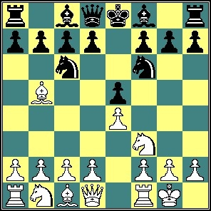
Strategic thinking = intelligence
?
Humans and computers have different relative strengths in these games:
humans
computers
?
?

Slide 9
Strategic thinking = intelligence
?
Humans and computers have different relative strengths in these games:
humans
computers
good at evaluating the strength of a board for a player
good at looking ahead in the game to find winning combinations of moves

Slide 10
Strategic thinking = intelligence
?
How could you figure out how humans approach playing chess?
humans
good at evaluating the strength of a board for a player

Slide 11
How humans play games…
An experiment was performed in which chess positions were shown to novice and expert players…
- experts could reconstruct these perfectly
- novice players did far worse…

Slide 12
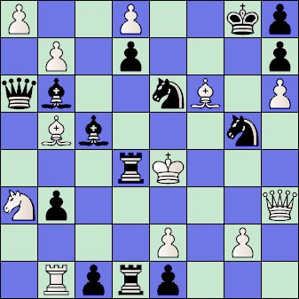
How humans play games…
Random chess positions (not legal ones) were then shown to the two groups
experts and novices did just as badly at reconstructing them!

Slide 13
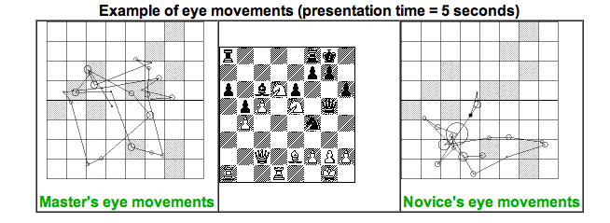
People are still working on this problem…
http://people.brunel.ac.uk/~hsstffg/frg-research/chess_expertise/

Slide 14
Tic Tac Toe as search
If we want to write a program to play tic tac toe, what question are we trying to answer?
Given a state (i.e. board configuration), what move should we make!

Slide 15
Tic Tac Toe as search
X

Slide 16
Tic Tac Toe as search
X
X
O
O
O
X
O
X
X
X
O
X
O
O
X
O
X

Slide 17
Tic Tac Toe as search
How can we pose this as a search problem?

Slide 18
Tic Tac Toe as search
X
X
…
X

Slide 19
Tic Tac Toe as search
X
Now what?

Slide 20
Tic Tac Toe as search
X
O’s turn!
X
O
X
O
X
…
O
…

Slide 21
Tic Tac Toe as search
Eventually, we’ll get to a leaf
X
X
O
X
X
O
X
X
O
X
O
O
X
X
O
…
O
X
O
X
O
X
O
O
X
X
O
WIN
TIE
LOSE
How does this help us?
Try and make moves that move us towards a win, i.e. where there are leaves with a WIN.

Slide 22
Tic Tac Toe
X’s turn
x
x
…
x
O’s turn
x
o
x
o
x
…
X’s turn
o
…
…
…
Problem: we don’t know what O will do

Slide 23
I’m X, what will ‘O’ do?
X
X
O
O
X
O
X
O’s turn
X
X
O
X
X
O
O
X
O
O
X
O
X
O
X
O
qq12314567890-\]’;lkjhgfdsazzxvbbvnm,./

Slide 24
Minimizing risk
The computer doesn’t know what move O (the opponent) will make
It can assume that it will try and make the best move possible
Even if O actually makes a different move, we’re no worse off. Why?
X
X
O
O
X
O
X
X
X
O
X
X
O
O
X
O
O
X
O
X
O
X
O

Slide 25
Optimal Strategy
An Optimal Strategy is one that is at least as good as any other, no matter what the opponent does
  If there's a way to force the win, it will
  Will only lose if there's no other option

Slide 26
Defining a scoring function
X
X
O
X
X
O
X
X
O
X
O
O
X
X
O
…
O
X
O
X
O
X
O
O
X
X
O
WIN
TIE
LOSE
+1
0
-1
Idea:
define a function that gives us a “score” for how good each state is
higher scores mean better

Slide 27
Defining a scoring function
X
X
O
Our (X) turn
O
O
X
O
X
What should be the score of this state?
+1: we can get to a win

Slide 28
Defining a scoring function
X
X
O
Opponent’s (O) turn
O
X
O
X
What should be the score of this state?
-1: opponent can get to a win

Slide 29
Defining a scoring function
X
X
O
O
X
O
-1
Opponent’s (O) turn
X
X
X
O
X
X
O
O
X
O
O
X
O
X
O
X
O
+1
-1

Slide 30
Defining a scoring function
X
O
Our (X) turn
O
X
What should be the score of this state?

Slide 31
Defining a scoring function
X
O
Our (X) turn
O
X
X
O
O turn
O
What’s the score of this state?
X
X
X
O
O
X
O
X
O
X
O
X turn
+1
O
+1
O
O
+1
O
+1
O
O
X
O
X
X
X
X
X
X
X
X
O
O
X
O
X
O
X
O
O
O
O
X
O
X
O
O
+1
+1
+1
+1
X
X
O
X
X
X
X
X
X
X
X

Slide 32
Defining a scoring function
X
O
Our (X) turn
+1
O
What’s the score of this state?
X
X
O
O turn
+1
O
X
X
X
O
O
X
O
X
O
X
O
X turn
+1
O
+1
O
O
+1
O
+1
O
O
X
O
X
X
X
X
X
X
X
X
O
O
X
O
X
O
X
O
O
O
O
X
O
X
O
O
+1
+1
+1
+1
X
X
O
X
X
X
X
X
X
X
X

