Slide 1
Search 2
David Kauchak
CS51A – Spring 2025

Slide 2
Admin
Assignment 8
Assignment 9

Slide 3
Copying a matrix
>>> m = [[0,0,0], [0,0,0], [0,0,0]]
>>> m2 = m[:]
>>> m2[0][0] = 1
Any problems?

Slide 4
Matrices
Summing all the values in a matrix
https://cs.pomona.edu/classes/cs51a/examples/matrix.txt
Copying a matrix
Be careful about aliasing
copy.deepcopy()

Slide 5
Search algorithm
Keep track of a list of states that we could visit, we’ll call it “to_visit”
General idea:
take a state off the to_visit list
if it’s the goal state
we’re done!
if it’s not the goal state
Add all of the next states to the to_visit list
repeat

Slide 6
Search algorithms
add the start state to to_visit
Repeat
take a state off the to_visit list
if it’s the goal state
we’re done!
if it’s not the goal state
Add all of the next states to the to_visit list
Two variants: breadth first search (BFS) and depth first search (DFS) depending on whether we use a stack or a queue for to_visit. Which is which?

Slide 7
Search algorithms
add the start state to to_visit
Repeat
take a state off the to_visit list
if it’s the goal state
we’re done!
if it’s not the goal state
Add all of the next states to the to_visit list
Depth first search (DFS): to_visit is a stack
Breadth first search (BFS): to_visit is a queue

Slide 8
Implementing the state space
What the “world” (in this case a maze) looks like
We’ll define the world as a collection of discrete states
States are connected if we can get from one state to another by taking a particular action
This is called the “state space”

Slide 9
Implementing state space
What the “world” (in this case a maze) looks like
We’ll define the world as a collection of discrete states
States are connected if we can get from one state to another by taking a particular action
This is called the “state space”
State:
Is this the goal state? (is_goal)
What states are connected to this state? (next_states)

Slide 10
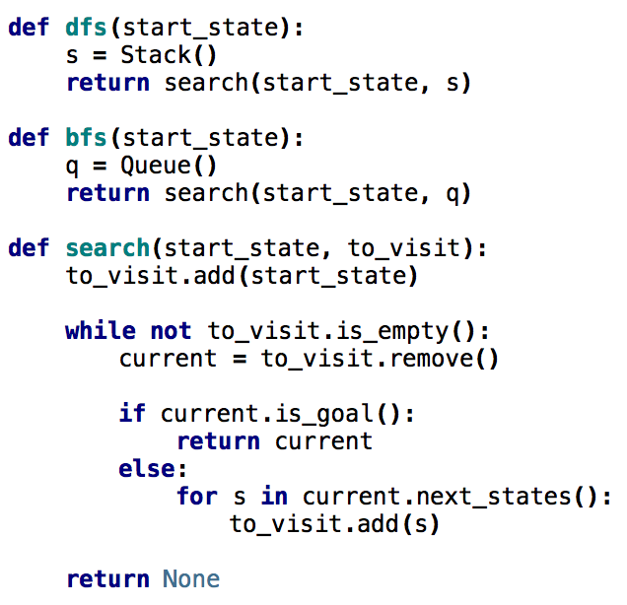
Search variants implemented
add the start state to to_visit
Repeat
take a state off the to_visit list
if it’s the goal state
we’re done!
if it’s not the goal state
Add all of the successive states to the to_visit list

Slide 11
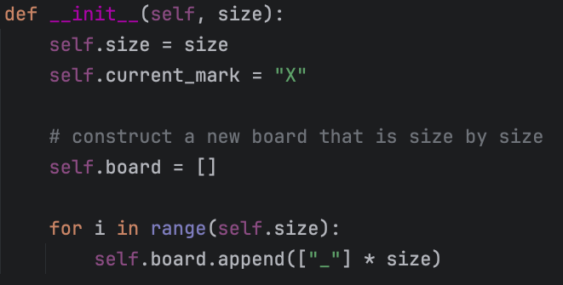
Tic tac toe
https://cs.pomona.edu/classes/cs51a/examples/tic_tac_toe.txt
Representing the board
Three pieces of information

Slide 12
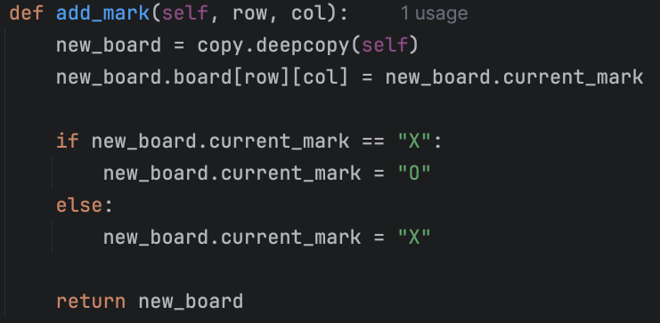
Tic tac toe
https://cs.pomona.edu/classes/cs51a/examples/tic_tac_toe.txt
Adding a move
Returns a new TicTacToe state
Need to update all information for the new state

Slide 13
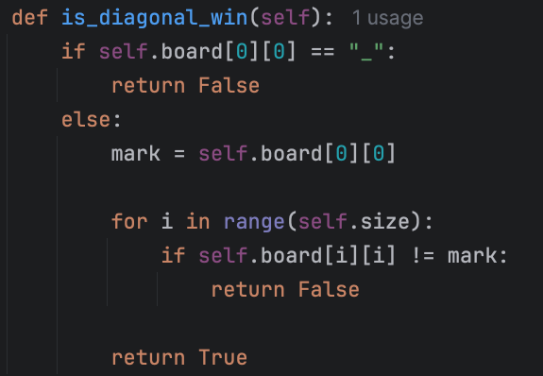
Tic tac toe
https://cs.pomona.edu/classes/cs51a/examples/tic_tac_toe.txt
Checking for a win (diagonal only)
1. Upper left to lower right?

Slide 14
Tic tac toe
https://cs.pomona.edu/classes/cs51a/examples/tic_tac_toe.txt
Checking for a win (diagonal only)
1. Upper left to lower right

Slide 15
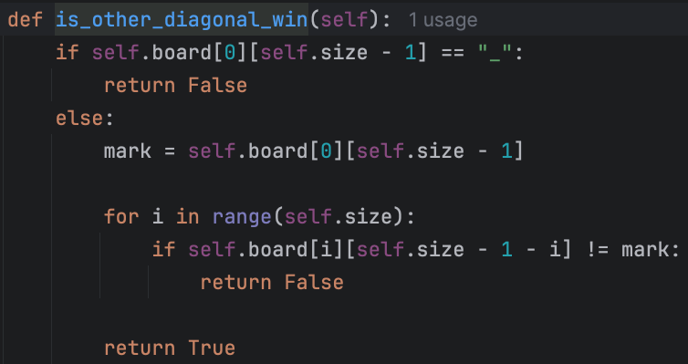
Tic tac toe
https://cs.pomona.edu/classes/cs51a/examples/tic_tac_toe.txt
Checking for a win (diagonal only)
2. Upper right to lower left?

Slide 16
Tic tac toe
https://cs.pomona.edu/classes/cs51a/examples/tic_tac_toe.txt
Checking for a win (diagonal only)
2. Upper right to lower left

Slide 17
Tic tac toe
https://cs.pomona.edu/classes/cs51a/examples/tic_tac_toe.txt
The rest of the code:
is_goal
__str__
Running the code

Slide 18

N-queens problem
Place N queens on an N by N chess board such that none of the N queens are attacking any other queen.
Solution(s)?

Slide 19
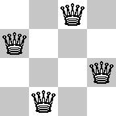
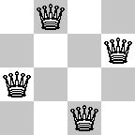
N-queens problem
Place N queens on an N by N chess board such that none of the N queens are attacking any other queen.

Slide 20
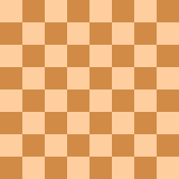
N-queens problem
Place N queens on an N by N chess board such that none of the N queens are attacking any other queen.
Solution(s)?

Slide 21
N-queens problem
Place N queens on an N by N chess board such that none of the N queens are attacking any other queen.
How do we solve this with search:
What is a state?
What is the start state?
What is the goal?
How do we transition from one state to the next?

Slide 22
Search algorithm
add the start state to to_visit
Repeat
take a state off the to_visit list
if it’s the goal state
we’re done!
if it’s not the goal state
Add all of the next states to the to_visit list
Is this a goal state?
What states can I get to from the current state?
Any problem that we can define these three things can be plugged into the search algorithm!

Slide 23
Start state

Slide 24
next_states?

Slide 25
next_states
Many options
Add a queen anywhere
Add a queen anywhere that doesn’t cause a conflict
Add a queen in the next row that doesn’t cause a conflict

Slide 26
next_states
Many options
Add a queen anywhere
Add a queen anywhere that doesn’t cause a conflict
Add a queen in the next row that doesn’t cause a conflict

Slide 27
next_states
Add a queen in the next row that doesn’t cause a conflict
Where are the options?

Slide 28
N queens problem
http://en.wikipedia.org/wiki/Eight_queens_puzzle

Slide 29
Foxes and Chickens
Three foxes and three chickens wish to cross the river. They have a small boat that will carry up to two animals. Everyone can navigate the boat. If at any time the foxes outnumber the chickens on either bank of the river, they will eat the chickens. Find the smallest number of crossings that will allow everyone to cross the river safely.
What is the “state” of this problem (it should capture all possible valid configurations)?

Slide 30
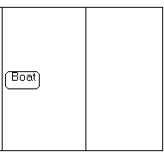

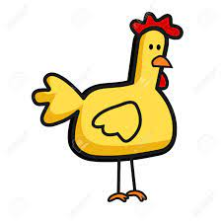
Foxes and Chickens
Three foxes and three chickens wish to cross the river. They have a small boat that will carry up to two animals. Everyone can navigate the boat. If at any time the foxes outnumber the chickens on either bank of the river, they will eat the chickens. Find the smallest number of crossings that will allow everyone to cross the river safely.

Slide 31
Foxes and Chickens
Three foxes and three chickens wish to cross the river. They have a small boat that will carry up to two animals. Everyone can navigate the boat. If at any time the foxes outnumber the chickens on either bank of the river, they will eat the chickens. Find the smallest number of crossings that will allow everyone to cross the river safely.
FFFCCC B
FFCC B FC
FC B FFCC
…

Slide 32
Searching for a solution
FFFCCC B ~~
What states can we get to from here?

Slide 33
Searching for a solution
FFFCCC B ~~
FCCC ~~ B FF
FFCCC ~~ B F
FFCC ~~ B FC
Next states?

Slide 34
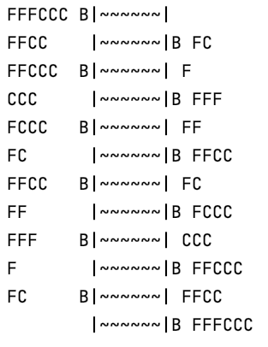
Fox and Chickens Solution
How is this solution different than the n-queens problem?

Slide 35
Fox and Chickens Solution
Solution is not a state, but a sequence of actions (or a sequence of states)

Slide 36
Code!
https://cs.pomona.edu/classes/cs51a/examples/chickens.txt

Slide 37
One other problem
FFFCCC B ~~
FCCC ~~ B FF
FFCCC ~~ B F
FFCC ~~ B FC
FFFCCC B~~
FFCCC B~~ F
FFFCCC B~~
What would happen if we ran DFS here?

Slide 38
One other problem
FFFCCC B ~~
FCCC ~~ B FF
FFCCC ~~ B F
FFCC ~~ B FC
FFFCCC B~~
FFCCC B~~ F
FFFCCC B~~
If we always go left first, will continue forever!

Slide 39
One other problem
FFFCCC B ~~
FCCC ~~ B FF
FFCCC ~~ B F
FFCC ~~ B FC
FFFCCC B~~
FFCCC B~~ F
FFFCCC B~~
Does BFS have this problem?

Slide 40
One other problem
FFFCCC B ~~
FCCC ~~ B FF
FFCCC ~~ B F
FFCC ~~ B FC
FFFCCC B~~
FFCCC B~~ F
FFFCCC B~~
Does BFS have this problem?
No!

Slide 41
DFS vs. BFS
Why do we use DFS then, and not BFS?

Slide 42
DFS vs. BFS
1
Consider a search problem where each state has two states you can reach
Assume the goal state involves 20 actions, i.e. moving between ~20 states
2
3
4
5
6
7
…
How big can the queue get for BFS?

Slide 43
DFS vs. BFS
1
Consider a search problem where each state has two states you can reach
Assume the goal state involves 20 actions, i.e. moving between ~20 states
2
3
4
5
6
7
…
At any point, need to remember roughly a “row”

Slide 44
DFS vs. BFS
1
Consider a search problem where each state has two states you can reach
Assume the goal state involves 20 actions, i.e. moving between ~20 states
2
3
4
5
6
7
…
How big does this get?

Slide 45
DFS vs. BFS
1
Consider a search problem where each state has two states you can reach
Assume the goal state involves 20 actions, i.e. moving between ~20 states
2
3
4
5
6
7
…
Doubles every level we have to go deeper.
For 20 actions that is 2²⁰ = ~1 million states!

Slide 46
DFS vs. BFS
1
Consider a search problem where each state has two states you can reach
Assume the goal state involves 20 actions, i.e. moving between ~20 states
2
3
4
5
6
7
…
How many states would DFS keep on the stack?

Slide 47
DFS vs. BFS
1
Consider a search problem where each state has two states you can reach
Assume the goal state involves 20 actions, i.e. moving between ~20 states
2
3
4
5
6
7
…
Only one path through the tree, roughly 2*20 states

Slide 48
One other problem
FFFCCC B ~~
FCCC ~~ B FF
FFCCC ~~ B F
FFCC ~~ B FC
FFFCCC B~~
FFCCC B~~ F
FFFCCC B~~
If we always go left first, will continue forever!
Solution?

Slide 49
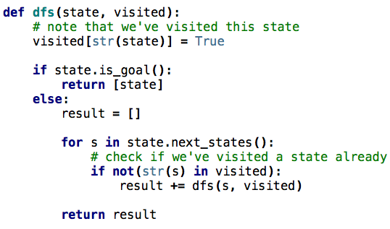
DFS avoiding repeats
Notes:
visited is a dictionary of states we’ve visited

Slide 50
Other search problems
What problems have you seen that could be posed as search problems?
What is the state?
Start state
Goal state
State-space/transition between states

