Slide 1
Problem solving via search
David Kauchak
CS51A – Fall 2019

Slide 2
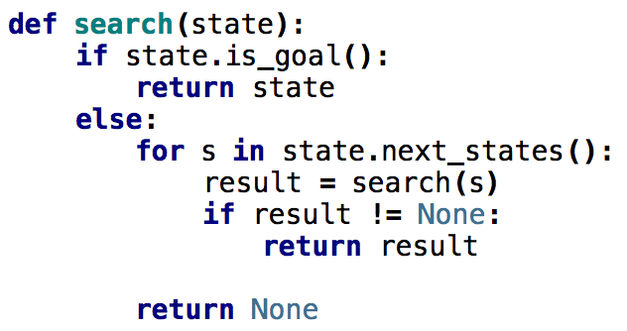
What order would this variant visit the states?
1
2
3
4
5
6
7
8
1, 2, 5
9

Slide 3
What order would this variant visit the states?
1
2
3
4
5
6
7
8
1, 2, 5, 3, 6, 9, 7, 8
9
What search algorithm is this?

Slide 4
What order would this variant visit the states?
1
2
3
4
5
6
7
8
1, 2, 5, 3, 6, 9, 7, 8
9
DFS!
Where’s the stack?

Slide 5
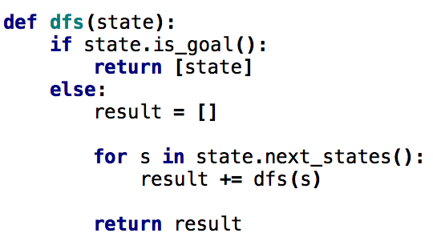
One last DFS variant
How is this different?

Slide 6
One last DFS variant
Returns ALL solutions found, not just one

Slide 7
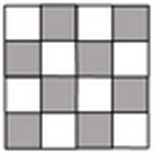
N-queens problem
Place N queens on an N by N chess board such that none of the N queens are attacking any other queen.
Solution(s)?

Slide 8
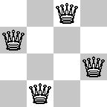
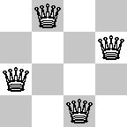
N-queens problem
Place N queens on an N by N chess board such that none of the N queens are attacking any other queen.

Slide 9
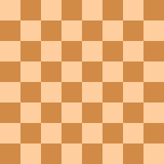
N-queens problem
Place N queens on an N by N chess board such that none of the N queens are attacking any other queen.
Solution(s)?

Slide 10
N-queens problem
Place N queens on an N by N chess board such that none of the N queens are attacking any other queen.
How do we solve this with search:
  What is a state?
  What is the start state?
  What is the goal?
  How do we transition from one state to the next?

Slide 11
Search algorithm
add the start state to to_visit
Repeat
  take a state off the to_visit list
  if it’s the goal state
    we’re done!
  if it’s not the goal state
    Add all of the next states to the to_visit list
Is this a goal state?
What states can I get to from the current state?
Any problem that we can define these three things can be plugged into the search algorithm!

Slide 12
N queens problem
http://en.wikipedia.org/wiki/Eight_queens_puzzle

