Slide 1

http://xkcd.com/894/

Slide 2
Neural Networks
David Kauchak/
Joseph C. Osborn
CS51A
Fall 2019
Notes:
<number>

Slide 3
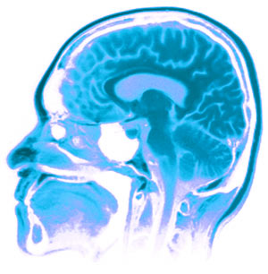
Neural Networks
Neural Networks try to mimic the structure and function of our nervous system
People like biologically motivated approaches
Notes:
<number>

Slide 4
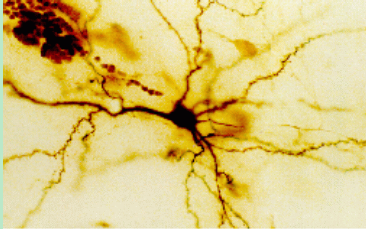
Our Nervous System
Neuron
What do you know?
Notes:
<number>

Slide 5
Our nervous system:
the computer science view
the human brain is a large collection of interconnected neurons
a NEURON is a brain cell
  they collect, process, and disseminate electrical signals
  they are connected via synapses
  they FIRE depending on the conditions of the neighboring neurons

Slide 6
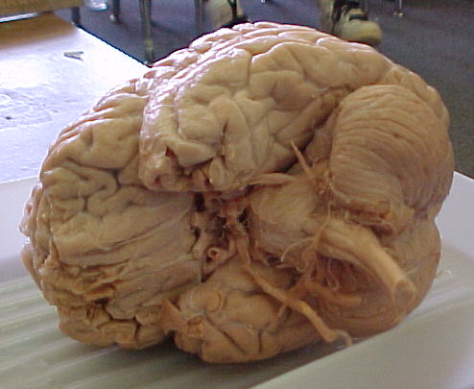
Our nervous system
The human brain
  contains ~10¹¹ (100 billion) neurons
  each neuron is connected to ~10⁴ (10,000) other neurons
  Neurons can fire as fast as 10⁻³ seconds
How does this compare to a computer?

Slide 7

Man vs. Machine
10¹¹ neurons
10¹¹ neurons
10¹⁴ synapses
10⁻³ “cycle” time
10¹⁰ transistors
10¹¹ bits of ram/memory
10¹³ bits on disk
10⁻⁹ cycle time

Slide 8

Brains are still pretty fast
Who is this?

Slide 9
Brains are still pretty fast
If you follow basketball, you’d be able to identify this person in under a second!
Given a neuron firing time of 10⁻³ s, how many neurons in sequence could fire in this time?
  A few hundred, maybe a thousand
What are possible explanations?
  either neurons are performing some very complicated computations
  brain is taking advantage of the massive parallelization (remember, neurons are connected ~10,000 other neurons)

Slide 10
Artificial Neural Networks
Node (Neuron)
Edge (synapses)
our approximation
Notes:
<number>

Slide 11
Node A
Weight w
Node B
(neuron)
(neuron)
W is the strength of signal sent between A and B.
If A fires and w is positive, then A stimulates B.
If A fires and w is negative, then A inhibits B.
Notes:
<number>

Slide 12
…
A given neuron has many, many connecting, input neurons
If a neuron is stimulated enough, then it also fires
How much stimulation is required is determined by its threshold
Notes:
<number>

Slide 13
A Single Neuron/Perceptron
Input x₁
Each input contributes:
x_{i} * w_{i}
Weight w₁
Weight w₂
Input x₂
Output y
threshold function
Input x₃
Weight w₃
Weight w₄
Input x₄
Notes:
<number>

Slide 14
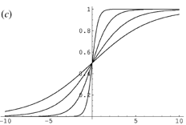
Possible threshold functions
hard threshold
sigmoid

Slide 15
A Single Neuron/Perceptron
1
1
1
-1
?
0
1
Threshold of 1
0.5
1
Notes:
<number>

Slide 16
A Single Neuron/Perceptron
1
1
1
-1
?
0
1
Threshold of 1
0.5
1
1*1 + 1*-1 + 0*1 + 1*0.5 = 0.5
Notes:
<number>

Slide 17
A Single Neuron/Perceptron
1
1
1
-1
0
Weighted sum is 0.5, which is not larger than the threshold
0
1
Threshold of 1
0.5
1
Notes:
<number>

Slide 18
A Single Neuron/Perceptron
1
1
0
-1
?
0
1
Threshold of 1
0.5
1
1*1 + 0*-1 + 0*1 + 1*0.5 = 1.5
Notes:
<number>

Slide 19
A Single Neuron/Perceptron
1
1
0
-1
1
Weighted sum is 1.5, which is larger than the threshold
0
1
Threshold of 1
0.5
1
Notes:
<number>

Slide 20
Neural network
inputs
Individual perceptrons/neurons
Notes:
- often we view a slice of them
<number>

Slide 21
Neural network
some inputs are provided/entered
inputs
Notes:
- often we view a slice of them
<number>

Slide 22
Neural network
inputs
each perceptron computes and calculates an answer
Notes:
- often we view a slice of them
<number>

Slide 23
Neural network
inputs
those answers become inputs for the next level
Notes:
- often we view a slice of them
<number>

Slide 24
Neural network
inputs
finally get the answer after all levels compute
Notes:
- often we view a slice of them
<number>

Slide 25
Neural networks
Different kinds/characteristics of networks
inputs
inputs
inputs
How are these different?

Slide 26
Neural networks
inputs
inputs
hidden units/layer
Feed forward networks

Slide 27
Neural networks
inputs
Recurrent network
Output is fed back to input
Can support memory!
How?

Slide 28
History of Neural Networks
McCulloch and Pitts (1943) – introduced model of artificial neurons and suggested they could learn
Hebb (1949) – Simple updating rule for learning
Rosenblatt (1962) - the perceptron model
Minsky and Papert (1969) – wrote Perceptrons
Bryson and Ho (1969, but largely ignored until 1980s--Rosenblatt) – invented back-propagation learning for multilayer networks
Notes:
<number>

Slide 29
Training the perceptron
First wave in neural networks in the 1960’s
Single neuron
Trainable: its threshold and input weights can be modified
If the neuron doesn’t give the desired output, then it has made a mistake
Input weights and threshold can be changed according to a learning algorithm
Notes:
<number>

Slide 30
Examples - Logical operators
AND – if all inputs are 1, return 1, otherwise return 0
OR – if at least one input is 1, return 1, otherwise return 0
NOT – return the opposite of the input
XOR – if exactly one input is 1, then return 1, otherwise return 0
Notes:
<number>

Slide 31
AND
x₁ | x₂ | x₁ and x₂
0 | 0 | 0
0 | 1 | 0
1 | 0 | 0
1 | 1 | 1
Notes:
<number>
We have the truth table for AND

Slide 32
AND
x₁ | x₂ | x₁ and x₂
0 | 0 | 0
0 | 1 | 0
1 | 0 | 0
1 | 1 | 1
Input x₁
W₁ = ?
T = ?
Output y
Input x₂
W₂ = ?
Notes:
<number>
And here we have the node for AND
Assume that all inputs are either 1 or 0, “on” or “off”
When they are activated, they become “on”
So what weights do we need to assign to these two links and what threshold do we need to put in this unit in order to represent an AND gate?

Slide 33
AND
x₁ | x₂ | x₁ and x₂
0 | 0 | 0
0 | 1 | 0
1 | 0 | 0
1 | 1 | 1
Input x₁
W₁ = 1
T = 2
Output y
Output is 1 only if
all inputs are 1
Input x₂
W₂ = 1
Inputs are either 0 or 1
Notes:
<number>

Slide 34
AND
Input x₁
W₁ = ?
W₂ = ?
Input x₂
T = ?
Output y
Input x₃
W₃ = ?
W₄ = ?
Input x₄
Notes:
<number>
We can extend this to take more inputs
What are the new weights and thresholds?

Slide 35
AND
Input x₁
W₁ = 1
W₂ = 1
Input x₂
T = 4
Output y
Output is 1 only if
all inputs are 1
Input x₃
W₃ = 1
W₄ = 1
Input x₄
Inputs are either 0 or 1
Notes:
<number>

Slide 36
OR
x₁ | x₂ | x₁ or x₂
0 | 0 | 0
0 | 1 | 1
1 | 0 | 1
1 | 1 | 1
Notes:
<number>

Slide 37
OR
x₁ | x₂ | x₁ or x₂
0 | 0 | 0
0 | 1 | 1
1 | 0 | 1
1 | 1 | 1
Input x₁
W₁ = ?
T = ?
Output y
Input x₂
W₂ = ?
Notes:
<number>
What about for an OR gate?
What weights and thresholds would serve to create an OR gate?

Slide 38
OR
x₁ | x₂ | x₁ or x₂
0 | 0 | 0
0 | 1 | 1
1 | 0 | 1
1 | 1 | 1
Input x₁
W₁ = 1
T = 1
Output y
Output is 1 if at
least 1 input is 1
Input x₂
W₂ = 1
Inputs are either 0 or 1
Notes:
<number>

Slide 39
OR
Input x₁
W₁ = ?
W₂ = ?
Input x₂
T = ?
Output y
Input x₃
W₃ = ?
W₄ = ?
Input x₄
Notes:
<number>
Similarly, we can expand it to take more inputs

Slide 40
OR
Input x₁
W₁ = 1
W₂ = 1
Input x₂
T = 1
Output y
Output is 1 if at
least 1 input is 1
Input x₃
W₃ = 1
W₄ = 1
Input x₄
Inputs are either 0 or 1
Notes:
<number>

Slide 41
NOT
x₁ | not x₁
0 | 1
1 | 0
Notes:
<number>

Slide 42
x₁ | not x₁
0 | 1
1 | 0
NOT
W₁ = ?
Input x₁
T = ?
Output y
Notes:
<number>
Now it gets a little bit trickier, what weight and threshold might work to create a NOT gate?

Slide 43
NOT
W₁ = -1
Input x₁
T = 0
Output y
Input is either 0 or 1
If input is 1, output is 0.
If input is 0, output is 1.
Notes:
<number>

Slide 44
How about…
x₁ | x₂ | x₃ | x₁ op x₂
0 | 0 | 0 | 1
0 | 1 | 0 | 0
1 | 0 | 0 | 1
1 | 1 | 0 | 0
0 | 0 | 1 | 1
0 | 1 | 1 | 1
1 | 0 | 1 | 1
1 | 1 | 1 | 0
Input x₁
w₁ = ?
w₂ = ?
Input x₂
Output y
T = ?
Input x₃
w₃ = ?

Slide 45
Training neural networks
Learn individual node parameters (e.g. threshold)
Learn the individual weights between nodes

Slide 46
Positive or negative?
NEGATIVE

Slide 47
Positive or negative?
NEGATIVE

Slide 48
Positive or negative?
POSITIVE

Slide 49
Positive or negative?
NEGATIVE

Slide 50
Positive or negative?
POSITIVE

Slide 51
Positive or negative?
POSITIVE

Slide 52
Positive or negative?
NEGATIVE

Slide 53
Positive or negative?
POSITIVE

Slide 54
A method to the madness
blue = positive
yellow triangles = positive
all others negative
How did you figure this out (or some of it)?

Slide 55
Training neural networks
x₁ | x₂ | x₃ | x₁ and x₂
0 | 0 | 0 | 1
0 | 1 | 0 | 0
1 | 0 | 0 | 1
1 | 1 | 0 | 0
0 | 0 | 1 | 1
0 | 1 | 1 | 1
1 | 0 | 1 | 1
1 | 1 | 1 | 0
Input x₁
w₁ = ?
w₂ = ?
Input x₂
Output y
T = ?
Input x₃
w₃ = ?
start with some initial weights and thresholds
show examples repeatedly to NN
update weights/thresholds by comparing NN output to actual output

