Slide 1
Naïve bayes
David Kauchak, Joseph C. Osborn CS 51A – Fall 2019

Slide 2
Longest word code
http://www.cs.pomona.edu/~dkauchak/classes/cs51a/examples/for_for.txt

Slide 3

Relationship between distributions
joint distribution
conditional distribution
unconditional distribution
Can think of it as describing the two events happening in two steps:
The likelihood of X and Y happening:
How likely it is that Y happened?
Given that Y happened, how likely is it that X happened?
Notes:
Called the chain rule
<number>

Slide 4
Relationship between distributions
$P\left(51Pass,EngPass\right)=P\left(EngPass\right)∗P\left(51Pass∨EngPass\right)$
The probability of passing CS51 and English is:
Probability of passing English *
Probability of passing CS51 given that you passed English
Notes:
Called the chain rule
<number>

Slide 5
Relationship between distributions
$P\left(51Pass,EngPass\right)=P\left(51Pass\right)∗P\left(EngPass∨51Pass\right)$
The probability of passing CS51 and English is:
Probability of passing CS51 *
Probability of passing English given that you passed CS51
Can also view it with the other event happening first
Notes:
Called the chain rule
<number>

Slide 6
Back to probabilistic modeling
train
probabilistic model:
p(label|data)
Build a model of the conditional distribution:
P(label | data)
How likely is a label given the data
training data
Notes:
<number>

Slide 7
Back to probabilistic models
For each label, calculate the probability of the label given the data
yellow, curved, no leaf, 6oz, banana
probabilistic model:
p(label|data)
yellow, curved, no leaf, 6oz, apple
features
label
Notes:
<number>

Slide 8
Back to probabilistic models
Pick the label with the highest probability
yellow, curved, no leaf, 6oz, banana
probabilistic model:
p(label|data)
0.004
0.00002
yellow, curved, no leaf, 6oz, apple
MAX
features
label
Notes:
<number>

Slide 9
Naïve Bayes model
Two parallel ways of breaking down the joint distribution
What is P(label|data)?

Slide 10
Naïve Bayes
$P\left(label | data\right)=\frac{P\left(label\right)∗P\left(data | label\right)}{P\left(data\right)}$
(This is called Bayes’ rule!)

Slide 11

Naïve Bayes
probabilistic model:
p(label|data)
MAX
Notes:
<number>

Slide 12

One observation
$\frac{P\left(positive\right)∗P\left(data | positive\right)}{P\left(data\right)}$
MAX
For picking the largest P(data) doesn’t matter!

Slide 13
One observation
MAX
$P\left(negative\right)∗P\left(data | negative\right)$
For picking the largest P(data) doesn’t matter!

Slide 14
A simplifying assumption (for this class)
$P\left(positive\right)∗P\left(data | positive\right)$
MAX
$P\left(negative\right)∗P\left(data | negative\right)$
If we assume P(positive) = P(negative) then:
MAX
Notes:
This is generally not true, but will make our life simpler for this class.
<number>

Slide 15
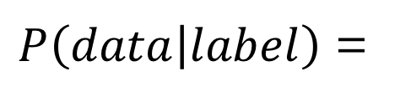

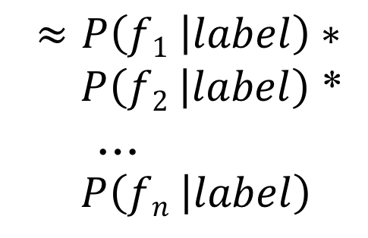
P(data|label)
=
*
…
This is generally not true!
However…, it makes our life easier.
This is why the model is called Naïve Bayes

Slide 16
Naïve Bayes
MAX
Where do these come from?

Slide 17
Training Naïve Bayes
train
probabilistic model:
p(label|data)
training data

Slide 18
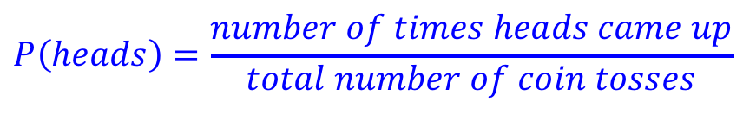
An aside: P(heads)
What is the P(heads) on a fair coin?
0.5
What if you didn’t know that, but had a coin to experiment with?

Slide 19
Try it out…

Slide 20
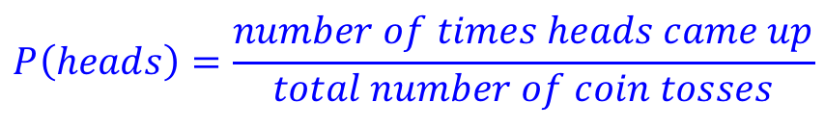

P(feature|label)
Can we do the same thing here? What is the probability of a feature given positive, i.e. the probability of a feature occurring in in the positive label?

Slide 21
P(feature|label)
Can we do the same thing here? What is the probability of a feature given positive, i.e. the probability of a feature occurring in in the positive label?
$P\left(feature | positive\right)=\frac{numberofpositiveexampleswiththatfeature}{totalnumberofpositiveexamples}$

Slide 22
Training Naïve Bayes
train
Count how many examples have each label
For all examples with a particular label, count how many times each feature occurs
Calculate the conditional probabilities of each feature for all labels:
probabilistic model:
p(label|data)
training data

Slide 23
Classifying with Naïve Bayes
For each label, calculate the product of p(feature|label) for each label
P(yellow|banana)*…*P(6oz|banana)
yellow, curved, no leaf, 6oz
MAX
P(yellow|apple)*…*P(6oz|apple)
Notes:
<number>

Slide 24
Naïve Bayes Text Classification
Positive
Negative
I loved it
I loved that movie
I hated that I loved it
I hated it
I hated that movie
I loved that I hated it
Given examples of text in different categories, learn to predict the category of new examples
Sentiment classification: given positive/negative examples of text (sentences), learn to predict whether new text is positive/negative
Notes:
<number>

Slide 25
Text classification training
Positive
Negative
I loved it
I loved that movie
I hated that I loved it
I hated it
I hated that movie
I loved that I hated it
We’ll assume words just occur once in any given sentence
Notes:
<number>

Slide 26
Text classification training
Positive
Negative
I loved it
I loved that movie
I hated that loved it
I hated it
I hated that movie
I loved that hated it
We’ll assume words just occur once in any given sentence
Notes:
<number>

Slide 27
Training the model
Positive
Negative
I loved it
I loved that movie
I hated that loved it
I hated it
I hated that movie
I loved that hated it
For each word and each label, learn:
p(word | label)
Notes:
<number>

Slide 28
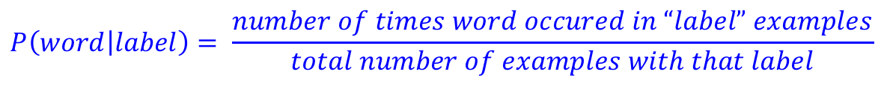
Training the model
Positive
Negative
I loved it
I loved that movie
I hated that loved it
I hated it
I hated that movie
I loved that hated it
P(I | positive) = ?
Notes:
<number>

Slide 29
Training the model
Positive
Negative
I loved it
I loved that movie
I hated that loved it
I hated it
I hated that movie
I loved that hated it
P(I | positive) = 3/3 = 1.0
Notes:
<number>

Slide 30
Training the model
Positive
Negative
I loved it
I loved that movie
I hated that loved it
I hated it
I hated that movie
I loved that hated it
P(I | positive) = 1.0
P(loved | positive) = ?
$P\left(word | label\right)=\frac{numberoftimeswordoccuredin“label”examples}{totalnumberofexampleswiththatlabel}$
Notes:
<number>

Slide 31
Training the model
Positive
Negative
I loved it
I loved that movie
I hated that loved it
I hated it
I hated that movie
I loved that hated it
P(I | positive) = 1.0
P(loved | positive) = 3/3
$P\left(word | label\right)=\frac{numberoftimeswordoccuredin“label”examples}{totalnumberofexampleswiththatlabel}$
Notes:
<number>

Slide 32
Training the model
Positive
Negative
I loved it
I loved that movie
I hated that loved it
I hated it
I hated that movie
I loved that hated it
P(I | positive) = 1.0
P(loved | positive) = 3/3
P(hated | positive) = ?
$P\left(word | label\right)=\frac{numberoftimeswordoccuredin“label”examples}{totalnumberofexampleswiththatlabel}$
Notes:
<number>

Slide 33
Training the model
Positive
Negative
I loved it
I loved that movie
I hated that loved it
I hated it
I hated that movie
I loved that hated it
P(I | positive) = 1.0
P(loved | positive) = 3/3
P(hated | positive) = 1/3
…
P(I | negative) = ?
Notes:
<number>

Slide 34
Training the model
Positive
Negative
I loved it
I loved that movie
I hated that loved it
I hated it
I hated that movie
I loved that hated it
P(I | positive) = 1.0
P(loved | positive) = 3/3
P(hated | positive) = 1/3
…
P(I | negative) = 1.0
$P\left(word | label\right)=\frac{numberoftimeswordoccuredin“label”examples}{totalnumberofexampleswiththatlabel}$
Notes:
<number>

Slide 35
Training the model
Positive
Negative
I loved it
I loved that movie
I hated that loved it
I hated it
I hated that movie
I loved that hated it
P(I | positive) = 1.0
P(loved | positive) = 3/3
P(hated | positive) = 1/3
…
P(I | negative) = 1.0
P(movie | negative) = ?
Notes:
<number>

Slide 36
Training the model
Positive
Negative
I loved it
I loved that movie
I hated that loved it
I hated it
I hated that movie
I loved that hated it
P(I | positive) = 1.0
P(loved | positive) = 3/3
P(hated | positive) = 1/3
…
P(I | negative) = 1.0
P(movie | negative) = 1/3
…
Notes:
<number>

Slide 37
Classifying
P(I | positive) = 1.0
P(loved | positive) = 1.0
p(it | positive) = 2/3
p(that | positive) = 2/3
p(movie|positive) = 1/3
P(hated | positive) = 1/3
P(I | negative) = 1.0
p(hated | negative) = 1.0
p(that | negative) = 2/3
P(movie | negative) = 1/3
p(it | negative) = 2/3
p(loved | negative) = 1/3
Notice that each of these is its own probability distribution
P(loved| positive)
P(loved | positive) = 2/3
P(no loved|positive) = 1/3

Slide 38
Trained model
P(I | positive) = 1.0
P(loved | positive) = 2/3
p(it | positive) = 2/3
p(that | positive) = 2/3
p(movie|positive) = 1/3
P(hated | positive) = 1/3
P(I | negative) = 1.0
p(hated | negative) = 1.0
p(that | negative) = 2/3
P(movie | negative) = 1/3
p(it | negative) = 2/3
p(loved | negative) = 1/3
How would we classify: “I hated movie”?

Slide 39
Trained model
P(I | positive) = 1.0
P(loved | positive) = 2/3
p(it | positive) = 2/3
p(that | positive) = 2/3
p(movie|positive) = 1/3
P(hated | positive) = 1/3
P(I | negative) = 1.0
p(hated | negative) = 1.0
p(that | negative) = 2/3
P(movie | negative) = 1/3
p(it | negative) = 2/3
p(loved | negative) = 1/3
P(I | positive) * P(hated | positive) * P(movie | positive) = 1.0 * 1/3 * 1/3 = 1/9
P(I | negative) * P(hated | negative) * P(movie | negative) = 1.0 * 1.0 * 1/3 = 1/3
Notes:
<number>

Slide 40
Trained model
P(I | positive) = 1.0
P(loved | positive) = 2/3
p(it | positive) = 2/3
p(that | positive) = 2/3
p(movie|positive) = 1/3
P(hated | positive) = 1/3
P(I | negative) = 1.0
p(hated | negative) = 1.0
p(that | negative) = 2/3
P(movie | negative) = 1/3
p(it | negative) = 2/3
p(loved | negative) = 1/3
How would we classify: “I hated the movie”?

Slide 41
Trained model
P(I | positive) = 1.0
P(loved | positive) = 2/3
p(it | positive) = 2/3
p(that | positive) = 2/3
p(movie|positive) = 1/3
P(hated | positive) = 1/3
P(I | negative) = 1.0
p(hated | negative) = 1.0
p(that | negative) = 2/3
P(movie | negative) = 1/3
p(it | negative) = 2/3
p(loved | negative) = 1/3
P(I | positive) * P(hated | positive) * P(the | positive) * P(movie | positive) =
P(I | negative) * P(hated | negative) * P(the | negative) * P(movie | negative) =

Slide 42
Trained model
P(I | positive) = 1.0
P(loved | positive) = 2/3
p(it | positive) = 2/3
p(that | positive) = 2/3
p(movie|positive) = 1/3
P(hated | positive) = 1/3
P(I | negative) = 1.0
p(hated | negative) = 1.0
p(that | negative) = 2/3
P(movie | negative) = 1/3
p(it | negative) = 2/3
p(loved | negative) = 1/3
P(I | positive) * P(hated | positive) * P(the | positive) * P(movie | positive) =
P(I | negative) * P(hated | negative) * P(the | negative) * P(movie | negative) =
What are these?

Slide 43
Trained model
P(I | positive) = 1.0
P(loved | positive) = 2/3
p(it | positive) = 2/3
p(that | positive) = 2/3
p(movie|positive) = 1/3
P(hated | positive) = 1/3
P(I | negative) = 1.0
p(hated | negative) = 1.0
p(that | negative) = 2/3
P(movie | negative) = 1/3
p(it | negative) = 2/3
p(loved | negative) = 1/3
P(I | positive) * P(hated | positive) * P(the | positive) * P(movie | positive) =
P(I | negative) * P(hated | negative) * P(the | negative) * P(movie | negative) =
0! Is this a problem?

Slide 44
Trained model
P(I | positive) = 1.0
P(loved | positive) = 2/3
p(it | positive) = 2/3
p(that | positive) = 2/3
p(movie|positive) = 1/3
P(hated | positive) = 1/3
P(I | negative) = 1.0
p(hated | negative) = 1.0
p(that | negative) = 2/3
P(movie | negative) = 1/3
p(it | negative) = 2/3
p(loved | negative) = 1/3
P(I | positive) * P(hated | positive) * P(the | positive) * P(movie | positive) =
P(I | negative) * P(hated | negative) * P(the | negative) * P(movie | negative) =
Yes. They make the entire product go to 0!

Slide 45
Trained model
P(I | positive) = 1.0
P(loved | positive) = 2/3
p(it | positive) = 2/3
p(that | positive) = 2/3
p(movie|positive) = 1/3
P(hated | positive) = 1/3
P(I | negative) = 1.0
p(hated | negative) = 1.0
p(that | negative) = 2/3
P(movie | negative) = 1/3
p(it | negative) = 2/3
p(loved | negative) = 1/3
P(I | positive) * P(hated | positive) * P(the | positive) * P(movie | positive) =
P(I | negative) * P(hated | negative) * P(the | negative) * P(movie | negative) =
Our solution: assume any unseen word has a small, fixed probability, e.g. in this example 1/10

Slide 46
Trained model
P(I | positive) = 1.0
P(loved | positive) = 2/3
p(it | positive) = 2/3
p(that | positive) = 2/3
p(movie|positive) = 1/3
P(hated | positive) = 1/3
P(I | negative) = 1.0
p(hated | negative) = 1.0
p(that | negative) = 2/3
P(movie | negative) = 1/3
p(it | negative) = 2/3
p(loved | negative) = 1/3
P(I | positive) * P(hated | positive) * P(the | positive) * P(movie | positive) = 1/90
P(I | negative) * P(hated | negative) * P(the | negative) * P(movie | negative) = 1/30
Our solution: assume any unseen word has a small, fixed probability, e.g. in this example 1/10

Slide 47
Full disclaimer
I’ve fudged a few things on the Naïve Bayes model for simplicity
Our approach is very close, but it takes a few liberties that aren’t technically correct, but it will work just fine ☺
If you’re curious, I’d be happy to talk to you offline

