Slide 1
Binary Arithmetic in Python
Computer Systems
+
>>
CS51 – Spring 2026
à
🥳

Slide 2
Administrative
Assignment 2
Assignment 3 available (complete first part before lab)
Lab tomorrow
Mentor hour attendance

Slide 3
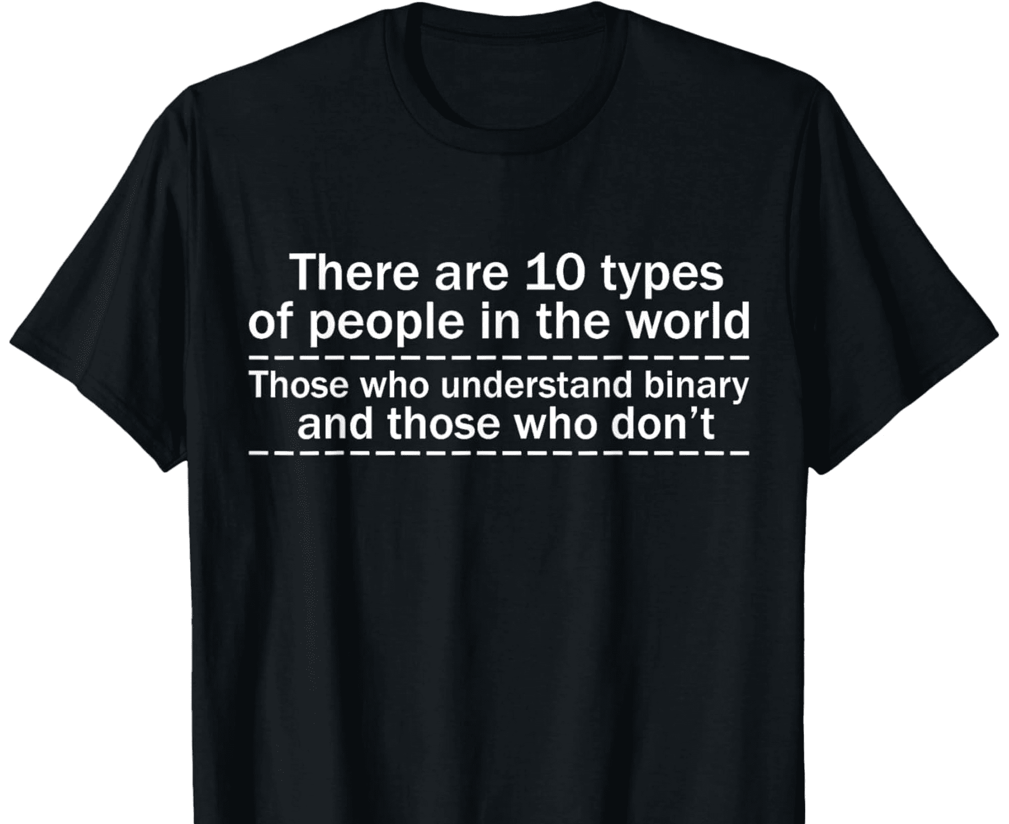

Slide 4
Bitwise operations

Slide 5
Bitwise operations
& - AND
~ - NOT
X | Y | X ∧ Y
0 | 0 | 0
0 | 1 | 0
1 | 0 | 0
1 | 1 | 1
X | ¬ X
0 | 1
1 | 0
Treat numbers as twos complement numbers
Perform Boolean operation per bit of two numbers
| - OR
^ - XOR
X | Y | X ∨ Y
0 | 0 | 0
0 | 1 | 1
1 | 0 | 1
1 | 1 | 1
X | Y | X ⊕ Y
0 | 0 | 0
0 | 1 | 1
1 | 0 | 1
1 | 1 | 0

Slide 6
Bitwise operations: & (bitwise-AND)
AND
X | Y | X ∧ Y
0 | 0 | 0
0 | 1 | 0
1 | 0 | 0
1 | 1 | 1
6 & 5 =
Convert numbers to binary (twos complement)
For each digit, computer the Boolean operation
Convert resulting Boolean number back to an int

Slide 7
Bitwise operations: & (bitwise-AND)
AND
X | Y | X ∧ Y
0 | 0 | 0
0 | 1 | 0
1 | 0 | 0
1 | 1 | 1
6 & 5 =
Convert numbers to binary (twos complement)
For each digit, compute the Boolean operation
Convert resulting Boolean number back to an int

Slide 8
Bitwise operations: & (bitwise-AND)
AND
0 1 1 0₂
X | Y | X ∧ Y
0 | 0 | 0
0 | 1 | 0
1 | 0 | 0
1 | 1 | 1
6 & 5 =
0 1 0 1₂
Convert numbers to binary (twos complement)
For each digit, compute the Boolean operation
Convert resulting Boolean number back to an int

Slide 9
Bitwise operations: & (bitwise-AND)
AND
0 1 1 0₂
X | Y | X ∧ Y
0 | 0 | 0
0 | 1 | 0
1 | 0 | 0
1 | 1 | 1
6 & 5 =
&
0 1 0 1₂
Convert numbers to binary (twos complement)
For each digit, compute the Boolean operation
Convert resulting Boolean number back to an int

Slide 10
Bitwise operations: & (bitwise-AND)
AND
0 1 1 0₂
X | Y | X ∧ Y
0 | 0 | 0
0 | 1 | 0
1 | 0 | 0
1 | 1 | 1
6 & 5 =
&
0 1 0 1₂
0 1 0 0₂
Convert numbers to binary (twos complement)
For each digit, compute the Boolean operation
Convert resulting Boolean number back to an int

Slide 11
Bitwise operations: & (bitwise-AND)
AND
0 1 1 0₂
X | Y | X ∧ Y
0 | 0 | 0
0 | 1 | 0
1 | 0 | 0
1 | 1 | 1
6 & 5 =
&
0 1 0 1₂
0 1 0 0₂
Convert numbers to binary (twos complement)
For each digit, compute the Boolean operation
Convert resulting Boolean number back to an int

Slide 12
Bitwise operations: & (bitwise-AND)
AND
0 1 1 0₂
X | Y | X ∧ Y
0 | 0 | 0
0 | 1 | 0
1 | 0 | 0
1 | 1 | 1
6 & 5 =
= 4
&
0 1 0 1₂
0 1 0 0₂
Convert numbers to binary (twos complement)
For each digit, compute the Boolean operation
Convert resulting Boolean number back to an int

Slide 13
Bitwise operations: | (bitwise-OR)
OR
X | Y | X ∨ Y
0 | 0 | 0
0 | 1 | 1
1 | 0 | 1
1 | 1 | 1
11 | -9 =
Convert numbers to binary (twos complement)
For each digit, compute the Boolean operation
Convert resulting Boolean number back to an int

Slide 14
Bitwise operations: | (bitwise-OR)
OR
0 1 0 1 1₂
X | Y | X ∨ Y
0 | 0 | 0
0 | 1 | 1
1 | 0 | 1
1 | 1 | 1
11 | -9 =
1 0 1 1 1₂
Convert numbers to binary (twos complement)
For each digit, compute the Boolean operation
Convert resulting Boolean number back to an int

Slide 15
Bitwise operations: | (bitwise-OR)
OR
0 1 0 1 1₂
X | Y | X ∨ Y
0 | 0 | 0
0 | 1 | 1
1 | 0 | 1
1 | 1 | 1
11 | -9 =
|
1 0 1 1 1₂
Convert numbers to binary (twos complement)
For each digit, compute the Boolean operation
Convert resulting Boolean number back to an int

Slide 16
Bitwise operations: | (bitwise-OR)
OR
0 1 0 1 1₂
X | Y | X ∨ Y
0 | 0 | 0
0 | 1 | 1
1 | 0 | 1
1 | 1 | 1
11 | -9 =
|
1 0 1 1 1₂
1 1 1 1 1₂
Convert numbers to binary (twos complement)
For each digit, compute the Boolean operation
Convert resulting Boolean number back to an int

Slide 17
Bitwise operations: | (bitwise-OR)
OR
0 1 0 1 1₂
X | Y | X ∨ Y
0 | 0 | 0
0 | 1 | 1
1 | 0 | 1
1 | 1 | 1
11 | -9 =
|
1 0 1 1 1₂
1 1 1 1 1₂
Convert numbers to binary (twos complement)
For each digit, compute the Boolean operation
Convert resulting Boolean number back to an int

Slide 18
Bitwise operations: | (bitwise-OR)
OR
0 1 0 1 1₂
X | Y | X ∨ Y
0 | 0 | 0
0 | 1 | 1
1 | 0 | 1
1 | 1 | 1
11 | -9 =
= -1
|
1 0 1 1 1₂
1 1 1 1 1₂
Convert numbers to binary (twos complement)
For each digit, compute the Boolean operation
Convert resulting Boolean number back to an int

Slide 19
Bitwise operations: ~ (bitwise-NOT)
NOT
X | ¬ X
0 | 1
1 | 0
~9 =
Convert numbers to binary (twos complement)
For each digit, compute the Boolean operation
Convert resulting Boolean number back to an int

Slide 20
Bitwise operations: ~ (bitwise-NOT)
NOT
X | ¬ X
0 | 1
1 | 0
~9 = 01001₂
For positive numbers, make sure to include a leading 0
Convert numbers to binary (twos complement)
For each digit, compute the Boolean operation
Convert resulting Boolean number back to an int

Slide 21
Bitwise operations: ~ (bitwise-NOT)
NOT
X | ¬ X
0 | 1
1 | 0
~9 = 01001₂
Convert numbers to binary (twos complement)
For each digit, compute the Boolean operation
Convert resulting Boolean number back to an int

Slide 22
Bitwise operations: ~ (bitwise-NOT)
NOT
X | ¬ X
0 | 1
1 | 0
~9 = 01001₂ = 10110₂
Convert numbers to binary (twos complement)
For each digit, compute the Boolean operation
Convert resulting Boolean number back to an int

Slide 23
Bitwise operations: ~ (bitwise-NOT)
NOT
X | ¬ X
0 | 1
1 | 0
~9 = 01001₂ = 10110₂
Convert numbers to binary (twos complement)
For each digit, compute the Boolean operation
Convert resulting Boolean number back to an int

Slide 24
Bitwise operations: ~ (bitwise-NOT)
NOT
X | ¬ X
0 | 1
1 | 0
~9 = 01001₂ = 10110₂ = -10
Convert numbers to binary (twos complement)
For each digit, compute the Boolean operation
Convert resulting Boolean number back to an int

Slide 25
Bitwise operations: length differences
^ - XOR
10 ^ 1 =
X | Y | X ⊕ Y
0 | 0 | 0
0 | 1 | 1
1 | 0 | 1
1 | 1 | 0
Convert numbers to binary (twos complement)
For each digit, compute the Boolean operation
Convert resulting Boolean number back to an int

Slide 26
Bitwise operations: length differences
^ - XOR
10 ^ 1 =
0 1 0 1 0₂
X | Y | X ⊕ Y
0 | 0 | 0
0 | 1 | 1
1 | 0 | 1
1 | 1 | 0
0 1₂
Convert numbers to binary (twos complement)
For each digit, compute the Boolean operation
Convert resulting Boolean number back to an int

Slide 27
Bitwise operations: length differences
^ - XOR
10 ^ 1 =
0 1 0 1 0₂
X | Y | X ⊕ Y
0 | 0 | 0
0 | 1 | 1
1 | 0 | 1
1 | 1 | 0
^
0 1₂
What do we do here?
Convert numbers to binary (twos complement)
For each digit, compute the Boolean operation
Convert resulting Boolean number back to an int

Slide 28
Bitwise operations: length differences
^ - XOR
10 ^ 1 =
0 1 0 1 0₂
X | Y | X ⊕ Y
0 | 0 | 0
0 | 1 | 1
1 | 0 | 1
1 | 1 | 0
0 0 0 0 1₂
^
Fill with zeros
Convert numbers to binary (twos complement)
For each digit, compute the Boolean operation
Convert resulting Boolean number back to an int

Slide 29
Bitwise operations: length differences
^ - XOR
10 ^ 1 =
0 1 0 1 0₂
X | Y | X ⊕ Y
0 | 0 | 0
0 | 1 | 1
1 | 0 | 1
1 | 1 | 0
0 0 0 0 1₂
^
0 1 0 1 1₂
Convert numbers to binary (twos complement)
For each digit, compute the Boolean operation
Convert resulting Boolean number back to an int

Slide 30
Bitwise operations: length differences
^ - XOR
10 ^ 1 =
0 1 0 1 0₂
X | Y | X ⊕ Y
0 | 0 | 0
0 | 1 | 1
1 | 0 | 1
1 | 1 | 0
0 0 0 0 1₂
^
0 1 0 1 1₂
Convert numbers to binary (twos complement)
For each digit, compute the Boolean operation
Convert resulting Boolean number back to an int

Slide 31
Bitwise operations: length differences
^ - XOR
10 ^ 1 =
0 1 0 1 0₂
X | Y | X ⊕ Y
0 | 0 | 0
0 | 1 | 1
1 | 0 | 1
1 | 1 | 0
= 11
0 0 0 0 1₂
^
0 1 0 1 1₂
Convert numbers to binary (twos complement)
For each digit, compute the Boolean operation
Convert resulting Boolean number back to an int

Slide 32
An aside
What is -3 in twos complement using:
Using 3 bits:
Using 4 bits:
Using 5 bits:
Using 32 bits:

Slide 33
An aside: -3
Using 3 bits
1 0 1
-2² 2¹ 1⁰
-4 2 1

Slide 34
An aside: -3
Using 4 bits
1 1 0 1
-2³ 2² 2¹ 1⁰
-8 4 2 1

Slide 35
An aside: -3
Using 5 bits
1 1 1 0 1
-2⁴ 2³ 2² 2¹ 1⁰
-16 8 4 2 1

Slide 36
An aside: -3
1 1 0 1
1 1 1 0 1
-2³ 2² 2¹ 1⁰
-2⁴ 2³ 2² 2¹ 1⁰
-8 4 2 1
-16 8 4 2 1
When we add a bit, we subtract 16

Slide 37
An aside: -3
1 1 0 1
1 1 1 0 1
-2³ 2² 2¹ 1⁰
-2⁴ 2³ 2² 2¹ 1⁰
-8 4 2 1
-16 8 4 2 1
When we add a bit, we subtract 16
But we also add 16 (-8 becomes 8)

Slide 38
An aside
number of bits | -3
3 | 101
4 | 1101
5 | 11101
6 | 111101
7 | 1111101
8 | 11111101
9 | 111111101
10 | 1111111101
… | 1…..101

Slide 39
An aside: -3
Using 4 bits
1 1 0 1
-2² 2¹ 1⁰
-4 2 1

Slide 40
Bitwise operations: length differences
^ - XOR
10 ^ -1 =
0 1 0 1 0₂
X | Y | X ⊕ Y
0 | 0 | 0
0 | 1 | 1
1 | 0 | 1
1 | 1 | 0
What do we do for -1?
Convert numbers to binary (twos complement)
For each digit, compute the Boolean operation
Convert resulting Boolean number back to an int

Slide 41
Bitwise operations: length differences
^ - XOR
10 ^ -1 =
0 1 0 1 0₂
X | Y | X ⊕ Y
0 | 0 | 0
0 | 1 | 1
1 | 0 | 1
1 | 1 | 0
1 1 1 1 1₂
Convert numbers to binary (twos complement)
For each digit, compute the Boolean operation
Convert resulting Boolean number back to an int

Slide 42
Bitwise operations: length differences
^ - XOR
10 ^ -1 =
0 1 0 1 0₂
X | Y | X ⊕ Y
0 | 0 | 0
0 | 1 | 1
1 | 0 | 1
1 | 1 | 0
1 1 1 1 1₂
Convert numbers to binary (twos complement)
For each digit, compute the Boolean operation
Convert resulting Boolean number back to an int

Slide 43
Bitwise operations: length differences
^ - XOR
10 ^ -1 =
0 1 0 1 0₂
X | Y | X ⊕ Y
0 | 0 | 0
0 | 1 | 1
1 | 0 | 1
1 | 1 | 0
^
1 1 1 1 1₂
1 0 1 0 1₂
Convert numbers to binary (twos complement)
For each digit, compute the Boolean operation
Convert resulting Boolean number back to an int

Slide 44
Bitwise operations: length differences
^ - XOR
10 ^ -1 =
0 1 0 1 0₂
X | Y | X ⊕ Y
0 | 0 | 0
0 | 1 | 1
1 | 0 | 1
1 | 1 | 0
^
1 1 1 1 1₂
1 0 1 0 1₂
Convert numbers to binary (twos complement)
For each digit, compute the Boolean operation
Convert resulting Boolean number back to an int

Slide 45
Bitwise operations: length differences
^ - XOR
10 ^ -1 =
0 1 0 1 0₂
X | Y | X ⊕ Y
0 | 0 | 0
0 | 1 | 1
1 | 0 | 1
1 | 1 | 0
= -11
^
1 1 1 1 1₂
1 0 1 0 1₂
Convert numbers to binary (twos complement)
For each digit, compute the Boolean operation
Convert resulting Boolean number back to an int

Slide 46

PRACTICE TIME – Bitwise operations
& - AND
~ - NOT
$x=5_{10}$ and ${y=−9_{10}}_{ }$
$\sim x$
$\sim y$
$x\&y$
$x|y$
$x∧y$
X | Y | X ∧ Y
0 | 0 | 0
0 | 1 | 0
1 | 0 | 0
1 | 1 | 1
X | ¬ X
0 | 1
1 | 0
| - OR
^ - XOR
X | Y | X ∨ Y
0 | 0 | 0
0 | 1 | 1
1 | 0 | 1
1 | 1 | 1
X | Y | X ⊕ Y
0 | 0 | 0
0 | 1 | 1
1 | 0 | 1
1 | 1 | 0
Notes:
Let's check our understanding with these two numbers.

Slide 47

ANSWER – Bitwise operations
& - AND
~ - NOT
$x=5_{10}$ and ${y=−9_{10}}_{ }$
$\sim x={11010}_{2}=−6_{10}$
$\sim y$ = ${01000}_{2}=8_{10}$
$x\&y={00101}_{2}=5_{10}$
$x|y={10111}_{2}={−9}_{10}$
$x∧y={10010}_{2}=−{14}_{10}$
X | Y | X ∧ Y
0 | 0 | 0
0 | 1 | 0
1 | 0 | 0
1 | 1 | 1
X | ¬ X
0 | 1
1 | 0
| - OR
^ - XOR
X | Y | X ∨ Y
0 | 0 | 0
0 | 1 | 1
1 | 0 | 1
1 | 1 | 1
X | Y | X ⊕ Y
0 | 0 | 0
0 | 1 | 1
1 | 0 | 1
1 | 1 | 0
Notes:
Did you get these results?

Slide 48
Masking
We can use bitwise operations to mask a certain number of bits in a number.
Masking resets, sets, or inverts certain bits
Bitwise AND will reset a subset of the bits to 0 (or can also be seen as copying a subset of bits and zeroing everything else out)
Bitwise OR will set a subset of the bits to 1
Bitwise XOR will invert a subset of the bits

Slide 49
Bitwise AND – Resetting bits to 0
We want to reset the three least significant bits to 0
Bit | 6th | 5th | 4th | 3rd | 2nd | 1st | 0th
Data | 0/1 | 0/1 | 0/1 | 0/1 | 0/1 | 0/1 | 0/1
Mask
Result
&
What number should we bitwise-AND (&) to do this?

Slide 50
Bitwise AND – Resetting bits to 0
We want to reset the three least significant bits to 0
Bit | 6th | 5th | 4th | 3rd | 2nd | 1st | 0th
Data | 0/1 | 0/1 | 0/1 | 0/1 | 0/1 | 0/1 | 0/1
Mask | 1 | 1 | 1 | 1 | 0 | 0 | 0
Result
&
What number should we bitwise-AND (&) to do this?

Slide 51
Bitwise AND – Resetting bits to 0
We want to reset the three least significant bits to 0
Bit | 6th | 5th | 4th | 3rd | 2nd | 1st | 0th
Data | 0/1 | 0/1 | 0/1 | 0/1 | 0/1 | 0/1 | 0/1
Mask | 1 | 1 | 1 | 1 | 0 | 0 | 0
Result
&
-8
4
2
1
-8

Slide 52
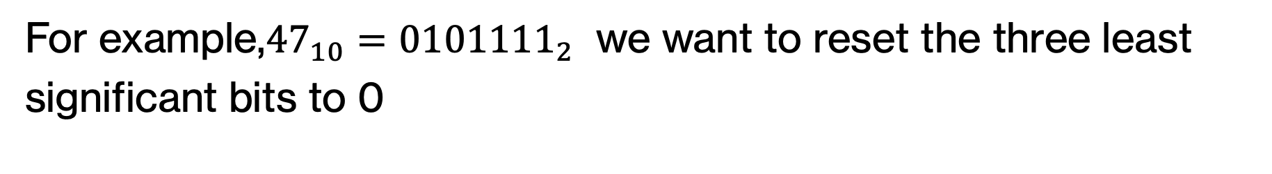
Bitwise AND – Resetting bits to 0
For example,${47}_{10}={0101111}_{2}$ we want to reset the three least significant bits to 0
Bit | 6th | 5th | 4th | 3rd | 2nd | 1st | 0th
Data | 0 | 1 | 0 | 1 | 1 | 1 | 1
Mask | 1 | 1 | 1 | 1 | 0 | 0 | 0
Result
&
& the mask

Slide 53
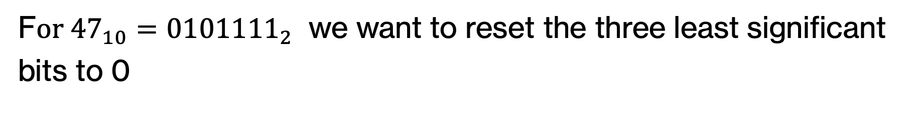
Bitwise AND – Resetting bits to 0
F$or {47}_{10}={0101111}_{2}$ we want to reset the three least significant bits to 0
Bit | 6th | 5th | 4th | 3rd | 2nd | 1st | 0th
Data | 0 | 1 | 0 | 1 | 1 | 1 | 1
Mask | 1 | 1 | 1 | 1 | 0 | 0 | 0
Result | 0 | 1 | 0 | 1 | 0 | 0 | 0
&
& the mask

Slide 54
Bitwise AND – Resetting bits to 0
F$or {47}_{10}={0101111}_{2}$ we want to reset the three least significant bits to 0
Bit | 6th | 5th | 4th | 3rd | 2nd | 1st | 0th
Data | 0 | 1 | 0 | 1 | 1 | 1 | 1
Mask | 1 | 1 | 1 | 1 | 0 | 0 | 0
Result | 0 | 1 | 0 | 1 | 0 | 0 | 0
&
40

Slide 55

PRACTICE TIME - Bitwise AND
What would the result be of applying the mask ${42}_{10}$ on the input ${85}_{10}$ using bitwise AND?.
Notes:
Your turn. Start by converting 42 abd 85 to binary before you apply bitwise AND. What was its effects on the bits? What will the result be in decimal?

Slide 56
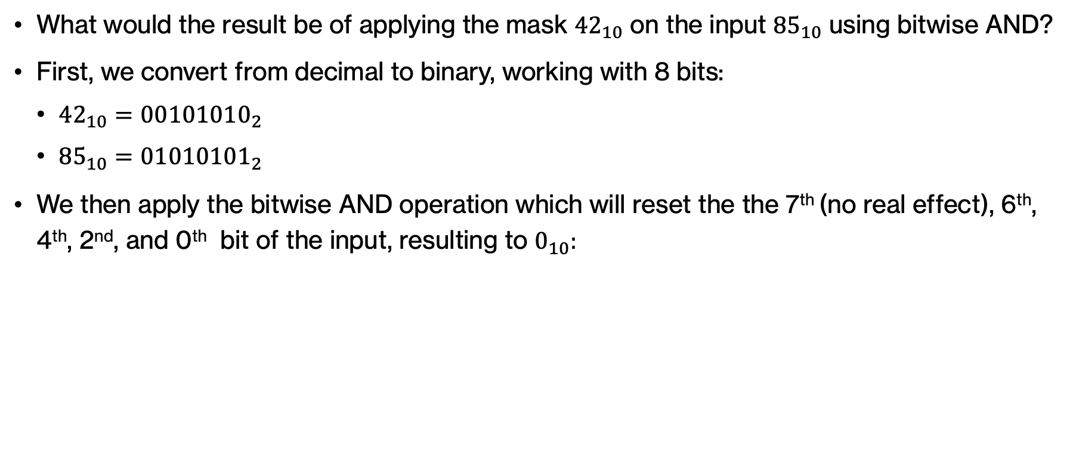
ANSWER - Bitwise AND
What would the result be of applying the mask ${42}_{10}$ on the input ${85}_{10}$ using bitwise AND?
First, we convert from decimal to binary, working with 8 bits:
${42}_{10}={00101010}_{2}$
${85}_{10}={01010101}_{2}$
We then apply the bitwise AND operation which will reset the the 7th (no real effect), 6th, 4th, 2nd, and 0th bit of the input, resulting to $0_{10}:$
Bit | 7th | 6th | 5th | 4th | 3rd | 2nd | 1st | 0th
Data | 0 | 1 | 0 | 1 | 0 | 1 | 0 | 1
Mask | 0 | 0 | 1 | 0 | 1 | 0 | 1 | 0
Result | 0 | 0 | 0 | 0 | 0 | 0 | 0 | 0

Slide 57
Bitwise OR – Setting bits to 1
We want to set the first two bits to 1
Bit | 7th | 6th | 5th | 4th | 3rd | 2nd | 1st | 0th
Data | 0/1 | 0/1 | 0/1 | 0/1 | 0/1 | 0/1 | 0/1 | 0/1
Mask
Result
|
What number should we bitwise-OR (|) to do this?

Slide 58
Bitwise OR – Setting bits to 1
We want to set the first two bits to 1
Bit | 7th | 6th | 5th | 4th | 3rd | 2nd | 1st | 0th
Data | 0/1 | 0/1 | 0/1 | 0/1 | 0/1 | 0/1 | 0/1 | 0/1
Mask | 1 | 1 | 0 | 0 | 0 | 0 | 0 | 0
Result
|
-128
64
32
16
8
4
2
1
What number should we bitwise-OR (|) to do this?

Slide 59
Bitwise OR – Setting bits to 1
We want to set the first two bits to 1
Bit | 7th | 6th | 5th | 4th | 3rd | 2nd | 1st | 0th
Data | 0/1 | 0/1 | 0/1 | 0/1 | 0/1 | 0/1 | 0/1 | 0/1
Mask | 1 | 1 | 0 | 0 | 0 | 0 | 0 | 0
Result
|
-128
64
32
16
8
4
2
1
-64

Slide 60
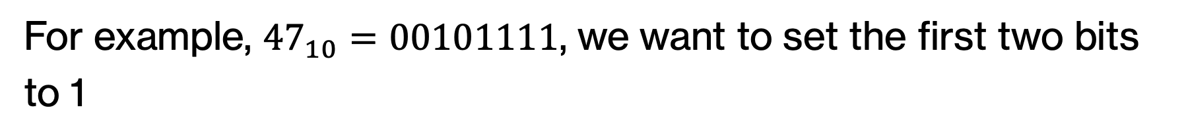
Bitwise OR – Setting bits to 1
For example, ${47}_{10}=00101111$, we want to set the first two bits to 1
Bit | 7th | 6th | 5th | 4th | 3rd | 2nd | 1st | 0th
Data | 0 | 0 | 1 | 0 | 1 | 1 | 1 | 1
Mask | 1 | 1 | 0 | 0 | 0 | 0 | 0 | 0
Result | 1 | 1 | 1 | 0 | 1 | 1 | 1 | 1
|
-128
64
32
16
8
4
2
1

Slide 61
Bitwise OR – Setting bits to 1
For example, ${47}_{10}=00101111$, we want to set the first two bits to 1
Bit | 7th | 6th | 5th | 4th | 3rd | 2nd | 1st | 0th
Data | 0 | 0 | 1 | 0 | 1 | 1 | 1 | 1
Mask | 1 | 1 | 0 | 0 | 0 | 0 | 0 | 0
Result | 1 | 1 | 1 | 0 | 1 | 1 | 1 | 1
|
-128
64
32
16
8
4
2
1
-17

Slide 62

PRACTICE TIME - Bitwise OR
What would the result be of applying the mask ${17}_{10}$ on the input ${−27}_{10}$ using bitwise OR?
Notes:
Your turn! As before, convert 17 and -27 to binary (using signed extension for two's complement) and assume you have 8 bits.

Slide 63
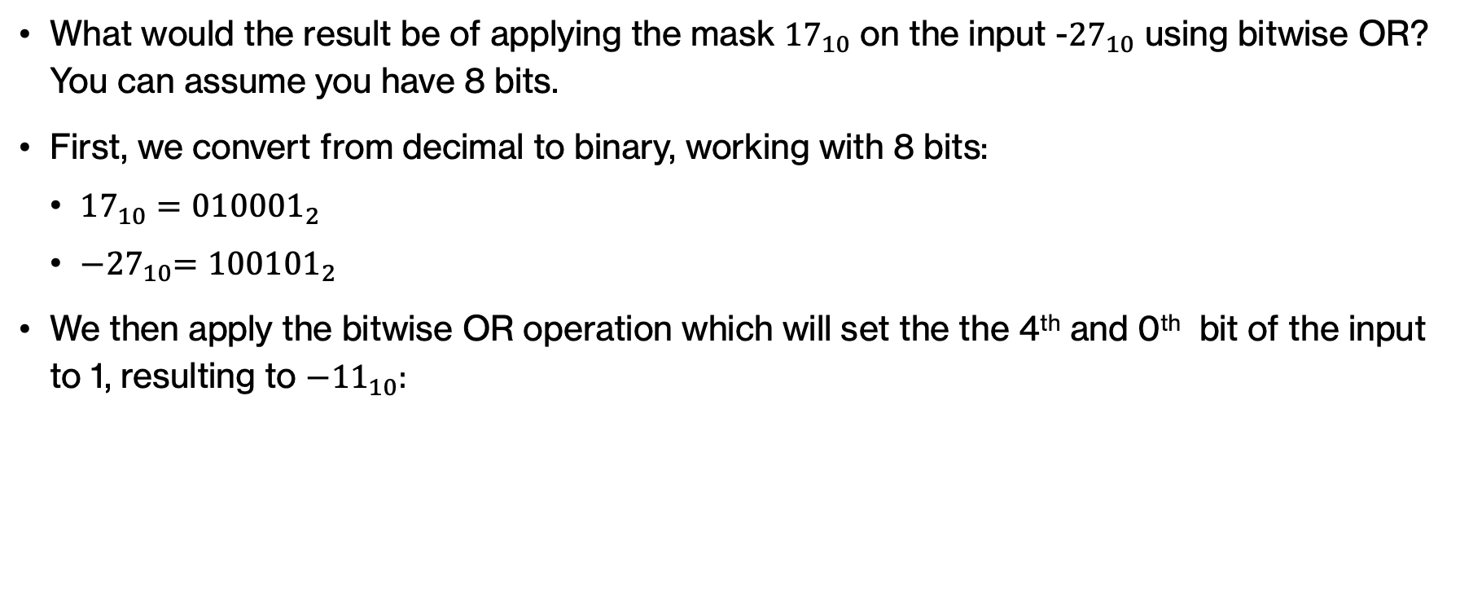
ANSWER - Bitwise OR
What would the result be of applying the mask ${17}_{10}$ on the input -${27}_{10}$ using bitwise OR? You can assume you have 8 bits.
First, we convert from decimal to binary, working with 8 bits:
${17}_{10}={010001}_{2}$
${−27}_{10}={100101}_{2}$
We then apply the bitwise OR operation which will set the the 4th and 0th bit of the input to 1, resulting to ${−11}_{10}:$
Bit | 5th | 4th | 3rd | 2nd | 1st | 0th
Data | 1 | 0 | 0 | 1 | 0 | 1
Mask | 0 | 1 | 0 | 0 | 0 | 1
Result | 1 | 1 | 0 | 1 | 0 | 1
Notes:
This will result in the 4th and 0th bit being set to 1.

Slide 64
Bitwise XOR – Inverting bits
We want to invert the first two and last two digits and leave the four in middle unchanged
Bit | 7th | 6th | 5th | 4th | 3rd | 2nd | 1st | 0th
Data | 0/1 | 0/1 | 0/1 | 0/1 | 0/1 | 0/1 | 0/1 | 0/1
Mask
Result
^
What number should we bitwise-XOR (^) to do this?
Notes:
bitwise XOR inverts the digits the digits that have a 1 in the mask.

Slide 65
Bitwise XOR – Inverting bits
We want to invert the first two and last two digits and leave the four in middle unchanged
Bit | 7th | 6th | 5th | 4th | 3rd | 2nd | 1st | 0th
Data | 0/1 | 0/1 | 0/1 | 0/1 | 0/1 | 0/1 | 0/1 | 0/1
Mask | 1 | 1 | 0 | 0 | 0 | 0 | 1 | 1
Result
^
-128
64
32
16
8
4
2
1
What number should we bitwise-XOR (^) to do this?
Notes:
bitwise XOR inverts the digits the digits that have a 1 in the mask.

Slide 66
Bitwise XOR – Inverting bits
We want to invert the first two and last two digits and leave the four in middle unchanged
Bit | 7th | 6th | 5th | 4th | 3rd | 2nd | 1st | 0th
Data | 0/1 | 0/1 | 0/1 | 0/1 | 0/1 | 0/1 | 0/1 | 0/1
Mask | 1 | 1 | 0 | 0 | 0 | 0 | 1 | 1
Result
^
-128
64
32
16
8
4
2
1
-61
Notes:
bitwise XOR inverts the digits the digits that have a 1 in the mask.

Slide 67
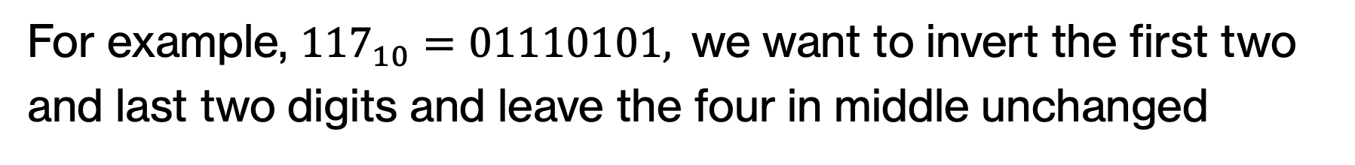
Bitwise XOR – Inverting bits
For example, ${117}_{10}=01110101,$we want to invert the first two and last two digits and leave the four in middle unchanged
Bit | 7th | 6th | 5th | 4th | 3rd | 2nd | 1st | 0th
Data | 0 | 1 | 1 | 1 | 0 | 1 | 0 | 1
Mask | 1 | 1 | 0 | 0 | 0 | 0 | 1 | 1
Result | 1 | 0 | 1 | 1 | 0 | 1 | 1 | 0
^
-128
64
32
16
8
4
2
1

Slide 68
Bitwise XOR – Inverting bits
For example, ${117}_{10}=01110101,$we want to invert the first two and last two digits and leave the four in middle unchanged
Bit | 7th | 6th | 5th | 4th | 3rd | 2nd | 1st | 0th
Data | 0 | 1 | 1 | 1 | 0 | 1 | 0 | 1
Mask | 1 | 1 | 0 | 0 | 0 | 0 | 1 | 1
Result | 1 | 0 | 1 | 1 | 0 | 1 | 1 | 0
^
-128
64
32
16
8
4
2
1
-74

Slide 69
PRACTICE TIME - Mystery 1
What does the following Python function do?
def mystery1(a, b):
return (a ^ b) == 0
Notes:
Think, what type will this function return? If you assume a and b are integers, what are good inputs to test? When would the result of applying a bitwise xor result to the decimal number 0?

Slide 70
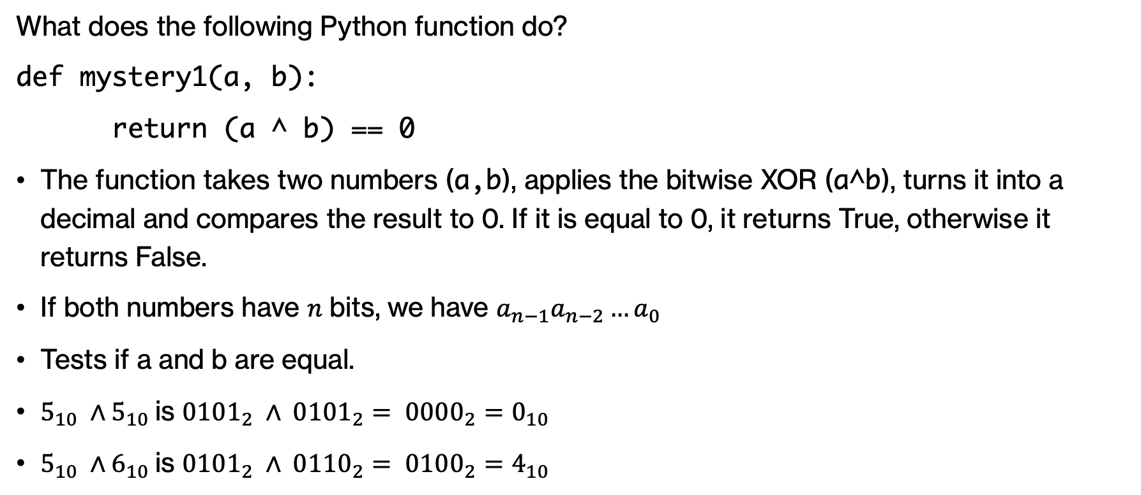
ANSWER - Mystery 1
What does the following Python function do?
def mystery1(a, b):
return (a ^ b) == 0
The function takes two numbers (a,b), applies the bitwise XOR (a^b), turns it into a decimal and compares the result to 0. If it is equal to 0, it returns True, otherwise it returns False.
If both numbers have $n$ bits, we have $a_{n−1}a_{n−2}…a_{0}$
Tests if a and b are equal.
$5_{10} ∧5_{10}$is ${0101}_{2} ∧ {0101}_{2}= {0000}_{2}=0_{10}$
$5_{10} ∧6_{10}$is ${0101}_{2} ∧ {0110}_{2}= {0100}_{2}=4_{10}$
Notes:
The function returns a bool. It seems like it's converting the result of the XOR bitwise operation on a and b to a decimal number and comparing it against 0. 0 in decimal is 0000…0 in binary. For the result of a bitwise XOR operation to always be 0, we would need every single bit we compare between the two numbers to be equal.

Slide 71
PRACTICE TIME - Mystery 2
What does the following Python function do? You can assume we are working with 4 bits
def mystery2(a):
return (a & (1<<3)) != 0
Notes:
Again, what is the return type? Try a few different inputs for a.

Slide 72
ANSWER - Mystery 2
What does the following Python function do? You can assume we are working with 32 bits
def mystery2(a):
return (a & (1<<3)) != 0
Checks whether a is negative by isolating the MSB.
Notes:
Don't forget that if you have an n-bit number, the MSB would be at the n-1 bit (starting 0 to the right and advancing to the left)

Slide 73
PRACTICE TIME - Mystery 3
What does the following Python function do?
def mystery3(a,b):
return (a & (1<<b)) != 0
Notes:
This should feel very familiar. The only thing we changed is 3 to b.

Slide 74
ANSWER - Mystery 3
What does the following Python function do?
def mystery3(a,b):
return (a & (1<<b)) != 0
Tests if the b-th bit in a is 1.
Notes:
So now we test the b-th bit, not necessarily the MSB. Ideally, we should have checked that b is within the n bits that a has but that's a bit complicated in languages like Python.

Slide 75
PRACTICE TIME - Mystery 4
What does the following Python function do?
def mystery4(a):
return a | 1
Notes:
Last head scratcher. What does this super concise function do? Let's start by realizing that it does not return a bool but a decimal number

Slide 76
ANSWER - Mystery 4
What does the following Python function do?
def mystery4(a):
return a | 1
If a is even, it returns a+1, if a is odd, it leaves it unchanged.
Notes:
Cool, huh?

Slide 77
bit_length()
Write a function that removes the most significant bit of a positive number

Slide 78
bit_length()
Write a function that removes the most significant bit of a positive number
& 0 1 1 1 1

Slide 79
bit_length()
Write a function that removes the most significant bit of a number
& 0 1 1 1 1
How can we get this number?

Slide 80
bit_length()
Write a function that removes the most significant bit of a number
& 0 1 1 1 1
1 0 0 0 0
-1

Slide 81
bit_length()
Returns the number of bits in a number (ignoring the sign bit)

Slide 82
bit_length()
Write a function that removes the most significant bit of a positive number
def remove_most_significant_bit(a):
bits = a.bit_length()
mask = (1 << bits - 1) - 1
return a & mask

Slide 83
Why bitwise operators?
Represent many Boolean values with a single integer (e.g., in memory constrained environments)
Are fast, so can speed up computation (if you can post your problem as a bitwise operation)
Interacting with low-level hardware

Slide 84
Beyond numbers

Slide 85
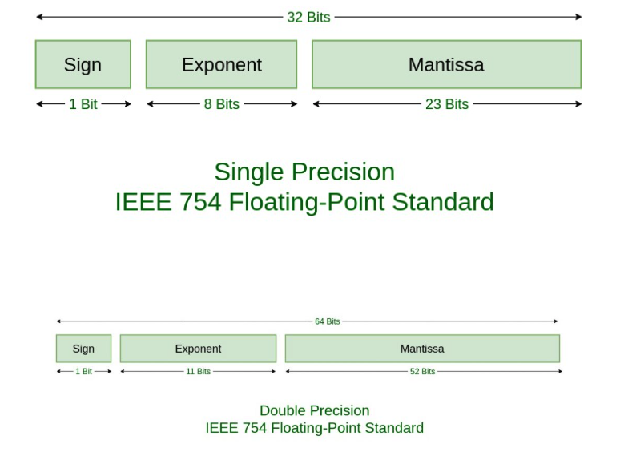
Floating point numbers

Slide 86
Representing information
But what about non-integer numbers, such as floating-point numbers, or any other type of information, such as letters, emojis, colors, sound etc?
There are different international standards that determine how binary is encoded into other representations.
For example, the most used standard to encode real numbers is the IEEE 754 standard.
Notes:
So far, we have seen that computers store information in bits and we have interpreted these bits as integers.
But what about non-integer numbers, such as floating-point numbers, or any other type of information, such as letters, emojis, colors, sound etc?
There are different international standards that determine how binary is encoded into other representations.
For example, the most used standard to encode real numbers is the IEEE 754 standard.
But under the hood, it’s all bits!

Slide 87
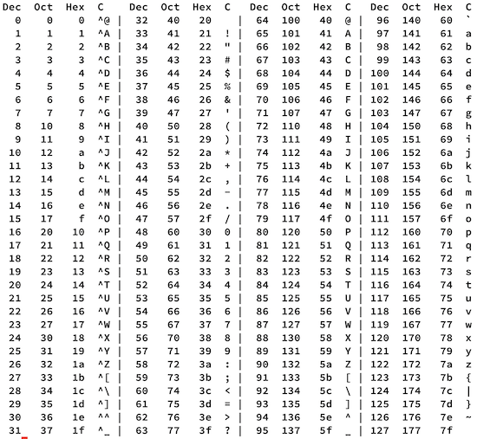
Text

Slide 88
Encoding text - ASCII
ASCII (American Standard Code for Information Interchange) which was established in the ‘60s and used 7 bits to represent 128 characters: These included the capital and lowercase letters of the English alphabet, digits 0-9, punctuation and special symbols like @.
For example, 01000011 01010011 00110101 00110001 00100001 represents the text “CS51!”
Notes:
ASCII (American Standard Code for Information Interchange) which was established in the ‘60s and used 7 bits to represent 128 characters: These included the capital and lowercase letters of the English alphabet, digits 0-9, punctuation and special symbols like @.
For example, 01000011 01010011 00110101 00110001 00100001 represents the text “CS51!”
ASCII was adopted by different computer manufacturers ensuring interoperability.
Soon an 8th bit was used to expand the available set to 255 characters.
In the US, this was used for accented characters and mathematical symbols and many other languages used these extra characters to encode their own alphabets.
But that meant that text written in different languages encoded to gibberish when read in a different context.

Slide 89
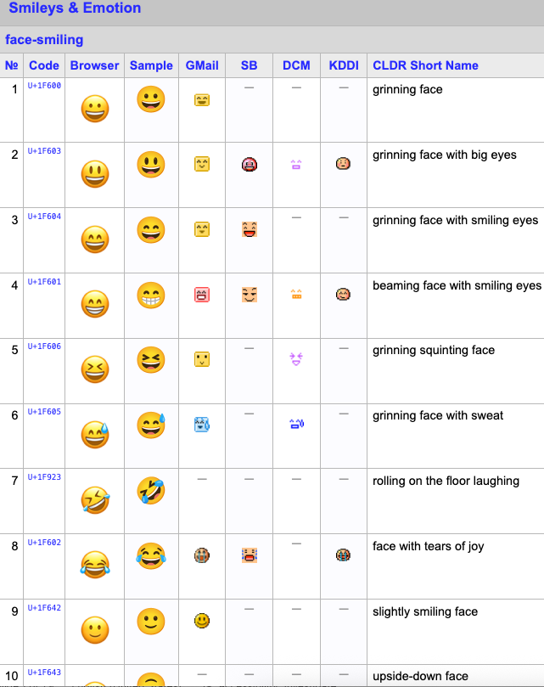
Encoding text - Unicode
In 1990s, Unicode expanded encoding to thousands of characters to account for all different schemes individual languages used and even includes emojis!
The most common implementations of Unicode are UTF-8 ,which was designed for backward compatibility with ASCII, and UTF-16.
Notes:
In 1990s, Unicode expanded encoding to thousands of characters to account for all different schemes individual languages used and even includes emojis!
The most common implementations of Unicode are UTF-8 ,which was designed for backward compatibility with ASCII, and UTF-16.

Slide 90

How is an image represented?

Slide 91
How is an image represented?
images are made up of pixels
for a color image, each pixel corresponds to an RGB value (i.e. three numbers)

Slide 92
Image features
for each pixel: R[0-255] G[0-255] B[0-255]

Slide 93
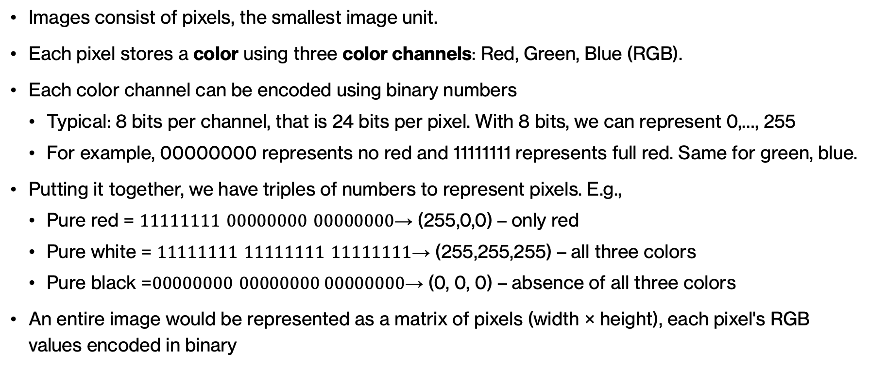
Encoding images
Images consist of pixels, the smallest image unit.
Each pixel stores a color using three color channels: Red, Green, Blue (RGB).
Each color channel can be encoded using binary numbers
Typical: 8 bits per channel, that is 24 bits per pixel. With 8 bits, we can represent 0,…, 255
For example, 00000000 represents no red and 11111111 represents full red. Same for green, blue.
Putting it together, we have triples of numbers to represent pixels. E.g.,
Pure red = $11111111 00000000 00000000$→ (255,0,0) – only red
Pure white = $11111111 11111111 11111111$→ (255,255,255) – all three colors
Pure black =$00000000 00000000 00000000$→ (0, 0, 0) – absence of all three colors
An entire image would be represented as a matrix of pixels (width × height), each pixel's RGB values encoded in binary
Notes:
Images consist of pixels, the smallest image unit.
Each pixel stores a color using three color channels: Red, Green, Blue (RGB).
Each color channel can be encoded using binary numbers
Typical: 8 bits per channel, that is 24 bits per pixel. With 8 bits, we can represent 0,…, 255
For example, 00000000 represents no red and 11111111 represents full red. Same for green, blue.
Putting it together, we have triples of numbers to represent pixels. E.g.,
Pure red = $11111111 00000000 00000000$→ (255,0,0) – only red
Pure white = $11111111 11111111 11111111$→ (255,255,255) – all three colors
Pure black =$00000000 00000000 00000000$→ (0, 0, 0) – absence of all three colors
An entire image would be represented as a matrix of pixels (width × height), each pixel's RGB values encoded in binary

Slide 94
PRACTICE TIME - Encoding images
f we have 8 bits for each of the three color channels, how many colors can we support in a 24-bit RGB system?
Notes:
Let's think for a moment, if we have 8 bits for each of the three color channels, how many colors can we support in a 24-bit RGB system?

Slide 95

ANSWER - Encoding images
If we have 8 bits for each of the three color channels, how many colors can we support in a 24-bit RGB system?
Each channel supports $2^{8}=256$ possible values.
Thus, the total number of supported colors is $256 ×256×256=16,777,216$
That means that a 24-bit RGB system, can represent over 16 million colors.
Notes:
Each channel supports $2^{8}=256$ possible values.
Thus, the total number of supported colors is $256 ×256×256=16,777,216$
That means that a 24-bit RGB system can represent over 16 million colors.

Slide 96
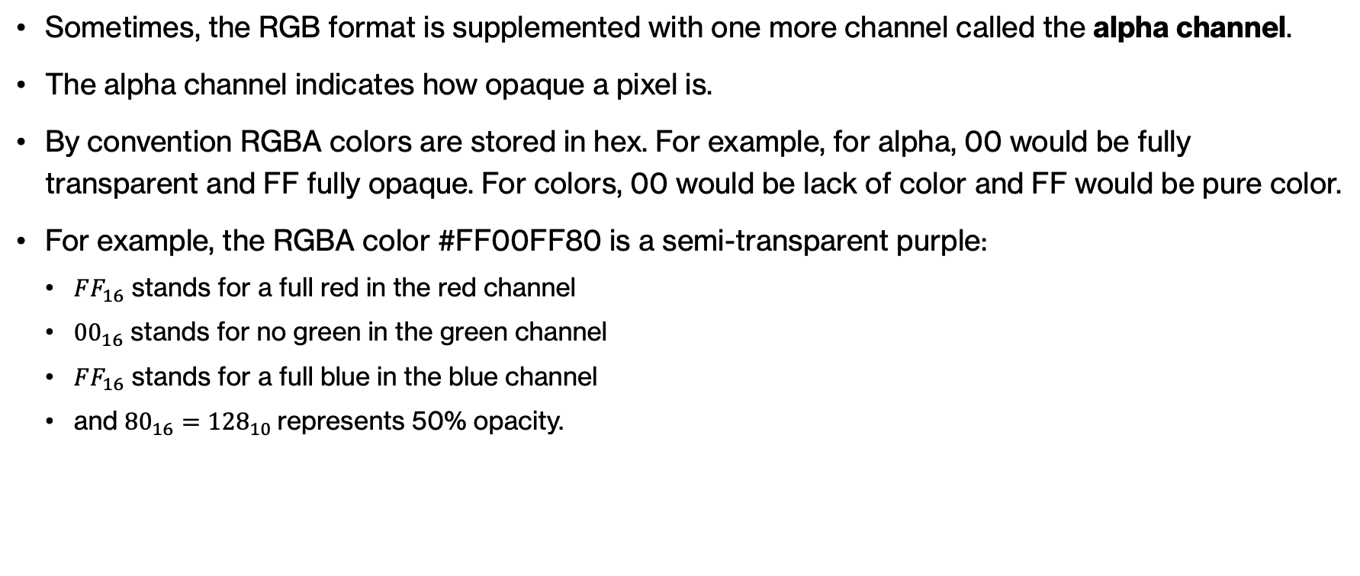
RGBA format
Sometimes, the RGB format is supplemented with one more channel called the alpha channel.
The alpha channel indicates how opaque a pixel is.
By convention RGBA colors are stored in hex. For example, for alpha, 00 would be fully transparent and FF fully opaque. For colors, 00 would be lack of color and FF would be pure color.
For example, the RGBA color #FF00FF80 is a semi-transparent purple:
$FF_{16}$ stands for a full red in the red channel
${00}_{16}$ stands for no green in the green channel
$FF_{16}$ stands for a full blue in the blue channel
and ${80}_{16}={128}_{10}$represents 50% opacity.
Notes:
Beyond rbg, we often encode one more piece of information about pixels, their alpha value which stands for how opaque a pixel is. We typically work with hex numbers, that is 00 would be fully transparent for alpha or lack of color for rgb, and ff would be fully opaque for alpha and full on color for rgb. You can now see why #FF00FF80 is a semi transparent purple.

Slide 97
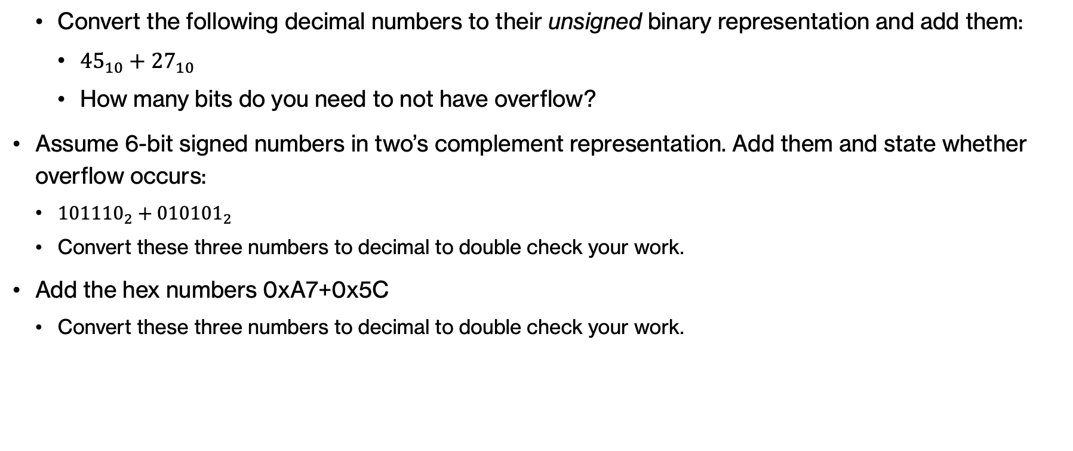
Practice Problems – Problem 1
Convert the following decimal numbers to their unsigned binary representation and add them:
${45}_{10}+{27}_{10}$
How many bits do you need to not have overflow?
Assume 6-bit signed numbers in two’s complement representation. Add them and state whether overflow occurs:
${101110}_{2}​+{010101}_{2}​$
Convert these three numbers to decimal to double check your work.
Add the hex numbers 0xA7+0x5C
Convert these three numbers to decimal to double check your work.

Slide 98
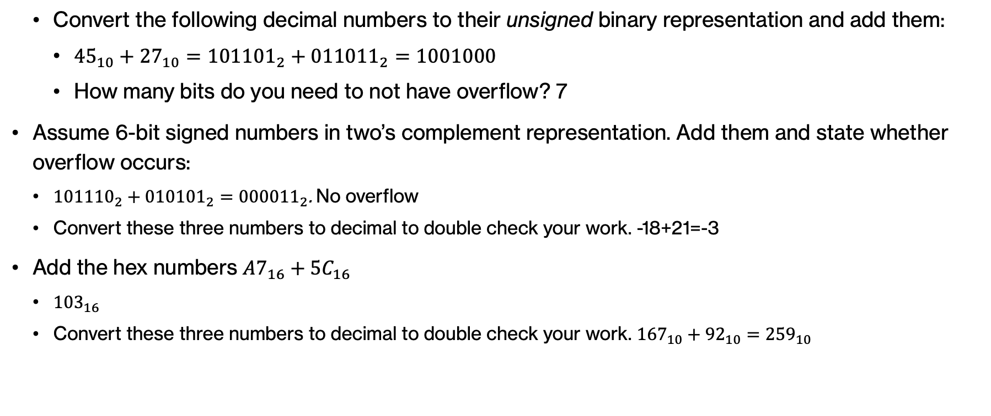
Practice Problems – Answer 1
Convert the following decimal numbers to their unsigned binary representation and add them:
${45}_{10}+{27}_{10}={101101}_{2}+{011011}_{2}=1001000$
How many bits do you need to not have overflow? 7
Assume 6-bit signed numbers in two’s complement representation. Add them and state whether overflow occurs:
${101110}_{2}​+{010101}_{2}​={000011}_{2}$. No overflow
Convert these three numbers to decimal to double check your work. -18+21=-3
Add the hex numbers $A7_{16}+5C_{16}$
${103}_{16}$
Convert these three numbers to decimal to double check your work. ${167}_{10}+{92}_{10}={259}_{10}$

Slide 99

Practice Problems – Problem 2
What will the results of the following operations be in binary and decimal assuming 8 bits?
${−28}_{10}≫2$

Slide 100

Practice Problems – Answer 2
What will the results of the following operations be in binary and decimal assuming 8 bits?
${−28}_{10}≫2 = {11100100}_{2}≫2 ={11111001}_{2}={−7}_{10}$

Slide 101

Practice Problems – Problem 3
Compute the following expressions in Python:
${101101012}_{2}​\&{11110000}_{2}$
${01011011}_{2}|{00101101}_{2}$
${11001010}_{2} ⋀1{0101100}_{2}​$

Slide 102

Practice Problems – Answer 3
Compute the following expressions in Python:
${101101012}_{2}​\&{11110000}_{2}={10110000}_{2}$
${01011011}_{2}|{00101101}_{2}={01111111}_{2}$
${11001010}_{2} ⋀1{0101100}_{2}​={01100110}_{2}$

