Slide 1
Lecture 22: Network Security
CS 181S December 3, 2018

Slide 2
Remote Adversaries

Slide 3
Categorizing Malware
Trojan: instructions hidden inside an otherwise useful program that do bad things.
Virus: instructions that, when executed, insert copies of themselves into other programs. Usually added to program after the fact (e.g., when an email is read).
Worm: a malicious program that replicates itself by installing copies of itself on other machines across a network.
Logic bomb: malicious instructions that trigger on some event in the future
Zombie: malicious instructions that can be triggered remotely to carry out some attack. Often large numbers of zombies are installed and then triggered simultaneously.
Notes:
How does malware get on your machine:
Trojans: usually downloaded by mistake (e.g., trick user by imitating legitimate software)
Virus: usually downloaded through carelessness (e.g., downloading malicious attachment)
Worm: usually propagates itself finding a vulnerable application on a remote machine

Slide 4
Networking Stack
7 - Application
Deliver content
HTTP
6 - Presentation
Manage encoding
5 - Session
Manage sessions
TLS/SSL
4 - Transport
Deliver (un)reliably
TCP/UDP
3 - Network
Deliver globally
IP
2 - Data Link
Deliver locally
Ethernet
1 - Physical
Deliver signals
0s and 1s

Slide 5
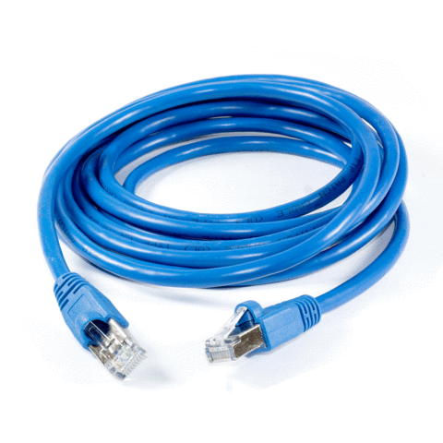
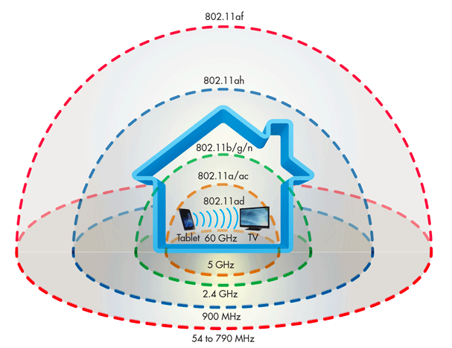
Physical Layer
Delivers unstructured stream of bits across a link
Examples: optical fiber, copper wire, radio frequencies
Network interface controller (NIC) implements electronic circuitry required to connect computer to network using a specific physical layer

Slide 6
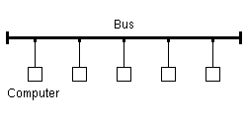
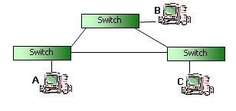
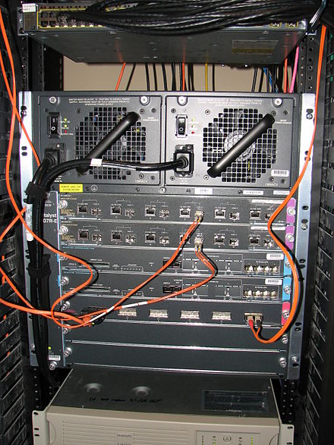
Data Link Layer
Organizes bits into packets, delivers packets across a single link
Examples: ethernet, 802.11 (wireless)

Slide 7
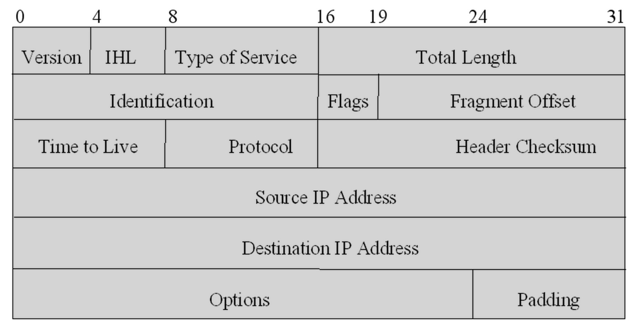
Network Layer
Computes paths through a network of links and switches, forwards packets along path from source to destination
Examples: ICMP, IP, IPSec

Slide 8
Ping Flood

Slide 9
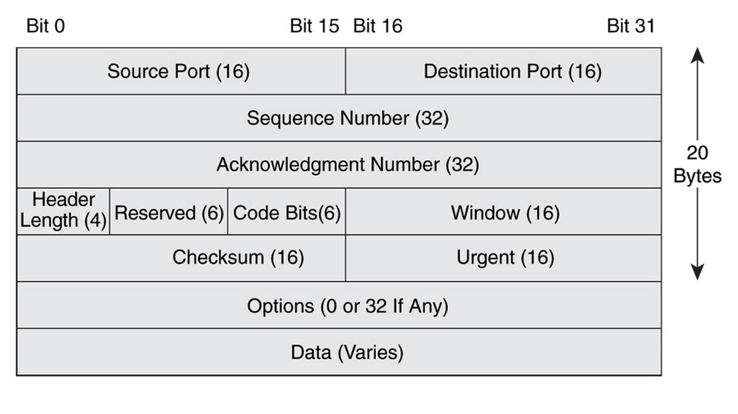
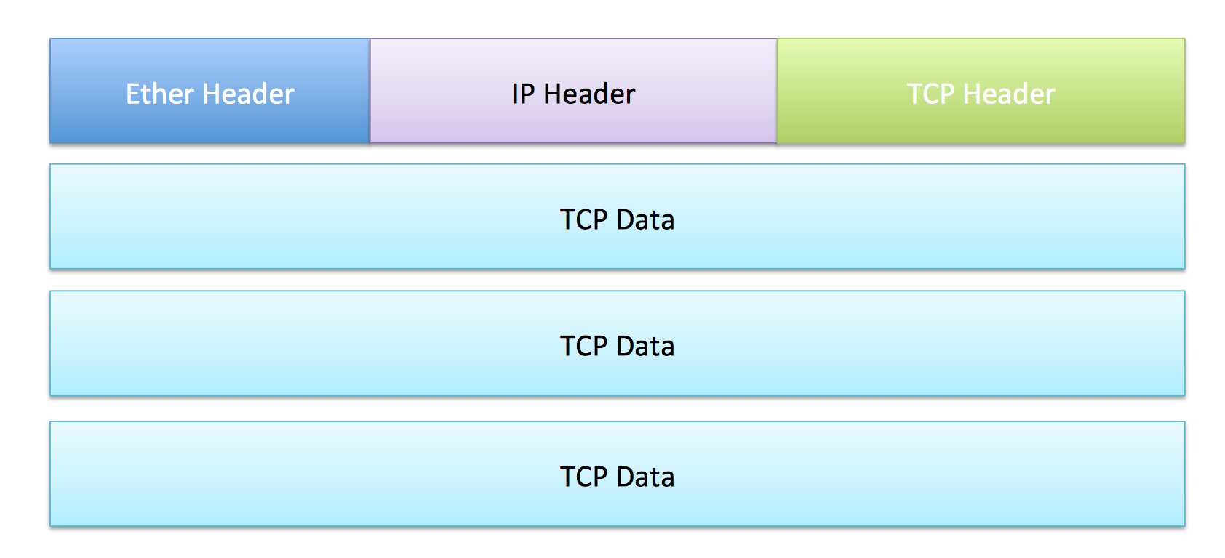
Transport Layer
Establishes (reliable) communication stream between a pair of systems across a network
Examples: UDP, TCP

Slide 10
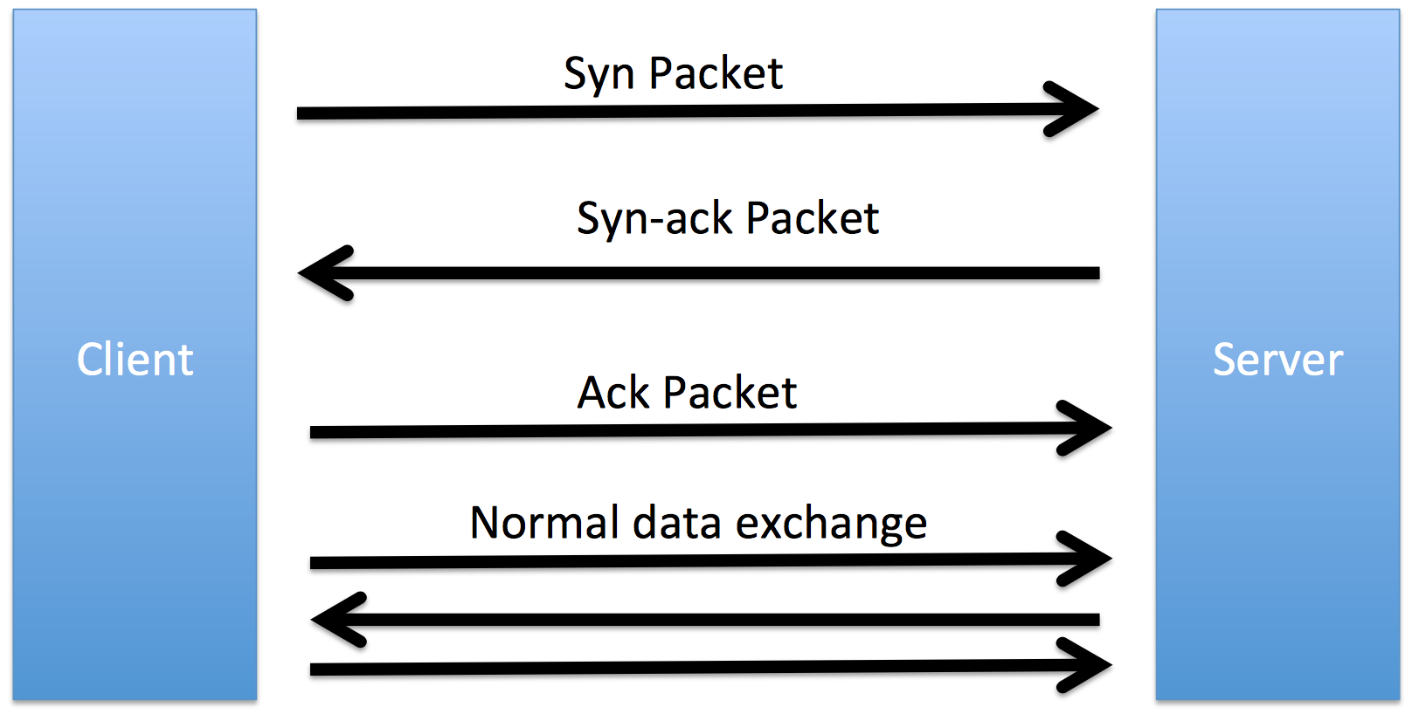
TCP
Reliable
acknowledgement
checksum
sequence number
In-order
sequence number
Congestion control
slow start
congestion avoidance
fast retransmit
fast recovery

Slide 11
Remote Requests
Port Open
Port Closed
No machine
ICMP response from router
Machine but port closed
TCP reset packet
Intercepted
Silence (depends on config)

Slide 12
Port Scanning
Notes:
Computer Fraud and Abuse Act of America Section 1030(a)(5)(B). This act applies against anyone who “intentionally accesses a protected computer without authorization, and as a result of such conduct, causes damage” (and meets other requirements).

Slide 13
Port Scanning
Starting Nmap 7.40 ( https://nmap.org ) at 2017-03-18 21:43 EDT
Nmap scan report for scanme.nmap.org (45.33.32.156)
Host is up (0.12s latency).
Other addresses for scanme.nmap.org (not scanned): 2600:3c01::f03c:91ff:fe18:bb2f
Not shown: 993 closed ports
PORT STATE SERVICE VERSION
21/tcp open ftp
22/tcp open ssh OpenSSH 6.6.1p1 Ubuntu 2ubuntu2.8 (Ubuntu Linux; protocol 2.0)
80/tcp open http Apache httpd 2.4.7 ((Ubuntu))
554/tcp open rtsp
7070/tcp open realserver
9929/tcp open nping-echo Nping echo
31337/tcp open Elite
Device type: general purpose
Running (JUST GUESSING): Linux 3.X (85%)
OS CPE: cpe:/o:linux:linux_kernel:3.13
Aggressive OS guesses: Linux 3.13 (85%)
No exact OS matches for host (test conditions non-ideal).
Network Distance: 13 hops
Service Info: OS: Linux; CPE: cpe:/o:linux:linux_kernel
Nmap done: 1 IP address (1 host up) scanned in 20.31 seconds

Slide 14
Firewalls

Slide 15
Packet Filtering
Protocol | Source IP | Dest. IP | Dest. Port | Action
TCP | * | 192.168.1.* | 25 | Permit
UDP | * | 192.168.1.* | 69 | Permit
TCP | 192.168.1.* | * | 80 | Permit
TCP | * | 192.168.1.18 | 80 | Permit
TCP | * | 192.168.1.* | * | Deny
TCP | * | 192.168.1.* | * | Deny

Slide 16
Stateful Inspection
Notes:
Discussion: how to detect/mitigate a port scan
SYN frequency: use keyed hash table & count SYNs, problem: attacker learns limit
sequential behavior: store last dest & count increment-by-1, problem: randomize order
diversity: count unique ip-port pairs, problem: complicated
failures: track failure/success ratio
anomaly detection: dest ip-port has probability P(d), high (5-10%) for popular dests, low for weird ones), accumulate anomaly score –log (P(d))

Slide 17
Random Scanning
Notes:
https://www.theregister.co.uk/2017/02/28/cloudpets_database_leak/
unauthenticated access to mongodb instance on port 2701
ransomware scheme
https://www.sophos.com/en-us/medialibrary/PDFs/technical-papers/SamSam-The-Almost-Six-Million-Dollar-Ransomware.pdf
https://portswigger.net/daily-swig/iranian-duo-charged-with-samsam-ransomware-slinging-campaign
SamSam ransomware: exploits vulnerability in Remote Desktop Protocol (RDP) by scanning for port 3389, then performs privilege escalation attack
Estimated $6 million in revenue over three years
https://hackaday.com/2018/04/18/fix-your-insecure-amazon-fire-tv-stick/
Port 5555 is used for Android Debug Bridge (ADB)
https://github.com/0x27/linux.mirai/blob/master/mirai/bot/scanner.c
creates botnet, controlled 2.5 million machines at peak
password map: https://krebsonsecurity.com/wp-content/uploads/2016/10/IoTbadpass-Sheet1.pdf
owners identified January 2017, arrested, pled guilty December 2017
clones (eg., Darkai) still operational

Slide 18
Deep-Packet Inspection
alert tcp $EXTERNAL_NET any -> $HOME_NET 53 (msg:"OS-LINUX OS-LINUX x86 Linux overflow attempt"; flow:to_server,established; content:"1|C0 B0 02 CD 80 85 C0|uL|EB|L^|B0|"; metadata:ruleset community, service dns; classtype:attempted-admin; sid:264; rev:13;)

Slide 19
DDoS

Slide 20
SYN Flood
Notes:
A syn flood is a form of DDoS attack that takes advantage of how TCP handles sessions. Recall that a session is established with a three-way TCP hand- shake: the source sends a SYN (synchronize) packet to the destination, the destination sends back a SYN+ACK packet, and the source completes the handshake by sending an ACK (acknowledge). The destination maintains a SYN RECV queue that keeps track handshakes in progress (those for which it has sent a SYN+ACK response but not yet received the final ACK). The default queue size on most modern machines is 1024 (machines with low memory have smaller queues); pending handshakes typically time out after minutes. A SYN flood proceeds by sending SYN packets but never completing the TCP handshake, filling up the queue and leaving the target unable to respond to additional incoming requests.
SYN floods are so common that TCP supports a special-purpose defense designed to mitigate this threat: SYN cookies. The idea is to eliminate the need to store pending SYN packets by encoding the necessary information in the sequence number using a pseudorandom function (more specifically, and HMAC). This prevents the SYN RECV queue from filling up, mitigating the thread of SYN floods. However, SYN cookies do not support all of the options available in the full TCP spec and are therefore officially recommended only as a last resort.

Slide 21
Reflection Attacks
Notes:
DNS amplification

Slide 22
Example DDoS Attack
vs
Notes:
October 21, 2016
Victims include: Airbnb, BBC, CNN, Comcast, Fox News, The Guardian, GitHub, Netflix, Paypal, Reddit, Slack, Tumbler, Twitter, Verizon, Visa, Yelp

Slide 23
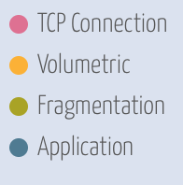
Example DDoS Attack
Notes:
The Dyn DDOS attack was accomplished through a large number of DNS lookup requests from tens of millions of IP addresses

Slide 24
DDoS as a Service
Notes:
https://krebsonsecurity.com/2018/04/ddos-for-hire-service-webstresser-dismantled/
Specify target, duration, method, pay with Paypal or bitcoin
WebStresser.org taken offline in April 2018, but many others do (and will) exist

Slide 25
DDoS as a Service

Slide 26
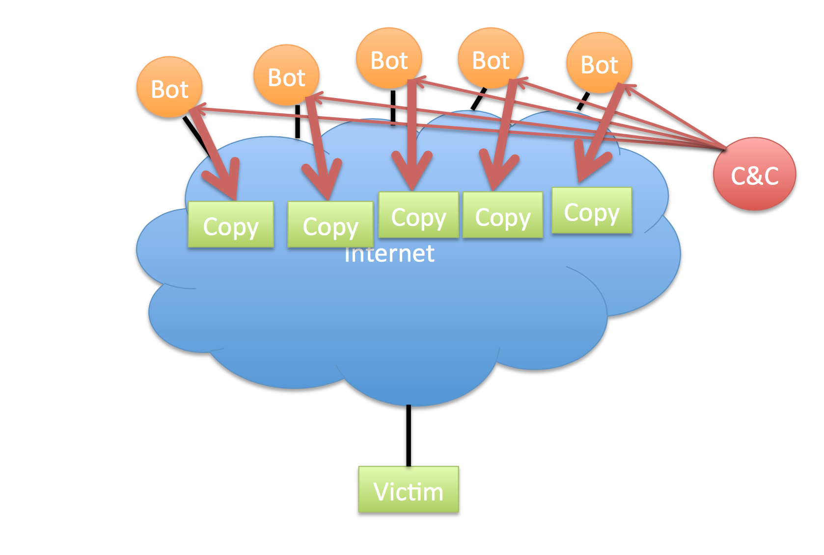
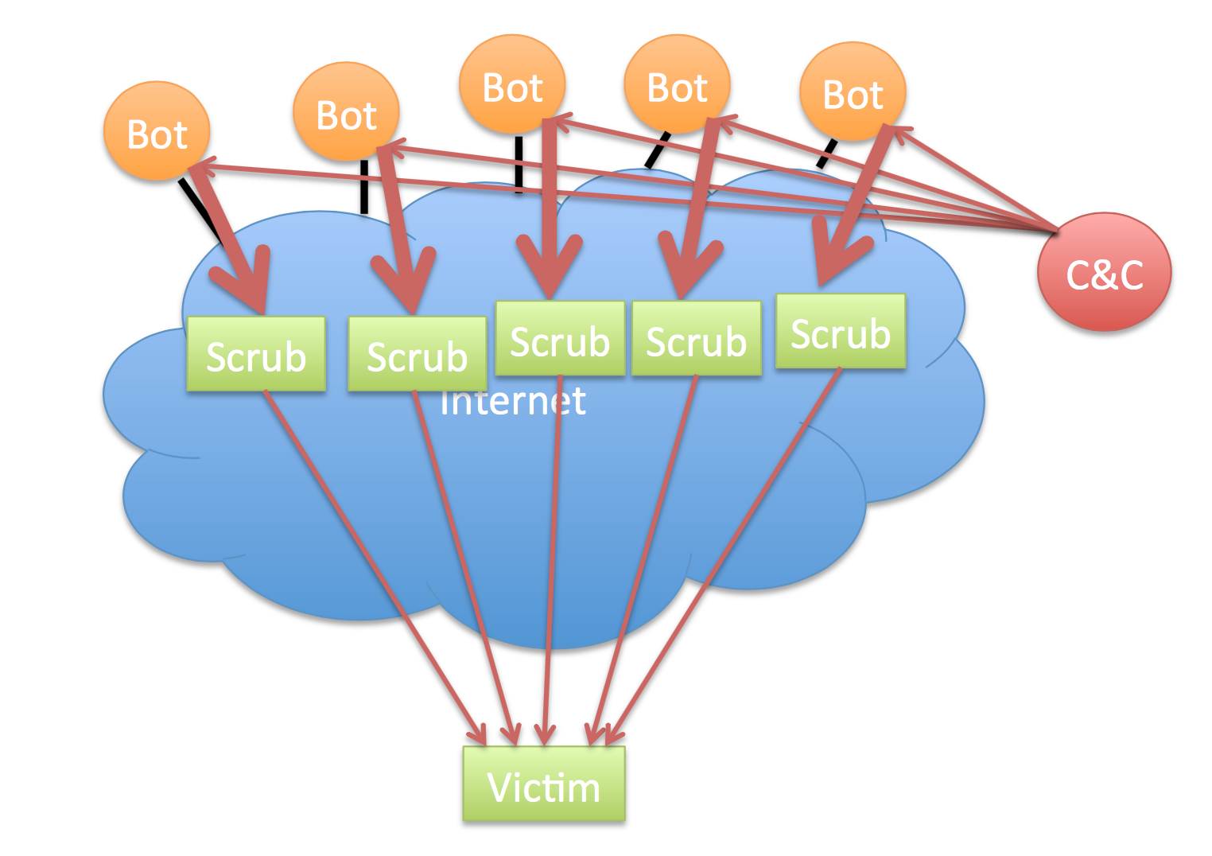
Mitigating DoS Attacks
Notes:
DDoS-mitigation strategies include content distribution (increasing the number of available replicas), distributed scrubbing (a distributed reverse proxy identifies and drops malformed or suspicious traffic), traffic shaping (buffering and rate-limiting incoming traffic), and egress filtering (preventing outgoing traffic from being used in a DDoS attack). As a general rule, DDoS mitigation depends on deploying extensive defensive resources and can be bypassed by a sufficiently determined and resourceful adversary.

Slide 27
Mitigating DoS Attacks
Notes:
Mitigating denial of service attacks is a complex and evolving art. Several companies (Akamai, CloudFlare, Google Shield) offer DDoS mitigation as a service, and their precise techniques are generally a closely-guarded trade secret.

