Slide 1
Lecture 15: Capabilities
CS 181S November 5, 2018

Slide 2
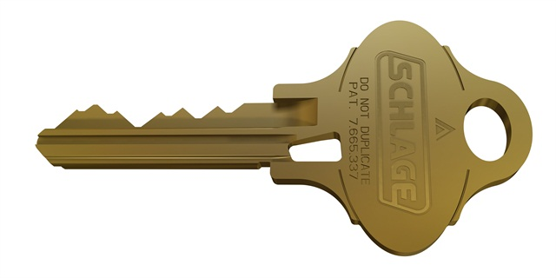
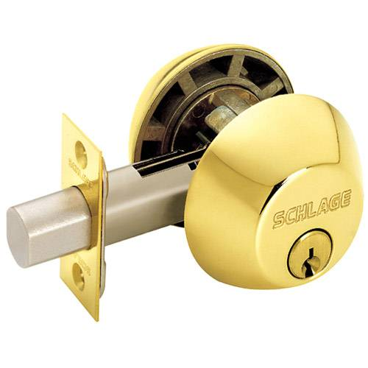
Where we were…
Authentication: mechanisms that bind principals to actions
Authorization: mechanisms that govern whether actions are permitted
Discretionary Access Control
Mandatory Access Control
Notes:
Examples:
Authentication: passwords, digital signatures, EV certificates in browsers
Authorization: file permissions, firewalls, visibility restrictions in FB
Audit: log files, log browsers, intrusion detection systems

Slide 3
Access Control Policy
An access control policy specifies which of the operations associated with any given object each principal is authorized to perform
Expressed as a relation $Auth$:
$$Auth$$ |  | Objects
 |  | dac.tex | dac.pptx
principals | ebirrell | r,w | r,w
 | faculty | r | r
 | student |  | r
Capability
Lists
Access Control Lists

Slide 4
Capability Lists
The capability list for a principal $P$ is a list $⟨O_{1},Privs_{1}⟩,⟨O_{2},Privs_{2}⟩, … ,⟨O_{n},Privs_{n}⟩$
e.g., ⟨dac.tex, {r,w}⟩ ⟨dac.pptx, {r,w}⟩
Capabilities carry privileges.
Authorization: Performing operation $op$ on object $O_{i}$ requires a principal $P$ to hold a capability $C_{i}=⟨O_{i},Privs_{i}⟩$ such that $op∈Privs_{i}$
Unforgeability: Capabilities cannot be counterfeited or corrupted.
Note: Capabilities are (typically) transferable

Slide 5
Capabilities
Advantages:
Natural approach for user-defined objects
Eliminates confused deputy problems
Disadvantages:
Review of permissions?
Revocation?
Delegation?
Privacy?
Notes:
Discussion

Slide 6
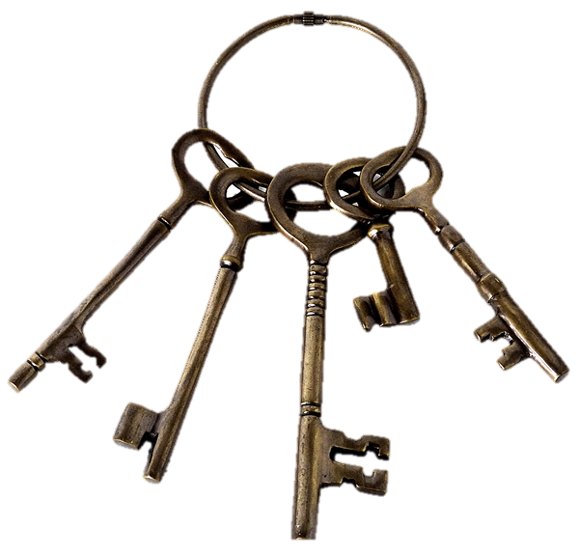
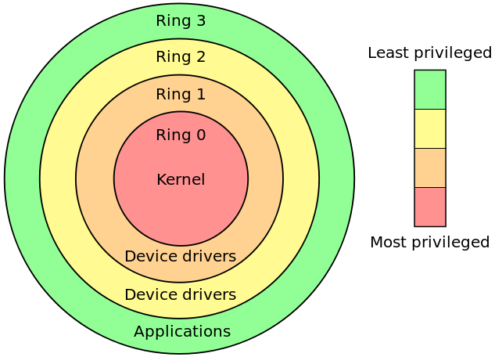
C-Lists
OS maintains and stores stores list of capabilities $C_{i}=⟨O_{i},Privs_{i}⟩$ for each principal (process)
Authorization: OS mediates access to objects, checks process capabilities
Unforgeability: capabilities are stored in protected memory region (kernel memory)

Slide 7
Example: File Descriptor Table
In Unix etc, a file descriptor is a handle used to reference files and I/O resources
File descriptors have modes (read, write) and are stored in per-process file descriptor table
File descriptors can be passed between processes using sendmsg()

Slide 8
Example: Google Fuchsia
new OS in development by Google
possibly intended as a universal across-platform OS for the IoT era (lots of speculation)
capability-based microkernel embraces capabilities (handles) for all kernel objects
socket, port, virtual memory region, process, thread, etc.

Slide 9
Example: OAuth2
Industry standard authorization protocol
Used for single sign-on by major IDPs
Facebook, Google
A bearer token contains a unique identifier
Notes:
Example: Facebook tokens confer permissions for various user data (e.g. public_profile, user_friends, user_posts, user_likes)
Cambridge Analytica as example
Focus on expiration, not revocation, tokens are transferable, but recommended uses are within application (e.g. client & server)

Slide 10
Cryptographically-protected capabilities
Object owner creates capabilities using a digital signature scheme
Capabilities are triples $C=⟨O,Privs, Sig(O,Privs;k_{O})⟩$
Authorization: P is permitted to perform op on O if P produces a capability for O with $op∈Privs$ and a valid signature
Unforgeability: digital signatures are unforgeable to adversaries who don't know private key $k_{O}$
Note: assumes PKI
Notes:
Attractive in distributed systems

Slide 11
Restricted Delegation
$C_{0}=\left\langle O, Privs_{0},k_{1},s_{0}\right\rangle$
where $s_{0}= Sig\left(O,Privs_{0},k_{1};k_{0}\right)$
$C_{1}=\left\langle O, Privs_{1},k_{2},{d_{0},s}_{1}\right\rangle$
Where $d_{0}= Sig\left(O,Privs_{0},k_{1};k_{0}\right)$ and $s_{1}= Sig\left(O,Privs_{1},k_{2},d_{0};k_{1}\right)$
$C_{2}= \left\langle O, Privs_{2},k_{3},{d_{0},d}_{1},s_{2}\right\rangle$
Where $d_{1}= Sig\left(O,Privs_{1},k_{2};k_{1}\right)$ and $s_{2}= Sig\left(O,Privs_{2},k_{3},d_{0},d_{1};k_{2}\right)$
$C_{n}= \left\langle O, Privs_{n},k_{n+1},{d_{0},…,d}_{n−1},s_{n} \right\rangle$
$W\text{here} d_{i}= Sig\left(O,Privs_{i},k_{i+1};k_{i}\right)$
$s_{i}= Sig\left(O,Privs_{i},k_{i+1},s_{0},…s_{i−1};k_{i}\right)$
Notes:
restricted delegation: include keys in credential, create chain
Check: (1) s_0 is signed by k_0 = k_O
(2) all signatures d_i are valid
(3) signature s_n is valid
(4) all privs are subsets

Slide 12
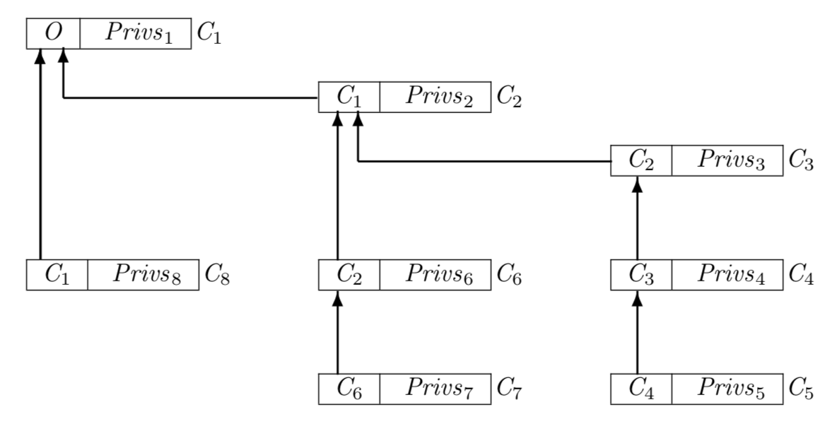
Revocation
Revocation Tags
Capabilities are tuples $C=⟨O,Privs, {rt}_{c}, Sig(O,Privs,rt_{c};k)⟩$
Access to object O is guarded by a reference monitor; monitor maintains a list of revoked tags ${rt}_{c}$
Capability Chains
Objects can be other capabilities!
$P$is authorized to perform $op$on $O$if $P$ holds a capability $C_{i}$ and $op∈Privs_{k}$ holds for every capability $C_{k}$ in the chain from $C_{i}$ to $C_{1}$

Slide 13
Keys as capabilities
Encrypt object
Decryption method functions as reference monitor:
Authorization: correct key will decrypt object -> allow access
Unforgeability: incorrect key will not decrypt
Note: no notion of separate privileges
Notes:
discuss: delegation (key chains), multi-key encryption

Slide 14
Example: Mac keychains
OSX/iOS password manager
uses password-based encryption (AES-256) to store username/password credentials
supports multiple keychains

Slide 15
Example: CryptDB
Encrypted database system. Inspiration for several application-grade encrypted database systems
Processes database queries on encrypted data
Uses chains of keys (starting with user password) to decrypt values/authorize users
onion encryption

Slide 16
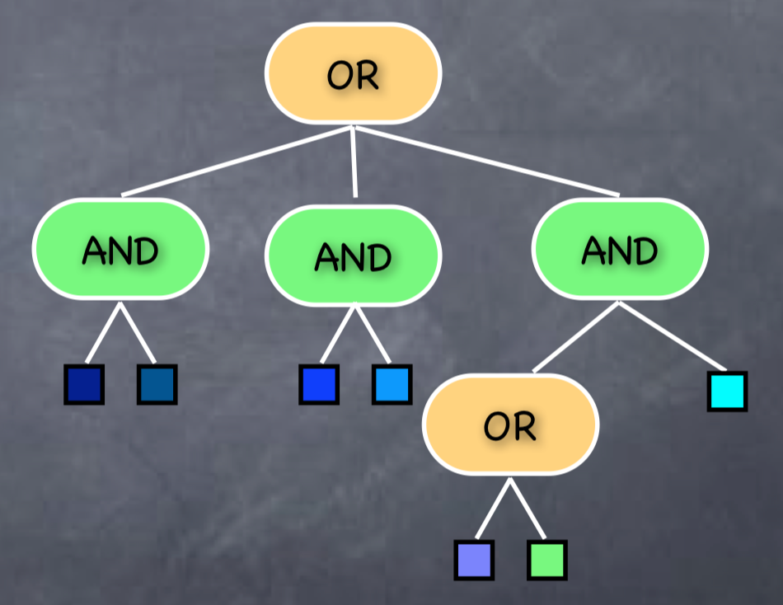
Attribute-based encryption
Type of public-key encryption in which secret keys depend on user attributes
Users can only decrypt a ciphertext if they hold a key for appropriate attributes
A KDC creates secret keys for users based on attributes
Notes:
applications: biometrics (some schemes support fuzzy matches), audit logs (authorized to read log is an attribute or policy for who is authorized to read)

Slide 17
What about privacy?
Notes:
what about tracking use of credential across system? -> anonymous credentials
Typically requires advanced crypto: zkp, commitments, blind signatures
• Two main approaches:
– RSA type signatures [CL02]
• B ased on strong version of RSA assumption
• Idemix (IBM)
– DSA type signatures [Brands 99]
• Based on discrete logarithm problem (more or less)
• UProve (Microsoft)
– Also third type based on elliptic curves with pairings [BCKL08]
• Less efficient
• Allows for extra features

