Slide 1
Lecture 15: Discretionary Access Control
CS 181S October 31, 2018

Slide 2
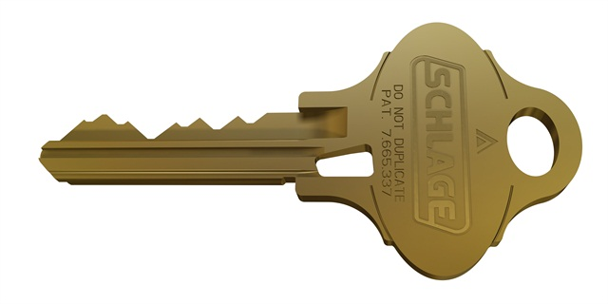
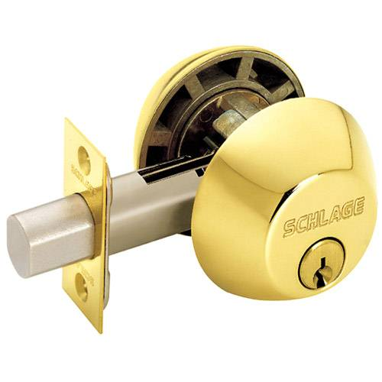
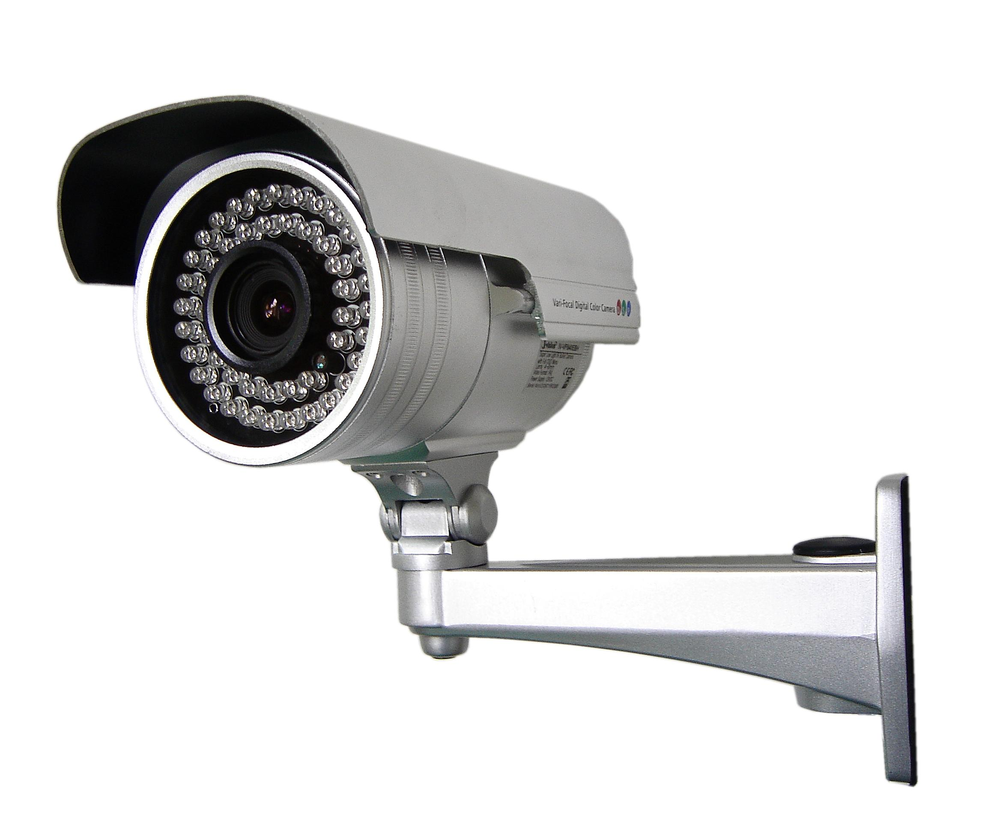
Where we were…
Authentication: mechanisms that bind principals to actions
Authorization: mechanisms that govern whether actions are permitted
Audit: mechanisms that record and review actions
Notes:
Examples:
Authentication: passwords, digital signatures, EV certificates in browsers
Authorization: file permissions, firewalls, visibility restrictions in FB
Audit: log files, log browsers, intrusion detection systems

Slide 3
Access Control Policy
An access control policy specifies which of the operations associated with any given object each principal is authorized to perform
Expressed as a relation $Auth$:
$$Auth$$ |  | Objects
 |  | dac.tex | dac.pptx
principals | ebirrell | r,w | r,w
 | elphaba | r | r
 | glinda |  | r

Slide 4
Who defines authorizations?
Discretionary Access Control: owner defines authorizations
Mandatory Access Control: centralized authority defines authorizations
Notes:
Discussion: Delegation
Facebook visibility as example, repo as example

Slide 5
Access Control Mechanisms
A reference monitor is consulted whenever one of a predefined set operations is invoked
operation $⟨P, O, op⟩$is allowed to proceed only if the invoker $P$ is authorized to perform $op$on object $O$
Can enforce confidentiality and/or integrity
Assumption: Predefined operations are the sole means by which principals can learn or update information.
Assumption: All predefined operations can be monitored (complete mediation).
Notes:
invoker: user, machine, process
operation: read, write, execute, higher-level (e.g., processes, programs)
objects: files, I/O devices, other passive OS abstractions
Discussion: what assumptions are we making?

Slide 6
Design Principles
Principle of Failsafe Defaults favors defining an access control policy by enumerating privileges rather than prohibitions.
Principle of Least Privilege is best served by having fine-grained principals, objects, and operations.
Notes:
Other considerations: usability (e.g., revocation)
Discussion: Are users an good granularity for principals? What granularity do we want?

Slide 7
Real-World Examples
Consider two real-world access control systems: (i) guest lists at clubs, and (ii) physical keys to doors.
How do each of those systems handle the primary concerns of access control:
granting access
preventing/determining access
revoking access
auditing access

Slide 8
Implementing DAC
Need some way to representing authorization relation (matrix) $Auth$.
That scheme must support certain functionality:
computing whether $⟨P, O, op⟩ ∈ Auth$ holds and (i.e., whether principal $P$is authorized to perform operation $op$on object $O$,
changing $Auth$in accordance with defined commands
associating a protection domain with each thread of control
performing transitions between protection domains as execution proceeds.

Slide 9
Instead of Matrices…
Access Control Lists
$$Auth$$ |  | Objects
 |  | dac.tex | dac.pptx
principals | ebirrell | r,w | r,w
 | elphaba | r | r
 | glinda |  | r
Capability
lists
An access control list encodes the non-empty cells associated with a column (object).
A capability list encode the non-empty cells associated with a row (principal).

Slide 10
Access Control Lists
The access control list for an object $O$is a list $⟨P_{1},Privs_{1}⟩,⟨P_{2},Privs_{2}⟩, … ,⟨P_{n},Privs_{n}⟩$
e.g., ⟨ebirrell, {r,w}⟩ ⟨elphaba, {r}⟩ ⟨glinda, {r}⟩
To check whether $P_{i}$is allowed to perform $op$on object $O$,
Look up $P_{i}$in ACL. If not in list, reject $op$.
Check whether $op$is in the sent $Privs_{i}$. If not , reject $op$.

Slide 11
Access Control Lists
Advantages:
Efficient review of permissions for an object
Centralized enforcement is simple to deploy, verify
Revocation is straightforward
Disadvantages:
Inefficient review of permissions for a principal
Large lists impede performance
Vulnerable to confused deputy attack
Notes:
Discussion

Slide 12
Groups in ACLs
A group declaration associates a group name with a set of principals.
The set is specified either by enumerating its elements or by giving a predicate that all principals in the set must satisfy.
An ACL entry $⟨G,Privs⟩$, where $G$ is a group name and $Privs$is a set of privileges, grants all privileges in $Privs$to all principals $P$that are members of $G$.

Slide 13
Wildcards
Many advocate terse representations for ACL entries, assuming that checking shorter access control lists is faster.
One approach is to employ patterns and wildcard symbols for specifying names of principals or privileges, so that a single ACL entry can replace many

Slide 14
Prohibitions
In order to conclude that $P$does not hold $op$ for an object $O$, we would have to enumerate and check the entire ACL.
Some systems allow a prohibition to appear in an ACL-entry.
The prohibition $\overline{op}$ specifies that execution of operation $op$ is prohibited.
Conflict resolution is not always specified (often first)

Slide 15
Demo: Access Control Lists
Notes:
Demo: ACLs in OSX
POSIX ls –la
ACLs (+) ls –lae (locate demo directory on Desktop so they can see ACL in action)
extended attributes (@) ls –la@

Slide 16
Protection Domains
Motivation: users are too coarse-grained to define privileges
Protection Domains:
Each thread of control is associated with a protection domain
Each protection domain is associated with a different set of privileges
We allow transitions from one protection domain to another as execution of the thread proceeds.

Slide 17
Protection Domains
Typical implementation: certain system calls cause protection-domain transitions.
System calls for invoking a program or changing from user mode to supervisor mode are obvious candidates.
Some operating systems provide an explicit domain-change system call instead
the application programmer or a compiler’s code generator is then required to decide when to invoke this domain-change system call
We use the term attenuation of privilege for a transition into a protection domain that eliminates privileges.
We use the term amplification of privilege for a transition into a protection domain that adds privileges.

Slide 18
Protection Domains
 |  | Objects
 |  | dac.tex | dac.pptx
principals | ebirrell@sh
 | ebirrell@edit | r,w
 | ebirrell@powerpoint |  | r,w
 | elphaba@sh
 | elphaba@edit | r
 | elphaba@powerpoint |  | r
 | glinda@sh
 | glinda@edit
 | glinda@powerpoint |  | r
 |  | Objects
 |  | dac.tex | dac.pptx | ebirrell@sh | ebirrell@edit | ebirrell@ powerpoint
principals | ebirrell@sh |  |  | e | e | e
 | ebirrell@edit | r,w
 | ebirrell@powerpoint |  | r,w
 | elphaba@sh
 | elphaba@edit | r
 | elphaba@powerpoint |  | r
 | glinda@sh
 | glinda@edit
 | glinda@powerpoint |  | r
Notes:
access control matrix = abstraction

Slide 19
Role-Based Access Control
Particularly in corporate and institutional settings, users might be granted privileges by virtue of membership in a group.
E.g., students who enroll in a class should be given access to that semester’s class notes and assignments simply due to their new role
Without groups, implementing role-based access control is error prone
Adding or deleting a member might require updating many access control lists. That can be error-prone.
Revocation is subtle. Should permission be removed with principal is removed from a group?

Slide 20
Confused Deputy
Server: operation( f : file )
S1: buffer := FileSys.Read( f )
S2: results := F( buffer ) S3: diff:= calcDiff( results ) S4: FileSys.Write( f , results ) S5: FileSys.Write( log.txt, diff) end Server
Notes:
consider a server to handle requests that name a client’s file. The server computes a function F on that file, writes that value to the file, and records billing information in the server’s file charges.txt. Further, suppose the server but no client holds a write privilege for charges.txt,
By naming charges.txt as the argument in its request, C would cause the server to execute with f = charges.txt. Execution of S4 would then corrupt charges.txt, since the server does hold a write privilege for that file.
Solution: check permissions. Impractical (usability)? IF…
Solution: sub-program protection domains (usability)
Soultion: combine name with privileges

Slide 21
Privilege Escalation
Notes:
A privilege escalation attack is a type of network intrusion that takes advantage of programming errors or design flaws to grant the attacker elevated access to the network and its associated data and applications.
March 19, 2018: privilege escalation attack on editors (e.g., vim, emacs) announced. https://go.safebreach.com/rs/535-IXZ-934/images/Abusing_Text_Editors.pdf

Slide 22
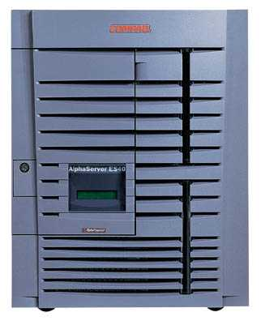
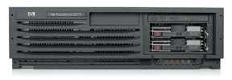
Cross-Site Request Forgery (CSRF)
Server Victim
establish session
1
send forged request
4
(w/ cookie)
2
User Victim
3
visit server (or iframe)
receive malicious page
Attack Server

Slide 23
Solving the Confused Deputy Problem
Server: operation( f : file )
S1: buffer := FileSys.Read( f )
S2: results := F( buffer ) S3: diff:= calcDiff( results ) S4: FileSys.Write( f , results ) S5: FileSys.Write( log.txt, diff) end Server
Notes:
Solution: check client permissions inline. Impractical (usability)? Relation to IF…
Solution: sub-program protection domains (usability)
Soultion: combine name with privileges… See capability lists

Slide 24
Capability Lists
Notes:
Example: Android apps
More on this next time

