Slide 1
Lecture 12: Passwords
CS 181S October 24, 2018

Slide 2
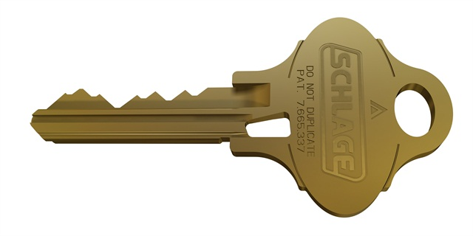
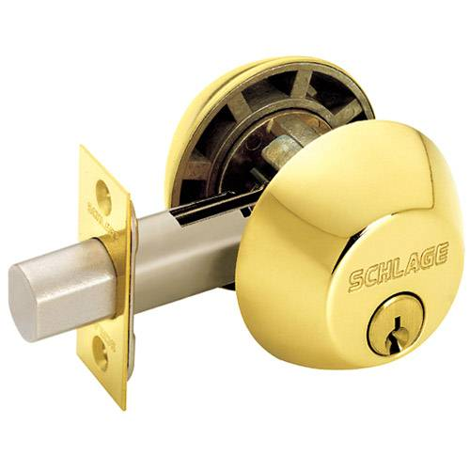
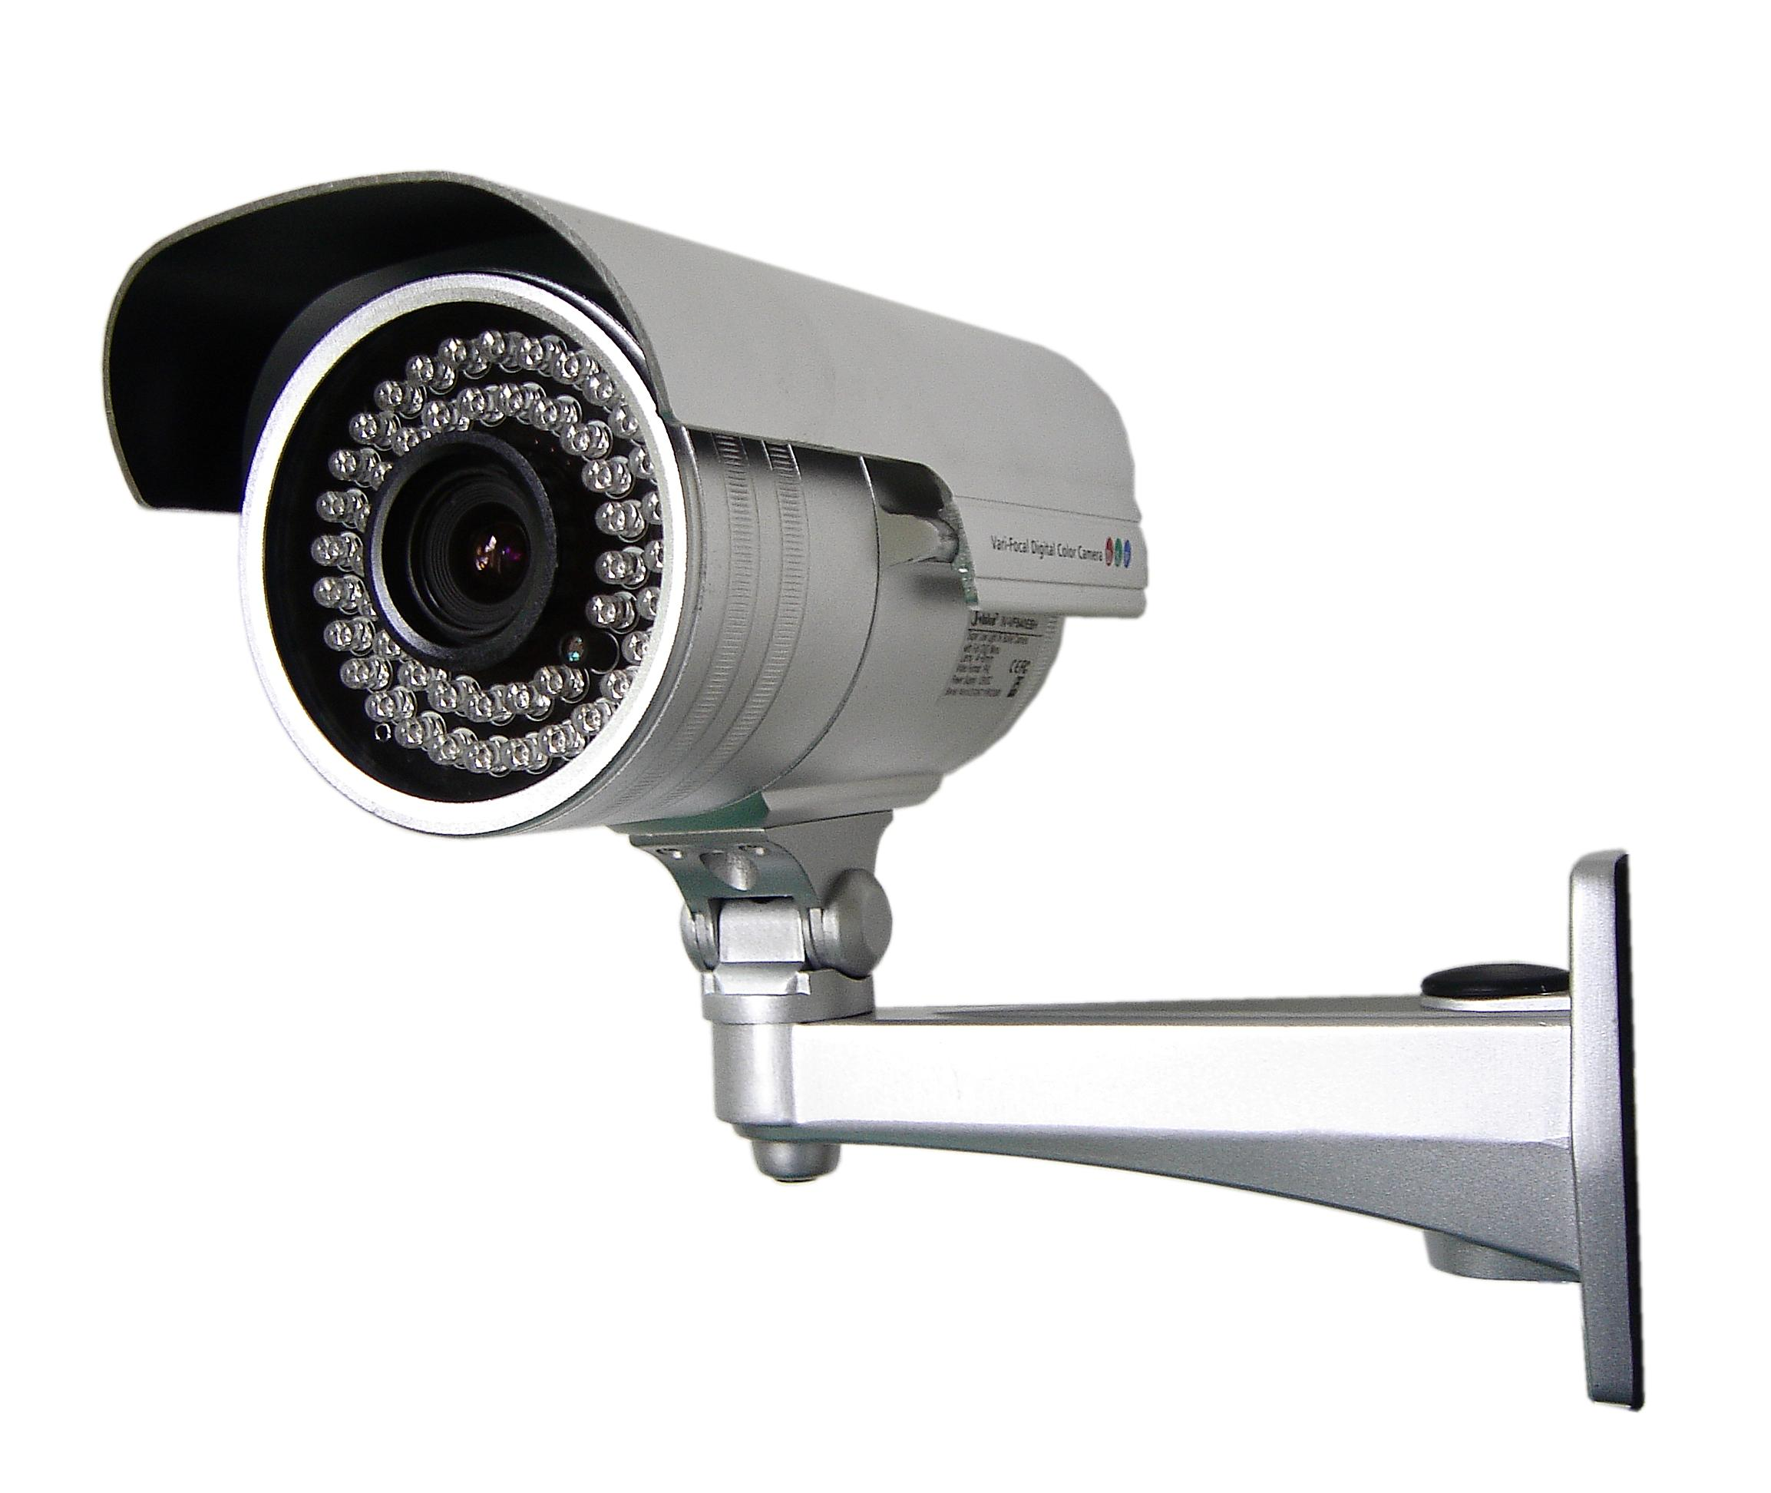
Where we were…
Authentication: mechanisms that bind principals to actions
Authorization: mechanisms that govern whether actions are permitted
Audit: mechanisms that record and review actions
Notes:
Examples:
Authentication: passwords, digital signatures, EV certificates in browsers
Authorization: file permissions, firewalls, visibility restrictions in FB
Audit: log files, log browsers, intrusion detection systems

Slide 3
Where we were…
Authentication: mechanisms that bind principals to actions
  Authenticating Humans
  Authenticating Machines
  Authenticating Programs

Slide 4
Where we were…
Something you are
  fingerprint, retinal scan, hand silhouette, a pulse
Something you know
  password, passphrase, PIN, answers to security questions
Something you have
  physical key, ticket, {ATM, prox, credit} card, token

Slide 5
Password lifecycle
Create: user chooses password
Store: system stores password with user identifier
Use: user supplies password to authenticate
Change/recover/reset: user wants or needs to change password

Slide 6
1. password Creation

Slide 7
Who creates?
User
Notes:
User: typically guessable passwords
System:
can produce hard-to-guess passwords (e.g., random ASCII character strings)
but users can't remember them
some systems use default passwords (bad!)
Administrator: reduces to one of the above

Slide 8
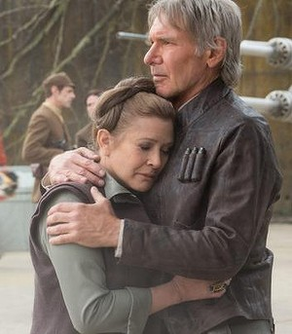
Weak passwords
Top 10 passwords in 2017:
  123456
  password
  12345678
  qwerty
  12345
  123456789
  letmein
  1234567
  football
  iloveyou
16: starwars, 27: jordan23, 28: harley
Top 20 passwords suffice to compromise 10% of accounts
Notes:
Password frequency source: https://www.teamsid.com/worst-passwords-2017-full-list/
Password distribution source: [Skyhigh Networks]

Slide 9
Who creates?
User
System
Administrator
Notes:
User: typically guessable passwords
System:
can produce hard-to-guess passwords (e.g., random ASCII character strings)
but users can't remember them
some systems use default passwords (bad!)
Administrator: reduces to one of the above

Slide 10
Strong passwords
How to characterize strength?
One Approach: Difficulty to brute force—"strength" or "security level"
  Recall: if 2^X guesses required, strength is X
Suppose passwords are L characters long from an alphabet of N characters
  Then N^L possible passwords
  Solve for X in 2^X = N^L
  Get X = L log₂ N
  This X is aka entropy of password
    Assuming every password is equally likely, X is the Shannon entropy of the probability distribution (cf. Information Theory)

Slide 11
Entropy of passwords
Option A: 8 character passwords chosen uniformly at random from 26 character alphabet
  entropy of 8 log₂ 26 ≈ 37 bits
  but that means abcdefgh equally likely as ifhslgqz
Option B: 1 word chosen at random from entire vocabulary
  average high-school graduate: 50k word vocabulary
  entropy of log₂ 50k ≈ 16 bits

Slide 12
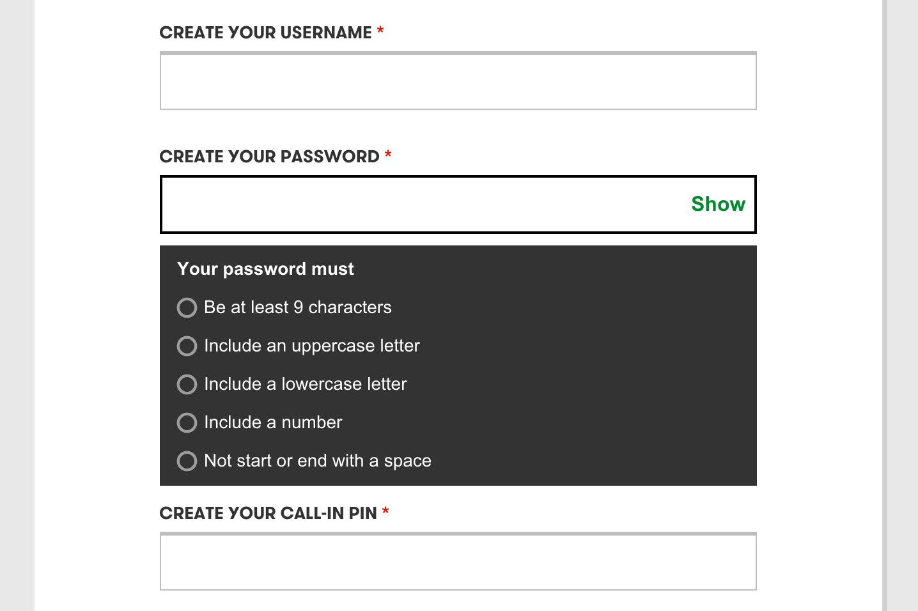
Password Recipes
Problem: guide users into choosing strong passwords
Solution: password recipes are rules for composing passwords
  e.g., must have at least one number and one punctuation symbol and one upper case letter
Notes:
https://www.ece.cmu.edu/~lbauer/papers/2012/oakland2012-guessing.pdf

Slide 13
Entropy estimation
Entropy estimates [NIST 2006 based on experiments by Shannon]:
  (assuming English and use of 94 characters from keyboard)
  1st character: 4 bits
  next 7 characters: 2 bits per character
  characters 9..20: 1.5 bits per character
  characters 21+: 1 bit per character
  user forced to use lower & upper case and non-alphabetics: flat bonus of 6 bits
  prohibition of passwords found in a 50k word dictionary: 0 to 6 bits, depending on password length

Slide 14
Entropy estimation
But:
"[NIST's] notion of password entropy...does not provide a valid metric for measuring the security provided by password creation policies."
Underlying problem: Shannon entropy not a good predictor of how quickly attackers can crack passwords
Notes:
[Weir et al. 2010]:

Slide 15
Password Cracking
Evaluate recipes based on
  percentage of passwords cracked
  number of guesses required to crack
Example recipes:
  ≥ 8 characters
  ≥ 8 characters, no blacklisted words ...with various blacklists
  ≥ 8 characters, no blacklisted words, one uppercase, lowercase, symbol, and digit ("comprehensive", c8)
  ≥ 16 characters ("passphrase", b16)
Results...
Notes:
[Kelley et al. 2012]: https://www.ece.cmu.edu/~lbauer/papers/2012/oakland2012-guessing.pdf

Slide 16
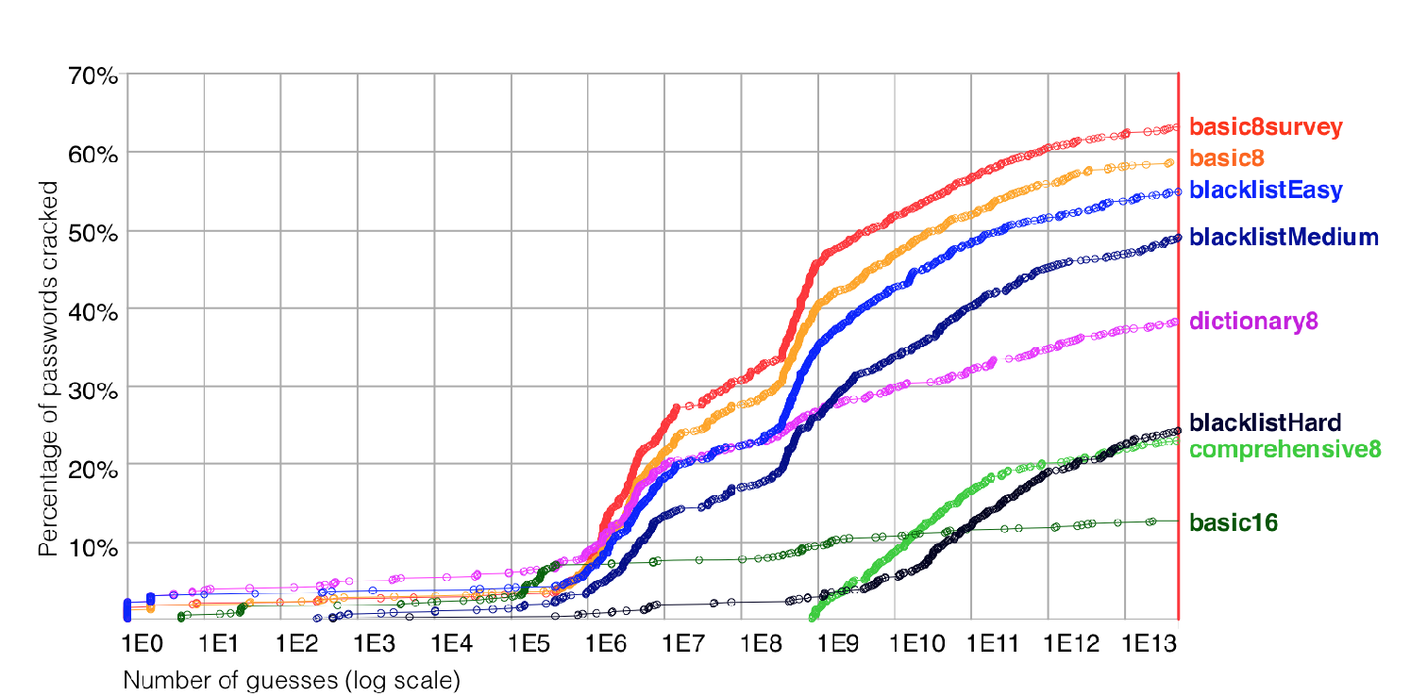
Recipe comparison
Notes:
http://ieeexplore.ieee.org/stamp/stamp.jsp?arnumber=6234434
basic8survey: 8 char password, survey scenario
basic8: 8 char password, email scenario
blacklistEasy: 8 char, no dictionary word
blacklistMedium: 8 char, no dictionary word, better dictionary
dictionary 8: 8 char, may not contain dictionary word, removed non-alphabetic chars before checking
blacklistHard: 8 char, blacklist created from cracked list instead of english dictionary
comprehensive8: 8 char, including an uppercase and lowercase letter, a symbol, and a digit. It may not contain a dictionary word.
basic16: 16 char password
[a warning on targeted attacks]: IBM red team using 80 GPUs w/ Windows' NT LAN Manager hash format cracked basic 8 char passwords (incl upper case num chars) in 30 seconds-9 minutes, avg 45mins-max 1.5hrs for full keyboard characters https://securityintelligence.com/the-inconvenient-truth-about-your-eight-character-password/

Slide 17
Recipe comparison
Comprehensive recipe (comprehensive8) makes it hard to crack passwords
  Doesn’t that contradict [Weir 2010]?
  No: even if NIST's Shannon entropy estimates are quantitatively invalid in general, c8 in particular is hard to crack
But blacklists make passwords almost as hard to crack
And passphrases (basic16) are hard to crack and are more usable [Komanduri et al. 2011]:
  Easier to create
  Easier to remember
  Threat to validity: maybe state-of-art crackers would improve to handle passphrases if people were required to use them
Notes:
http://www.guanotronic.com/~serge/papers/chi11b.pdf

Slide 18
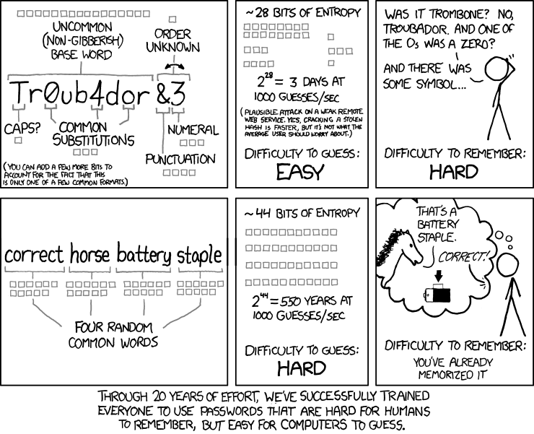

Slide 19
Passwords
NIST (2017) recommends:
minimum of 8 characters
up to 64 characters should be accepted
blacklist compromised values
no other security requirements
Notes:
https://pages.nist.gov/800-63-3/sp800-63b.html#memsecret

Slide 20
2. password Storage

Slide 21
Password Storage
Passwords typically stored in a file or database indexed by username
Strawman idea: store passwords in plaintext
  requires perfect authorization mechanisms
  requires trusted system administrators
  ...

Slide 22
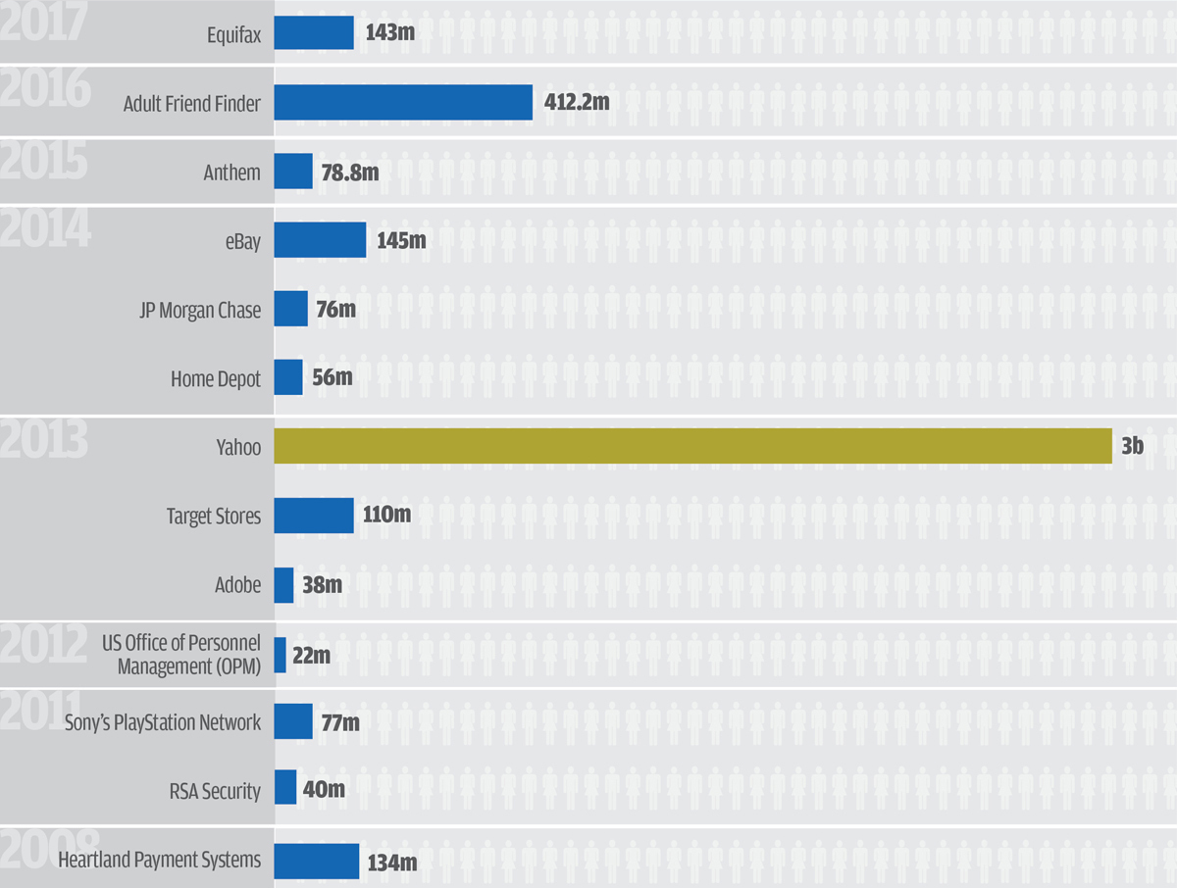
Threat Model: Offline Attack
Adversary can read files from disk
Adversary can read process memory
Note: users make this worse by reusing passwords across systems.
Notes:
73% of accounts use duplicated passwords (US & UK sample)
54% of users us <=5 passwords for everything
47% of users rely on passwords that haven't been changed in 5 years
https://www.telesign.com/resources/research-and-reports/telesign-consumer-account-security-report/

Slide 23
Password Storage
Want: a function f such that...
  easy to compute and store f(p) for a password p
  hard given disclosed f(p) for attacker to recover p
  hard to trick system by finding password q s.t. q != p yet f(p) = f(q)
Encryption would work, but then the key has to live somewhere
Cryptographic hash functions suffice!
  one-way property gives (1) and (2)
  collision resistance gives (3)

Slide 24
Hashed passwords
Each user has:
  username uid
  password p
System stores: uid, H(p)
Notes:
[On board]: authentication protocol
Discuss: Why not 3'. L->S: uid, h(p)
Counterintuitive: From user’s perspective, sending plaintext password is better!
When password database leaked, 3’ immediately enables attacker to authenticate, whereas 3 forces attacker to invert hash
From the two machines’ perspectives, about the same: one hash computation
From DY adversary’s perspective, the same: can replay either message if security of channel is broken

Slide 25
Hashed passwords are still vulnerable
Assume: attacker does learn password file (offline guessing attack)
Hard to invert: i.e., given H(p) to compute p
But what if attacker didn't care about inverting hash on arbitrary inputs?
  i.e., only have to succeed on a small set of p's: p1, p2, ..., pn
Then attacker could build a dictionary...

Slide 26
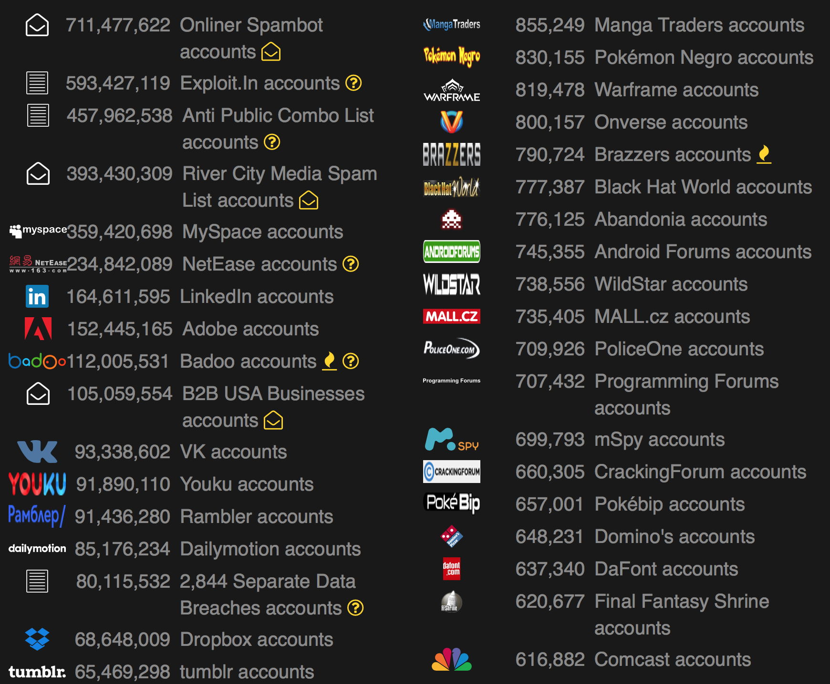
Dictionary attacks
Dictionary:
  p1, H(p1)
  p2, H(p2)
  ...
  pn, H(pn)
Dictionary attack: lookup H(p) in dictionary to find p
And it works because most passwords chosen by humans are from a relatively small set
Notes:
aka offline guessing attacks
https://haveibeenpwned.com/PwnedWebsites

Slide 27
Typical passwords
[Schneier quoting AccessData in 2007]:
7-9 character root plus a 1-3 character appendage
  Root typically pronounceable, though not necessarily a real word
  Appendage is a suffix (90%) or prefix (10%)
Dictionary of 1000 roots plus 100 suffixes (= 100k passwords) cracks about 24% of all passwords
More sophisticated dictionaries crack about 60% of passwords within 2-4 weeks
Given biographical data (zip code, names, etc.) and other passwords of a user...
  success rate goes up a little
  time goes down to days or hours

Slide 28
Salted hashed passwords
Vulnerability: one dictionary suffices to attack every user
Vulnerability: passwords chosen from small space
Countermeasure: include a unique system-chosen nonce as part of each user's password
Notes:
make every user's stored hashed password different, even if they chose the same password
make passwords effectively be from larger space

Slide 29
Salted hashed passwords
Each user has:
  username uid
  unique salt s
  password p
System stores: uid, s, H(s, p)
Notes:
[On board]: authentication protocol
Salt needs to be unique even across systems; easiest way to achieve is to choose randomly
Length of salt should be related to strength of cryptography employed in rest of system
[Evaluation]: https://securityintelligence.com/the-inconvenient-truth-about-your-eight-character-password/

Slide 30
3. password Usage

Slide 31
Authenticating to a remote server
Each user has:
  username uid
  unique salt s
  password p
System stores: uid, s, H(s, p)
1. Hu->L: uid, p
2. L and S: establish secure channel
3. L->S: uid, p
4. S: let h = stored hashed password for uid;
let s = stored salt for uid;
if h = H(s, p)
then uid is authenticated
Notes:
Salt needs to be unique even across systems; easiest way to achieve is to choose randomly
Length of salt should be related to strength of cryptography employed in rest of system

Slide 32
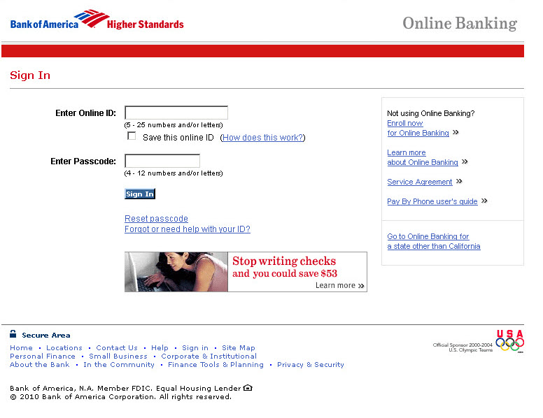
Threat Model: Online Attack
Adversary can interact with the server as a user

Slide 33
When authentication fails
Guiding principle: the system might be under attack, so don't make the attacker's job any easier
Don't leak valid usernames:
  Prompt for username and password in parallel
  Don't reveal which was bad
Record failed attempts and review
  Perhaps in automated way by administrators
  Perhaps manually by user at next successful login
Lock account after too many attempts
Rate limit login

Slide 34
Rate limiting
Vulnerability: hashes are easy to compute
Countermeasure: hash functions that are slow to compute
  Slow hash wouldn't bother user: delay in logging hardly noticeable
  But would bother attacker constructing dictionary: delay multiplied by number of entries
  Ideally, enough to make constructing a large dictionary prohibitively expensive
Examples: bcrypt, scrypt, Argon2,...
Notes:
scrypt recommended for memory hardness

Slide 35
Slowing down fast hashes
Given a fast hash function...
Slow it down by iterating it many times:
z1 = H(p);
z2 = H(p, z1);
...
z1000 = H(p, z999);
output z1 XOR z2 XOR ... XOR z1000
Number of iterations is a parameter to control slowdown
  originally thousands
  current thinking is 10s of thousands
Aka key stretching

Slide 36
Password-Based Encryption
PBKDF2: Password-based key derivation function [RFC 8018]
Output: derived key k
Input:
  Password p
  Salt s
  Iteration count c
  Key length len
  Pseudorandom function (PRF): "looks random" to an adversary that doesn't know an input called the seed (commony instantiated with an HMAC)

Slide 37
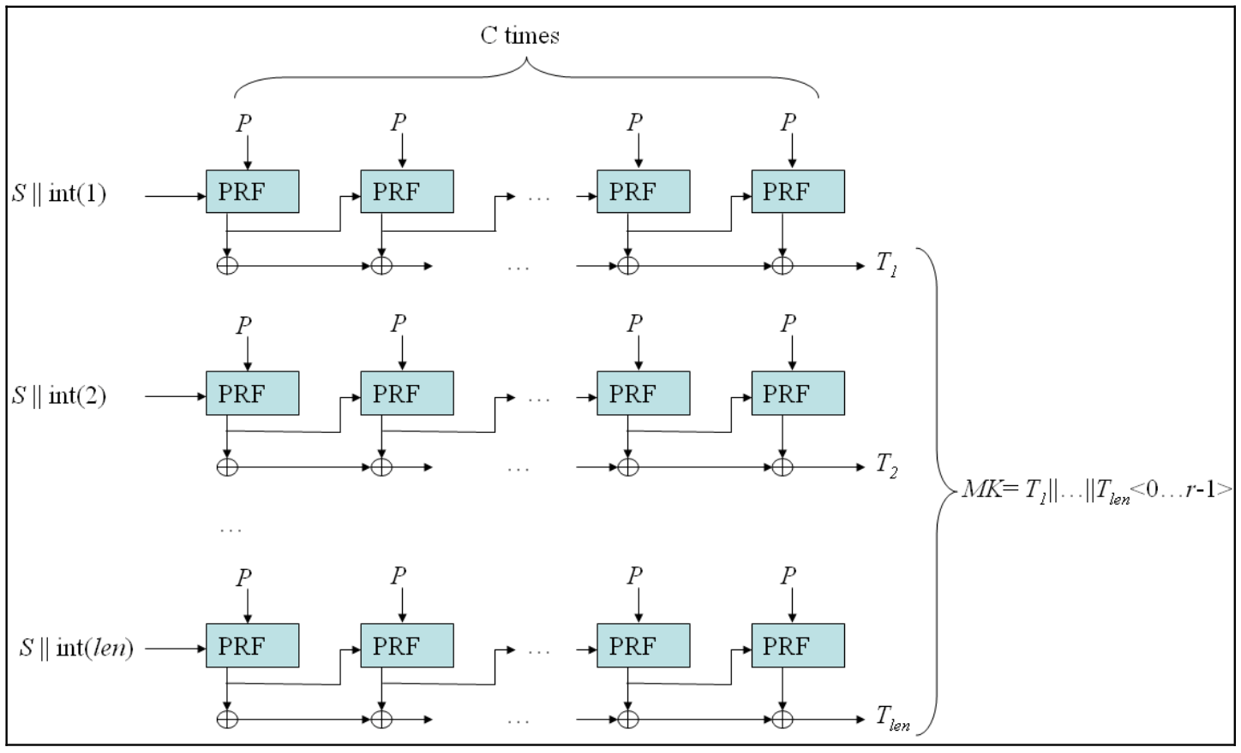
PBKDF2
Algorithm:
F(p, s, i, c) = U(1) XOR ... XOR U(c)
  U(1) = PRF(s, i; p)
  U(j) = PRF(U(j-1); p)
  F is in essence a salted iterated hash...
k = F(p, s, 1, c) || F(p, s, 2, c) || ... || F(p, s, n, c)
  enough copies to reach keylen
  || denotes bit concatenation
Notes:
Could use to store passwords
F(p,s,c,1) is essentially what we agreed to store for salted and iterated-hash protected passwords
But easier to attack speed than scrypt/bcrypt
Note: Argon2 also key derivation, but less standard

Slide 38
4. password Change

Slide 39
Password change
Motivated by...
User forgets password (maybe just recover password)
System forces password expiration
  Naively seems wise
  Research suggests otherwise
Attacker learns password:
  Social engineering: deceitful techniques to manipulate a person into disclosing information
  Online guessing: attacker uses authentication interface to guess passwords
  Offline guessing: attacker acquires password database for system and attempts to crack it
Notes:
[Cranor 2016]: https://www.ftc.gov/news-events/blogs/techftc/2016/03/time-rethink-mandatory-password-changes
When users do change passwords, they change them predictably
Foreknowledge of expiration causes users to choose weaker passwords

Slide 40
Change mechanisms
Tend to be more vulnerable than the rest of the authentication system
  Not designed or tested as well
  Have to solve the authentication problem without the benefit of a password
Two common mechanisms:
  Security questions
  Emailed passwords

Slide 41
Security questions
Something you know: attributes of identity established at enrollment
Pro: you are unlikely to forget answers
Assumes: attacker is unlikely to be able to answer questions
Con: might not resist targeted attacks
Con: linking is a problem; same answers re-used in many systems

Slide 42
Emailed password
Might be your old password or a new temporary password
  one-time password: valid for single use only, maybe limited duration
Assumes: attacker is unlikely to have compromised your email account
Assumes: email service correctly authenticates you

Slide 43
Password lifecycle
Create: user chooses password
Store: system stores password with user identifier
Use: user supplies password to authenticate
Change/recover/reset: user wants or needs to change password

Slide 44
Beyond passwords?
Passwords are tolerated or hated by users
Passwords are plagued by security problems
Can we do better?
Criteria:
  Security
  Usability
  Deployability
Notes:
[Bonneau et al. 2012] https://www.cl.cam.ac.uk/~fms27/papers/2012-BonneauHerOorSta-password--oakland.pdf

Slide 45
Schemes to replace passwords
Password managers
Proxies
Federated identity management
Graphical
Cognitive
Paper tokens
Visual cryptography
Hardware tokens
Phone-based
Biometric

Slide 46
Schemes to replace passwords
Most schemes do better than passwords on security
Some schemes do better and some worse on usability
Every scheme does worse than passwords on deployability
Passwords are here to stay, for now
Schemes offering some variation of single sign on seem to offer best improvements in security and usability...
Notes:
[Bonneau et al. 2012] https://www.cl.cam.ac.uk/~fms27/papers/2012-BonneauHerOorSta-password--oakland.pdf

