Slide 1
Lecture 11: Human Authentication
CS 181S October 10, 2018

Slide 2


In the news…
Notes:
https://www.theregister.co.uk/2018/10/08/google_plus_minus/
Kaspersky Labs took credit for discovering and reporting the active attacks on CVE-2018-8453. This elevation of privilege flaw in the way Win32K handles drivers allows attackers to run their code with kernel mode access, granting the ability to do things like create new accounts and full ability to write or delete data. Vulnerabilities in Windows 7,8, and 10 and in Windows Server https://www.theregister.co.uk/2018/10/09/october_patch_tuesday/

Slide 3
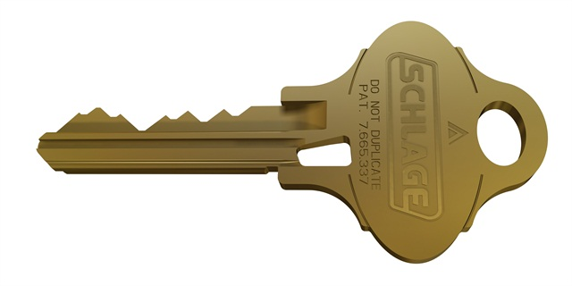
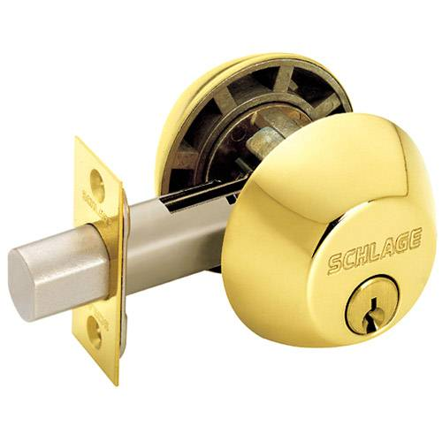
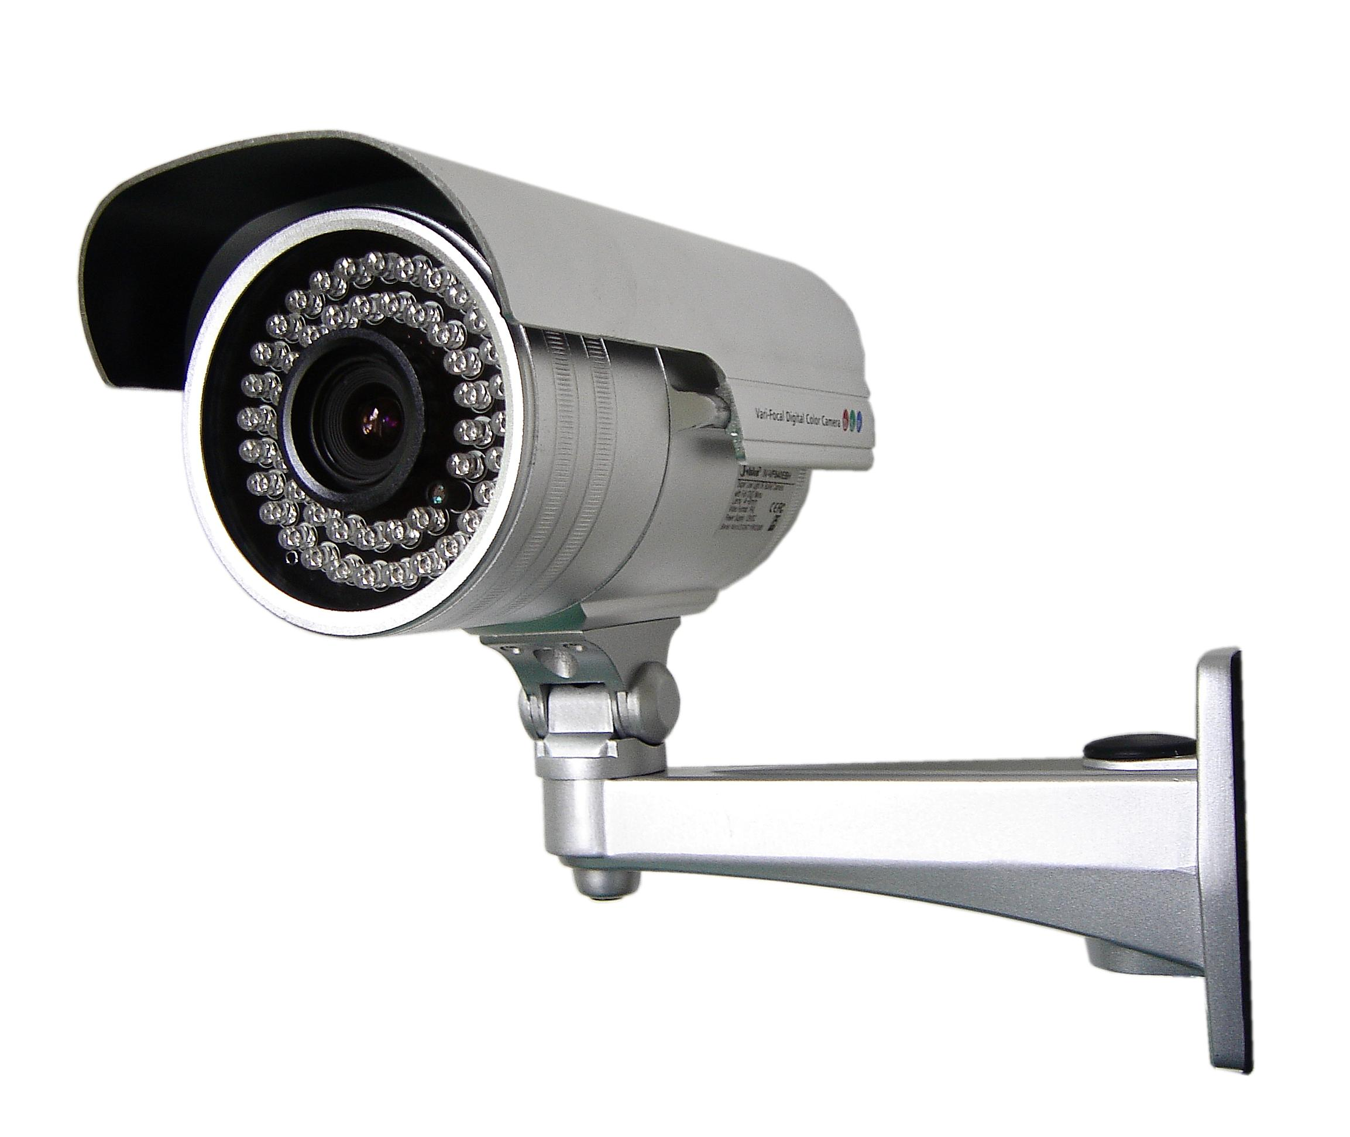
Classes of Countermeasures
Authentication: mechanisms that bind principals to actions
Authorization: mechanisms that govern whether actions are permitted
Audit: mechanisms that record and review actions
Notes:
Examples:
Authentication: passwords, digital signatures, EV certificates in browsers
Authorization: file permissions, firewalls, visibility restrictions in FB
Audit: log files, log browsers, intrusion detection systems

Slide 4
Classes of Principals
Authentication: mechanisms that bind principals to actions
  Authenticating Machines
  Authenticating Programs
  Authenticating Humans

Slide 5
Identity

Slide 6
Personal identity
Major philosophical problem
  People are not identical to themselves over time, but their identity persists throughout changes
  cf. Ship of Theseus
Intrinsic identity: continuation of consciousness
Extrinsic identity: relationship to everything else
Control: individual's, others', no one's?
Notes:
Ship of Theseus [Plutarch,1st century] Is it still the same ship after every board has been replaced? What if the original boards were gathered and used to build the same model ship? Would it be identical?
Discussion: how do you identify people?
You control your clothing choices, others control the ID numbers assigned to you, no one controls your age.

Slide 7
Digital identity
Digital identity: data that describes a person and its relationship to others
  not the person itself; not a personal identity
A person could have many digital identities, some overlapping, some contradictory
Data could be incorrect, outdated, incomplete
Notes:
fictional people, dead people, virtual people (AIs?)

Slide 8
Aspects of digital identity
Name
NetID
Email address
URL
IP address
Citizenship
Political party
...

Slide 9
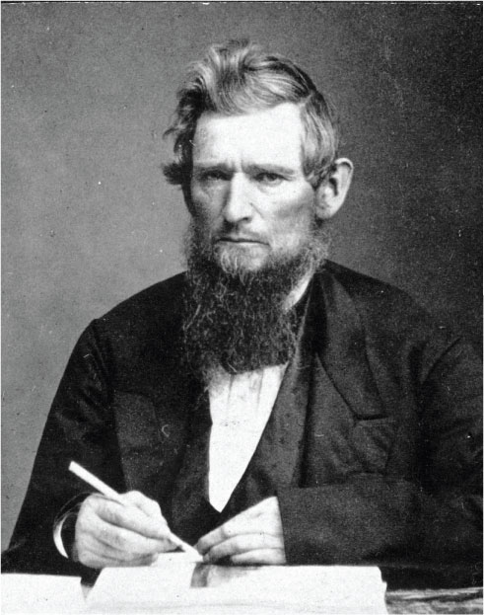
Identity
Attribute: property of a principal
  name is "James Blaisdell", birthdate is 12/15/1867, mother's maiden name is Grassie
Identity: set of attributes
  each principal may have many identities of use in different scenarios (student, taxpayer, athlete)
Identifier: an attribute that is unique within a population
Verifier: an attribute that is hard to produce hence can be used as a basis for authentication

Slide 10
Identity
Enrollment: establishing identity with a system
  Create an account
  Get an ID card, visa
  Register a machine on a network
  Get a signing key from a provider
System might (not) verify claimed attributes during enrollment
  Websites rarely do
  Governments often do

Slide 11
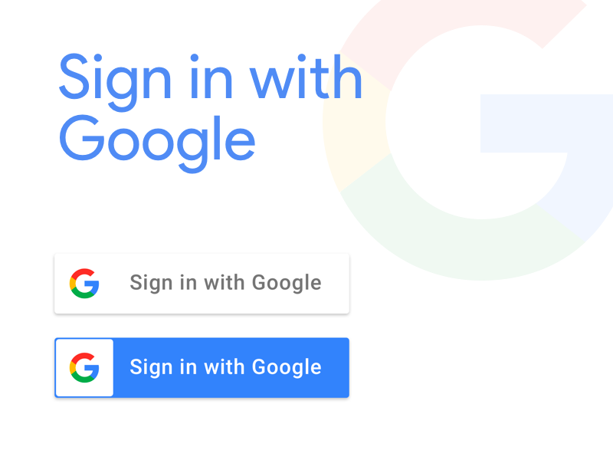

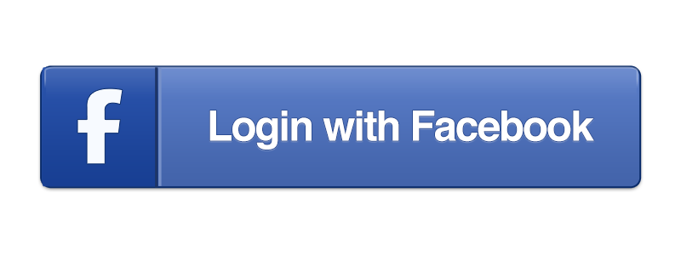
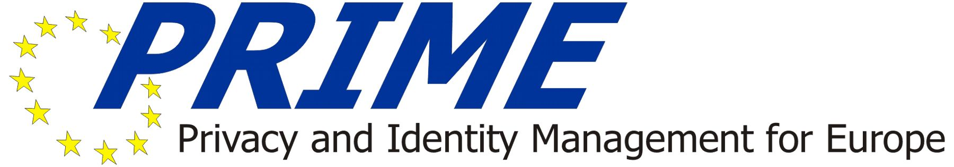
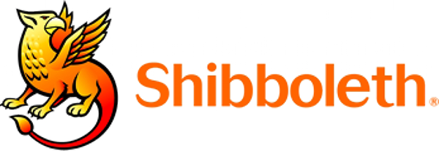
Identity Management Systems

Slide 12
Human Authentication

Slide 13
Authentication of humans
Categories: [IBM, TR G520-2169, 1970]
Something you are
  fingerprint, retinal scan, hand silhouette, a pulse
Something you know
  password, passphrase, PIN, answers to security questions
Something you have
  physical key, ticket, {ATM, prox, credit} card, token
Notes:
Discussion: different possible examples
Note: bring in border cases (e.g., A sheet of passwords, each valid only once, could be "know" or "have." A finger could be "have" or "are.")

Slide 14
Authentication of humans
Two-factor authentication: authenticate based on two independent methods
  ATM card plus PIN
  password plus registered mobile phone
Multi-factor authentication: two or more independent methods
Best to combine separate categories, not reuse categories
  non-example: requiring two passwords from a single human: arguably not independent
  non-example: requiring single password from each of two humans: authenticates two humans then makes authorization decision

Slide 15
Something you Are

Slide 16
Biometric
Biometric: measurement of biological and behavioral attributes (something you are)
  biological attributes can be confounded by behavior
  biology and behavior is non-constant: variation from one measurement to the next
Notes:
Fingerprint is by far most common; not great for error rates but serves as a good deterrant.
Iris is by far the best for error rates (even zero FAR) and for measurement, so long as individuals are willing to get close to the camera

Slide 17
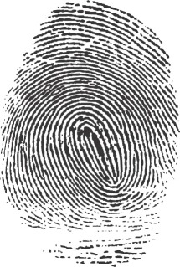
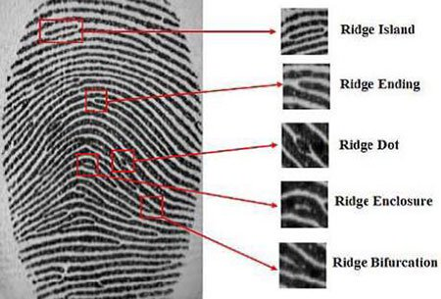
Example: Fingerprint
Particular use: California social services
  prevent applicants for welfare from defrauding state by receiving assistance under multiple identities
Fingerprint stored as bitmap and as minutae
  When user authenticates, computer compares minutiae
  If they match, human additionally reviews bitmap images (about 15 out of 10000 authentications have minutiae match even though fingerprints do not)
Notes:
Used as identifiers since 19th century

Slide 18
Example: Hand geometry
Used in 2012 Olympic Games, Walt Disney World, nuclear facilities, data centers, ...
Camera images palm and side of hand (no texture information)
Images reduced to (e.g.) 31000 points then 90 measurements then 9 bytes of data
  Final data not directly related to any source measurements
  Data stored as a template for later comparison
When user authenticates, another set of images taken
  If data are close enough to stored template, user deemed authenticated
  Can adjust threshold per-user, in case some users are difficult to authenticate
Each time user is authenticated, template is updated to account for change over time
Notes:
longest biometric in use in modern computing systems (1980s)
Disney parks: used in conjunction with passes

Slide 19
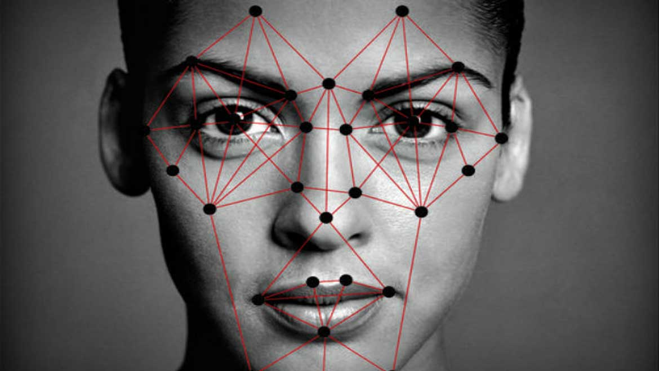
Example: Facial recognition
Used in border control, Facebook, iPhone X
Operates on 2D image or depth map
Modern systems use ML classifiers to identify matches
  Most systems perform poorly on profiles, low-res images
  Most systems perform less well on women and minorities

Slide 20
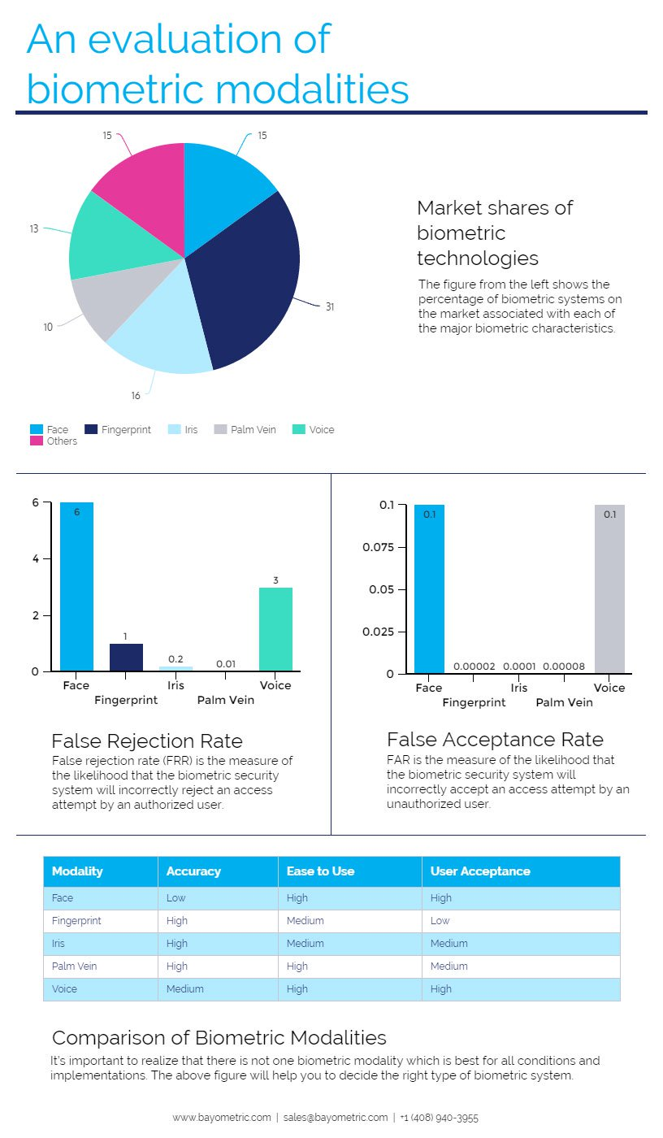
Other Biometrics
Notes:
Discussion: what biometrics have people seen/heard of in the real world?
Example: Aadhaar (Indian universal ID, uses photograph, fingerprints, iris scans)
fingerprint, iris, retina, face, voice, handwriting, hand shape, hand veins, hand print, (DNA?)

Slide 21
Biometric attributes as verifiers
Advantages:
  Can't lose or forget a biometric
  Easy to use some biometrics (e.g., fingerprint scan vs. PIN on iPhone)
Disadvantages:
  Updating identities after disclosure is hard (new fingerprints? new retina?)
    So enrolling a biometric identifier places permanent trust in receiver, even if they go bankrupt, retroactively change privacy policies, get taken over by new administration, ...
  Impossible to be application specific (your hand geometry is the same regardless of what system you use)
  Physical process with errors...
  Fear of negative implications for privacy...

Slide 22
Biometric attributes as verifiers
Requirements:
Identifier
Easy to measure
Small variation over time and measurement
Difficult to spoof
Acceptable to users
Notes:
Discussion: what do we want to look for in a biometric identifier?

Slide 23
Evaluating Biometrics
Notes:
Discussion: what might we want to consider?

Slide 24
Accuracy
False accept: authenticate a principal with wrong identity (fraud)
False reject: fail to authenticate a principal under right identity (insult)
Hypothesis testing:
  null hypothesis: human being authenticated has claimed identity
  false reject = type I error
  false accept = type II error
Tunable trade off of sensitivity between which error is more likely
  False acceptance rate (FAR): percentage of attempts in which imposters are authenticated (with wrong identity)
  False reject rate (FRR): percentage of attempts in which legitimate users are denied authentication

Slide 25
Sensitivity
  Receiver operating characteristics (ROC) curve: graph of FRR vs. FAR (or perhaps 1-FAR, perhaps nonlinear axes)
  γ = sensitivity
Notes:
ROC comes from radar operation in WW2: turn up gain on radar too high and enemy is lost in clutter; too low, can't see at all.
UK banks in 1996 set a goal of FAR=1% and FRR=.01% for biometrics.
Strictly speaking, some people would say ROC is (1-FAR) vs FRR and detection error tradeoff (DET) curve is FAR vs FRR on axes scaled by standard normal deviates or just logarithmically [Wikipedia!]
Graph source: http://www.csee.wvu.edu/~natalias/biom426/performance_fall09.pdf

Slide 26
ROC comparison
Two matchers (A=solid; B=dashed)
At point C, matchers have same FAR and FRR
To the left of C, matcher A has lower FRR for same FAR
To the right, matcher B has lower FRR for same FAR
Notes:
Graph source: http://www.csee.wvu.edu/~natalias/biom426/performance_fall09.pdf

Slide 27
ROC comparison
Crossover error rate (CER): value on ROC at which FAR=FRR (aka equal error rate, ERR)
Many other statistics for comparison possible
  Anytime a graph is reduced to a single number, we lose information
What matters most for biometrics is the use case/threat model

Slide 28
Use cases
Entry to military facility:
  letting imposters in might be worse than (temporarily) delaying entry of personnel
  so prefer low false accept rate
Entry to hotel lobby:
  letting non-guests in might be better than (temporarily) delaying entry of guests
  so prefer low false reject rate
Notes:
Note: connect back to threat model
Activity:
Construct a new, plausible scenario in which false accepts would be far more problematic than false rejects.
Construct a new, plausible scenario in which false rejects would be far more problematic than false accepts.

Slide 29
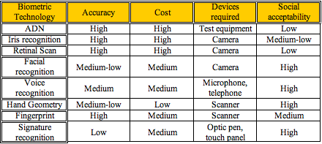
Comparing Biometrics

Slide 30
Spoofing
Active adversary fools sensor with artificial object
Solution:
  better sensors
  better biometrics
  multi-factor authentication

Slide 31
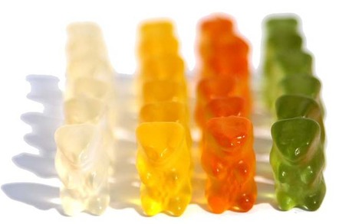
Gummy Bear Attack
Notes:
First demonstrated by Tsutomu Matsumoto in 2002, effective against modern fingerprint readers (e.g., iPhone)
https://www.theregister.co.uk/2002/05/16/gummi_bears_defeat_fingerprint_sensors/

Slide 32
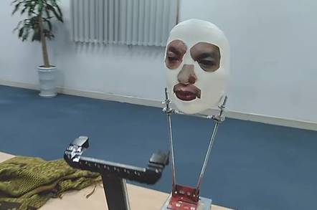
Face ID Attack
Notes:
In November 2017, Bkav Corporation, an tech security company, demonstrated how to bypass the face recognition system on the iPhone X with a $150 3D printed mask.
http://www.bkav.com/FaceID
https://www.youtube.com/watch?v=i4YQRLQVixM

Slide 33
Privacy concerns
Humans might have concerns about measurements (have photo taken, parts of body scanned)
Humans might not want to disclose attributes during enrollment (SSN, political party)
Humans might not want action bound to their identity (buying medication)
Humans might not want their actions linked to other actions, exposing them to inference about what they thought were unrelated activities.
Notes:
India uses biometric based identity cards (Aadhaar); data includes photos, fingerprints, iris scans. In january 2018, journalists reported they were able to access records for 500 rupees ($8.75); unclear if access was being sold by hackers or insiders.

Slide 34
Privacy and biometrics
Biometrics can violate intrinsic privacy by requiring submission to bodily contact or measurement
  Fear of germs
  Religious prohibitions
Biometrics can violate informational privacy
  Biometric identifiers might effectively become a standard, universal identifier, enabling linking

Slide 35
Principles for privacy
When building authentication systems...
Seek consent: get permission to authenticate and store identity
Select minimal identity: use the smallest possible set of attributes
Limit storage: don't save information about identity or authentication without need, and delete when no longer needed
Avoid linking: don't reuse identifiers across systems

