Slide 1
Lecture 10: Authenticating Machines
CS 181S October 8, 2018

Slide 2
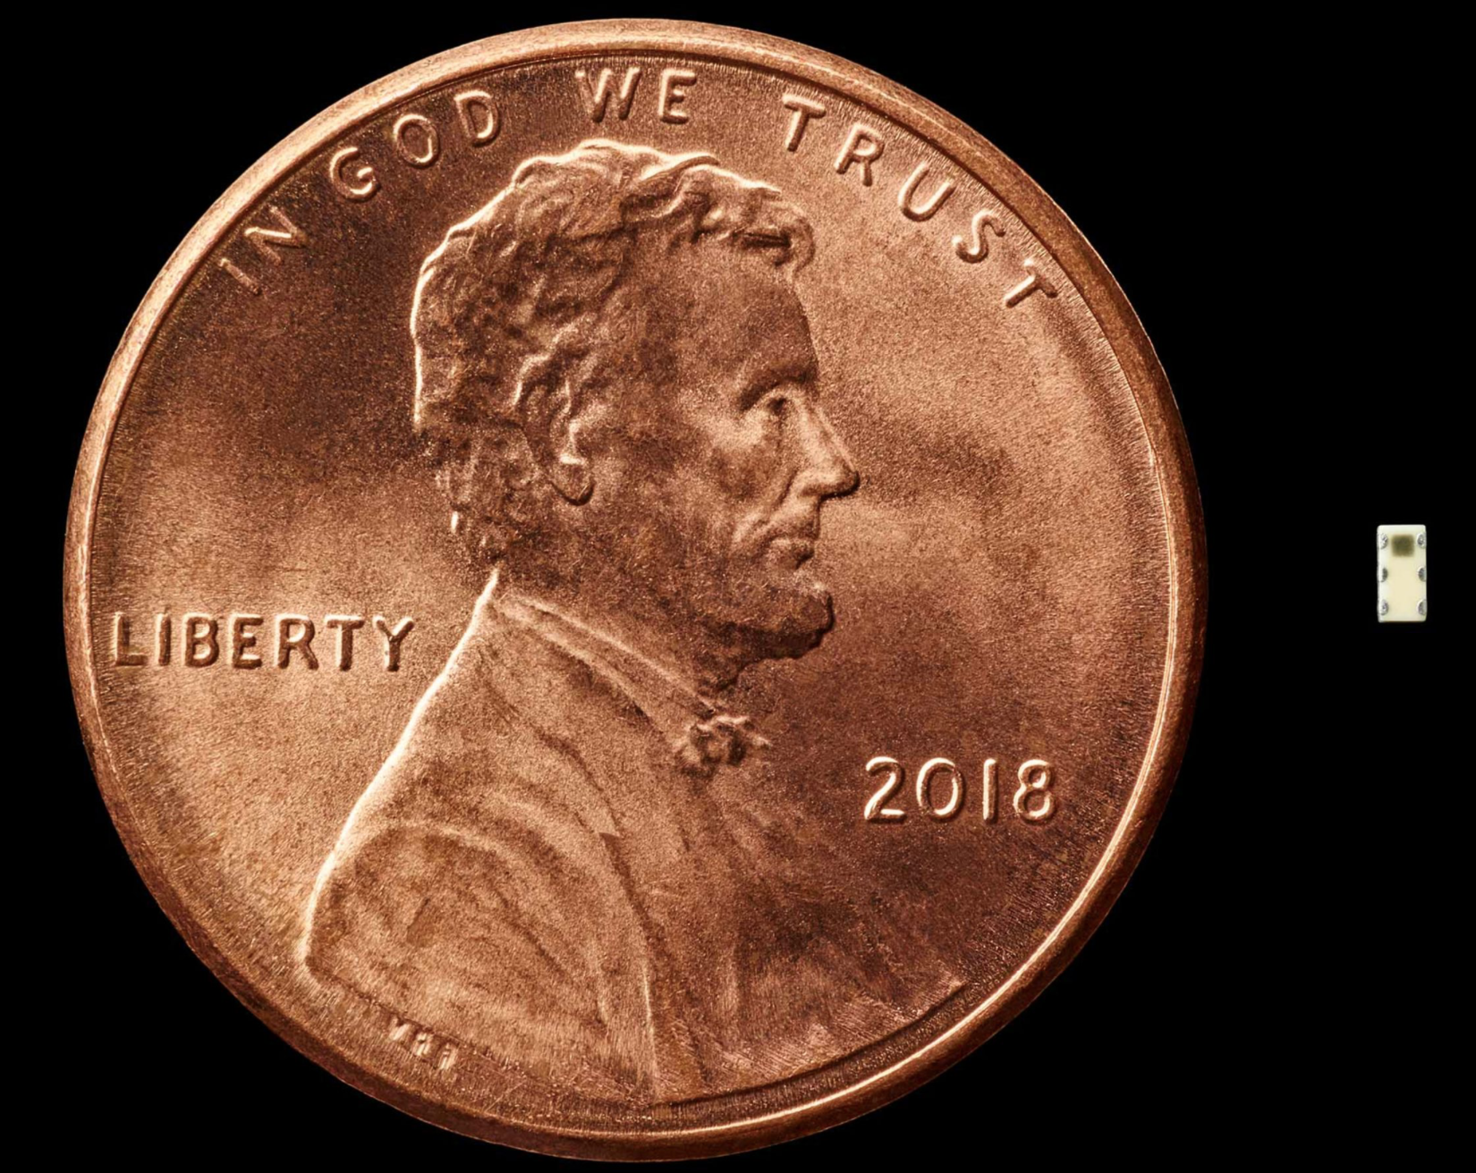
Supply Chain Security
Notes:
https://www.bloomberg.com/news/features/2018-10-04/the-big-hack-how-china-used-a-tiny-chip-to-infiltrate-america-s-top-companies
https://www.theregister.co.uk/2018/10/04/supermicro_bloomberg/

Slide 3
Authentication with Symmetric Encryption
KDC
1. A, B, nA
2. Enc(B,nA,kAB,
Enc(A,kAB;kB);kA)
A
B
3. Enc(A,kAB;kB)
4. Enc(nB;kAB)
5. Enc(nB-1;kAB)
Notes:
Messages 4 and 5 intended to convince B that kAB is fresh,
Without having to communicate with S.
The minus operation isn’t essential, just needs to be some function.
[Denning and Saco 1981] published attack on freshness.

Slide 4
SSL/TLS Handshake
Version, cipher suites, nonce
ClientHello
Version, cipher suite, nonce,
certificate
ServerHello
ServerKeyExchange
(optional)
ClientKeyExchange
Compute master secret
Compute master secret
ChangeCipherSpec
ChangeCipherSpec
Encrypted Messages

Slide 5
SSL/TLS Handshake
Version, cipher suites, nonce
rC, [ECDH,…]
Version, cipher suite, nonce,
certificate
rS, ECDH, $g^{b}$
rS, ECDH, cert_S
$$g^{a}$$
Compute
ms_p = $g^{ab}$
ms = PRF(ms_p,rC,rS)
Compute
ms_p = $g^{ab}$
ms = PRF(ms_p,rC,rS)
ChangeCipherSpec
ChangeCipherSpec
Encrypted Messages
Notes:
TODO: switch to ECDHE

Slide 6
Certificates
Digital certificate is a signature binding together:
identity of principal
public key of that principal (might be encryption or verification key)
Notation: Cert(S; I) is a certificate issued by principal I for principal S
Cert(S; I) = (id_s, K_S, Sign(id_s, K_S; k_I))
Issuer I is certifying that K_S belongs to subject id_S
Fingerprint: H(Cert(S; I))

Slide 7
Public-key infrastructure (PKI)
System for managing distribution of certificates
Two main philosophies:
Decentralized: anarchy, no leaders
Centralized: oligarchy, leadership by a few elite

Slide 8
PKI Example 1: PGP
Uses a decentralized PKI philosophy
"Pretty Good Privacy" [Zimmerman 1991]
toolset for PKI, encryption, signing of files and emails
OpenPGP is implemented by GNU Privacy Guard (GPG)
Users manage a keyring:
Alice has her own key in her keyring
When Alice meets up with Bob at a key-signing party...
She copies his key into her keyring
She marks Bob as fully or marginally trusted as an introducer
And she copies other keys he might have collected, too
Notes:
PGP, a program implementing encryption and digital signature schemes, was invented by Phil Zimmerman in 1991. He made it and source code publicly available. This was notable as the first time there had been popular open source for public-key cryptography. Zimmerman investigated by US Customs for arms trafficking.The US Customs Service launched a criminal investigation for violation of export laws. High-strength cryptography was classified as a munition, so there was some question that Zimmerman might have been guilty of arms trafficking. After three years, the investigation was dropped.

Slide 9
PKI Example 2: CAs
Uses a centralized PKI philosophy (at least as evolved in marketplace)
Invented (?) by Digital [Gasser et al. 1989], used in early Netscape browsers
Certificate authority (CA): principal whose purpose is to issue certificates

Slide 10
X.509 certificates
[RFC 5280]
Contents of certificate:
subject distinguished name
subject public key (and the algorithm)
issuer distinguished name
serial number (unique within certs issued by this issuer)
validity interval (start and end time)
extensions...
issuer's signature on the above (and the name of the algorithm)

Slide 11
X.509 distinguished names
Originally designed for general purpose directory services
As commonly used in X.509 certificates:
Common name (CN): e.g., a person's full name, a server's name or domain name
Organizational unit (OU): e.g., Finance, HR, CS
(might be many nested OUs...)
Organization (O): e.g., Pomona, Google
Other fields: Street Address, Locality, State, Country, Postal Code, etc.

Slide 12
Certificate examples
https://www.google.com
https://www.cs.pomona.edu
Notes:
Currently to view certs in Safari: Click on the lock symbol->click Show Certificate->open Details

Slide 13
X.509 certificate extensions
Informational extensions: extra information about certificate, issuer, subject
Constraint extensions: warn user of certificate about what not to do with it
Critical flag: if set, software must process extension or reject certificate

Slide 14
Some informational extensions
Key usage:
digital signature
encryption of session keys
encryption of data
verification of certificates (i.e., issuer key)
(others)
Alternative name: anything that doesn't fit in a distinguished name, e.g., email address, URL, IP address

Slide 15
Finding a useful certificate
Certificate chain: sequence of certificates that certify each other
on one end, a certificate for the principal you want to authenticate
on the other end, a certificate for a principal you already know: the root of trust
you must trust every issuer in the chain to issue certificates

Slide 16
A constraint extension
"Basic constraint": two values:
a Boolean: is this key permitted to be used to verify other certificates? i.e., can it be an issuer's key?
At best redundant w.r.t key usage extension, which itself is more precise
an integer: number of intermediate certificates permitted to follow this one in a chain
ought to be marked critical
Notes:
It isn't always marked as critical, sometimes it's ignored, sometimes there are legacy reasons why developers choose to ignore it (i.e. compatibility with old MS IE *bugs*). It's a mess.
http://www.cypherpunks.to/~peter/T2a_X509_Certs.pdf

Slide 17
Using a CA
Your system comes pre-installed with CA's self-signed certificate Cert(CA; CA)
When you receive a message signed by Alice:
you contact CA to get Cert(Alice; CA)
or Alice just includes that certificate with her message

Slide 18
CAs and web browsers
Web server has certificate Cert(server; CA) installed
Server’s identity is its URL
CA is a root for which Cert(CA; CA) is installed in browser
Browser authenticates web server
Using server’s URL and public key from certificate
Machines are authenticating machines

Slide 19
Many CAs
There can't be only one
No single CA is going to be trusted by all the world's governments, militaries, businesses
Though within an organization such trust might be possible
So there are many
Around 1500 observed on public internet
Your OS and/or browser comes with some pre-installed
Organizations act as their own CA, e.g....
Company issues certificates to employees for VPN
Bank issues certificates to customers
Central bank issues certificates to other banks
Manufacturer issues certificates to sensing devices

Slide 20
Enrollment with a CA
You create a key pair: you do this so that CA doesn't learn your private key
You generate a certificate signing request (CSR); it contains the identity you are claiming
You send the CSR to a CA, perhaps along with payment
The CA verifies your identity (maybe)
The CA signs your key, thus creating a certificate, and sends certificate to you

Slide 21
Issuing certificates
Conflicting goals:
CA private signing key must be kept secret
the public verification key is pre-installed on user systems; hard to update
if ever leaked, signing key could be used to forge certificates
easy way to realize goal: keep it in cold storage
CA private signing key must be available for use
to sign new certificates when users request them
easy way to realize goal: keep it in computer's memory

Slide 22
Issuing certificates
Solution: use root and intermediate CAs
root CA: the certificate at root of trust in a chain; pre-installed; key kept in highly secure storage
intermediate CA(s): certified by root CA, themselves certify user keys; might be run by a different organization than root

Slide 23
Problems with PKI

Slide 24
Problem 1: Revocation
Keys (subject's, issuer's) get compromised
Or subject leaves an organization
...certificates therefore need to be revoked
There's no perfect solution
Fast expiration
Certificate revocation lists (CRLs)
Online certificate validation

Slide 25
Revocation
Fast expiration
Idea:
Validity internal is short, e.g. 10 min to 24 hr
A kind of revocation thus happens automatically
Any compromise is bounded
Problem:
CAs have to issues new certificates frequently, including checking identities
Machines have to update certificates frequently

Slide 26
Revocation
Certificate revocation lists (CRLs)
Idea:
CA posts list of revoked certificates
Clients download and check every time they need to validate certificate
Problems:
Clients don't (because usability)
Or they cache, leading to TOCTOU attack
CRL must always be available (so an attractive DoS target)
Chromium does this, with a CRL limited to 250kb

Slide 27
Revocation
Online certificate validation
Idea:
CA runs validation server
Clients contact it each time to validate certificate
Problems:
Clients don't
Server must always be available (so an attractive DoS target)
Reveals to CA which websites you want to access

Slide 28
Revocation
Online certificate validation
Follow-on solution: stapling
Certificates must be accompanied by fresh assertion from CA that certificate is still valid
Whoever presents certificate to client is responsible for acquiring assertion
Firefox does this but doesn't hard fail because "[validation servers] aren't yet reliable enough”
Unless web site has previously served up a certificate to browser with Must Staple extension set

Slide 29
Problem 2: Authority
CAs go rogue, get hacked, issue certificates that they should never have issued
e.g., Dutch CA DigiNotar (2011), which was included in many root sets: 500 bogus certificates issued, including for Google, Yahoo, Tor
Missing a means for authorization of who may issue certificates for which principals

Slide 30
Authority
There's no perfect solution
Key pinning: upon first connection to a server, client learns a set of public keys for server; in future connections, certificate must contain one of those keys
Certificate transparency: maintain a public log of issued certificates; require any presented certificate to be in that log; monitor log to notice misbehavior
Certificate Authority Authorization (CAA): piggyback on DNS system; DNS record for entity specifies allowed CAs; a good CA won’t issue cert unless they are authorized
DNS-based Authentication of Named Entities (DANE): piggyback like CAA; client checks whether cert comes from authorized CA
Notes:
Key pinning: supported in Firefox (soft) and Chrome (for now) but not IE or Safari as of Spring 2018
Certificate transparency: Chrome requires EV certs to appear in a public log (required since October 2017)
CAA: CAs & browser vendors have agreed as of about 20 days ago that will become mandatory in Sept 2017
DANE: requires extra DNS lookups, DNSSEC used to use lower security strength than it should (but that’s mostly fixed now) and creates a single universal CA, DANE available as extension for Chrome and Firefox

Slide 31
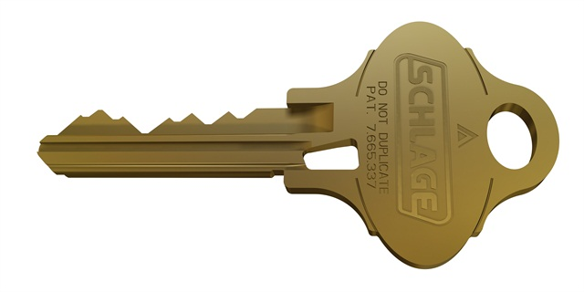
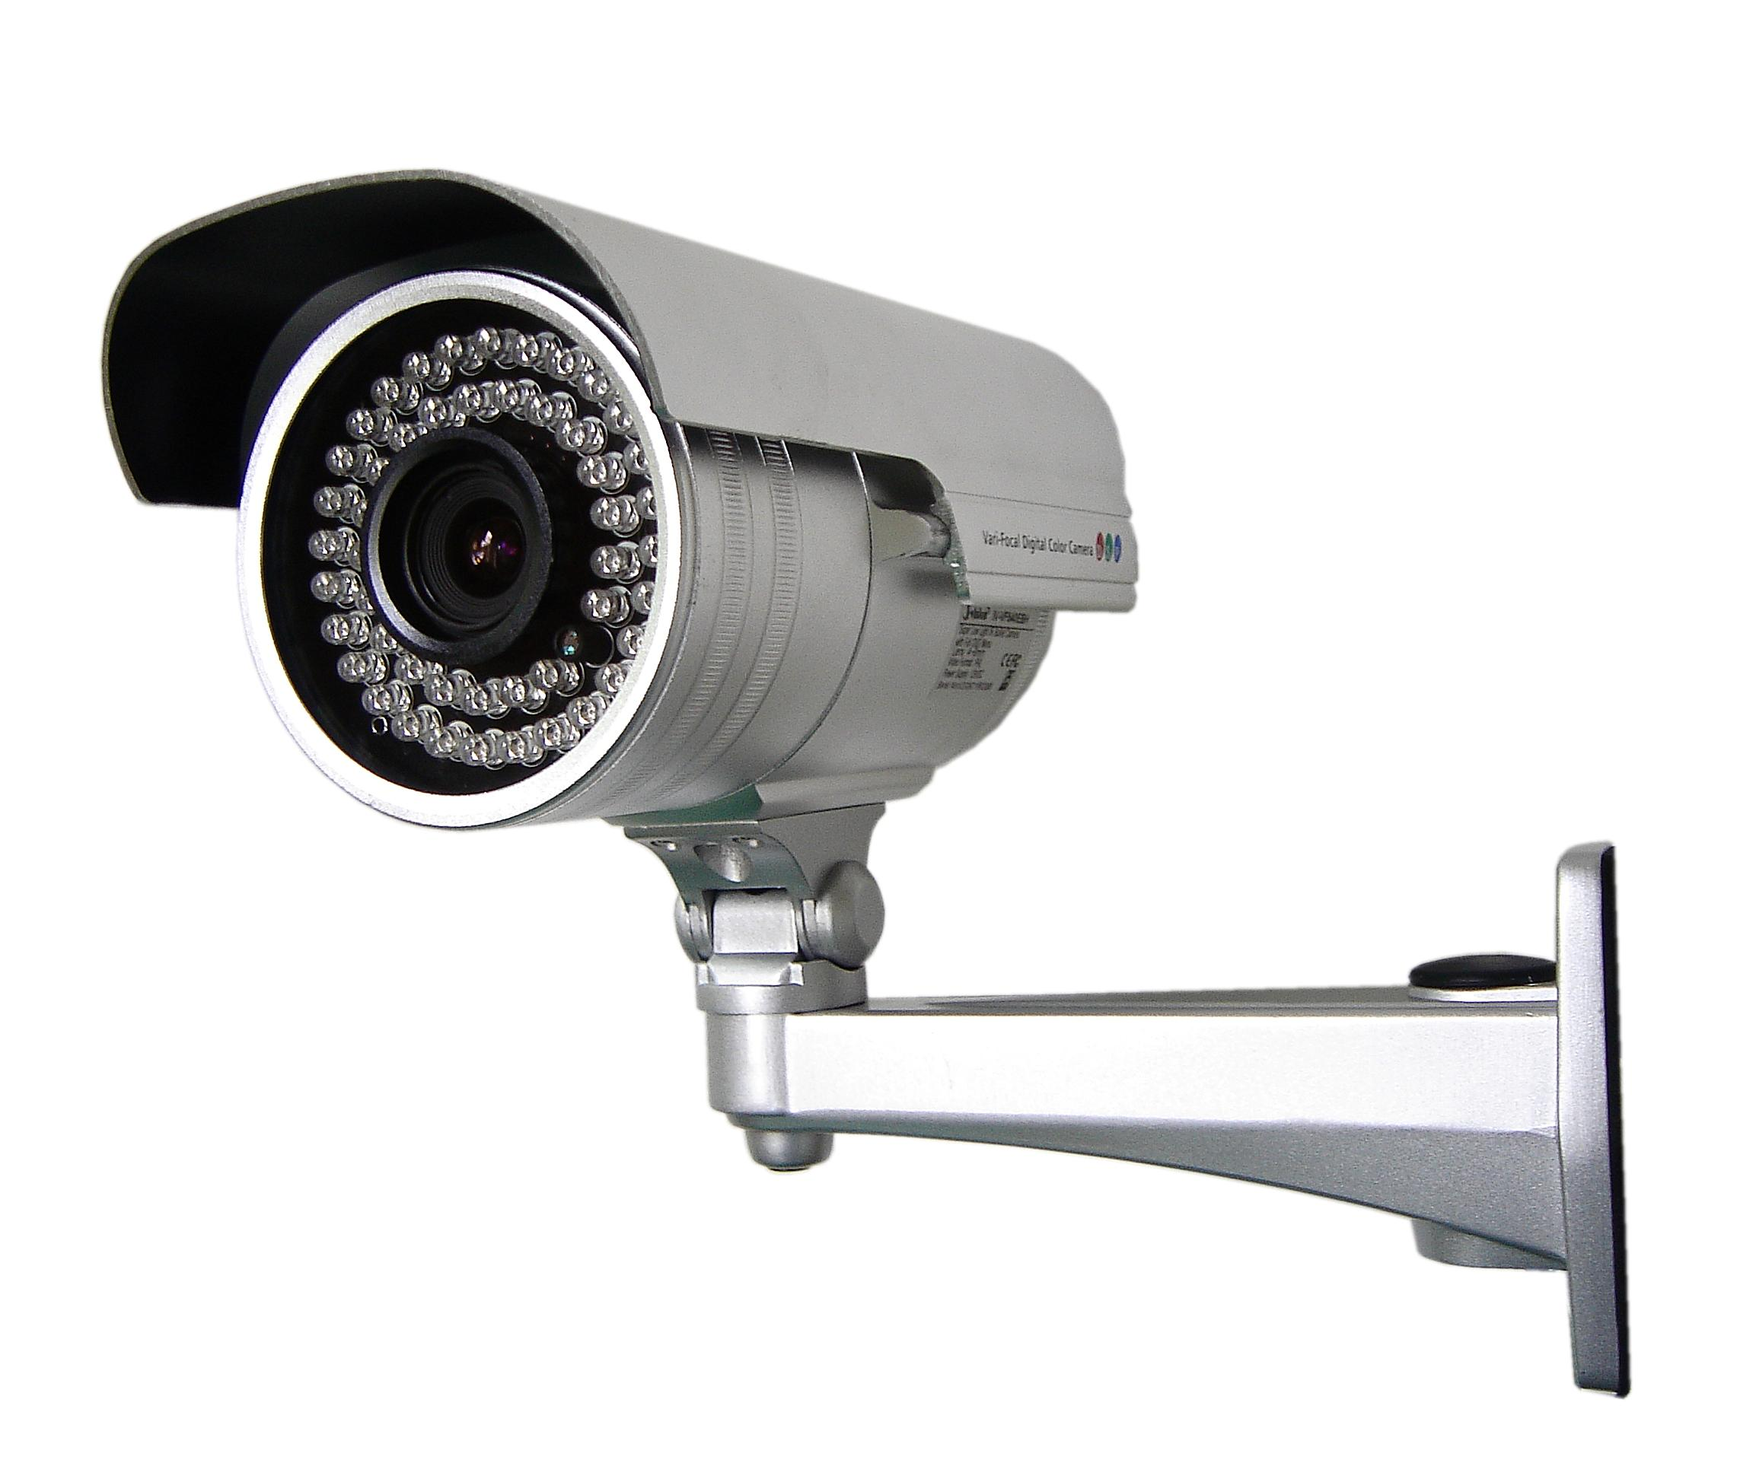
Where we are going…
Authentication: mechanisms that bind principals to actions
Authorization: mechanisms that govern whether actions are permitted
Audit: mechanisms that record and review actions
Notes:
Examples:
Authentication: passwords, digital signatures, EV certificates in browsers
Authorization: file permissions, firewalls, visibility restrictions in FB
Audit: log files, log browsers, intrusion detection systems

Slide 32
Where are going…
Authentication: mechanisms that bind principals to actions
Authenticating Machines
Authenticating Programs
Authenticating Humans

Slide 33
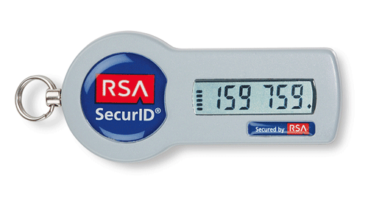
Authentication Techniques
123456
password
12345678
qwerty
12345
Notes:
entropy, computational power
-knowledge of key (signature, decrypt, key agreement)

Slide 34
When authentication goes wrong…

