Slide 1
Lecture 9: Protocols
CS 181S October 3, 2018

Slide 2
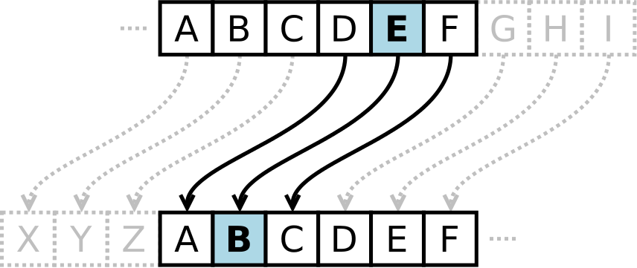
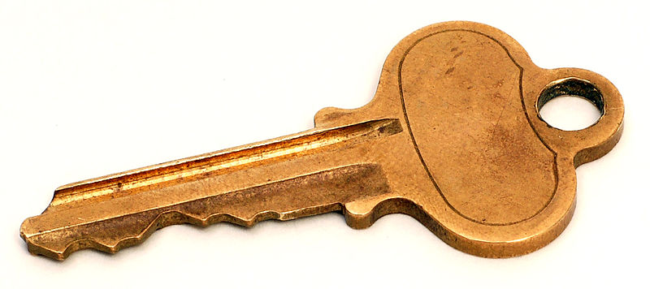
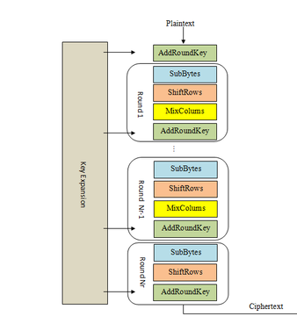
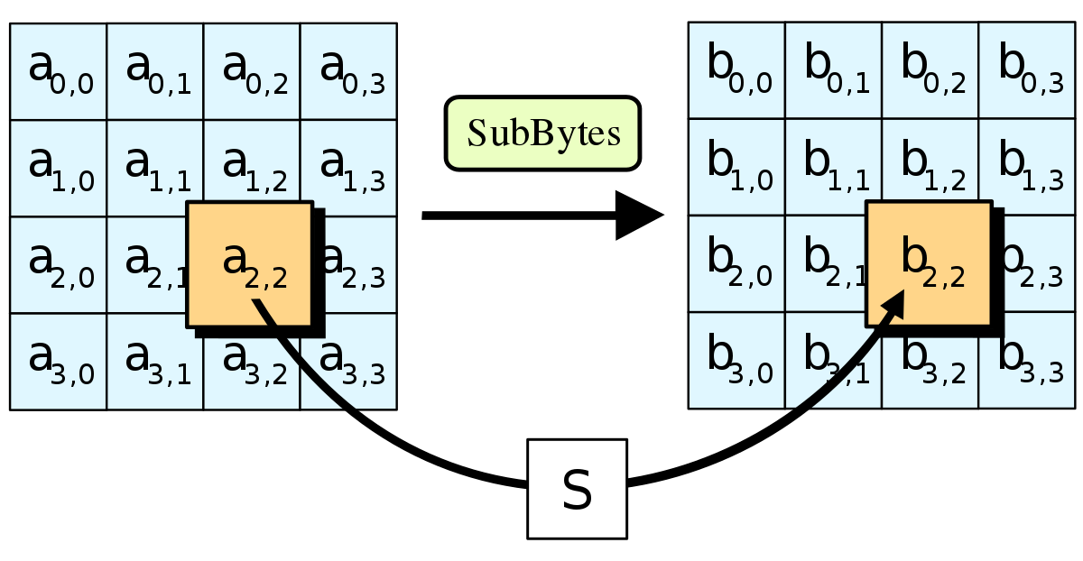
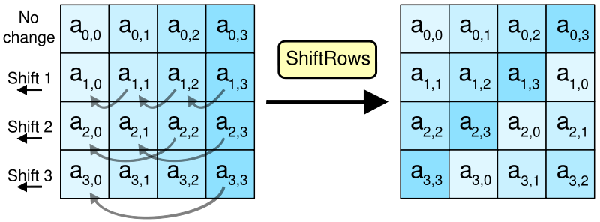
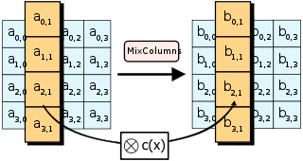
Crypto Thus Far…
Sign
Notes:
The problem: too many keys (n^2), no good transportation mechanism

Slide 3
Monday: Secure Channels

Slide 4
Today: Authentication Protocols
An authentication protocol allows a principal receiving a message to determine which principal sent that message
It's sunny in New York
I prefer rain

Slide 5
Threat Model
Dolev-Yao attacker
controls the network, can read, modify, create packets
A replay attack occurs when an adversary repeats fragments of a previous protocol run
A reflection attack occurs when an adversary sends messages from an ongoing protocol back to the originator
A man-in-the-middle attack occurs when an adversary secretly relays (and potentially changes) communications between two principals who believe they are communicating directly with eachother
Notes:
Note: these definitions are interwoven with a sequence of authentication protocols

Slide 6
Authentication with Symmetric Keys
Assumption: Alice and Bob have a shared key k_AB
B: r <- {0,1}^n
B -> A: B, r
A -> B: Enc(A, r; k_AB)
B: check whether Dec(m3; k_AB) = (A, r)
Notes:
Note: this is the final authentication protocol (Protocol 3)

Slide 7
Key Distribution Protocols
Key Distribution Center
(KDC)
$$k_{A}$$
$$k_{B}$$
$$k_{C}$$
$$k_{Z}$$
…

Slide 8
Needham-Schroeder
A -> KDC: A, B, r
KDC -> A: Enc(A, B, r, k_AB; k_B)
A->B: A, B, Enc(A, B, k_AB; k_B)
B->A: Enc(r'; k_AB)
A->B: Enc(r'+1; k_AB)
Notes:
Note: worked up to this with a sequence of protocols and attacks

Slide 9
Otway-Rees
A->B: n, A, B, Enc(r1, n, A, B; k_A)
B->KDC: n, A, B, Enc(r1, n, A, B; k_A)
KDC->B: n, Enc(r1, k_AB; k_A), Enc(r2, k_AB; k_B)
B->A: n, Enc(r1, k_AB; k_A)

