Slide 1
Lecture 9: Public-Key Cryptography
CS 181S September 26, 2018
Notes:
Liger cub: cross between lion and tiger
Asymmetric encryption uses big integers, not byte arrays
in theory could use block modes like with symmetric encryption in practice, that's too inefficient...
big integer operations are slow, say, 1 to 3 orders of magnitude slower than block ciphers

Slide 2
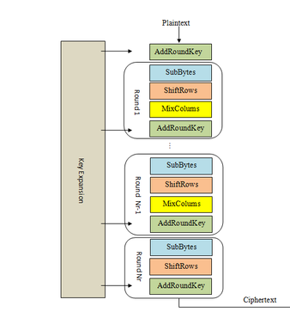
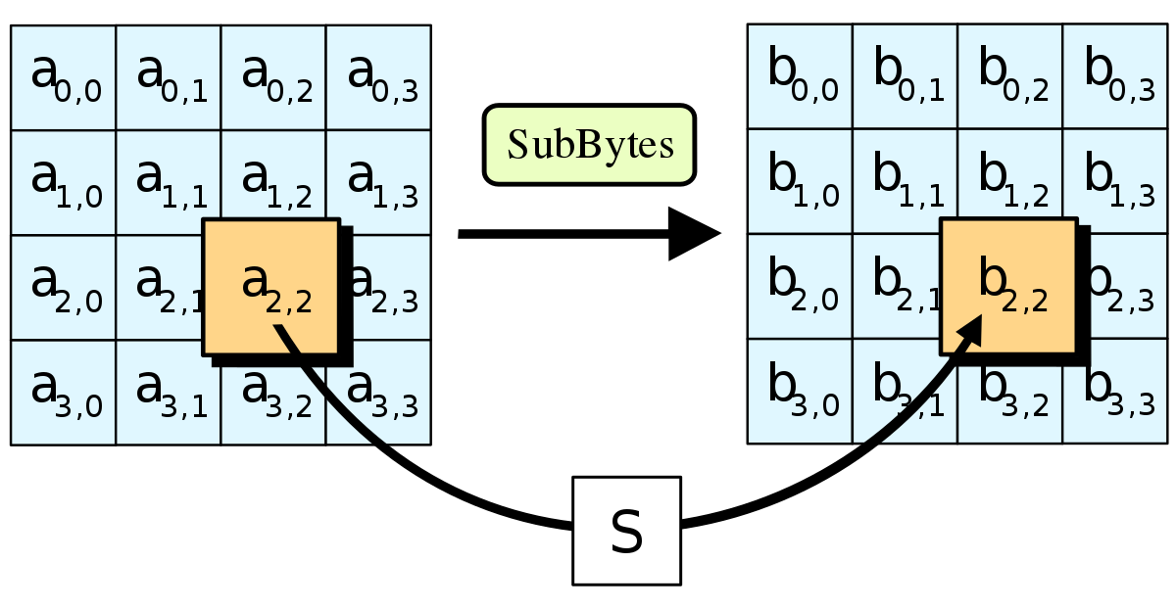
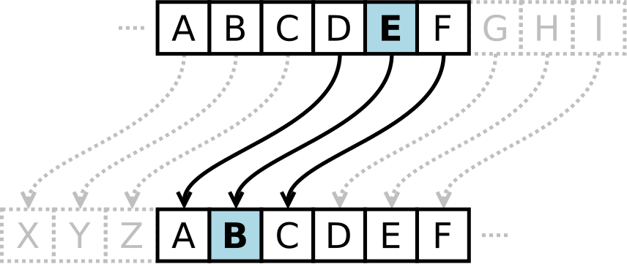
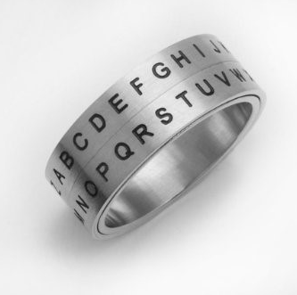
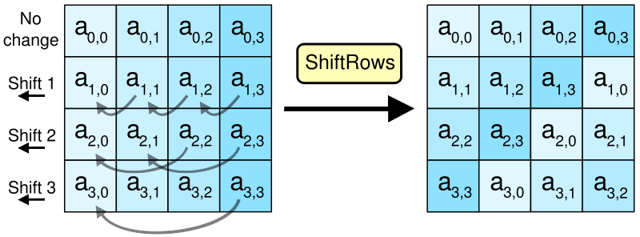
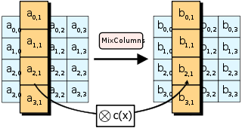
Crypto Thus Far…
Notes:
The problem: too many keys (n^2), no good transportation mechanism

Slide 3
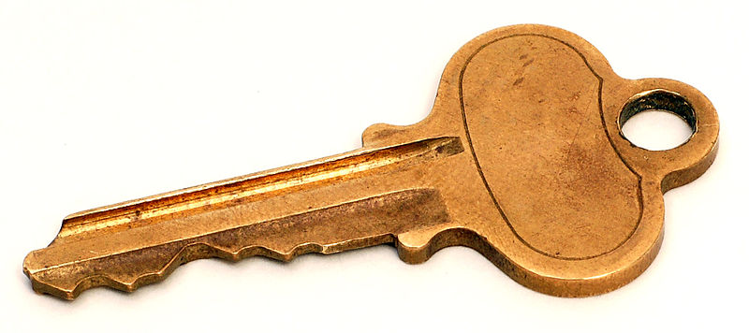
Key pairs
Instead of sharing a key between pairs of principals...
...every principal has a pair of keys
public key: published for the world to see
private key: kept secret and never shared

Slide 4
Protocol to exchange encrypted message
1. A: c = Enc(m; pk_B)
2. A -> B: c
3. B: m = Dec(c; sk_B)
key pair: (pk_B, sk_B)

Slide 5
Public keys
0. B: (K_B, k_B) = Gen(len)
...
All public keys published in "phonebook"
So A can lookup B's key to send message
Length of phonebook is O(n)
So quadratic problem reduced to linear!
Eliminates key distribution problem!

Slide 6
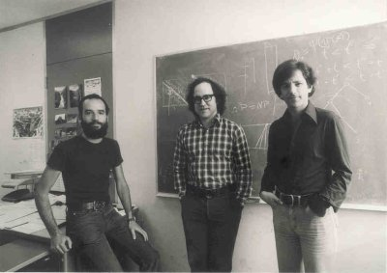
RSA
[Rivest, Shamir, Adleman 1977]
Shared Turing Award in 2002: ingenious
contribution to making public-key crypto
Gen(len):
Pick primes $p,q$
Choose $e,d$ such that $ed=1 mod lcm(p−1, q−1)$
$pk=\left(n, e\right), sk=(p,q, d)$
Enc(m, pk)
Dec(c, sk):
$$c=m^{e} mod n$$
$$m=c^{d} mod n$$
Notes:
size of modulus bounds size of keys and methods: usually 2048 bit (note: much bigger than AES keys!!!)
recommendations for strength summarized at https://www.keylength.com/en/
factoring n would break RSA (assumed to be hard) Largest challenge broken so far is 768-bit modulus [2010]
Shor's algorithm factors in polynomial time on a quantum computer: largest factorization so far is of the number 56153 (i.e., 16 bits); motivates work on post-quantum cryptography

Slide 7
Problems with Textbook RSA
Deterministic: given same plaintext and key, always produces the same ciphertext
Small numbers: if m^e < n, then log is easy to compute
Big numbers: if m > n, can't compute do math mod n

Slide 8
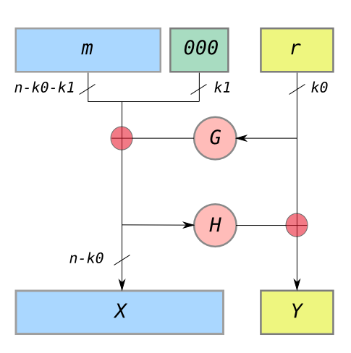
Solution 1: Padding
PKCS#1 v1.5: 0x00 0x02 [non-zero bytes] 0x00 [message]
Vulnerable to a padding oracle attack!
OAEP (Optimal Asymmetric Encryption Padding)
Security proof (with assumptions)

Slide 9
Square-and-Multiply
res = 1;
while (exp > 0) {
if (exp % 2 == 1){
res = res * base % p;
}
base = base^2 % p;
exp >> 1;
}
return res;

Slide 10
Side Channels
Power
Timing
EM Radiation
Acoustics

Slide 11
Blinded RSA
[Rivest, Shamir, Adleman 1977]
Shared Turing Award in 2002: ingenious
contribution to making public-key crypto
Gen(len):
Pick primes $p,q$
Choose $e,d$ such that $ed=1 mod lcm(p−1, q−1)$
$pk=\left(n, e\right), sk=(p,q, d)$
Enc(m, pk)
Dec(c, sk):
$$c={(mr)}^{e}⋅r^{−e} mod n$$
$$m=c^{d} mod n$$
Notes:
size of modulus bounds size of keys and methods: usually 2048 bit (note: much bigger than AES keys!!!)
recommendations for strength summarized at https://www.keylength.com/en/
factoring n would break RSA (assumed to be hard) Largest challenge broken so far is 768-bit modulus [2010]
Shor's algorithm factors in polynomial time on a quantum computer: largest factorization so far is of the number 56153 (i.e., 16 bits); motivates work on post-quantum cryptography

Slide 12
Solution 2: Hybrid encryption
Assume:
Symmetric encryption scheme (Gen_SE, Enc_SE, Dec_SE)
Public-key encryption scheme (Gen_PKE, Enc_PKE, Dec_PKE)
Use public-key encryption to establish a shared session key
Avoids quadratic problem, assuming existence of phonebook
Avoids problem of key distribution
Use symmetric encryption to exchange long plaintext encrypted under session key
Gain efficiency of block cipher and mode
Notes:
Liger cub: cross between lion and tiger
Asymmetric encryption uses big integers, not byte arrays
in theory could use block modes like with symmetric encryption in practice, that's too inefficient...
big integer operations are slow, say, 1 to 3 orders of magnitude slower than block ciphers

Slide 13
Protocol to exchange encrypted message
m
0. B: (pk_B, sk_B) = Gen_PKE(len_PKE)
publish (B, pk_B)
1. A: k_s = Gen_SE(len_SE)
c1 = Enc_PKE(k_s; pk_B)
c2 = Enc_SE(m; k_s)
2. A -> B: c1, c2
3. B: k_s = Dec_PKE(c1; sk_B)
m = Dec_SE(c2; k_s)

Slide 14
Session keys
If key compromised, only those messages encrypted under it are disclosed
Used for a brief period then discarded
cryptoperiod: length of time for which key is valid
in this case, for a single (long) message
not intended for reuse in future messages
only intended for unidirectional usage:
A->B, not B->A
Notes:
Why only one way? A chose the key, not B

Slide 15
Digital Signatures

Slide 16
Recall: Key pairs
Instead of sharing a key between pairs of principals...
...every principal has a pair of keys
public key: published for the world to see
private key: kept secret and never shared

Slide 17
Key pair terminology
 | Encryption | Digital Signatures
Public key | Encryption key | Verification key
Private key | Decryption key | Signing key

Slide 18
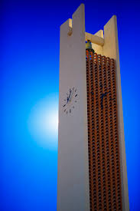
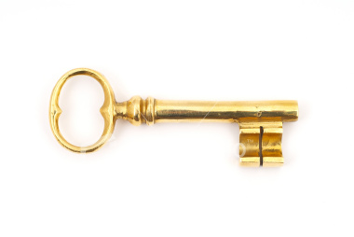
Digital signature scheme
A digital signature scheme is a triple (Gen, Sign, Ver):
Gen(len): generate a key pair (pk,sk) of length len
Sign(m; sk): sign message m with key sk, producing signature s as output
Ver(m, s; sk): verify signature s on message m with key pk
Sign

Slide 19
Protocol to exchange signed message
0. A: (K_A,k_A) = Gen(len)
1. A: s = Sign(m; k_A)
2. A -> B: m, s
3. B: accept if Ver(m; s; K_A)
Message is sent in plaintext: no protection of confidentiality
Goal is to detect modification not prevent
...what if message is too long for asymmetric algorithms?

Slide 20
Security of digital signatures
Must be hard to forge signature for a message without knowledge of key
...like handwritten signatures
Even if in possession of multiple (message, signature) pairs for that key
...unlike handwritten signatures

Slide 21
DSA
DSA: Digital Signature Algorithm [Kravitz 1991]
Standardized by NIST and made available royalty-free in 1991/1993
Used for decades without any serious attacks
Closely related to Elgamal encryption
Notes:
The DSA patent credits Kravitz; NIST is who introduced it.

Slide 22
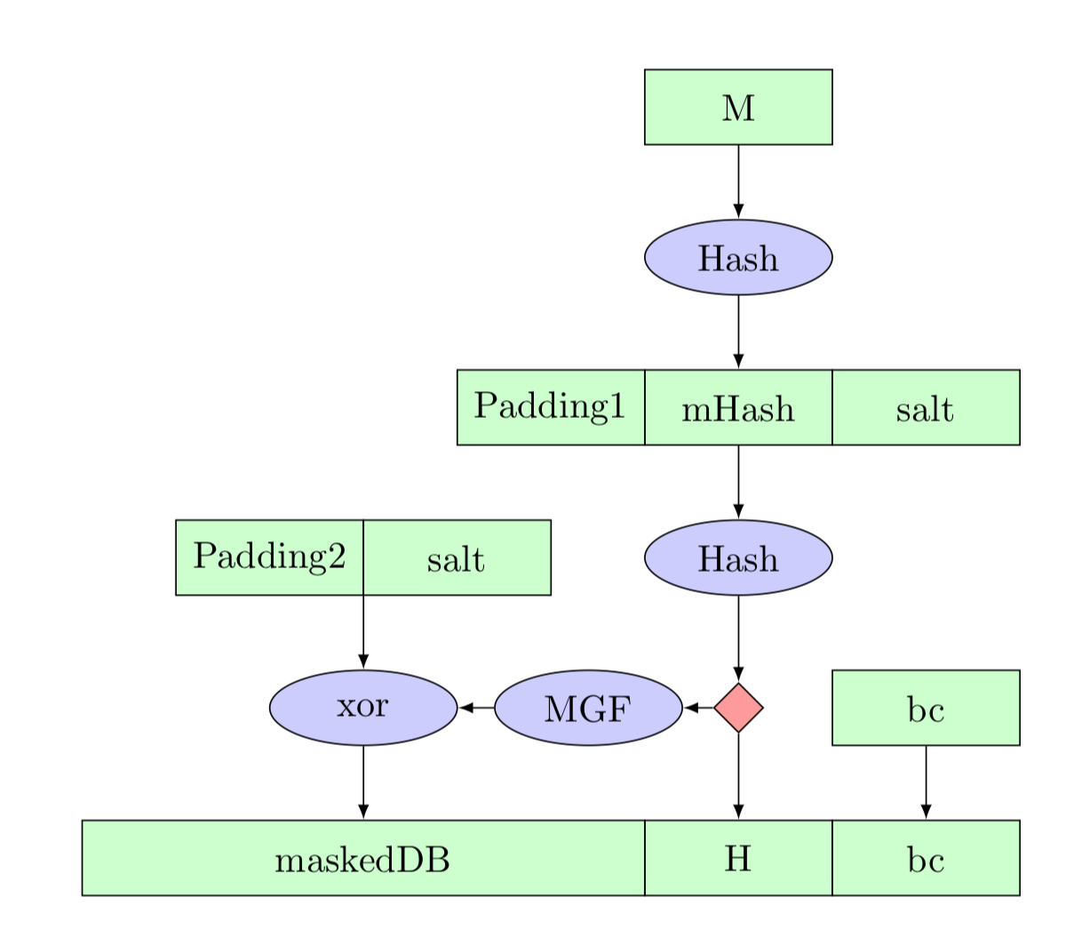
RSA
Core ideas are the same as RSA encryption
Common mistake: “RSA sign = encrypt with private key”
Truth (in real world, outside of textbooks):
there's a core RSA function R that works with either pk or sk
RSA encrypt = do some prep work on m then call R with pk
RSA sign = do different prep work on m then call R with sk
Prep work: recall “textbook RSA is insecure”
(For encryption: OAEP)
For signatures: PSS (probabilistic signature scheme)
Also need to handle long messages…
Notes:
The DSA patent credits Kravitz; NIST is who introduced it.

Slide 23
Signatures with hashing
1. A: s = Sign(H(m); k_A)
2. A -> B: m, s
3. B: accept if Ver(H(m); s; K_A)
Notes:
So common a practice that I won't bother to write the hashing from now on

Slide 24
Blind signatures
[Chaum 1983]
Purpose: signer doesn’t know what they are signing
Two additional algorithms: Blind and Unblind
Unblind(Sign(Blind(m); k)) = Sign(m; k)
Uses: e-cash, e-voting

Slide 25
Group signatures
[Chaum and van Heyst 1991]
Purpose: one member of group signs anonymously on behalf of group
Introduces a group manager who controls membership
Two new protocols: Join and Revoke, to manage membership
One new algorithm: Open, which manager can run to reveal who signed a message

