Slide 1
Lecture 5: Principles of Security
CS 181S September 19, 2018

Slide 2
Last Time
Functional requirements
Threat analysis
Harm analysis
Security goals
Feasibility analysis
Security requirements
Notes:
Do this on the board

Slide 3
Example: Eleanor's Place
New restaurant in Claremont
You are contracted to build a system for online reservations
What are the functionality requirements for this reservation system?
What is the threat model?
What confidentiality, integrity, and availability harms does Eleanor's Place face?
What security goals should it have?
Are they feasible? How could these be refined to security requirements?
What countermeasures could be employed to implement security requirements?

Slide 4
Countermeasures

Slide 5
Countermeasures
A defense that protects against attacks by neutralizing either the threat or vulnerability involved
Strategy:
Prevent: block attack or close vulnerability
Deter: make attack harder
Deflect: make other targets more attractive
Mitigate: make harm less severe
Detect: as it happens or after the fact
Recover: undo harm
Prevention
Risk Management
Deterrence through Accountability
Notes:
Prevention is most of what we do here
But it's not a 100% achievable goal
We don't have the technical means.
Formal verification still doesn't scale well enough
Exhaustive testing isn't feasible
We largely don't know how to defend against unknown attacks
We can't control people adequately (they make mistakes, ...)
Risk management seems sensible and more achievable.
Focus on paying as little as possible for as much security as possible
Buy insurance for any residual risk
But it requires making rational investments, which requires quantitative calculations; we don't have the numbers
How to value C? I? A?
How to reason about low-probability events? (Humans are bad—overestimate Pr of unlikely+bad events they haven't experienced)
Actuarial models can't be constructed; not enough data about attacks, cost to recover, probability of them, etc.
No one wants to release this data for themselves; undermines trust in them!
Metrics for cybersecurity just don't exist
Accountability treats security through the lens of crime.
Must be able to perform forensics, identify perpetrators, prosecute. Each is problematic.
Forensics are difficult for the same reasons prevention is, though there is a body of art/science one can learn
Attributing actions of machines to actions of humans is complicated and demands a tradeoff between confidentiality/privacy and that attribution. Policy makers tend to underestimate that tradeoff.
Prosecution requires cooperation across jurisdictions, possibly international with very different local laws.

Slide 6
Principles of Prevention
[Saltzer and Schroeder, The Protection of Information in Computer Systems, 1975]
Accountability
Complete Mediation
Least Privilege
Failsafe Defaults
Separation of Privilege
Defense in Depth
Economy of Mechanism
Open Design
Psychological Acceptability
Notes:
Danger of seeming too abstract

Slide 7
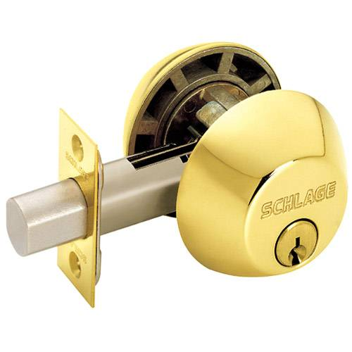
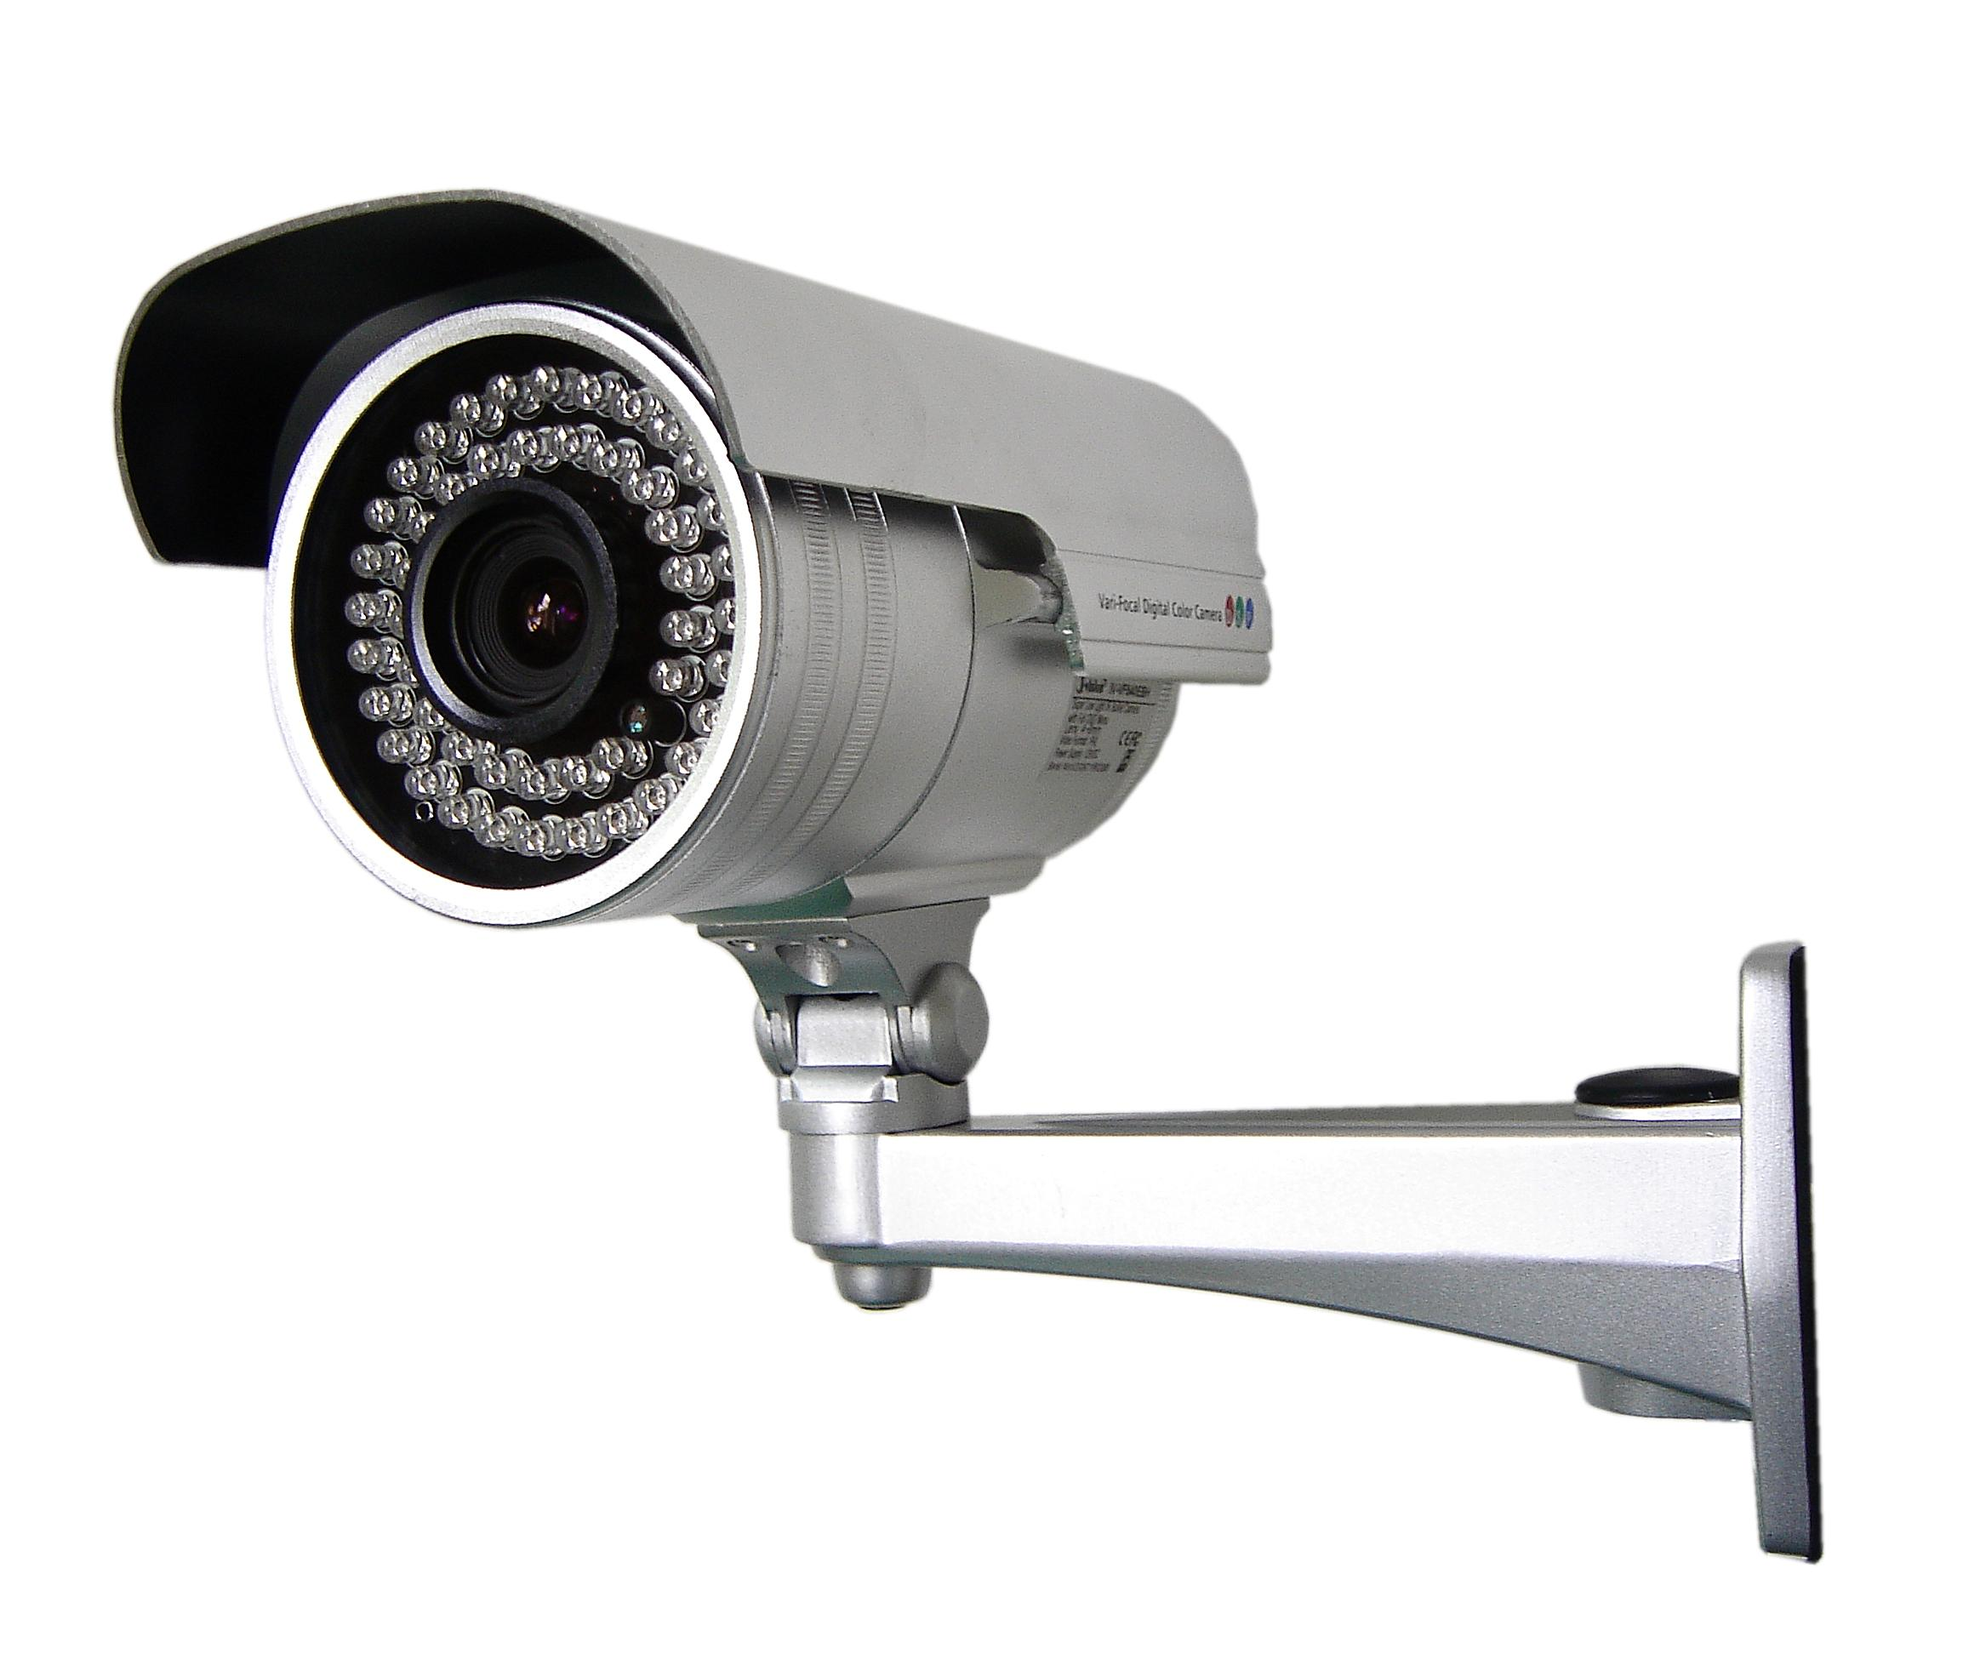
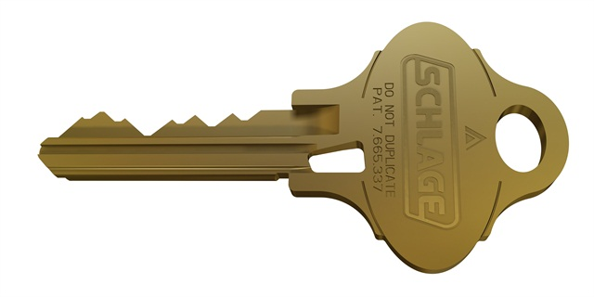
Accountability
Hold principals responsible for their actions
Notes:
Umbrella: insurance, risk management

Slide 8
Accountability
Hold principals responsible for their actions
Authorization: mechanisms that govern whether actions are permitted
Authentication: mechanisms that bind principals to actions
Audit: mechanisms that record and review actions
Notes:
Warning: people often confuse authorization and authentication!
Examples:
Authorization: file permissions, firewalls, visibility restrictions in FB
Authentication: passwords, digital signatures, EV certificates in browsers
Audit: log files, log browsers, intrusion detection systems

Slide 9
Accountability
Hold principals responsible for their actions
Authorization: mechanisms that govern whether actions are permitted
Authentication: mechanisms that bind principals to actions
Audit: mechanisms that record and review actions
... Gold Standard [Lampson 2000]

Slide 10
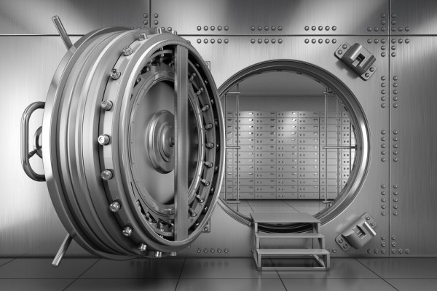
Complete Mediation
Every operation requested by a principal must be intercepted and determined to be acceptable according to the security policy

Slide 11
Complete Mediation
Every operation requested by a principal must be intercepted and determined to be acceptable according to the security policy
Component that does the interception and determination is the reference monitor
Related to Accountability
Restricts caching of information, including previous decisions

Slide 12
Least Privilege
Principals should be given the minimum privileges necessary to accomplish their task
Limits the damage that can result from accident or malice
Cf. "need to know"
Notes:
Examples:
Valet key
Normal users can't write to most system files, but root can
Web server can read files only from certain directories, not others

Slide 13
Failsafe Defaults
Base decisions on the presence of privilege, not the absence of prohibition
The default answer is "no"
Say "yes" only when there is an explicit reason to do so
Principals who discover they don't have access will complain
Attackers who discover they do have access won't complain!

Slide 14
Failsafe Defaults
Java stack inspection circa 1998:
checkPermission(T) {
// loop newest to oldest stack frame
foreach stackFrame {
if (local policy forbids access to T by class executing in
stack frame) throw ForbiddenException;
if (stackFrame has enabled privilege for T)
return; // allow access
if (stackFrame has disabled privilege for T)
throw ForbiddenException;
}
// end of stack
if (Netscape || …) throw ForbiddenException;
if (MS IE4.0 || JDK 1.2 || …) return;
}
Notes:
The rationale had to do with code signing. IE wasn't going to let you run unsigned code, and they figured if you trusted the signer, that was good enough. Netscape didn't have that implemented. What do they do now, I wonder?

Slide 15
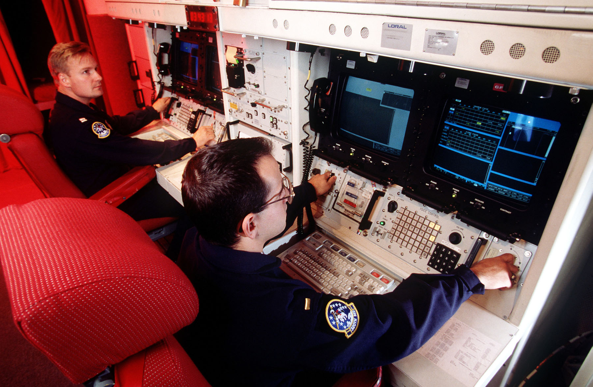
Separation of Privilege
Different operations should require different privileges
Disseminate privileges for an operation amongst multiple principals (Separation of Duty)
Notes:
Examples:
r,w,x are separate privileges on Unix file systems
Examples:
Company checks that must be counter-signed by two officers
Missile launch systems that require two keys

Slide 16
Defense in Depth
Prefer a set of complementary mechanisms over a single mechanism
Complementary:
Independent: attack that compromises one mechanism is unlikely to compromise others
Overlapping: attacks must compromise multiple mechanisms to succeed
Notes:
Examples:
Your bank might use both a password and a hardware token to authenticate customers.
Your apartment building might have multiple door locks and an electronic security system.
Your university IT department might use firewalls and virus scanners to prevent spread of malware.

Slide 18
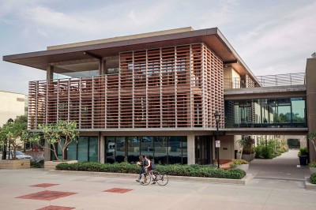
Exercise
Consider the security mechanisms
deployed in your dorm and/or in
academic buildings on campus.
These systems are designed to
prevent access by unauthorized
people.
To what extent do those security features enforce Complete Mediation?
To what extent do those security features enforce Least Privilege?
To what extent do those security features satisfy the independence requirement of Defense in Depth?
To what extent do those security features satisfy the overlapping requirement of Defense in Depth?

Slide 19
Economy of Mechanism
Prefer mechanisms that are simpler and smaller
Easier to understand, construct, analyze
Hence less likely to have unknown vulnerabilities
Applies to any aspect of system, not just security
Trusted computing base (TCB): mechanisms that implement the core security functionality
...keep the TCB small

Slide 20
Open Design
Security shouldn't depend upon the secrecy of design or implementation
/* efdtt.c Author: Charles M. Hannum <root@ihack.net> */
#define m(i)(x[i]^s[i+84])<<
unsigned char x[5],y,s[2048];main(n){for(read(0,x,5);read(0,s,n=2048);write(1,s
,n))if(s[y=s[13]%8+20]/16%4==1){int i=m(1)17^256+m(0)8,k=m(2)0,j=m(4)17^m(3)9^k
*2-k%8^8,a=0,c=26;for(s[y]-=16;--c;j*=2)a=a*2^i&1,i=i/2^j&1<<24;for(j=127;++j<n
;c=c>y)c+=y=i^i/8^i>>4^i>>12,i=i>>8^y<<17,a^=a>>14,y=a^a*8^a<<6,a=a>>8^y<<9,k=s
[j],k="7Wo~'G_\216"[k&7]+2^"cr3sfw6v;*k+>/n."[k>>4]*2^k*257/8,s[j]=k^(k&k*2&34)
*6^c+~y;}}
Notes:
DVDs were protected by the Content Scrambling System (CSS), a proprietary encryption scheme meant to protect DVDs from copying. Details of the algorithm were kept secret and revealed only to licensees (who paid money, signed contracts, hence could be held legally responsible). But in 1999 a group in Norway reverse engineered the algorithm. The code here is shortest known C decryption algorithm for it. These days Blu Ray is protected by AES, an openly designed algorithm.

Slide 21
Open Design
Security shouldn't depend upon the secrecy of design or implementation
Arguments for open design:
Secrets eventually come out: reverse engineering is possible, employees move around
Making details public increases chance of identifying and repairing vulnerabilities

Slide 22
Open Design
Security shouldn't depend upon the secrecy of design or implementation
Arguments against open design:
Secrecy supports Defense in Depth by making it harder to find vulnerabilities
Lack of hard evidence that Linus' Law really holds ("given enough all eyeballs, all bugs are shallow")
After identification, some vulnerabilities cannot quickly or easily be repaired
Notes:
"Maybe the eyeballs aren't looking"

Slide 23
Psychological Acceptability
Minimize the burden of security mechanisms on humans
Don't make operations (much) more difficult to complete than if security mechanisms were absent
Don't make configuration difficult
Produce comprehensible error messages
...always a tradeoff between security and usability

Slide 24
Alternative su
A student who didn't take 181S decides to build a new version of su that works as follows:
If the open operation succeeds, then the password is checked. If it is indeed the correct password for u2, then u1 is granted access to the account of u2.
If the open operation fails, then u1 immediately is granted access to the account of the superuser (“root”). The student’s intention is that u1 would then be able to fix the misconfiguration.
Notes:
The su command enables a UNIX user u1 to access the account of another user u2. Unless u1 is the superuser (“root”), su prompts u1 to enter the password of u2. Checking whether that password is correct requires su to open the password file, /etc/passwd. On a correctly configured UNIX system, that particular open operation will always succeed. Then su can proceed with checking whether the password is correct.

Slide 25
Principles of Security
Accountability
Complete Mediation
Least Privilege
Failsafe Defaults
Separation of Privilege
Defense in Depth
Economy of Mechanism
Open Design
Psychological Acceptability

Slide 27
What skills will your project need?

Slide 28
Forming a group…
What skills/experience will you bring to a group?
What system(s) are you exciting about building?
How challenging do you want your project to be?
How often/when are you available to meet?

