Slide 1
Lecture 2: Vulnerabilities
CS 181S September 10, 2018

Slide 2
The Big Picture
Attacks are perpetrated by threats that inflict harm by exploiting vulnerabilities which are controlled by countermeasures.

Slide 3
Bugs
"bug": suggests something just wandered in
[IEEE 729]
Fault: result of human error in software system
E.g., implementation doesn't match design, or design doesn't match requirements
Might never appear to end user
Failure: violation of requirement
Something goes wrong for end user
Human error
Fault
Failure
Notes:
First bug found by Grace Hopper
https://www.schneier.com/blog/archives/2008/05/random_number_b.html

Slide 4
Vulnerability
An unintended aspect of a system (design, implementation, or configuration) that can cause the system to do something it shouldn't, or fail to do something it should
E.g., buffer overflows, code injection, cross-site scripting, missing authentication or access control, misconfiguration
National databases: CVE, NVD
Ignoring vulnerabilities is risky
Too often: "no one would/could ever exploit that"
Weakest link phenomenon
Assumptions are vulnerabilities

Slide 5
Memory: A Quick Review
Stack
Heap
Globals
Code
0x00000000

Slide 6
The Stack

Slide 7
Stack Smashing

Slide 8
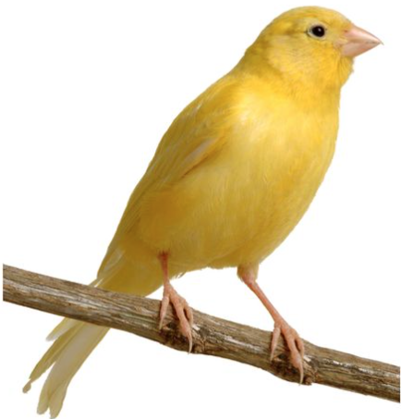
Canaries
Notes:
Discussion: what would make a good canary value?

Slide 9
Memory: A Quick Review
Stack
Heap
Globals
Code
0x00000000

Slide 10
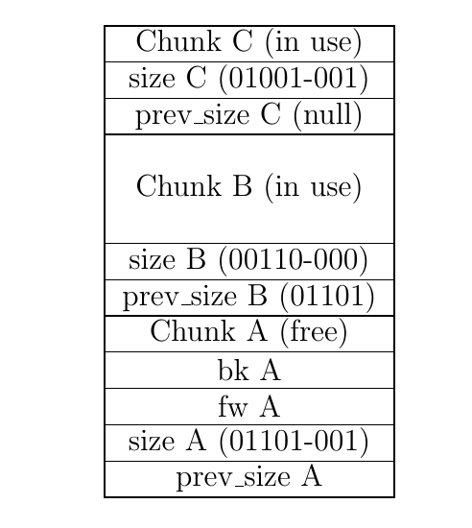
The Heap

Slide 11
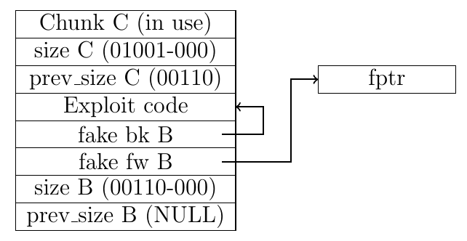
Heap Smashing

Slide 12
Memory Tagging
W $⊕$ X

Slide 13
Return-into-libc

Slide 14
Address Space Layout Randomization

Slide 15
x86
Intel Instruction Set Architecture (ISA)
Introduced 1978, still supported
As of 2018, most common architecture on servers, PCs, and laptops
dense instruction set
variable length instructions
not word aligned

Slide 16
Return Oriented Programming
f7 c7 07 00 00 00
0f 95 45 c3
test $0x00000007, %edi
setnzb -61 (%ebp)
c7 07 00 00 00 0f
95
45
c3
movl $0x0f0000000, (%edi)
xchg %ebp, %eax
inc %ebp
ret

Slide 17
Example Gadgets

Slide 18
Return Oriented Programming
Image By: Dino Dai Zovi

Slide 19
Return-Oriented Shellcode

Slide 20
Gadget Elimination

Slide 21
Control Flow Integrity

Slide 22
CFI = Insert Monitors
Code
Code

Slide 23
CFI Overhead

Slide 24
Control Flow Guard
Approximate CFI implementation in Windows 8.1, 10
Jump is valid if it beginning of function
Granularity: 8 bytes
Check implemented as bitmap
Code
Code

Slide 25
Vulnerabilities by Year
Notes:
https://www.cvedetails.com/vulnerabilities-by-types.php

Slide 26
Vulnerabilities

