Slide 1
Path Planning
Mobile Robotics
Anthony J. Clark

Slide 2
Today
Path planning definition and example
Practical Considerations
Configuration space
Safety bounds
Map representations
Obstacle avoidance
Popular algorithms (A* and RRT)
Relationship with localization and mapping

Slide 3
Simple Path Planning
Given
(Optional) Map
Start position
Goal position
Notes:
Can be more complicated
Including just a set of obstacles (not a map)
Given a full configuration for start and goal
Must minimize a cost function

Slide 4
Simple Path Planning
Given
(Optional) Map
Start position
Goal position
Problem
Find a safe, feasible, and continuous path from the start to the goal
Notes:
Can be more complicated
Including just a set of obstacles (not a map)
Given a full configuration for start and goal
Must minimize a cost function

Slide 5
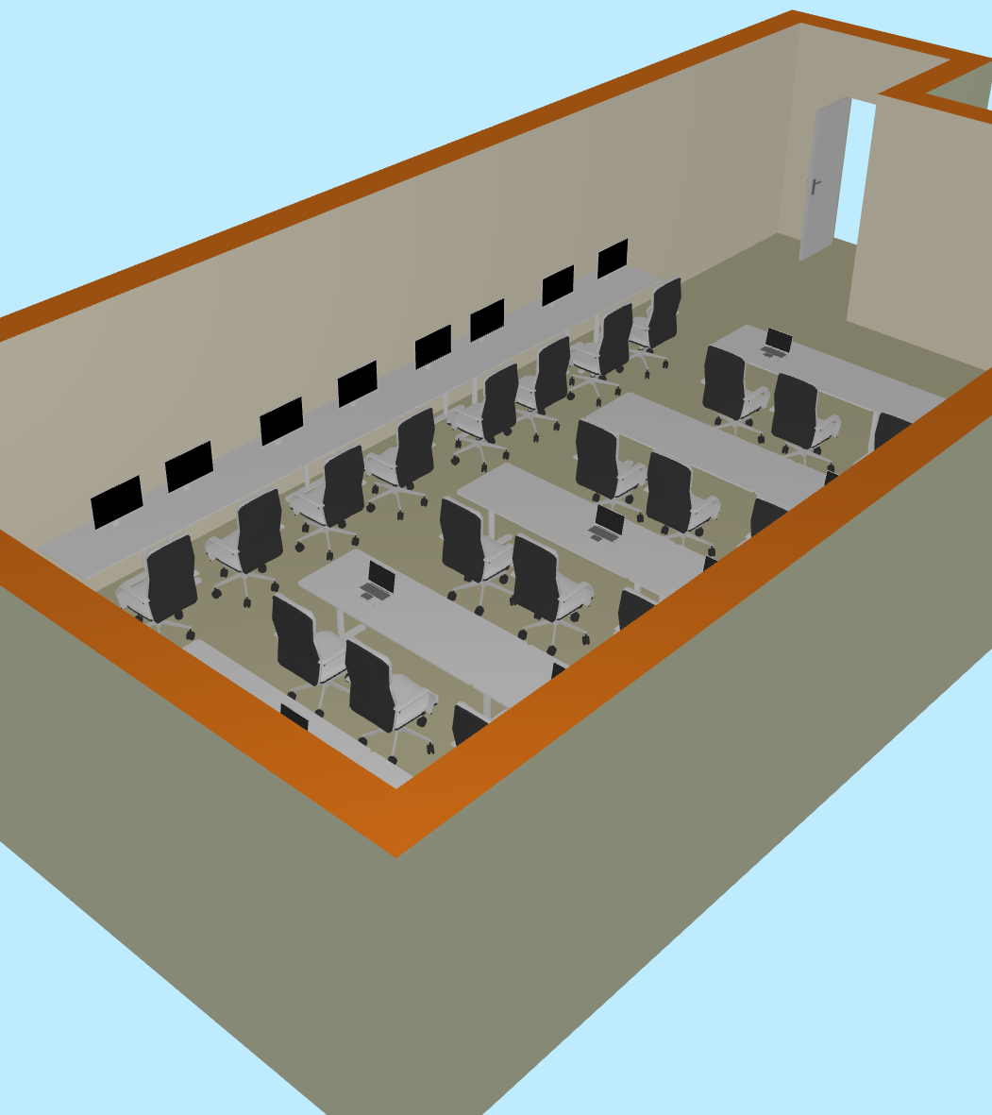
Path Planning
https://floorplancreator.net/plan/shared?id=4422109&code=jRjChM-nAobwz:Dc
What level of abstraction is useful for our task?

Slide 6
Edmunds Room 105
Notes:
Differential drive robot makes this easy with the zero-degree turning radius

Slide 7
Level of Detail
Notes:
Differential drive robot makes this easy with the zero-degree turning radius

Slide 8
How do we plan a path?

Slide 9
Practical Considerations
Do we need a full path to get to our goal?
Configuration space
Safety Bounds
Map representation

Slide 10
“No-Path” Path Planning
“Bug” algorithms
Notes:
Bug0
Move toward goal
Always turn left (or always right)

Slide 11
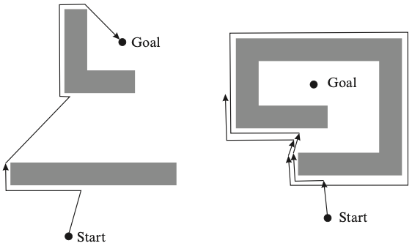
Bug Algorithms
Move toward the goal until an obstacle is detected or the goal is reached.
Follow obstacle contours (always in the same direction) until motion in a straight line toward the goal is again possible.
Companion Materials Klancar, Zdesar, Blazic, Skrjanc: Wheeled Mobile Robotics

Slide 12
“No-Path” Path Planning
Move toward the goal until an obstacle is detected or the goal is reached.
Follow obstacle contours (always in the same direction) until motion in a straight line toward the goal is again possible.
“Bug” algorithms
Notes:
Bug0
Move toward goal
Always turn left (or always right)

Slide 13
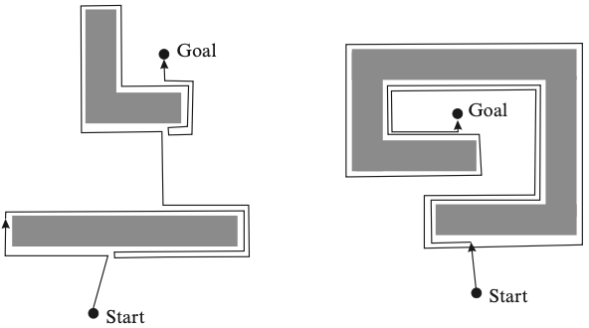
Bug Algorithms
Move toward the goal until an obstacle is detected or the goal is reached.
Follow obstacle contours (always in the same direction) until motion in a straight line toward the goal is again possible.
Move toward the goal until an obstacle is detected or the goal is reached.
Follow obstacle contours to find the to find the closest point and then resume moving toward the goal.
Companion Materials Klancar, Zdesar, Blazic, Skrjanc: Wheeled Mobile Robotics

Slide 14
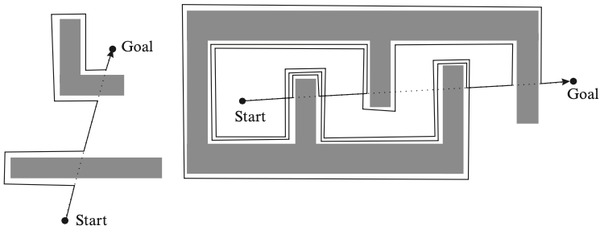
Bug Algorithms
Move toward the goal until an obstacle is detected or the goal is reached.
Follow obstacle contours (always in the same direction) until motion in a straight line toward the goal is again possible.
Move toward the goal until an obstacle is detected or the goal is reached.
Follow obstacle contours to find the to find the closest point and then resume moving toward the goal.
Move toward the goal until an obstacle is detected or the goal is reached.
Follow obstacle contour (always in the same direction) until the main line is reached.
Companion Materials Klancar, Zdesar, Blazic, Skrjanc: Wheeled Mobile Robotics

Slide 15
Practical Considerations
Do we need a complete plan?
Configuration space
Safety Bounds
Map representation

Slide 16
Configuration Space
Differential drive robot makes this easy with the zero-degree turning radius

Slide 17
Configuration Space
Imagine the configuration space for an Ackermann-Style vehicle.
Notes:
Differential drive robot makes this easy with the zero-degree turning radius

Slide 18
Practical Considerations
Do we need a complete plan?
Configuration space
Safety Bounds
Map representation

Slide 19
Safety Bounds
Notes:
Differential drive robot makes this easy with the zero-degree turning radius

Slide 20
Safety Bounds
Notes:
Differential drive robot makes this easy with the zero-degree turning radius

Slide 21
Safety Bounds
Notes:
Differential drive robot makes this easy with the zero-degree turning radius

Slide 22
Safety Bounds
Notes:
Differential drive robot makes this easy with the zero-degree turning radius

Slide 23
Safety Bounds
Notes:
Differential drive robot makes this easy with the zero-degree turning radius

Slide 24
Safety Bounds
Notes:
Differential drive robot makes this easy with the zero-degree turning radius

Slide 25
Safety Bounds
Notes:
Differential drive robot makes this easy with the zero-degree turning radius

Slide 26
Safety Bounds
We need to “inflate” the obstacles
We could create an offset edge for each edge
We could inflate the region around the obstacle by a fixed amount
We could take into account the shape of the robot
Obstacles inflation demo

Slide 27
Practical Considerations
Do we need a complete plan?
Configuration space
Safety Bounds
Map representation

Slide 28
Map Representations

Slide 29
Map Representation: Approximate Decomposition to Cells

Slide 30
Map Representation: Approximate Decomposition to Cells

Slide 31
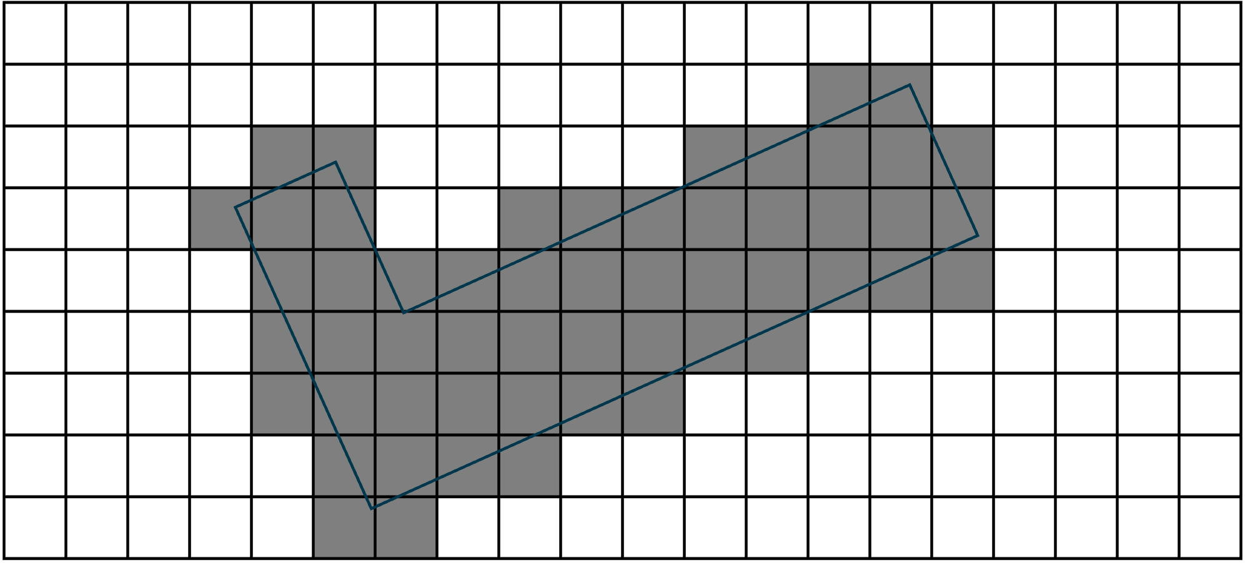
Map Representation: Approximate Decomposition to Cells
Find a path from the start to the goal

Slide 32
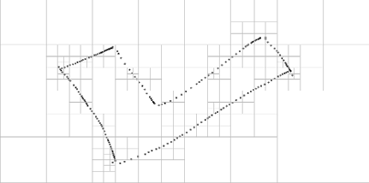
Map Representation: Approximate Decomposition to Cells
Fixed Cell Size
Variable Cell Size
https://www.autoradstudio.com/simulator/quad-tree-sim.html

Slide 33
Map Representation: Approximate Decomposition to Cells

Slide 34
Map Representation: Approximate Decomposition to Cells
What does the decomposition look like for Edmunds 105?

Slide 35
Map Representation: Approximate Decomposition to Cells

Slide 36
Map Representation: Approximate Decomposition to Cells

Slide 37
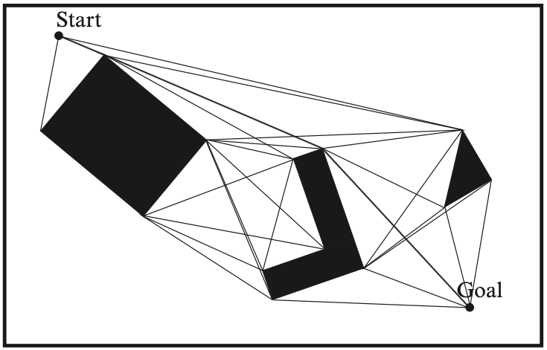
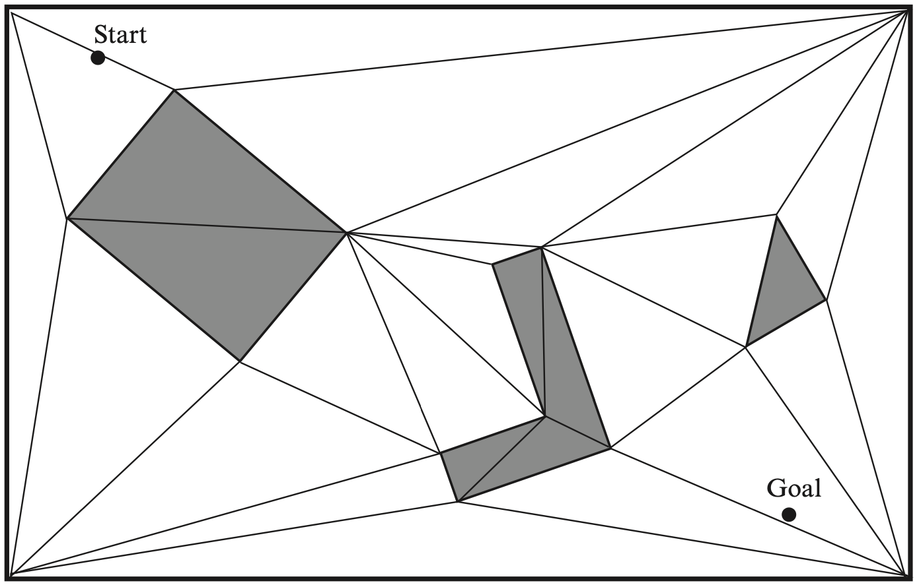
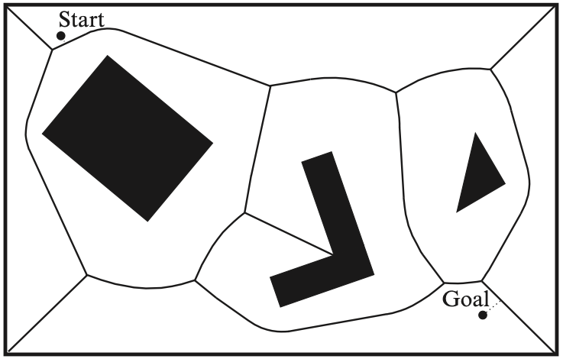
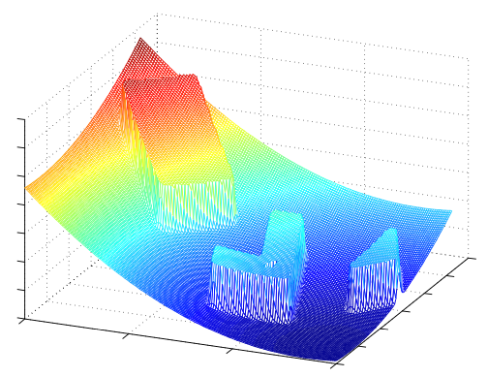
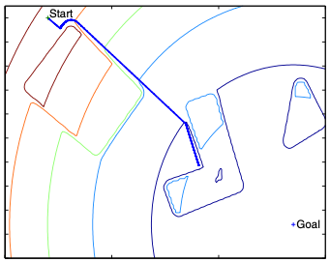
Other Map Representation Algorithms
Visibility Graph
Delaunay
Triangulation
Voronoi Graph
Potential Fields
Companion Materials Klancar, Zdesar, Blazic, Skrjanc: Wheeled Mobile Robotics

Slide 38
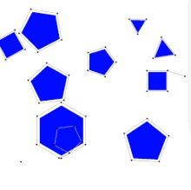
Popular Algorithms
Graph-Based Methods (require a representation of the configuration space)
Simple graph search with DFS or BFS
Dijkstra’s Algorithm
A* (A-Star) Algorithm
Sampling-Based Methods (does not require calculation of the full space)
Rapidly-Exploring Random Trees (RRT)
Probabilistic Roadmap (PRM)
https://en.wikipedia.org/wiki/Probabilistic_roadmap

Slide 39
Breadth-First Search (BFS)
1 procedure BFS(G, start, goal)
2 let Q be a queue
3 label start as explored
4 Q.enqueue(start)
5 while Q is not empty
6 v := Q.dequeue()
7 if v is the goal
8 return v
9 for all edges from v to w
10 if w is not labeled as explored
11 label w as explored
12 w.parent := v
13 Q.enqueue(w)

Slide 40
A* (A Star) Algorithm
https://en.wikipedia.org/wiki/A*_search_algorithm
Consider both
The cost to get to the next node AND
The cost to get from the next node to the goal

Slide 41
A* Pathfinding Algorithm Visualization on a Real Map

Slide 42
Comparison
BFS
A*
https://qiao.github.io/PathFinding.js/visual/

Slide 43
Comparison
BFS
A*
https://algo-vz.netlify.app/#

Slide 44
Rapidly-Exploring Random Trees (RRT)
1 procedure RRT(start, goal, |V|, d)
2 let G be a graph
3 add start to G
4 for k = 1 to |V|
5 rand = random feasible configuration
6 near = nearest(G, rand)
7 new = near + d * rand
8 G.add_vertex(new)
9 G.add_edge(near, new)
10
11 return BFS(G, start, goal)

Slide 45
Rapidly-Exploring Random Trees (RRT)
https://vinayak-d.github.io/MotionPlanningVisualizer/customgrid

Slide 46
Relationship With Localization and Mapping
What if we don’t have a map?
We can build one as we drive around.
We can then use it to efficiently return to previous locations.

Slide 47
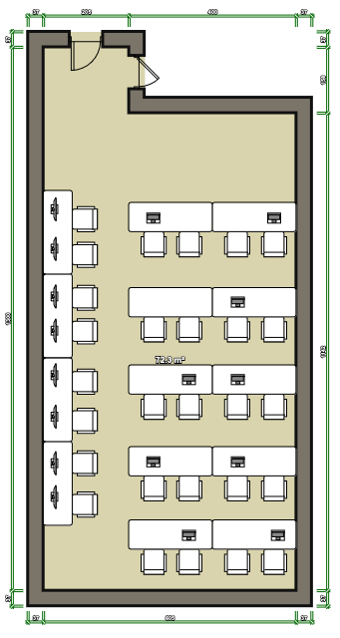
Localization and Mapping
Notes:
Differential drive robot makes this easy with the zero-degree turning radius

Slide 48
Localization and Mapping
Notes:
Differential drive robot makes this easy with the zero-degree turning radius

Slide 49
Localization and Mapping
Notes:
Differential drive robot makes this easy with the zero-degree turning radius

