Slide 1
Simulation
Mobile Robotics
Anthony J. Clark

Slide 2
Today
Simulation

Slide 3
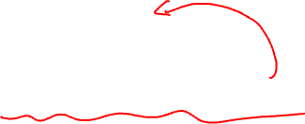
Simulation
Find the right level of abstraction
Answer the question: what do you care about?

Slide 4
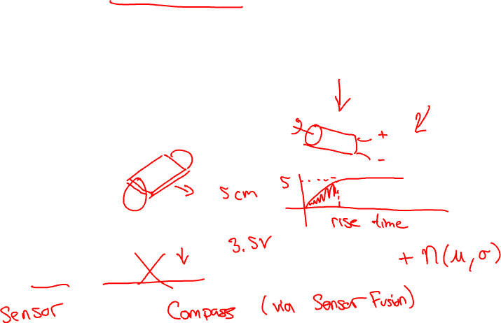
Simulation
Find the right level of abstraction
Answer the question: what do you care about?
  Do you care about the electromechanical properties?
  Do you care about inertia?
  Do you care about battery levels or capacity?
  Do you care about noise? Or wheel slippage?

Slide 5
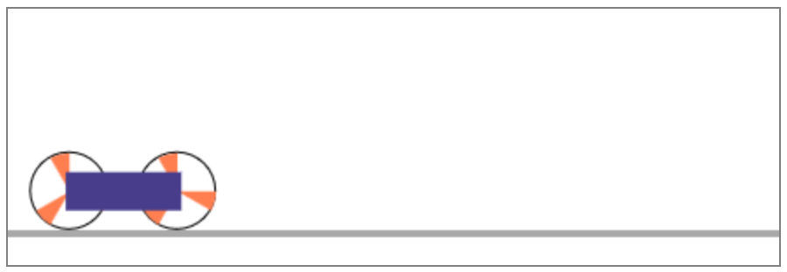

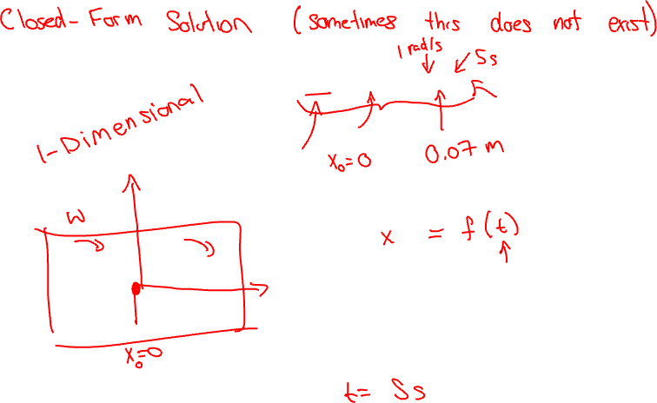
Analytical Model Simulation
Example: A Two-Dimensional WMR
$$x_{t}=x_{0}+ωrt$$
Analytical Model Simulation

Slide 6
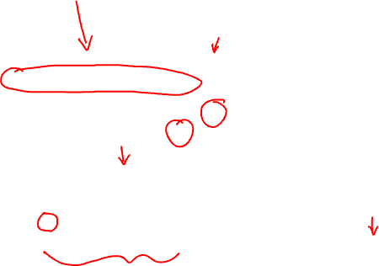
Analytical Model Simulation
Example: A Two-Dimensional WMR
$$x_{t}=x_{0}+ωrt$$
let initialPosition = 0;
let chassisPosition;
let angularVelocity = 1;
let wheelRadius = 1;
function simulate( time ) {
// x = x0 + ω r t
v = angularVelocity * wheelRadius
chassisPosition = initialPosition + v * time;
}
Analytical Model Simulation

Slide 7
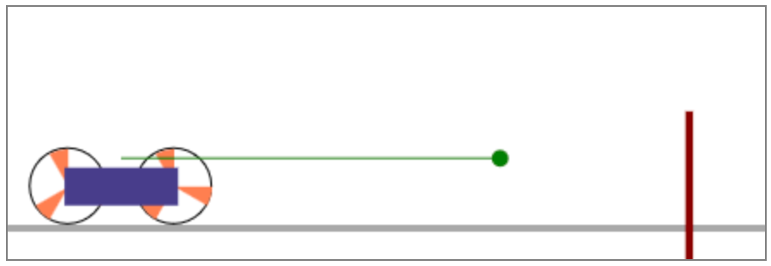

What if We Add a Wall?
$$x_{t}=x_{0}+ωrt$$
Analytical Model Simulation

Slide 8
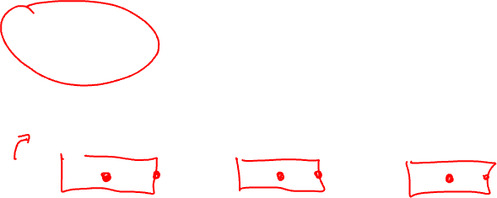
What if We Add a Wall?
$$x_{t}=x_{0}+ωrt$$
if ( distanceToWall > 0 ) {
chassisPosition = initialPosition + v * time;
}
Analytical Model Simulation

Slide 9

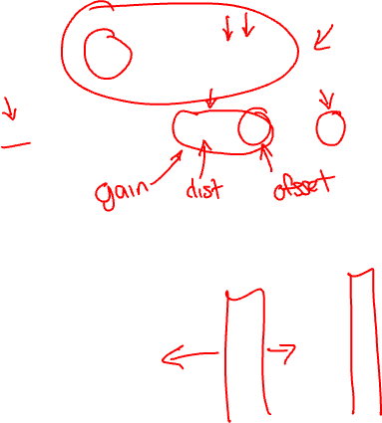
What if We Want Dynamic Control?
$$x_{t}=x_{0}+ωrt$$
Where,
$ω=$ constrain$(Kd+b,−Ω,Ω)$
Analytical Model Simulation
Notes:
K is control gain
d is distance
b is control offset
Omega is control limits

Slide 10
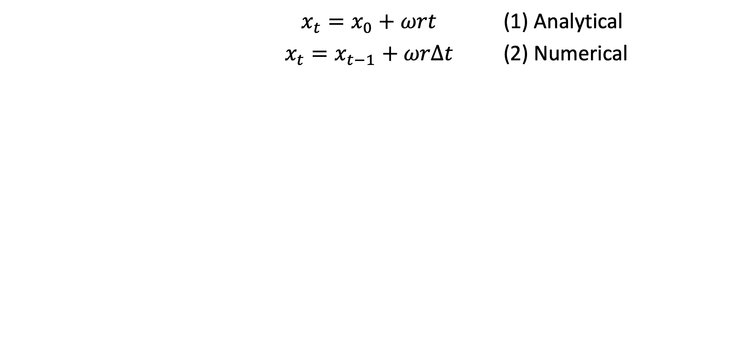
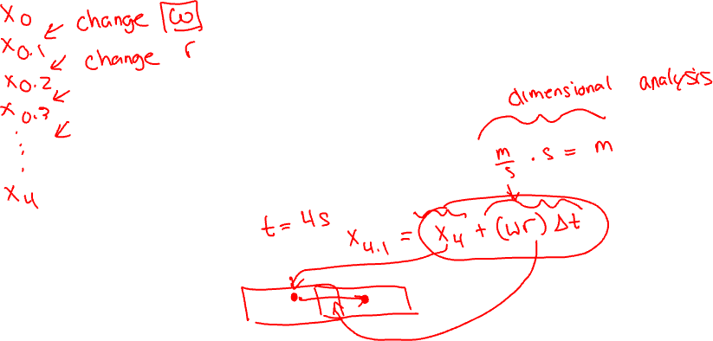
Numerical Simulation
$x_{t}=x_{0}+ωrt$ (1) Analytical
$x_{t}=x_{t−1}+ωrΔt$ (2) Numerical
Dynamic Control

Slide 11


Numerical Simulation Code
$$x_{t}=x_{t−1}+ωrΔt$$
let initialPosition = 0;
let chassisPosition = initialPosition;
let angularVelocity = 1;
let wheelRadius = 1;
function simulate( duration ) {
let time = 0;
const timeStep = 0.01;
let v = angularVelocity * wheelRadius
while ( time < duration ) {
chassisPosition += v * timeStep;
time += ;
}
}

Slide 12
Demo

