Slide 1
Embedded Systems
Mobile Robotics
Anthony J. Clark

Slide 2
Today
Our robot’s task
Project workflow
Hardware Systems
Software Systems
Arduino Ecosystem

Slide 3
Our Robot’s Task

Slide 4
Project Workflow
Specify the requirements
Design your software
Program your software
Upload your program
  Connected using a “programmer”
  Connected with USB using a bootloader
  Connected over Wi-Fi using OTA
Monitor and direct your robot using WebSockets

Slide 5
Embedded Systems

Slide 6
Hardware System
CPU: Xtensa® dual-core 32-bit LX7 microprocessor (240 MHz)
Cache: 16 KB instruction and 32 KB data
  four-way set associative
  16 bytes block size
Internal memory: 384 KB ROM and 512 KB SRAM
External memory: 8 MB PSRAM and 8 MB Flash

Slide 7
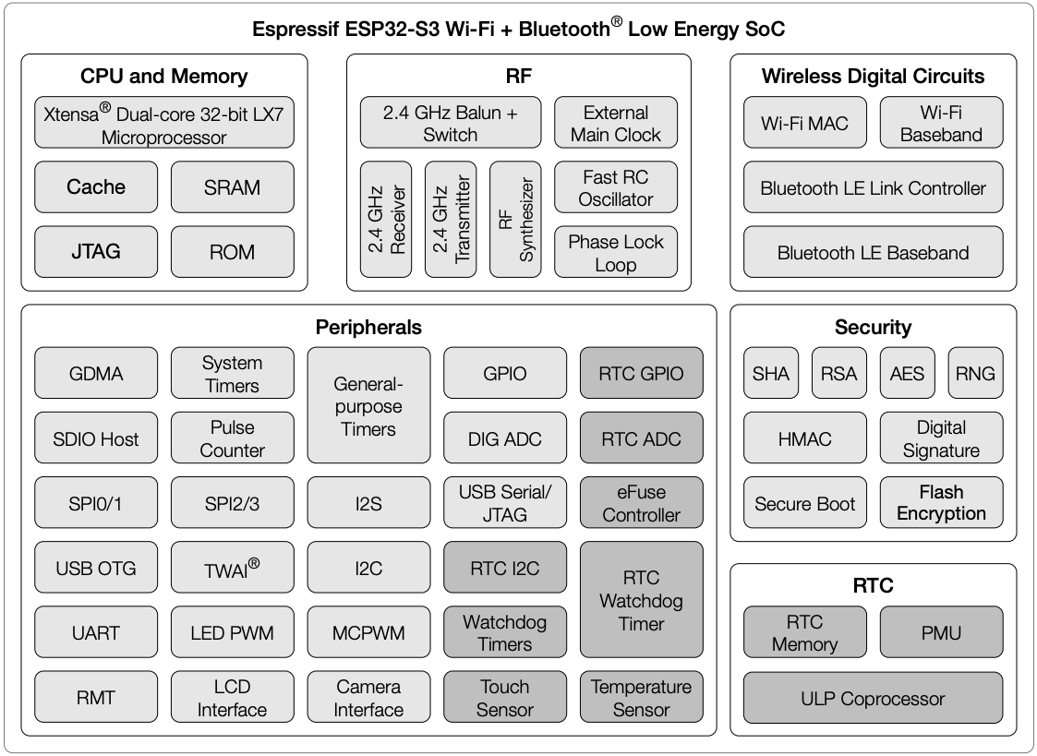

Slide 8
Motor Driver Interface

Slide 9
Other Peripherals Using I²C

Slide 10
Wi-Fi Communication

Slide 11
Hardware/Software Interface
High Memory Address
External Memory
Stack
Flash
SPI RAM
Internal Memory
Heap
Cache
Uninitialized Static (bss segment)
dRAM
Initialized Static (data segment)
iRAM
Code (text segment)
ROM
Low Memory Address

Slide 12
On Reset (Jumps to Bootloader)

Slide 13
Toit (and Jaguar) vs. Bare Metal (ESP-IDF)

Slide 14
Blinking With Toit
import gpio
main:
pin := gpio.Pin 32 --output
while true:
pin.set 0
sleep --ms=500
pin.set 1
sleep --ms=500

Slide 15
Fibers: Independent Control Flow
import gpio
LED1 ::= gpio.Pin.out 17
LED2 ::= gpio.Pin.out 18
main:
task:: my-task-1
task:: my-task-2
my-task-1:
while true:
sleep --ms=500
LED1.set 1
sleep --ms=500
LED1.set 0
my-task-2:
while true:
sleep --ms=123
LED2.set 1
sleep --ms=123
LED2.set 0

Slide 16
Why Leave Toit?
[jaguar] INFO: program 8358aee2-45c6-0193-6318-b75de00f59f3 stopped
[jaguar] INFO: program c6925192-2d45-548f-7f78-726e3c457cad started
Heap report @ out of memory in primitive 6:2:
┌────────┬────────┬────────────────────────────────────────────────┐
│ Bytes │ Count │ Type │
├────────┼────────┼────────────────────────────────────────────────┤
│ 40960 │ 12 │ toit processes │
│ 16384 │ 4 │ system 0 0ff85ae2-63d2-e530-c9fe-c844785c0276 │
│ 20480 │ 5 │ other 1 31709de1-906c-ce7d-8698-87e163711ebb │
│ 4096 │ 1 │ current 7 c6925192-2d45-548f-7f78-726e3c457cad │
│ 667648 │ 1 │ heap metadata │
│ 4096 │ 1 │ spare new-space │
│ 16808 │ 7 │ heap overhead │
│ 192 │ 4 │ thread/other │
└────────┴────────┴────────────────────────────────────────────────┘
Total: 729704 bytes in 16 allocations (8%), largest free 7452k, total free 7471k
******************************************************************************
Decoding by `jag`, device has version <2.0.0-alpha.159>
******************************************************************************
MALLOC_FAILED error.
0: Bus.test <sdk>/i2c.toit:65:5
1: Bus.scan <sdk>/i2c.toit:60:10
2: main display.toit:23:18
******************************************************************************
[jaguar] ERROR: program c6925192-2d45-548f-7f78-726e3c457cad stopped - exit code 1

Slide 17
Blinking With ESP-IDF
void app_main(void) {
configure_led();
while (1) {
blink_led();
s_led_state = !s_led_state;
vTaskDelay(CONFIG_BLINK_PERIOD / portTICK_PERIOD_MS);
}
}
#include <stdio.h>
#include "freertos/FreeRTOS.h"
#include "freertos/task.h"
#include "driver/gpio.h"
#include "esp_log.h"
#include "led_strip.h"
#include "sdkconfig.h"
#define BLINK_GPIO CONFIG_BLINK_GPIO
static uint8_t s_led_state = 0;
static void blink_led(void) {
gpio_set_level(BLINK_GPIO, s_led_state);
}
static void configure_led(void) {
gpio_reset_pin(BLINK_GPIO);
gpio_set_direction(BLINK_GPIO, GPIO_MODE_OUTPUT);
}
https://github.com/espressif/esp-idf/blob/master/examples/get-started/blink/main/blink_example_main.c

Slide 18
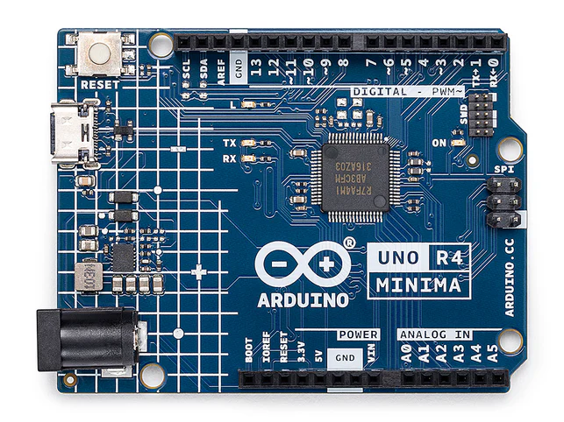
Arduino Ecosystem
Bootloader (otherwise, must use a hardware programmer)
Open-source hardware (kits, boards, and shields)
Open-source software (many Arduino libraries)
Arduino® UNO R4 Minima

Slide 19
Blinking an LED (Light-Emitting Diode)
void setup() {
pinMode(LED_BUILTIN, OUTPUT);
}
void loop() {
digitalWrite(LED_BUILTIN, HIGH);
delay(1000)
digitalWrite(LED_BUILTIN, LOW);
delay(1000)
}

Slide 20
Arduino Bootloader

Slide 21
#include <Arduino.h>
int atexit(void (* /*func*/ )()) { return 0; }
void initVariant() __attribute__((weak));
void initVariant() { }
void setupUSB() __attribute__((weak));
void setupUSB() { }
int main(void) {
init();
initVariant();
setup();
for (;;) {
loop();
if (serialEventRun) serialEventRun();
}
return 0;
}
https://github.com/arduino/ArduinoCore-avr/blob/master/cores/arduino/main.cpp
https://github.com/espressif/arduino-esp32/blob/master/cores/esp32/main.cpp

Slide 22
Embedded Software
Don’t block other tasks with delays
Deal with hardware and time constrains
Use an event-driven approach

Slide 23
Blinking is Blocking
void setup() {
pinMode(LED_BUILTIN, OUTPUT);
setupMotors();
}
void loop() {
if shouldHaltMotors() haltMotors();
digitalWrite(LED_BUILTIN, HIGH);
delay(1000)
digitalWrite(LED_BUILTIN, LOW);
delay(1000)
}
void setup() {
pinMode(LED_BUILTIN, OUTPUT);
}
void loop() {
digitalWrite(LED_BUILTIN, HIGH);
delay(1000)
digitalWrite(LED_BUILTIN, LOW);
delay(1000)
}

Slide 24
Blinking Without Blocking
void setup() {
pinMode(LED_BUILTIN, OUTPUT);
}
void loop() {
digitalWrite(LED_BUILTIN, HIGH);
delay(1000)
digitalWrite(LED_BUILTIN, LOW);
delay(1000)
}
const int blinkInterval = 1000;
int ledState = LOW;
unsigned long previousMillis = 0;
void setup() {
pinMode(LED_BUILTIN, OUTPUT);
}
void loop() {
unsigned long currentMillis = millis();
if (currentMillis - previousMillis >= blinkInterval) {
previousMillis = currentMillis;
ledState = (ledState == LOW) ? HIGH : LOW;
digitalWrite(LED_BUILTIN, ledState);
}
}

Slide 25
Blinking Without Blocking
const int blinkInterval = 1000;
int ledState = LOW;
unsigned long previousMillis = 0;
void setup() {
pinMode(LED_BUILTIN, OUTPUT);
setupMotors();
}
void loop() {
if shouldHaltMotors() haltMotors();
unsigned long currentMillis = millis();
if (currentMillis - previousMillis >= blinkInterval) {
previousMillis = currentMillis;
ledState = (ledState == LOW) ? HIGH : LOW;
digitalWrite(LED_BUILTIN, ledState);
}
}

Slide 26
Pseudocode For Software Architecture
global state for module 1
global state for module 2
…
set update period for module 1
set update period for module 2
…
setup
initialize non-trivial global states
loop
short update/poll for module 1
short update/poll for module 2
…

Slide 27
Pseudocode For Software Architecture
const int blinkInterval = 1000;
int ledState = LOW;
unsigned long previousMillis = 0;
void setup() {
pinMode(LED_BUILTIN, OUTPUT);
setupMotors();
}
void loop() {
if shouldHaltMotors() haltMotors();
unsigned long currentMillis = millis();
if (currentMillis - previousMillis >= blinkInterval) {
previousMillis = currentMillis;
ledState = (ledState == LOW) ? HIGH : LOW;
digitalWrite(LED_BUILTIN, ledState);
}
}
global state for module 1
global state for module 2
…
set update period for module 1
set update period for module 2
…
setup
initialize non-trivial global states
loop
short update/poll for module 1
short update/poll for module 2
…

